Slide 1
Youth Business Alliance (YBA) Guest Speaker at Alliance William & Carol Ouchi HS
The Life of an Entrepreneur …
Jonathan Carson
April 13, 2015

Slide 2
Today’s Agenda
Entrepreneurship
… an overview
… our foundation
… today
… tomorrow
… the KCC experience
… the aftermath
What can you do now?

Slide 3
Entrepreneurship … an overview
But first my background -- a road less taken.

Slide 4
Entrepreneurship … an overview
American Heritage Dictionary:
Entrepreneur: n. A person who organizes, operates, and assumes the risk for a business venture.

Slide 5
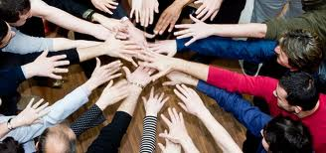
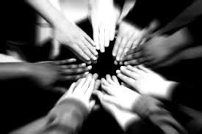
BREAKOUT #1
Describe an entrepreneur …

Slide 6
Entrepreneurship … word mapping

Slide 7
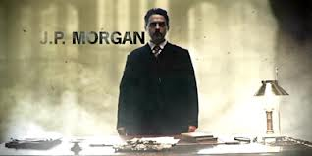
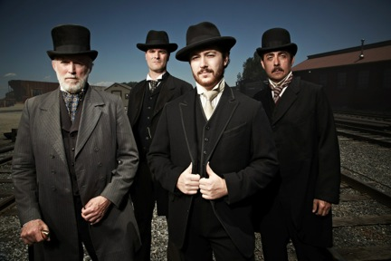
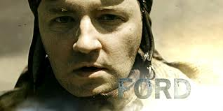
The Men Who Built America
Entrepreneurship … our foundation

Slide 8
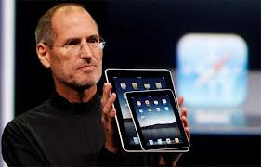
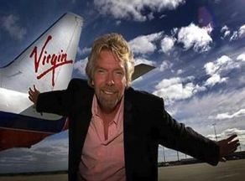
Entrepreneurship … today

Slide 9
Entrepreneurship … tomorrow

Slide 10
Entrepreneurship … the KCC experience
the BIG idea

Slide 11
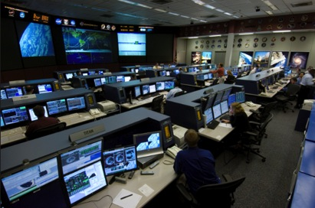
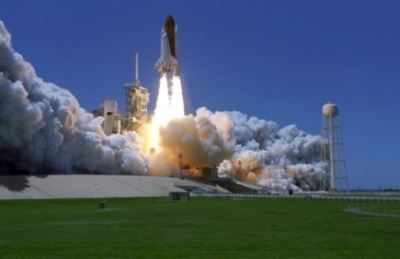
Entrepreneurship … the KCC experience
Initial Strategy
Pre-launch
Go to Market

Slide 12
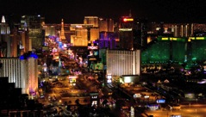
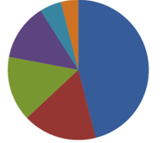
Entrepreneurship … the KCC experience
Managing growth & scale
Know respective strengths and weaknesses
Revenue
Market Share
Headcount

Slide 13
Entrepreneurship … the KCC experience
Finalizing our plan …

Slide 14
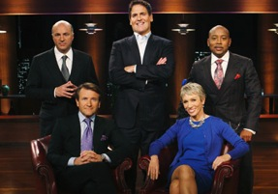
BREAKOUT #2
Bring on the Shark Tank?

Slide 15
Entrepreneurship … the aftermath

Slide 16
Questions?
Notes:
Add Cartoon

Slide 17
What can you do now …
Build your network
Pursue your interests
Have fun …

Slide 18
What can you do now …
Build your network
Pursue your interests
Have fun …

