Slide 1
The Life You Create. You Create.
YBA 2017
Prepared by a woman who changed her life once - promptly did it again - and then yet again. Realizing, along the way, she was capable of doing anything.

Slide 2
Who has ever done something in their lives they didn’t think they were capable of doing?
Notes:
These are transformational experiences. How did it feel? Did you surprise yourself?

Slide 4
so…
Why is the idea of capability important to me?
more so…
Why do I think it might be important to you?
Notes:
2 daughters- My decisions affect theirs. Big ticket items:
School/College > Marriage/Divorce > Childbirth/Family > Career
Am I daunted? Have I been daunted? YES
Does it stop me from doing and living? NOT AT ALL
Your entire life is at your feet. Will you make Decisions based on capability? Or, based on limitations?

Slide 5
Let’s Start Here
Twitter
Forever ginger and lover of love. Oh, and I work for EA - #views & #opinions my own.
LinkedIn
Employer/Talent Brand Advocate and Champion for Promoting the Employee Experience
Notes:
Our public billboards tell the world who were are. But is this it?

Slide 6
I am a compassionate, loving and capable human being. Thankful for the gifts I’ve been afforded. I’m creating incredible life experiences for me and my family, and choosing to do things that inspire and connect all of us together and to the world.
Notes:
Would you prefer to be introduced by our public billboard bio or with a statement about who you really are?
I encourage you to think about how you would introduce yourself, friends or family.

Slide 7
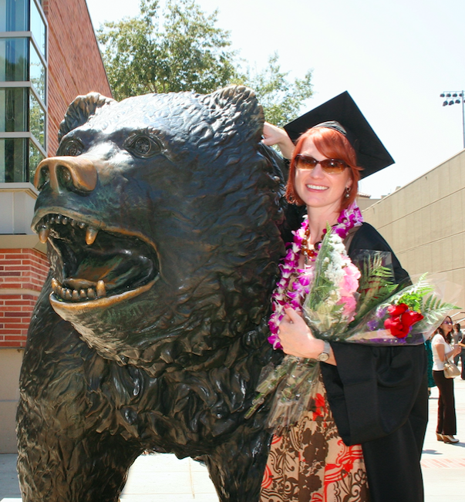
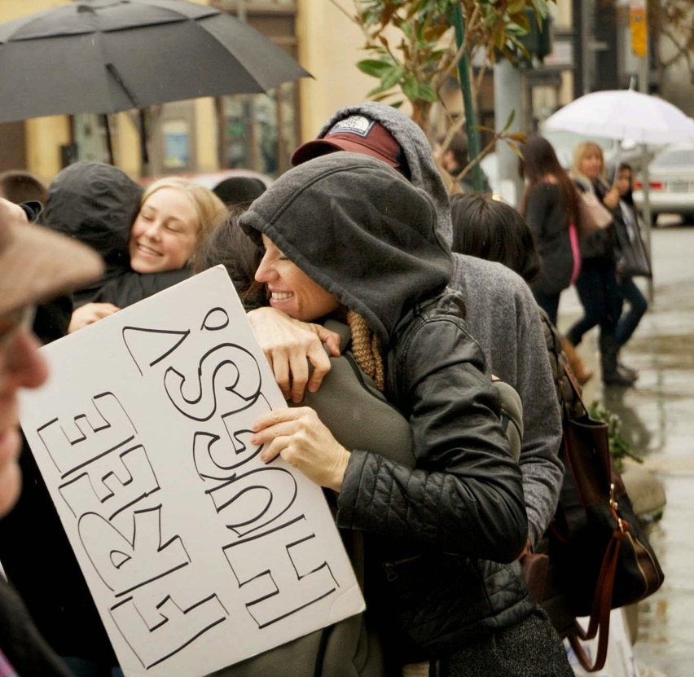
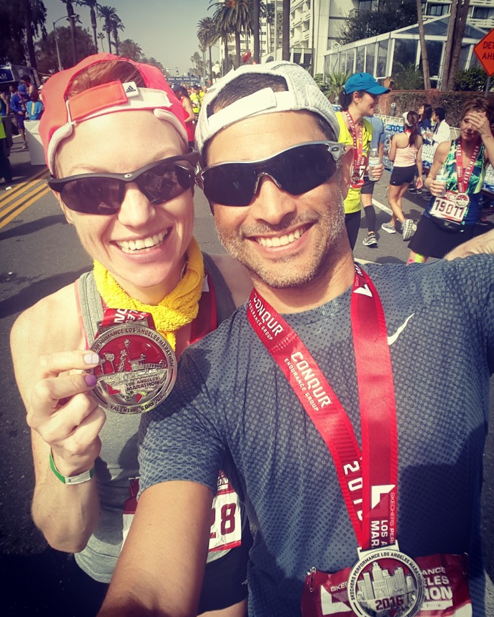
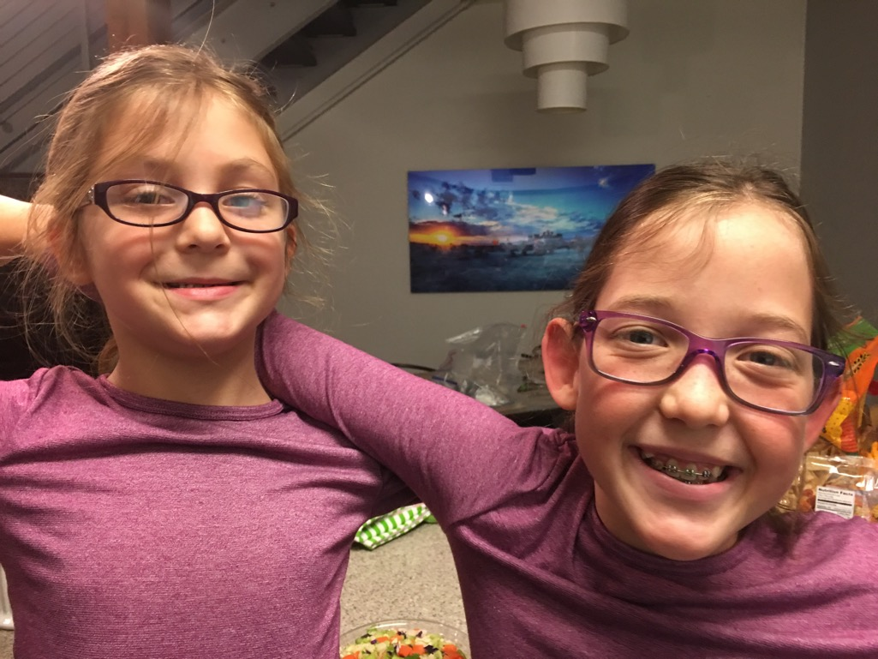
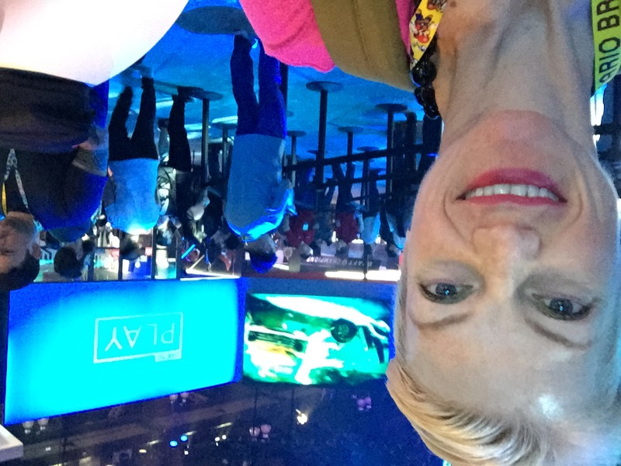
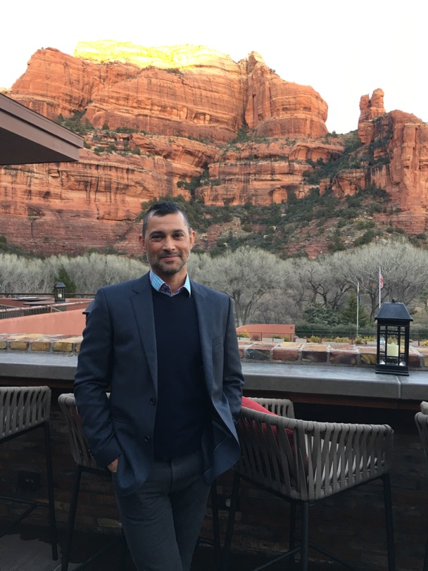
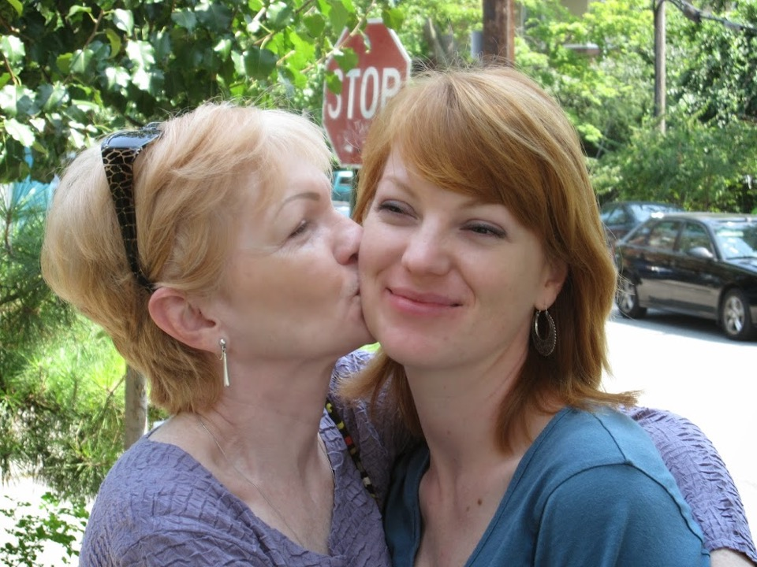
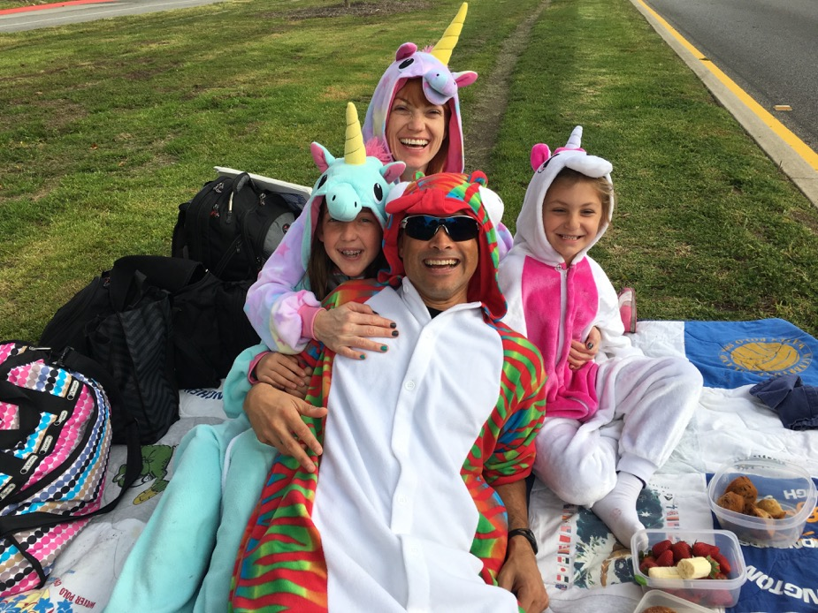
My Roadmap
Notes:
Continuously starting over..never staying down
Perseverance, yes. Capability, For Sure.

Slide 8
What is my Job?
employer branding –
/əmˈploiər brandiNG/
Noun
the process of promoting a company, or an organization, as the employer of choice to a desired target group, one which a company needs and wants to recruit and retain.

Slide 9
One More Time?
My team creates stories which will (we hope) get people excited about working at EA! We market those stories across social media, events, videos, websites and advertising.
Notes:
I love my job. Never trained for it. Saw an open door and threw myself into it.

Slide 10
Let’s Agree on the Scary Stuff
Failure
Taking a Chance
Our Limitations
Failure is Good For You.
Taking Chances Can Be Positively Life changing.
Limitations are Misperceived.
Notes:
not good enough, don’t have enough money, too young, too old, don’t know how, not healthy, blah, blah, blah
Here's the thing about the scary stuff:
Failure - Move to Arizona was a big fail. Motivated me to get it together.
Taking a chance - Left restaurant industry for a Corp Career with no former exp or knowledge.
Limitations - Misperceived Limitations. Never being active to a Marathon
THE SCARY STUFF OPENS DOORS TO LIFE YOU MAY NOT HAVE NOTICED OTHERWISE.

Slide 11
Where I’ve Netted With My Life
Reinvention
Every day you're given a chance to do something different.
Not settling
Life is too short to settle for anything less than 100% happiness.
Life will be different
Embrace it. Don't fight it. Change will happen.
Notes:
REINVENTION– life give opps to reinvent what we aren't happy w/.
NOT SETTLING- it’s easier to believe the challenges life has dealt are challenges you have to live w/.
YOUR LIFE WILL BE DIFF– where you are today is not where you will be tomorrow.

Slide 12
Guide Posts For Your Roadmap
Be aware.
Notes:
…of what’s going on around you. Look for those open doors.
Pay attention to the people in your orbit, no matter where they are. Don't burn bridges. Everyone matters.
You never know. You’d be surprised where people and opportunities can lead you.

Slide 13
Guide Posts For Your Roadmap
Be present.
Notes:
For you and everyone in your life.
Mute your phone/ Mute your laptop/ Sit by yourself for five or ten minutes a day.
Sit with someone you care for without touching your phone. Look them in the eye and just be with them.
The feeling will astound you.

Slide 14
Guide Posts For Your Roadmap
Be loving.
Notes:
Isn’t this the foundation of life? Love.
How many ppl in this room don’t like hugs?
Free Hugs story

Slide 15
Guide Posts For Your Roadmap
Be kind.
Notes:
It’s easier to be kind than to not be. Take an extra second and smile at someone today. Pick up something that someone dropped on the floor. Wait for someone at the door and hold it open.
It's the little things that make the biggest diff.

Slide 16
Guide Posts For Your Roadmap
Be in control of your life.
Notes:
No one else is in control of your life.
When you leave here today I’d like you take some time, tonight, tomorrow, this week, whenever to think about your own capability. The fact that you are in this room, a part of this program, already speaks volumes.

Slide 17
Thank you! Have a beautiful now.
jribeiro@ea.com
Linkedin.com/in/jennjribeiro
We are only bounded by the earth, and the ocean, and the sky. For all our failings, despite our limitations and fallibilities, we humans are capable of greatness. – Carl Sagan
Notes:
I’m not anyone special. I’m a Midwestern girl who came from divorce, had an absentee father, started and stopped too many schools to count. While my upbringing made it difficult to even consider how I’d ever get out of the cycle of it all - It didn’t impede me from creating the life I wanted, which was a life of joy.

