Slide 1
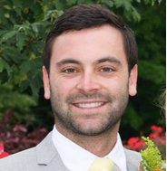
Youth Business Alliance
Guest Speaker: Jesse Starkey
Founder, VP Sales
Workpop

Slide 2
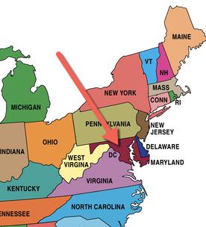
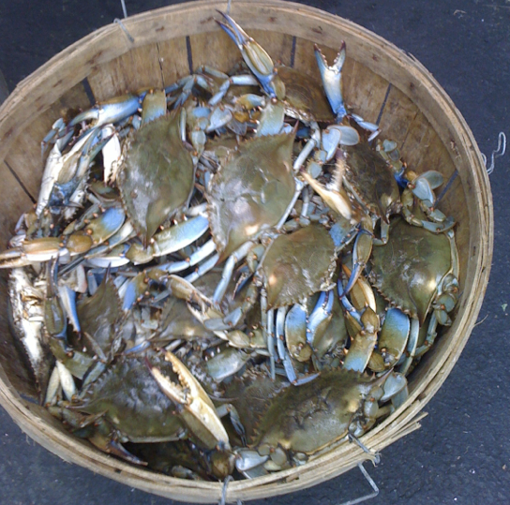
Introduction
Grew up in Southern Maryland
29 years old
Workpop – Santa Monica, CA
Helping people find jobs they love
VP Sales in charge of getting new customers to use our product/platform

Slide 3
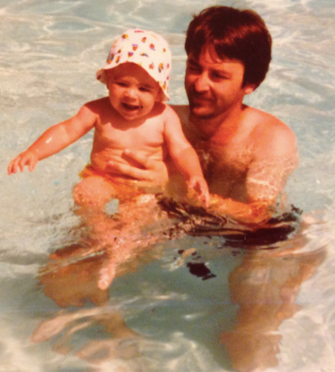
Family Background
My Father passed away when I was very little
It was very hard for me in school at a young age when everyone else seemed to have 2 parents by I only had 1
My Mom was born in Cuba, her family left everything behind to move to the US

Slide 4
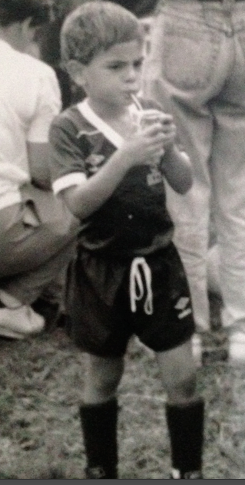
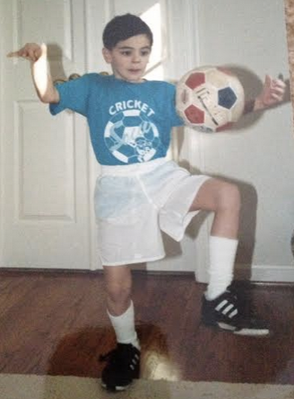
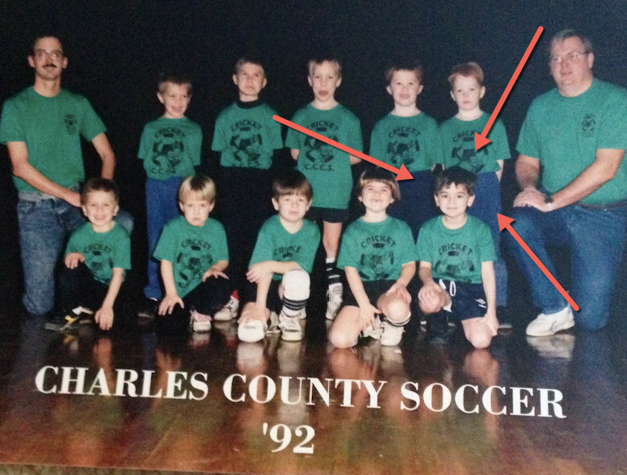
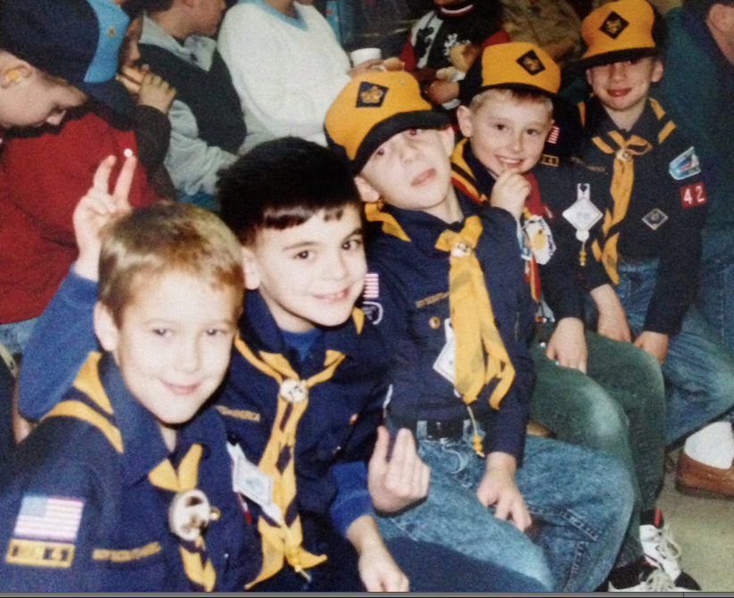
Early Years
I was a very hyper-active kid growing up so my mom always tried to keep me busy
Playing sports was one of my favorite things, especially soccer
Boy Scouts was a fun activity that I learned a whole lot from
Always open to trying new things

Slide 5
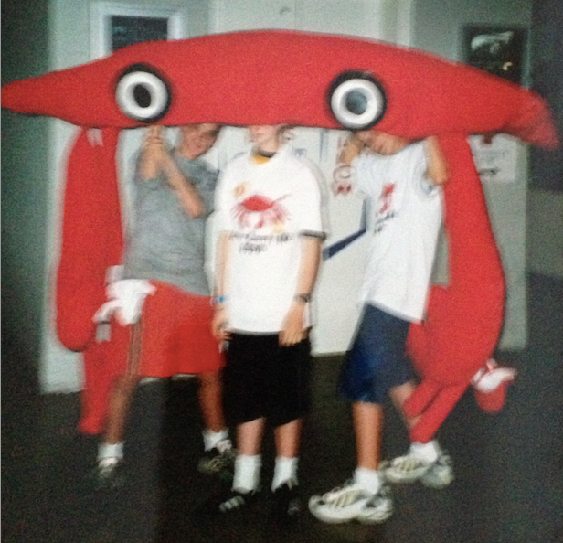
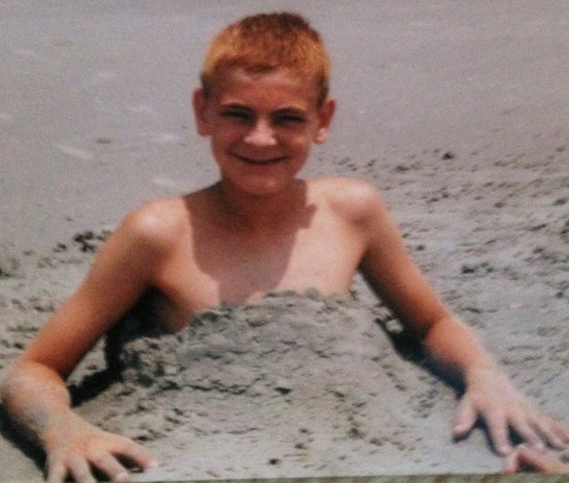
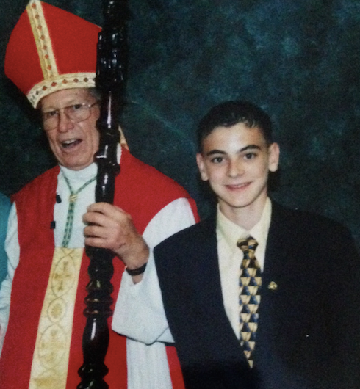
Middle School: The Awkward Years
Everyone goes through awkward phases in life… middle school was the start of mine!
6th Grade
7th Grade
8th Grade
Once I tried dying my hair blonde to be cool, it came out orange and my mom made me keep it ☺. I was very self-conscious all through middle school because I had braces and was so scrawny. My academics is what gave me confidence.

Slide 6
Academics
Favorite Subjects:
Math
Science
History
Writing
Least Favorite Subjects:
Art
Spanish

Slide 7
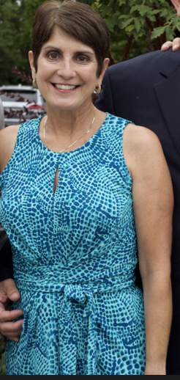
High School Goal: Get Into College!
If you don’t work hard in high school you won’t get into college!
Made it my personal goal to never get a B
I was never known as a ‘cool kid’ in high school and I was completely ok with that
More of a nerdy kid who played sports and was involved in everything possible

Slide 8
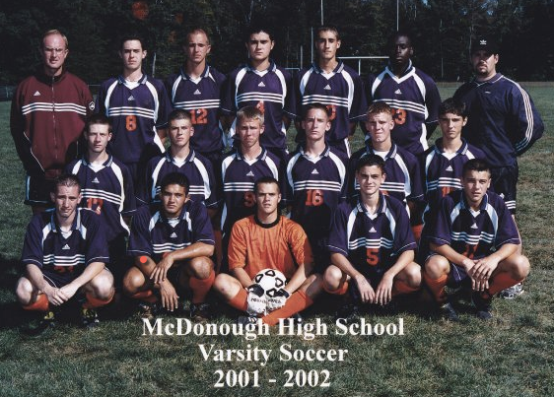
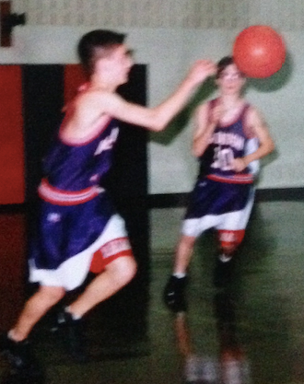
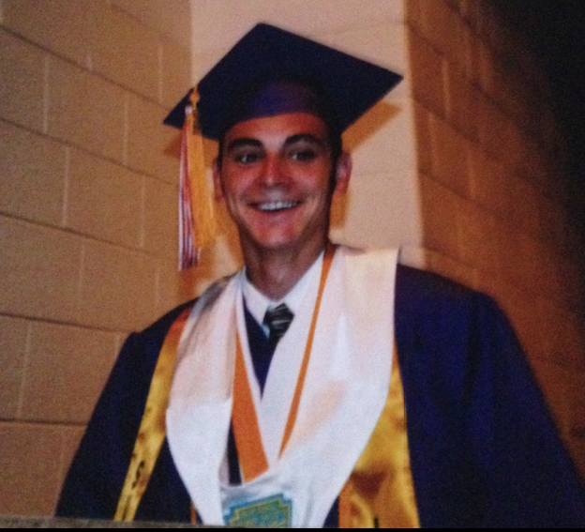
I did everything I could to boost my resume
High School Activities:
Soccer, basketball, tennis
Class President
Student Council
Honor Society
Odyssey of the Mind
Math Team
Volunteering

Slide 9
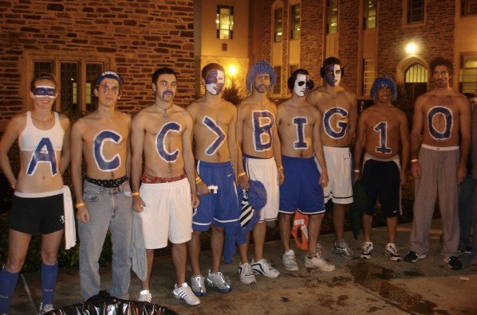
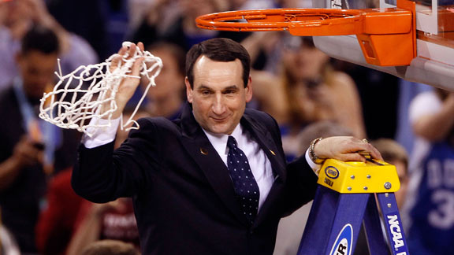
It paid off when I got into my dream school!

Slide 10
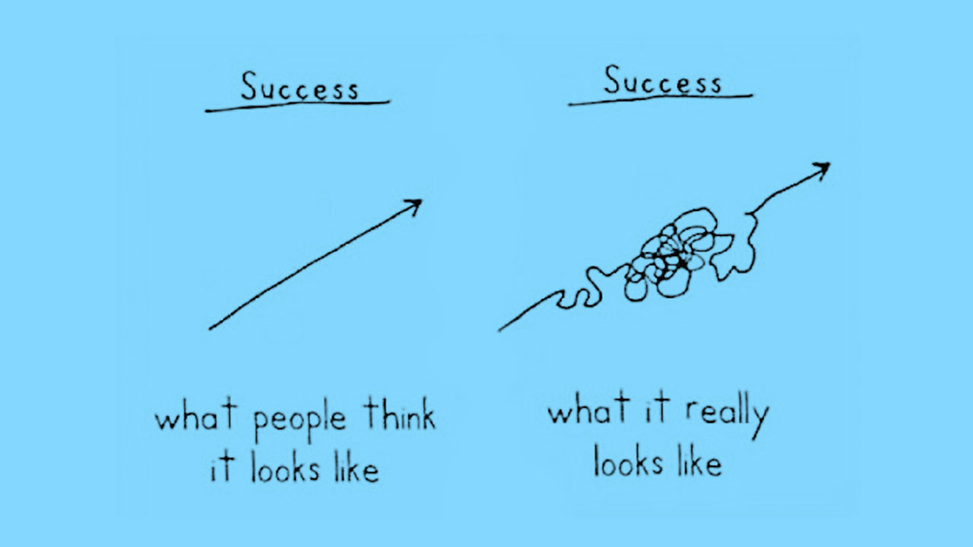
I thought I had it made! I was wrong

Slide 11
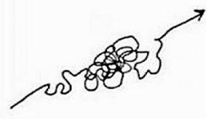
I failed plenty but learned every step of the way
Workpop
Technology
Consulting
Sales
Ledo’s Pizza
Project Management
Best Buy

Slide 12
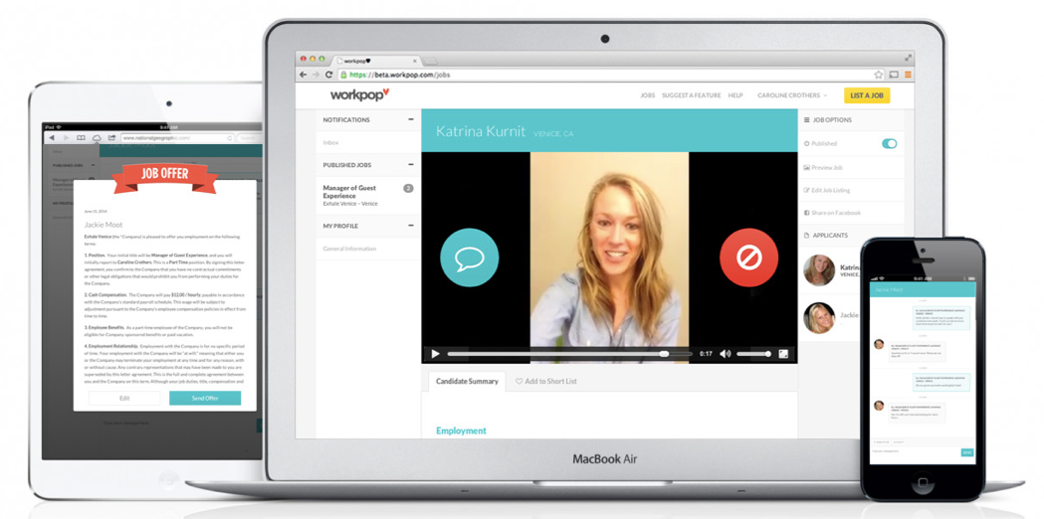
Workpop: Find a job you love!
I used to work to help other people build their companies, now I get to build my own!

Slide 13
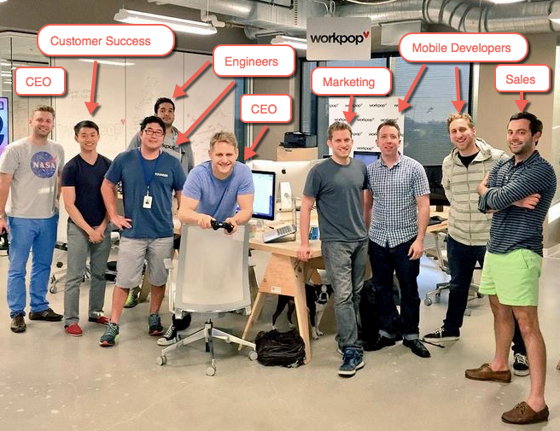
Meet the Workpop team
CEO: Run the company
Engineers: Write code to build our product
Mobile Engineers: Write code to build Iphone Apps
Sales: Find new businesses to use our product
Customer Success: Make sure all customers are successful/happy
Marketing: Advertise our product and get new users to apply to jobs

Slide 14
Academic Exercise
We will now spend a few minutes discussing the day’s academic module and how it is relevant in the ‘real world’

Slide 15
Question & Answer

Slide 16
Thank you!!!

