Slide 1
YBA GUEST
RESOURCE TEMPLATE
Marcia Ann Mims Coppertino, Pd.D

Slide 2
INTRODUCTION
My name is Marcia Ann Mims Coppertino and I am 50+ years old.
I am the Executive Director and CEO for Mercy Mission Bear Hospital and Adoption Agency and Director of Operations for non profit and for profit organizations around the world
Mercy Mission Hospital accepts donated teddy bears in all shapes, sizes and conditions from around the world to distribute to sick and homeless children and children awaiting treatments for life threatening diseases. Children terminally ill and in hospice centers also received donated teddy bears from our hospital along with needed resources and other practical needs. The teddy bears received are first repaired and “surgically” operated on by the replacement of missing limbs, detached ears and noses and other necessary operations before donated to ill children, many on wait lists. Our volunteer medical doctors are on board to work with the teddy bears to bring them back to life to share with ill and lonely children.

Slide 3
The Early Years…
I was born in Enid, Oklahoma and was raised in South Central Los Angeles in an apartment complex located at 10023 Beach Street, Los Angeles, Ca 90001. The building has long since been replaced by planned community buildings but the street sign from 103rd street is still up and visible to travelers to the community. I loved to play outside and make new friends. I love children so it was not hard for me to excel at most of the childhood plans embarked on because I truly loved others.
I was especially a bright child in all subjects studied in school and at the age of fourteen I tutored a group of students in a geometry class when the teacher did not show up in class. When I was sixteen I received a four year scholarship to study medicine at Stanford University. My heart was in other places at the time and I opted for a career finally in law and finance and did not look back until I was diagnosed with serious medical problems and once again my life took another turn.

Slide 4
More Early Years…
My family was very dysfunctional and unloving during my early years because my father was incarcerated during my early childhood life and I was ashamed to really step out and make great things happen. I really missed him and thought my life would be a lot better had he been at home with my and the family. As I was so ashamed that my friends knew he was in prison, I just immersed myself in books and tales of wonder to pass the time away and to cover and help heal the hurt, but the structure I had built around myself to cover the pain ended up being my first best blessing….seeing the entire world thru the eyes of a back!

Slide 5
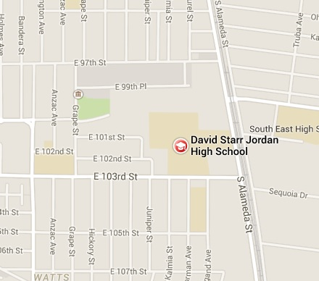
HIGH SCHOOL
I attended David Star Jordan High School in South Central Los Angeles, California and graduated in 1969
\

Slide 6
HIGH SCHOOL
As a High School student I was in the debate club, secretary of high school chess club, and I enrolled in Spanish class.
As a High School student I was shy, and helped everyone with their homework.
\

Slide 7
HIGH SCHOOL
Things I enjoyed in HS
Things I did not enjoy in HS
Study and big cookies
When the last school bell rung to go home

Slide 8
HIGH SCHOOL
Activities/Athletics in HS
Jobs I worked while in HS
I ran track
I ironed clothes, and babysat for my neighbors
I read books to kids at the library
Tutored kids in geometry

Slide 9
HIGH SCHOOL
Fondest memories from HS
Obstacles/Adversity you had to overcome in HS
I was the teacher’s pet
I visited my teacher’s home

Slide 10
College or
Graduate School
I received a fully paid four year medical scholarship at Stanford University, but opt’d instead for a degree in law and finance
\

Slide 11
College or
Graduate School
Activities/Athletics in College
Jobs I worked while in College

Slide 12
College or
Graduate School
Favorite classes
Least favorite classes
mathematics
physical ED

Slide 13
College or
Graduate School
Fondest memories
Obstacles or adversity that you had to overcome
MY FRIENDS
Study

Slide 14
Career Path
I started as a mail room girl cleaning pots attrys and accountants spit in
I was promoted to lower management after one year
I am now the CEO of many local community organization
Notes:
You may use this chart to describe your journey to the current career

Slide 15



Career
Company pic
Company pic #2
Company pic #3

Slide 16
Career
My first Job
My worst Job
Jr Accountant for Eugene Schaffer and Company
None. Loved them all!

Slide 17
Career
Some challenges I had to overcome in my career
Staying on target with the task at hand

Slide 18
CURRENT ROLE
History
Size
Location
Products
Services
Notes:
Use this graph to give more description of your current company (history, size, location, products and services, etc.)

Slide 19
Current Role
CURRENT ROLE
Notes:
Use this graph to give more description of your role specifically (responsibilities, typical work week, direct reports, etc.)

Slide 20
Career Compensation
Mailroom
$20k
Notes:
Use this graph to show general compensation ranges for people in various roles in your company

Slide 21
ACADEMIC EXERCISE
We will now spend several minutes discussing the day’s academic module and how it is relevant in the ‘real world’

Slide 22

QUESTION AND ANSWER

