Slide 1
THE YOUTH BUSINESS ALLIANCE
Presentation For:
ALLIANCE COLLINS FAMILY
Given by:
Brad Pollak
March 23, 2015

Slide 2
Introduction
My name is BRAD POLLAK and I am 55 years old.
I’m the owner and president of:
BRAD POLLAK COMPANY
I’m a Management Coach and a
Career Development Coach

Slide 3
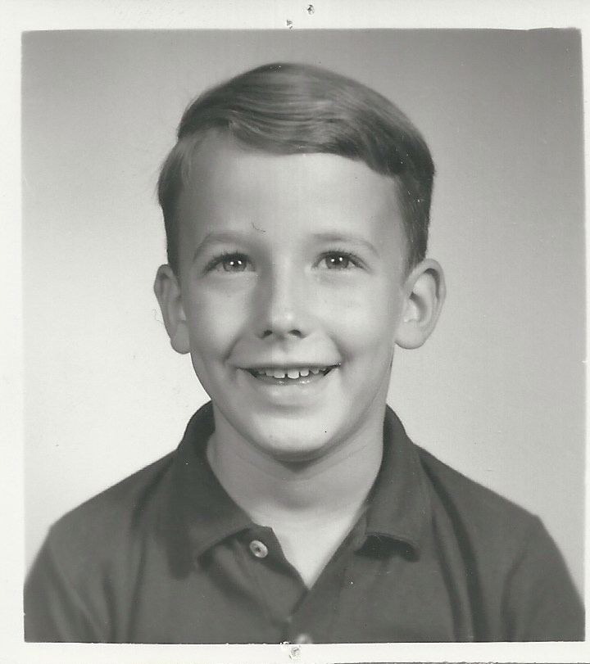
My childhood
I was born in Los Angeles and was raised in Mexico and in England.
This is a picture of me around age 6

Slide 4
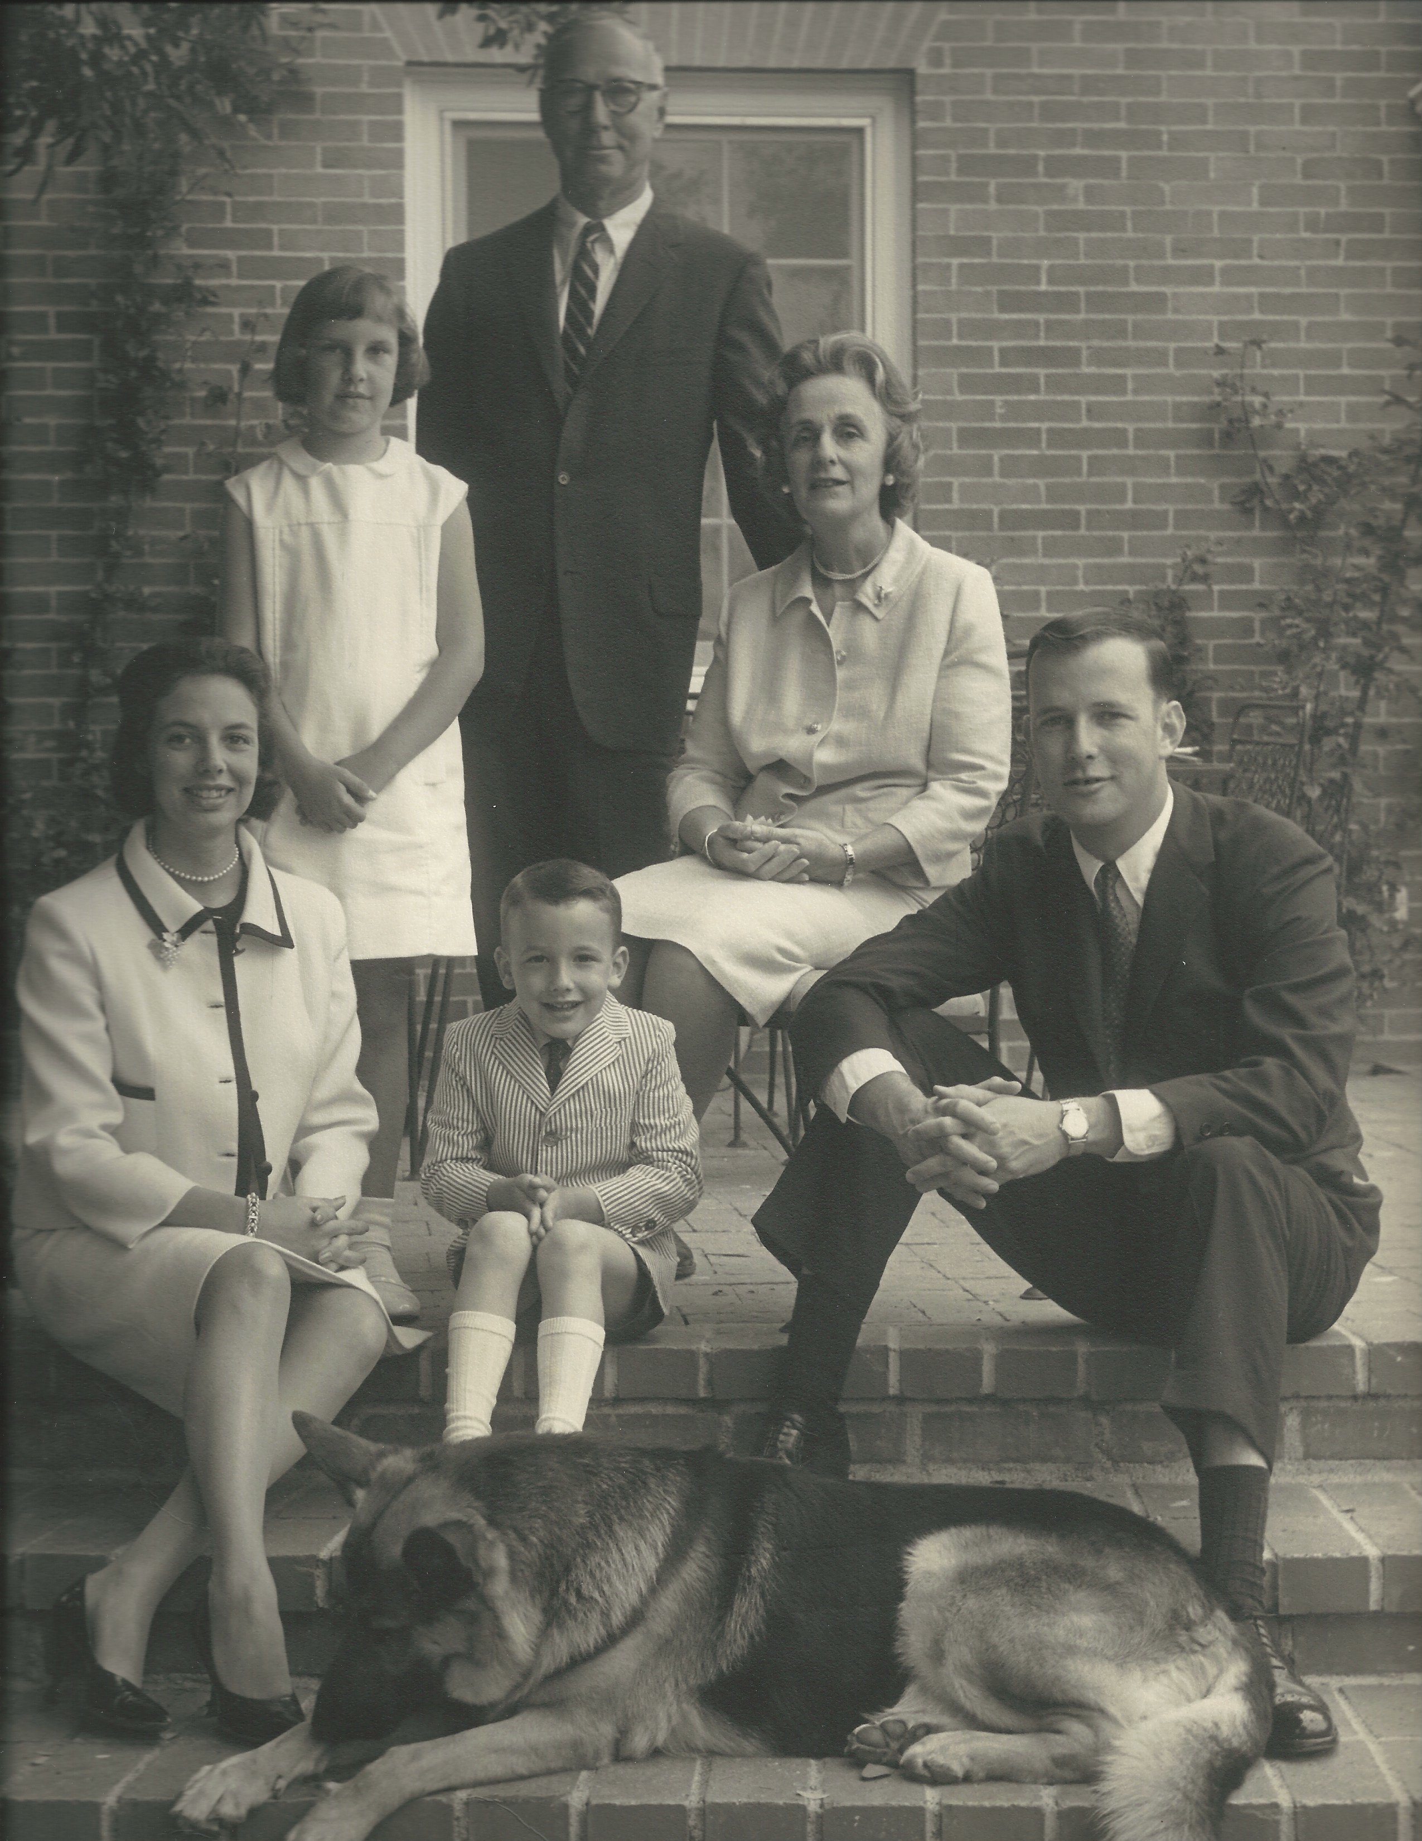
My family
I grew up in a tight-knit and loving family…
This is me with my grandparents, my mom and dad, my sister and our dog, Glenn.

Slide 5
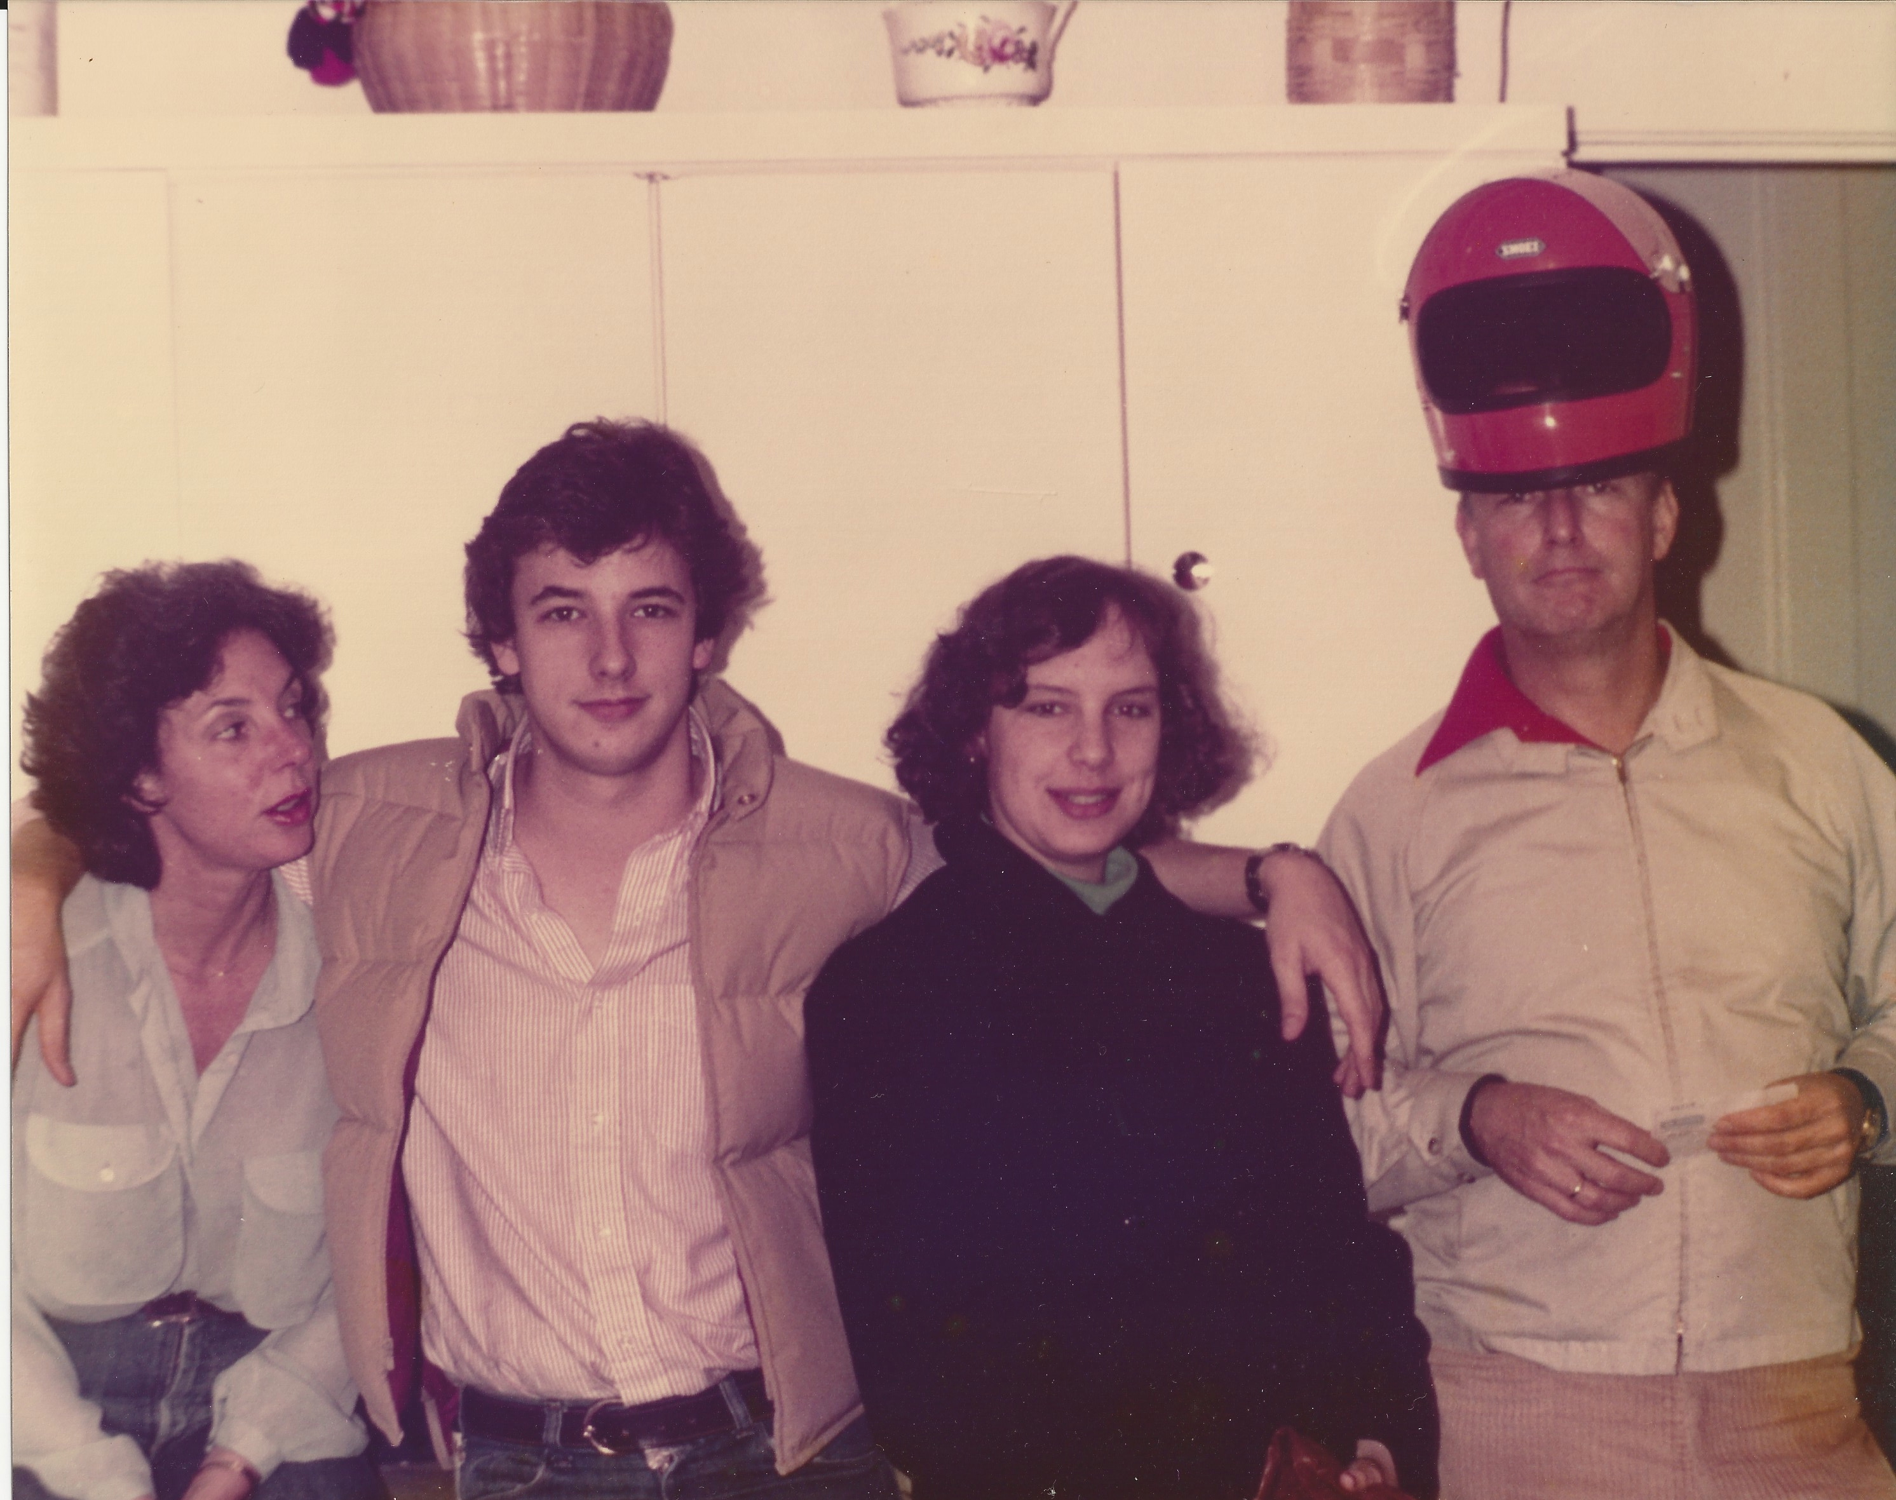
My family (continued)
Our style of dress grew looser as we grew older…
This is a picture of me, my mom, my sister, and my dad

Slide 6
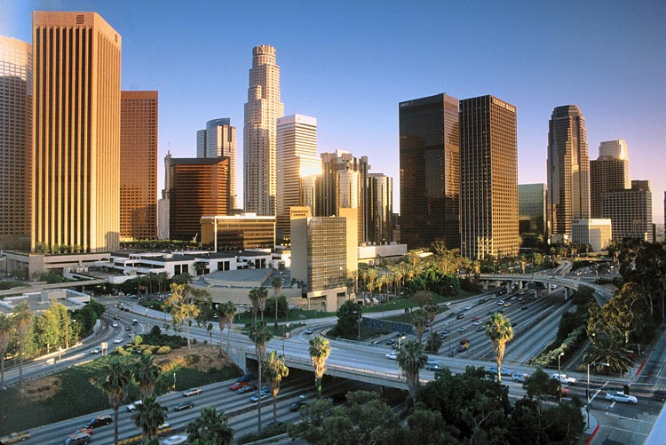
My life began in Los Angeles…

Slide 7
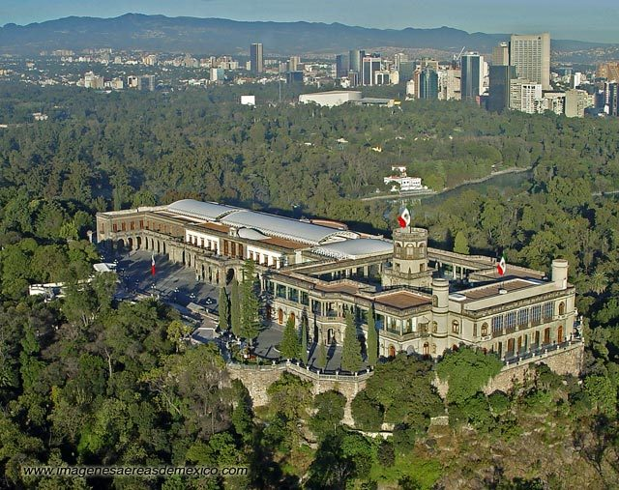
…continued in Mexico City

Slide 8
…went on to London

Slide 9
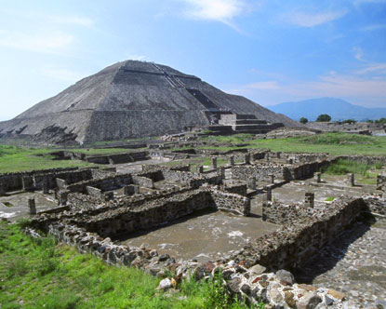
…then back to Mexico City

Slide 10
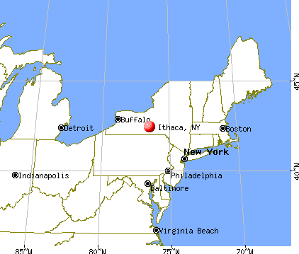
…then to Ithaca, New York

Slide 11
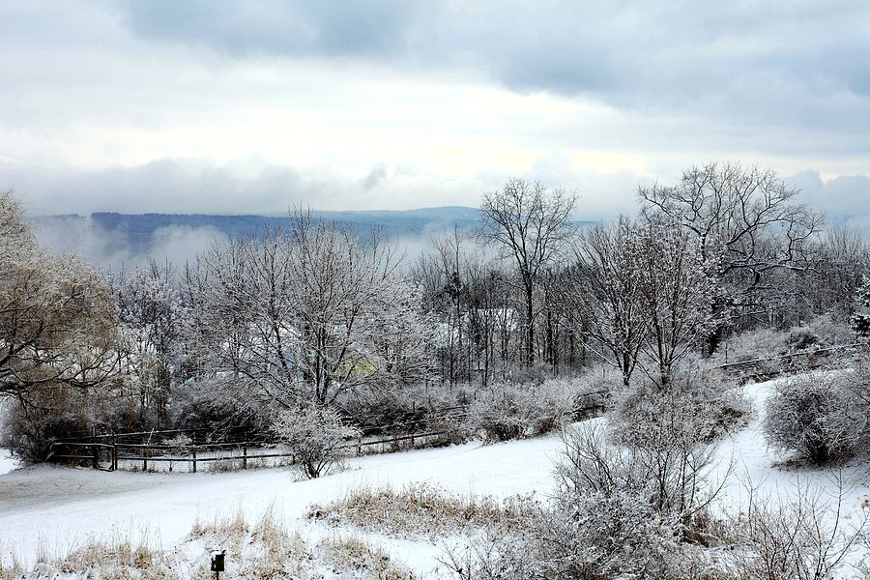
…here’s Ithaca in winter

Slide 12
…then to San Francisco…

Slide 13
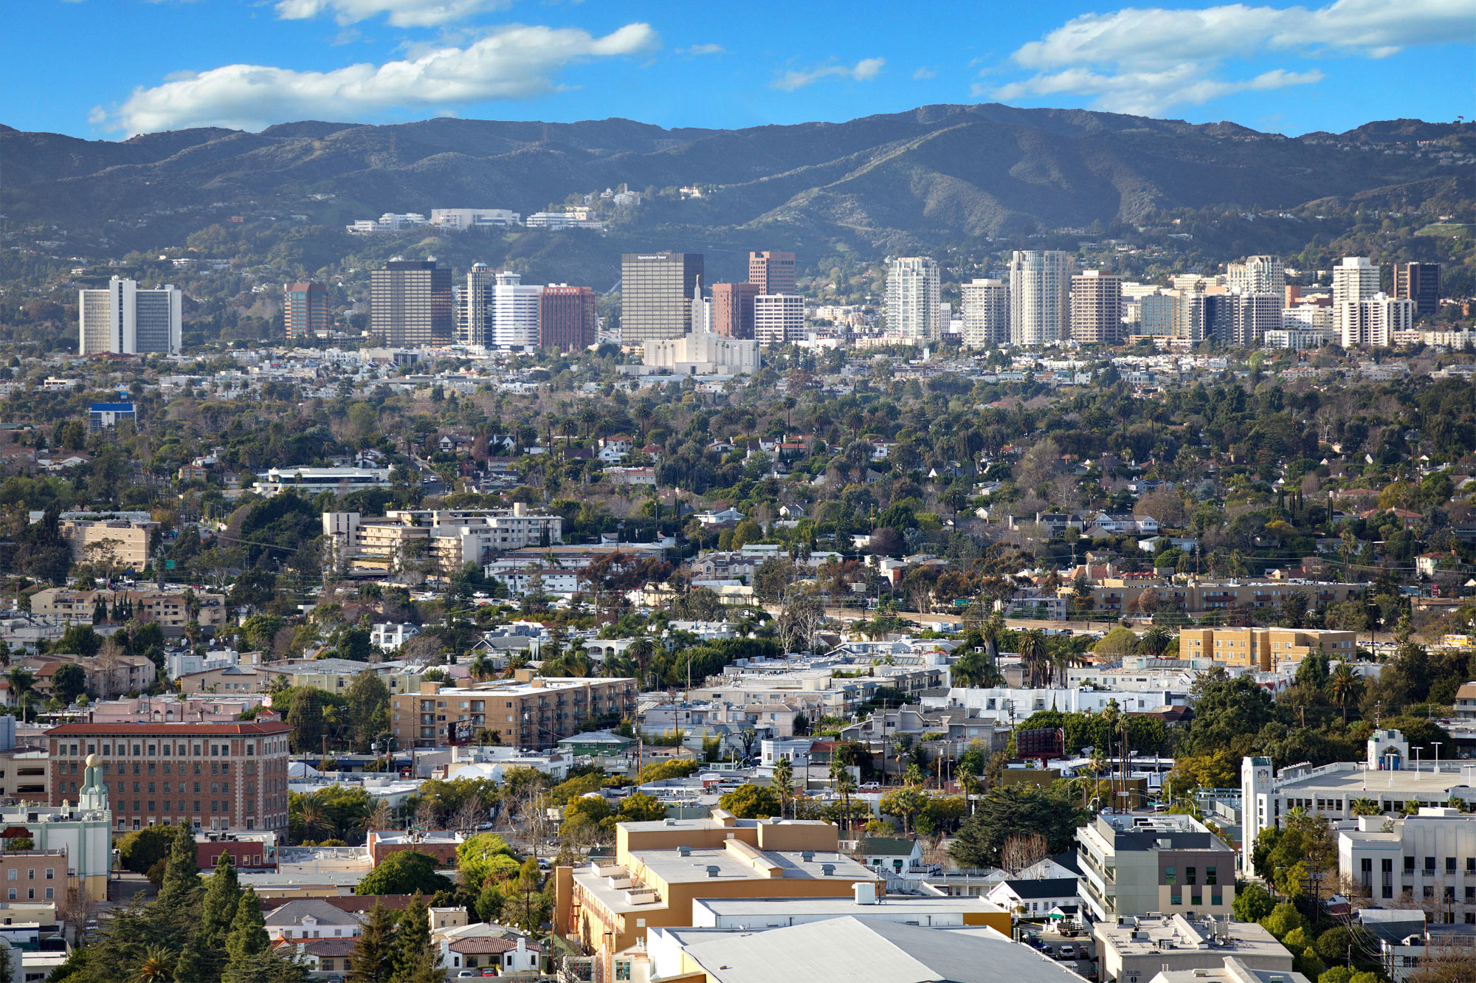
…then back to Los Angeles…

Slide 14
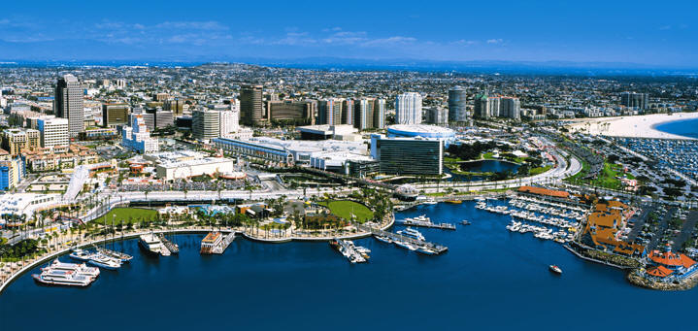
…and on to Long Beach

Slide 15
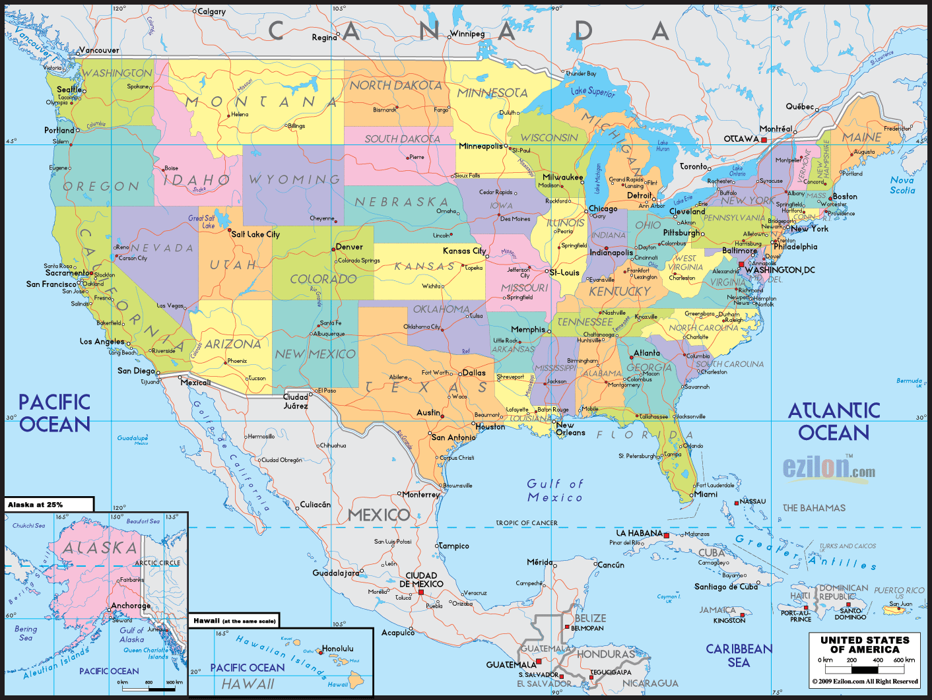
The first part of the journey…

Slide 16
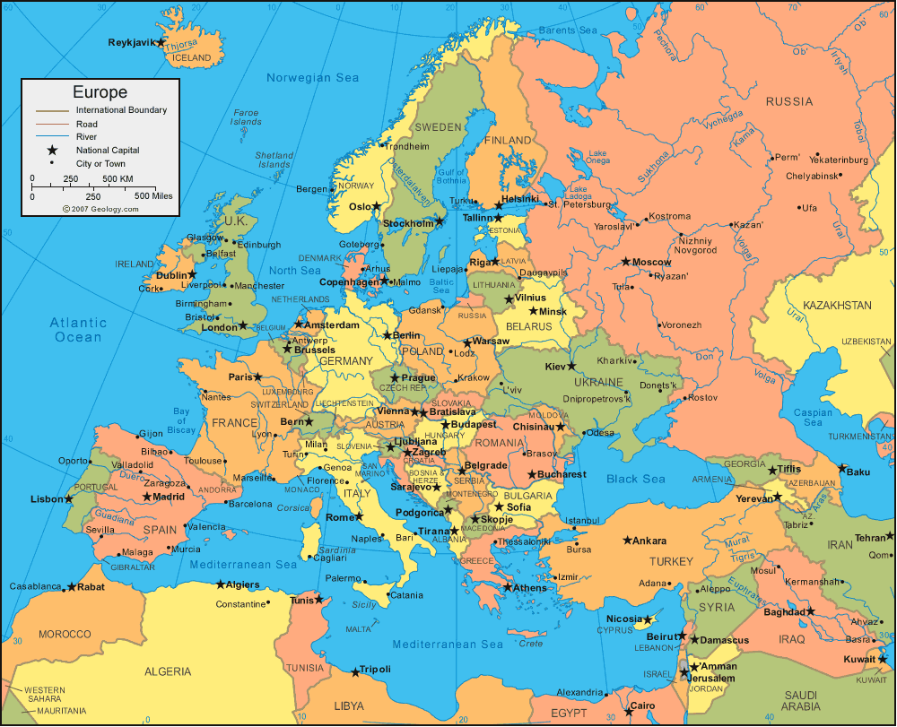
The second part of the journey…

Slide 17
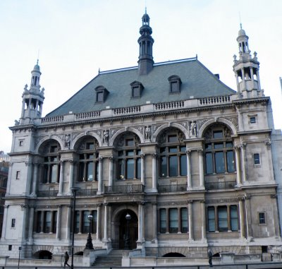
My High School
I attended City Of London School in London

Slide 18
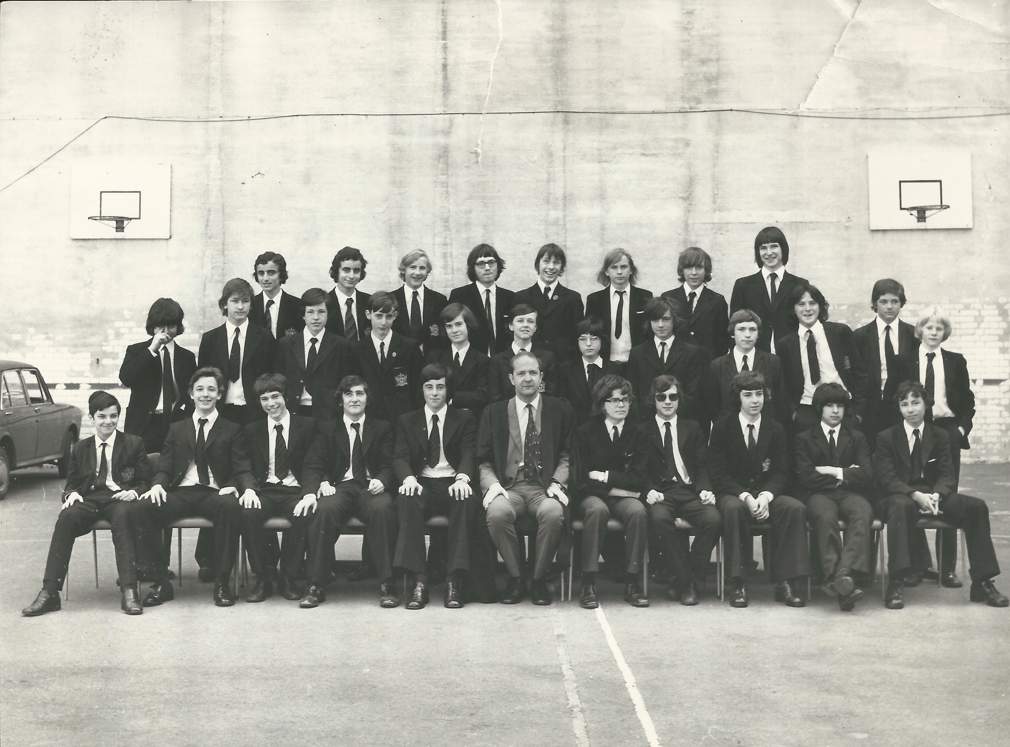
My High School (continued)
This is my sophomore class in London…

Slide 19
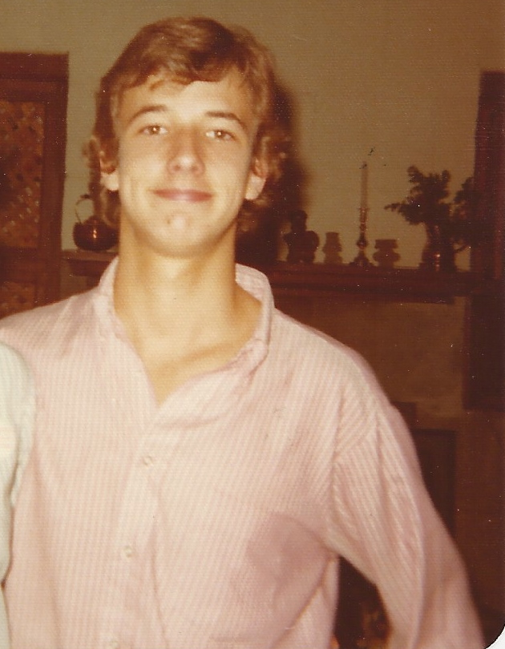
My High School (continued)
I finished High School in Mexico City

Slide 20
High School (continued)
As a High School student I was outgoing but also shy at times, because I wasn’t a very good student. I found schoolwork hard.
My favorite classes were English, Music, French, and Spanish.
My hardest classes were Math and Science.

Slide 21
High School (continued)
My best years in High School were my Junior
and Senior years, when I had returned to Mexico
City. I attended the Colegio Británico.
I spent most of my time playing the piano, listening to music (mostly jazz, rock and funk), and spending time with my friends.
We were all very independent.

Slide 22
High School (continued)
The biggest challenges for me in High School were:
Keeping up with the pace of the teachers.
Finding the courage to ask my teachers for extra help.
Recognizing that I was smart, even though I wasn’t necessarily “book smart.”

Slide 23
High School (continued)
The smartest thing I did in High School was:
Work hard. Even though I studied and learned at a slower pace than many of my fellow students, I still worked hard.
Push myself to meet new people.
Not be afraid to take creative risks with my music.
Embrace the guidance of my parents. Yes, I rebelled a bit, but I never disrespected them. Why? Because they respected me.

Slide 24
High School (continued)
Jobs I worked while I was in High School were:
Ages 14 and 15:
Selling wallpaper, furniture fabric and paint
for a company called Laura Ashley. I worked
every Saturday, from 9am to 5pm. It was a
minimum wage job and I loved it.

Slide 25
High School (continued)
Jobs I worked while I was in High School were:
Ages 16-17:
Working summers at an amusement park called Astroworld in Houston, Texas. I worked as an attendant on different rides around the park. It was a minimum wage job and I loved it!
Teaching drums to several fellow students at my High School (throughout the year).

Slide 26
High School (continued)
Jobs I worked while I was in High School were:
Ages 17-18:
Working during the summer on a construction site in Houston, Texas, helping builders clear the way for doing electrical work, putting up drywall, etc. It paid minimum wage and was a good job.
Working as a grill cook at McDonald’s in Houston, Texas. It was minimum wage and tough. I learned a lot about customer service.

Slide 27
Getting in to College
When I applied to college, I think that several
colleges were interested in me because of my
strong ability as a writer and due to my passion
for music.
I had my own jazz trio when I was 16, and while we weren’t very good, it was clear to the college admissions folks that I was passionate about what I did. I’m a very creative type of person and I think my sense of creativity came across well in my college applications.

Slide 28
Getting in to College (continued)
Another area of interest to the college admissions folks was the fact that I had worked in jobs (during High School) that taught me a great deal about life and about myself.
I think I came across as someone who wasn’t afraid to take risks and who took pride in learning new things.

Slide 29
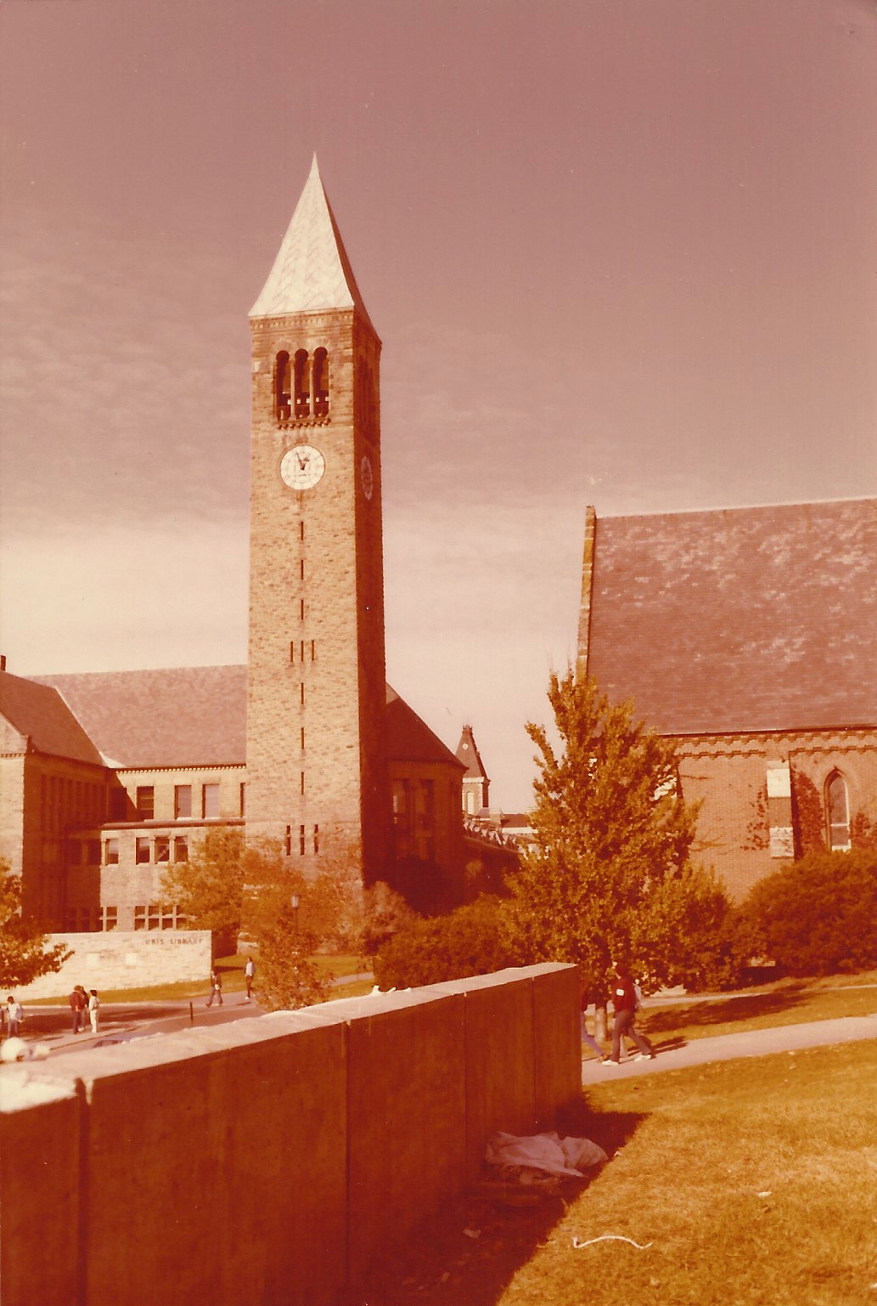
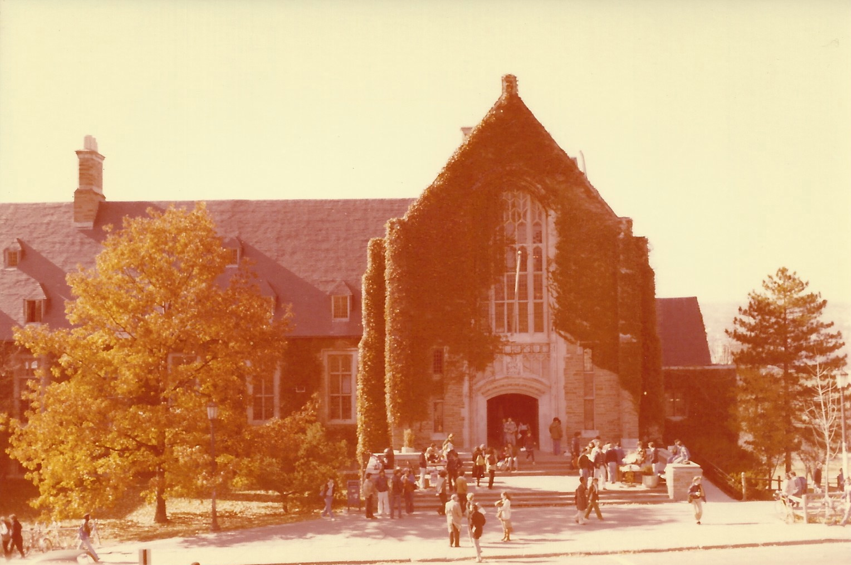
College
I attended Cornell University in
Ithaca, New York

Slide 30
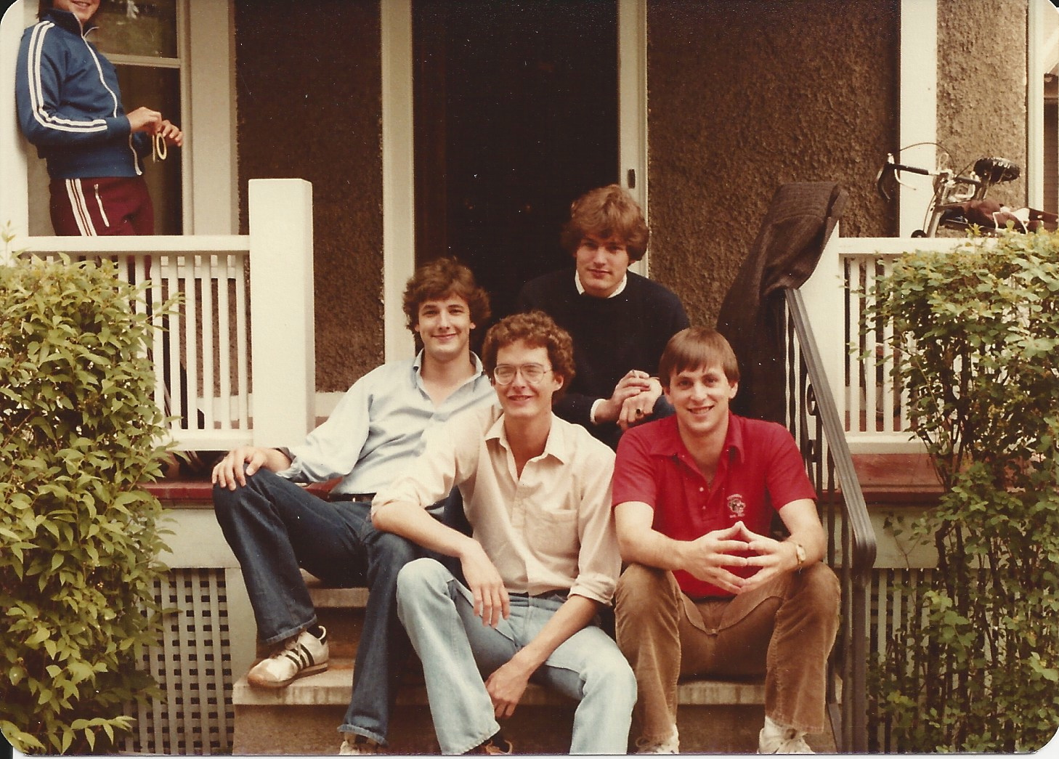
College (continued)
I had great friends…

Slide 31
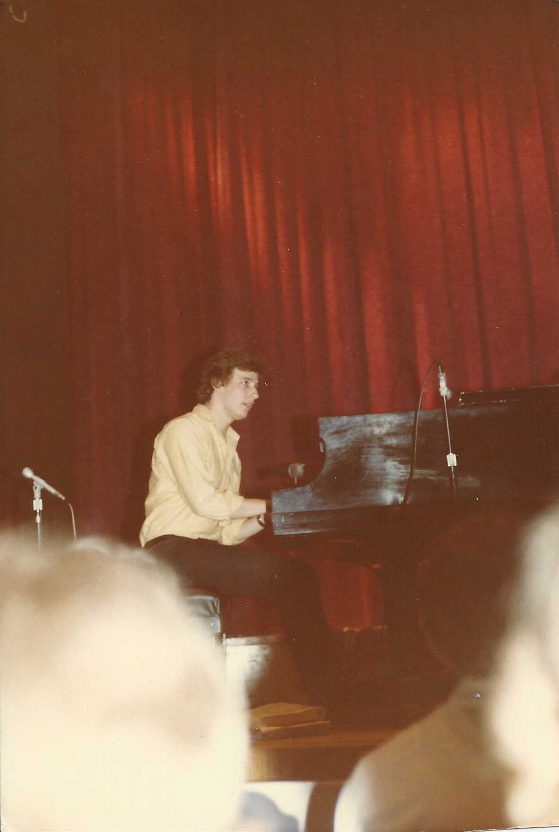
College (continued)
I played the piano as much as possible…

Slide 32
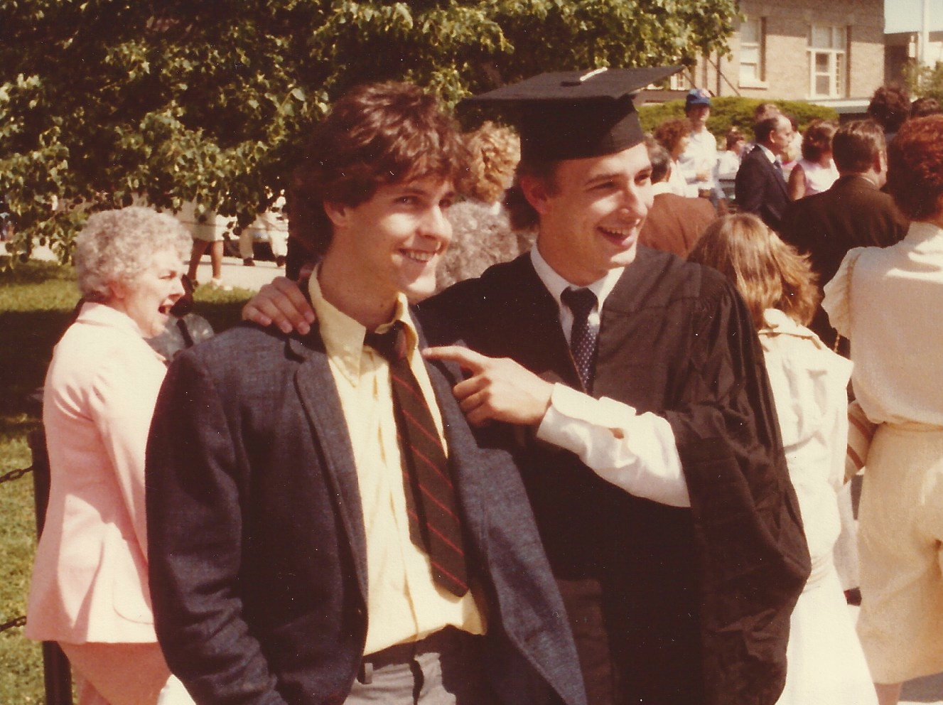
College (continued)
And I graduated!! Yeah!!

Slide 33
College (continued)
Things I enjoyed in college
Things I didn’t enjoy in college
Meeting new people from all over the world.
Being exposed to subjects/topics that I never knew existed.
Learning how to find my own voice in my writing.
Developing great work habits.
The competitive nature of my college.
The weather. It would rain or snow for days and weeks on end.
Pulling “all-nighters” to get papers done. This was before I developed better work/study habits.

Slide 34
College (continued)
Favorite classes
Least favorite classes
Political Science
History
French Literature
Biology
Philosophy
Music Theory

Slide 35
College (continued)
Jobs I worked while I was in college were:
Tutoring fellow students in Spanish and in French.
Running the kitchen in my Fraternity (I got free room and board for doing this).
Selling wallpaper, fabric and paint for a company called “Laura Ashley.”
Working as an intern for an advertising agency in New York City (not too far from Cornell).

Slide 36
College (continued)
Things that felt difficult or challenging for me while I was in college were:
I spent the first 2 years of college learning how to develop study habits. My successful fellow students were organized in the way they approached their work. I was disorganized so I made it a priority to change that. When I did, the final 2 years of college were MUCH more enjoyable.

Slide 37
Getting a job after College
There is no way to “ensure” that you’ll get the first job you want after college, but here’s what will help:
Work hard during college to develop strong communication skills (written and verbal).
Be honest with yourself about what you would like to do (ideally).
Think of yourself as an “investigative journalist” and make a target list of industries, job functions, and actual companies that are in any way of interest to you. Start by asking your professors about suggested industries that could be good for you.

Slide 38
Getting a job after College (continued)
Practice telling your story so that you can tell prospective employers what you’ve been studying, why you’ve been studying it, and how you feel you can add value to an organization. This kind of story is often called an “elevator pitch.”
Try to get an internship (paid or unpaid) so you can truly get a sense of what it’s like to be in that environment.
Set up “informational interviews” at companies so you can ask them directly for advice about how someone like you, with your background, skill sets, drive, hard work ethic, etc. could open doors of opportunity for yourself in xyz field. (I’ll explain).

Slide 39
My Career Path
In my 20’s I focused on becoming a musician (singer/songwriter), and had many jobs to help pay the bills while I perfected my craft:
Drove a delivery van
Drove a milk truck
Sold corporate apartments (I’ll explain)
Did data entry for a health insurance company
Answered phones for an accounting firm
And more…
Notes:
You may use this chart to describe your journey to the current career

Slide 40
My Career Path (continued)
August Alley
Notes:
You may use this chart to describe your journey to the current career

Slide 41
My Career Path (continued)
In my late 20’s, all the way up to my late 40’s, I worked in the record business, helping market new and well known artists in the rock and pop music fields. I worked in these areas:
Radio promotion (getting music played on the radio)
Marketing (writing and implementing marketing plans for each release)
Managing (helping various artists manage their careers)
General Manager (running an independently owned $2 million dollar record label)
Notes:
You may use this chart to describe your journey to the current career

Slide 42
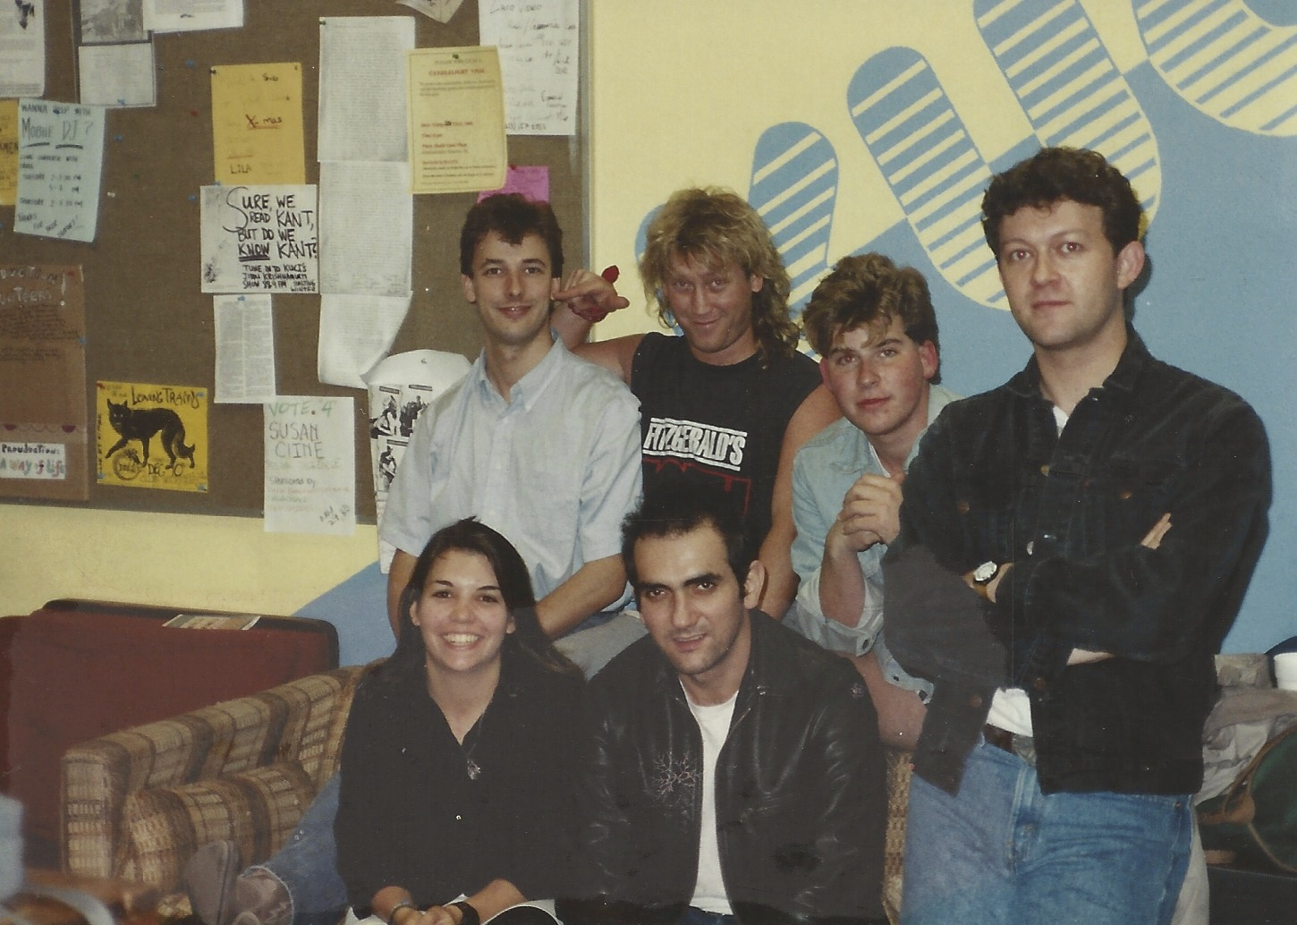
My Career Path (continued)
At radio station KUCI with Paul Kelly and the Messengers
Notes:
You may use this chart to describe your journey to the current career

Slide 43
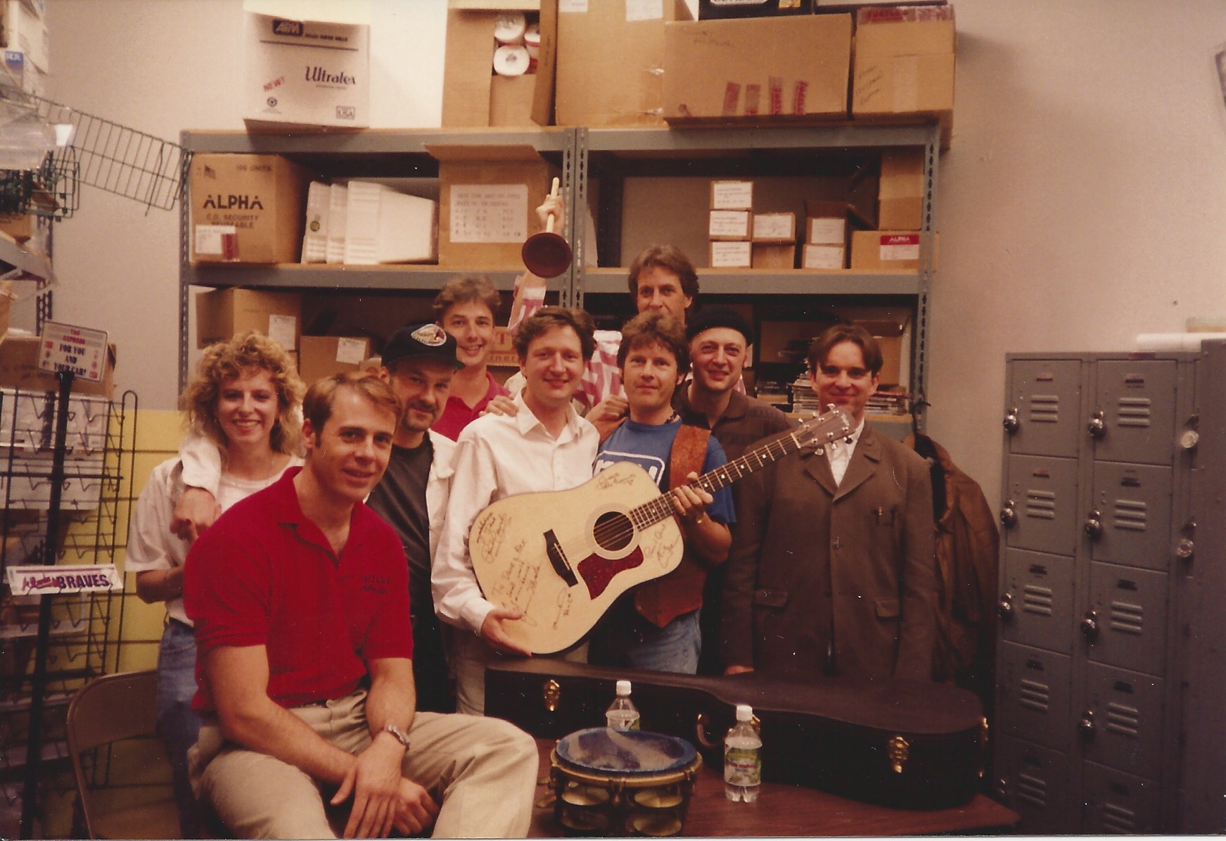
My Career Path (continued)
Visiting a guitar manufacturer with a band called Squeeze
Notes:
You may use this chart to describe your journey to the current career

Slide 44
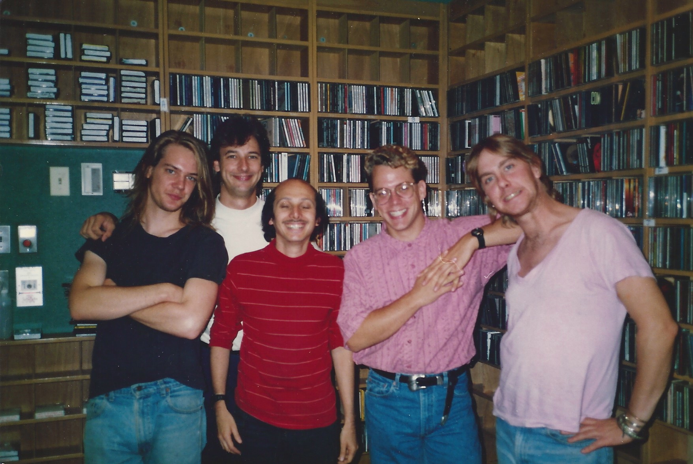
My Career Path (continued)
At radio station WHFS in Washington D.C. with a band called Soul Asylum
Notes:
You may use this chart to describe your journey to the current career

Slide 45
My Career Path (continued)
In my late 40’s, after I left the record business, I was determined to start my own company, but I did these 2 things first:
Worked for an online ad agency in order to learn 21st Century technology (especially how to market using social media and beyond).
Worked as a managing director for an executive search firm, helping experienced professionals find work.
Notes:
You may use this chart to describe your journey to the current career

Slide 46
My Career Path (continued)
Once I felt I had enough of an understanding of technology, and when I had learned a great deal from being a recruiter, I started Brad Pollak Company in 2010.
The funny thing is that the work I do today isn’t much different from what I did in the record business. As a record executive I helped artists get to the next level in their careers, and as a management coach and a career development coach, I help individuals and teams get to the next level in their careers, too.
Notes:
You may use this chart to describe your journey to the current career

Slide 47
This is My Company
Brad Pollak Company

Slide 48
This is My Company (continued)
Career Development Coaching:
I help students, recent graduates and seasoned professionals have a better understanding of how to market themselves when they’re looking for work.
In other words, I help them figure out how to tell their story when they’re looking for work.

Slide 49
This is My Company (continued)
Management Coaching:
I help owners and managers of small-to-medium size businesses, and managers of departments within organizations understand how to:
(1) Manage more efficiently
(2) Teach their teams how to communicate more effectively with one another and
(3) Teach their teams how to improve customer service.

Slide 50
The biggest challenge of my career
The biggest challenge I’ve had to face in my career was re-inventing myself after the record business imploded and diminished in size.
I had to have an honest conversation with myself about my core competencies, about what I love to do, and then determine how to transfer those skills into different areas.

Slide 51
More than just work
When I am not at work I like to:
Spend time with my family, especially doing outdoor activities, to keep my two sons active. This includes biking, swimming, playing basketball, etc.
Play the piano
Spend time with friends
Read (mysteries, “how to” books, biographies)
Travel (I love traveling to new places. Love it!!!)
Write (books and articles, blogs)

Slide 52
Do it all over again?
If I could talk to my high school self, what would I say?
I would have pushed myself to learn more Math and
Science.
I would have pushed myself more to ask for academic help.
I would have learned to sight-read music.
I would have volunteered more in my community.

Slide 53
QUESTION AND ANSWER

