Slide 1
Anita Jennison
Vice President of
Marketing & Business Development
Pixi & POP Beauty

Slide 2


Slide 3


Slide 4

WHERE IM FROM
Population 626K
6th Smallest State (territorial) in the US
2nd Smallest Population in the US
50% of High School Graduates go to College
vs 68% National Average
80% of kids attending High School graduate

Slide 5
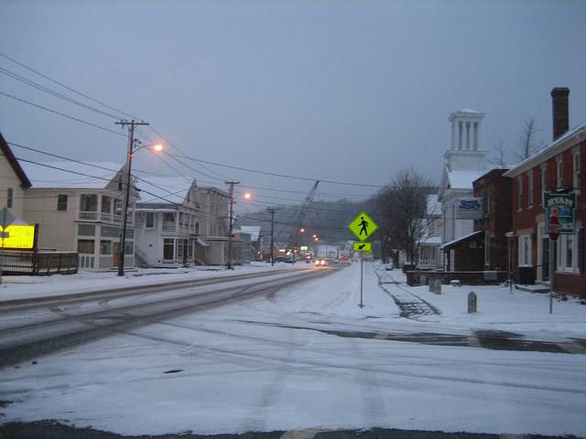
Town looked like this

Slide 6
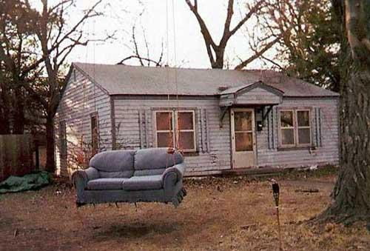
Front Yards Like this

Slide 7
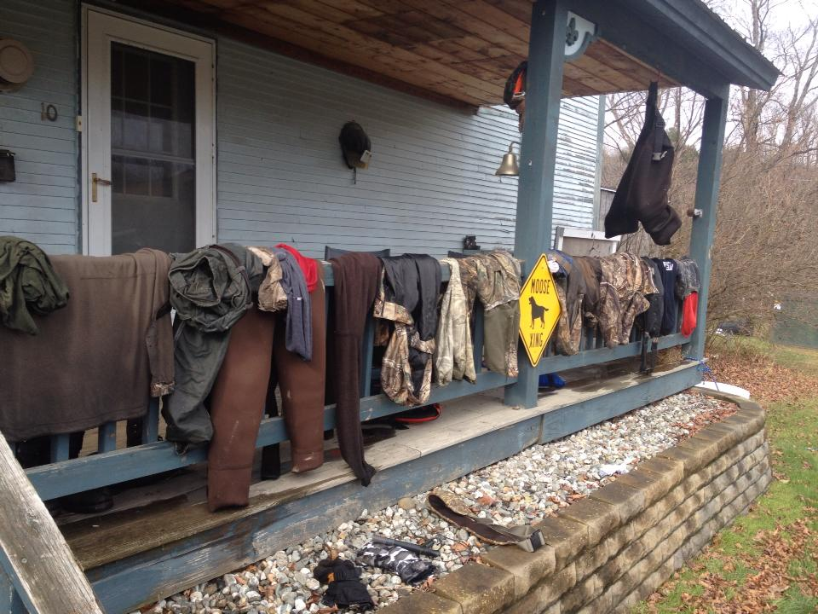
Houses Looked like this

Slide 8

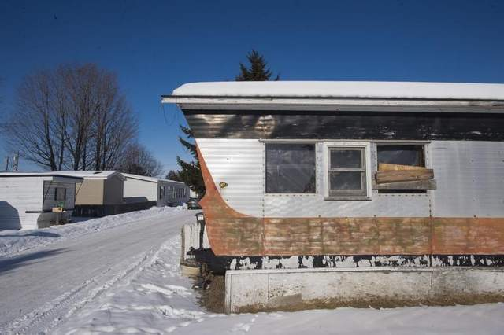
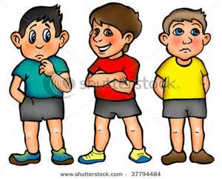
ME
I grew up in
one of these
I had
three of these

Slide 9

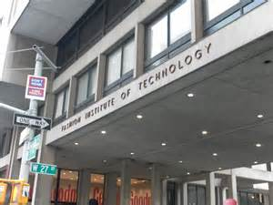
My Journey 17 to 34

Slide 10












Slide 11



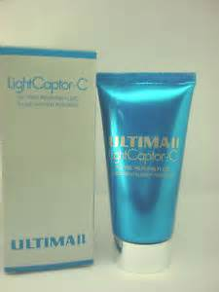


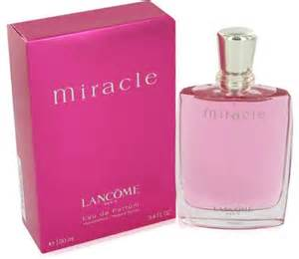


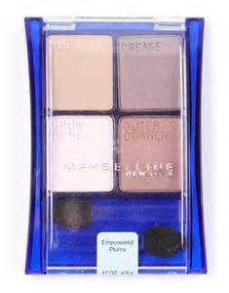
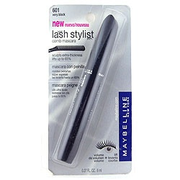
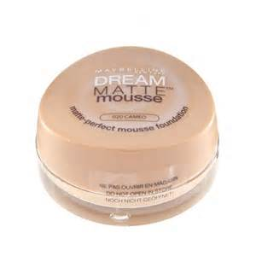

Slide 12



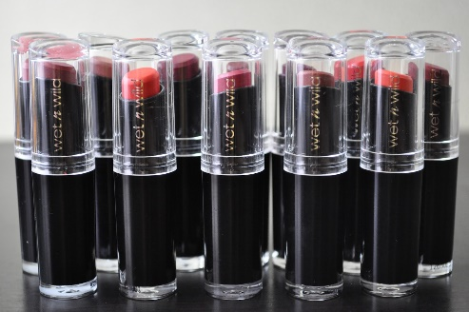




Slide 13
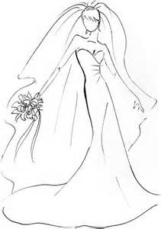



Slide 14
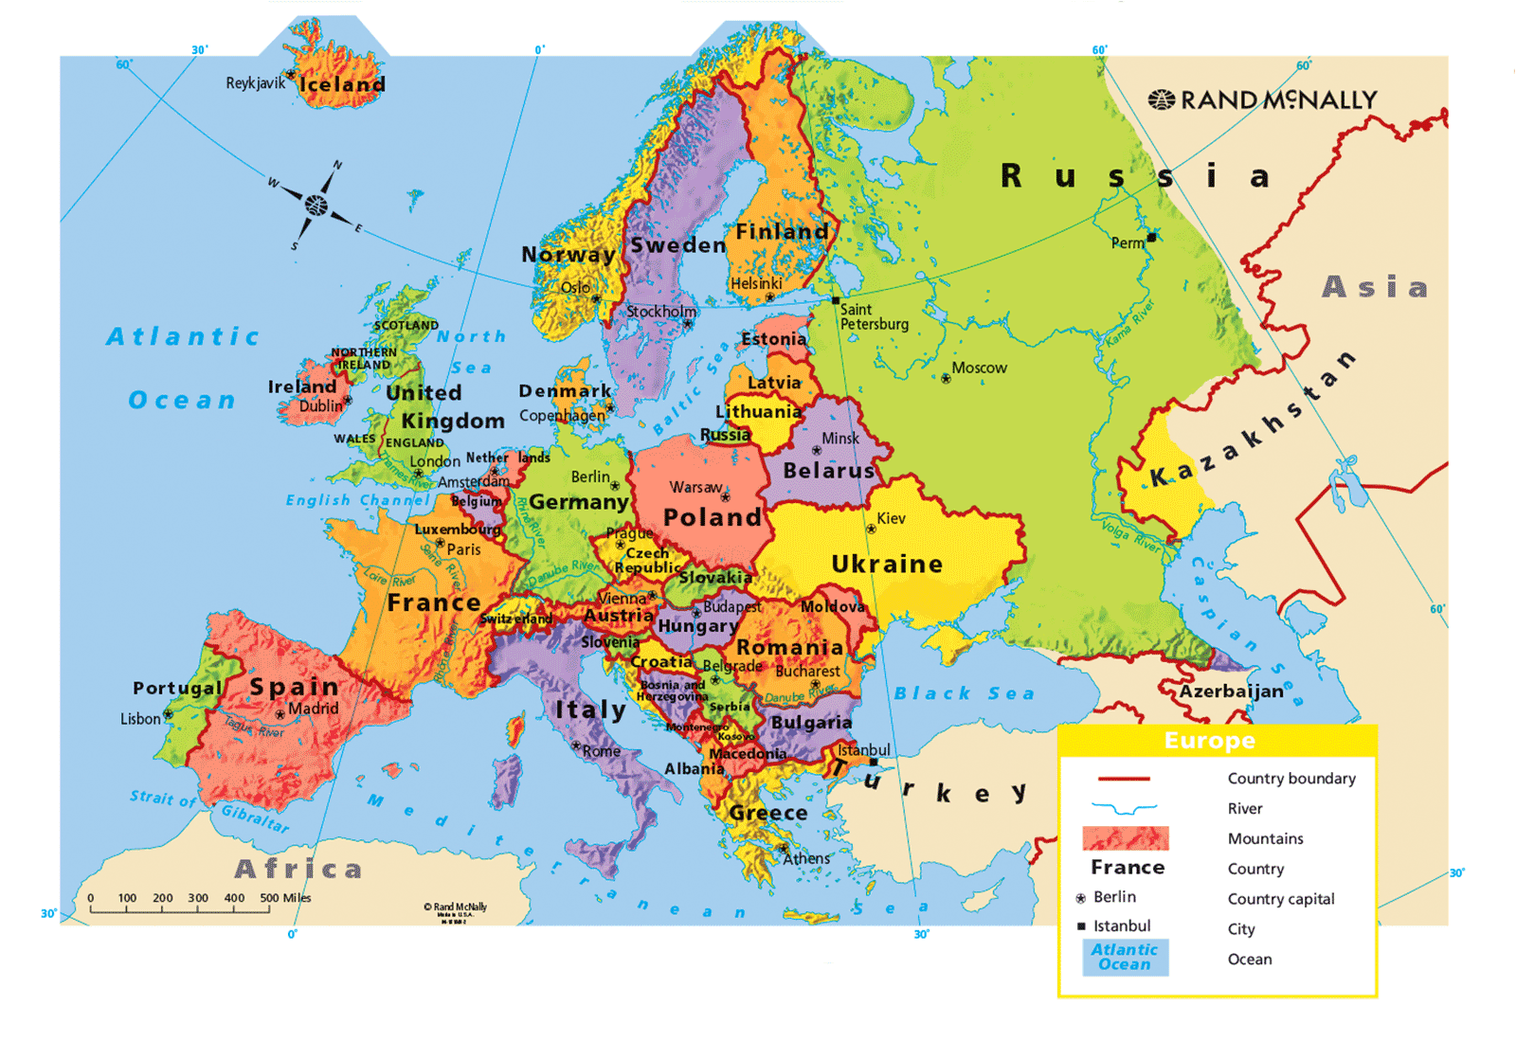
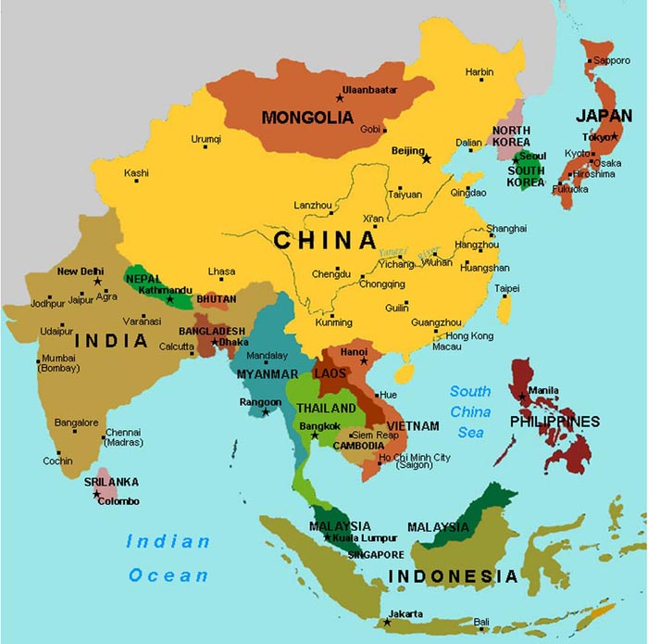

Slide 15
Four C’s
It is! | It is NOT!
Growth mindset: Learning & Embracing Life’s Challenges | Keeping up appearances & growing
Recognize & Resist Negative Group Pressures | Conforming to harmful & superficial norms
Connect – Acts of Kindness Caring is Sharing ☺ | Digital World is Distracting
Believe in yourself. Think Positive. Have a Goal | Looking for acceptance & acknowledgement
Character
Confidence
Connection
Courage

Slide 16
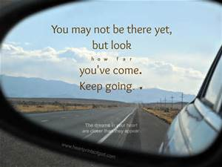

Slide 17

https://www.youtube.com/watch?v=FH50mR9ACeE

Slide 18
NOTES NOT TO BE PRESENTED

Slide 19
ACCEPT YOURSELF
BE PROUD
BE HUMBLE
BE TRUE TO YOURSELF
LAUGH
LOVE
CELEBRATE YOUR WINS
CRY
BUT DO NOT QUIT!

Slide 20
I grew up in Vermont which contains 626k people, and within a town of 1200 (now 3200) people. Lived in 3 room trailer with a family addition. Grew up with my father making little less then 19k/year for a family of six, my father was a trailer park landlord. My parents had a torturous relationship, so much 2 of my 3 brothers were taken out of the home. I was the only adopted child, witness a lot. By the time i was 16 I emancipated my parents to divorce the divorce battle . At 16, I lived with my 23 year boyfriend and his friends, something a girl my age should not be doing. Emotionally rattled, mother estranged, I was determined to get out from the bandwidth of country life and at 17 moved to NYC. I hadn't know what college I wanted to go to, as I had no money, not like my parents were going to help...but Somehow I picked FIT. My 3 brothers financially helped me the best they could and I worked 2 jobs, took 21 credits per semester, worked my tail off! I applied for every grant, scholarship and internship I could. 24 years later here I am. A MBA graduate from Pepperdine, got into one of the most elite programs the school has to offer. I lived in NYC for 18 years before moving to California 7 years ago. I have been around the world in over 20 countries, and numerous cities. I have a story, not a lot of people believe. I was told in high school I didn't have what it took to succeed. I remember my Latin teacher disappointing me we a horrible letter of recommendation and my school counselor telling me to go to not think too big. I have hit rock bottom more then once, even more than twice. I believed in myself and I believe each child needs to believe they can do it. They need dreams! They must think big!
Every Action no matter how big and Small make a difference
Discovery
Thinking about your life
Pondering dreams imagining
What kind of people you will become
Enormous Potential. Make a difference
Mark out future - who you be and what you will stand for & What will you stand For
Live a life that truly matters. Its about People not stuff
Give yourself…
Positive influence to the people around you
Embrace your Uniqueness - use it

