Slide 1
JENNIFER BIRN
YBA Talk for Amino Venice HS
3/28/16

Slide 2
I knew what I wanted to do from a very young age

Slide 3
INTRODUCTION
My name is Jennifer Birn. I was a successful writer, reporter and editor at magazines for several years before leaving the world of 9 to 5 five years ago to figure out what I wanted to do next.
Based on relationships I made and things I learned while a journalist, today I own a creative consulting company called Simplyjen Creative Consulting and I’m able to work from home, consulting on a varied slate, marketing strategy and PR for brands, including Hello Products and currently launching a new fruit wine jello shots company, running and doing PR for celebrity-driven events, to freelancing and consulting for magazines like Maxim Magazine, where I filled in as West Coast Editor last year. I also cast and produced my first indie film last year – starring Tommy Chong, Once Upon a Time’s wicked witch Rebecca Mader and Twilight’s Booboo Stewart and recently turned in a novel I wrote with a former NFL player.
When I’m not working, I’m hanging out with friends, playing tennis, traveling, volunteering or doing yoga – because life is about a balance.

Slide 4
WORD CLOUD OF ME

Slide 6
The Early Years
I lived in a suburban neighborhood in Houston, TX until I was I was 12-years-old. I was a bit shy, but when I was 10-years-old the most popular girl in school said to me, “You should smile more, you have a pretty smile.” That’s all it took for me to come out of my shell – someone I looked up to believing in me.
By the following year, when I was in 6th grade, I had enough confidence to run for class Treasurer. I didn’t win, but I enjoyed the campaign where I asked everyone to “Save Every Penny and Vote for Jenny.” It was the first of several failures I’d learn from on my road to many successes.

Slide 7
The Early Years
I grew up in a picture perfect family with my mom, dad, one sister and a dog. My parents set high standards for my sister and I (we had to get at least Bs, but As were expected) but they always believed in us and told us we could do whatever we wanted to do – after we went to college.
In the meantime they exposed us to as much as they could and I took tennis lessons, soccer twice a week, gymnastic twice/week and art classes.

Slide 9
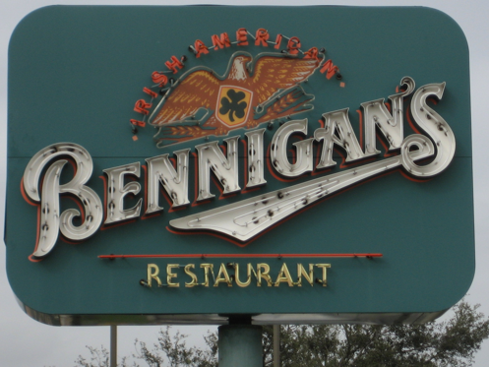
HIGH SCHOOL/FIRST JOB
When I was 12 we moved from Texas to Long Island. I attended Commack High School in Commack, NY. I was the ‘new girl’ in 7th grade – and I didn’t have a New York accent so people though I sounded funny.
I did well in English and decided I wanted to be a writer.
More important to me at the time, I wanted to go to Cancun for my senior trip. My parents said no. Well, they said they weren’t paying for it, so I walked down the street to Bennigan’s where I got my first job, as a hostess, at 16.
\

Slide 10
FIRST JOB/COLLEGE
Working at Bennigan’s I made lots of new friends, learned some responsibility…And made enough money to go to Cancun, so my parents let me go.
I’d planned to go to college at Boston University, which I’d fell in love with during a 7th grade trip, but after getting in, my parents suggested I go to Arizona State University. It took me years to realize it may have been because BU was about $35,000/year and ASU was less than half that much. But – everything happens for a reason…even if that reason isn’t readily apparent.
\

Slide 11
FIRST LIFE HICCUP
My storybook life was interrupted for the first time after my first semester at college at Arizona State when my dad got very sick and I had to stay home a semester and take care of my sister, who was still in high school, while again working at Bennigan’s. My mom slept at the hospital most nights.
Thankfully and most importantly, after a couple of months my dad got better…But between medical bills and my dad not working, my parents couldn’t afford to send me back to college.
\

Slide 12
PERSEVERANCE Back to School…
Not going back to ASU wasn’t acceptable for me so I saved money for a plane ticket, went back, slept on a friend’s couch, took the bus to Mesa Community College, a local school near ASU and worked at Bennigan’s in Arizona until I could save enough money and get financial aide to go back to Arizona State.
One semester later I was back at ASU and working at a bar near campus. I was pre-law because I was a good test-taker and thought I could be a good lawyer and get into Stanford Law School.

Slide 13
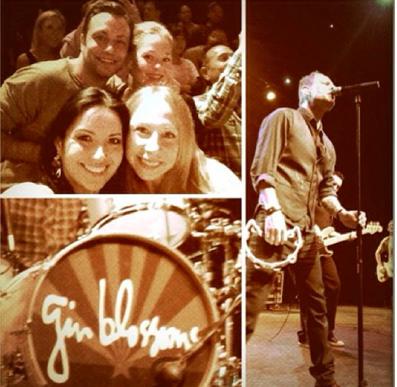
NEW DIRECTION
While working at a music bar a popular band of the day called the Gin Blossoms broke up. I pitched the story to Rolling Stone and got my first rejection letter. It’s now framed.
But, when local music editors called the bar trying to reach the Gin Blossoms and they declined interviews, I asked them to give me an interview. They humored me and I got a job writing about music at the local newspaper. Afterwards my mom said, “Why don’t you change your major to journalism, it’s obviously what you like to do.”

Slide 14
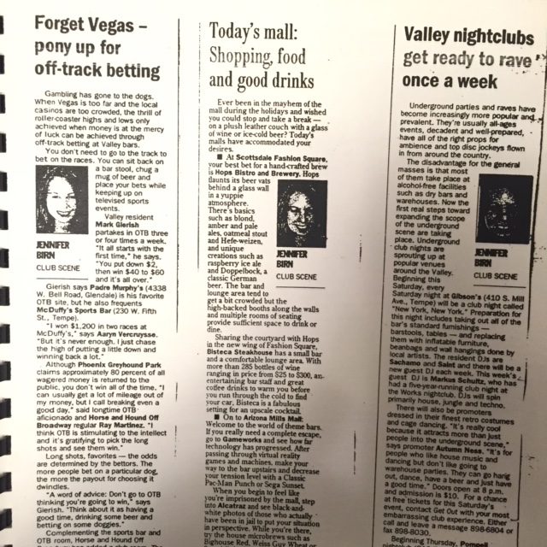
Waitress to Columnist
So, I changed my major to journalism and the local newspaper (that for a long time wasn’t aware I hadn’t graduated yet!) gave me a column

Slide 15
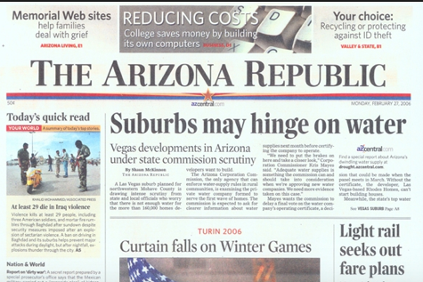
First post-college job…
When I graduated college I was offered a job as a columnist and feature writer for The Arizona Republic.

Slide 16
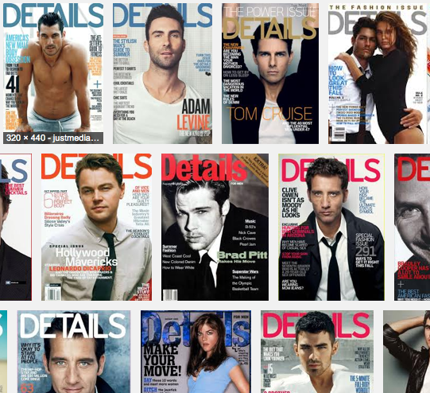
Still hungry…
I was happy to have a fun job where I continued to grow and learn at The Arizona Republic, but I wanted to move to NYC and write for a big glossy magazine like Details

Slide 17
Persistence…
But Details temporarily went out of business because Maxim took over the category – so I wanted to work for Maxim…
I’d try to brainstorm brilliant story ideas and would email them to the editors.
Finally one responded.

Slide 18
Pays off…
This was my first article for Maxim

Slide 19
But I was still hungry
I sent out a classified ad about myself to magazine editors that I could turn around a story better and faster than anyone else.
I wanted to travel, but didn’t have money to travel, so I bartended and pitched magazines stories that would pay me to travel. I covered fashion week in Paris for Us Weekly, Survivor in Panama for In Touch Weekly and did a story on a then Denver Bronco in Colorado for ESPN Magazine.
Celebrity weeklies started growing, they became really competitive and so did the salaries , so I went staff…And worked for them all….

Slide 20
CAREER

Slide 22
I met Sir Richard Branson

Slide 23
Take chances free of fear…
Not knowing much about the brilliant entrepreneur I told him I had an idea...It led to seven years and counting consulting for Virgin brands.
Lesson: It reaffirmed, don’t be afraid. If I knew then what I know about him now, I may never have been so bold.

Slide 24
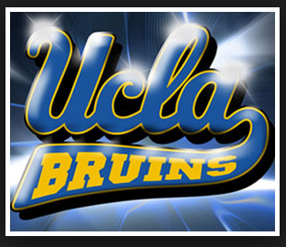
New Chapters…
I got bored of knowing every detail of Kim Kardashian, Snooki and Lindsay Lohan’s lives and took writing classes at UCLA after work for extra stimulation.

Slide 25
And then…
I realized I was enjoying the creative writing assignments in class and the marketing and events I was doing with Virgin brands more than my job at OK!, so I quit and decided I’d figure out what was next.
Full of energy and with an innate love to work, I didn’t have any days off….

Slide 26
I did Nano

Slide 27
I cast and produced an indie film…

Slide 28
I do marketing and PR for cool brands like hello

Slide 29
Current Role
CEO
Novelist
Journalist
Creative Marketing
Publicist
Notes:
Use this graph to give more description of your role specifically (responsibilities, typical work week, direct reports, etc.)

Slide 30
Career Compensation
Celebrity Weekly Editor
$120K
Reporter
$45K
Starting Journalist$20k
Self-employed $75K-125K
Notes:
Use this graph to show general compensation ranges for people in various roles in your company

Slide 31
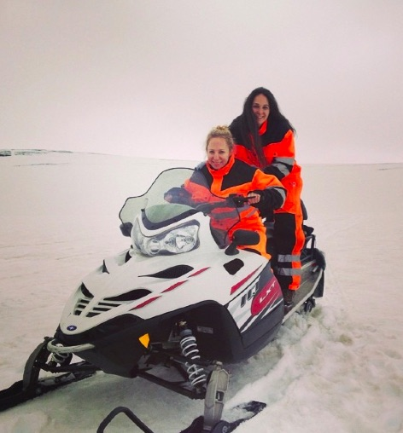
Lessons I learned
Maintain balance between work and play for longevity.
In addition to work I love…

Slide 34
QUESTION AND ANSWER

