Slide 1
YBA GUEST Marveina Peters

Slide 2
INTRODUCTION
My name is Marveina Peters and I am 39 years old.
I’m co-owner of TP Executive Realtors, Inc. (TPER, Inc.)
We help low to mid-size families transition from renters to property owners.
We are property investors; we buy homes all around LA and house families that are not ready to buy yet.
My role at TPER, Inc is President
As president I manage all day to day operations and research our next project.

Slide 3
My Early Years…
Born in LA, raised in Baldwin Hills. I’m the oldest of four and was raised with both parents.
This is a picture of my parents, brother, 2 sisters and I

Slide 4
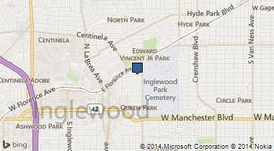
HIGH SCHOOL
I attended St. Mary Academy here in Inglewood
\

Slide 5
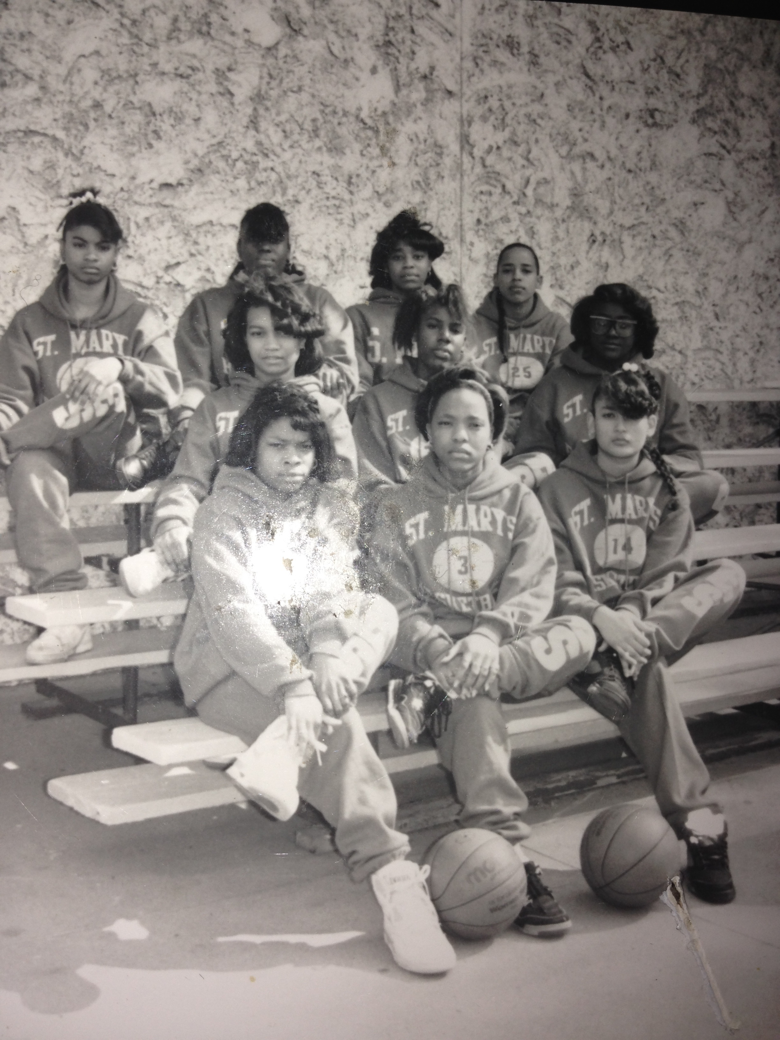
HIGH SCHOOL
As a HS student I was involved in sports and drama. I played basketball, ran track and was in theatre.
I was outgoing yet the one conservative of the class. I was always a B-C student and didn’t really like school, but loved athletics (basketball, track, volleyball).
\
Here’s me in 10th grade with St. Mary’s varsity basketball team

Slide 6
HIGH SCHOOL
Activities/Athletics in HS
Jobs I worked while in HS
Basketball –point guard
Track – 200/400/4X4
Cross country
Drama
Taco Bell –Fox Hills Mall
Miller’s Outpost- Fox Hills Mall
Ladera Park- youth counselor

Slide 7
HIGH SCHOOL
Fondest memories from HS
Obstacles/Adversity you had to overcome in HS
Football games (rolling 20 deep)
My friends getting kicked out and me sliding
My sweet 16 party (300 people)
Prom
Adjusting to an all girls school
“To be or not to be” popular

Slide 8
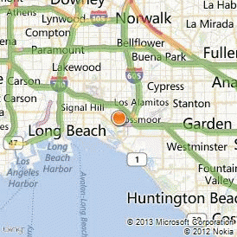
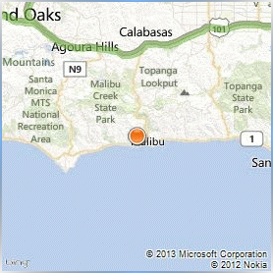
College or Graduate School
I attended Cal State Long Beach and Pepperdine University grad school.
\

Slide 9
College
Activities in College
Jobs I worked while in College
Speech/public speaking
-published in the universities text books.
Sorority life
Campus cafeteria (cashier)
-benefits
eat for free
making lots of friends
United Airlines
-benefits
fly for taxes
flexible schedule
stock

Slide 10
College or Graduate School
Favorite classes
Least favorite classes
Speech
Theatre
Accounting
Economics
US History
I could never understand these classes

Slide 11
College or Graduate School
Fondest memories
Obstacles or adversity that I had to overcome
Being selected to be published in text books
Step shows
Pledging Zeta Phi Beta
Pregnancy sophomore year
Leaving my roommate with the responsibility of our apartment and moving back home
Making the decision to go back to school after childbirth

Slide 12
My Career Path is a diverse one
Notes:
You may use this chart to describe your journey to the current career

Slide 13
Career

Slide 14
Career
My first Job
My worst Job
Ladera Park
Student Summer Youth Counselor
Assist counselors with the day to day activities at the park
Group assignment/supervise kids
Pass out lunch
Keep younger kids 8-13 years entertained
Has anyone worked a summer job yet?
Taco Bell-Fox Hills Mall
At 16 years old
Attention from boys-following me
Uniform
What I learned about TB food
Everyone wanting a discount
Cleaning up behind others

Slide 15
Career
I’ve had the luxury of having two careers in my lifetime. With both careers came challenges I had to overcome.
Law Enforcement Career
Trying to fit in with people different than I am.
Gaining the respect and cooperation of local gangsters and residents in Inglewood.
Lie with a straight face (undercover work/prostitution)
Reassuring my husband and family that I am ok/safe at work at that “I WILL SEE YOU LATER”
President of a Company
Convincing employees that I’m the best person for the job and I wasn’t just given my position because I’m the child of the boss’
Proving myself to agents/employees older than I am
Disciplining/firing employees, that were personal friends of my parents
Going back to school as a mother and wife to learn how to operate a business
Transitioning from one career to a completely different career

Slide 16
CURRENT ROLE
Notes:
Use this graph to give more description of your current company (history, size, location, products and services, etc.)

Slide 17
Current Role
Notes:
Use this graph to give more description of your role specifically (responsibilities, typical work week, direct reports, etc.)

Slide 18
Career Compensation
Notes:
Use this graph to show general compensation ranges for people in various roles in your company

Slide 19
ACADEMIC EXERCISE
Bachelor’s degree in Criminal Justice from Cal State University, Long Beach
Masters degree in Business from Pepperdine University
Certification in Real Estate Principles, Practice
Certification in Probate Sales
Certification in Organizational Transition Management-UCLA

Slide 20
QUESTION AND ANSWER

