Slide 1

INTRODUCTION
My name is Richard Rizika and I am 50 years old.
I work for
CBRE is the world’s largest commercial real estate services firm.
My role at CBRE is Vice Chairman for the Retail Services Group.
As Vice Chairman, I lead a team of professionals who offer industry-leading strategy and services to owners, retailers and investors of commercial real estate.
I was previously trained as a chef and have owned multiple restaurants.

Slide 2

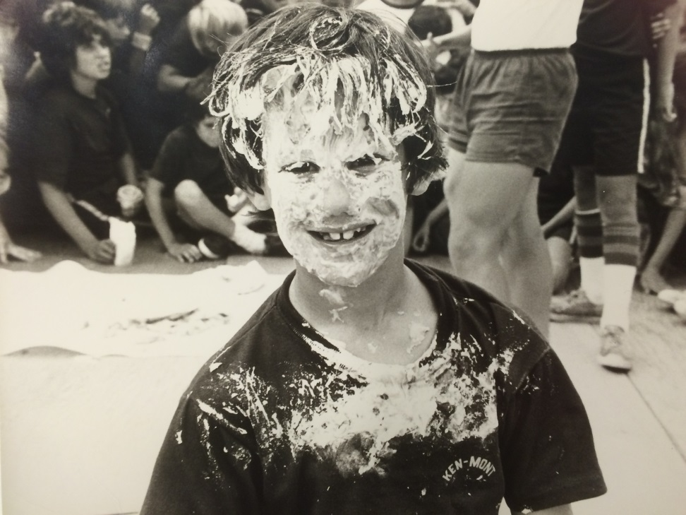
The Early Years…
I was born and raised in New York City.

Slide 3
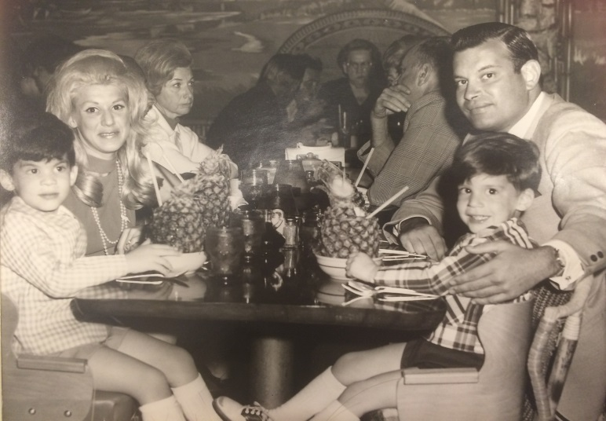
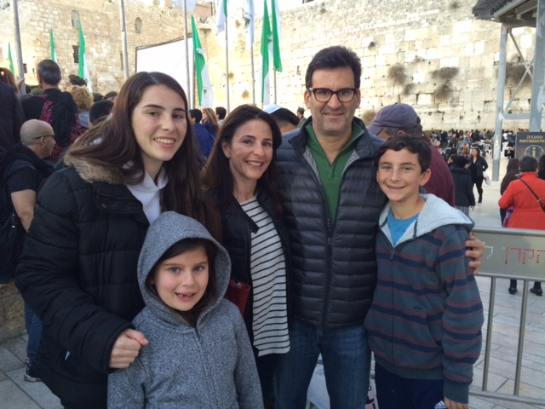
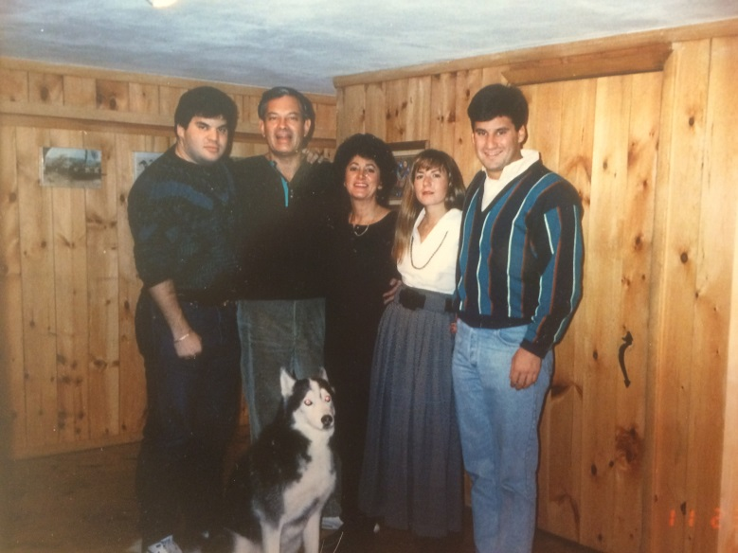
More Early Years…
A little about my family…

Slide 4
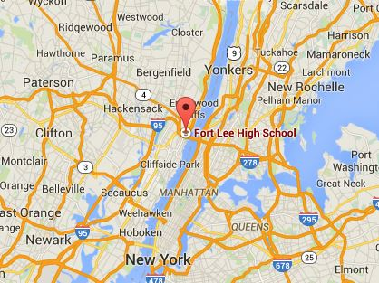
HIGH SCHOOL
I attended Fort Lee High School in Fort Lee, New Jersey.
\

Slide 5
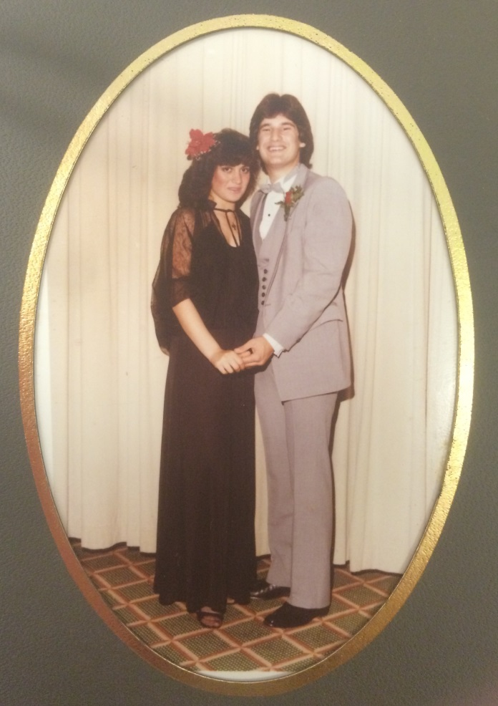
HIGH SCHOOL
As a HS student I was athletic and outgoing… pretty much a normal kid. Not too popular, but not unpopular. I had a good group of friends and was very busy with sports and student council.

Slide 6
HIGH SCHOOL
Things I enjoyed in HS
Things I did not enjoy in HS
Sports
  Basketball
  Soccer
  Golf
In School Activities
  Student Government
Classes
  Biology
  P.E.
Out of School Activities
  Restaurants
  Video Games
Classes
  English Literature
  Chemistry
Detention
Burnouts & Bullies

Slide 7
HIGH SCHOOL
Activities/Athletics in HS
Jobs I worked while in HS
I was not a very good student in HS, but I enjoyed athletics.
I worked various jobs while in HS and always liked learning on the job rather than in the classroom.
I’ve been working since I was 12 years old.
Some of the jobs I had in HS were: transported cars throughout the tri-state area, working at a gas station, and a waiter/cook at local restaurants.

Slide 8
HIGH SCHOOL
Fondest memories from HS
Obstacles/Adversity you had to overcome in HS
Hanging out with my friends
Buying my own car
Playing sports and participating in school activities
I had difficulty at home…my dad traveled during the week and I did not have a loving relationship with my step-mother.
I left high school in the middle of my Junior year and received my high school equivalency diploma.

Slide 9
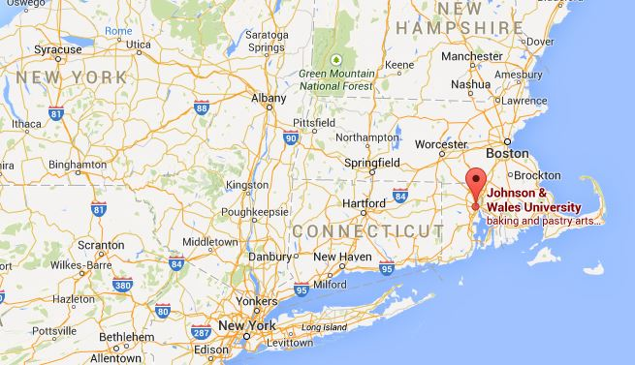
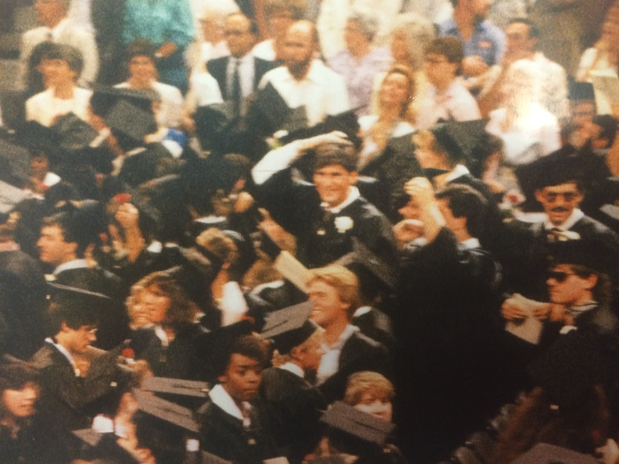
College
I attended college at Johnson & Wales University in Providence, Rhode Island.
Providence, Rhode Island
College Graduation

Slide 10


College
Activities/Athletics in College
Jobs I worked while in College
Basketball
Rugby
Cooking
I worked in 21 different restaurants over 4 years. I was obsessed with learning about different food and beverage operations from McDonald's to 5 star restaurants and everything in between.

Slide 11

College
Favorite classes
Least favorite classes
Hospitality Law
Marketing
International Kitchens
English Literature

Slide 12
College
Fondest memories
Obstacles or adversity that you had to overcome
Learning to be independent by living away from home
Junior year abroad in Europe
Playing basketball
I wanted a culinary degree but it was not offered with a Business Management degree
I did not have any money to pay for room and board, etc.

Slide 13
Career Path
I began my career in restaurant management…
Switched into Commercial Real Estate Industry
I now lead the retailer practices for CBRE in the Western US….
Notes:
You may use this chart to describe your journey to the current career

Slide 14
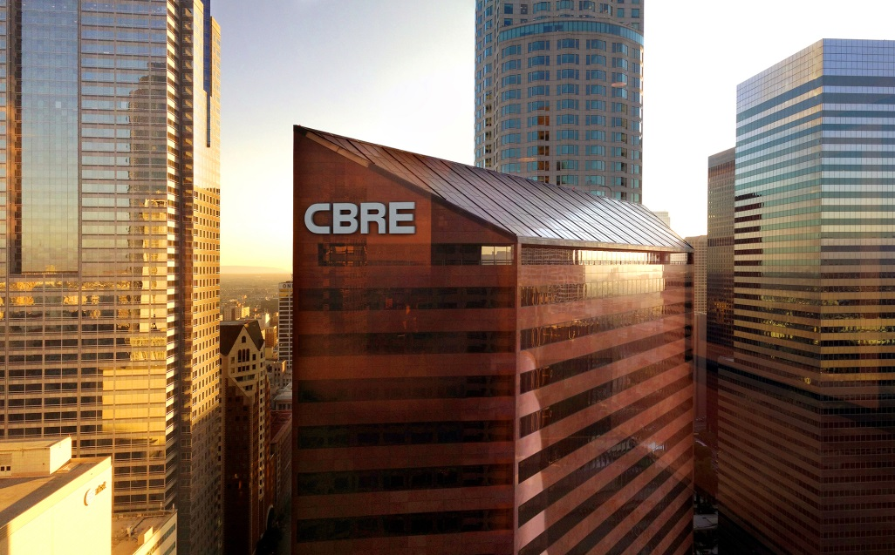

Career

Slide 15
Career
My first Job
My worst Job
My first job was a newspaper route. My route consisted of 1,600 apartments in 2 high rise buildings.
I started with 220 accounts and built it up to 470. The deliveries were quick. Collecting monthly payment took much more time.
It helped me to learn to overcome objections and understand the importance of delivering value and not being afraid to be compensated for my hard work.
My worst job was selling books in NYC. In preparation of Operation Sail, I sold commemorative books throughout NYC.
Unfortunately I did not know that there were 100’s of other people selling the same book. I had to carry my daily inventory of books everyday throughout the city.
I did not have the permission to sell where I felt would be most effective.
I was robbed 3 times and still had to pay for each book as if I had sold them.

Slide 16

Career
Some challenges I had to overcome in my career
Changing careers is challenging. Once you have developed a degree of competency, you go right back to the starting line.
However, I had made the decision at a young age to specialize in a specific industry and limited my education to specialize.
Regardless, as I get older I have learned that we are always starting new at something and we must always challenge ourselves to get through whatever obstacle that may be in front of us.
NEVER GIVE UP! NEVER!

Slide 17
CURRENT ROLE
History
The firm that is now CBRE traces its roots to San Francisco in 1906
CBRE is the first-and only- commercial real estate services company included in the prestigious Fortune 500 and S&P 500.
Size
The company has more than 52,000 employees (excluding affiliates)
Serves real estate owners, investors and occupiers through more than 370 offices worldwide
Location
I work out of the South Bay Office in El Segundo, CA
CBRE has offices in 42 countries.
Products
Services
We are a service company and our product is our employees and the service they provide.
CBRE offers strategic advice and execution for property sales and leasing; corporate services; property, facilities and project management; mortgage banking; appraisal and valuation; development services; investment management; and research and consulting.
Notes:
Use this graph to give more description of your current company (history, size, location, products and services, etc.)

Slide 18
Current Role
Vice Chairman, Retail Services Group
Sales
Consulting
Global Corporate Services
Leasing
Notes:
Use this graph to give more description of your role specifically (responsibilities, typical work week, direct reports, etc.)

Slide 19
Career Compensation
Management
$250k+
Sales Professional
$75k-1 M+
Sales Trainee
$25k-60K
Client Services Coordinator
$40k-70K
Notes:
Use this graph to show general compensation ranges for people in various roles in your company

Slide 20
ACADEMIC EXERCISE
We will now spend several minutes discussing the day’s academic module and how it is relevant in the ‘real world’

Slide 21

QUESTION AND ANSWER

