Slide 1
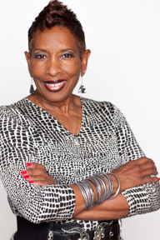
Proprietor/CEO/CMO/CTO/CVO….
Curator of Tech Tools
For Business & Lifestyle

Slide 2
Zenobia here. I share my worlds of technology (I'm a geek [cute though]/serial entrepreneur), my mad passion for jazz and all rich music, and my pursuit to live passionately.
Tech Diva, that's me, has been sculpted by 30+ years in entertainment technologies as
a recording engineer
a sales engineer - I've equipped film lots, broadcast facilities, recording and home studios with high end professional audio products
the first African-American chapter chair of the prestigious international Audio Engineering Society
the first female member of the venerable Sapphire Group - a society of audio pioneers, engineers, and audio enthusiasts
a digital video arts and production educator and college curriculum author
an award winning interactive multimedia producer
digital media technologies consultant
the Super Gear Girl - professional audio, video, and computing products sales, consulting, and tech education -the Media Technologies MarketPlace online store at MediaTechMarketPlace.com/marketplace - and www.facebook.com/MTMTech for gear
Breathe ........
Opportunity to diversify landed me in the world of exotic cars as proprietor of Klassy Kars Rental Services, the Ultimate Provider of Exotic and Luxury Cars to Connoisseurs of Luxury Living to the Palm Springs region. We've supplied cars for golf buddies hanging out, hubby taking the wife to dinner, and numerous weddings as well as sometimes eclectic occasions, including:
a European high fashion magazine shoot
a wedding car for a facebook executive and co-founder Mark Zuckerberg as the best man
a music video for a famous European pop star (watch the video Surround Me) My Ecstacy is my 1991 Rolls Royce Silver Spur II!
Breathe again .........

Slide 3
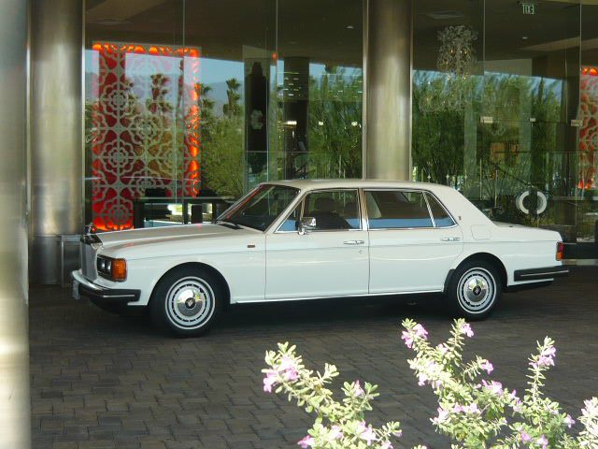
Oops, where do I put my jazz radio personality life throughout college that has now come full circle? Just throw it into the mix. Tech Diva and the Luxury Lifestyle Online TV Show has wrapped these worlds together for enlightening and entertaining around the planet, curated by me especially for my audience.
Oh, on the personal side, I'm the mother of two gorgeous women and NaNa Zee to 5 grands (who ask to Skype NaNa).
My bucket list includes deploying myself to far off parts of the world improving life and living with technology efficiencies and going to every jazz festival around the world.
Exhale........
So, you know more about me now. I’m here to help the transition to Digital Business and Lifestyle 2.0 and make the world work better!
Serial Entrepreneurship
Tech Flavors

Slide 6
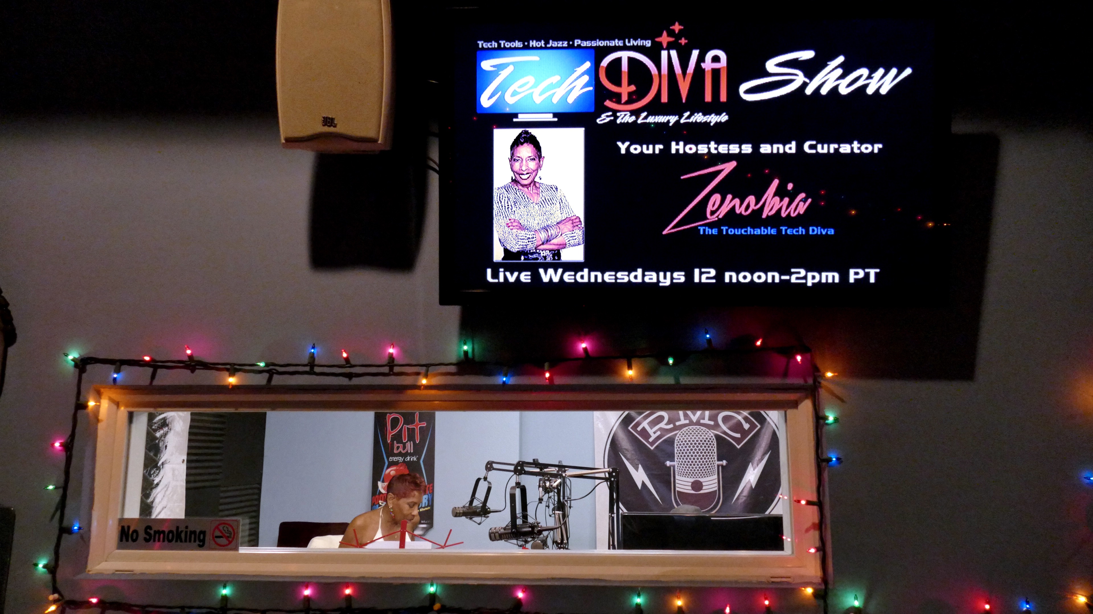

Slide 7
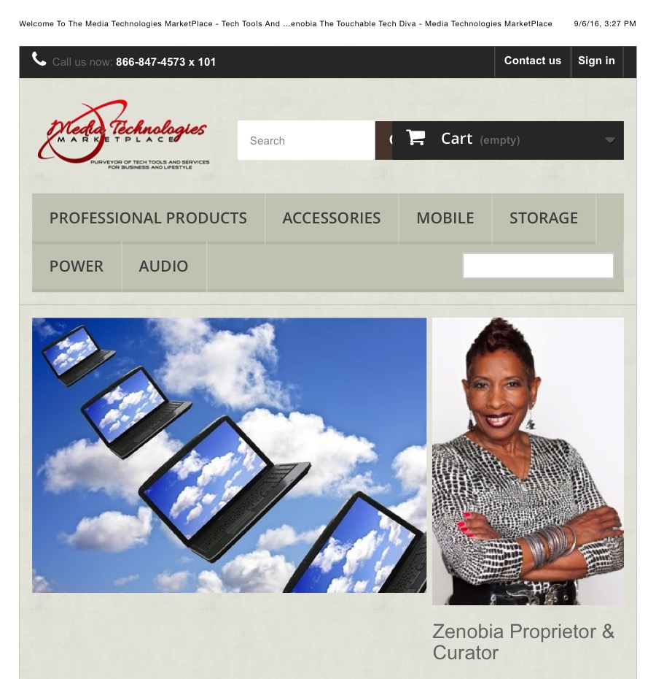

Slide 8
Goings On…
Workshops in Los Angeles Area
Private sessions always available - in person, via Skype, Google Hangout, etc.
facebook.com/MTMTech has more information.
Producer/Hostess
Tech Diva & The Luxury Lifestyle Online TV Show
Tech Tools, Toys, News ・Hot Jazz ・Passionate Living
TechDivaTV.com - join Tech Diva’s Community for replays, galleries, escapades
Tech Diva’s available for speaking engagements

Slide 9
Powered by
Zenobia Millet
E: Zenobia@MediaTechMarketPlace.com
P: 866.847.4573 x 101
W: MediaTechMarketPlace.com
F: facebook.com/MTMTech
T: @TouchableTechZ
L: linkedin.com/in/Zenobia
Thank you!

