Slide 1
Marisela Arechiga Co-Founder New Generation Improvements

Slide 2
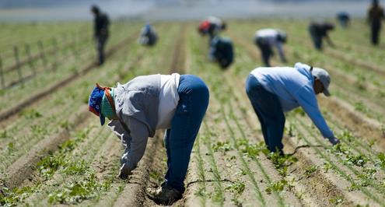
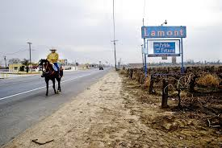
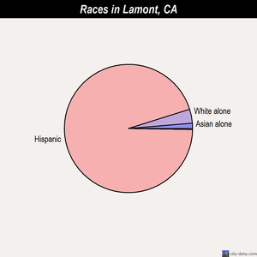
Lamont, California
Notes:
15,000 Population

Slide 3
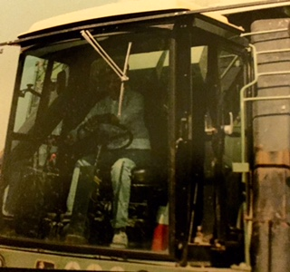
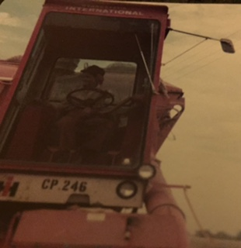
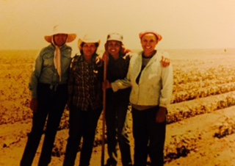
Jose & Alejandrina Gonzalez
Notes:
Born in Mexico. Came to the United States in adolescence. Made a life for themselves in agriculture

Slide 4
Family of eight
Notes:
Picture of family

Slide 5
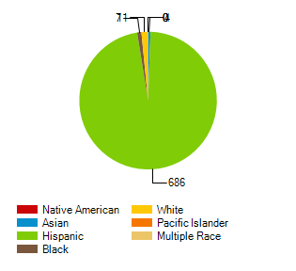
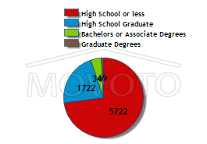
Arvin High School

Slide 6
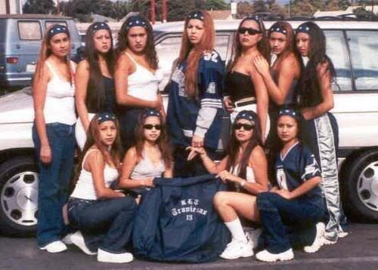
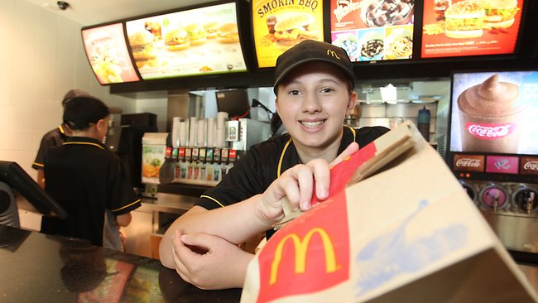
What is there to do in such a place?
Notes:
The colliseum seats over 100k people.

Slide 7
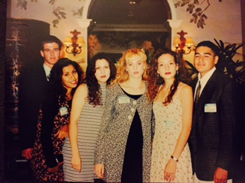
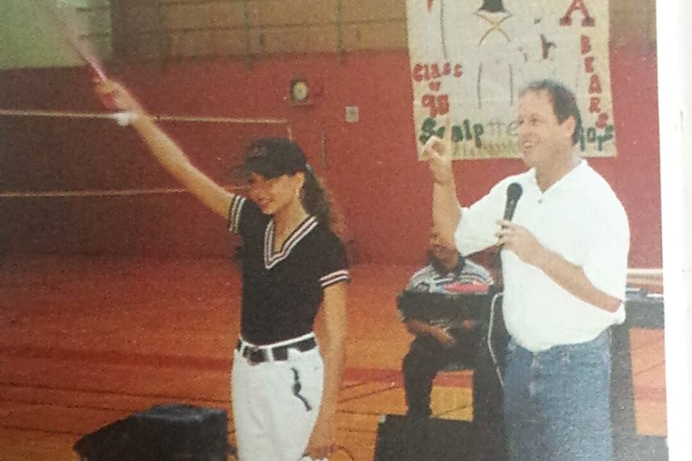
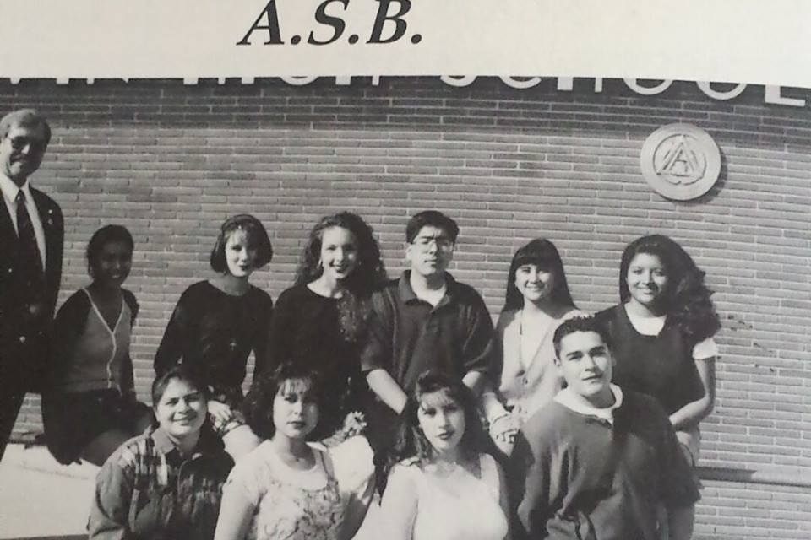
High school version of me
Notes:
Sports, Student Government, Debate Team

Slide 8
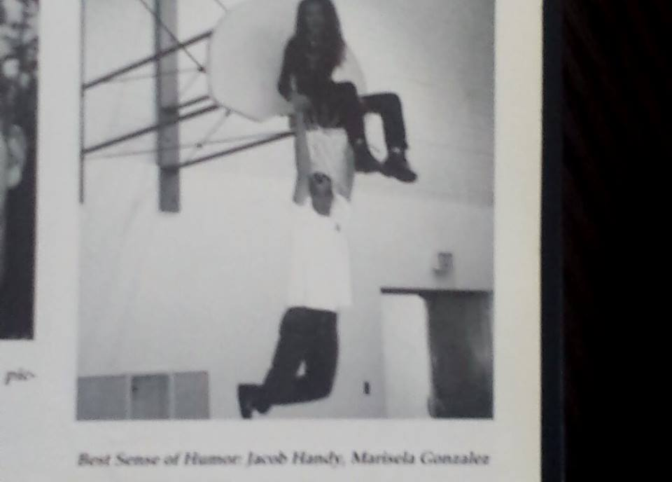
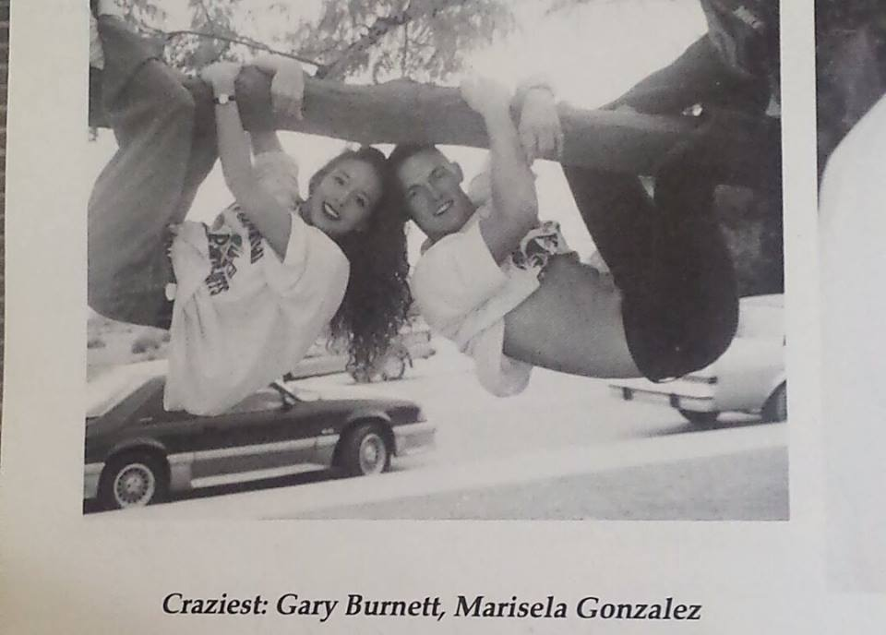
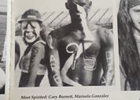
High School version of me

Slide 9
Friends

Slide 10
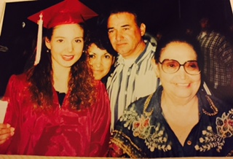
What was there after high School?
Notes:
Group Picture of Friends

Slide 11
The loner…

Slide 12
What I learned about myself in HS.
1. Needed to lead in order to be engaged.
2. I was good with people.
3. Worked well against odds.
4. I was LIKED but not LIKE.
Notes:
1. I wanted to be liked but not LIKE everyone else. 2. I was good with people. 3. I needed to be engaged to be focused. 4.

Slide 13
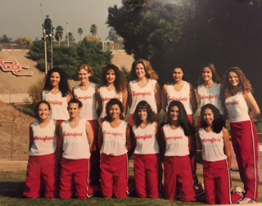
COLLEGE????
Notes:
Bakersfield College

Slide 14
The Break Through

Slide 15
The shift in Demographics

Slide 16
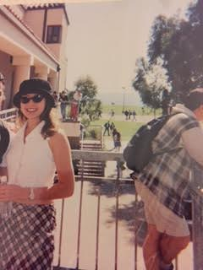
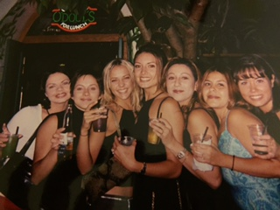
The college version of me

Slide 17
Who I wanted to be

Slide 18
Who I wanted to be…

Slide 19
Who I wanted to be

Slide 20
Who I wanted to be…

Slide 21
Who I wanted to be…

Slide 22
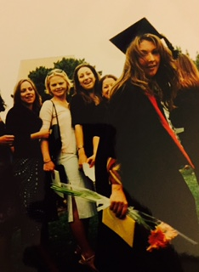
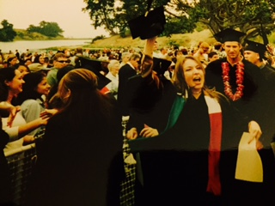
College Graduation

Slide 23
What I learned about me in college
I was a minority.
Intimidation is a silencer.
My gut would take me….further.
Some things shouldn’t change
a. I was best with people
b. I was liked but not like.
c. Was comfortable with the odds…

Slide 24
Post College

Slide 25
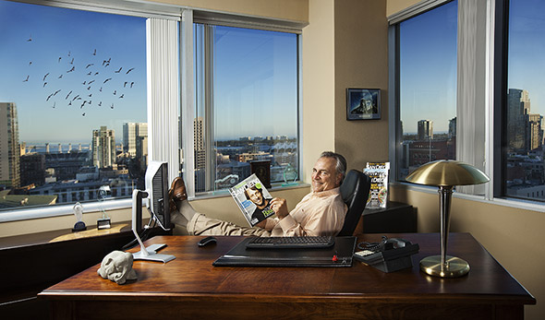
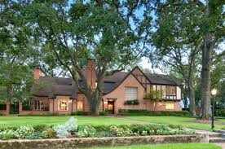
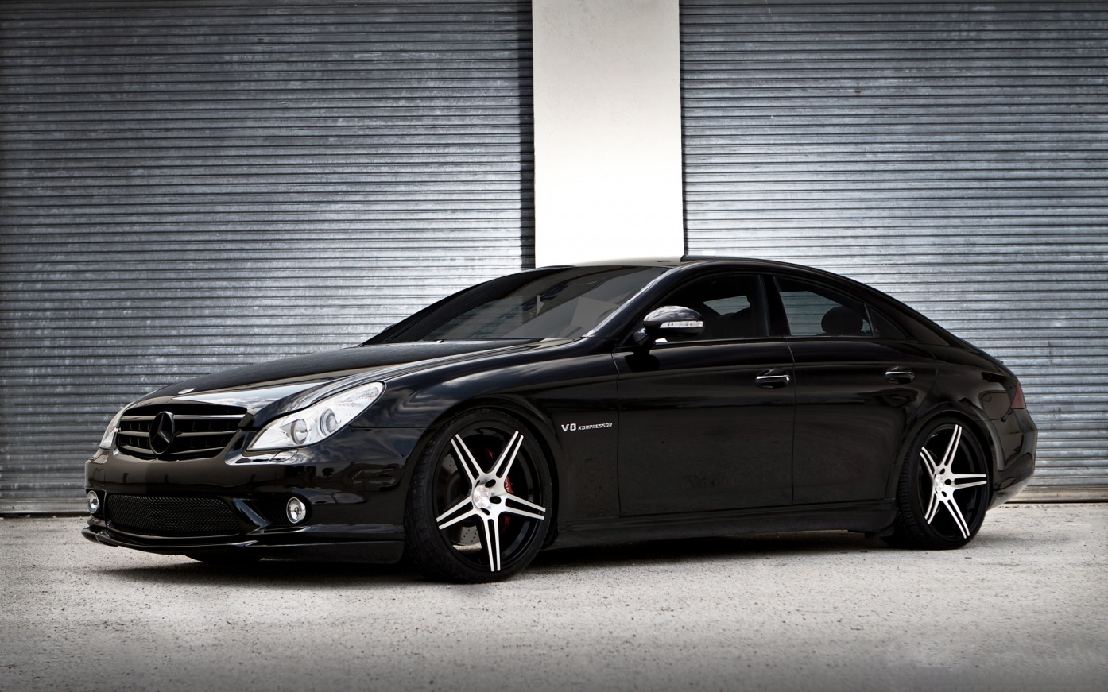
My image of Success

Slide 26
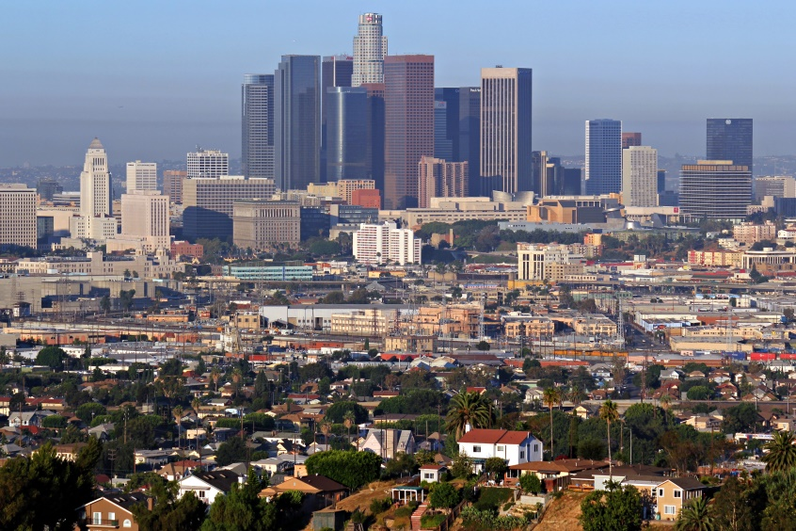
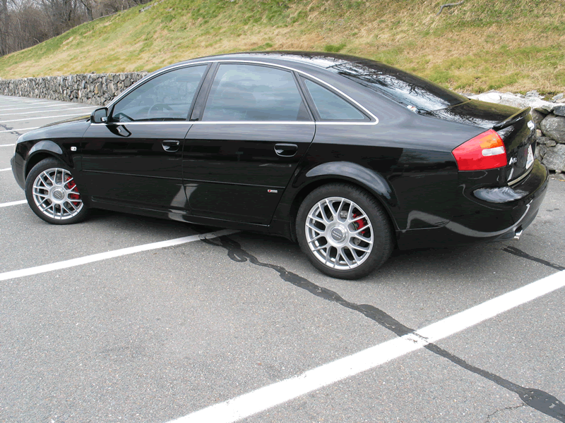
First job out of college

Slide 27
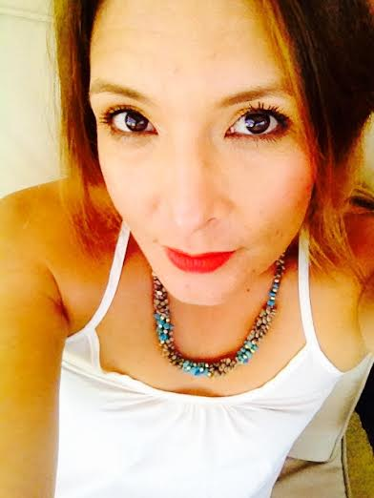
The Image vs. Marisela

Slide 28
10 years in my box

Slide 29
The Meeting…
Mario Arechiga
Raised in South East Los Angeles.
Son of Immigrants
Dropped out of college to return 6 years later
First job out of college: Pushing Paper.
Best at Building.

Slide 30
And then a very simple idea…

Slide 31
New Generation: The Decision

Slide 32
New Generation: The timing
2009

Slide 33
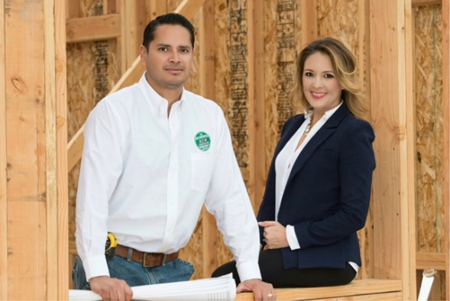
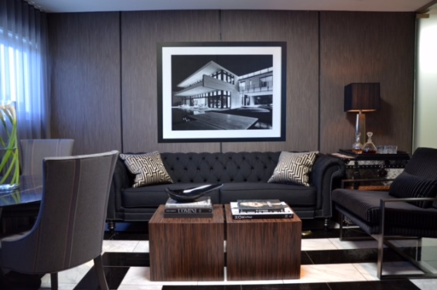
New Generation: Who we are

Slide 34
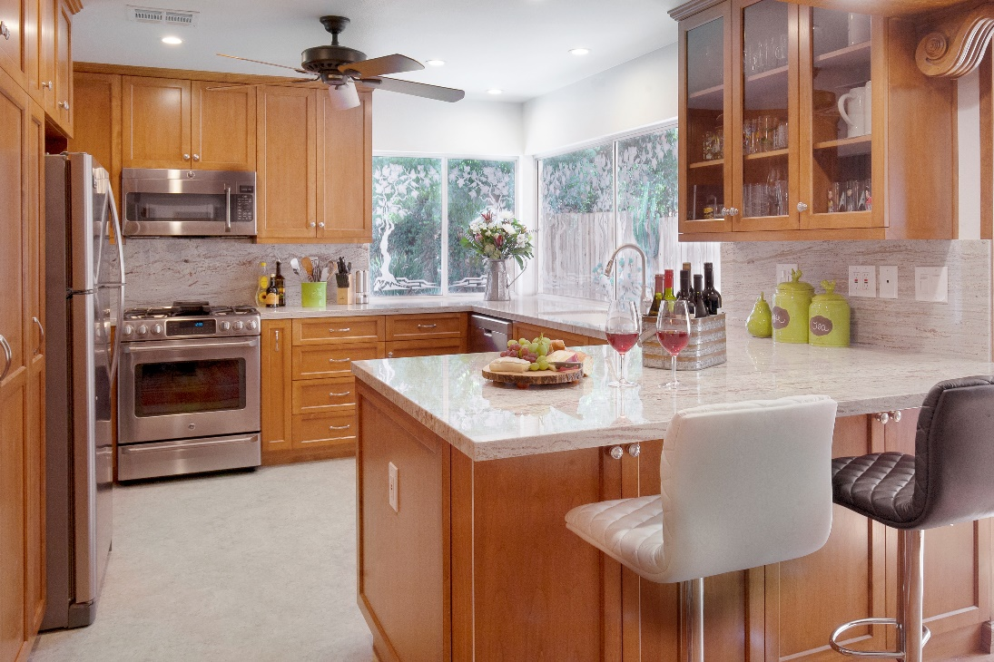
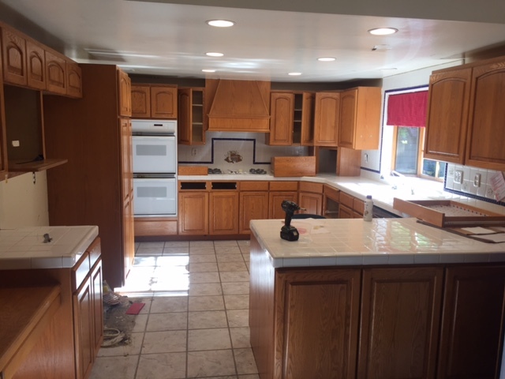
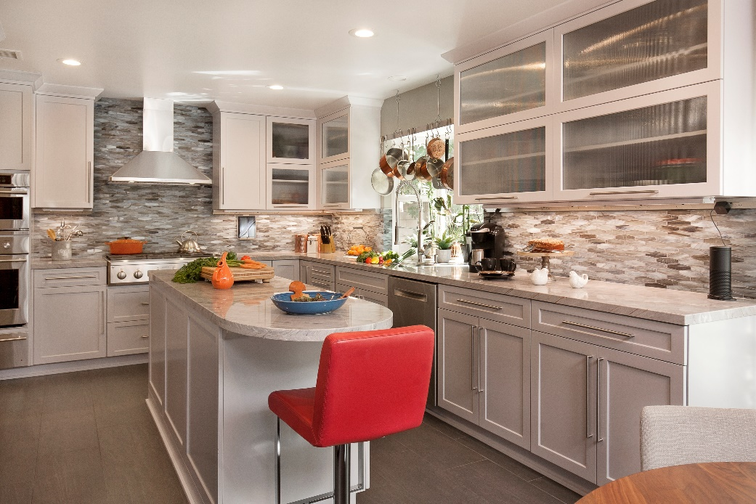
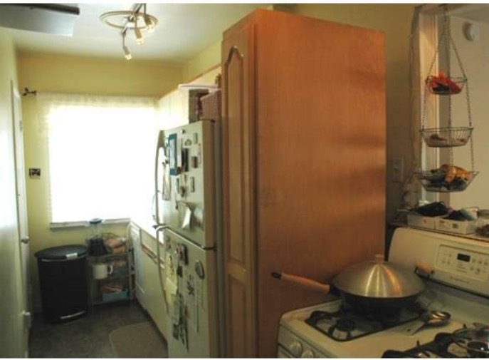
New Generation: what we do
Transform Space
Before
BEFORE
After
After

Slide 35
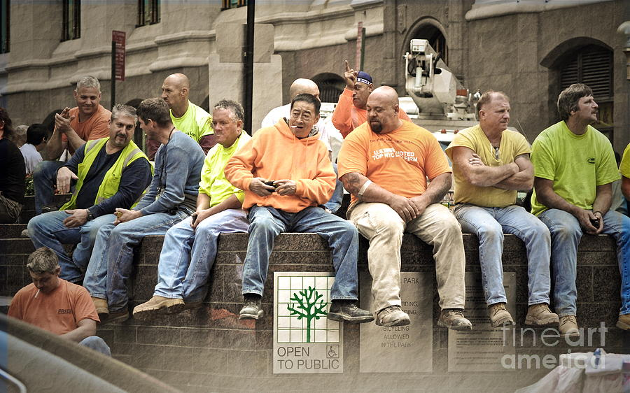
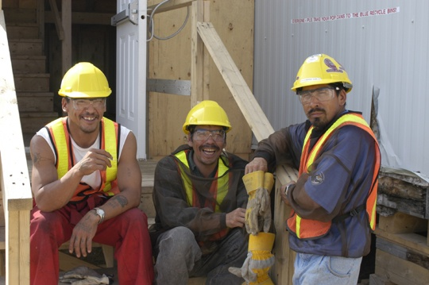
New Generation: a girl?
Odd?

Slide 36
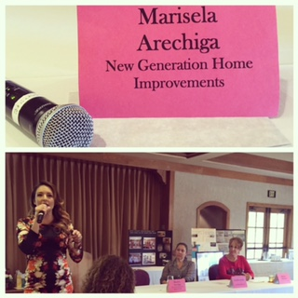
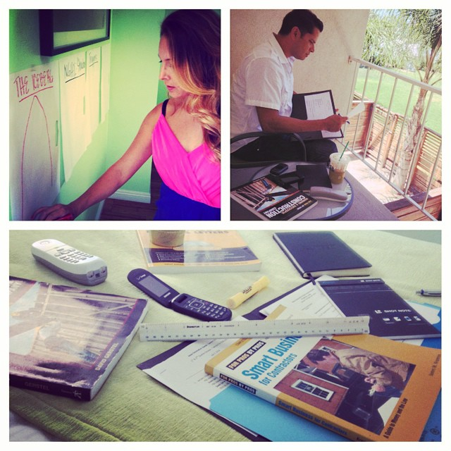
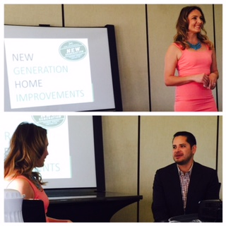
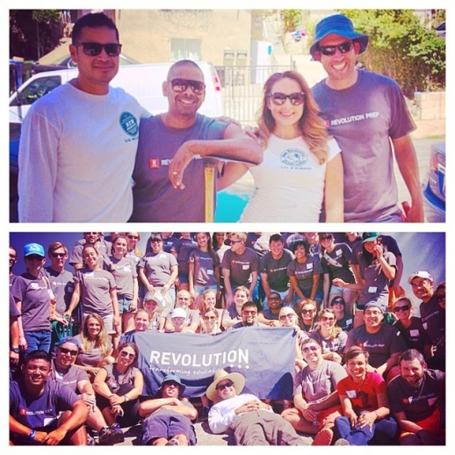
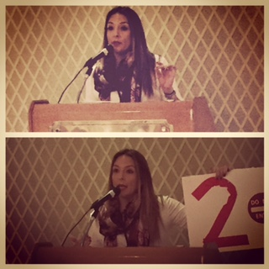
New Generation: at my best
My Job:
1. Talk to as many people about NGHI.
2. Book Business by talking with people.
3. Lead and execute new initiatives.

Slide 37
New Generation: The First Million

Slide 38
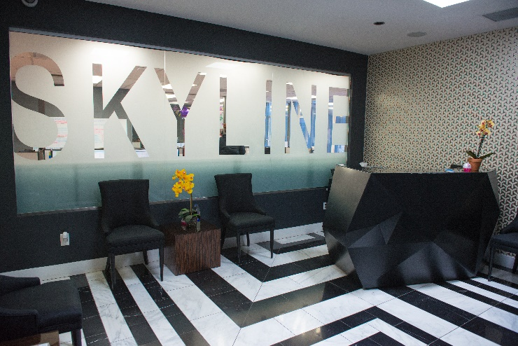
New Generation: The Future

Slide 39
A New Image
of Success.

Slide 40
New image of success: Dave Tran
1.Born In Vietnam
2.Fled to US to Escape Communism
3. Education: Work Chile Fields in China
4. English remains 2nd Language.

Slide 41
$60 MILLION

Slide 42
New Image of success: Sara Blakely
Mom is an Artist
Grew up small town in Florida
Attended a State School
Failed my Law Admissions
Sold door to door Fax machines

Slide 43
$1.1 BILLION

Slide 44
New Image of Success: Dave Gold
Born to Russian Immigrants
Attended City College
Ran family liqour store for 25 years.

Slide 45
1.$6 BILLION

Slide 46
Here’s the point:

Slide 47
Here’s the Point
1. You Were Born to Succeed.
2. Most of what you’ll use is already in you.
3. Be Curious and look for the patterns.

Slide 48
Be. You. Bravely.

Slide 49
Thank you!

