Slide 1
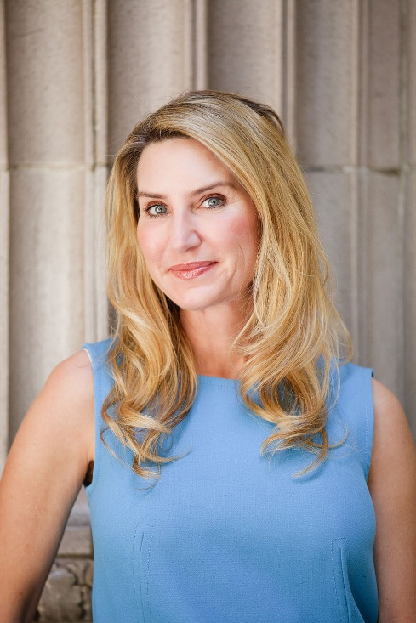
Holy Smokes. Joy is in the house.

Slide 2
INTRODUCTION
My name is Joy Belinda Beland and I am 49 years old.
I work for LA IT Girl, Inc.
We provide computer network support to small businesses in Los Angeles (Servers, Firewalls, PC’s, Macs, phones, mobile devices, you name it).
My role at LA IT Girl, Inc is Owner and President.
I’ve been the VP of Sales, HR Director, Service Desk Manager, Senior Engineer, and Financial Controller for 19 years now.

Slide 3
The Early Years…
I was born in Huntington Beach and raised in Bend, OR
This is a picture of me at 12 years old.

Slide 4
More Early Years…
A little about my family…
This is a picture of me and my siblings … I’m on the left at 9, then there’s my older sister Lori age 11, my little sister Cindy age 4 and my brother David, age 6.

Slide 5
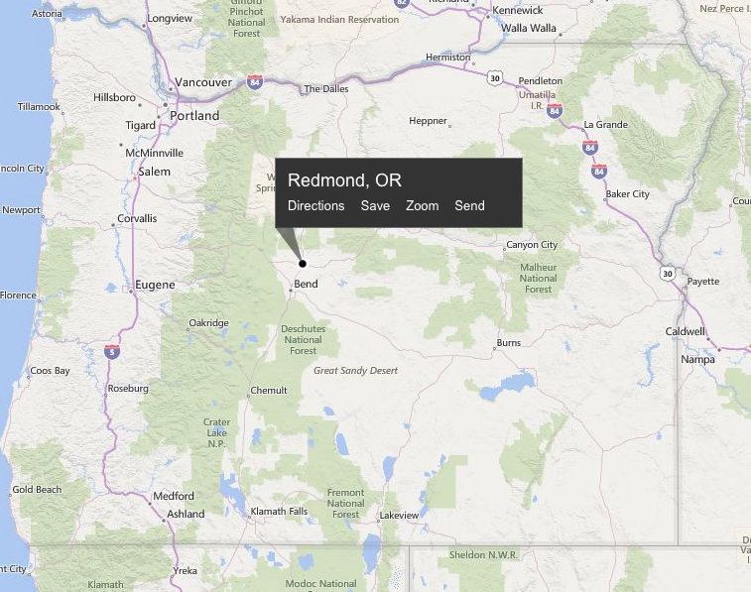
HIGH SCHOOL
I attended Redmond High School in Redmond, OR
Insert map shot here
\

Slide 6
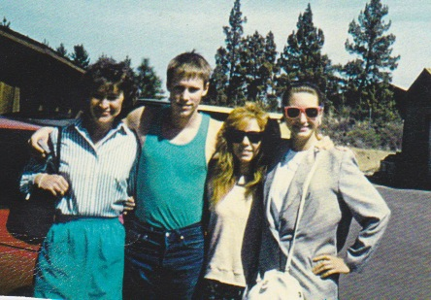
HIGH SCHOOL
As a HS student I was involved in sports early on. My freshman year, I ran track and field and I played basketball.
As a HS student I was very shy and awkward. I didn’t fit in and I wore hand-me-downs because our family was very poor…….
\
Here is a shot of me in High School, on the right.

Slide 7
HIGH SCHOOL
Things I enjoyed in HS
Things I did not enjoy in HS
Making friends. To do this, I started to party and hang out with “the wrong crowd.”
Typing and Shorthand – won #2 in the state for Shorthand skills
Home Ec – believe it or not – I loved cooking and sewing.
Math. I was good at it but actually I hated it. I took Algebra II as a freshman, which fulfilled my High School requirements, and never took another math class.

Slide 8
HIGH SCHOOL
Activities/Athletics in HS
Jobs I worked while in HS
Track and field – the 1 mile and 4 mile were my favorite. I always placed in the top five.
Basketball. I once won a free-throw contest for making 13 of 25 free-throws in the 15 year old category.
2 jobs in one summer:
Secretary/receptionist for a Real Estate Company
Secretary/invoice processor for a collection agency

Slide 9
HIGH SCHOOL
Fondest memories from HS
Obstacles/Adversity you had to overcome in HS
Partying.
My family. Let’s talk about that.

Slide 10
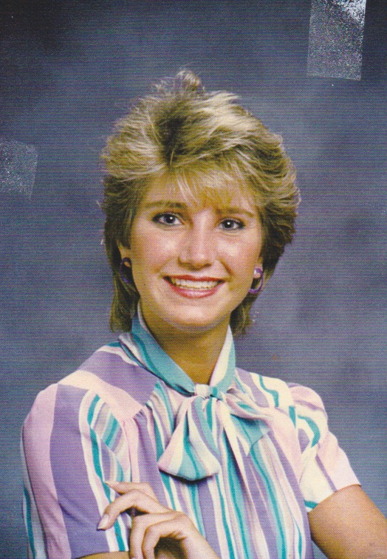
College or Graduate School
I attended some Santa Monica College classes when I moved to LA at 17 years old, one week after graduation.
I was working full-time professionally at 17. I never stopped.
In 2004 I passed my first Microsoft Server Certification Exam – and I never looked back.
But, let’s talk about my path to sobriety during this time.
\

Slide 11
Then I became an IT Consultant
Fondest memories
Obstacles or adversity that I had to overcome
Figuring stuff out.
Having clients who LOVE the idea of a female doing their IT.
Having vendors look at me like I was an alien (first conference experience).
No formal education or training. Completely self-taught.
Only female that did what I do – I was intimidated.
Limited access to training resources.

Slide 12
Career Path
I started as a secretary and sales admin
I was promoted to middle management after 7 years with my 3rd employer
I am now the Owner and President of LA IT Girl, Inc – for 18 years!
Notes:
You may use this chart to describe your journey to the current career

Slide 13
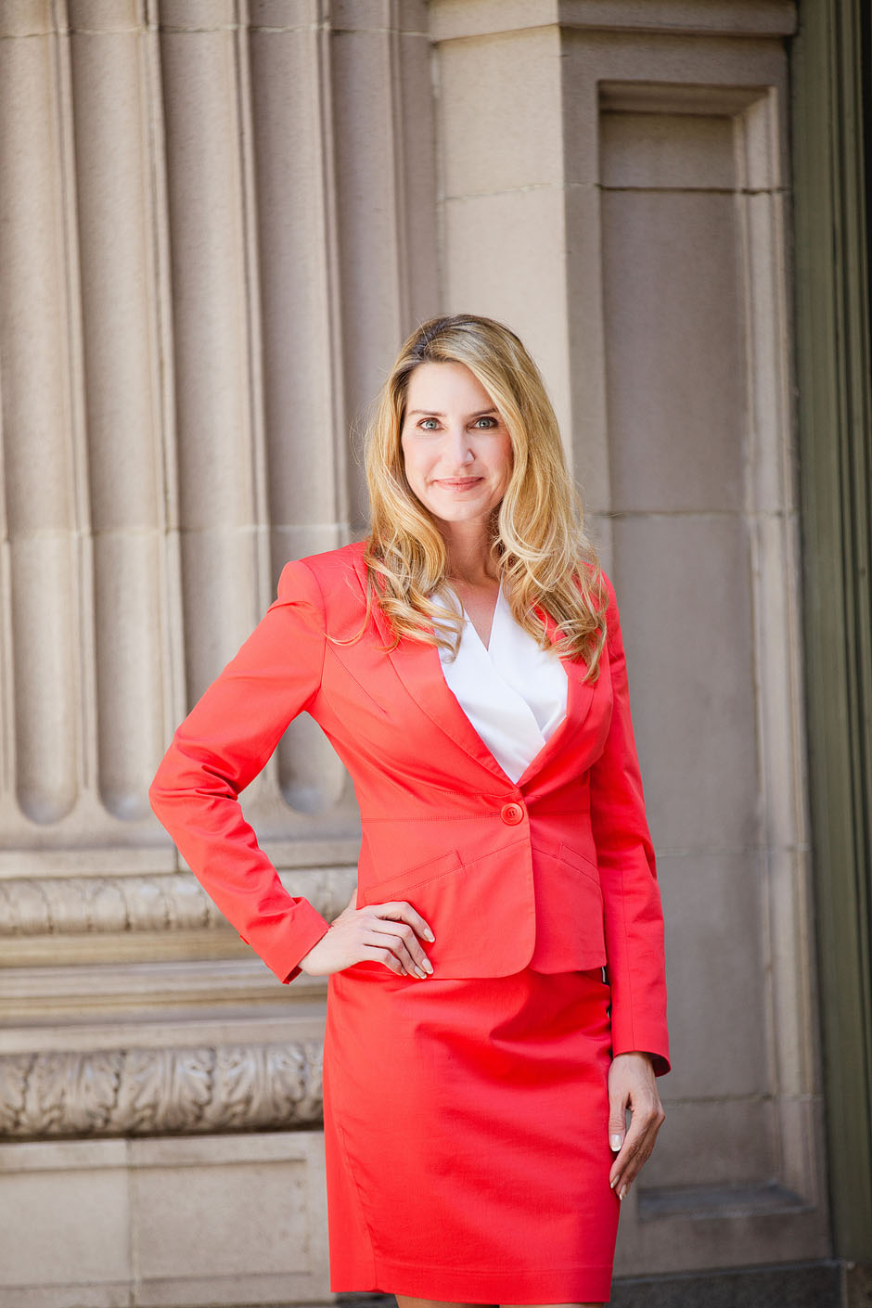
Career

Slide 14
Career
My first Job
My worst Job
Keeping track of who is not paying their bills at a collection agency when I was 15 years old.
Keeping track of who is not paying their bills at a collection agency when I was 15 years old.

Slide 15
Career
Some challenges I had to overcome in my career
Finding my own way to educate and credential myself
Being brave in a room full of men, at all times
Believing in myself
Having the energy to get past some very big challenges, day after day
Staying motivated
Work/Life balance

Slide 16
CURRENT ROLE
History
Started in 1994 as a business consultant, not IT consultant
Now one of top 5% service providers with Microsoft Cloud Solutions
Size
Started with just me, for many years (seven!)
Now we have six full-time employees, and three contractors
Location
Westchester, CA
Service all of greater Los Angeles
Products
Services
We sell hardware (PC’s, Monitors, Printers, Servers, Firewalls)
We sell software too
We evaluate network structure and staff needs, recommend servers and solutions, then install and implement those solutions. We provide ongoing support and are known for our ability to give trusted advice on upgrades, budgeting, and business solutions.
Notes:
Use this graph to give more description of your current company (history, size, location, products and services, etc.)

Slide 17
Current Role
Owner/ President
Money Manager
Senior Engineer
Sales Woman
Leadership
Notes:
Use this graph to give more description of your role specifically (responsibilities, typical work week, direct reports, etc.)

Slide 18
Career Compensation
Owner / President
$120k to $160k
Executive Assistant to Disney CSO
$83k
Middle Management
$45k
Secretary
$15k
Notes:
Use this graph to show general compensation ranges for people in various roles in your company

Slide 19
ACADEMIC EXERCISE
We will now spend several minutes discussing the day’s academic module and how it is relevant in the ‘real world’

Slide 20
QUESTION AND ANSWER

