Slide 1
INTRODUCTION
My name is Aimee Gilbreath and I am 40 years old.
I work for the Found Animals Foundation
My company is a non-profit that creates programs to help pets and people. We support affordable spay/neuter and microchipping for pets and operate two retail pet adoption centers in Los Angeles.
My role at Found Animals is Executive Director and I have been doing this job for seven years
Every day I manage our programs and my staff of 70 employees and nearly 400 volunteers. I get to work on our strategy for new programs and solve problems for our current ones.
Before Found Animals I worked for a consulting firm and at Motorola.

Slide 2
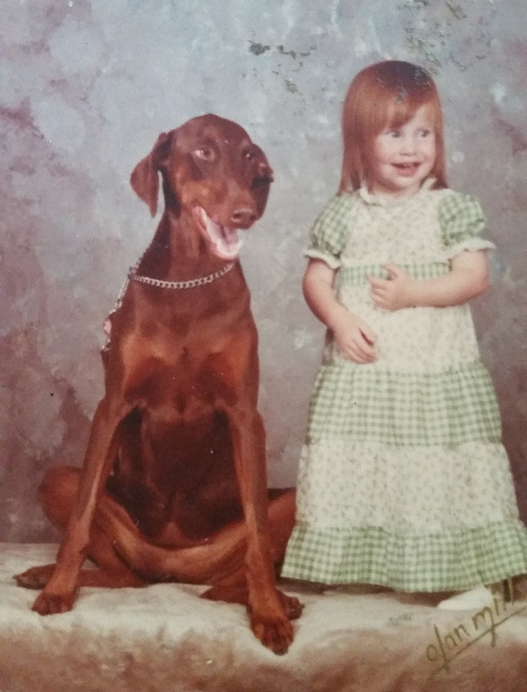
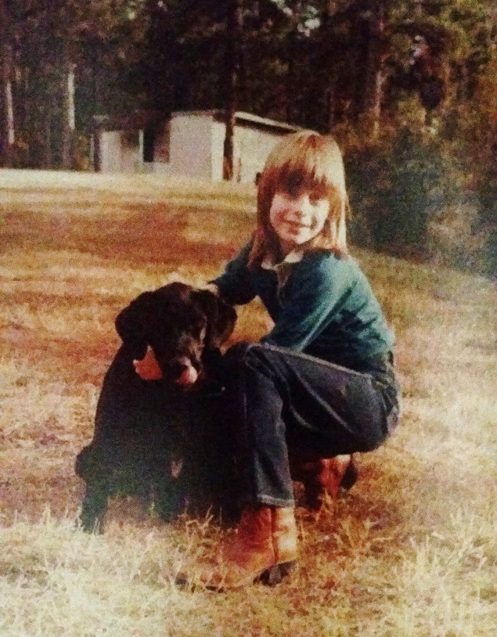
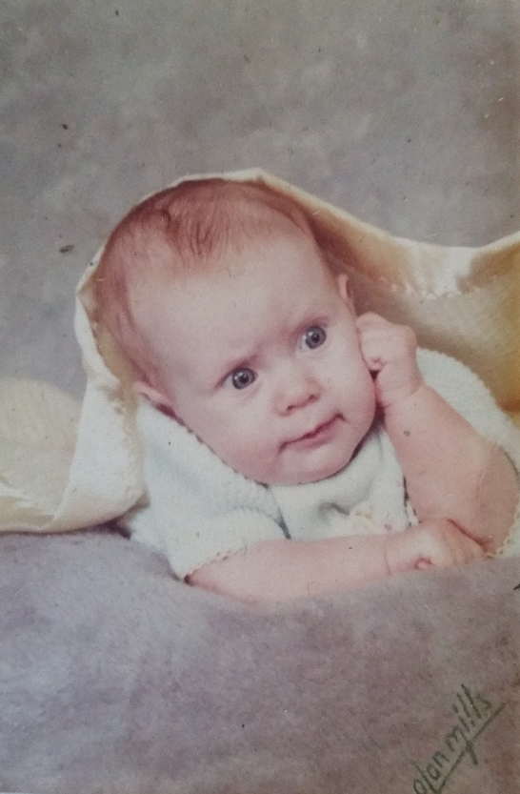
My childhood
I was born in and raised in Tempe, AZ (a suburb of Phoenix)
This is a picture of me at 4 months old
This is a picture of me at 2 years old with my first dog, a Doberman named Heidi
Age 9 with Black Labrador Joe

Slide 3
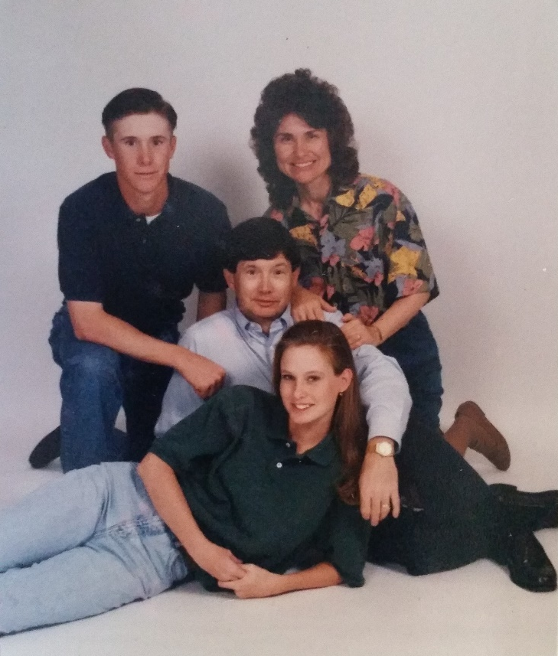
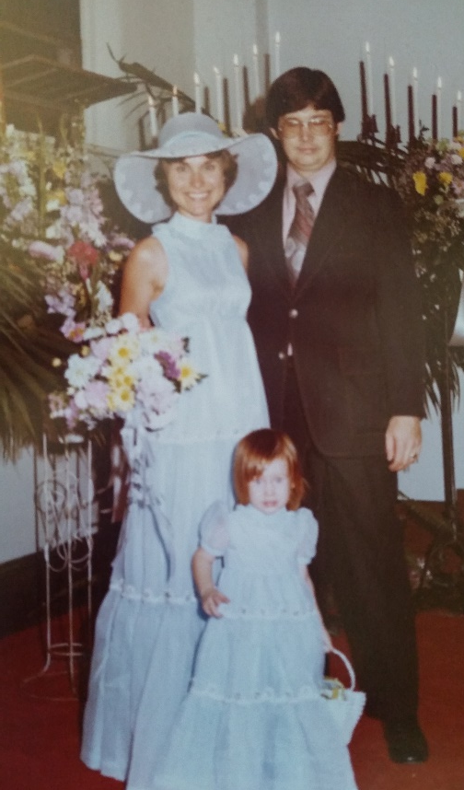
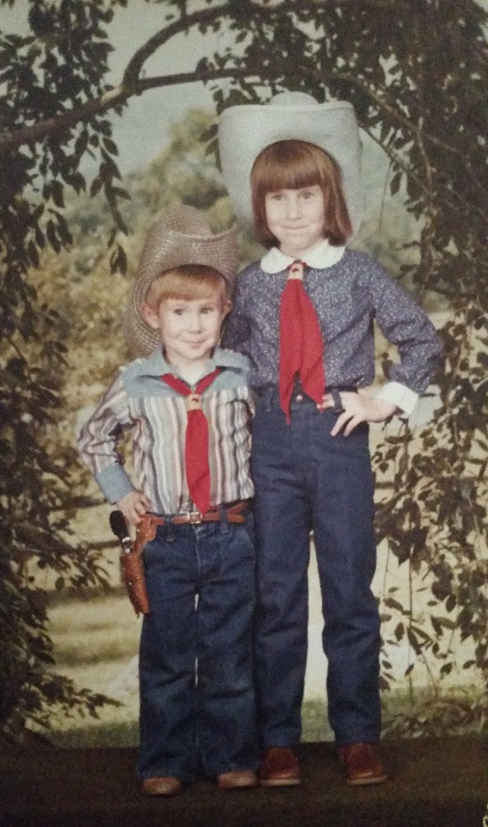
My family
I have one younger brother and my parents are still married after 44 years together! Our household was strict and loving. I get my love of animals from my parents.
With my parents at 2 years old
With my brother Matt at 5 years old
The whole family when I was in college

Slide 4
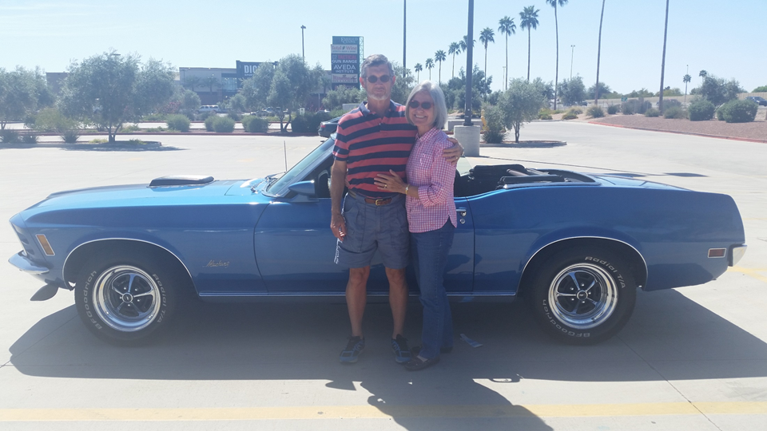
My PARENTS
My parents still live in Phoenix and have retired. They like classic cars. They are way cooler than I remember them being when I lived at home!

Slide 5
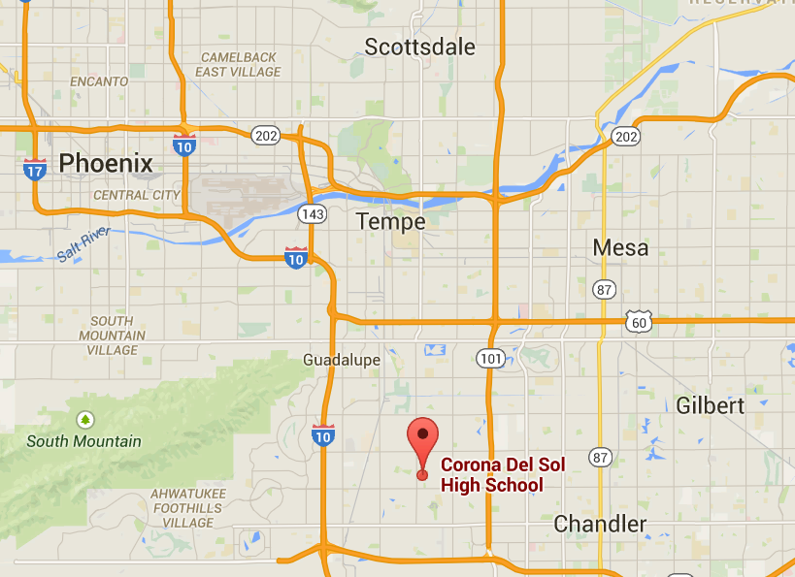

MY HIGH SCHOOL
I attended Corona del Sol High School in Tempe AZ

Slide 6
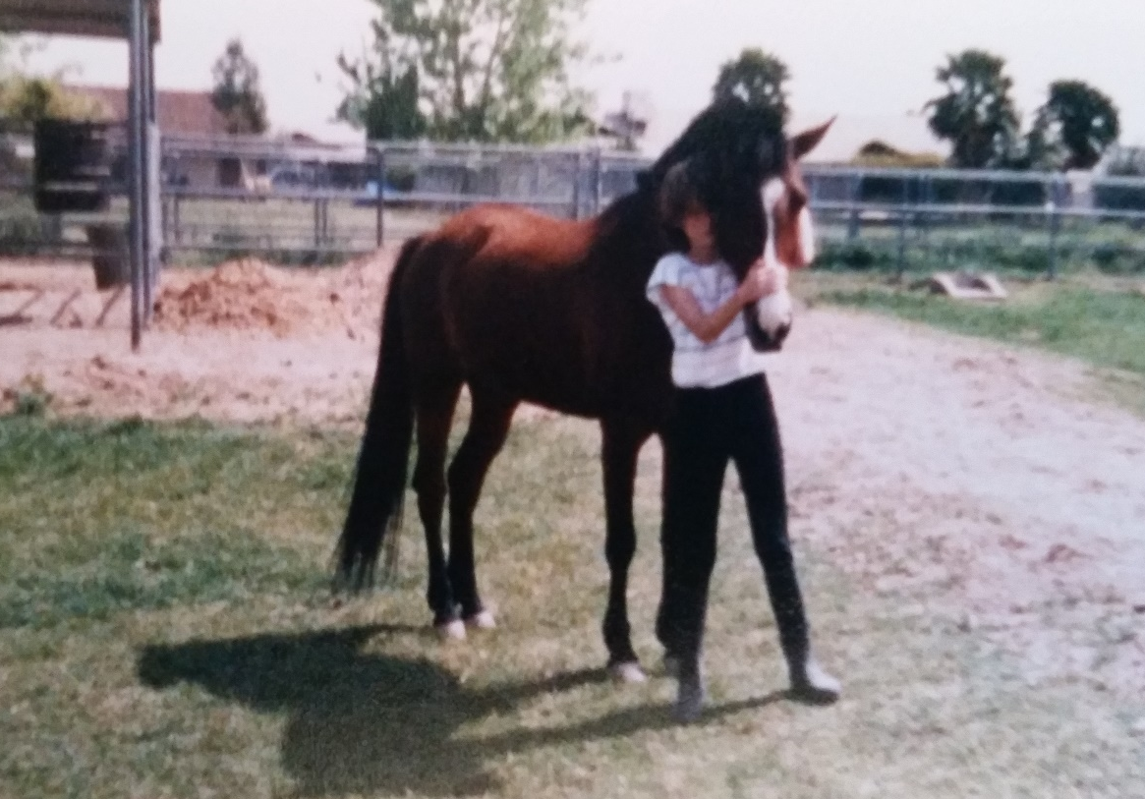
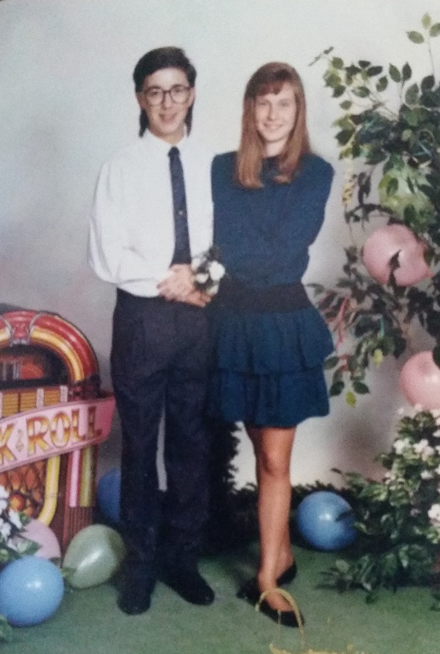
High School
As a HS student I was very shy and nerdy. I liked to read a lot and study hard and get good grades. I played tennis and was in the band and rode horses.
In the backyard of my house with one of my horses, Kidd. We had up to three at a time.
First boyfriend, sophomore homecoming

Slide 7
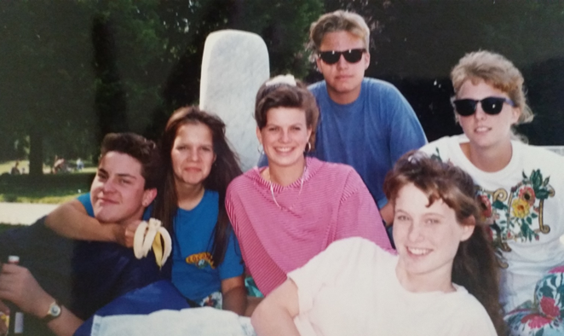
High School
Things I liked:
Classes:
Biology
Chemistry
Spanish
School Activities:
Tennis
Band
Government team
Outside Activities:
Riding Horses
Exchange program
Things I did NOT like:
Calculus
My Calculus teacher
Cool kid cliques
Being the youngest in my class
How strict my parents were

Slide 8
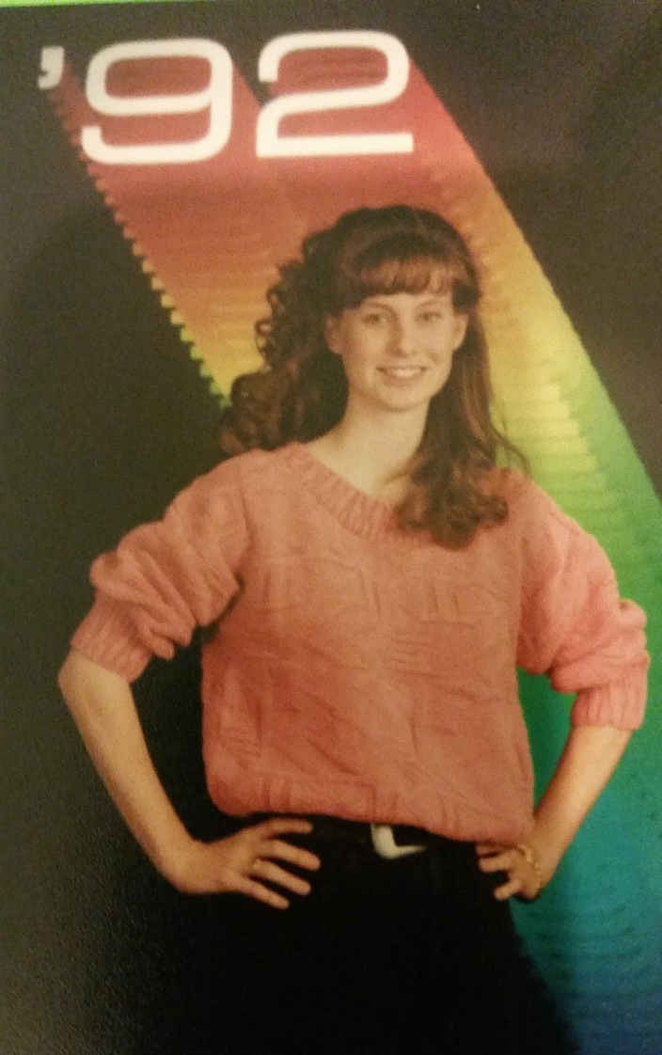
High School
I worked as a hostess at a Mexican restaurant starting the summer after my junior year.
During my senior year I went straight from school to work most days so I had to do homework after the restaurant closed.
Some days I even had team meetings for my government team after work, then homework, it was super fun but I was always tired!

Slide 9
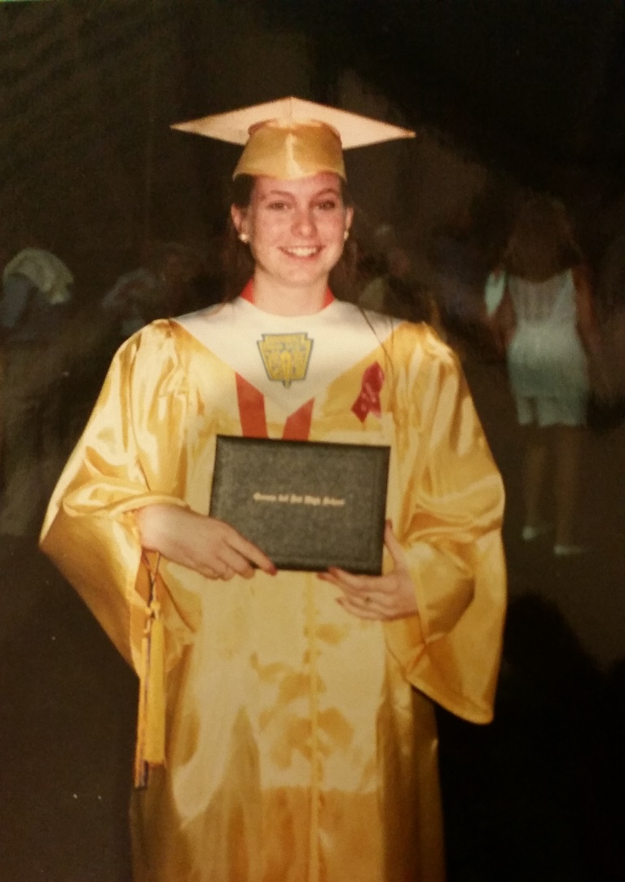
High School
High School Challenges:
I knew I wasn’t one of the cool kids and that always felt kind of crappy.
I was awkward and a late bloomer, I didn’t have a lot of self esteem.
Boys and dating completely mystified me. So uncomfortable!
Having a few good friends I could count on – my fellow freaks and geeks – got me through.
By my senior year I had a lot more self confidence.

Slide 10
Getting in to College
Good grades were really important to me for college. AZ had a program where you could get free in-state tuition if you graduated in the top 5% of your class. It was very competitive at my school.
I looked at schools in other states too. I was accepted at USC and got a scholarship there but it was still going to be incredibly expensive and I didn’t want to do that to my family. I looked at the University of Illinois as well but decided their winters were too cold!
I took the SAT twice because my dad didn’t like my score the first time. After studying for weeks longer I got the EXACT same score the second time. Grrrrr.
I tried to be sure I was “well rounded” with good grades and test scores but also extra curricular activities, a job, etc.
I worked closely with my HS counselor on college applications and essays. It was really helpful to have a “coach”.

Slide 11


College
I attended college at the University of Arizona and
graduate school at Stanford University
Bachelor of Science in Molecular Biology
Master of Business Administration

Slide 12
College
Things I enjoyed:
Things I did NOT enjoy
Living away from home
Being in charge of my own finances
Biology
Friends and parties
Road trips
Calculus & Physics
8 am classes (I once slept through a final)
Writing long papers
Cramming for finals
Boyfriend breakups and drama
Girl friend drama (often over boys)

Slide 13
College
Jobs
I worked at least 20 hours a week through college, and full time during the summers
Jobs I worked:
Secretary for an on-campus certificate program
Telemarketer
Hospital orderly
Summer between my junior and senior year I worked nights at the hospital 7pm – 7am, then went straight from work to a summer class three days a week
Volunteering
I was an “Arizona Ambassador” and gave campus tours to prospective students and their parents. I learned to walk backwards for that role ☺
I also volunteered as a homework tutor for ESL grade school kids

Slide 14
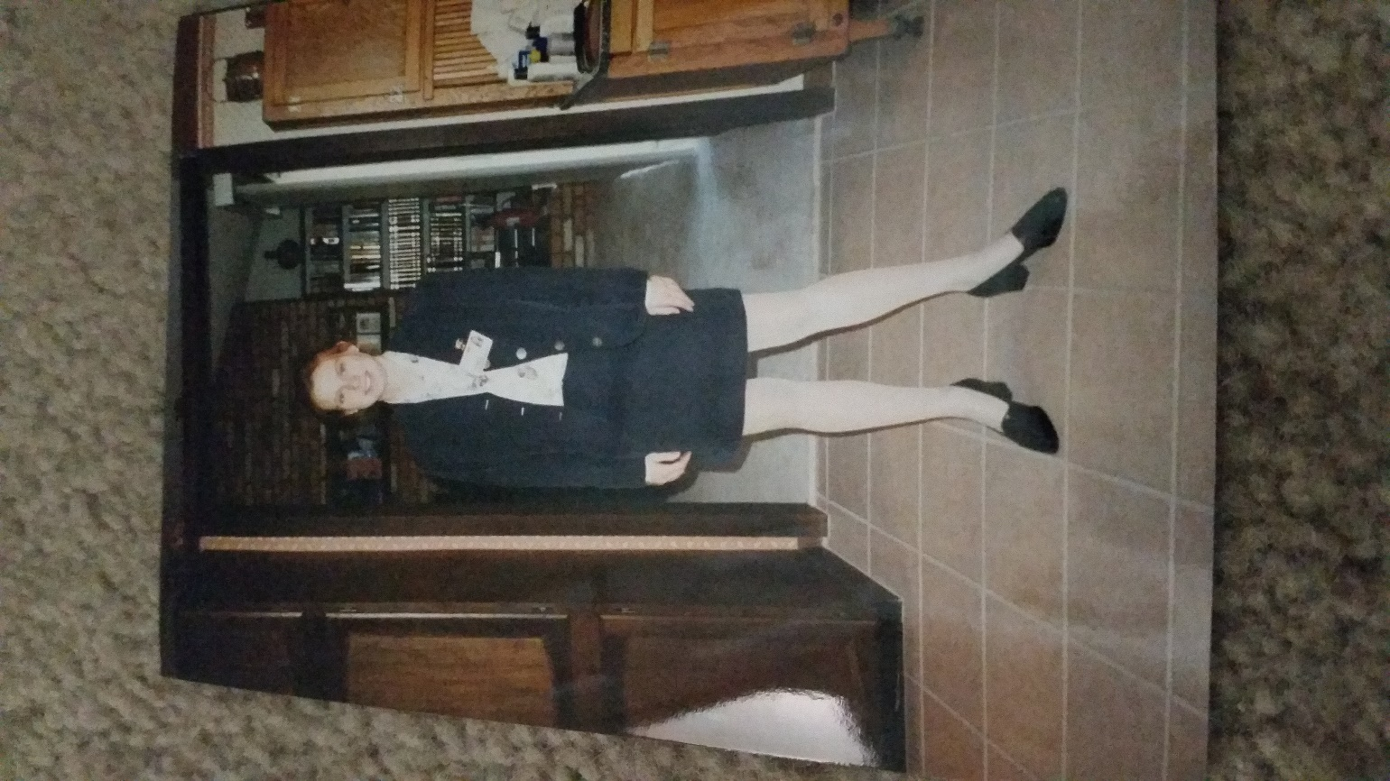
job after College
The top few things I did to ensure I got a good job after college were:
I used the campus career center to find opportunities and get help with writing your resume and practicing for interviews
I wanted to keep my options open so I interviewed for several different roles from pharmaceutical sales to research and development
I asked adult friends of my parents and mentors for advice and introductions
First day of work at Motorola

Slide 15

This is My Company
Every day at the Found Animals Foundation we help pets and the people who love them.

Slide 16
My Career Path
I got a technical job and got promoted
I got a consulting job and was promoted to managing teams and projects
I went back to graduate school and got my MBA
I was recruited to be the founding Executive Director of Found Animals and build the organization
Notes:
You may use this chart to describe your journey to the current career

Slide 17
My Career
The first job I had after college was:
Process engineer at Motorola. I was doing research and development of biotechnology products with a team of scientists and engineers. I got to run experiments and work in clean rooms. It was upper fun and challenging!
The worst job I have ever had was:
Working as a telemarketer as a summer job. I had to call parents that had kids and try to sell them Disney books over the phone. No one wants to talk to a telemarketer! Funny story. . . That job made me want to work hard in school so I could get a better job and never have to do telemarketing again!

Slide 18
My Career
Challenges I have had to overcome throughout my career are:
During my first job at Motorola I quickly realized that unless I got a graduate degree there would only be a certain set of promotions I could pursue. It was a very technical company and if you weren’t a PhD your career options were limited.
After I got my MBA the consulting firm I worked was heavily male dominated as were most of the senior clients we worked for. I had to work really hard to earn the respect of clients that were as old as my father.
When I left the consulting job to start Found Animals everyone thought I was crazy. I was not passionate about consulting and I had to take a risk and pursue my dream.

Slide 19
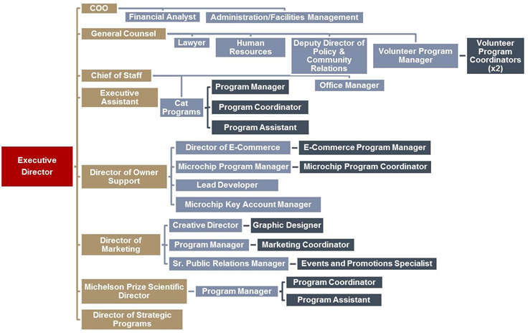
My role within organization
Notes:
Use this graph to give more description of your role specifically (responsibilities, typical work week, direct reports, etc.)

Slide 20
Compensation at my company
Senior Management
($100-250K)
Management
($60-100K)
Program Manager
($40-75)
Entry Level
($11/hr)
Notes:
Use this graph to show general compensation ranges for people in various roles in your company

Slide 21
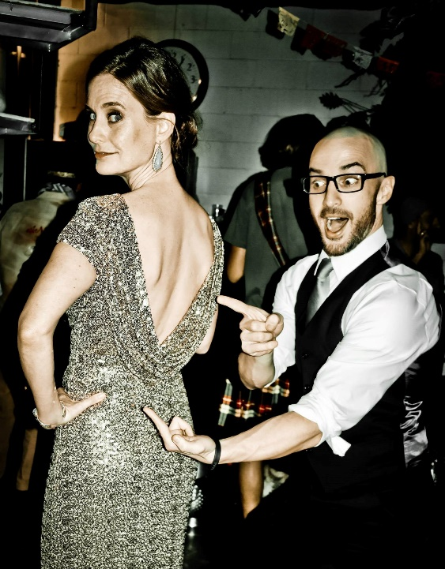
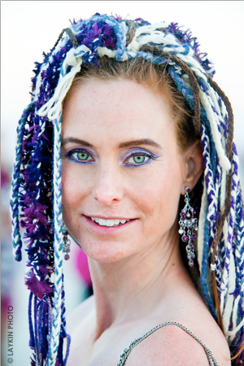
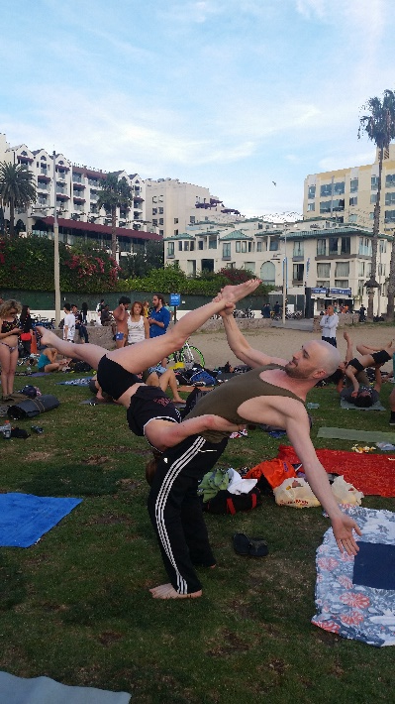
More than just work
When I am not at work I like to exercise, eat, hang out with friends, and travel and have new adventures.
We have been going to Burning Man since 2002 and got married there in 2012.
Goofing off at a fancy party
My Burning Man wedding portrait
Practicing acro yoga at Muscle Beach

Slide 22
Do it all over again?
If I could talk to my high school self, what would I say?
Don’t worry so much. Work hard, do your best, and ask for help when you need it.
Good friends are worth everything. Find people that you love and support and that do the same for you and then hang onto them through life’s ups and downs.
Be sure to follow your passions – either as a career or as a hobby – it will keep you young and alive.
Don’t ever stop learning and growing, it’s a key to happiness.
ENJOY THE RIDE!

Slide 23
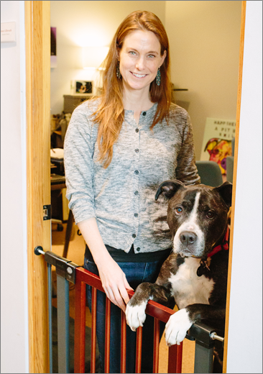
Questions?

