Slide 1
Tuesday Conner
My Story…
From Costume Designer to Producer

Slide 2
INTRODUCTION
My name is Tuesday and I’m 50 something.
I work for myself at Inner City Cultural Center II, Inc.
I produce Performing Arts Events and provide Artists a place to learn, grow, perform and sell their art.
I Teamed up with Piccolo’s Books to provide Arts & Education to communities Worldwide.
I became the Executive Director for our Nonprofit Organization called The Gift of Knowledge Foundation.
My role at The Gift of Knowledge Foundation is to make magic happen.
I create blue prints for events and organize Art Festivals.

Slide 3
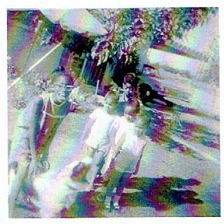
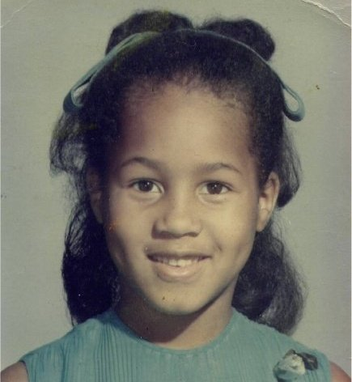
The Early Years…
I was born in the City of Angels and
Raised in Los Angeles.
Me at 4, in front of the line.
We visited our grandparents in
Arizona every summer.
This is me at 6
When I went to Arlington
Heights Elementary School

Slide 4
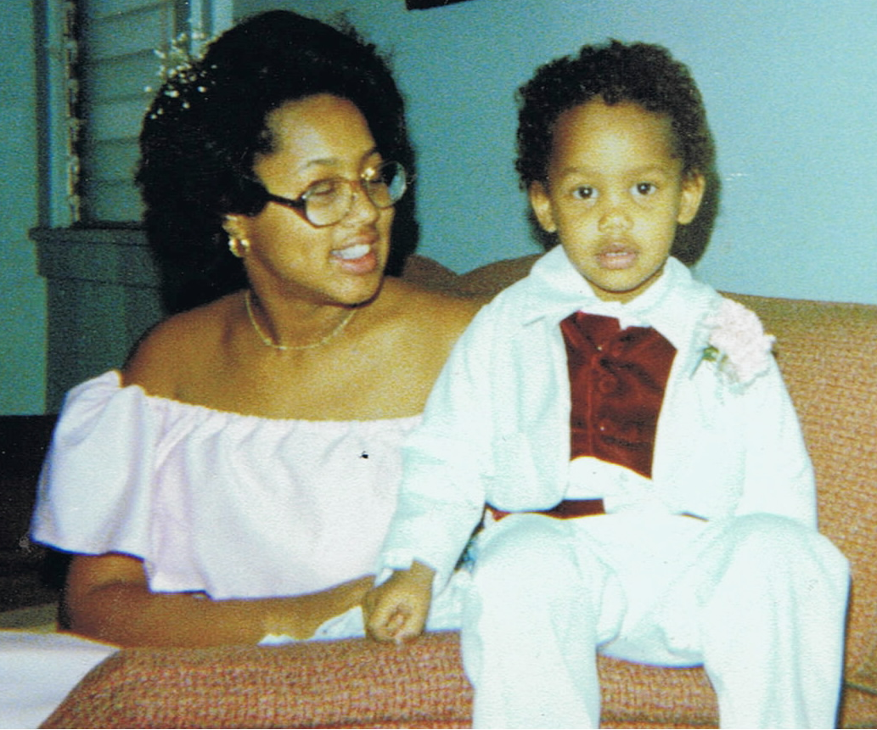
More Early Years…
A little about my family…
This is a picture of my cousins Harold,
Barbara and Frederick, my sister Lynne,
my brother Tony and me at Christmas.
This is a picture of me and my son,
He was born when I was 14
I went to St. Ann’s Maternity School
and Graduated with Straight ‘A’s.

Slide 5
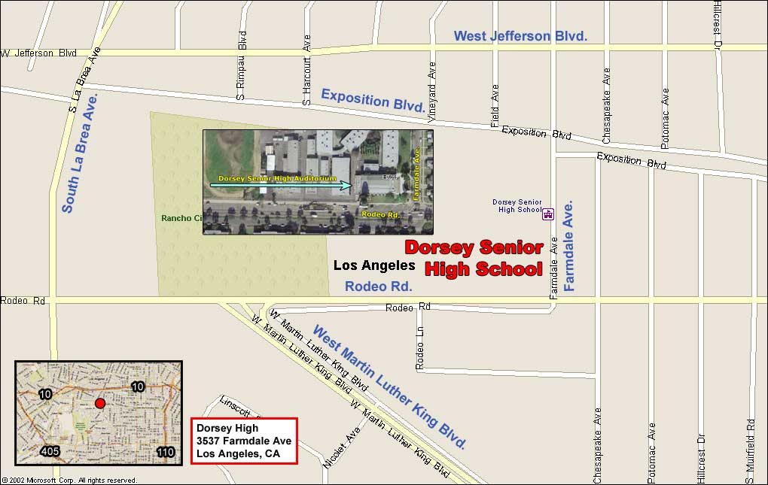
HIGH SCHOOL
I attended Susan Miller Dorsey in Los Angeles, California
\

Slide 6
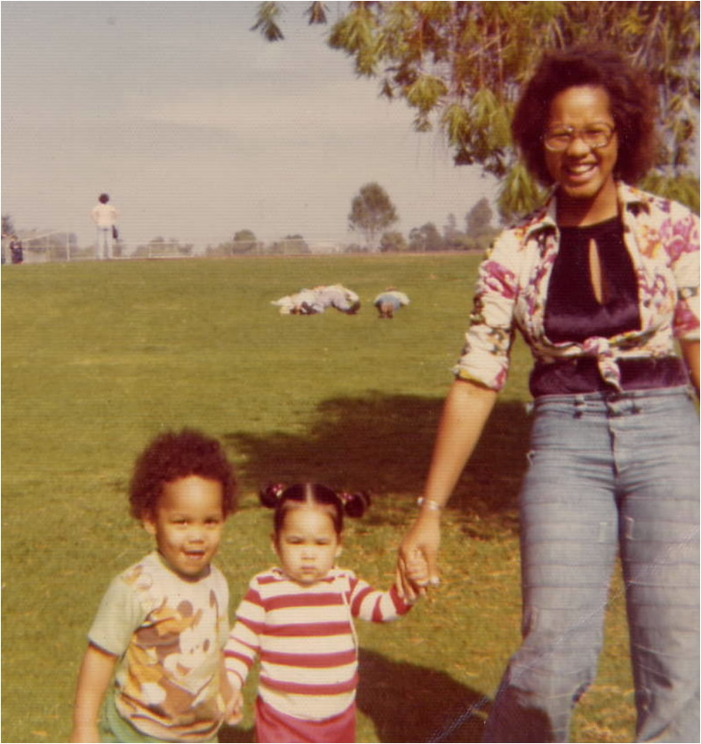
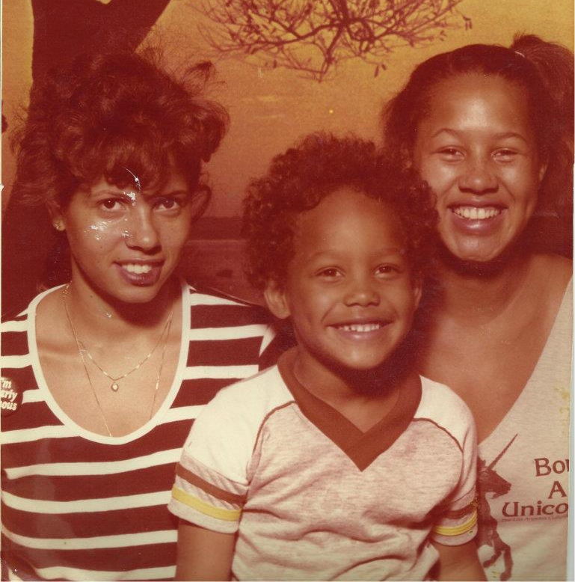
HIGH SCHOOL
As a HS student I wasn’t involved in extra curricula activities, I was a single mom with a job.
\
Here is a shot of me in HS
Me as a 12th grade student

Slide 7
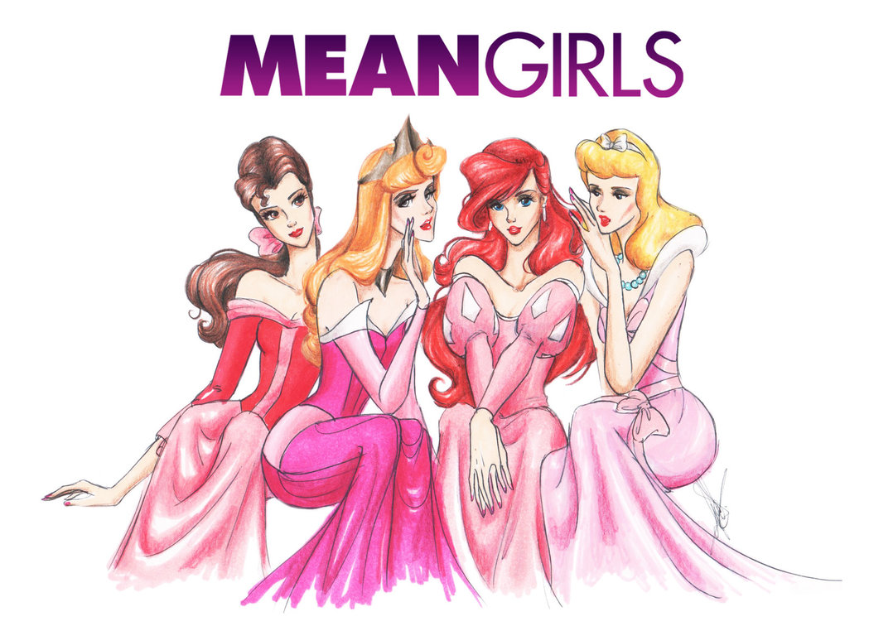

HIGH SCHOOL
Things I enjoyed in HS
Things I did not enjoy in HS
I was in the first aviation class, my teacher had his own plane and would let us fly.
I was a Tom Boy, boys were always my best friend and Girls hated me for it.

Slide 8
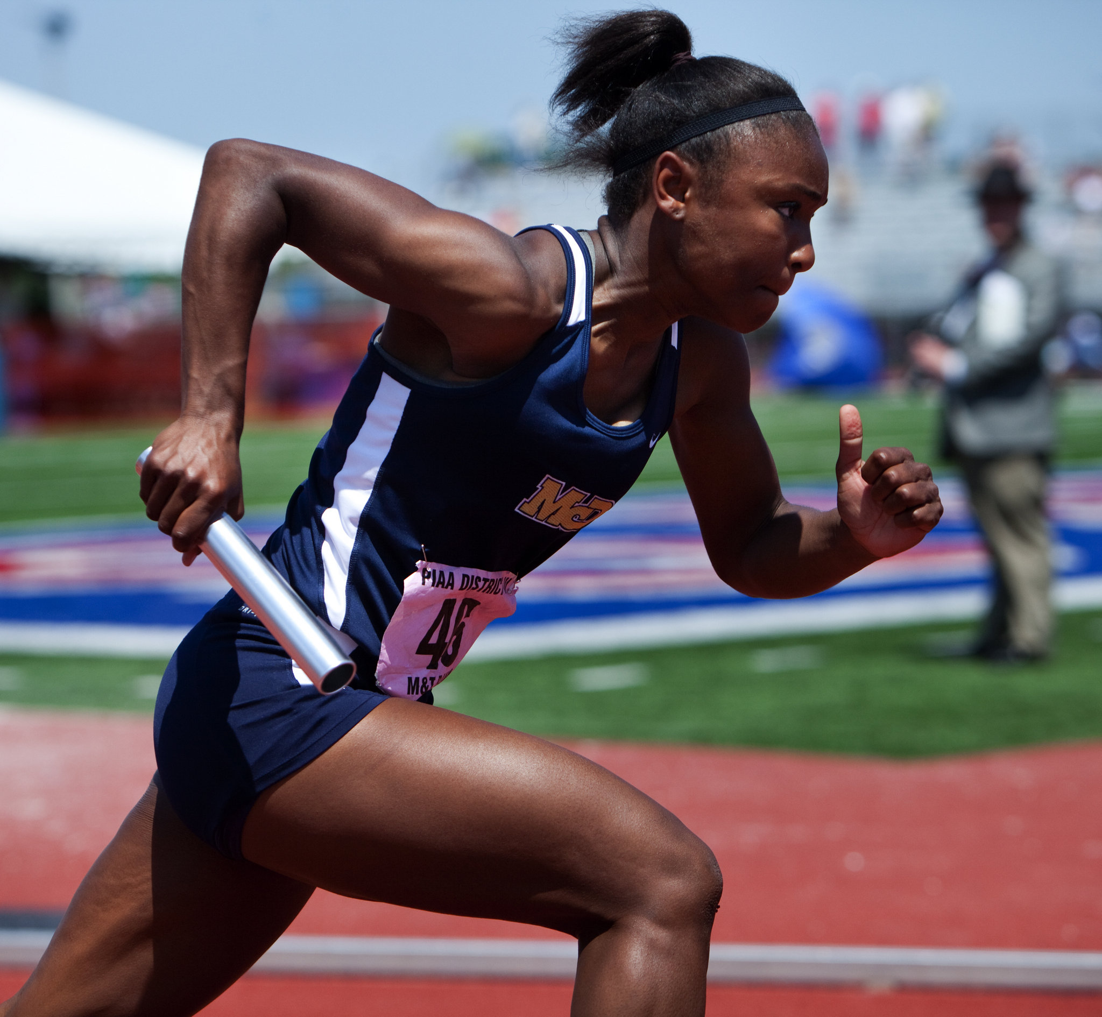
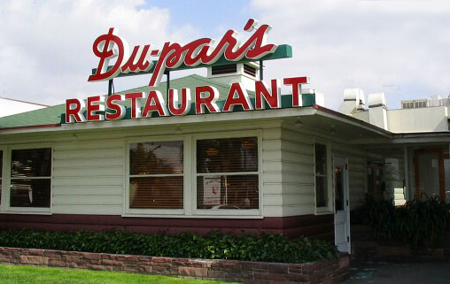
HIGH SCHOOL
In High School I ran Track & Field
When I was 16 years old, I was a waitress while attending High School. I told them I was 18 and took cash money home every night.

Slide 9
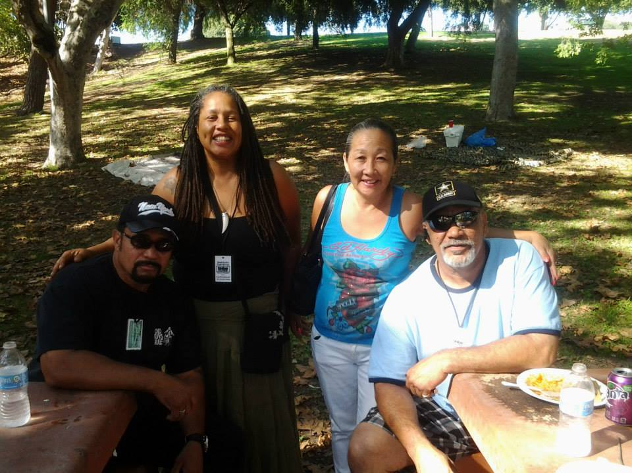
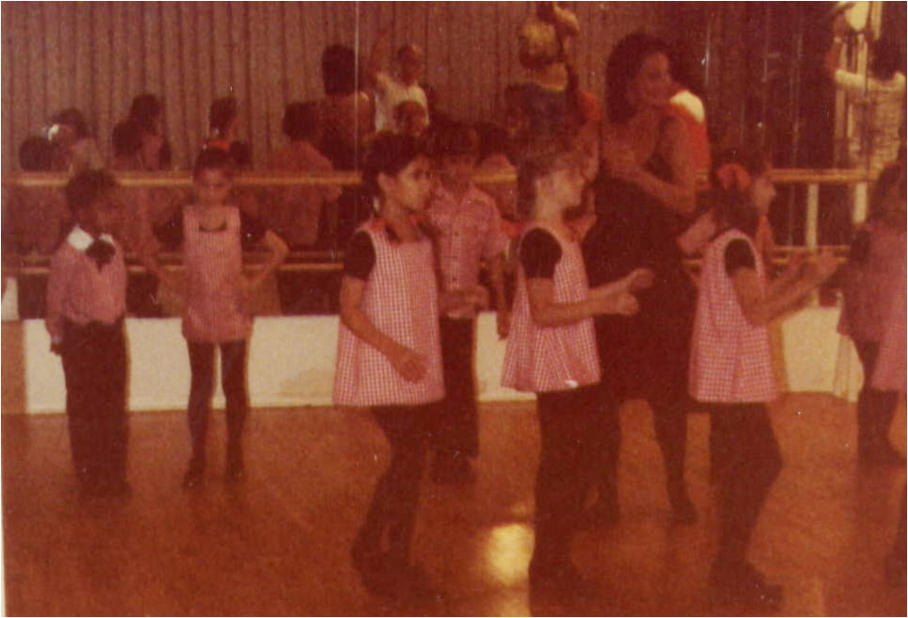
HIGH SCHOOL
My Fondest memories from High School are my lifelong friends.
An Adversity I had to overcome in High School was to keep my son active in the community while I was at work.

Slide 10
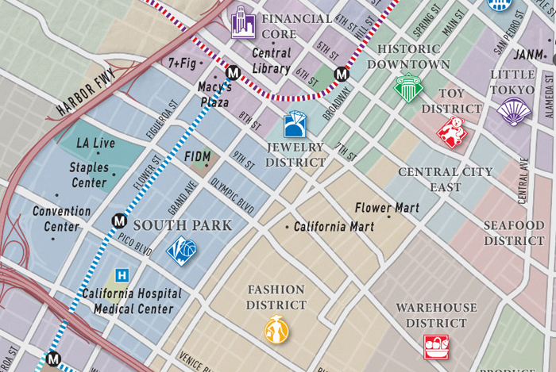
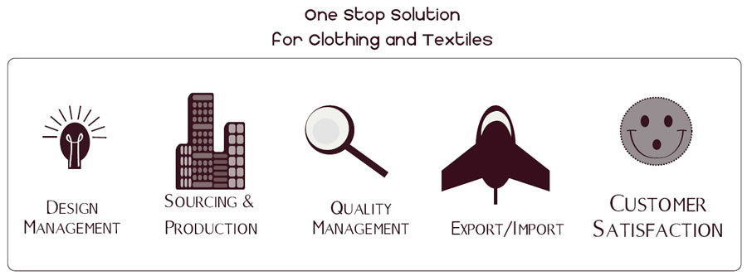
College
I attended The Fashion Institute of Design & Merchandising in Los Angeles, California
My 2nd Semester of college I changed my major to Manufacturing & Management
\

Slide 11
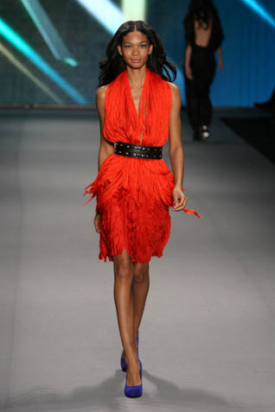
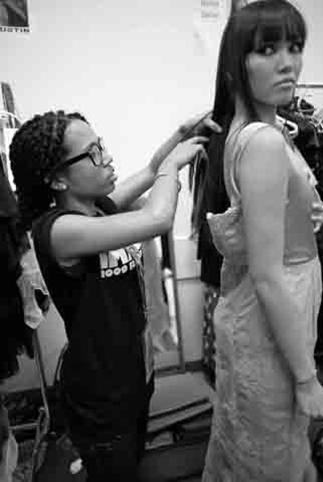
College
In College I worked at the California Mart Fashion Office
I worked as a “Dresser”
for Fashion Shows in College

Slide 12
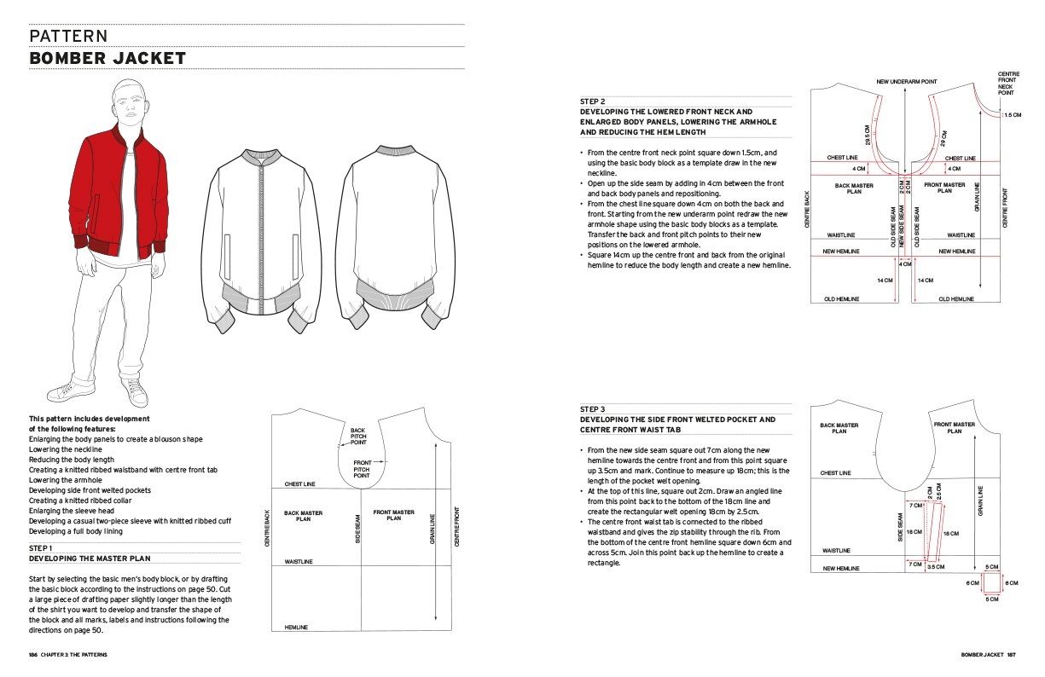
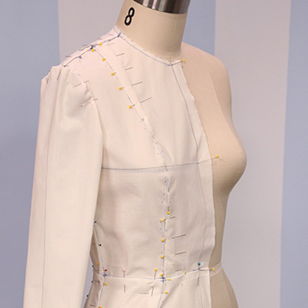
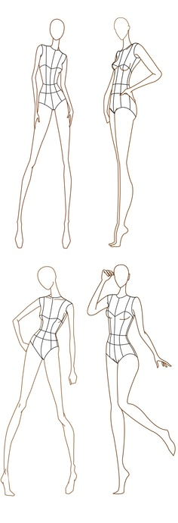
Graduate School - CSUN
My Favorite class was
Pattern Making
I didn’t have a Least favorite class
I even liked Math

Slide 13
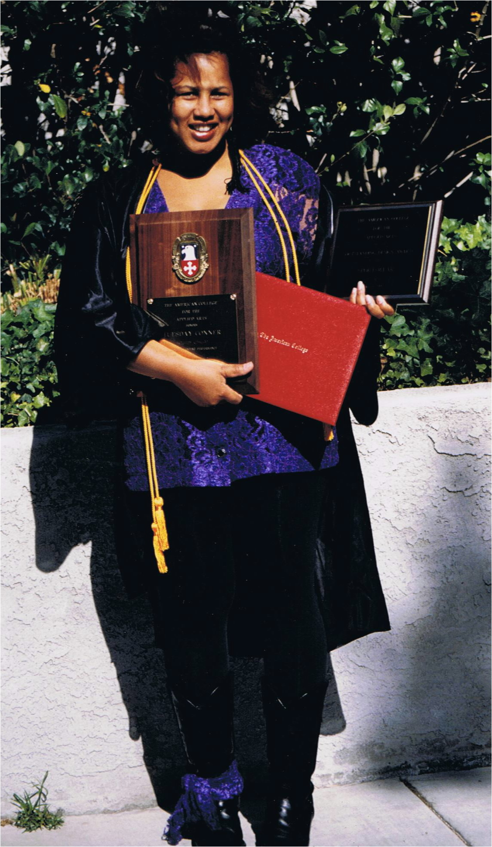
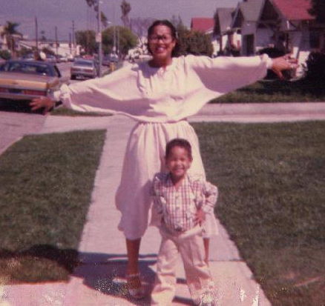
At the American College for Applied Arts
My Fondest memory is when my name was called as Designer of the Year.
I had to overcome the obstacles of being a Teen Parent

Slide 14
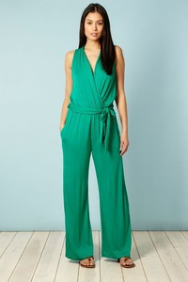
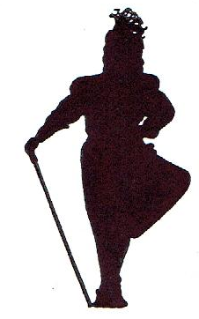
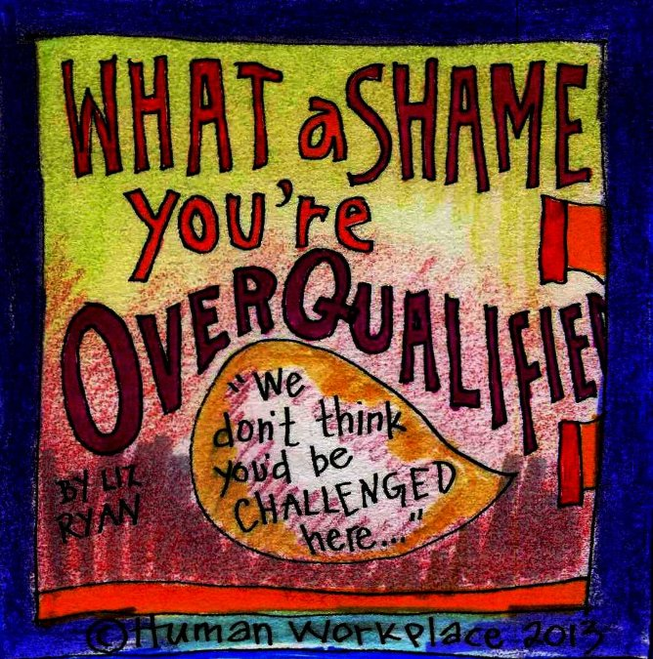
Career Path
When I was 27
I got tired of being hired as the Assistant all the time and
Went back to college.
My first job out of college I was Assistant Designer at the
Bob Mackie Blouse Division.
After that, every job I applied for
I was told…You’re over qualified.
I created
My own company
I created my own niche In the world.
I designed exclusively For celebrities.
My mom gave me my 1st adult client when I Was 11 years old.
I made her a green Jumpsuit from scratch.
Notes:
You may use this chart to describe your journey to the current career

Slide 15
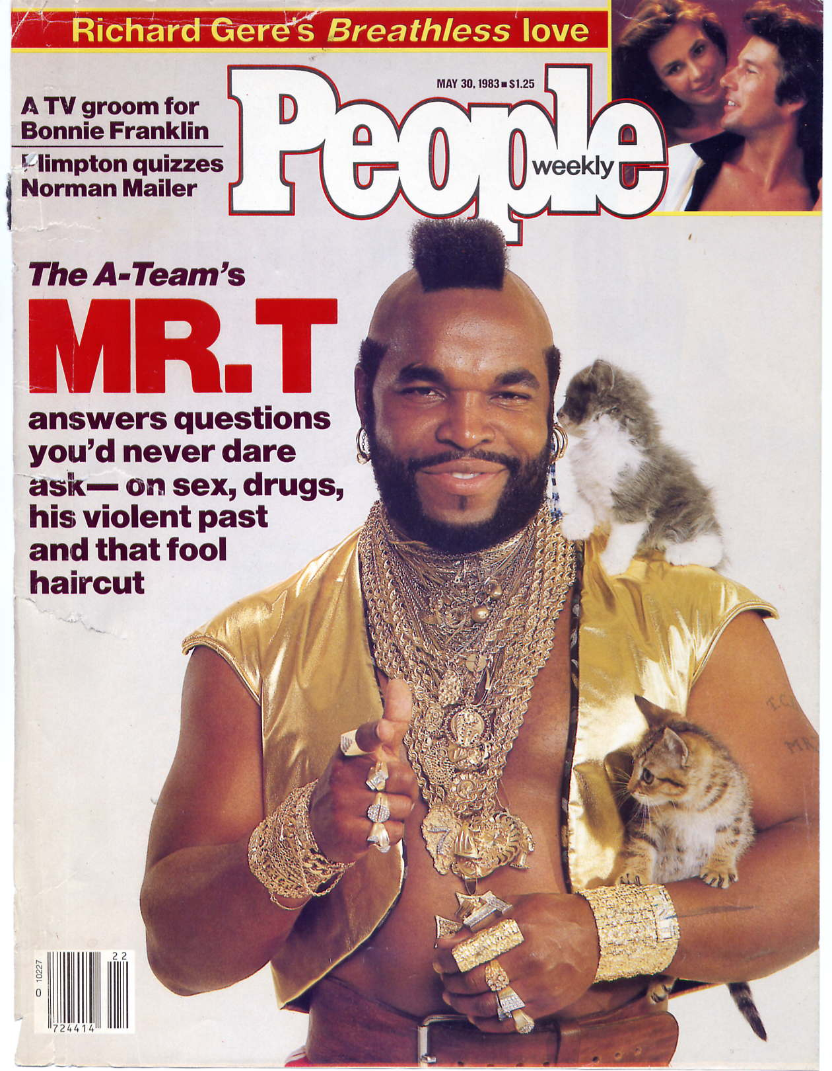
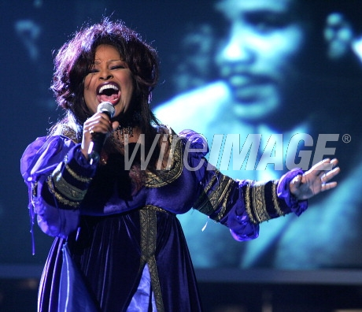
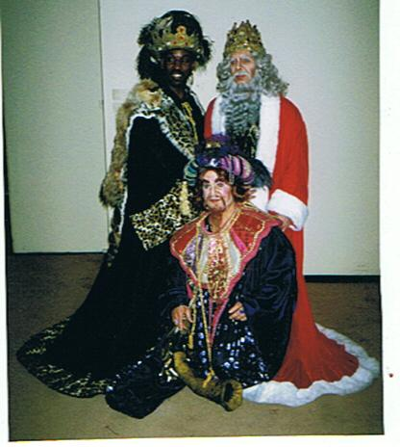
My Designing Career
My 1st Publication
My 3 Kings in Amahl & The Night Visitor on Broadway at the Lincoln Center in New York City
Chaka Khan in a Tuesday Conner Design
Performing at the United Negro College Fund in a Tribute to Quincy Jones

Slide 16

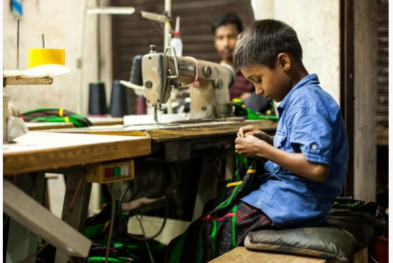
Career
My first Job was at my mother’s sewing factory when I was 6.
My worst Job is when I was a waitress, I had to take cash home every night.

Slide 17

Career
Some challenges I had to overcome in my career
It's freelance
and offers no job security,

Slide 18
CURRENT ROLE
History
Size
Location
Products
Services
Founder and Executive Director of Inner City Cultural Center II, Inc. A nonprofit performing arts institute.
We have 7 team members, plus artists.
We operate out of the Vision Theatre in Leimert Park, Los Angeles, CA
Talent is developed, Art is created in all forms and mediums.
We teach and provide space for artists to grow, learn and sell their art.
Notes:
Use this graph to give more description of your current company (history, size, location, products and services, etc.)

Slide 19
Current Role
CURRENT ROLE
Founder
International Liaison
Executive Director
Marketing
Notes:
Use this graph to give more description of your role specifically (responsibilities, typical work week, direct reports, etc.)

Slide 20
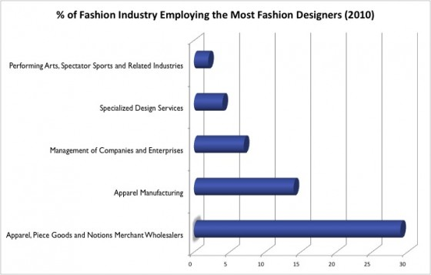
Career Compensation
Salary, Earnings and Benefits
The earnings of costume designers vary in accordance with the nature of job and experience. Annual average salary in the United States is $55,840. Self-employed or freelance designers often earn more than professionals holding salaried positions. However, the income of freelance and self-employed designers depends mostly on the costume designer’s reputation, business ability, talent, and client base.
Wardrobe | THEATRICAL AND TELEVISION MOTION PICTURE
Wardrobe Supervisor | Per individual negotiation
Costume Designer | Per individual negotiation
Key Wardrobe/ Lead Set Wardrobe | $34.88
Costumer/Buyer/ Stylist | 29.63
Set Costumer | 29.63
Key Tailor/Fitter (MD) | 31.62
Seamstress/Tailor/ Stitcher/Sewer | 29.63
Notes:
Use this graph to show general compensation ranges for people in various roles in your company

Slide 21
ACADEMIC EXERCISE
We will now spend several minutes discussing the day’s academic module and how it is relevant in the ‘real world’

Slide 22

Ask Me Anything!

