Slide 1
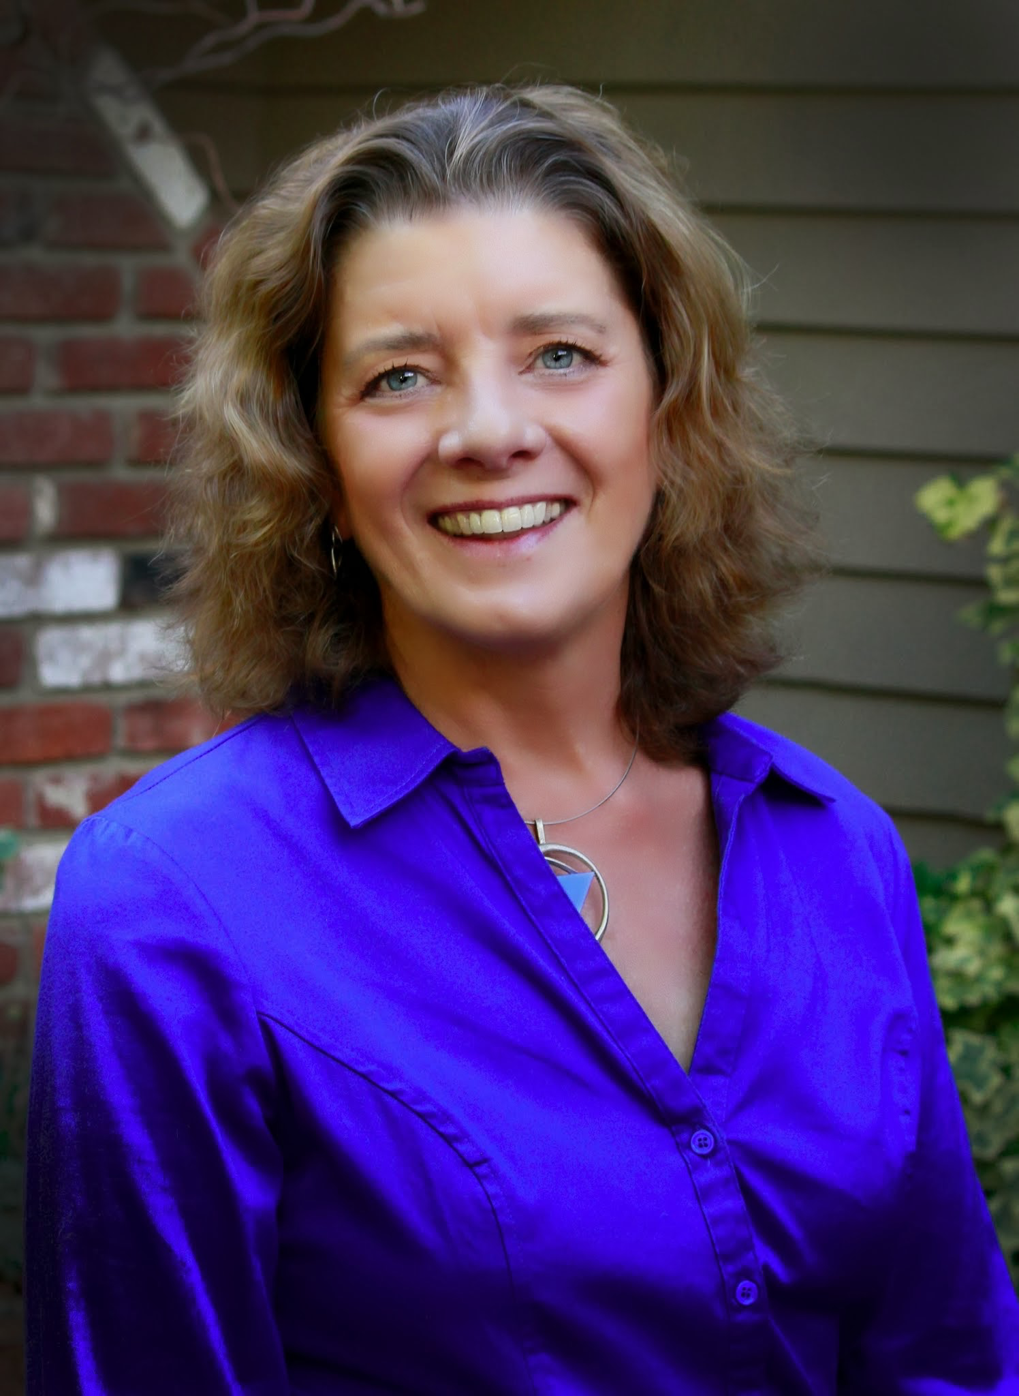
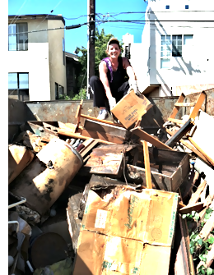
A clear path: My JouRney into junk

Slide 2
www.aClearPath.net

Slide 3
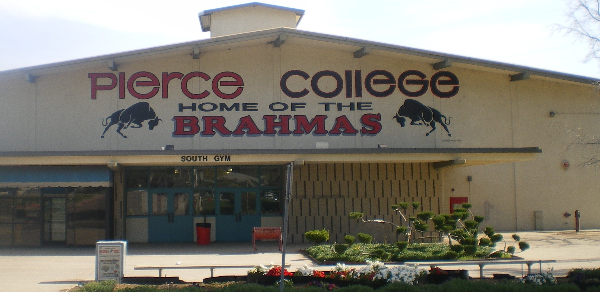
www.aClearPath.net

Slide 4
www.aClearPath.net

Slide 5
www.aClearPath.net

Slide 6
www.aClearPath.net

Slide 7
www.aClearPath.net

Slide 8
www.aClearPath.net

Slide 9
www.aClearPath.net

Slide 10
www.aClearPath.net

Slide 11
www.aClearPath.net

Slide 12
www.aClearPath.net

Slide 13
www.aClearPath.net

Slide 14
www.aClearPath.net

Slide 15
www.aClearPath.net

Slide 16
www.aClearPath.net

Slide 17
www.aClearPath.net

Slide 18
“Opportunity… often it comes disguised in the form of misfortune or temporary defeat.” –Napoleon Hill
www.aClearPath.net

Slide 19
www.aClearPath.net

Slide 20
www.aClearPath.net

Slide 21
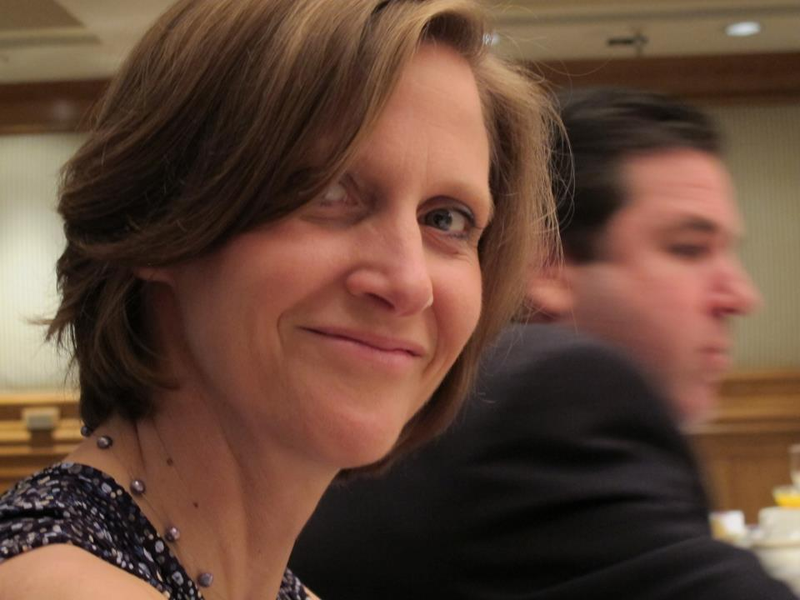
www.aClearPath.net

Slide 22
www.aClearPath.net

Slide 23
www.aClearPath.net

Slide 24
Boomer & Senior Downsizing
www.aClearPath.net

Slide 25
www.aClearPath.net

Slide 26
www.aClearPath.net

Slide 27
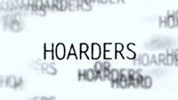
www.aClearPath.net

Slide 28
www.aClearPath.net

Slide 29
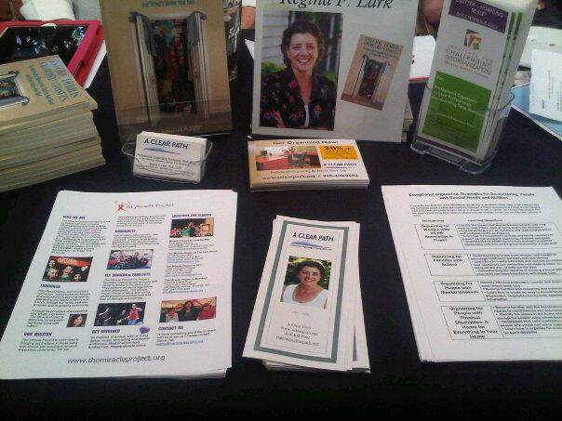
www.aClearPath.net

Slide 30
www.aClearPath.net

Slide 31
Workshops and Talks…
De-clutter 101: Getting Started Is life among the rubble making it hard to work and play? Are you barely able to move around your space? Start de-cluttering today and get organized with these breakthrough strategies!
It’s About Time: 6 Strategies to Accomplish your Goals Everyday. Do any of these phrases sound familiar? I don’t have time. I’m
running out of time. I’m always late. I spend way too much time on
this, and not enough on that. Let’s face it. Many of us just don’t have
a good relationship with “time.”
Help for Hoarding: It Takes a Village: The team-work approach to helping the most cluttered among us. Based on the work of Michael and Tamara Hartl Tomkins, this talk provides mental health professionals with the tools to create a “harm reduction” team to help clients de-clutter their physical environment.

Slide 32
The Organizer’s Song
I love your clutter oh let me get at it!
Sorting and grouping, I’m nearly an addict
Paper clips, tsotchkies, and binders with rings,
These are a few of my favorite things.
Bumm-dabada-bumm-dabada
Bumm-dabada-bumm-dabada
Miles of files and 8-tracks and cables.
‘Containerize this! Oh you’ll love it with labels!
Organized kitchens, and closets and beads,
Call us we’ll help with your de-clutter needs!
Use a timer! Think of SMART Goals!
Fold it this way and you’ll see…
Just Clear the Path now, don’t delay, this is how…
And soon you be … relieved
www.aClearPath.net

Slide 33
The End of Mess… And Clutter
www.aClearPath.net

