Slide 1
Sean Nasiri 07/04/1989 GenYrator

Slide 2
INTRODUCTION
My name is Sean Nasiri and I am 25yrs old
I am Co-founder of GenYrator
A startup that helps other startups get to the next level!
As Co-Founder and CEO
I RUN things!

Slide 3
The Early Years…
I was born in 1989 and raised in The Bay AREAAA
Me at 5.
Me at 7.

Slide 4
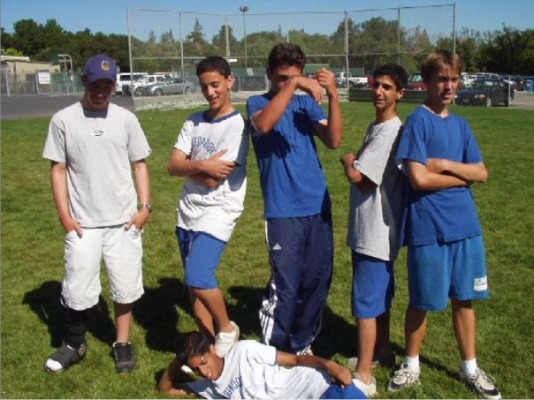
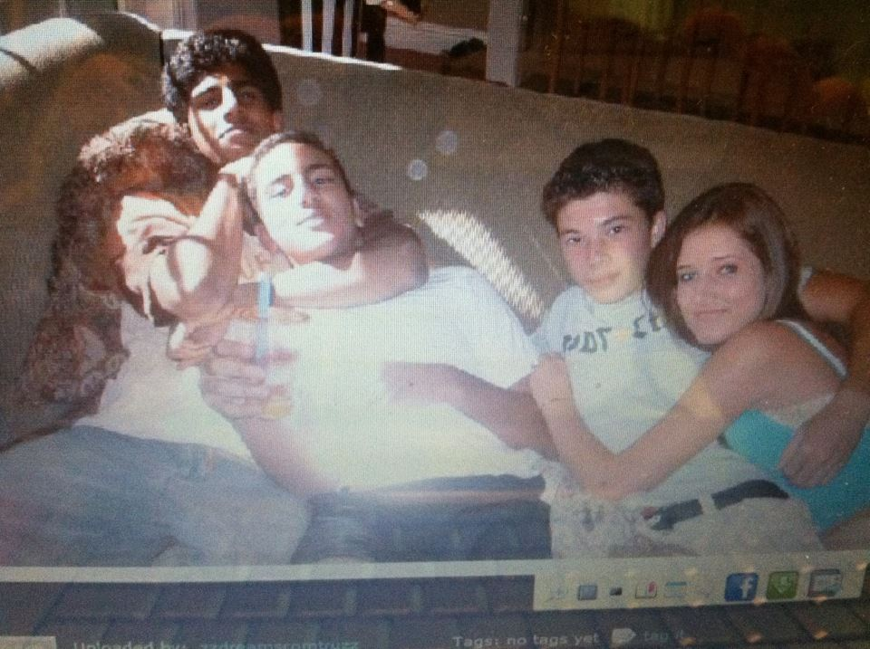
More Early Years…
Getting Older
7th Grade
Sophmore Year HS

Slide 5
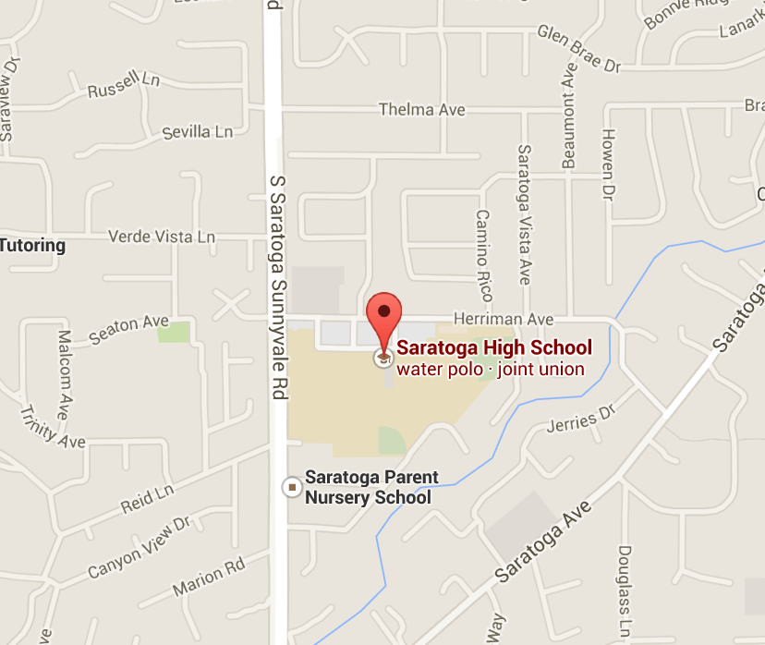
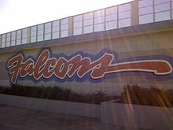
HIGH SCHOOL
I attended Saratoga High school in Silicon Valley
\

Slide 6
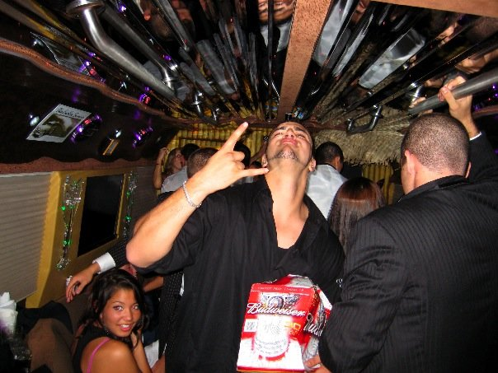
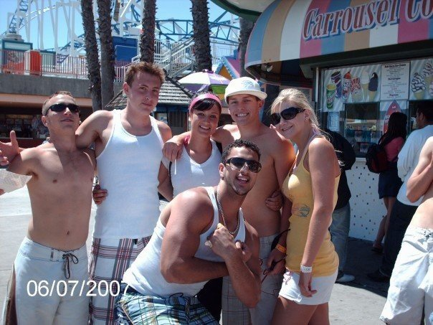
HIGH SCHOOL
As a HS student I was not the nicest guy aka D-Bag
As a HS student I was an athlete, class clown, bully, and someone who never lived up to their full potential.
\
Prom
Beach day in Santa Cruz

Slide 7
HIGH SCHOOL
Football
Fun

Slide 8
HIGH SCHOOL
Bad Kid in a Good Situation….
Unmotivated
Limited aspirations
Insensitive
Troublemaker
Jock
Misunderstood……

Slide 9
HIGH SCHOOL
Change Your Identity
The BOYS

Slide 10
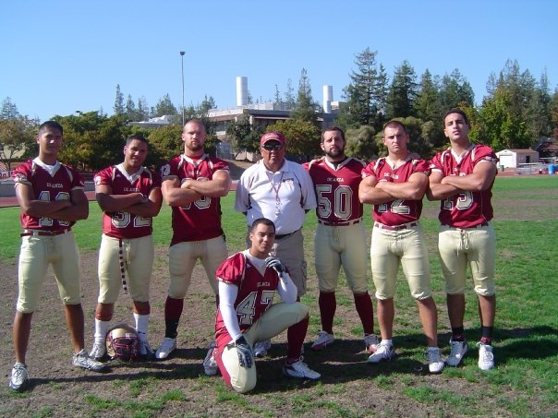
JC College

Slide 11
College
I attended college/grad school in BLANK CITY, STATE
\

Slide 12
College
Favorite classes
Least favorite classes
Major Classes:
If you don’t love it, leave it!
Entrepreneurship and Management
Small Classes with Group Projects
Philosophy
Bad Teachers
Busy Work
Art/History
Anything on Fridays…

Slide 13
College

Slide 14
Career Path
Motorola Mobility (Intern)
Salesforce.com
Personal Trainer
CEO: GenYrator
Notes:
You may use this chart to describe your journey to the current career

Slide 15
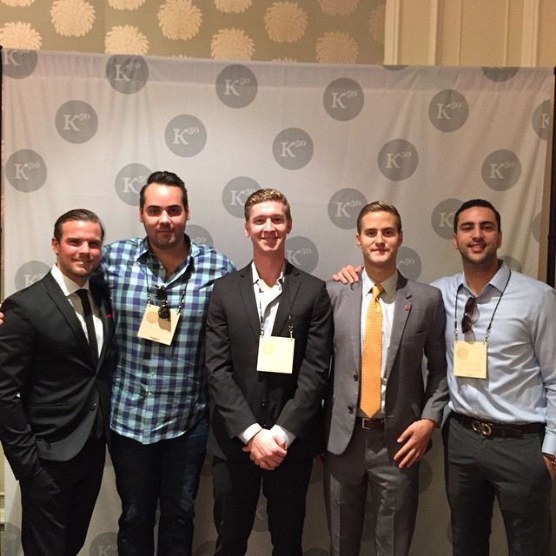
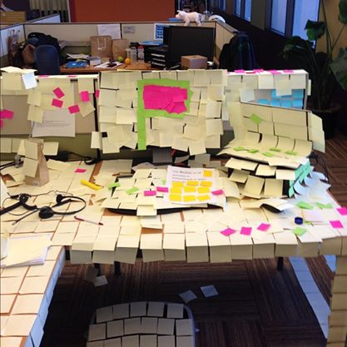
Career
Company pic
Company pic #2
Entrepreneur
Corporate

Slide 16
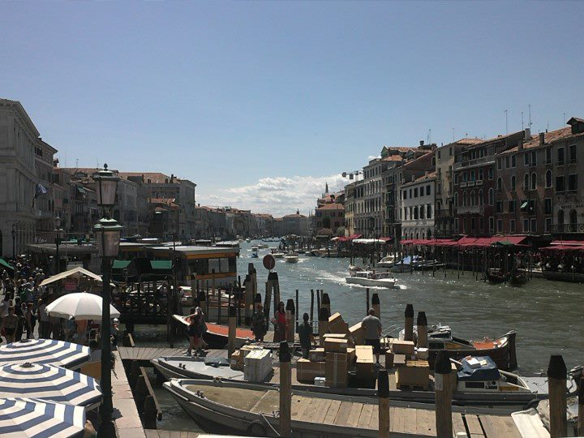
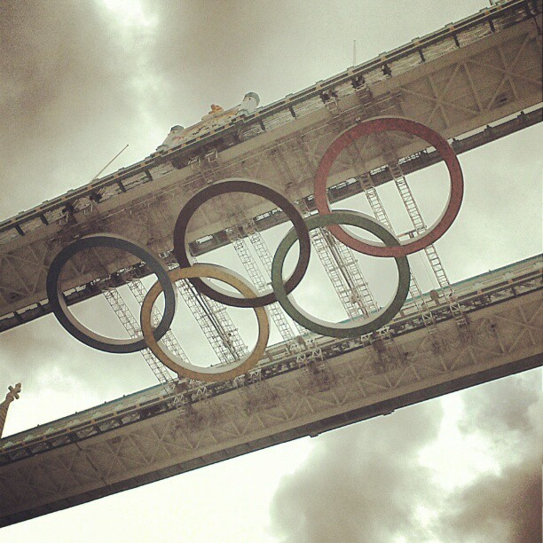
Career
Balance!

Slide 17
Current Role
CEO
Investor
Team
Company
Customer
Notes:
Use this graph to give more description of your role specifically (responsibilities, typical work week, direct reports, etc.)

Slide 18
ACADEMIC EXERCISE
We will now spend several minutes discussing the day’s academic module and how it is relevant in the ‘real world’

Slide 19
QUESTION AND ANSWER

