Slide 1
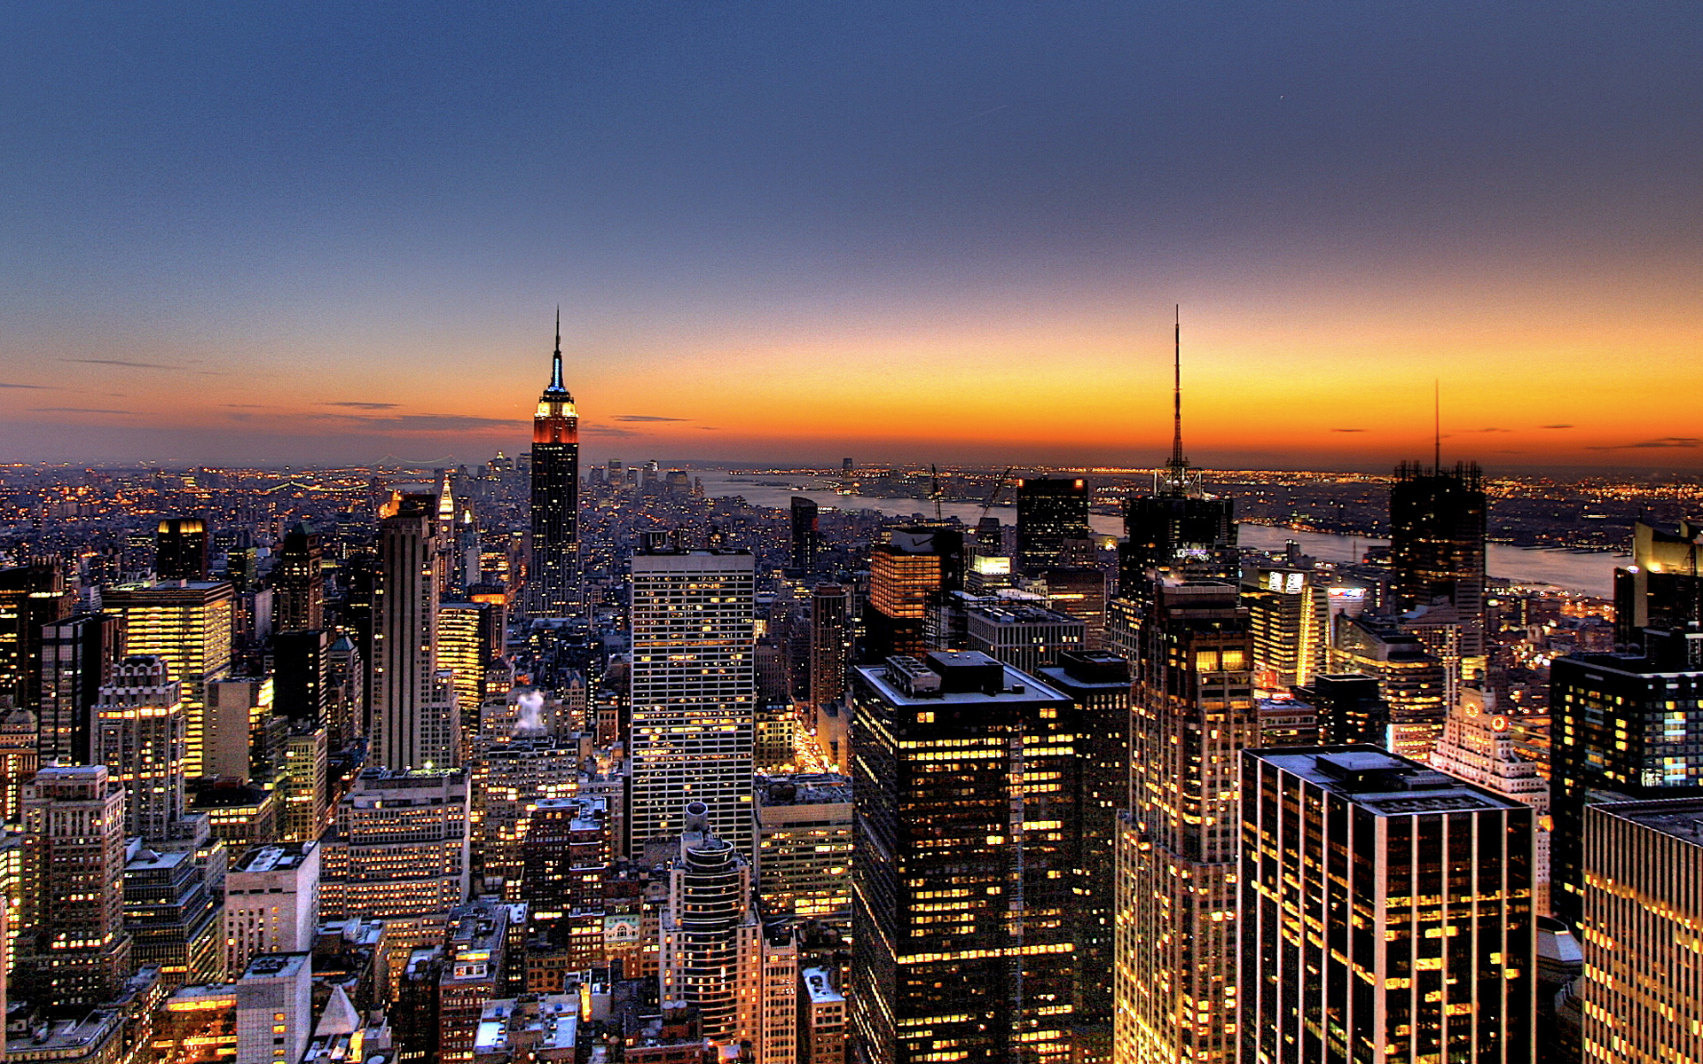
youth business alliance
Youth Business Alliance
Guest Speaker: Angela McLain
Guest Speaker: Angela McLain

Slide 2
Introduction
My name is Angela McLain and I am old enough!
I own Type A, Inc.
Type A is a back office, business management firm
My role at Type A is CEO/Partner
In that role, I create a no hassle, respectful work environment, delivering great work to driven business owners and high net worth individuals.

Slide 3
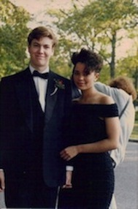
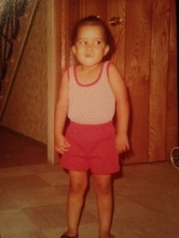
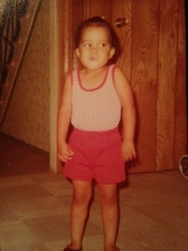
The Early Years…
I was born and raised in New York, on Long Island
This is a picture of me at 17, Senior Prom, don’t judge the big hair, it was New York in the 80’s!
This is a picture of me at 3, my happiest!

Slide 4
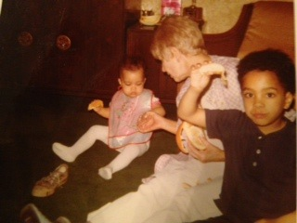
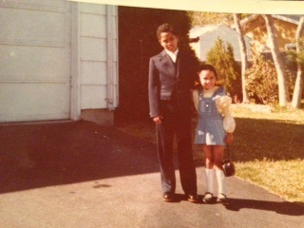
More Early Years…
A little about my family…
This is a picture of me and my brother Georgie, my hero.
This is a picture of me and my nana and brother

Slide 5

HIGH SCHOOL
I attended The Stony Brook School, in Stony Brook, NY
Insert map shot here
\
It was a boarding school. Living with other kids my age and
growing up with them changed my life. I loved the motto ‘Character before
Career’ and carry it with me still.

Slide 6
HIGH SCHOOL
As a HS student I was involved in tennis, cheerleading and lacrosse.
I was very outgoing, but I tended to be a gossip, who cared
a lot of what others thought of me, so I tried hard to fit in. It took me time to realize the impact of my words, but when I did, I changed it.
\

Slide 7
HIGH SCHOOL
Things I enjoyed in HS
Things I did not enjoy in HS
Living on campus
Tennis, lacrosse and field hockey
History
Workjobs
Cheerleading (they made me do it)
Cross country
Strict rules

Slide 8
HIGH SCHOOL
Activities/Athletics in HS
Jobs I worked while in HS
Workjob captain
Student government
Dorm leader
Tennis
Workjob
Busboy
Grocery store cashier
Retail
Babysitter

Slide 9
HIGH SCHOOL
Fondest memories from HS
Obstacles/Adversity you had to overcome in HS
My roommates
Senior prom
Night study hall
Weekend dances
Insecurity
Loneliness
Gossiping

Slide 10


College
I attended Loyola Marymount University in Los Angeles

Slide 11
College
Activities/Athletics in College
Jobs I worked while in College
Black Student Union
KXLU radio
Cocktail waitress
Hotel cleaning person
The Gap (retail)
Work study on campus

Slide 12
College
Favorite classes
Least favorite classes
Art History
English
Accounting
Communications/Film
Statistics
Philosophy
Criminal law

Slide 13
College
Fondest memories
Obstacles or adversity that you had to overcome
Having my first apartment off campus
Meeting my first love
On-campus activities
No money!
Being far from home
Balancing a FT job with full class load

Slide 14
Career Path
Notes:
You may use this chart to describe your journey to the current career

Slide 15



Career
Company pic

Slide 16
Career
My first Job
My worst Job
Actual job? Busboy
Professional job? Receptionist
Busboy-I was bad at it!

Slide 17
Career
Some challenges I had to overcome in my career
Not being sure of myself
Underestimating myself
Being in challenging environments

Slide 18
CURRENT ROLE
Notes:
Use this graph to give more description of your current company (history, size, location, products and services, etc.)

Slide 19
Current Role
Notes:
Use this graph to give more description of your role specifically (responsibilities, typical work week, direct reports, etc.)

Slide 20
Career Compensation
Notes:
Use this graph to show general compensation ranges for people in various roles in your company

Slide 21
ACADEMIC EXERCISE
We will now spend several minutes discussing the day’s academic module and how it is relevant in the ‘real world’

Slide 22

QUESTION AND ANSWER

