Slide 1
YBA GUEST
Sam Sheth

Slide 2
INTRODUCTION
My name is Sam Sheth and I am 49 years old.
I work for VerityPoint
VerityPoint is an executive and employee benefit consulting firm
My role at VerityPoint is Co-Founder and Senior Managing Director
My partners and I worked for another similar company for 15 years, and founded VerityPoint 9 years ago

Slide 3
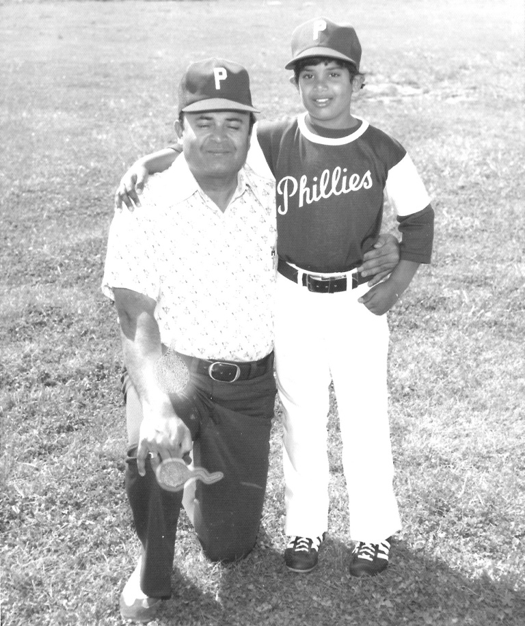
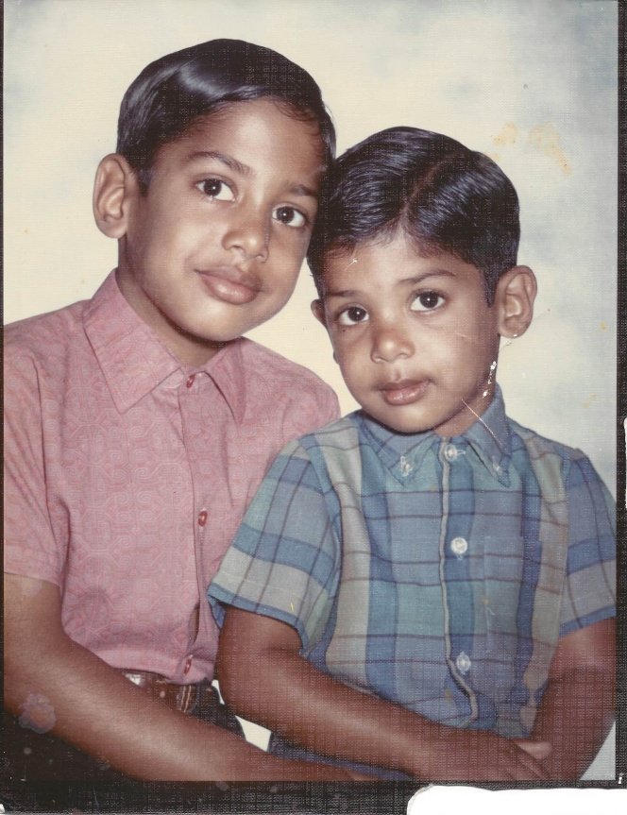
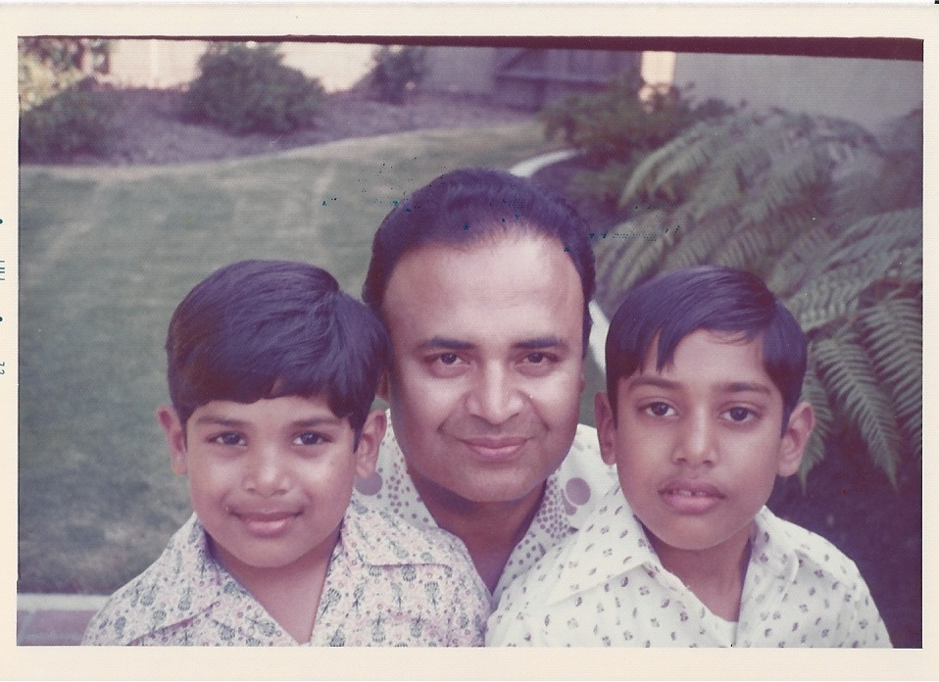
The Early Years…
I was born in Torrance, California and raised in Rancho Palos Verdes

Slide 4
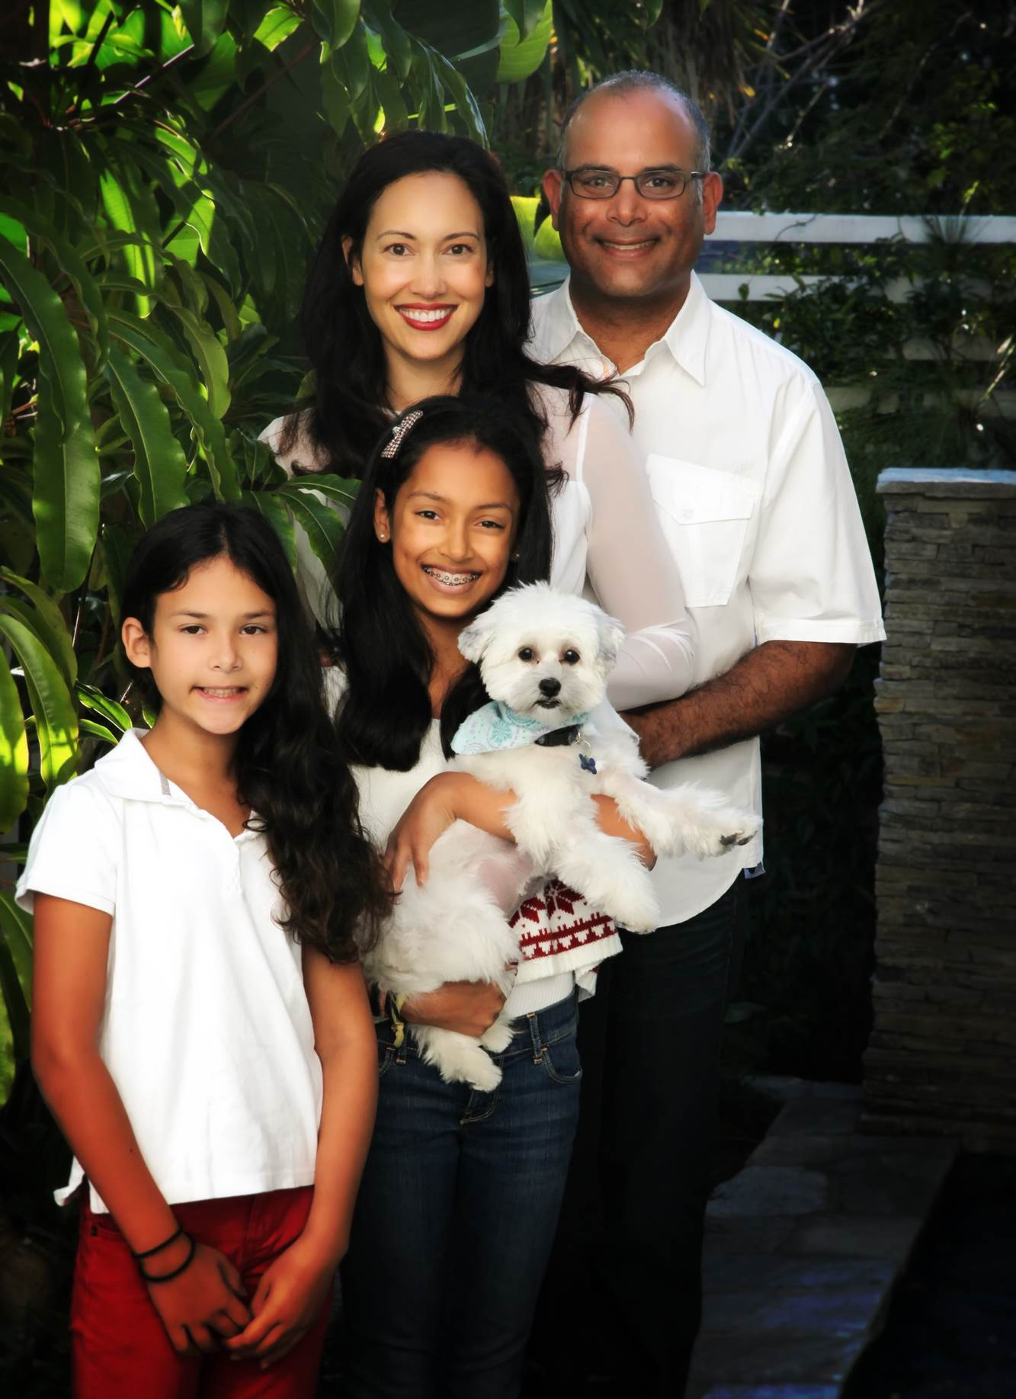
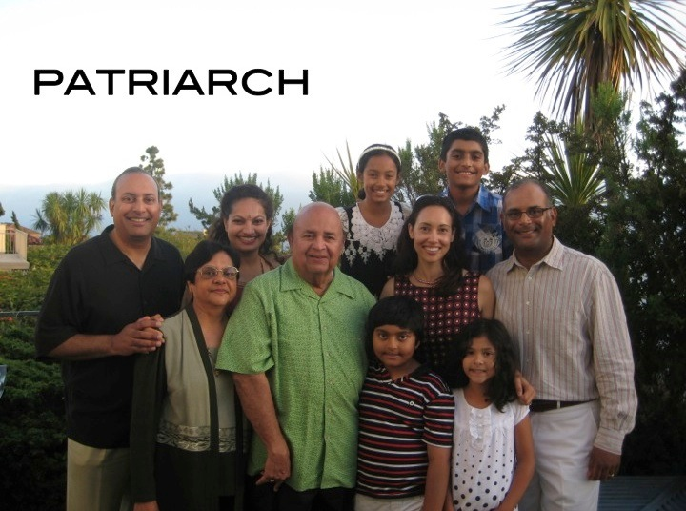
My Family Today…

Slide 5
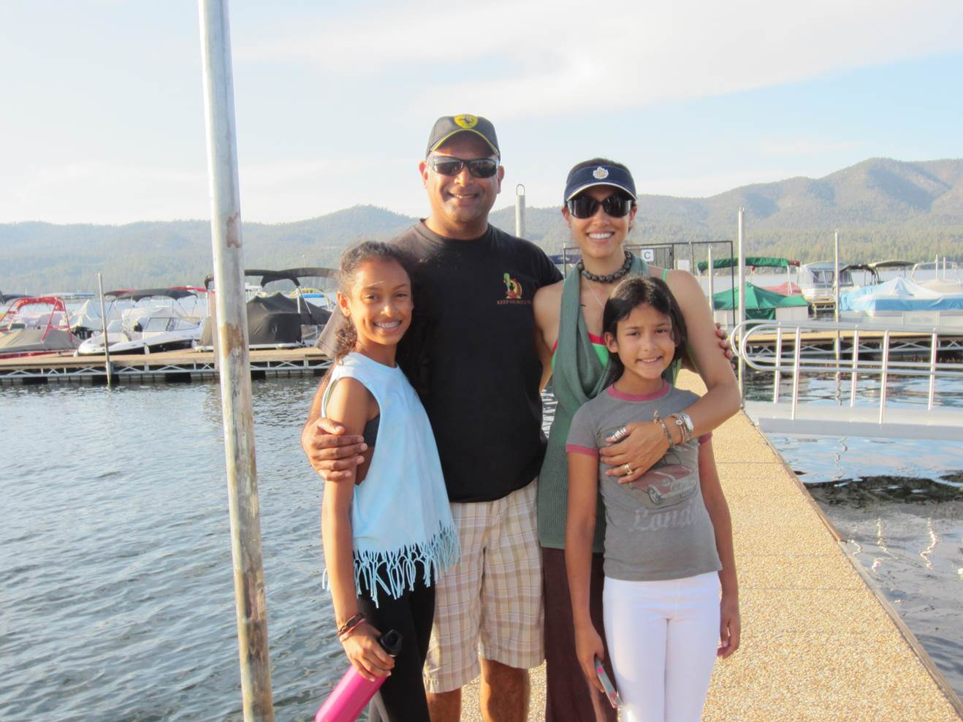
My Family Today…

Slide 6
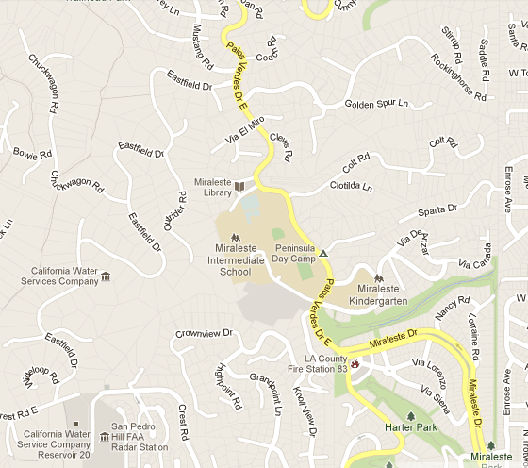
HIGH SCHOOL
I attended Miraleste HS in Rancho Palos Verdes, CA
Insert map shot here
\

Slide 7
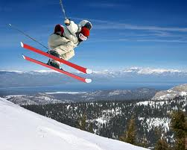


HIGH SCHOOL
As a HS student I was involved in a variety of activities, including student council, service clubs, band, ski club and other activities
As a HS student I was a good student, who was popular and was pretty short

Slide 8
HIGH SCHOOL
Things I enjoyed in HS
Things I did not enjoy in HS
Some classes
  Math
  Science
  Economics
In-school activities
  Student Council
  Events – Sports, Dances, etc.
  Service Clubs
  Band
Outside activities
  Skiing
  Beach
  Playing the drums in a band
Some classes
  English teacher (Junior year)
  Math teacher (Senior year)
Being too short to play basketball
Gossip/Badmouthing
Getting in trouble (breaking curfew, dining and ditching)

Slide 9
HIGH SCHOOL
Activities/Athletics in HS
Jobs I worked while in HS
Between all of my activities, I was often at school until dinner time. After dinner, I would do homework until I went to sleep, so there wasn’t much time for fun like playing video games or watching TV.
I was always doing odd jobs to make extra money. I would wash cars, had a newspaper route, and would sell gum at school. In the summers, I had a landscaping business for homes in our neighborhood, and was making good money. After I was 16, I was working summer jobs at my Mom’s company.

Slide 10
HIGH SCHOOL
Fondest memories from HS
Obstacles/Adversity you had to overcome in HS
Doing fun things with my friends (trips, sporting events, concerts)
Girlfriends
Getting good grades
Making enough of my own money to be able to do things
School Activities
Hanging at the Beach
Dealing with different groups of friends that didn’t always get along
Girlfriends
Figuring out if I was “Indian” or “American”
Being short and hanging out with my buddies who were all on the basketball team

Slide 11
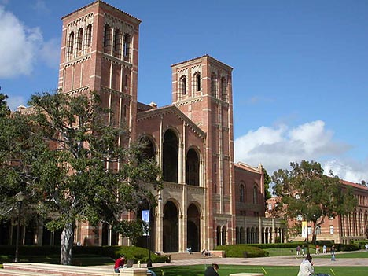
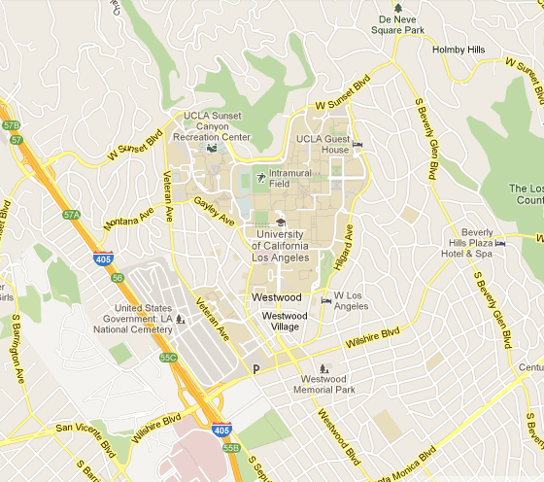

College or
Graduate School
I attended University of California, Los Angeles (UCLA)
Insert map shot here
My 2nd year of college
\

Slide 12
College or
Graduate School
Activities/Athletics in College
Jobs I worked while in College
Intramural sports
Being President of the Business Club
Learning more about the
“city” of Los Angeles
Meeting people from all over the world
Having lots of fun
Working in the research library (BORING)
Calling donors for donations (NOT FUN)
Working summers at my Mom’s company (OK, but still BORING)

Slide 13
College or
Graduate School
Favorite classes
Least favorite classes
Economics
Finance
Accounting
Special classes – Public Speaking, Sociology of Education, Nuclear Decommissioning
Philosophy
Statistics
Watching a “surgery” in Biology (when I realized I didn’t want to be a Doctor)
Art History

Slide 14
College or
Graduate School
Fondest memories
Obstacles or adversity that you had to overcome
Being independent
Learning a lot
Meeting my wife (now 23 years together)
Making friends from all different backgrounds
Great concerts and parties
Business Club
Graduating
Competing with some of the smartest kids in the world
Figuring out what I wanted to study (Pre-Med or Business)
Hanging out with different groups that came from different backgrounds

Slide 15
Career Path
Started my career in strategic consulting
Joined a consulting firm and starting developing business opportunities
Founded my own consulting firm with people I had work with for a long time
Notes:
You may use this chart to describe your journey to the current career

Slide 16
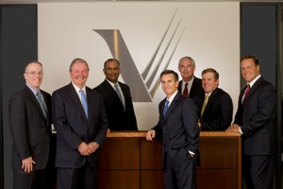
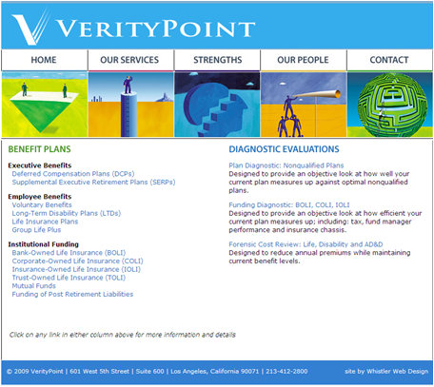
Career
Company pic
Company pic #2

Slide 17
Career
My first Job
My worst Job
My first real business was in 7th grade. I would pull weeds out of neighbors yards. I was so good at “getting the roots out” that my neighbors started referring me to other neighbors. Pretty soon I had so much business that I had to hire other kids from the neighborhood to work for me. We split the money and I realized I liked being the “boss”.
My worst job was digging ditches. My friend’s father had a construction business and paid us to dig ditches one summer all the way around a house he was building. It was sweaty, hot, and dirty, and all I could do was fall asleep when I came home.

Slide 18
Career
Some challenges I had to overcome in my career
Leaving a salaried job for a “commission” job, and not knowing whether I would succeed (my Mom was worried)
Learning that some people in my firm didn’t want me to succeed
Having faith in myself when no one else did

Slide 19
CURRENT ROLE
History
VerityPoint was founded in 2007.
We provide executive and employee benefits to large companies
Size
We have over 120 large corporations and banks as clients
We have lots of people that work for us
Location
VerityPoint has offices in downtown Los Angeles
We have clients all over the United States
Products
Services
Retirement Plans
Investments
VerityPoint is a consultant to many large companies on their retirement plans, employee benefits and investments
Notes:
Use this graph to give more description of your current company (history, size, location, products and services, etc.)

Slide 20
Current Role
Senior Managing Director
Sales
Strategy
Finance
Client work
Notes:
Use this graph to give more description of your role specifically (responsibilities, typical work week, direct reports, etc.)

Slide 21
Career Compensation
Senior Managing Director
Unlimited
Managing Director
$100K-????
Sales Consultant
$50K - ????
Salaried Consultant
$35K
Notes:
Use this graph to show general compensation ranges for people in various roles in your company

Slide 22

QUESTION AND ANSWER

