Slide 1
A Journey of Interesting Stuff
Notes:
This template can be used as a starter file for a photo album.

Slide 2
Tracey johnson president & CEO of exousia llc
Introducing

Slide 3
My Name is Tracey Marie Wallace-Johnson and I am the Founder, President and CEO of Exousia LLC Originally started in NJ where I’m from.
I am a LEO born on July 23rd and I LOVE being a LEO, I am strong, determined, analytical and creative.
My journey is very different from any other’s you may hear. I own my OWN and YOU CAN TOO. So let’s talk…

Slide 4
A Kid in the 70’s (gosh!!!)

Slide 5
WHEN I WAS A KID IN THE 70’S
I was BIG into the Arts. I was an excellent at drawing and was put in advanced art class. I have paintings, sculptures, charcoal drawings that my Mom still has.
I was also extremely musical. I came from a musical Family. I took lessons and learned to play the violin, the piano along with singing lessons. It all worked for me in my life.
I loved Barbie and had everything Barbie. My room was a community of Barbie. I had the dream house, cars, clothes, w/lots of Barbie and Ken dolls.
I had an easel in my room for painting, a desk for drawing and Calligraphy. I had a comic strip in the school paper called Tragically stupid in high school.
In the last part of my room was a music corner with a Casio Keyboard where I wrote, created music, made beats and learned to play songs from the radio.
In school I was advanced in English and was a really quiet kid known as a “PK” or a Preacher’s Kid, because I was a Preachers Kid.

Slide 6
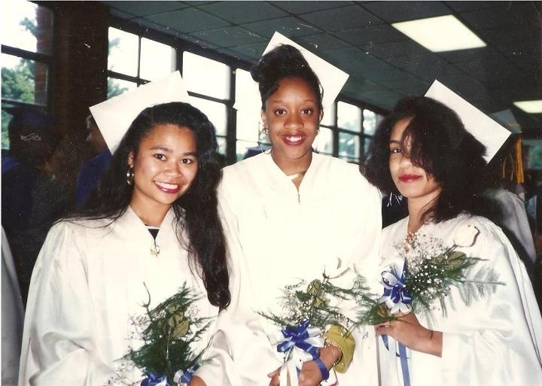
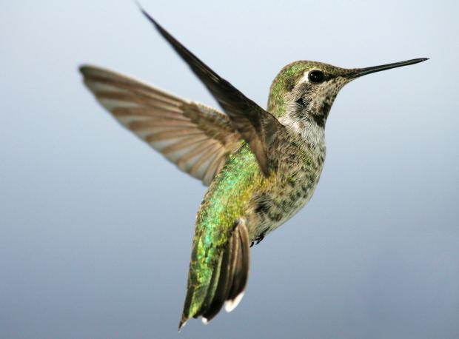
Then came Corporate…
In High School I finished my credits early, ready for graduation by my Sophmore year so I went to work. Cooperative Education placed us in State Jobs – I started in a Human Resources Department for Environmental Protection with my Friends. It was so much fun! It was the set up!

Slide 7
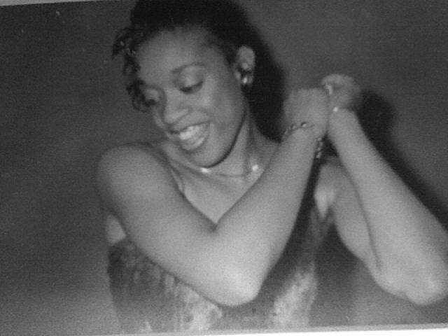
My College years were interesting because I continued to work for the State while taking classes majoring in Business and Human Resources. I didn’t do an extra curricular activities because I was on a TV show, was a hip-hop background dancer and was offered a record deal and a modeling contract, that I turned down….super fun times tho! #YOLO

Slide 8
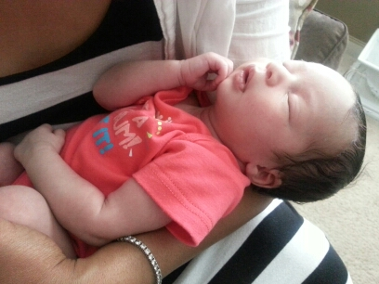
I became pregnant with my Daughter Lola at the age of 20 in the middle of a modeling contract and it changed my life. I took my Corporate Career more seriously. I was hired by an HR Consulting firm named The Rosen Group where I worked for 10 years!

Slide 9
Human Resources is a very fun and rewarding Field!
HUMAN RESOURCES
I worked my way up through the ranks in Human Resources from an HR Clerk, doing filing, administrative work, paperwork etc. It got fun when I became an HR Generalist, Manager and Senior Manager when I started dealing with performance management issues, employee relations concerns, defending the Corporation in court and dealing internationally!

Slide 10
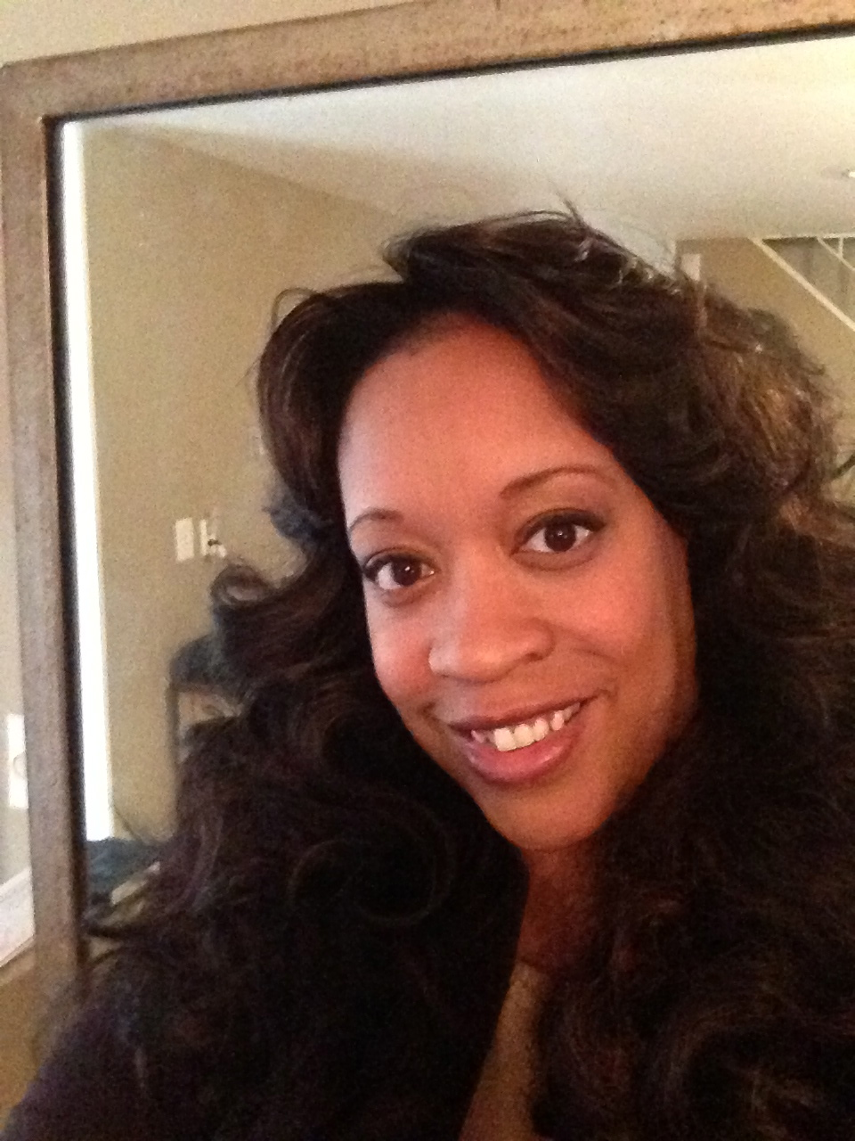
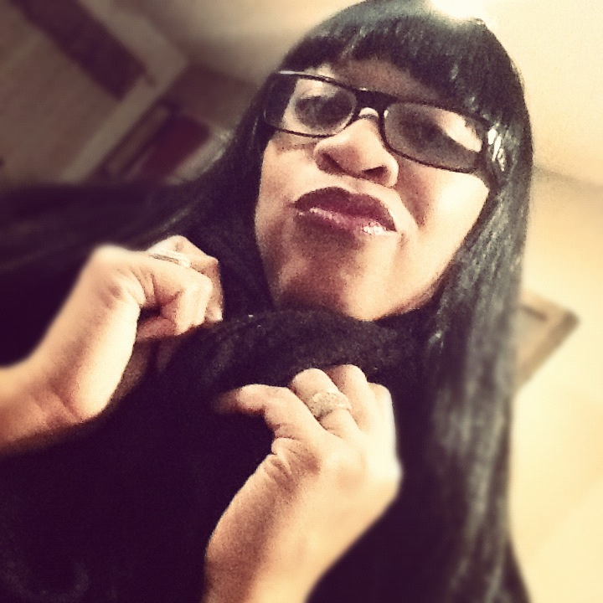
Snapshots
Mechanical Flower
After 10 years and a six figure salary I got bored working for others & started Exousia LLC in 2008 – at that time it was an HR Consulting Firm. It was really hard but we provided HR Services for some BIG Companies & made great money!

Slide 11
STORY TIME!!!!!!!!!!!!!
STORY 1: Children’s Hospital of Philadelphia – Foreigner Fallout!
So I am an HR Manager over 1500 employees at the top Children’s Hospital in
The World. Picture this….a world class Research Institute filled w/International
Researchers from China, Japan, Philippines, India, Russia, Switzerland, Africa,
And everywhere else you can think of. Great strides being made in experiments
And discovery however, LOTS of cultural miscommunication….
STORIES 2-5: St. Mary’s Hospital – (1) Jersey City Brawl! – (2) 88 y/o Employee – (3) Fight to the Death!!
Seems like all the good stories happen with my Hospital Clients!! In this scenario
We are a 10-minute drive from NYC which means outspoken, aggressive hard
Core emotional workers. I am overseeing an M&A (Merger & Acquisition) when
One Company comes in buys the other Company and fires all of the bought
Companies workers. I am brought in to communicate the purchase, lay off
981 people, re-assign 300 nurses, and 400 union workers.

Slide 12
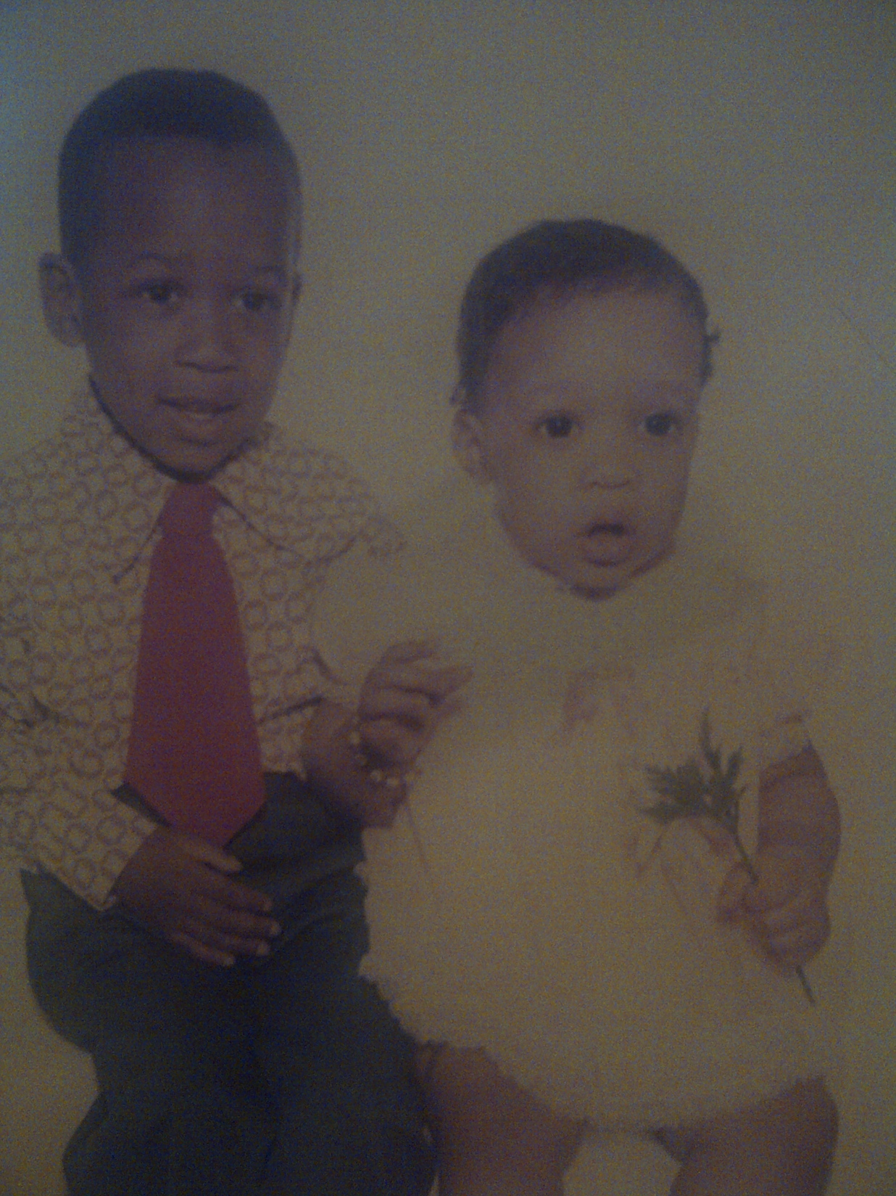
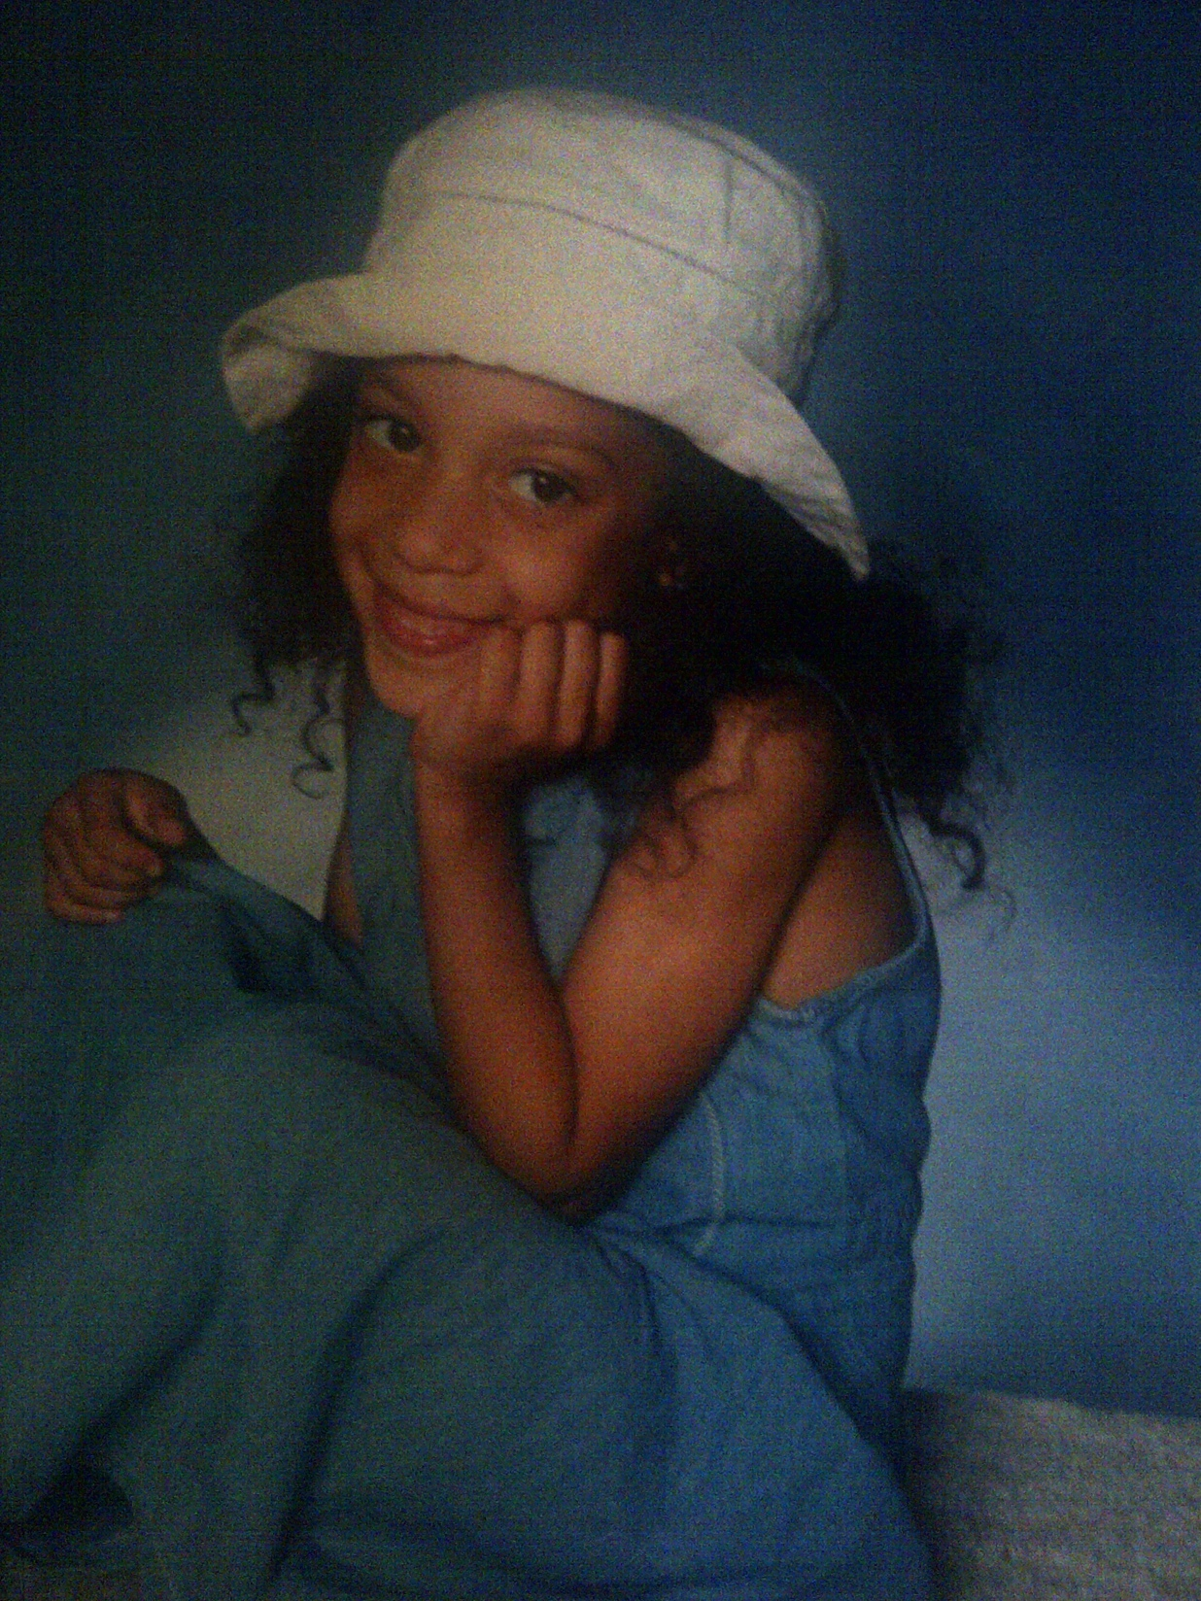
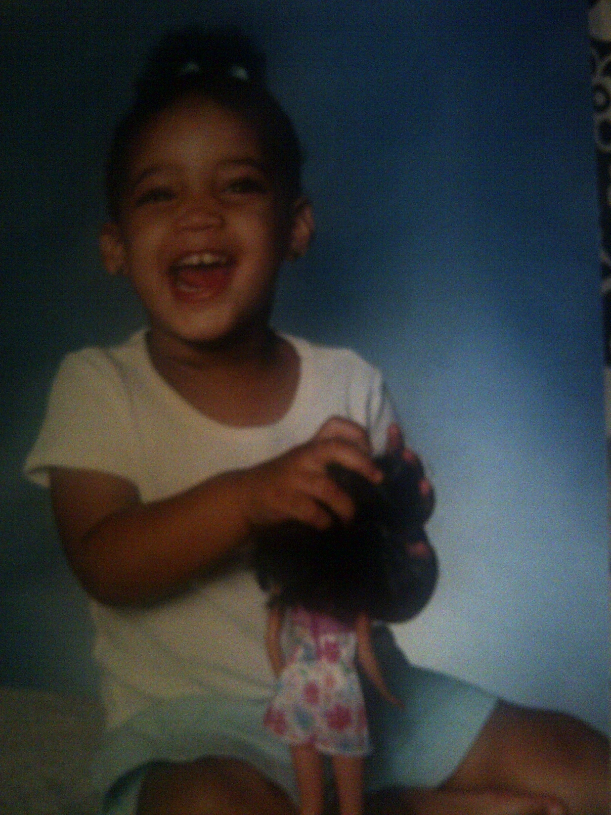
TRACEY MARIE
ROB & TRACEY
ABSTRACT
MY FAMILY
ALEXIS “LOLA” TYLER
AYANA MONAE

Slide 13
My Daughters: Lola & Yani
I had my first Daughter at 20, married at 21 and my second at 23, I worked and built my business with them right with me every step of the way. You can do anything that you set you mind to!!! Now they are Models and Business Owners themselves because they sat in on Board Meetings with Me!

Slide 14
EXOUSIA TODAY 2015
One thing that is great about Business is that it is always changing. Trends
And the economy dictate what the World needs and how a Company
Can compete in the Global Market Place.
When I turned 42, I decided that I wanted to make a bigger change and a greater
Impact on others. HR was great because I was increasing the quality of life and careers of individuals one person at a time, but I wanted to do more. I wanted a Mission focused life, so I began reading and thinking how can I help? How can I do more? This is when Exousia added Capital Formation and Project Management to our services offerings.
Exousia now finances construction projects, budgets and economic development projects domestically (a little) and in Third World Counties (a lot). We have funded over $5 Billion dollars worth of projects that are building homes for less fortunate, Gas/Oil Power Plants, Solar Farms, Hospitals, Dams, Water filtration/Systems from wells and much more. All of these helps overall Countries have better qualities of life while boosting their economy and global marketplace positioning.

Slide 15
India
Exousia is participating in the design and financing a Power Plant in a very poor City that will bring hundreds of sustainable jobs, boost their economy while allowing the area to provide oil not only to the Country to the World!!

Slide 16
United States
Exousia is currently engaged in the financing of a $1.3B mixed use Real Estate project that will create about 10,000 jobs to include jobs w/ Google, Samsung, Apple who are building
Campuses there. Mixed Use =
Retail, Office, Hotel, Restaurants, etc. Beautiful Property, Beautiful purpose!

Slide 17
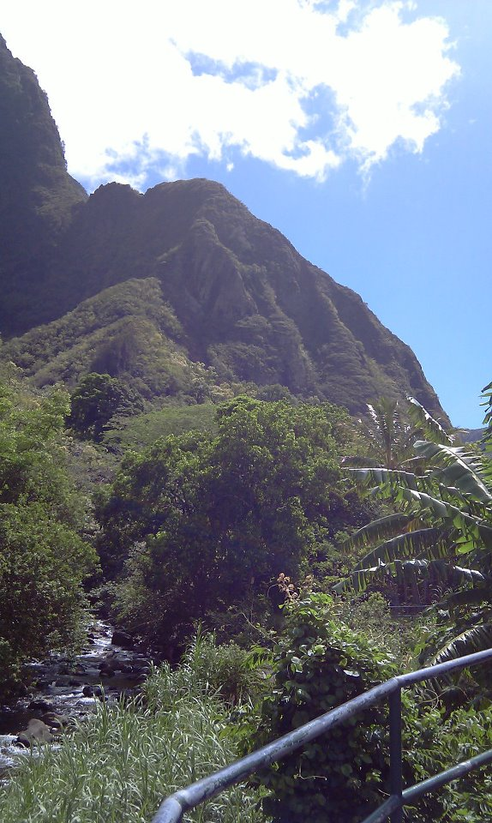
East Africa
Exousia is overseeing the project management of $2B in building projects of power plants, infrastructure, civil offices, hospitals, power plants that create over 15,000 sustainable jobs!

Slide 18
Q: What do you notice most in my Home Office? A: BOOKS!

Slide 19
MOTTO TO LIVE BY…
In all that you do stay True to Yourself work HARD and HAVE FUN!!!!!!!!!!!!
I have lots of fun, I do! I still sing, perform and create Art!

Slide 21
