Slide 1
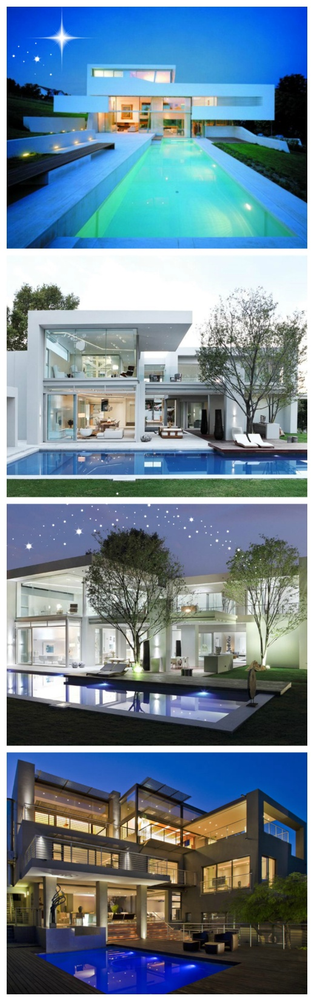

TAMMY BEHNAM
Mother
Entrepreneur
Superwoman

Slide 2
INTRODUCTION
My name is Tammy Behnam
I am the owner and founder of two companies: MVP Real Estate Group and MVP Relocation Associates
I am a real estate broker and international relocation consultant

Slide 3
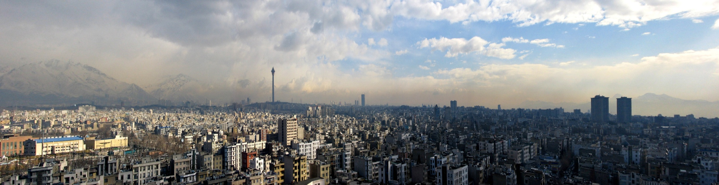
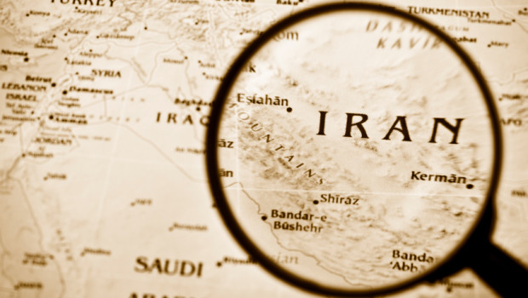
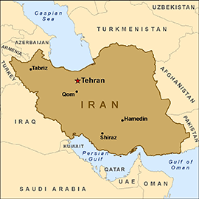
The Early Years…
I was born and raised in Tehran, Iran.

Slide 4
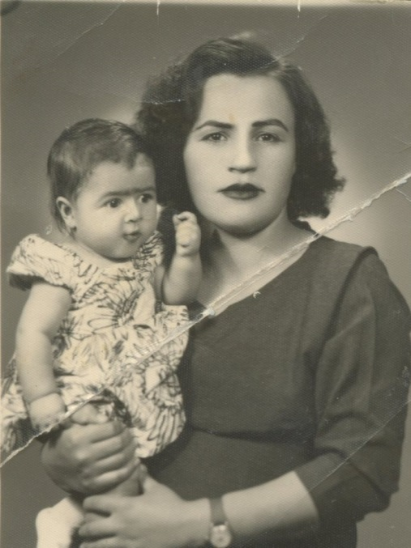
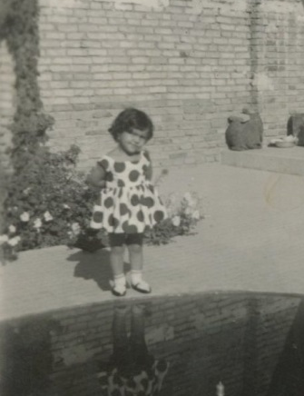
More Early Years…
A little about my family…
This is a picture of me and my mother.
This is a picture of me when I was 4 years old.

Slide 5
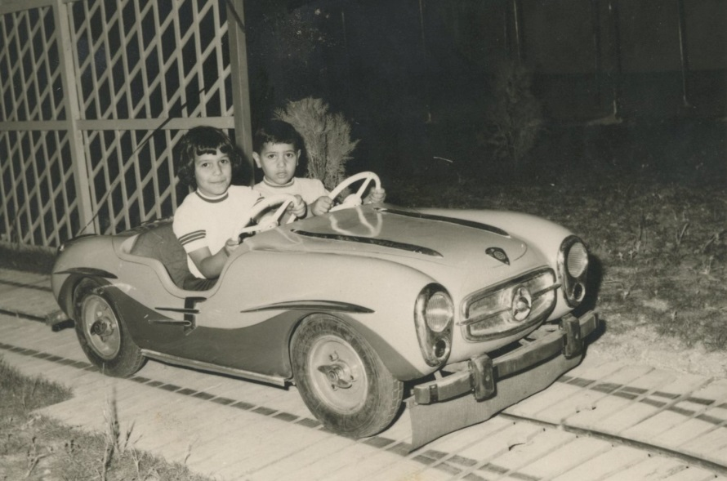
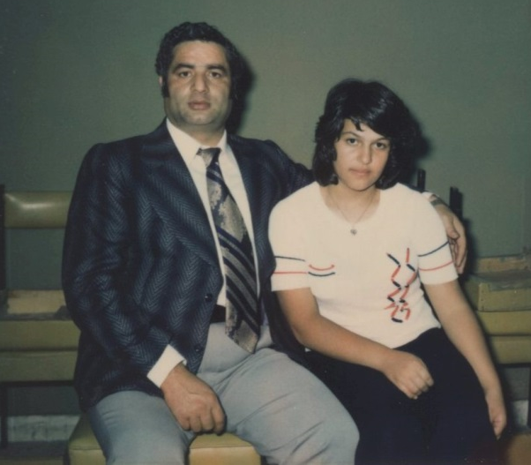
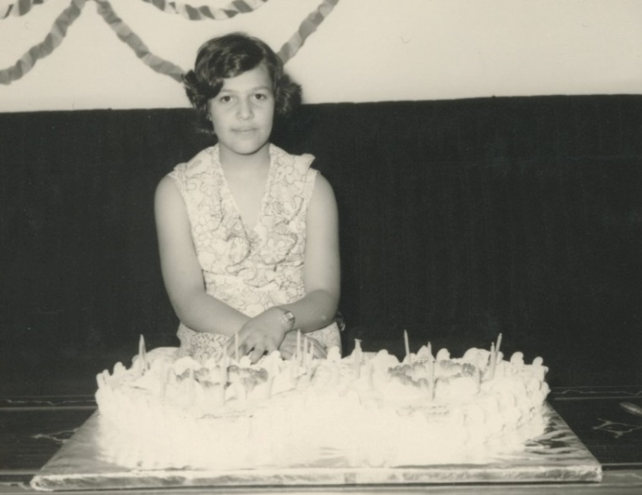
More Early Years…
A little about my family…
This is a picture of me and my father.
Me and my brother.

Slide 6
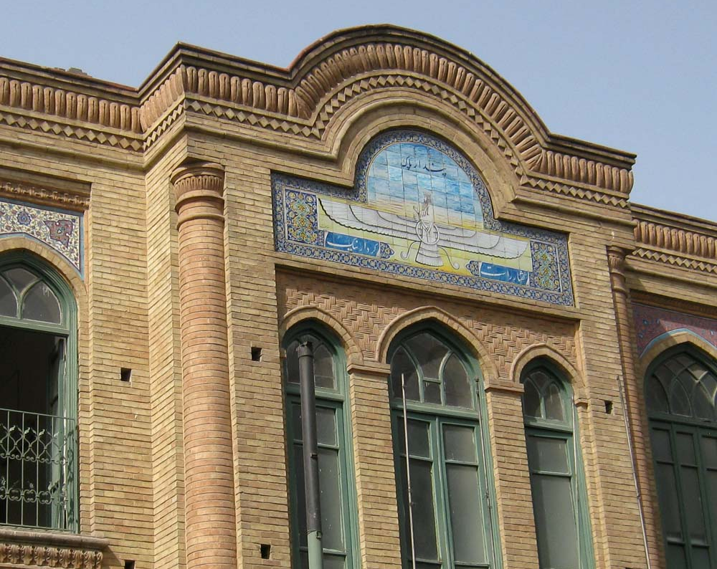
HIGH SCHOOL
I attended Marjan Highschool in
Tehran, Iran.
\

Slide 7
HIGH SCHOOL
Things I enjoyed in HS
Things I did not enjoy in HS
English class
Math
Creative writing
Science
Being with friends
Playing
Some favorite teachers
Too much discipline
Too much distance between teachers and student
Strict punishment
Arabic class
History class
Chemistry

Slide 8
HIGH SCHOOL
Activities/Athletics in HS
Jobs I worked while in HS
Volleyball
Swimming
Debate Team
I never worked while I was in High School, because it is not customary in Iran.

Slide 9
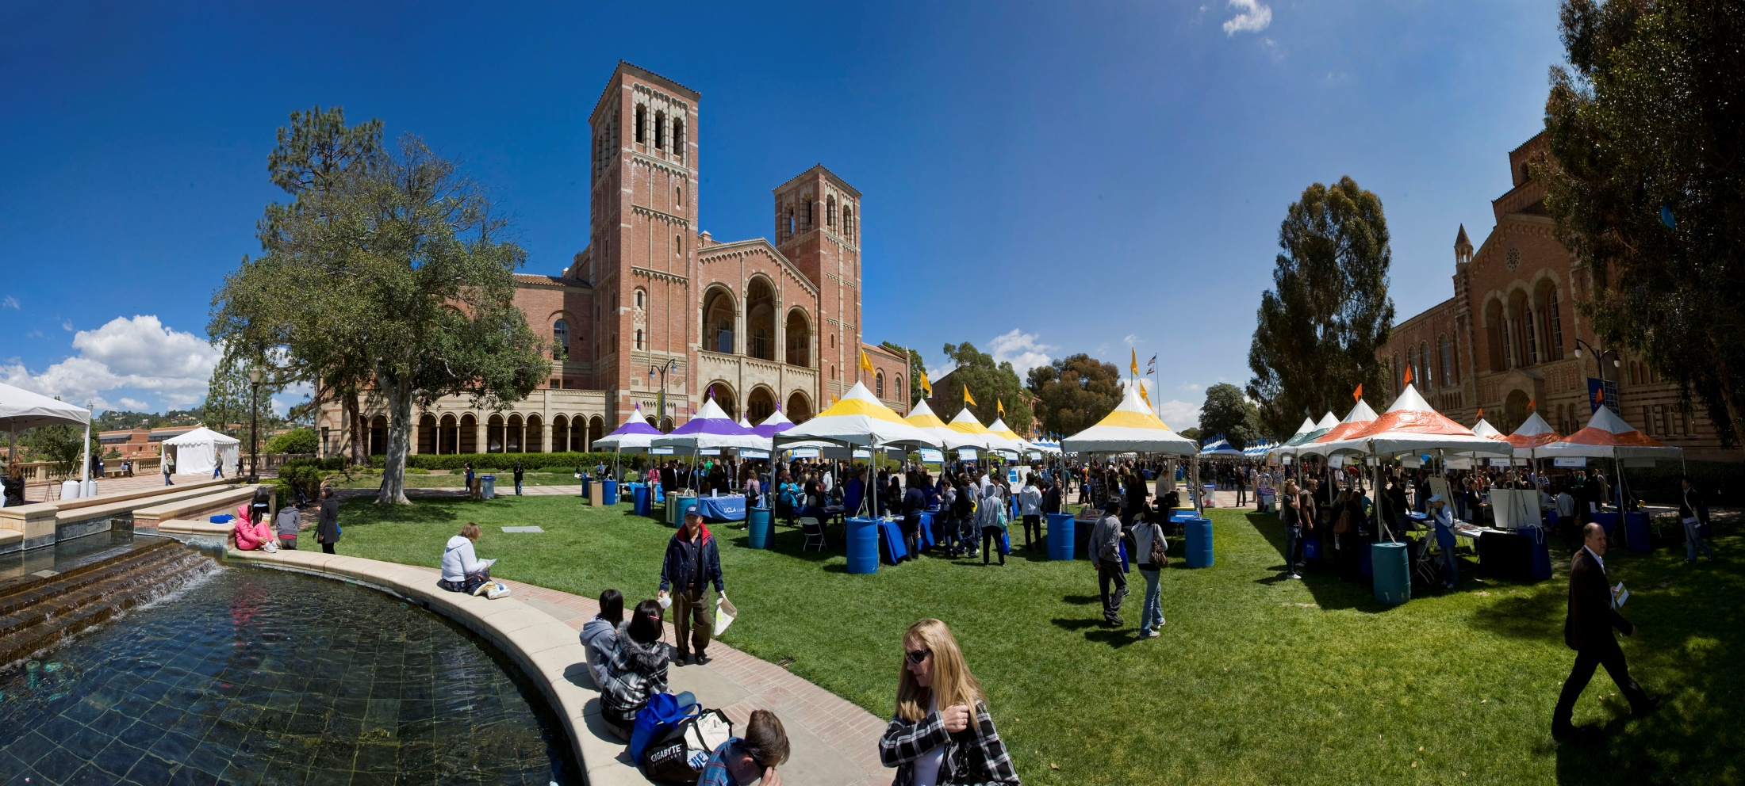
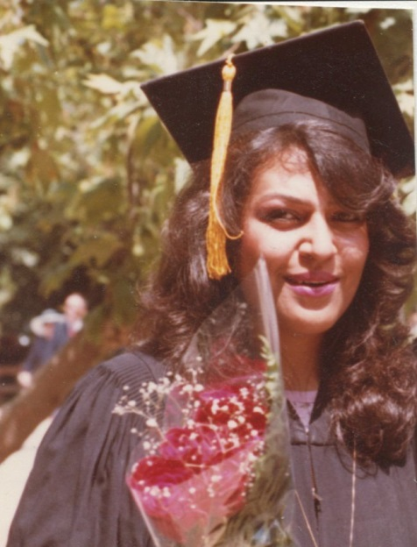

UNIVERSITY
I attended UCLA in Los Angeles, CA
Insert map shot here
My 2nd year of college
\

Slide 10

Activities/Athletics in College
Jobs I worked while in College
International Iranian Club
Iranian cultural events
I worked as an accounting clerk for the UCLA expense department
I worked for the school cafeteria, cutting vegetables

Slide 11

Favorite classes
Least favorite classes
Engineering class
Business class
Economics
Math
Psychology
Creative Writing
Anything with English, since English was my second language

Slide 12
Fondest memories
Obstacles or adversity that you had to overcome
Getting together with my classmates to study
Going to clubs
Parties
Socializing
Having guests over, being a good hostess
Language barrier
Having no family support
Being away from my family

Slide 13
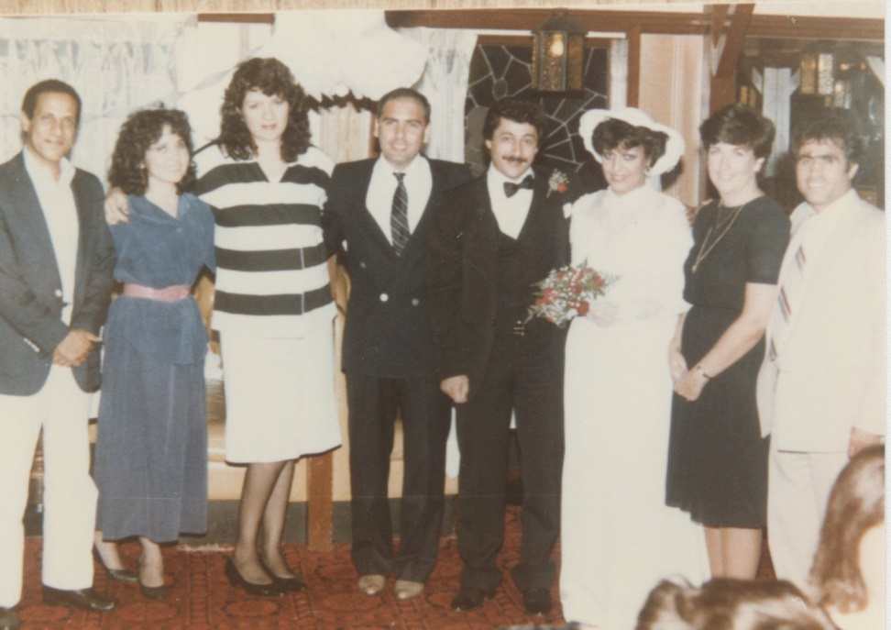
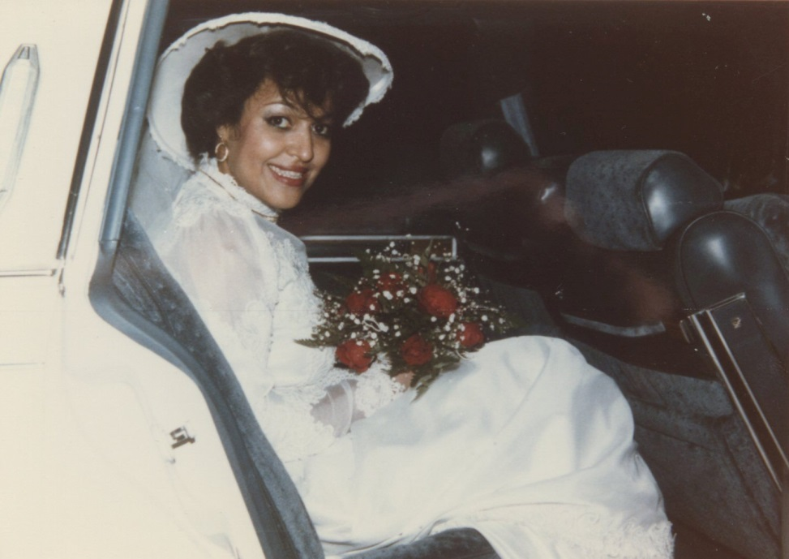
WEDDING
DAY!

Slide 14
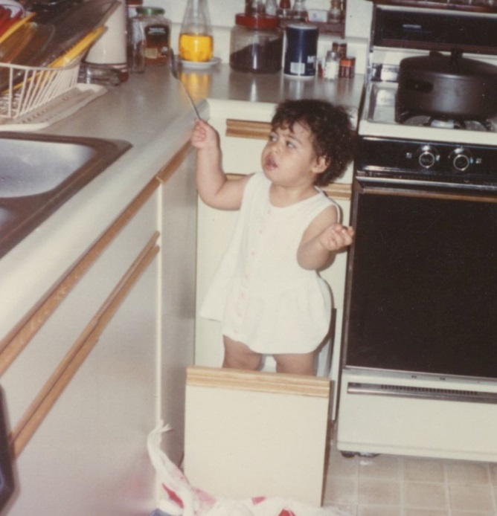
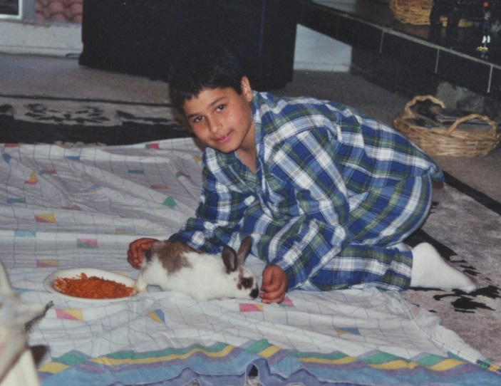
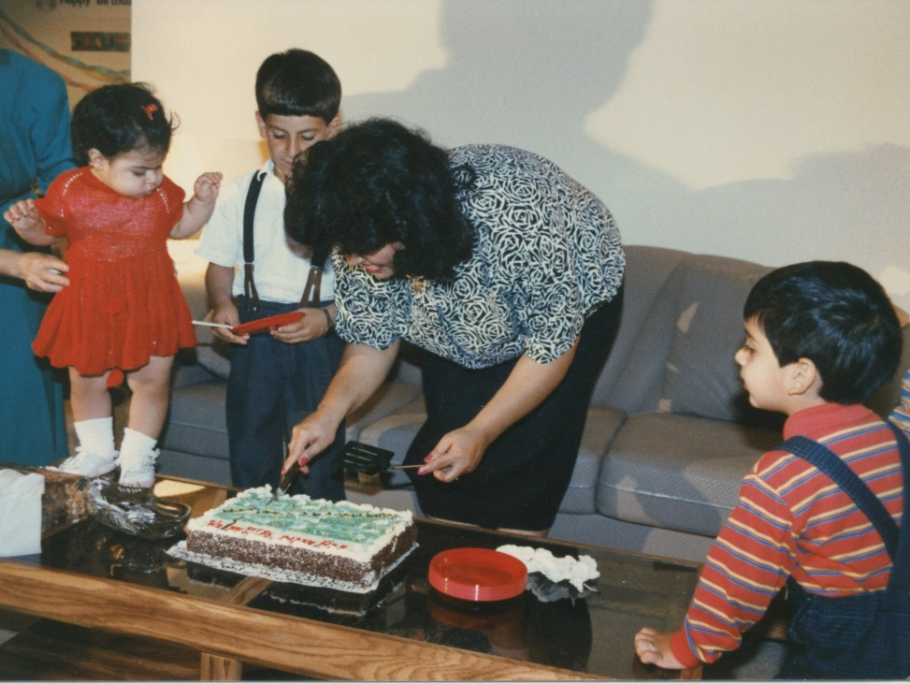
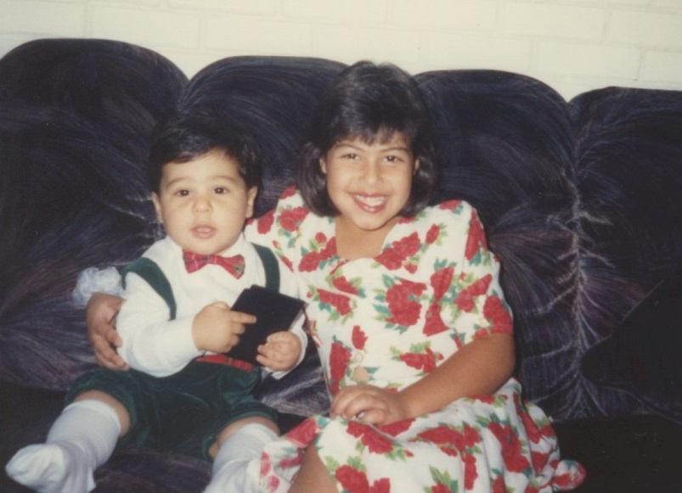
MY KIDS
WHEN THEY WERE LITTLE…

Slide 15

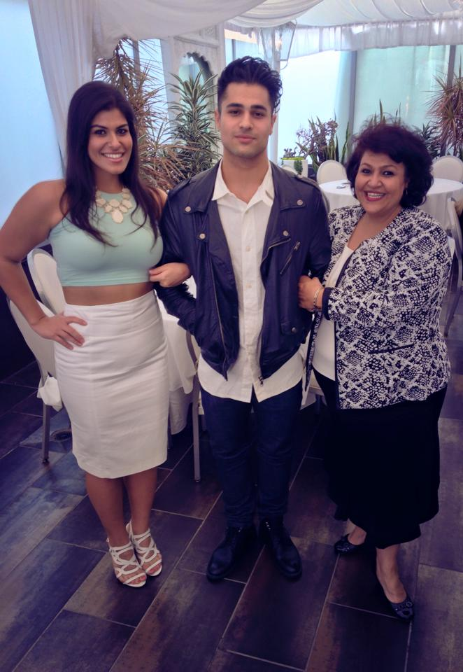
MY FAMILY NOW

Slide 16

My Career Path
I started as an accounting clerk…
I owned a computer school for 17 years…
I am now the CEO of
MVP Real Estate Group and MVP Relocation Associates
Notes:
You may use this chart to describe your journey to the current career

Slide 17


REAL ESTATE
Selling homes
Purchasing homes
Leasing homes
Commercial Real Estate (Buying or selling strip malls, restaurants, etc.)

Slide 18



RELOCATION
Assist individuals and families who relocate internationally or domestically:
Home Search
Area Tour
Social Security
Banking
Utilities
School search
Furniture rental
Child care

Slide 19
Career
Some challenges I had to overcome in my career
Having to start over after my divorce
Starting another business from scratch
Financial challenges
Bureaucracy – having to obtian business permits and licenses

Slide 20
CURRENT ROLE
History
Founded in 2010
Size
Small business
Location
Beverly Hills
Services
Services
Destination services, purchasing and selling homes
Commerical Real Estate Services
Notes:
Use this graph to give more description of your current company (history, size, location, products and services, etc.)

Slide 21
My Job Responsibilities
CEO/
President
manage
communication
meetings
leadership
Notes:
Use this graph to give more description of your role specifically (responsibilities, typical work week, direct reports, etc.)

Slide 22
Career Compensation
$150.000,00/year
Accounting clerk
$6 per hour
Notes:
Use this graph to show general compensation ranges for people in various roles in your company

Slide 23

QUESTION AND ANSWER

