Slide 1
YBA GUEST RESOURCE TEMPLATE
DRAFT

Slide 2
INTRODUCTION
My name is Catherine de Castelbajac and I am over 30 years old—ANCIENT!
I work for leVoid, Inc. and as an Independent author and Consultant
LeVoid creates Fashion products that combine culture, humor, rock and roll, provocation to bring intelligent conversation to contemporary life.
My role at Le Void is CEO
My duties consist of assessing market trends, collaborating with the designer, Louis Marie de Castelbajac, Social Media, Communications, Shipping, Follow through, future planning.

Slide 3
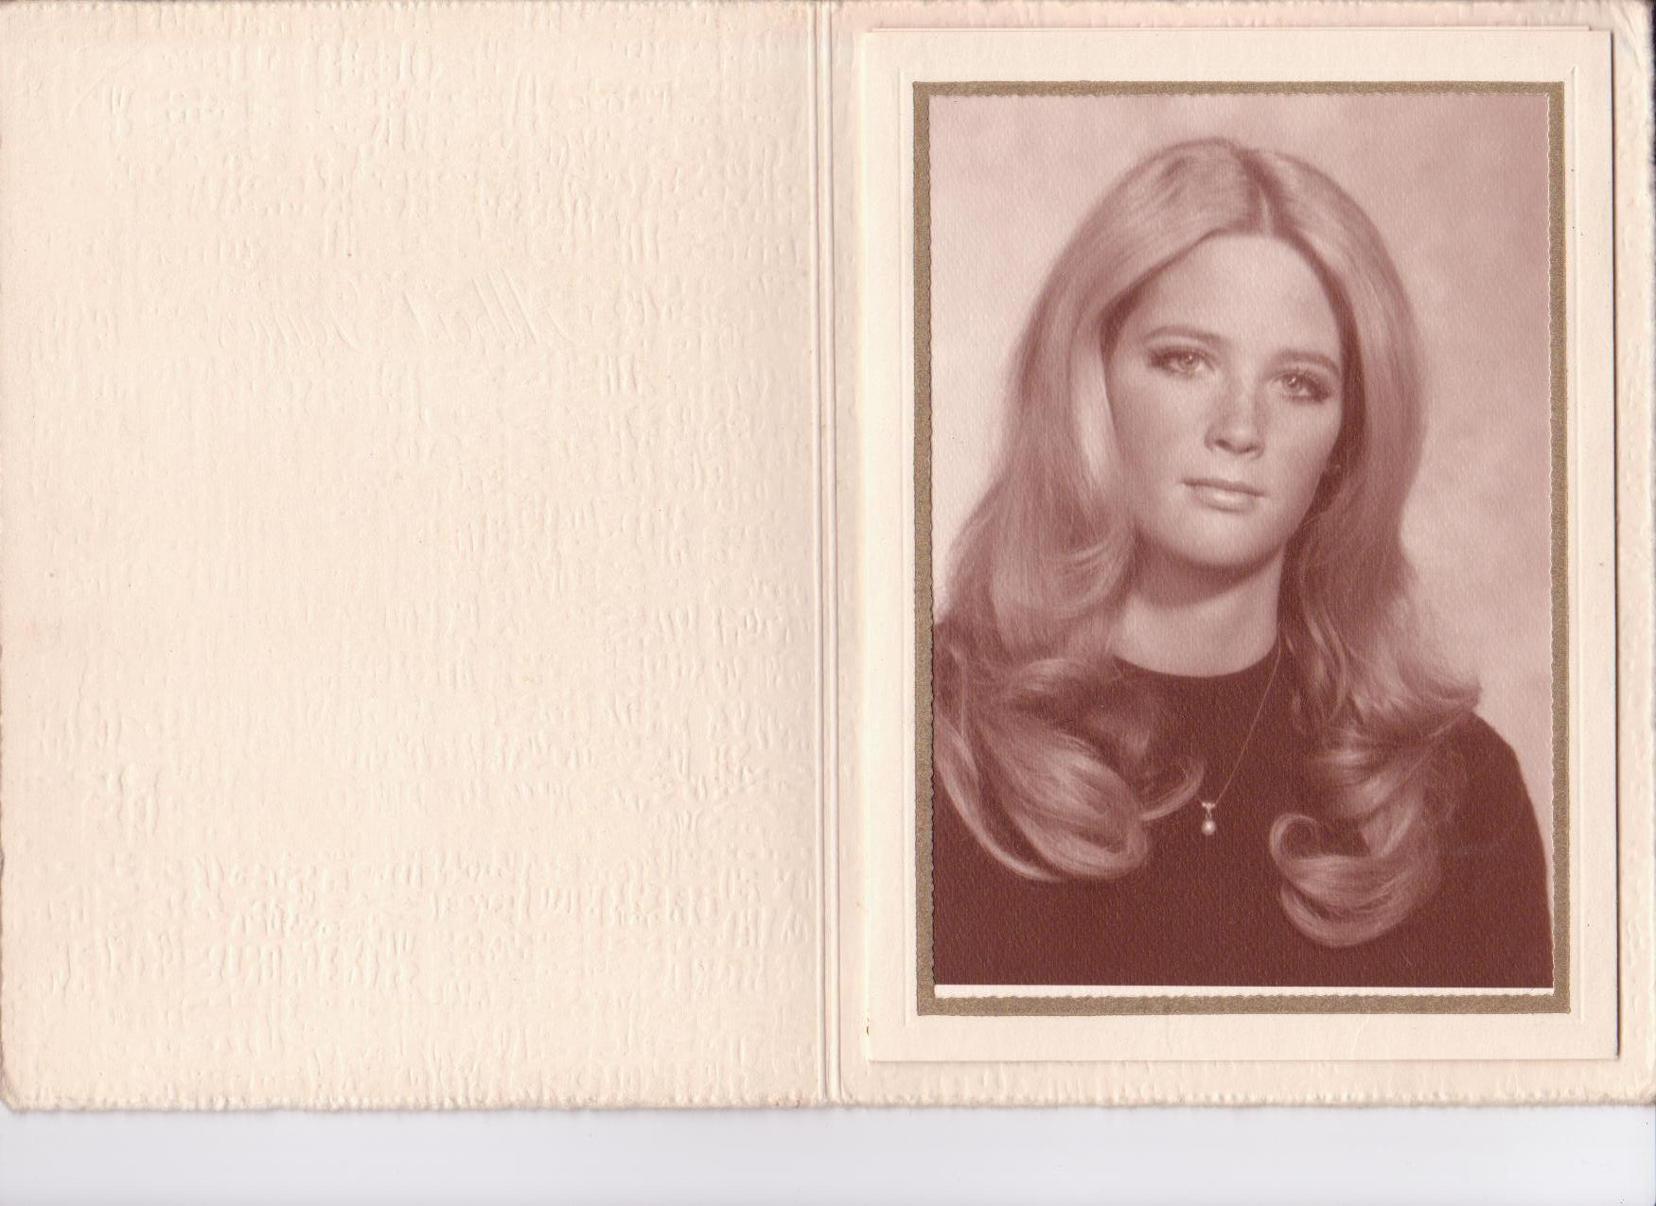
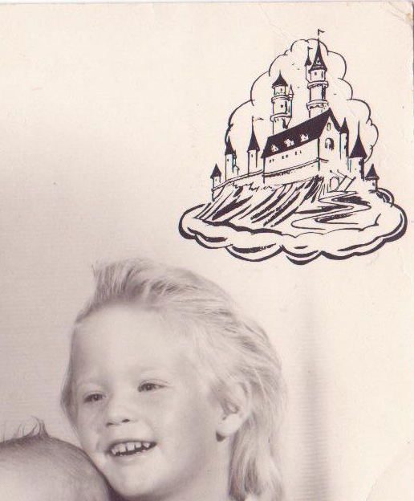
More Early Years…
ly…
This is a picture of me and INSERT FAMILY NAMES.
This is a picture of me and INSERT FAMILY NAMES.

Slide 4
The Early Years…
I was born in Santa Monica and raised in Orange County
This is a picture of me at three years old.

Slide 5
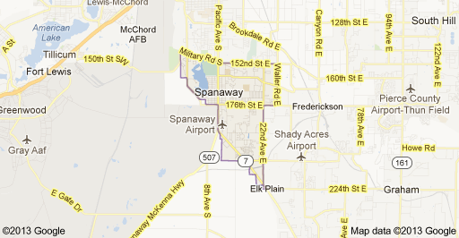
HIGH SCHOOL
I attended Foothill High school in Tustin, CA
Insert map shot here
\

Slide 6
HIGH SCHOOL
As a HS student I was involved in Student Government, Tennis, English Literature, Rock and Roll, Blues,
Jimmy Hendricks, The Cream, Bob Dylan, Janis Joplin, Muddy Waters, BB King, The Rolling Stones, The Beatles--wanting something else in life but sports and football..…………………………………………………
As a HS student I was odd. I was the tallest girl in my class, wore coke bottle glasses until the 10th grade, studied art and music, was not popular in the surfer, California sense of the word. ……………………………………………………………….
\
Here is a shot of me in HS
Me as a Blank grade student

Slide 7
In my senior year I was a member of a cheesy band—the star sisters
Things I did not enjoy in HS
The conformity and the lack of challenges and diversity. My high school experience was academically exciting but intellectually styf.

Slide 8
HIGH SCHOOL
Activities/Athletics in HS
Jobs I worked while in HS
Tennis
Saturday Night all night shift at a cafe

Slide 9
HIGH SCHOOL
Fondest memories from HS
Obstacles/Adversity you had to overcome in HS
Getting a job working the night shift on Saturday nights at a fast food café.
Going to concerts with friends. Seeing Jimi Hendricks play. Getting into college!
Convincing my parents to let me go to an elite Ivy league college.
They said NO!

Slide 10
College or Graduate School
I attended college at Columbia University in New York City
Insert map shot here
\

Slide 11
College or Graduate School
Activities/Athletics in College
Jobs I worked while in College
I spent most of my college years studying and working.
I worked my way through college by babysitting and bartending. I often bartended for political events which was fascinating.

Slide 12
College or Graduate School
Favorite classes
Least favorite classes
English Literature
French

Slide 13
College or Graduate School
Fondest memories
Obstacles or adversity that you had to overcome
As part of my work/study program, I had to be a guide for many events around campus. For the career day, I was scheduled to guide a fashion magazine’s editors to their speaking engagement. They became my biggest supporters and suggested I become a model with Eileen Ford. They subsequently published a 6 page spread about transforming me from a college graduate into a fashion model.
The stigma of coming from a small town in California to a big city with a sophisticated culture.

Slide 14
Career Path
I started as a model in New York City
I moved to Paris, France, married a fashion designer, became a product, (bag and shoe designer) for 20 years.
I wrote a book entitled “The Face of the Century, 100 Years of Makeup and Style” which was published in 1995 by Rizzoli. ….
I was an editor for “ Mirabella Magazine” and “House and Gardens”.
Notes:
You may use this chart to describe your journey to the current career

Slide 15
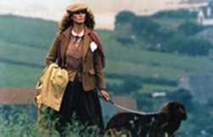
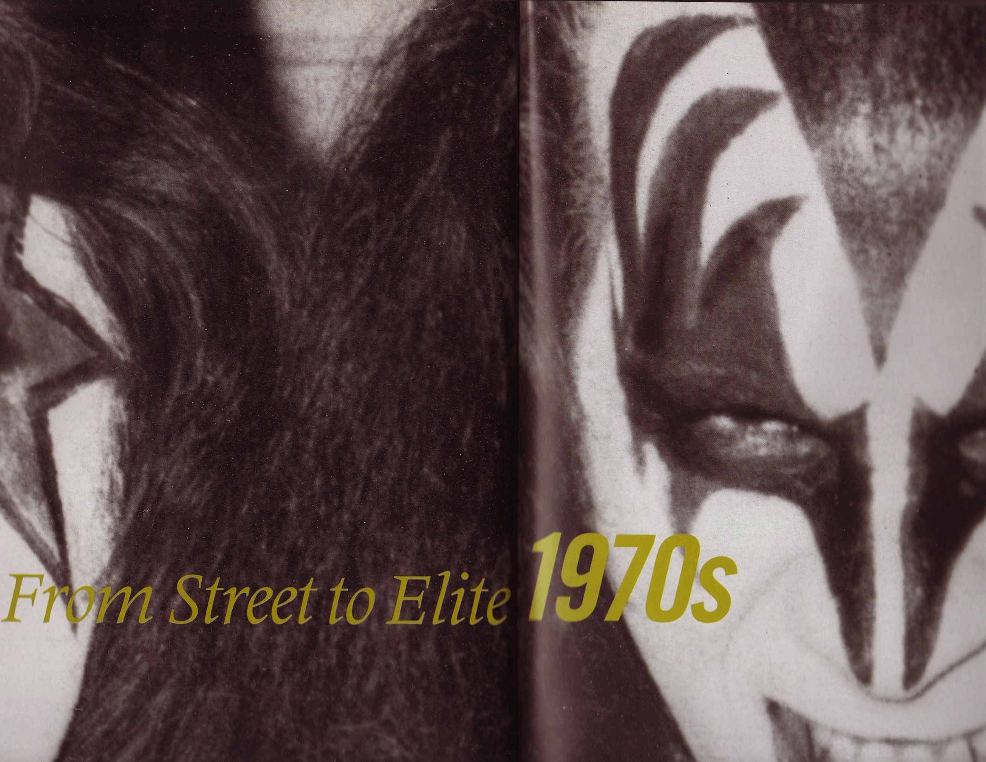
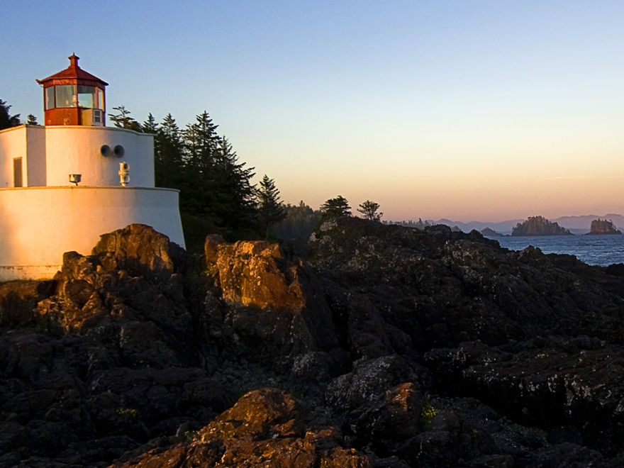
Career
Company pic
Company pic #2
Company pic #3

Slide 16
Career
My first Job
My worst Job
Working an all night shift at a café.
Retail.

Slide 17
Career
Some challenges I had to overcome in my career
Closing a register and managing a store and employees.
I much prefer research and development than handling money.

Slide 18
CURRENT ROLE
History
Developing a startup retail company.
Size
2 people
Location
Los Angeles, CA
Products
Services
T Shirts and Sportswear
Notes:
Use this graph to give more description of your current company (history, size, location, products and services, etc.)

Slide 19
Current Role
CEO
Concept
Social Media
design
Marketing
Notes:
Use this graph to give more description of your role specifically (responsibilities, typical work week, direct reports, etc.)

Slide 20
Career Compensation
?
Notes:
Use this graph to show general compensation ranges for people in various roles in your company

Slide 21
ACADEMIC EXERCISE
How Chance and Determination can alter one’s life and give meaning to how we live.

Slide 22
QUESTION AND ANSWER

