Slide 1
Roots y Wings
Zulmara Maria Teixeira de Lima
October 20, Animo Pat Brown HS

Slide 2
INTRODUCTION
Soy Dra. Zulmara Maria Teixeira de Lima and I am old enough to have earned my doctorate, worked as a kindergarten teacher, taught at the university, and started my own business.
I am the owner and founder at Roots y Wings, a company dedicated and committed to the personal, professional, and creative growth of others.
I am on a mission to help a Million DIVAS Manifest Multi-Millions!!!

Slide 3


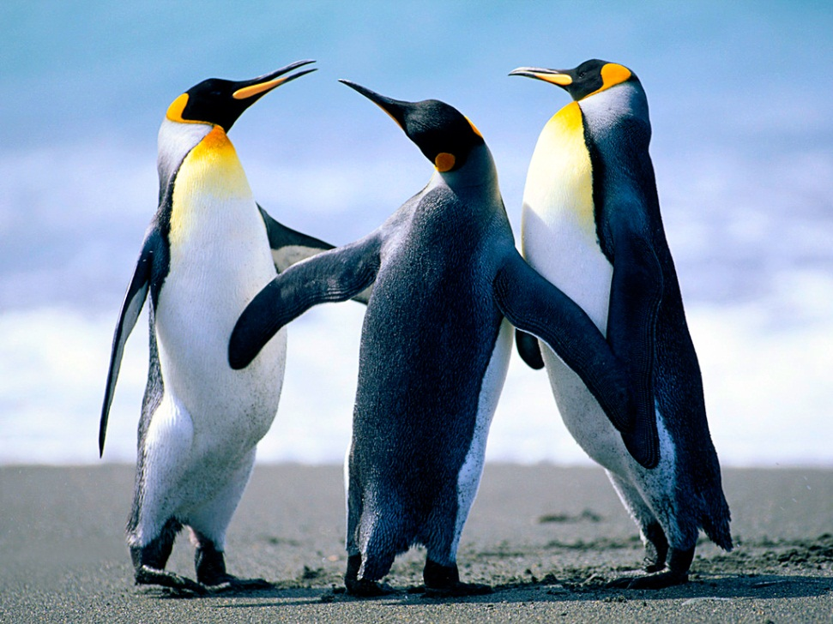

The Early Years…
I was born in Belo Horizonte, Brasil and raised in New York City and Los Angeles

Slide 4
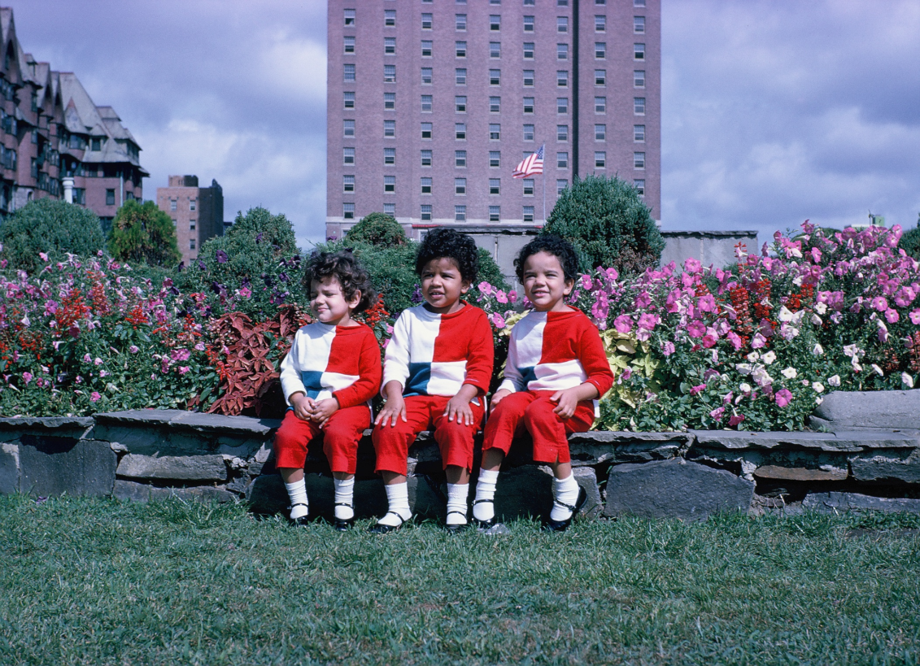
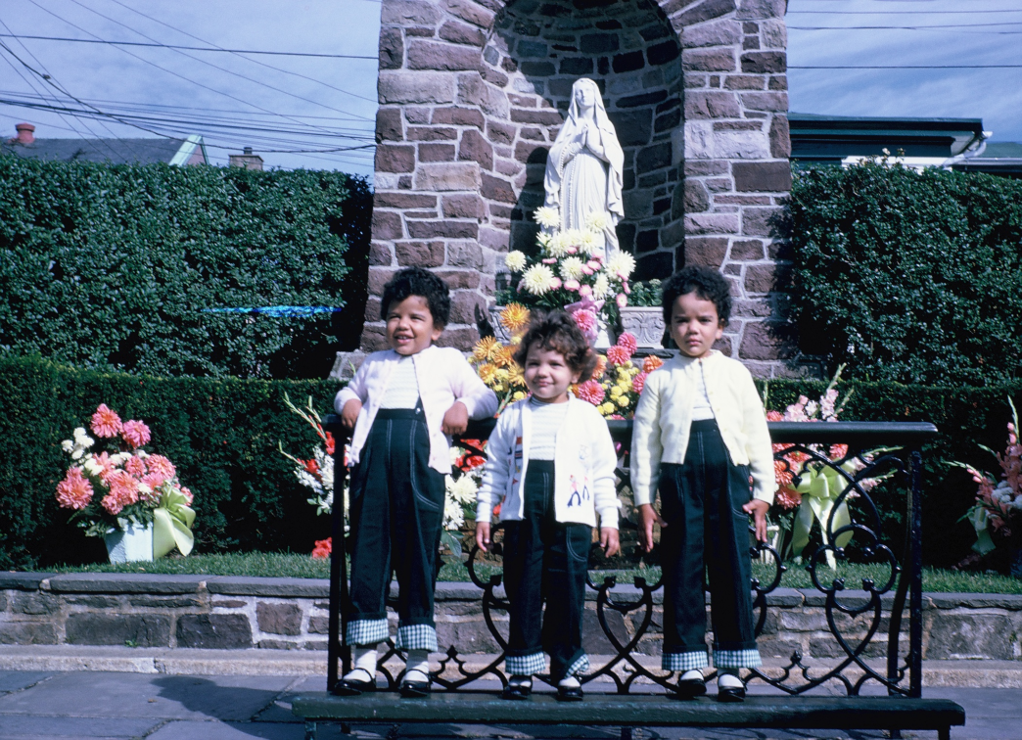
More Early Years…

Slide 5
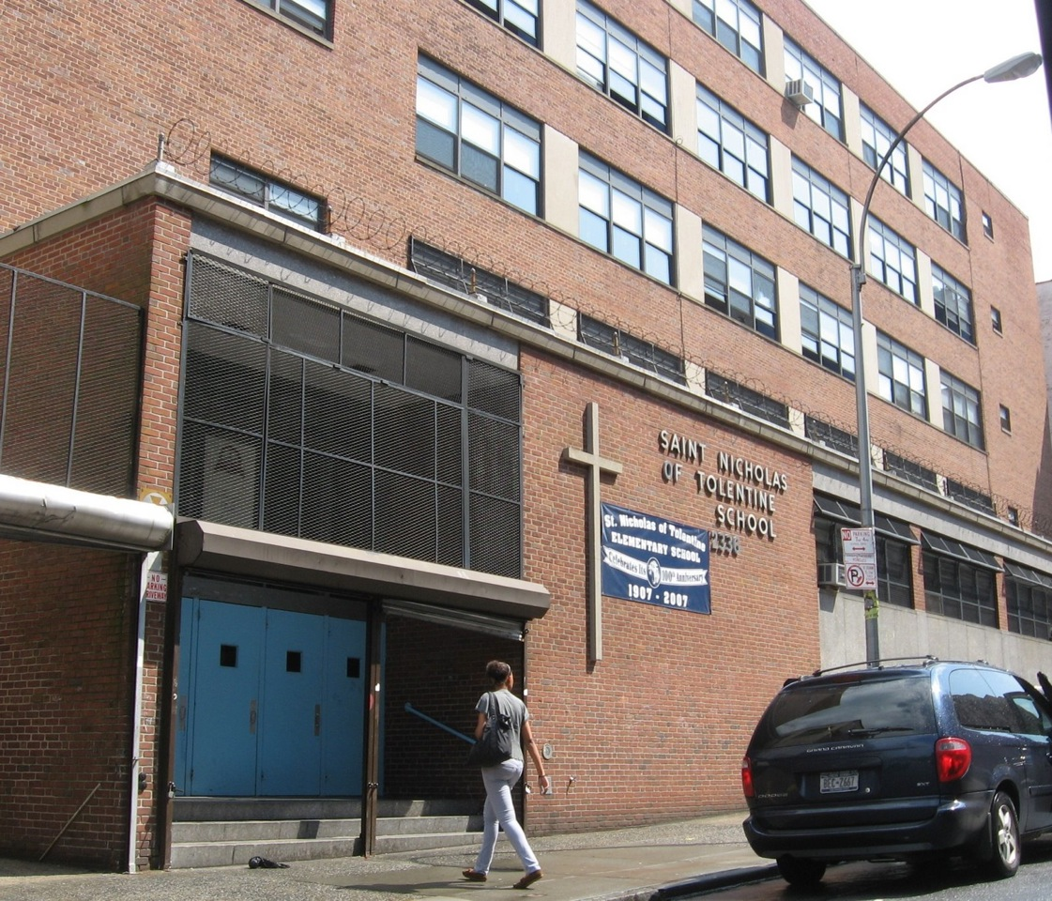
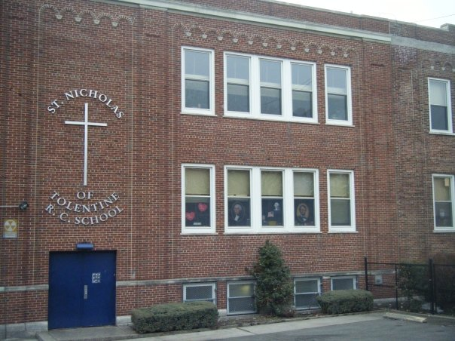
More Early Years…

Slide 6
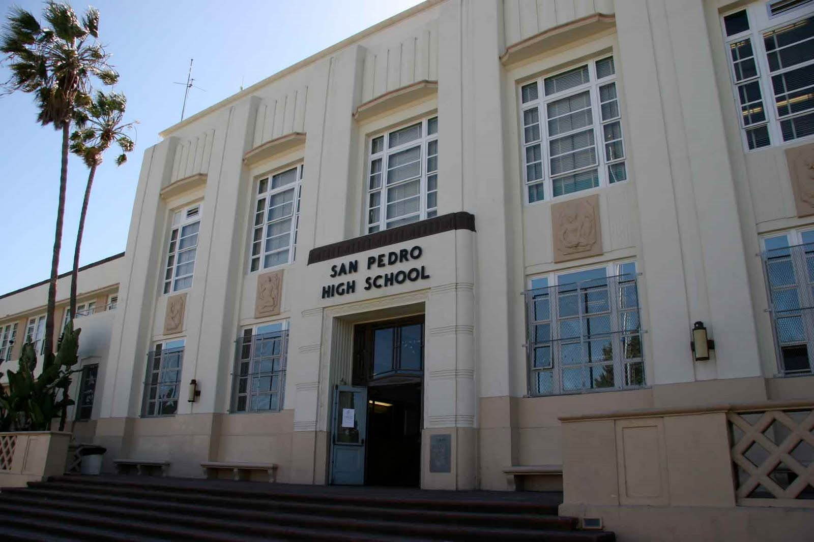
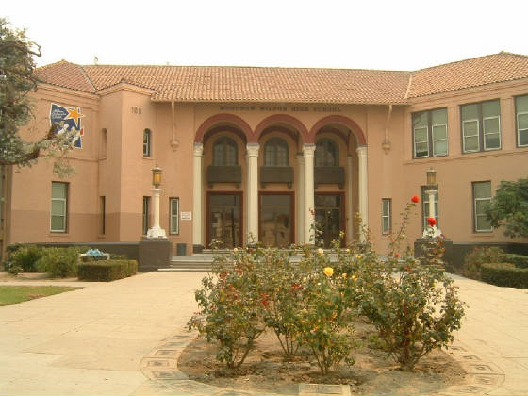
HIGH SCHOOL
I attended San Pedro High School and graduated from Wilson High School in Long Beach.
Insert map shot here
\

Slide 7
HIGH SCHOOL
As a HS student I was not involved in much because I had to care for my little sister after school.
As a HS student I was smart, going places, and determined. My teachers never thought I would amount to much and were surprised that I was accepted to the University of California at Santa Barbara.
I loved reading and social studies. I didn’t care too much for science and I dreaded math!!!
However, I graduated with a 3.98 and went straight to UCSB!!! For my undergrad work.
\

Slide 8
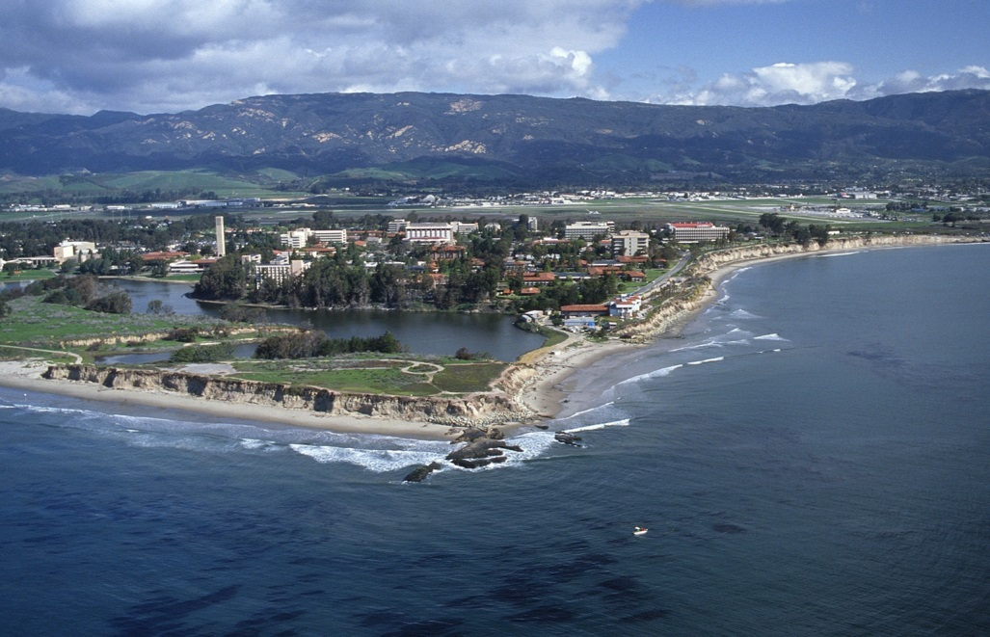
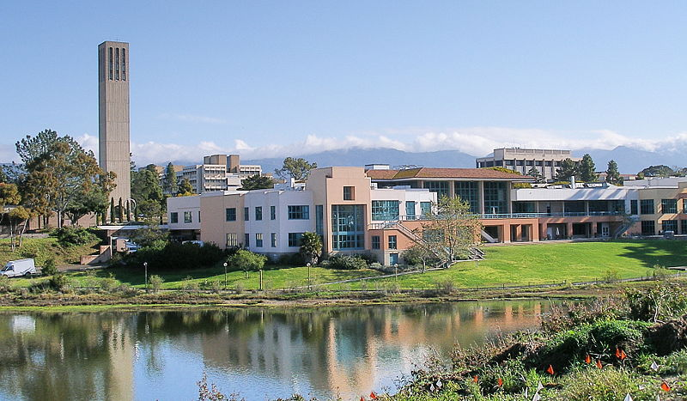
University of California Santa Barbara
I attended the University of California Santa Barbara for my Bachelor’s- Master’s – Teaching credential-Administrative Credential and Doctorate…as you can see, I love my alma mater.
Insert map shot here
\

Slide 9
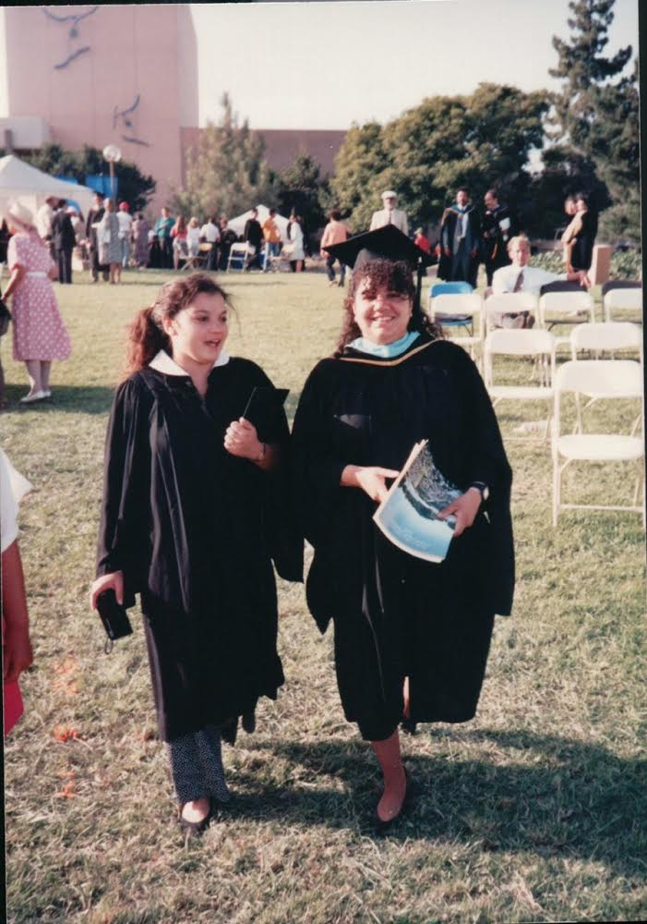
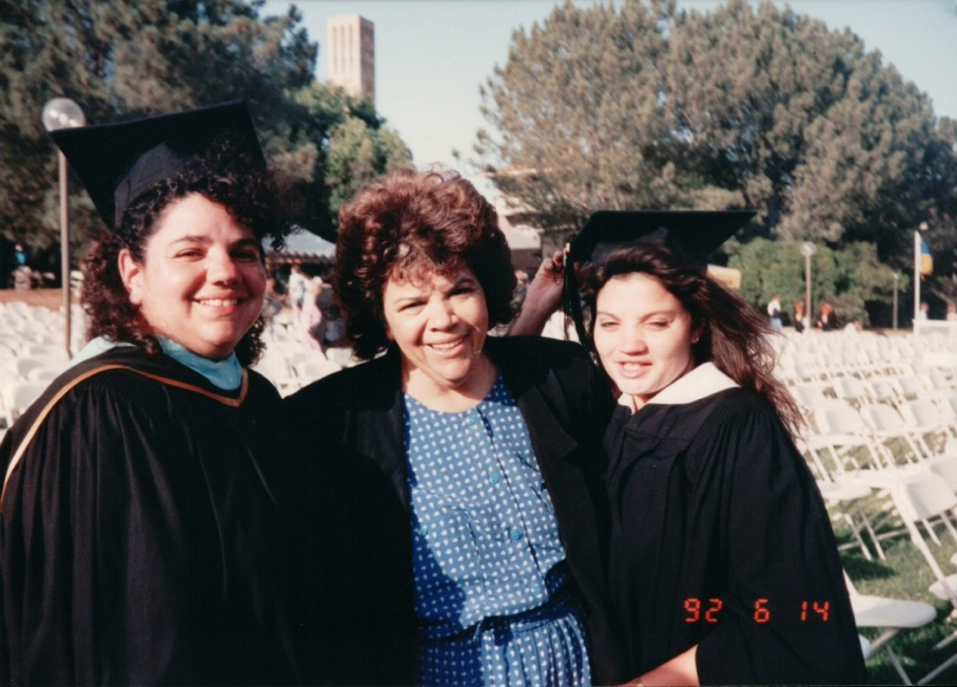
College or
Graduate School
Me, my sister, and my mom at my Masters Graduation
Me and my sister sharing a graduation day

Slide 10
Graduate School
Favorite classes
Least favorite classes
I loved all of my classes
I was in professional preparation and everything was relevant and useful.
I struggled with statistics, but made it through with a study buddy.

Slide 11
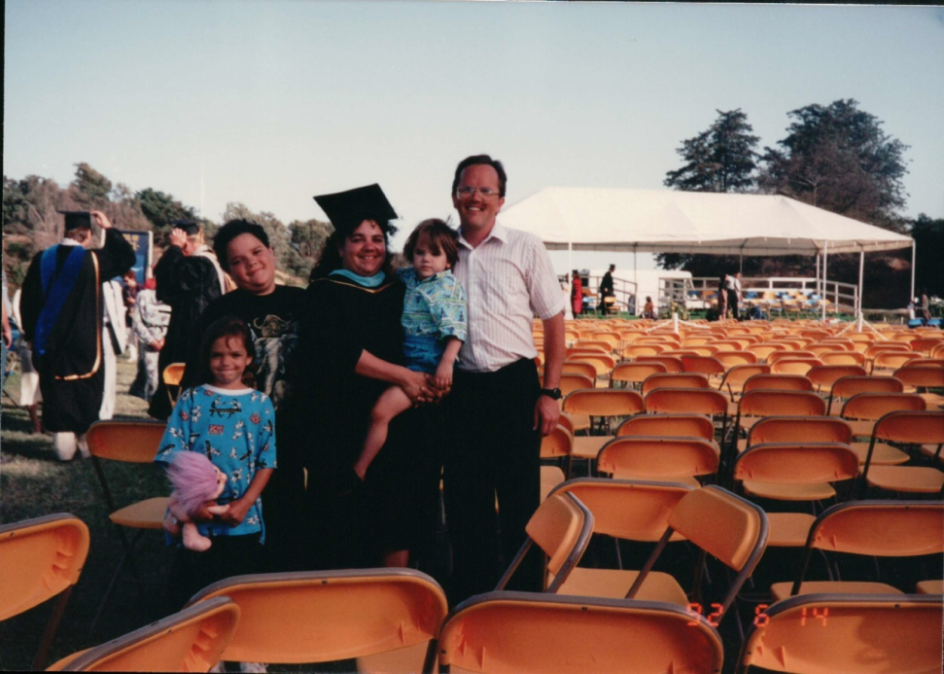
Graduate School
Fondest memories
Obstacles or adversity that you had to overcome
I was a mother of 3 when I started my graduate studies. I was working full time as a teacher and I earned my Admin Credential, my Masters and my Doctorate while being a working mother. It was challenging, but I would not trade it for any other experience I have had.

Slide 12
Career Path
I started as a a kindergarten teacher
I became an administrator and was a Middle School Dean, Director of the Migrant Program and then Director of the Even Start Program
I am now a business owner at Roots y Wings and I work for the CSU Chancellor’s office.
Notes:
You may use this chart to describe your journey to the current career

Slide 13
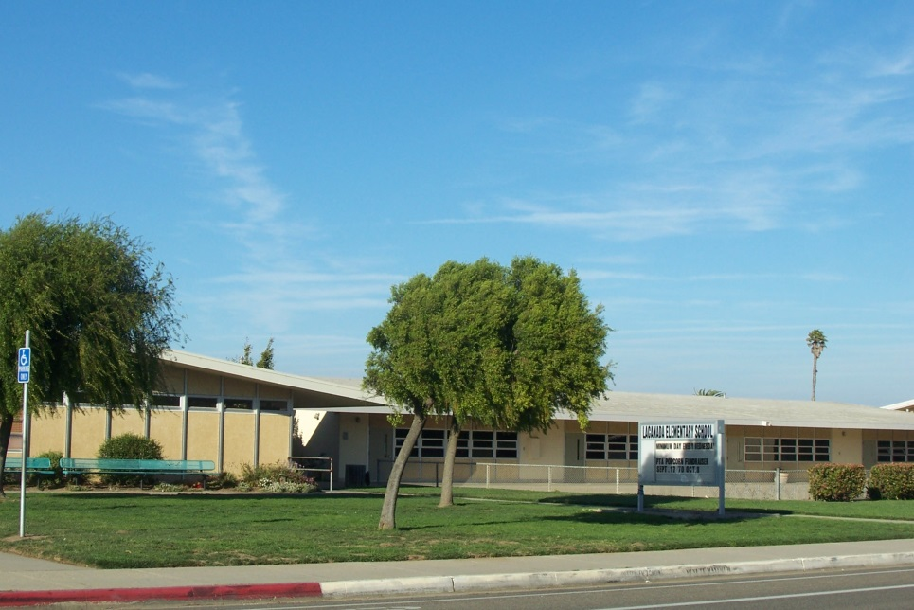
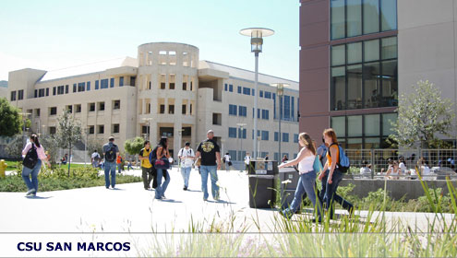

Career
Teacher: La Canada Elementary School
Professor: Cal State San Marcos
Director: California State University Office of the Chancellor

Slide 14
Career
My first joy
My latest joy
…was as a Kindergarten teacher.
I was taught Kindergarten for 10 years before moving into K-12 Administration.
I was an administrator for 6 years before becoming a professor.
…is working for the CSU Chancellor’s office and building my business.
My work at the CSUSO helps me make a living…
My business is helping me build my fortune.

Slide 15
Business
Roots y Wings
Started as a celebration of my life and my accomplishments…I wanted to share what I had learned with others
Focus on personal, professional, and creative growth
Current Signature Program: Millionaire DIVAS

Slide 16
Current Role
Business Owner
Social Media
Accounting
Marketing
Product
Notes:
Use this graph to give more description of your role specifically (responsibilities, typical work week, direct reports, etc.)

Slide 17
Career Compensation
Admin
Over 100K
Professor
65K
Kindergarten Teacher
$45K
McDonald’s
$5K
Notes:
Use this graph to show general compensation ranges for people in various roles in your company

Slide 18
ACADEMIC EXERCISE
We will now spend several minutes discussing the day’s academic module and how it is relevant in the ‘real world’

Slide 19

QUESTION AND ANSWER

