Slide 1
Rasool Raheem

Slide 2
INTRODUCTION
My name is Rasool Raheem and I am 38 years old.
I work for Deaf Man’s BBQ Sauce
Deaf Man’s BBQ Sauce produce sauce, spices and snacks.
My role at Deaf Man’s BBQ Sauce is CEO.
Since we are a two man company, I wear many hats from productions down to sales.

Slide 3
The Early Years…
I was born in Sierra Madrea, CA and raised in Los Angeles, CA
This is a picture of me at BLANK age.
This is a picture of me at BLANK age.

Slide 4
More Early Years…
A little about my family…
Married 2 kids
8 years old son & 5 month old little girl
Known my wife since college
Married in 2014
This is a picture of me and INSERT FAMILY NAMES.

Slide 5
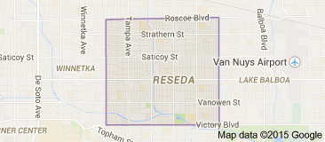
HIGH SCHOOL
I attended Cleveland in Reseda, CA
\

Slide 6
HIGH SCHOOL
As a HS student I was involved in Basketball, Track & Field
As a HS student I was (outgoing, popular, athletic, academic, didn’t have a lot of friends.) ……………………………………………………………….
\

Slide 7
HIGH SCHOOL
Things I enjoyed in HS
Things I did not enjoy in HS
Sports
Math
Economic
Philosophy
Science
History
English

Slide 8
HIGH SCHOOL
Activities/Athletics in HS
Jobs I worked while in HS
Basketball
Track & Field
No job in high school

Slide 9
HIGH SCHOOL
Fondest memories from HS
Obstacles/Adversity you had to overcome in HS
Graduating with a 3.2 GPA
A chance to travel
Winning the conference in 300 intermediate hurdles
Winning the 4x400 relay
Being deaf was a challenge on and off the court
In school it was a challenge
I was always the underdog

Slide 10
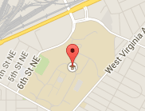
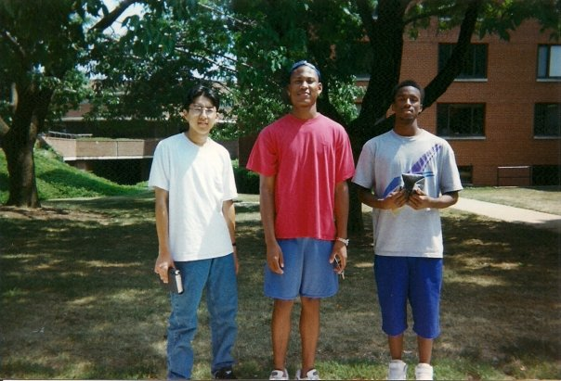
College or Graduate School
I attended Gallaudet University in Washington D.C.
My 1st year of college
\

Slide 11
College or Graduate School
Activities/Athletics in College
Jobs I worked while in College
Basketball
Track & Field
Had a summer job at the local super market

Slide 12
College or Graduate School
Favorite classes
Least favorite classes
Economic
Business
Political Science
math
English

Slide 13
College or Graduate School
Fondest memories
Obstacles or adversity that you had to overcome

Slide 14
Career Path
I started as a Home Retention Specialist
I was promoted Foreclosure Specialist after 1 years
I am now the CEO of Deaf Man’s Inc.
Notes:
You may use this chart to describe your journey to the current career

Slide 15
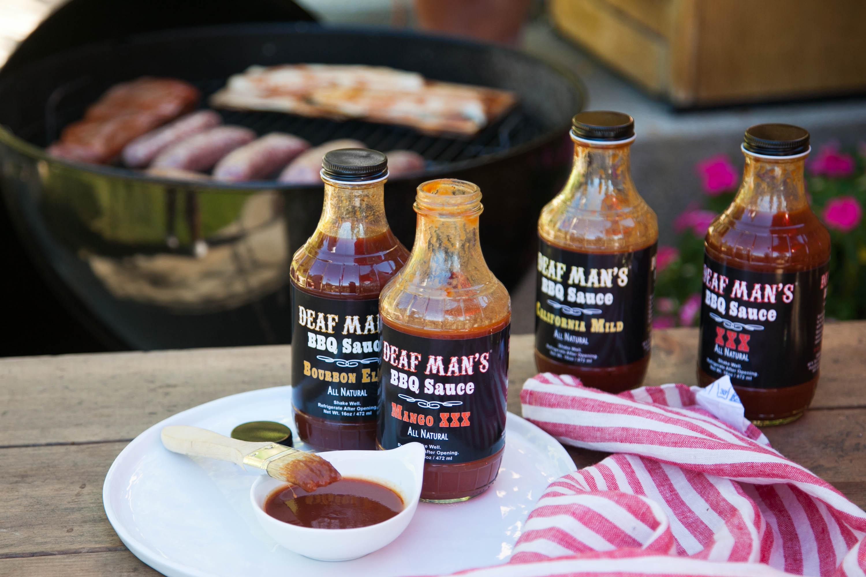
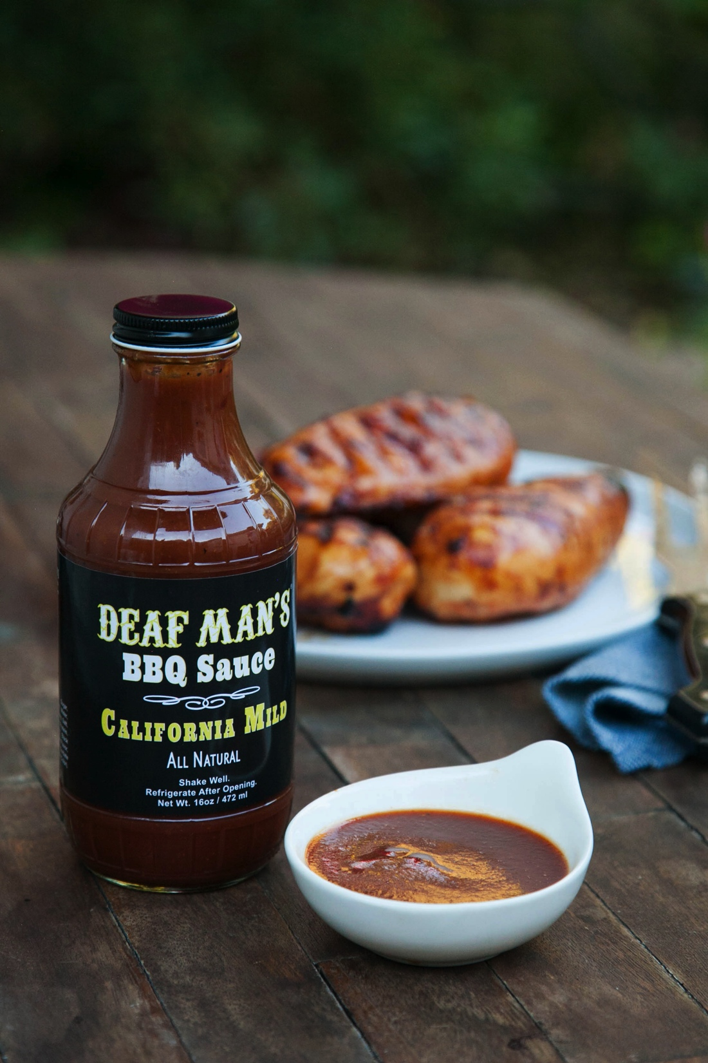
Career
Company pic
Company pic #2

Slide 16
Career
My first Job
My worst Job
Hughes Market
Staples

Slide 17
Career
Some challenges I had to overcome in my career
Communication
Learn to work with others regardless of disagreement

Slide 18
CURRENT ROLE
History
CEO
Deaf Man’s BBQ Sauce
Size
2 employees
Grew business by 800% from first year
Location
Farmers markets
Bristol Farms, Whole Foods, local stores
Products
Services
BBQ Sauce
Spice Rub
Snacks
We strive to provide you with a better experience on taste & flavor when it comes to using BBQ sauce as a condiment
Notes:
Use this graph to give more description of your current company (history, size, location, products and services, etc.)

Slide 19
Current Role
CEO
Marketing
Sales
logistic
Production
Notes:
Use this graph to give more description of your role specifically (responsibilities, typical work week, direct reports, etc.)

Slide 20
Career Compensation
CEO
Foreclosure Specialist
Event Marketing
bagger
$20k
Notes:
Use this graph to show general compensation ranges for people in various roles in your company

Slide 21
ACADEMIC EXERCISE
We will now spend several minutes discussing the day’s academic module and how it is relevant in the ‘real world’

Slide 22
QUESTION AND ANSWER

