Slide 1
Veronica corona Entrepreneur, Latina Leader, Speaker
Believe in yourself and follow your passion!

Slide 2
INTRODUCTION
My name is Veronica Corona and I am 40 something years old.
I work for CM Cleaning Solutions, Inc..
My company does:
Janitorial services for commercial, medical office buildings, schools, retail centers and apartment buildings:
My role at CM Cleaning Solutions, Inc. is President
Every day I handle all customer calls, day to day operational issues or complaints. Also, I am following up with prospects for new business.

Slide 3
My childhood
I was born in San Fernando Valley and raised in Pacoima, so I am like a totally awesome valley girl.
This is a picture of me at 2 year of age

Slide 4
My family
A little about my family
I come from a very Mexican Household I have 2 brothers and 1 sister.
This is a picture this past October with my mom, sister, brothers, their wife’s and my 2 nephews and 3 nieces.

Slide 5
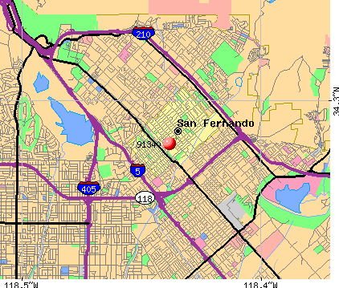
MY HIGH SCHOOL
I attended San Fernando High School in Pacoima, CA
(Insert map or image of high school or mascot etc. here)

Slide 6
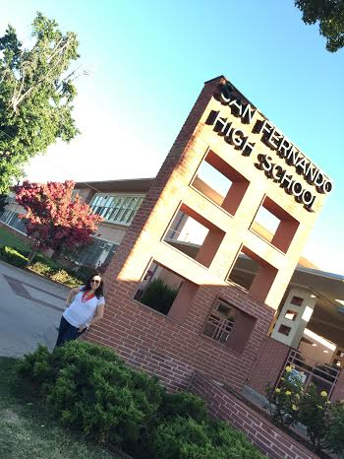
High School
As a HS student I was a bit nerdy had good grades. I was also very popular and had a lot of friends. ……………………………………………………………….

Slide 7
High School
Things that I really liked in High School were:
History
English
Hanging out with my friends
Recess/Lunch to see all my friends
Hanging out after school to do our homework
Football games to support the mighty Tigers
Going shopping with my friends
School Dances

Slide 8
High School
Things that felt difficult or challenging for me while I was in High School were:
Geometry
Algebra
Government~ I still can’t figure out politics..
I went to 2 different high schools and it was not easy getting adjusted moving from one where I was getting know everyone, to coming back to my old neighborhood and getting reacquainted with my friends from Jr. High.

Slide 9
High School
Jobs I worked while I was in High School were:
My mom was a seamstress and she had sewing machines at the house and morning and evenings in the garage so I would help her. I liked learning to work the machines, but did not like having to do the work.
I worked for Pollo Loco~ and I remember having to clean public restrooms I found it gross..
Being the oldest, I had to do chores around the house and I did not get paid for that, but learned to clean, cook and maintain the house.

Slide 10
Getting in to College
The top few things I did to ensure I got into college were:
The truth is I was not sure what I need to do because I was the first one to go into college in my family and I only had a neighbor to turn to that guided me. My parents spoke little English so they just left it up to me..
My counselor always told me to have good grades
Get involved in school activities
Hard work ethic
Responsible for my actions in school and outside of school.
Take the SAT test

Slide 11
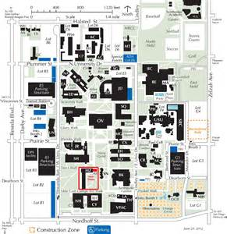
College
I attended college Cal State Northridge in Northridge, CA
Insert map shot here

Slide 12
College
Things I enjoyed in College
Things I didn’t enjoy in College
Meeting new people
Making new friends
Business Classes
Math Classes
Exploring the Campus
Too much homework
Not having someone to help me or guide me
Some classes I did not understand or know what to do..

Slide 13
College
Favorite classes
Least favorite classes
Accounting
Marketing
Business Law
Social Studies
Real Estate
Liberal Arts
Overall I liked being in school and enjoyed most of my classes.

Slide 14
College
Jobs I worked while I was in College were:
I worked at JC Penny as a sales clerk in the shoe department and yes I have a love for shoes. I also learned to deal with different type of people and that customer is always right.
I then transferred to UPS and worked as an audit clerk. I really liked this job the pay was a lot more $5.00 an hour instead of $3.35 an hour at JC Penny. I learned to work in a warehouse environment and how the shipping business works.
I was an intern at an accountants office helping during the tax season.

Slide 15
College
Things that felt difficult or challenging for me while I was in College were:
Working and going to school was really tough.
Also, lots of homework, I wanted to make sure my parents were proud since I was the first to go to college. I wanted to be a straight A student but my grade average was B.
Some of my adversities was being in school, lots of homework, working and still wanting to go out to parties with my friends.

Slide 16
Getting a job after College
The top few things I did to ensure I got a good job after college were:
Good Grades
Internship at an office doing taxes and payroll for small business owners.
Good work ethic in my previous jobs
Used our career center for job referral

Slide 17
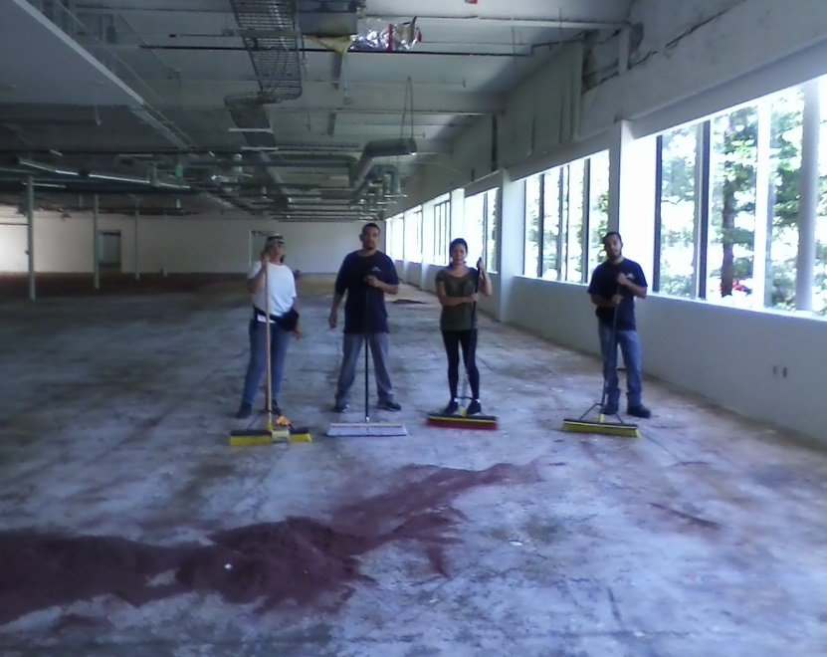
This is My Company
Every day at my company:
We provided janitorial services for commercial and medical office buildings, retail centers and school. “We keep it clean while you sleep” I handle some of the day to day operations, customer calls and requests and bringing in new business.
Insert company picture

Slide 18
My Career Path
I started as a Benefits Coordinator and promoted to Customer Service Manager then Branch Manager
I was promoted to Branch Manger after 3 years
I am now President and owner of a Janitorial Service Company
Notes:
You may use this chart to describe your journey to the current career

Slide 19
My Career
The first job I had after college was:
I was working in a bookkeepers office doing payroll, account payable, accounts receivable, translations and tax return preparation for small business owners. Worked here for 8 years.
The worst job I have ever had was:
Working at Pollo Loco- I didn’t eat chicken for a long time. I also really disliked cleaning the restrooms and how funny is that now I own a cleaning company and we clean lots of restrooms.

Slide 20
My Career
Challenges I have had to overcome throughout my career are:
Work under pressure and not let the stress get to me
No matter how hard you work there will always be someone that won’t appreciate you. You just have to always do your best.
Dealing with people that were above me in position and did not know what they were doing~ but not matter what always respect them and their position.
There will be people that won’t be happy with your success. You need to keep focus on what you want as long as you are being honest and ethical and always wish them the best.

Slide 21
My role within organization
Business Partner & ME
Night Manager
Day Porters
Cleaners
Floor Crew
Notes:
Use this graph to give more description of your role specifically (responsibilities, typical work week, direct reports, etc.)

Slide 22
Compensation at my company
Business Owner
($150K)
Management
($125K)
Middle Manager
($65K)
Entry Level
($20K)
Notes:
Use this graph to show general compensation ranges for people in various roles in your company

Slide 23
More than just work
When I am not at work I like to:
Spending time with my family and friends
Prayer/Meditation, Exercise, Affirmations
Golfing
Reading- currently reading 3 books~ “Warrior Goddess”, “Millionaire Mindset” and “All the light we cannot see” my book club read with my customers
Travel- weekend getaways
Volunteer my time in several non- profit organizations.

Slide 24
Do it all over again?
If I could talk to my high school self, what would I say?
DON’T worry everything is going to be okay!
Enjoy yourself more
Have fun! Trust me everything is going to be okay
Don’t sweat the small stuff..

Slide 25
QUESTION AND ANSWER

