Slide 1
YBA GUEST
Jeff burum
MAJ. RETIRED, USAF

Slide 2
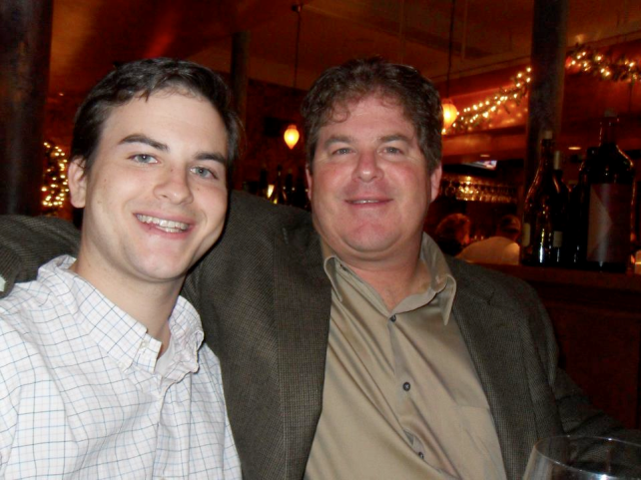


INTRODUCTION
My name is Jeff Burum and I am 55 years old.
I am the President and Founder of Professional Financial Planning, Inc. and Jeff Burum, CPA, MBA LLC, since 1998
My company does:
  Income Taxes
  Financial Planning
  Estate Planning
  Consultations

Slide 3
Military career
Enlisted 1978, Medical Services Technician
U.S. Air Force Academy Graduate in 1984
ICBM Combat Crew Commander 1984-1988
Assistant Professor of Military Art and Science, USAF Academy, 1988-1992
Chief of Financial Management and Analysis, 1992-1998
  Controller of Government Funds, USAF during Desert Storm in Saudi Arabia, 1993-1994
Retired in 1998, due to Gulf War Illness from Chemical and Biological Warfare

Slide 4
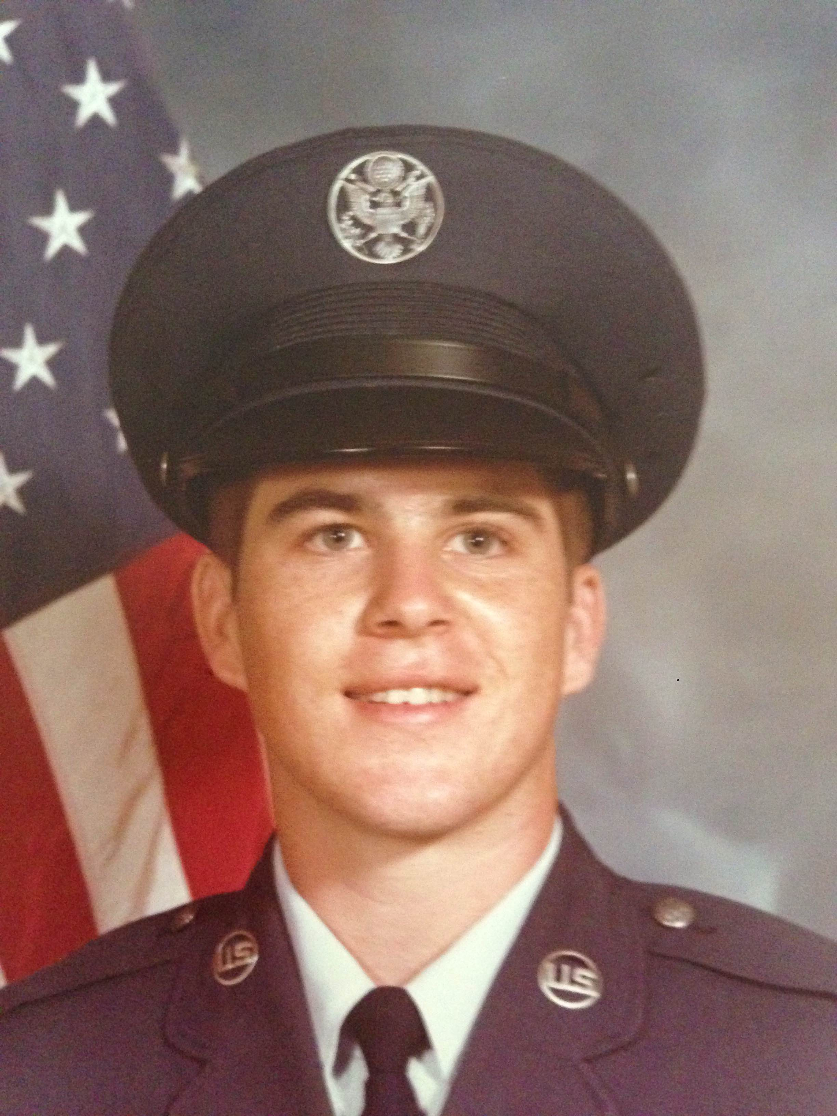
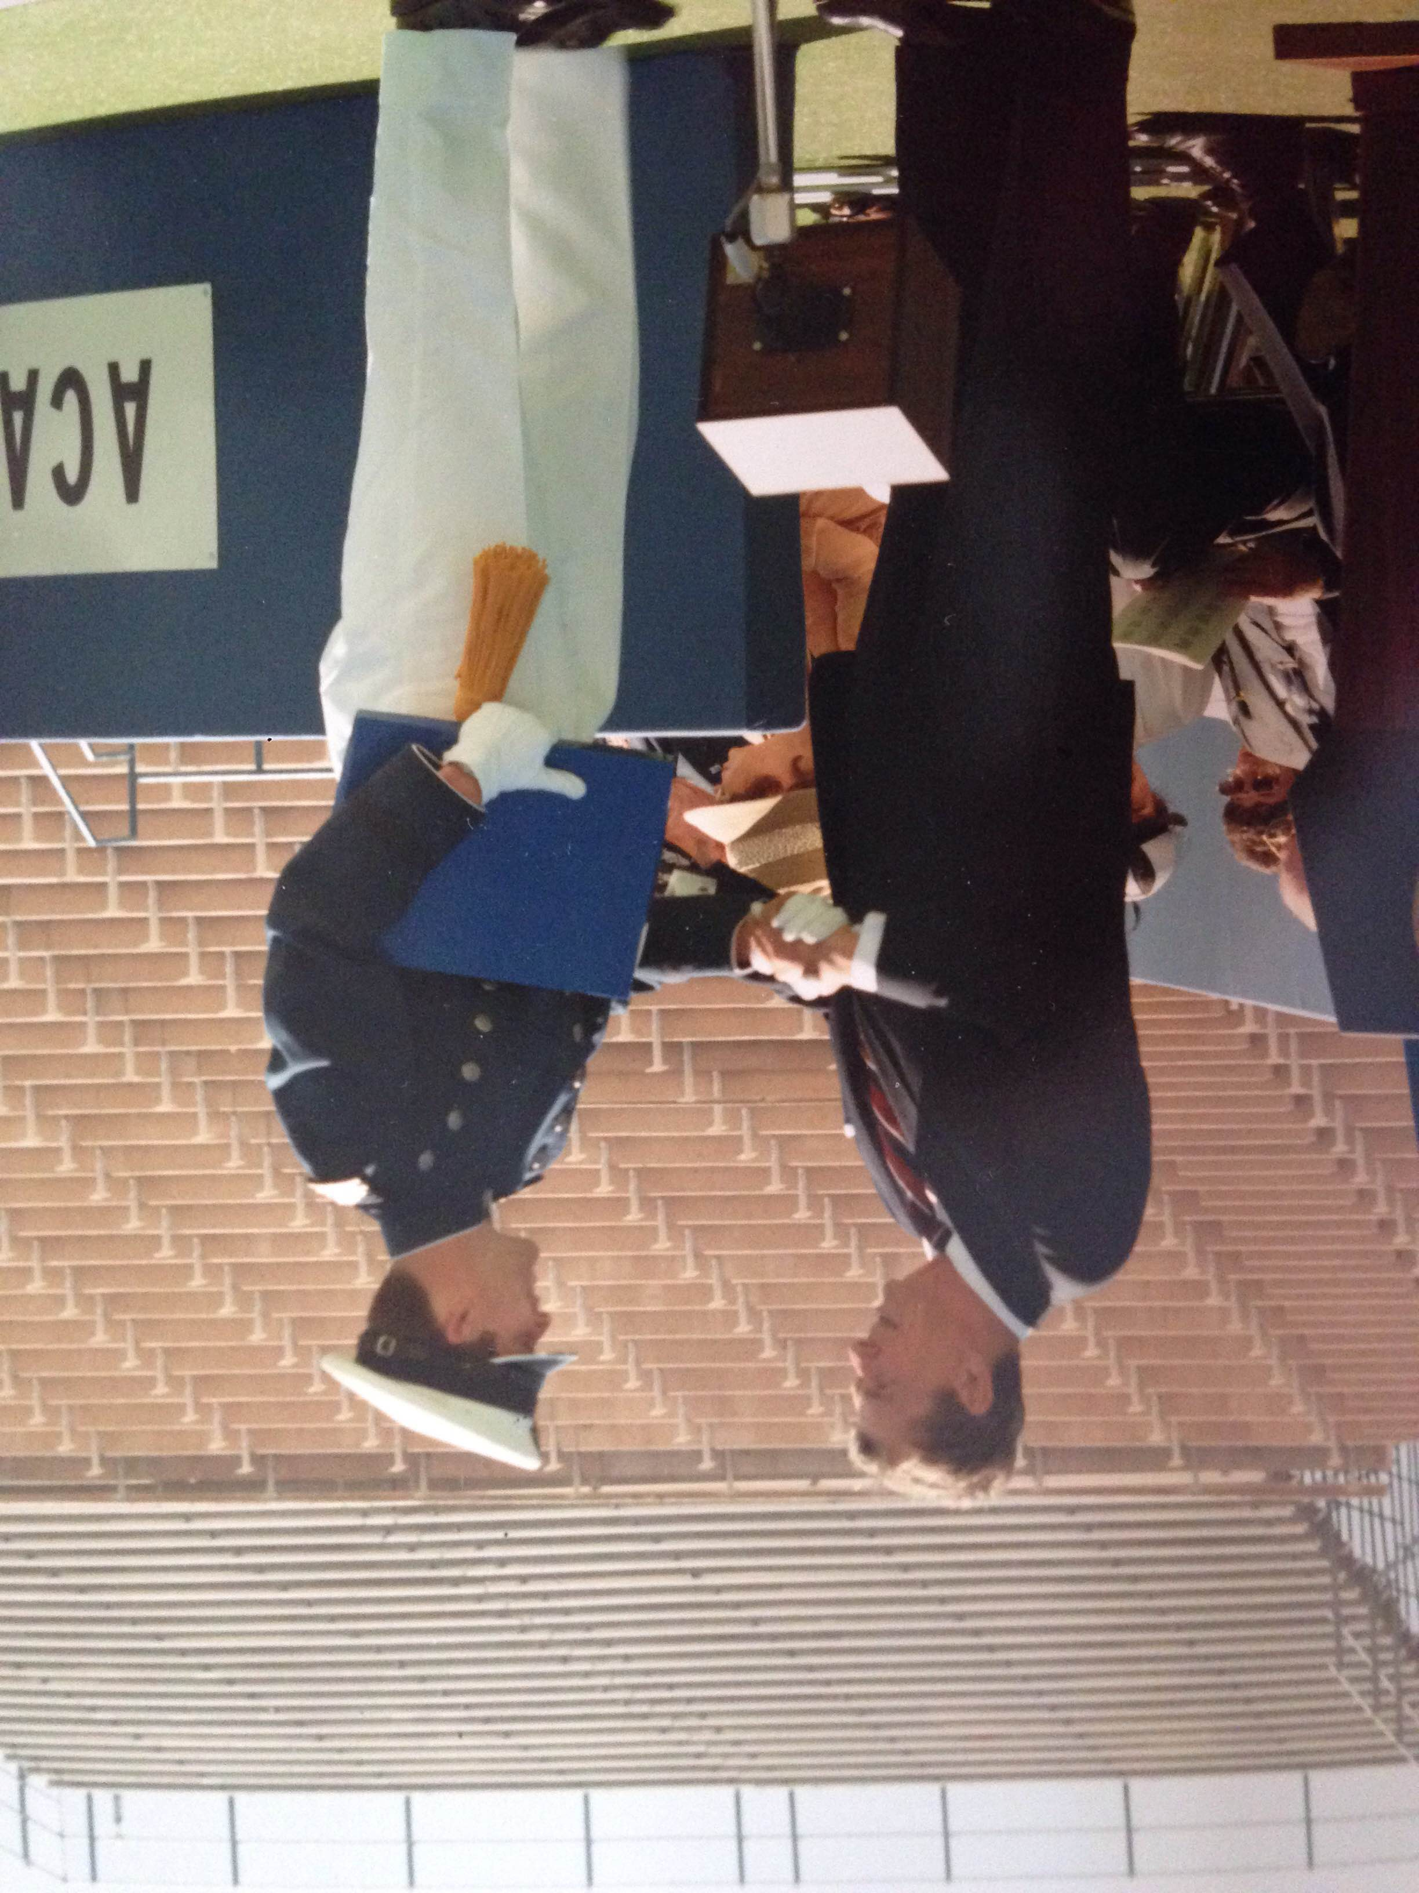
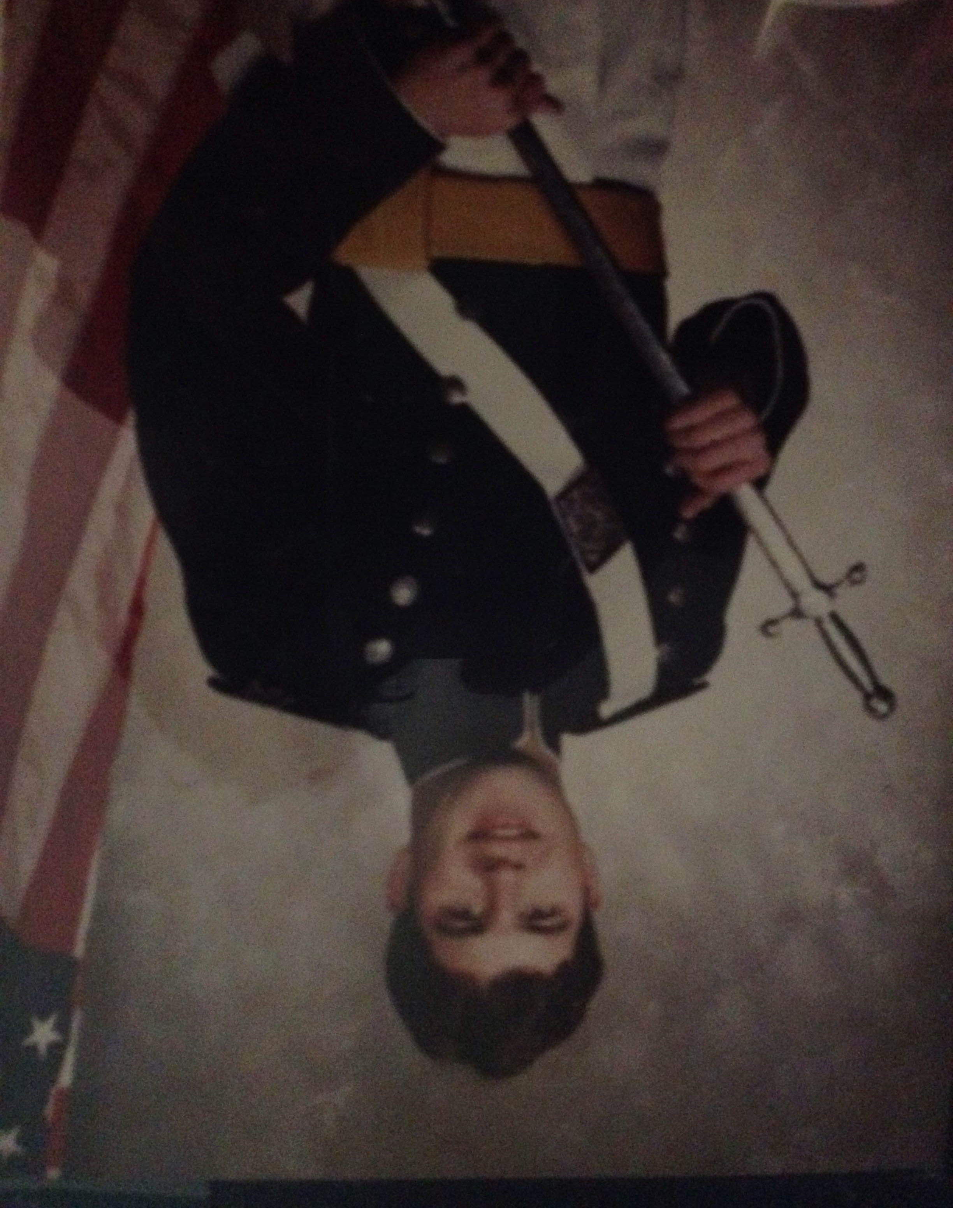

Slide 5
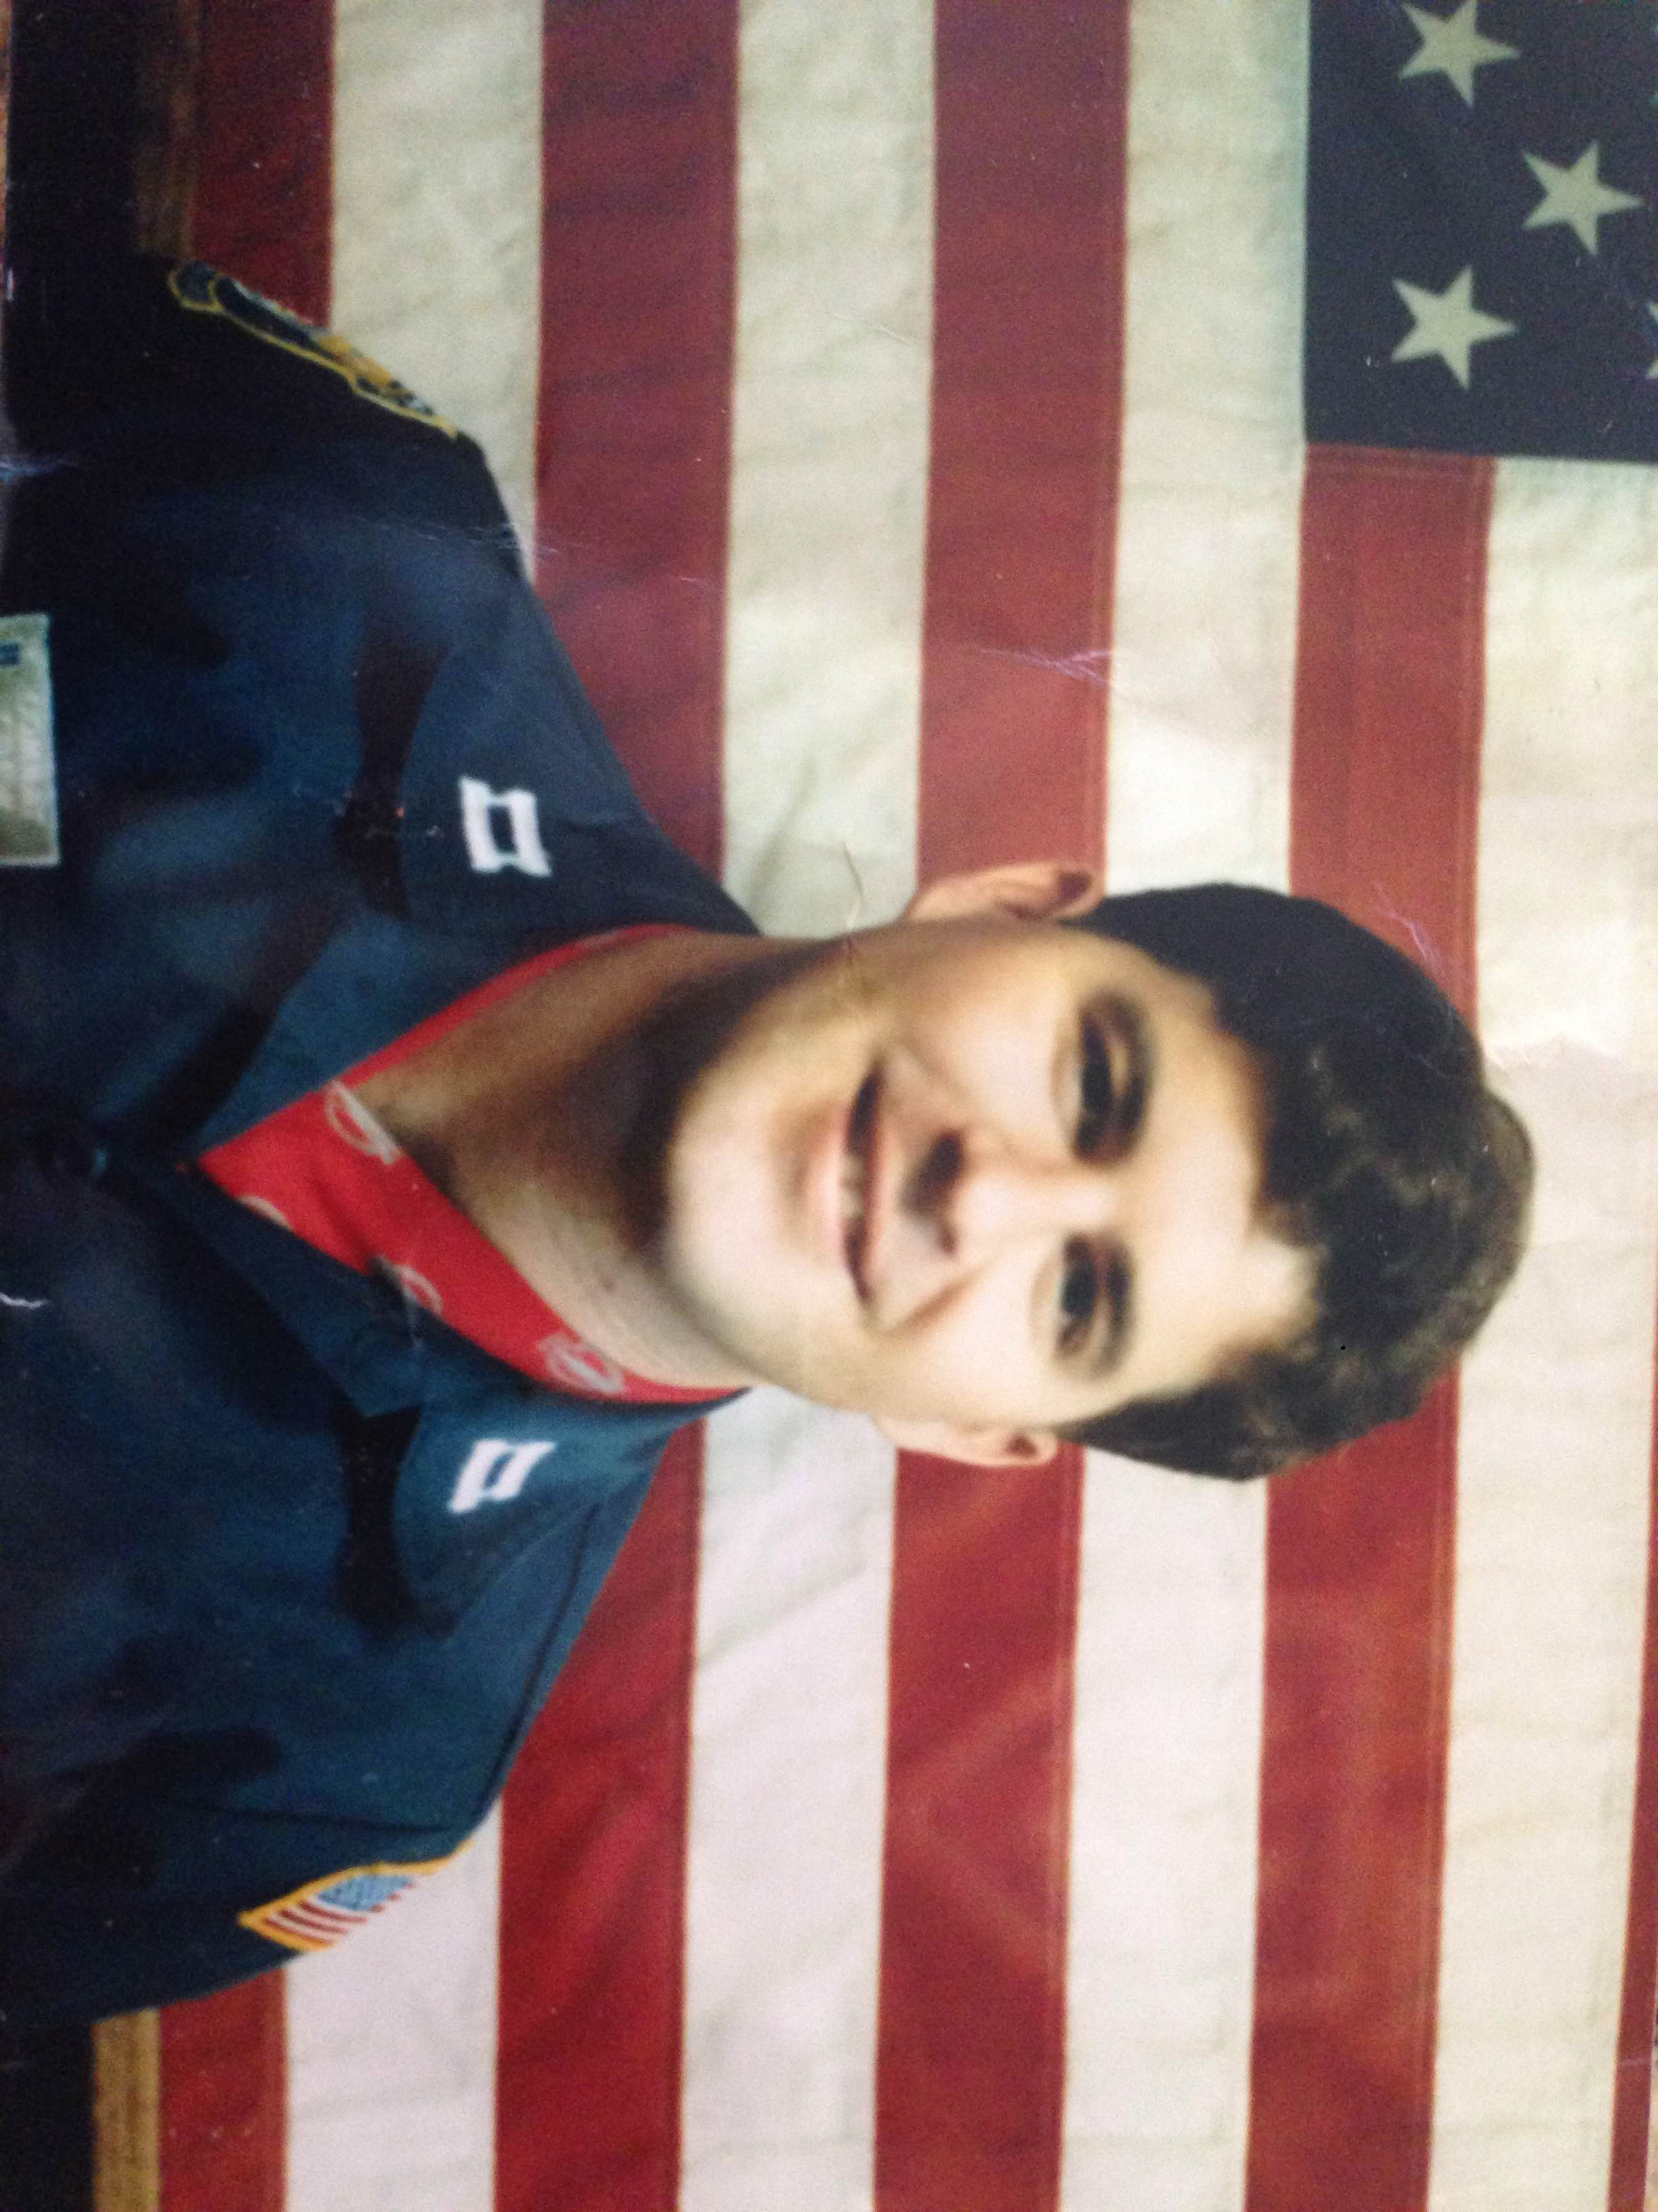
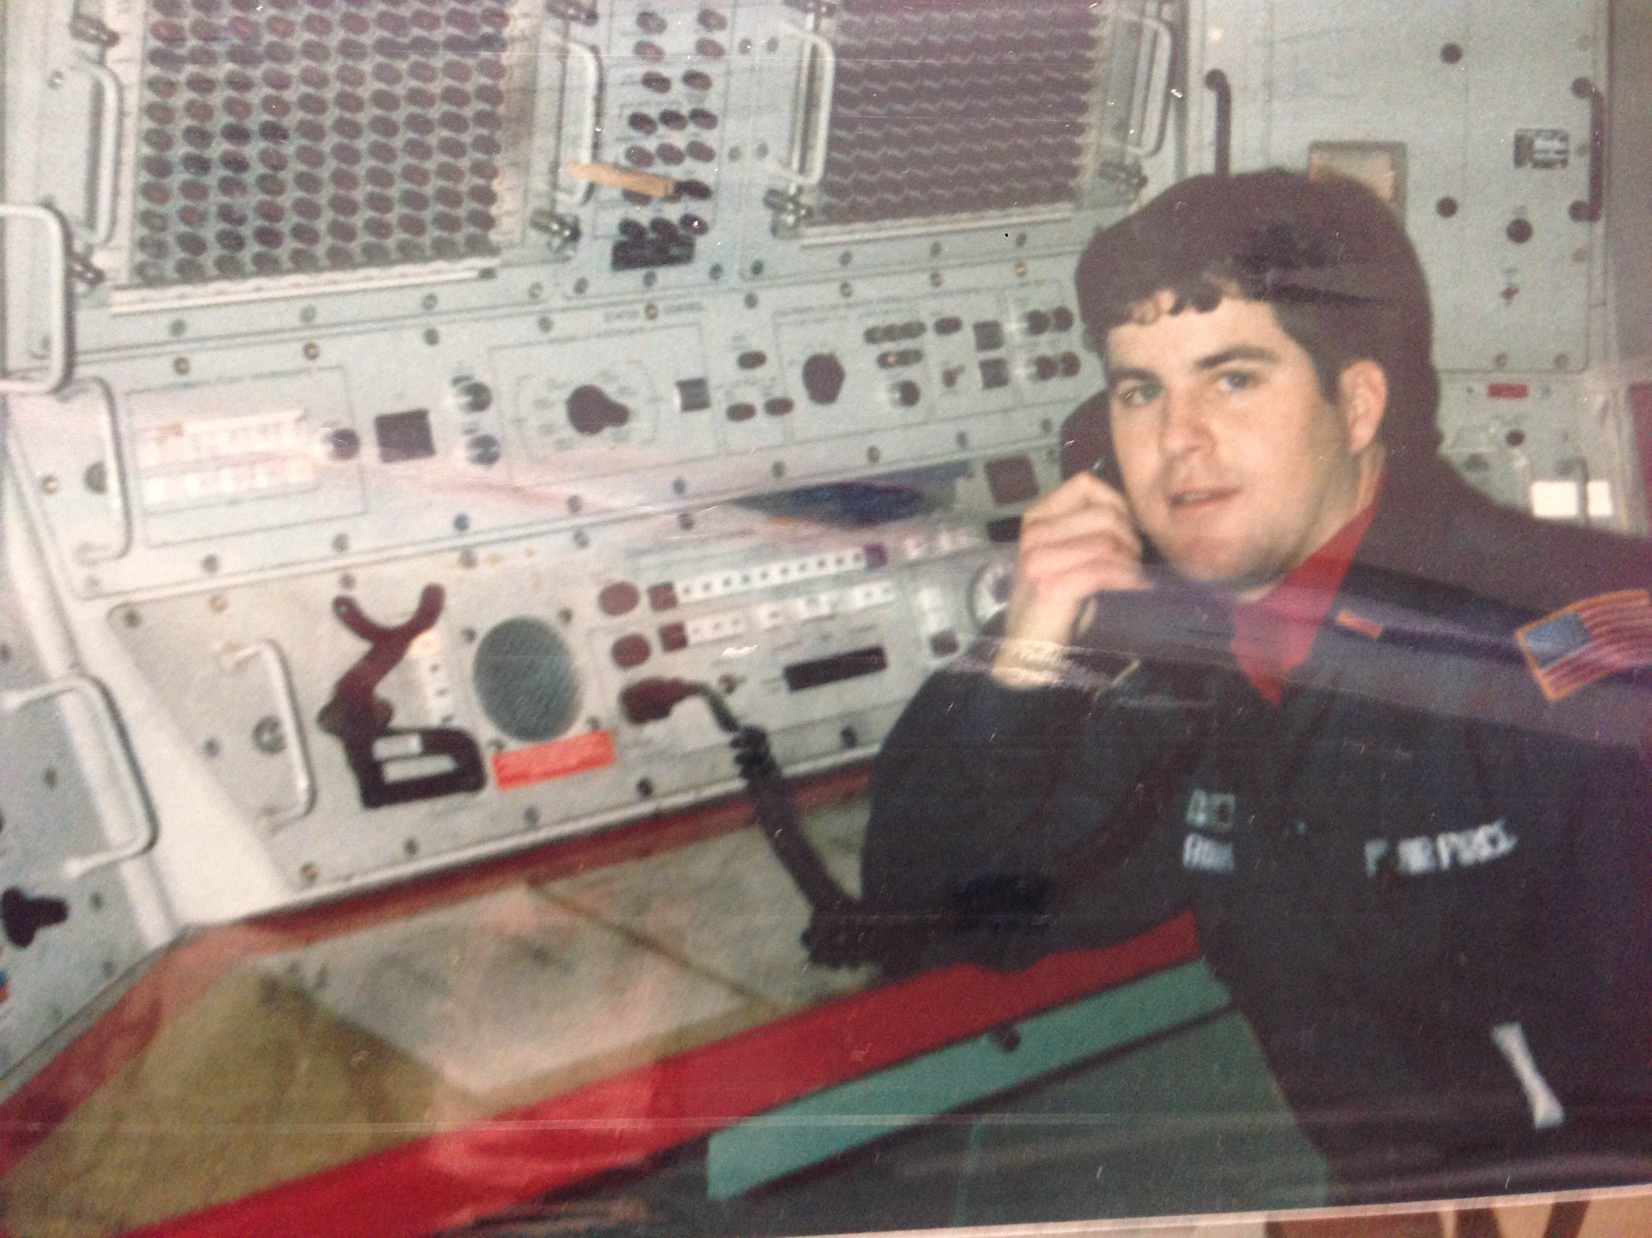
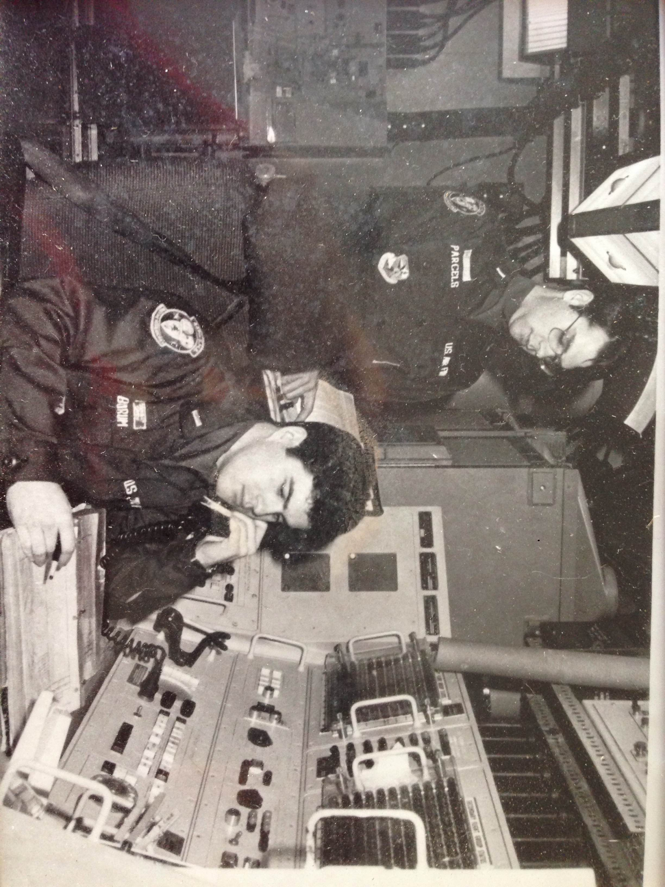
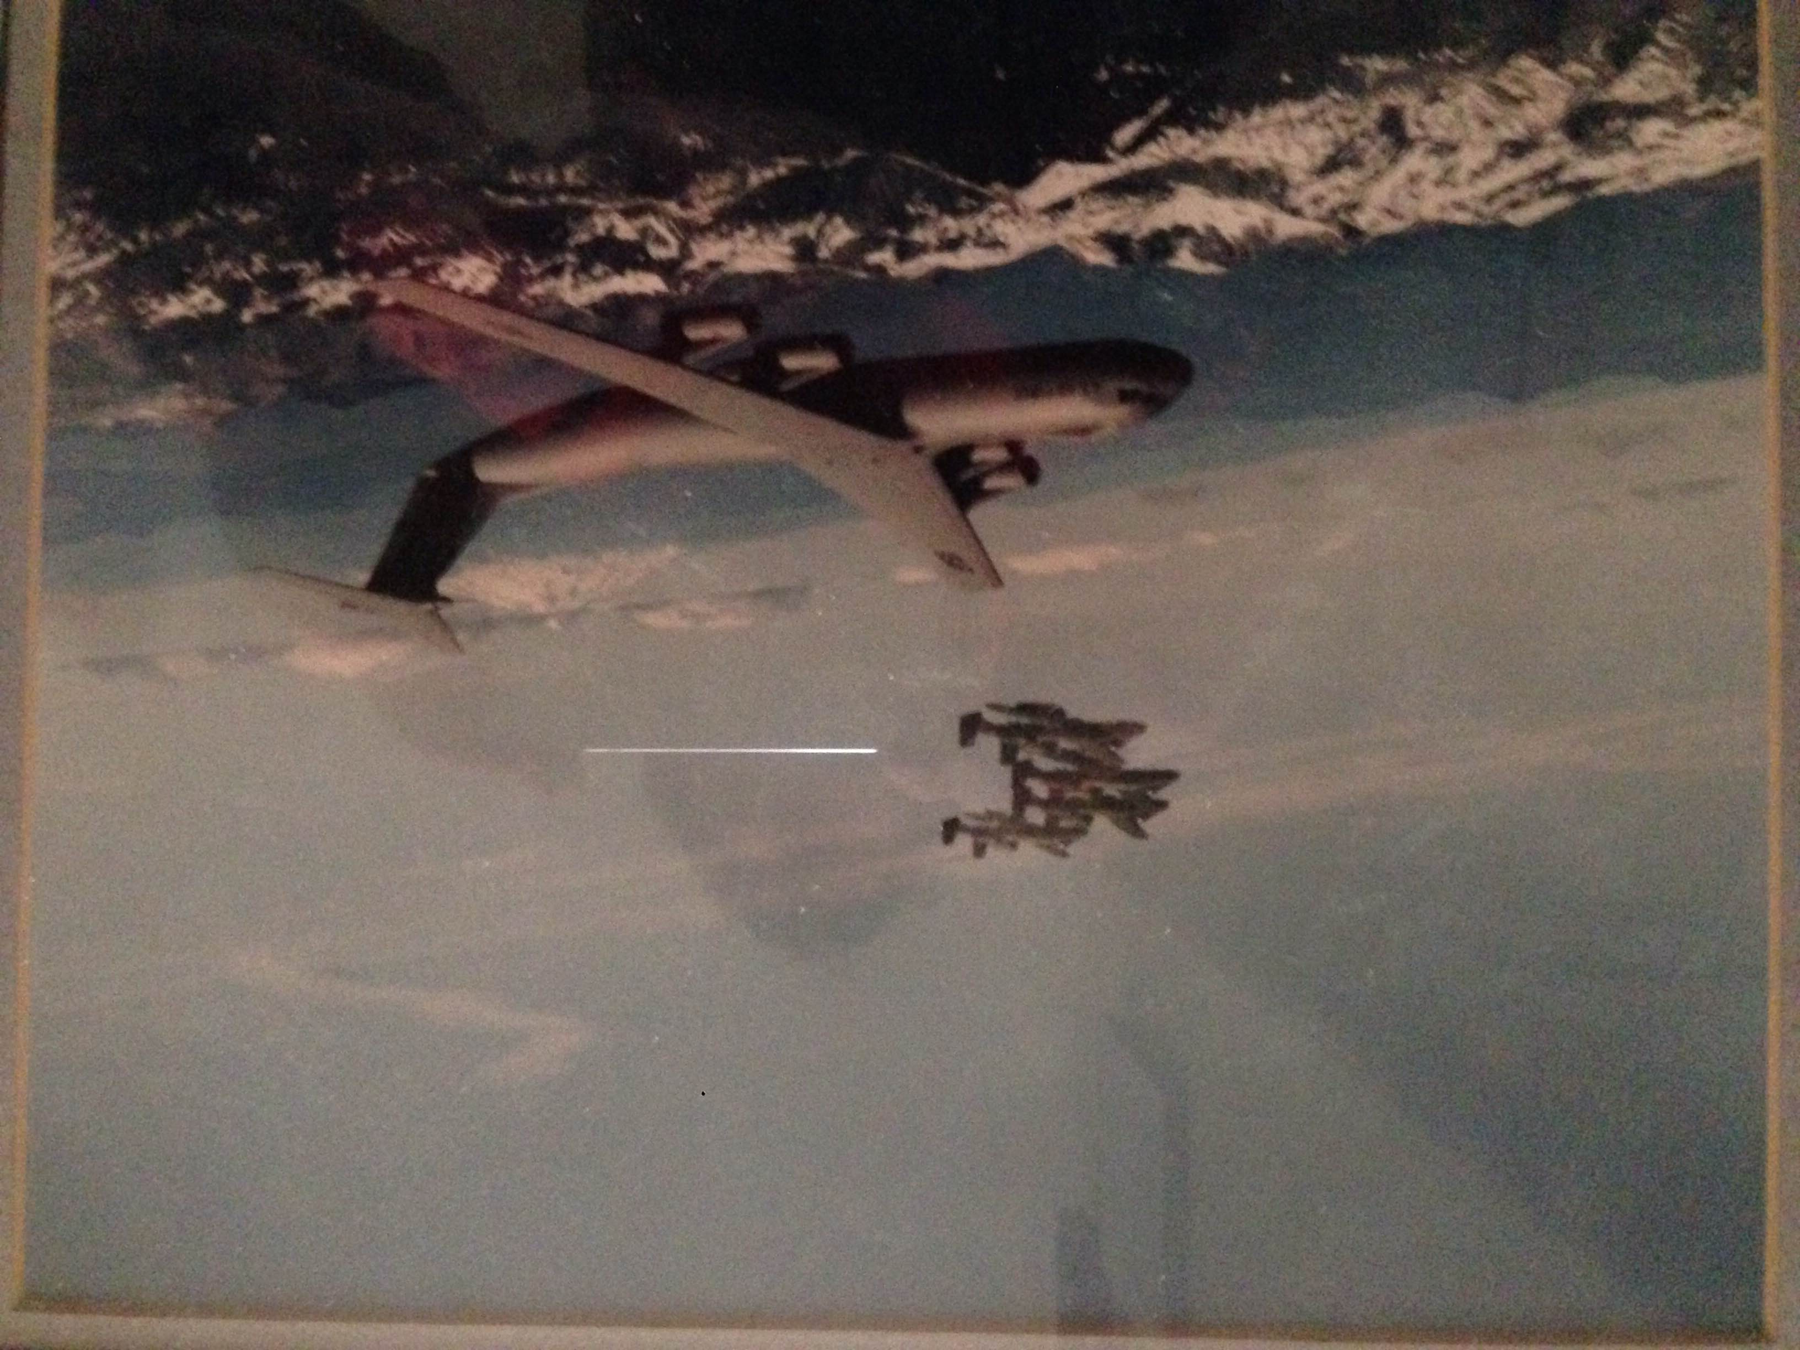
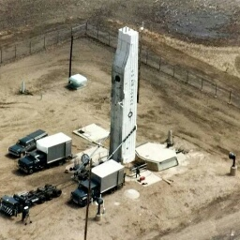
ICBM Combat Crew, Grand Forks, ND

Slide 6

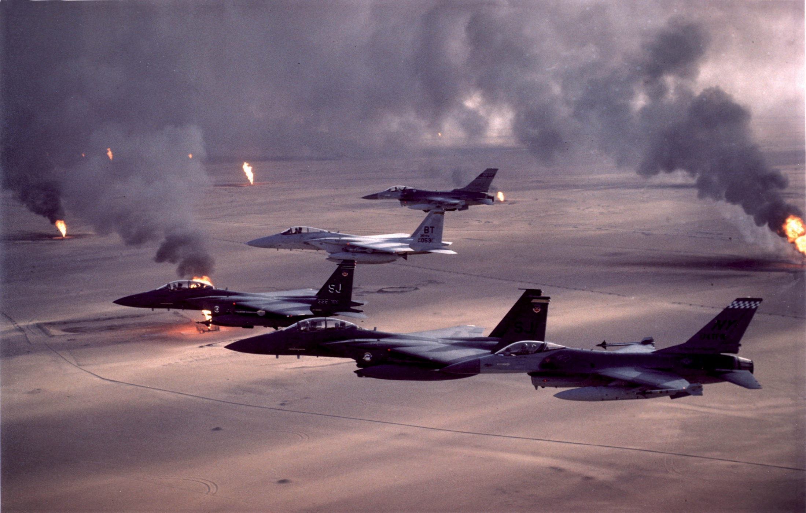

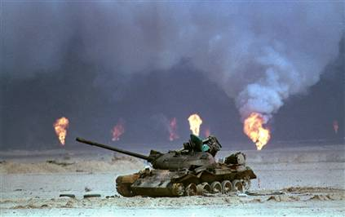
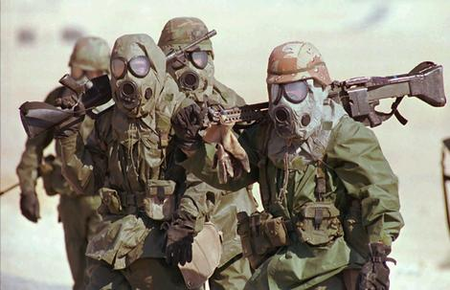
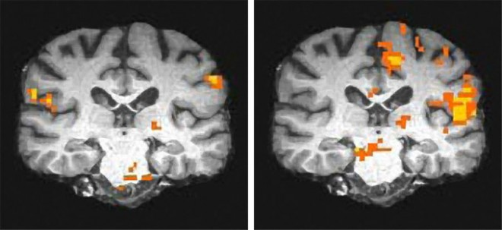

Slide 7
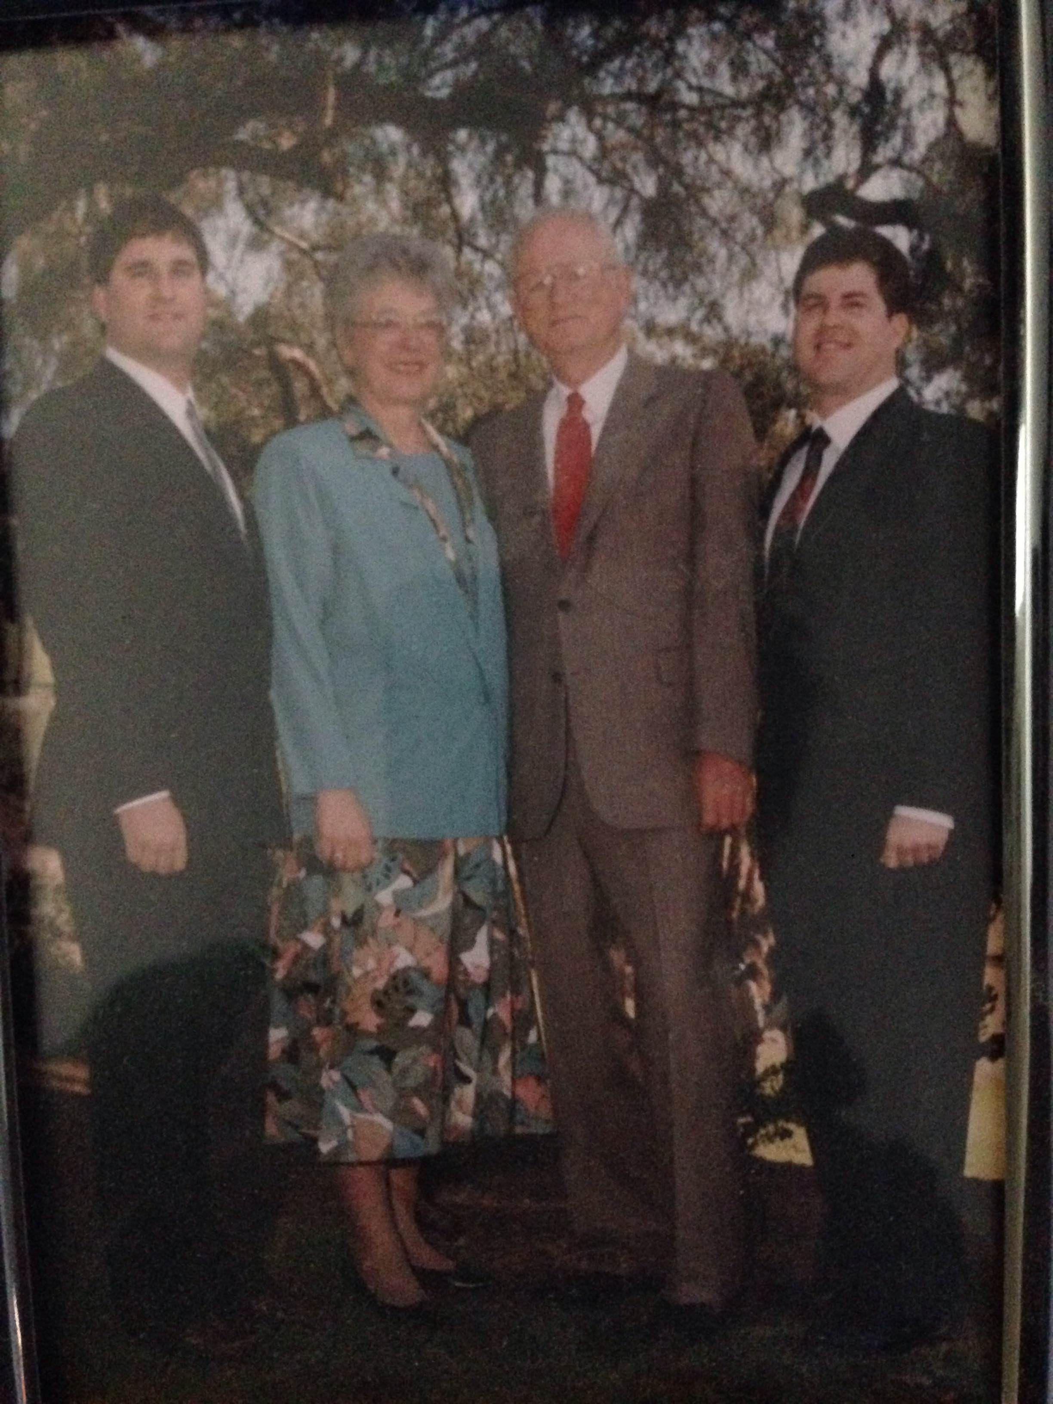
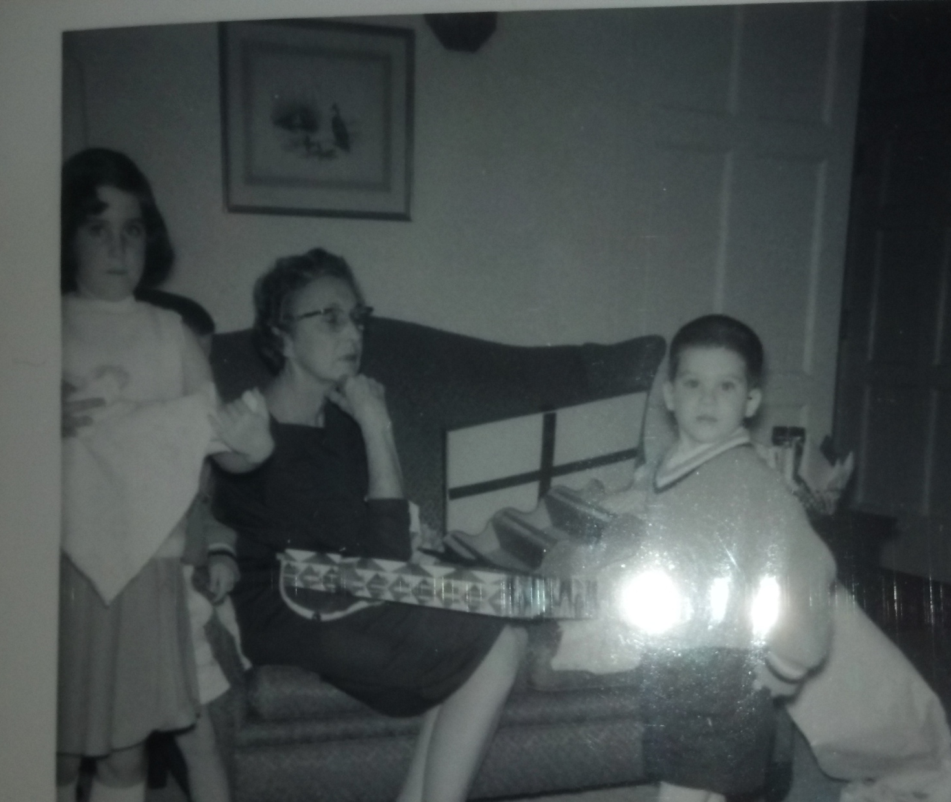
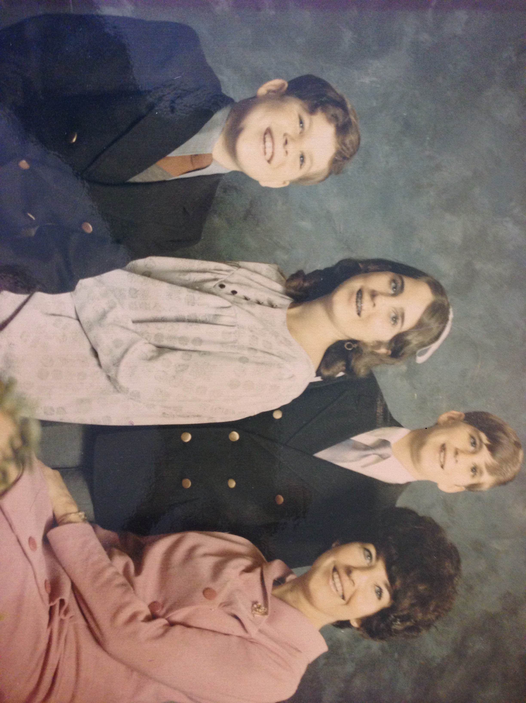
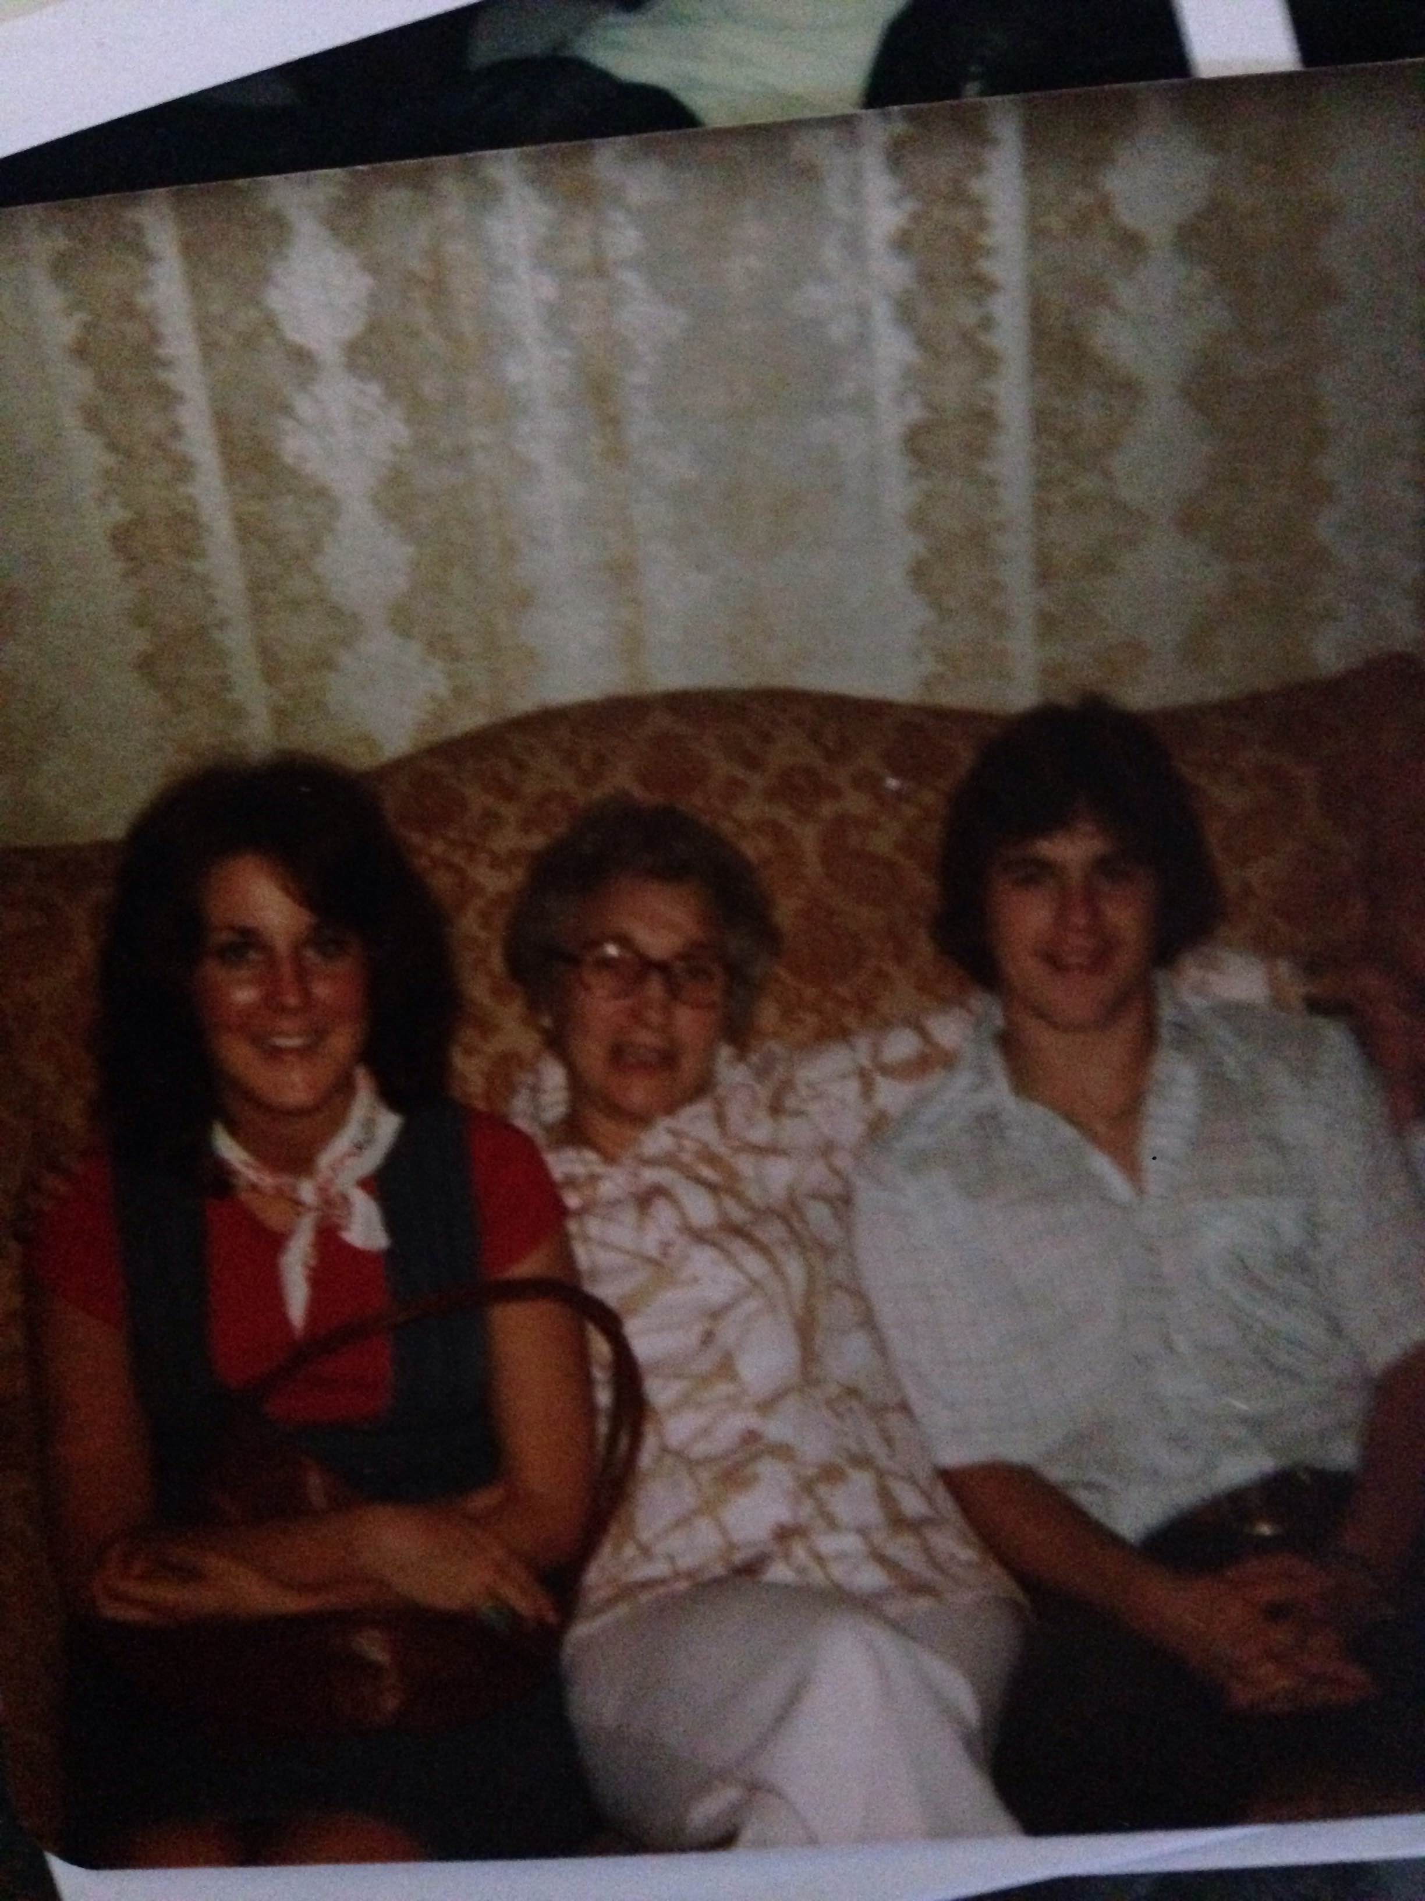
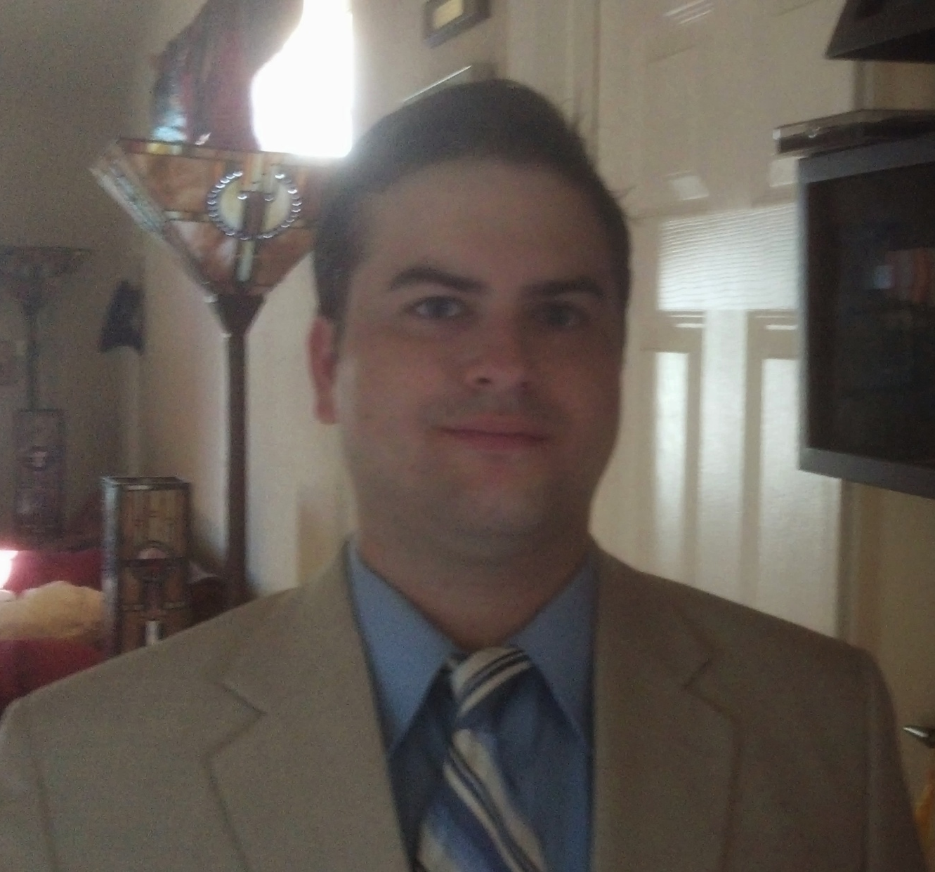
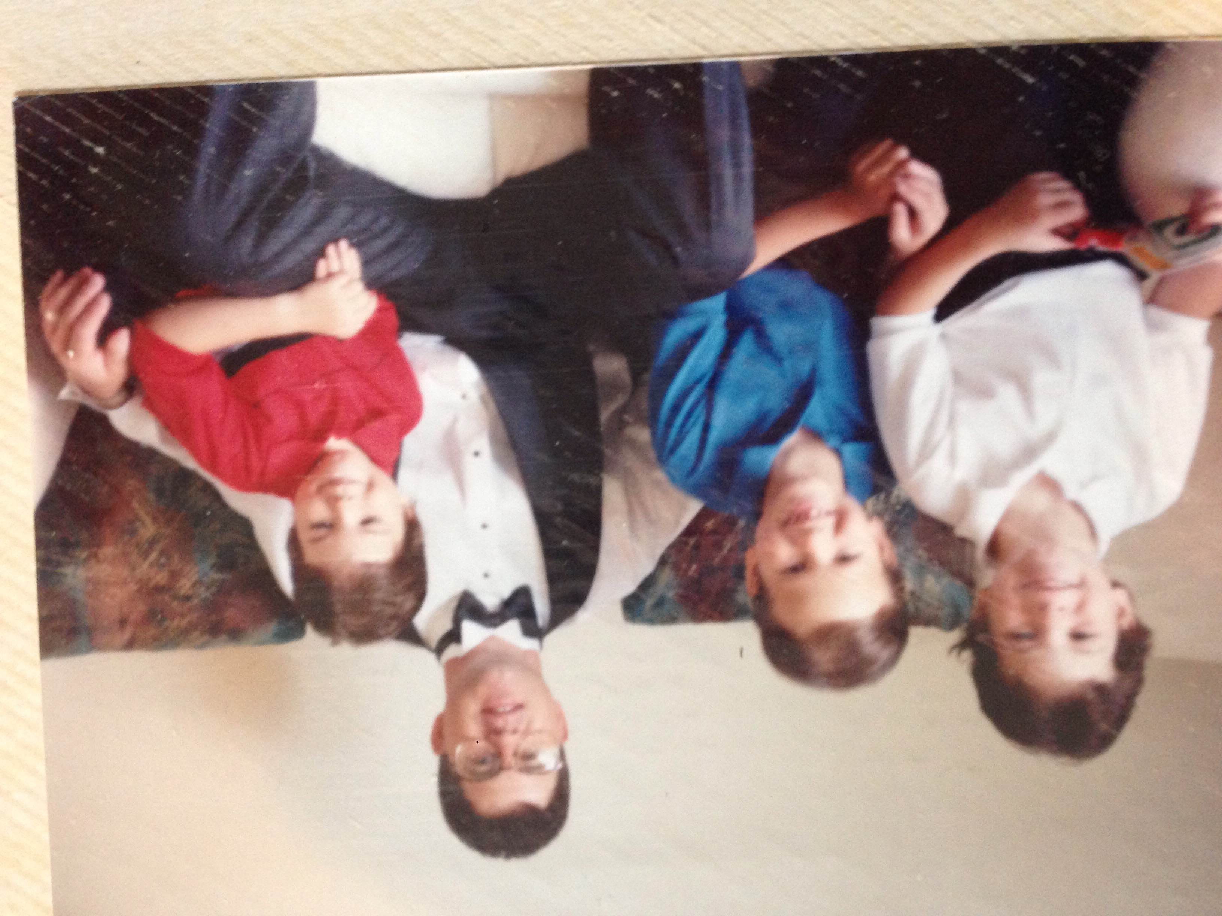
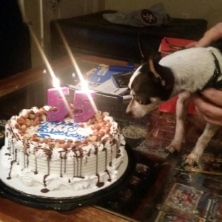
My family
This is a picture of me and (insert family member names)

Slide 8
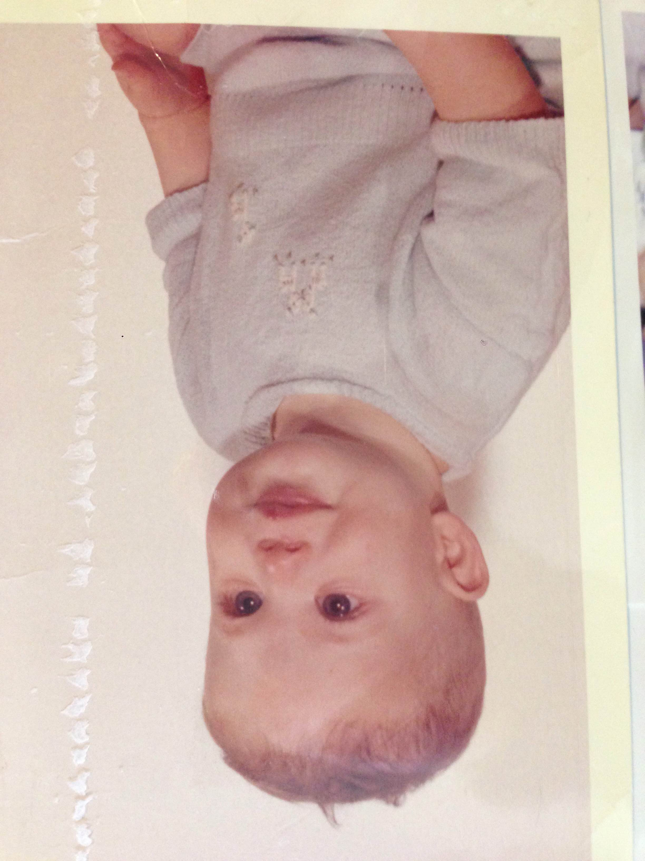
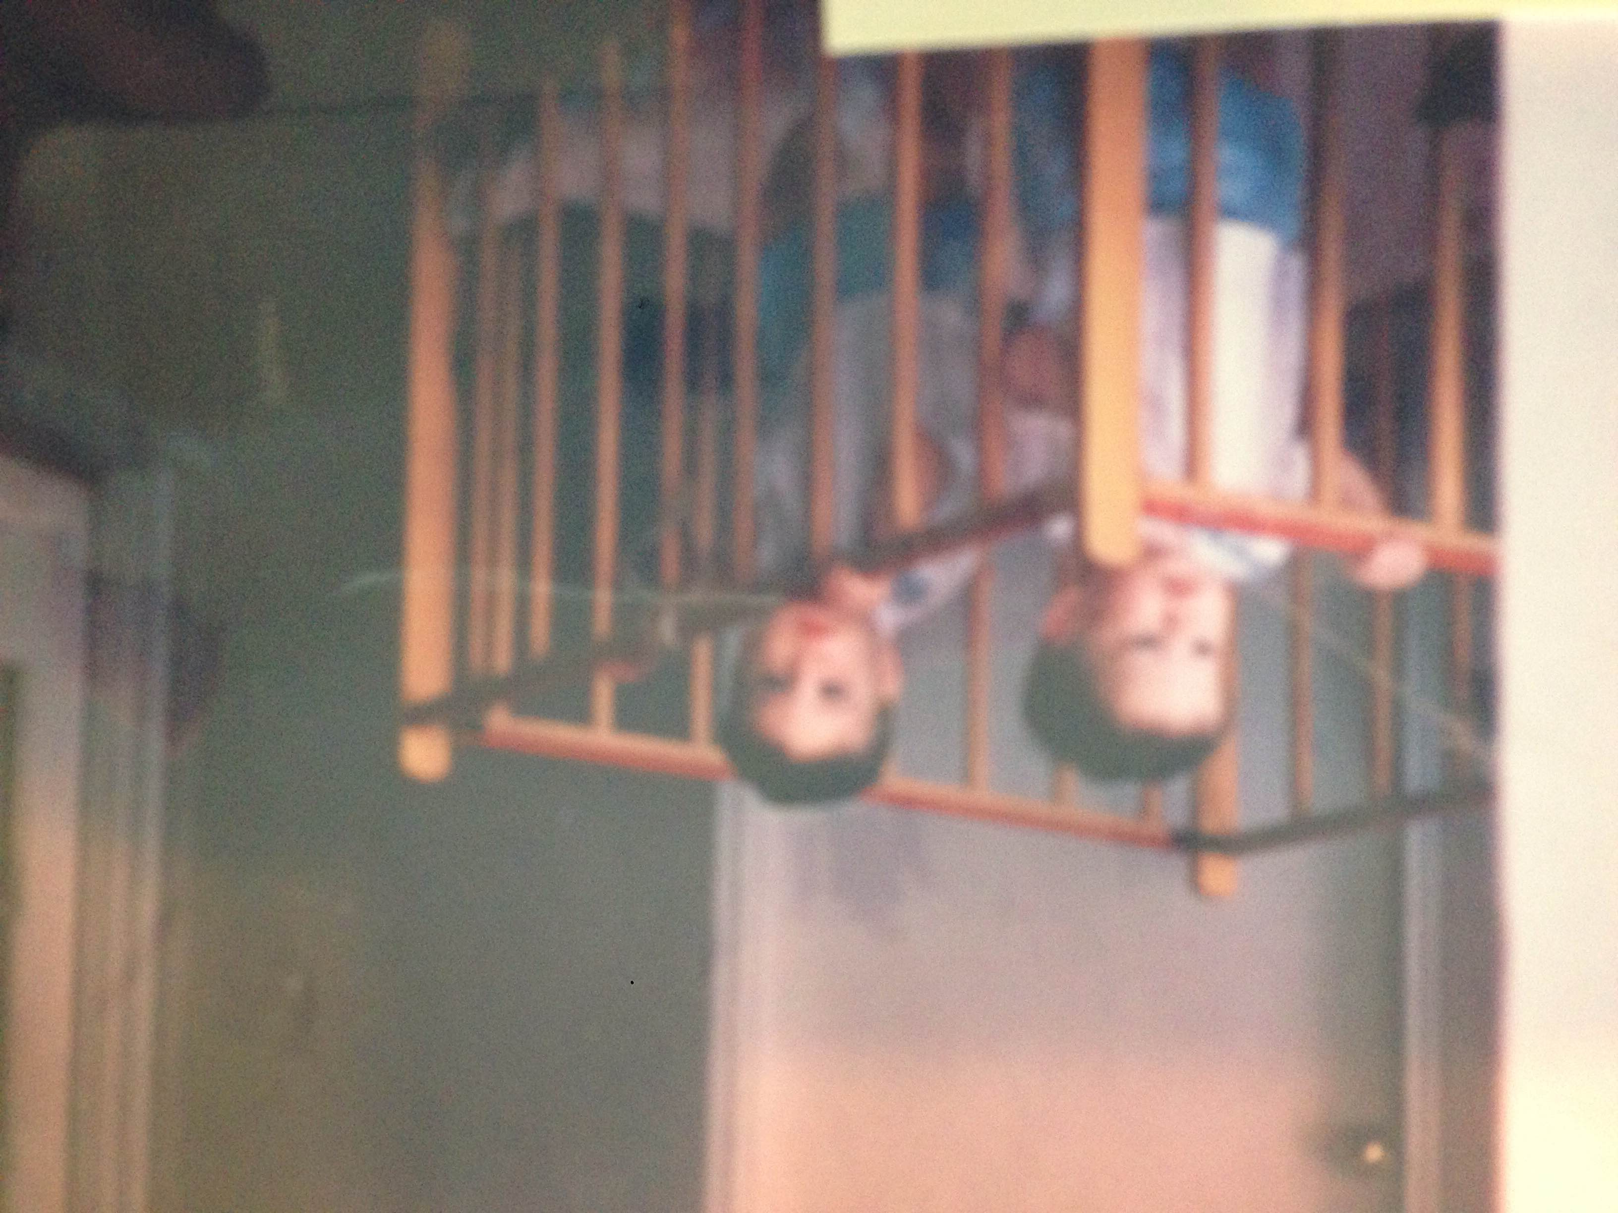
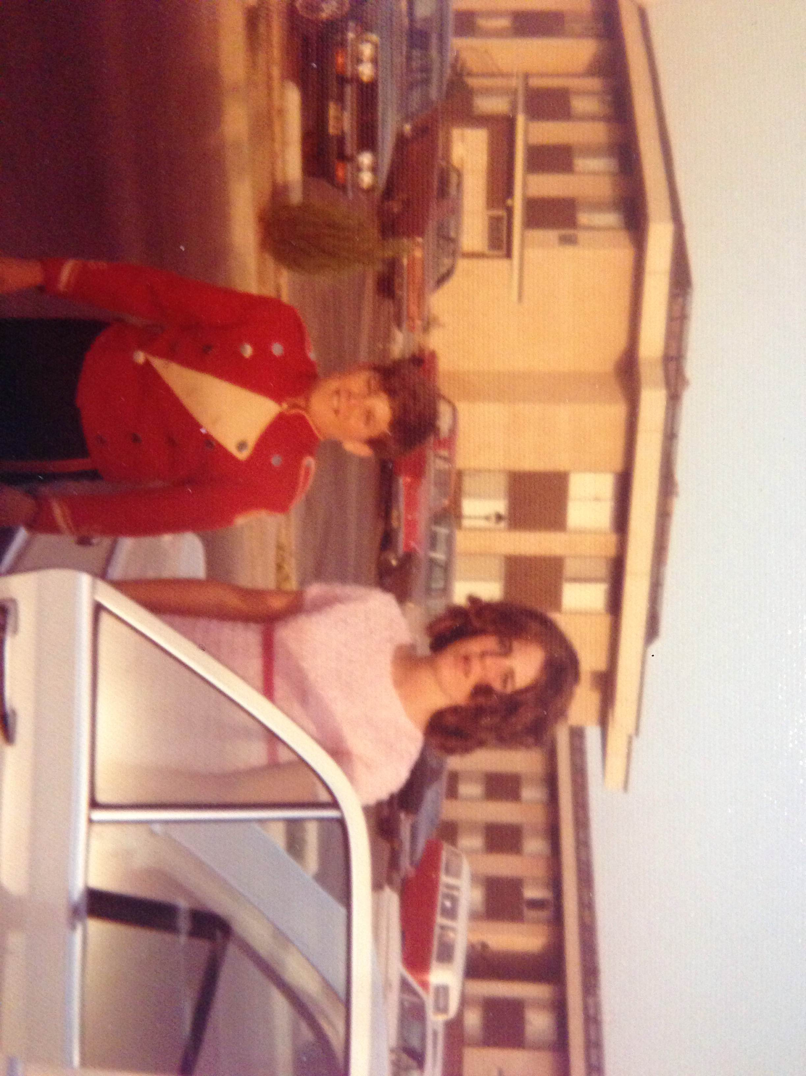
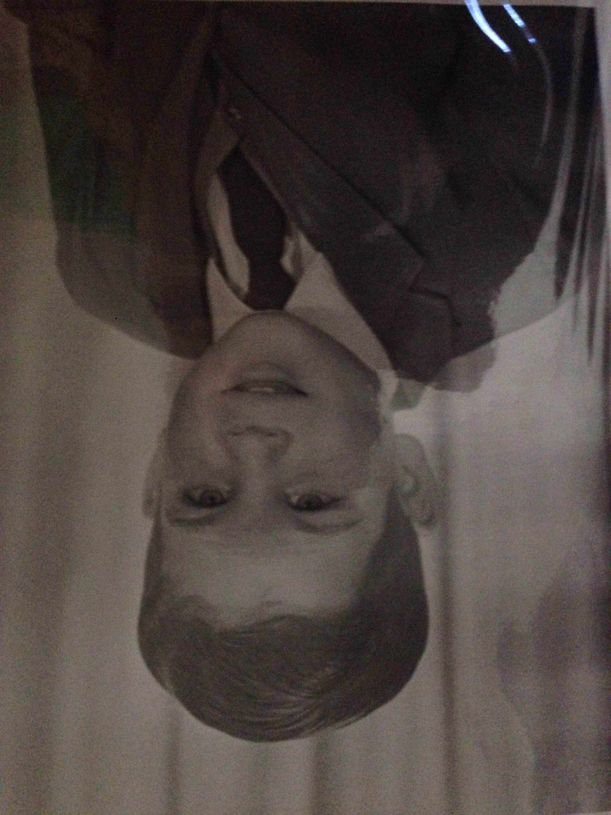
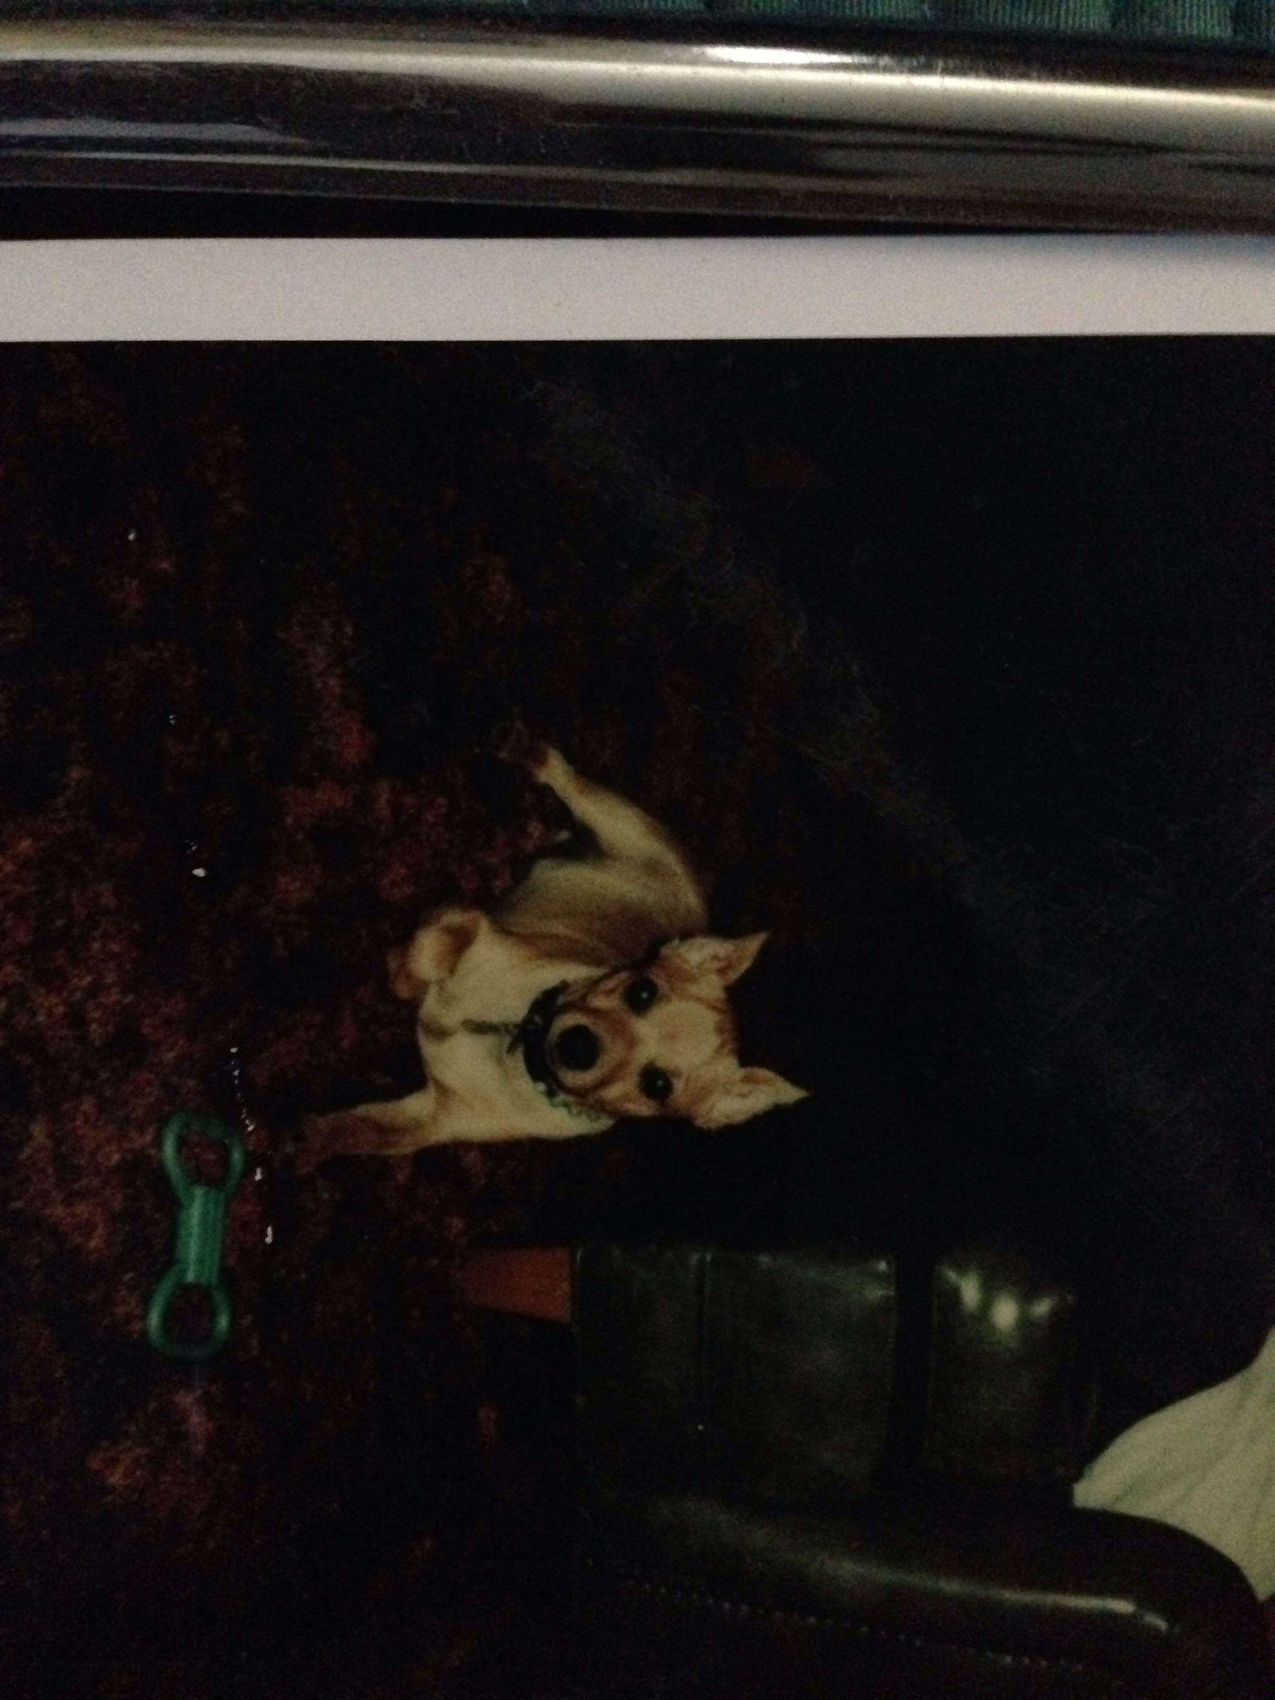
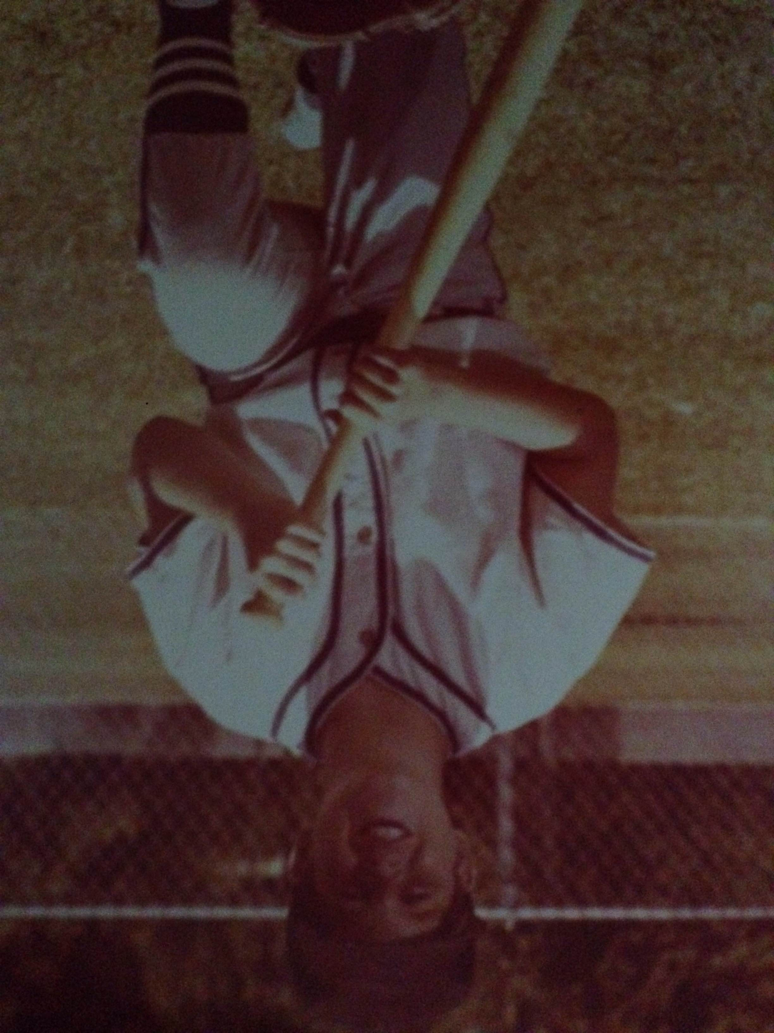
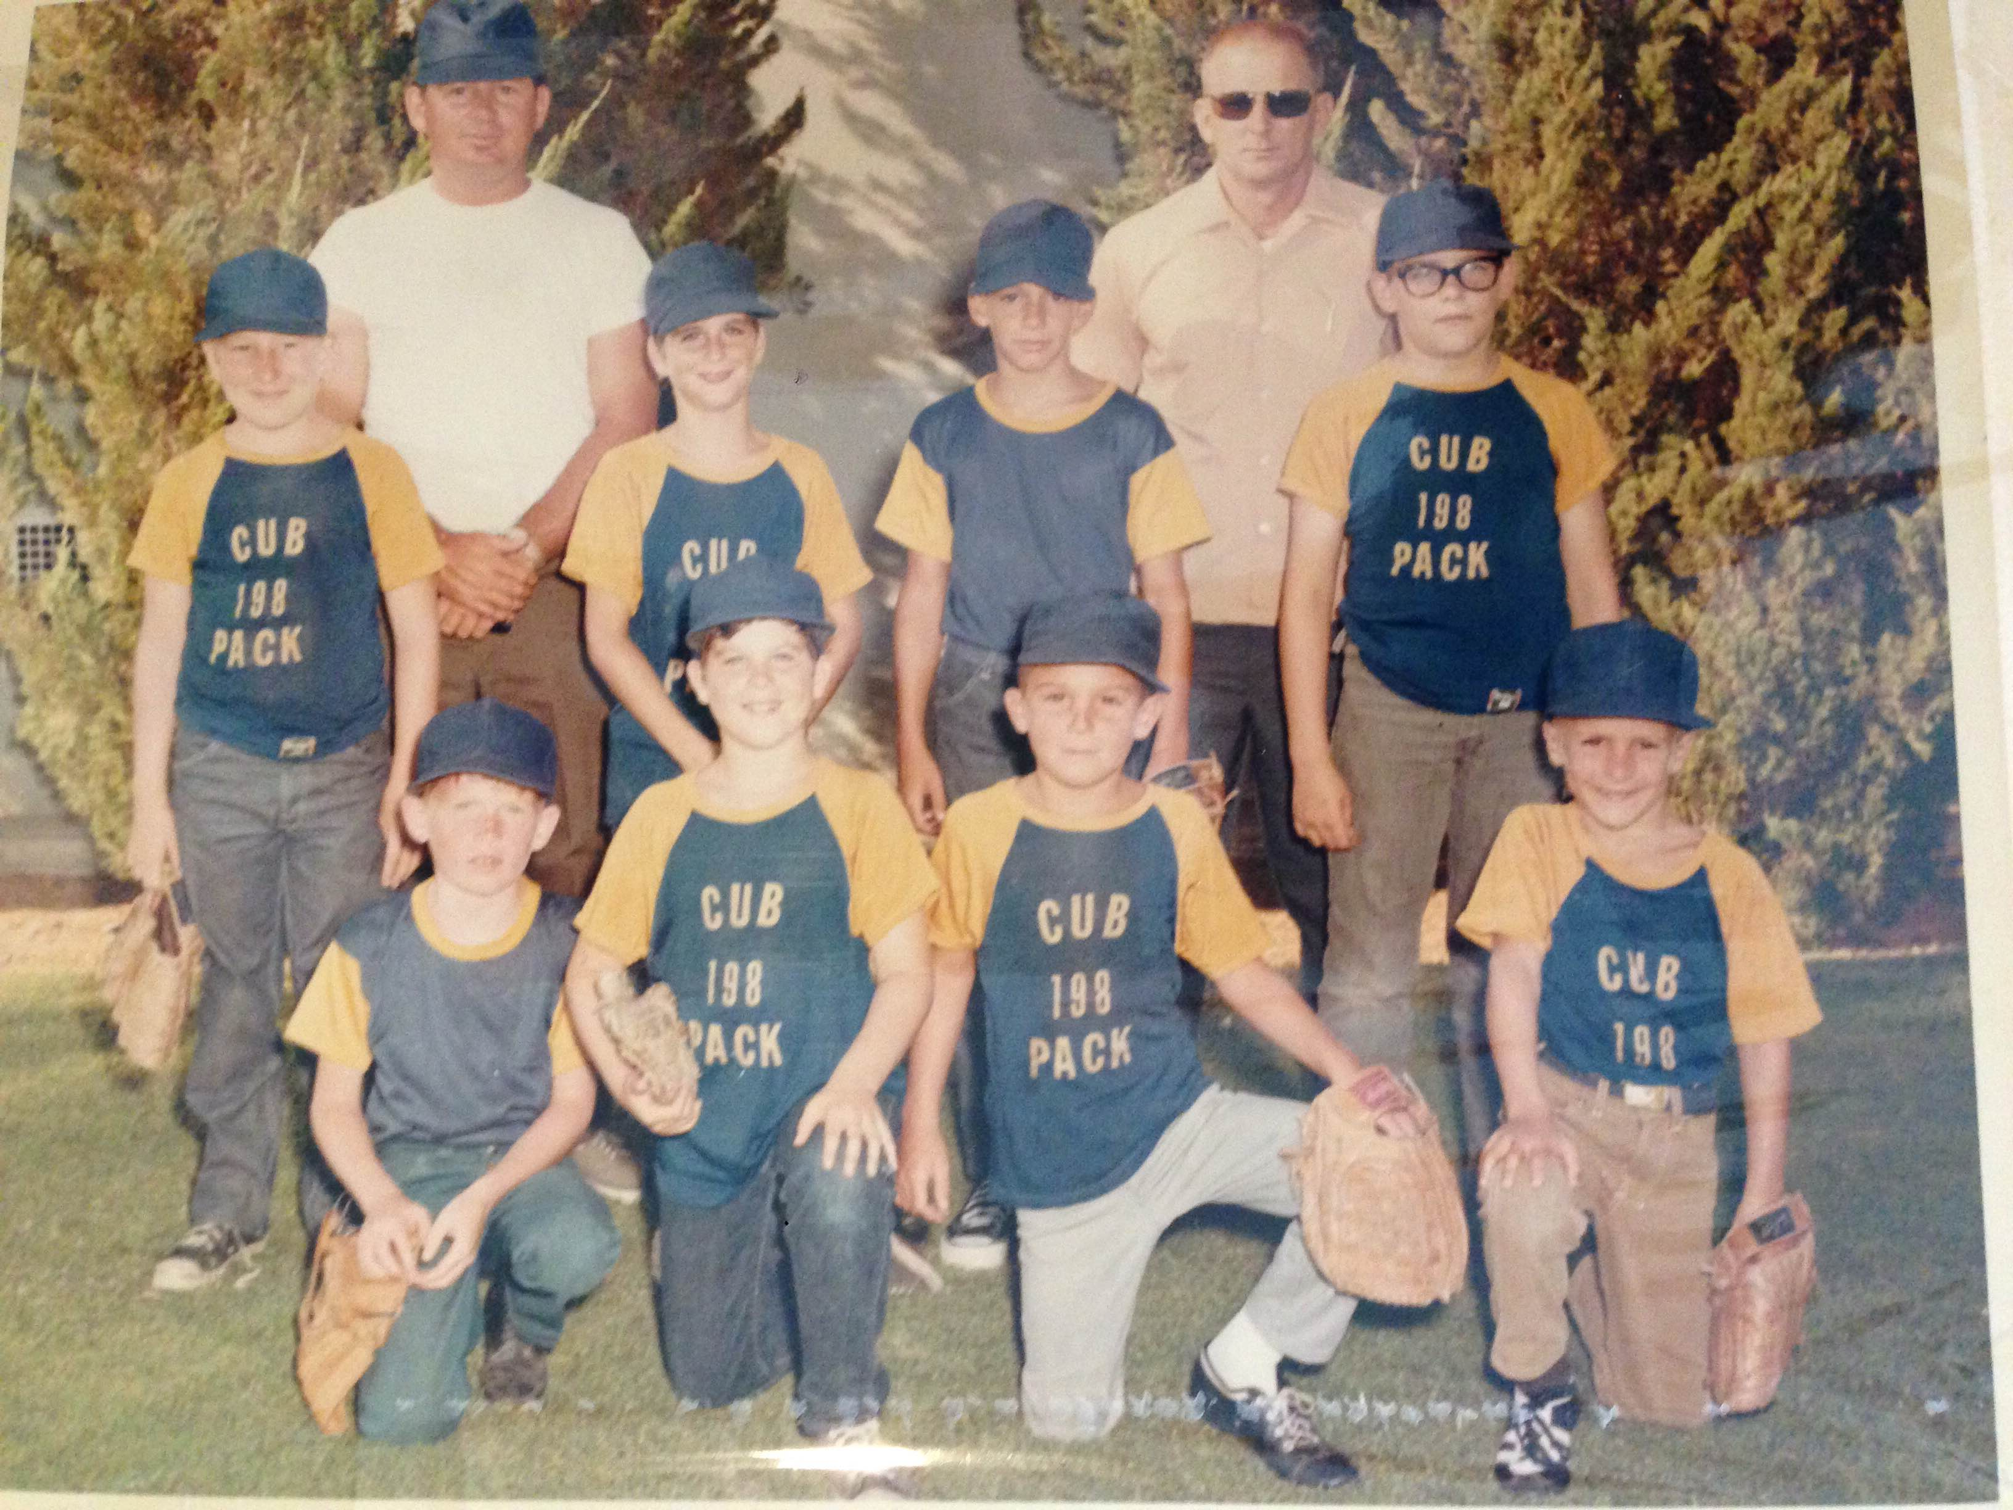
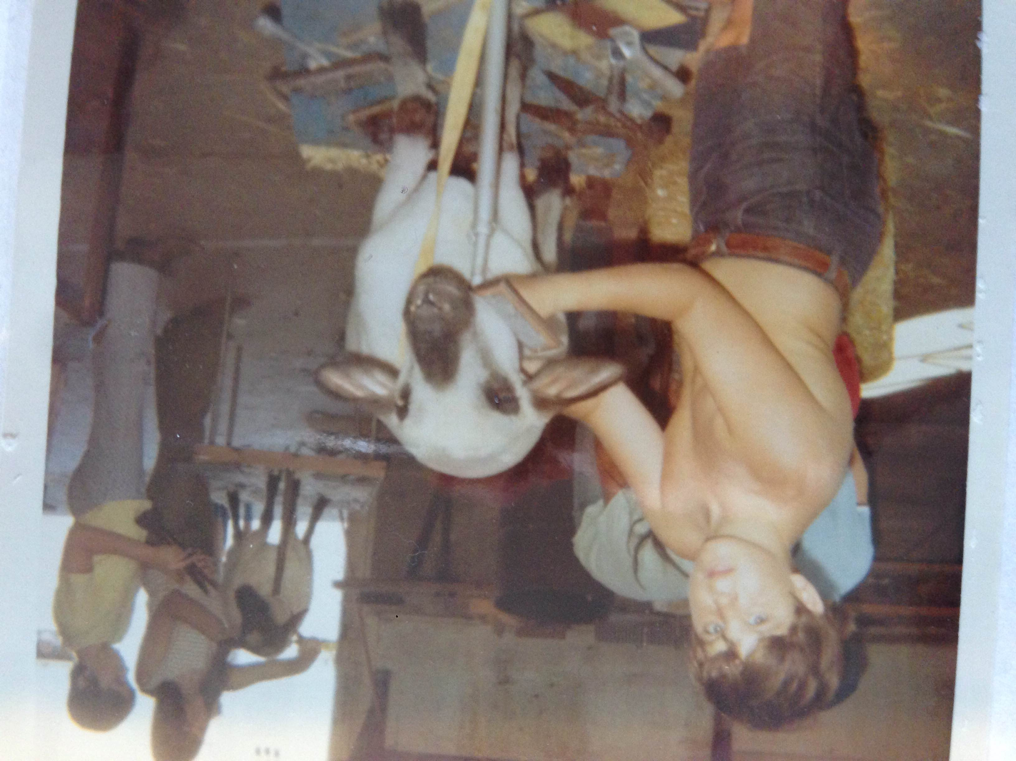
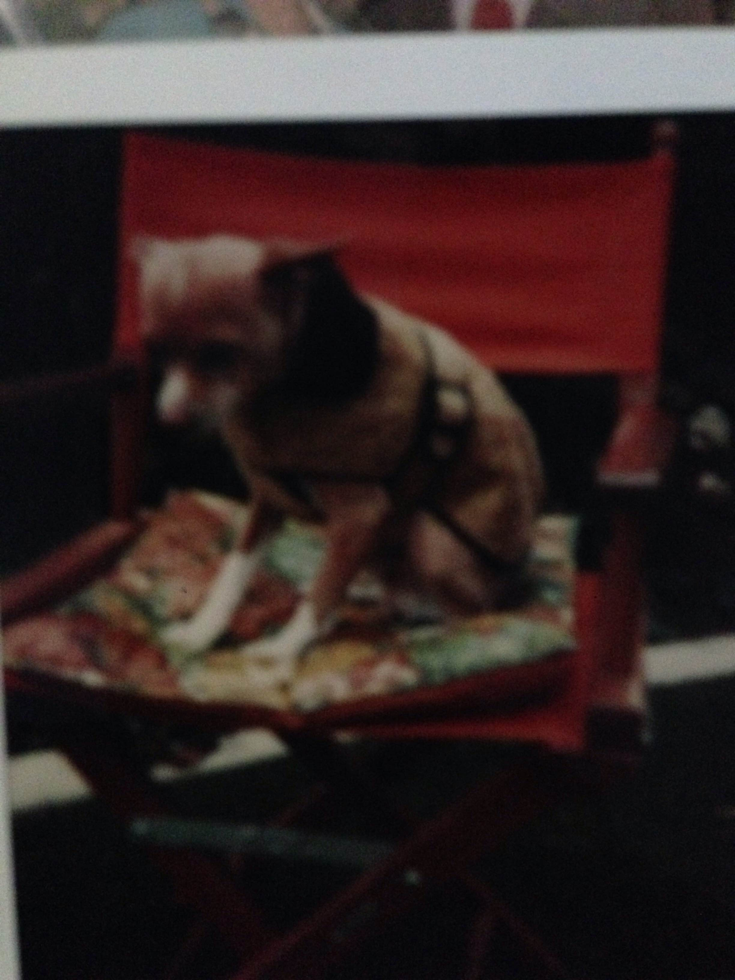
My childhood
I was born and raised in Bakersfield, CA
This is a picture of me at (BLANK) age

Slide 9
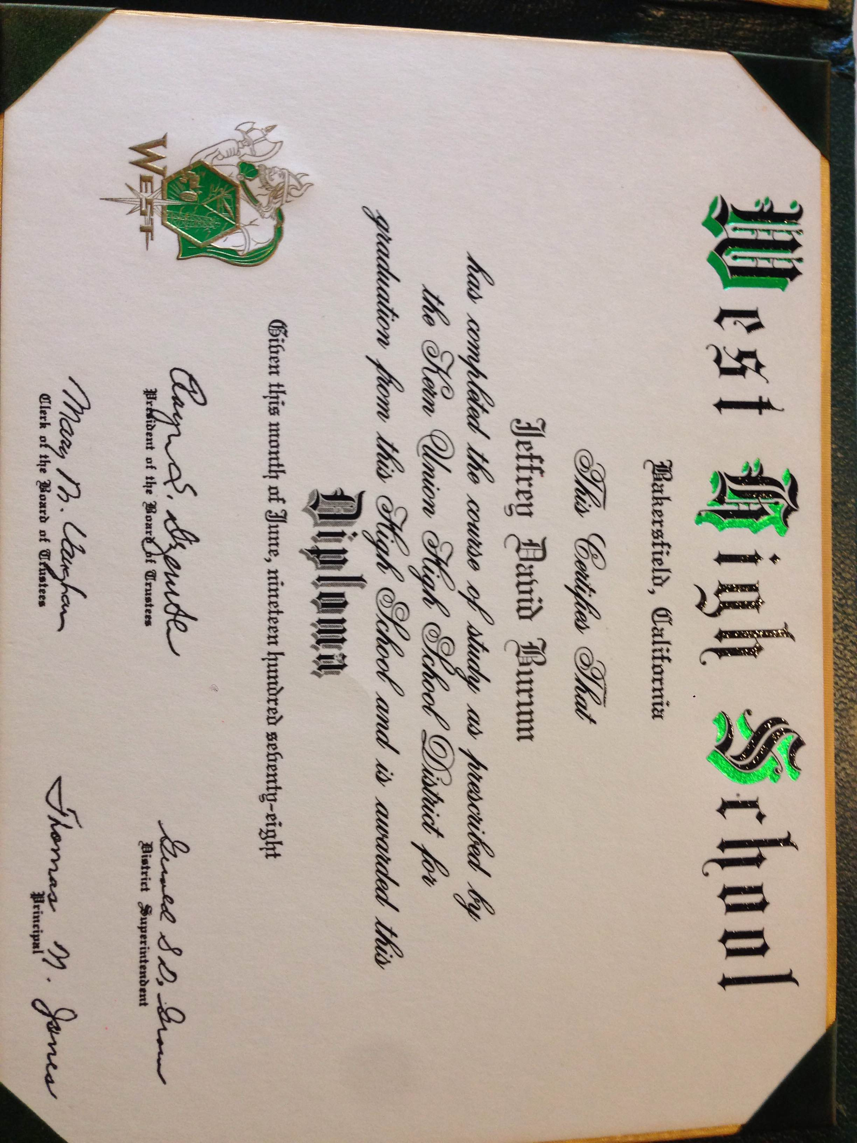
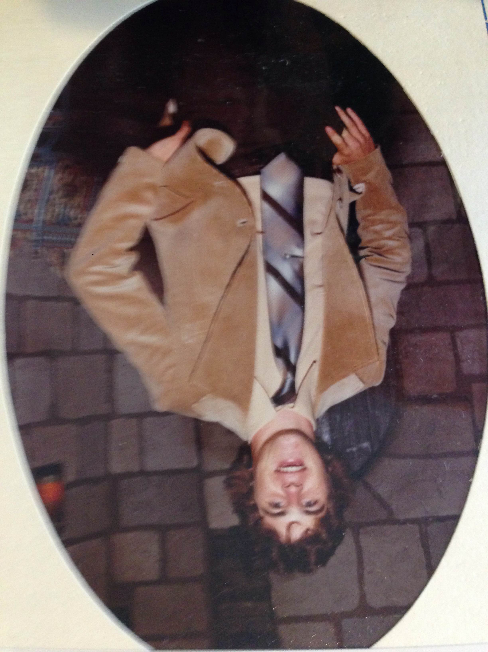
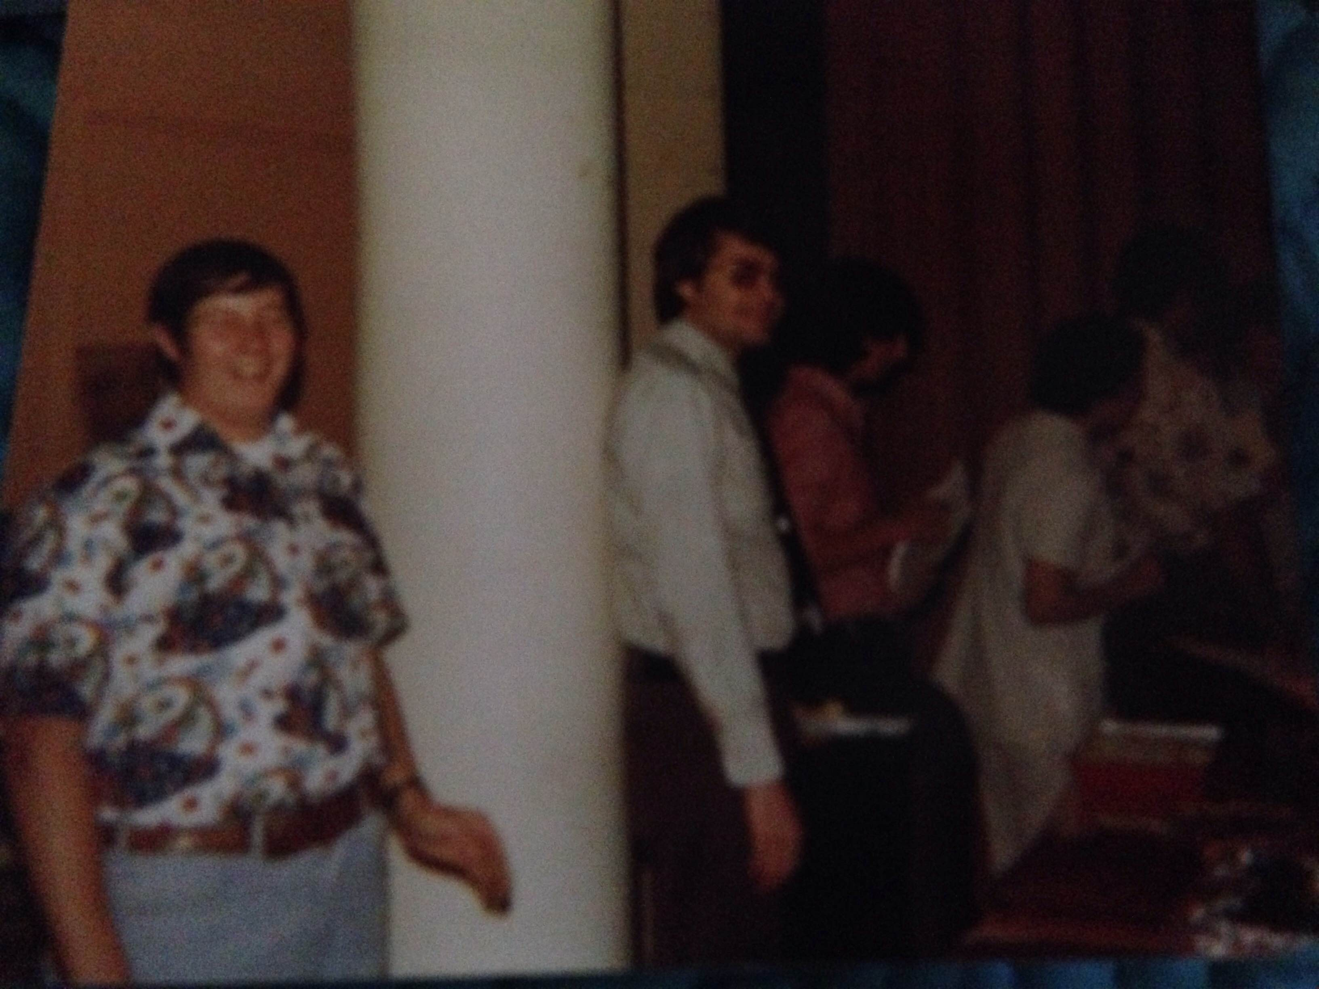
High School 1974-1978
As a HS student, I was a member of the Spanish Club, National Honor Society, CA Scholarship Federation, Football, Worked Part-time, participated in Student Government, Member of the Speech and Debate Team

Slide 10
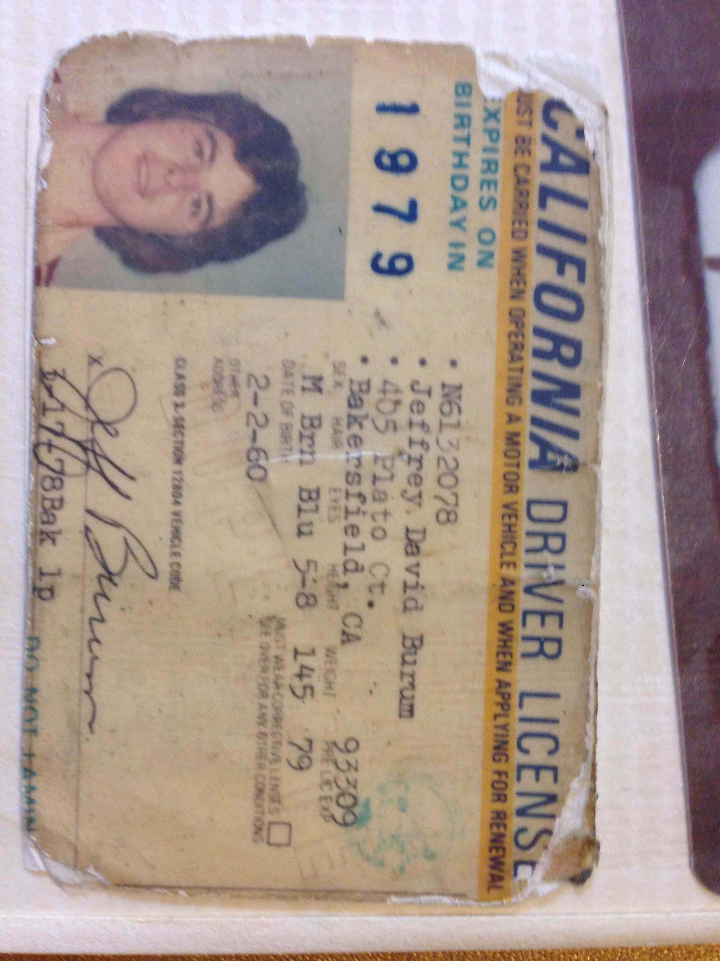
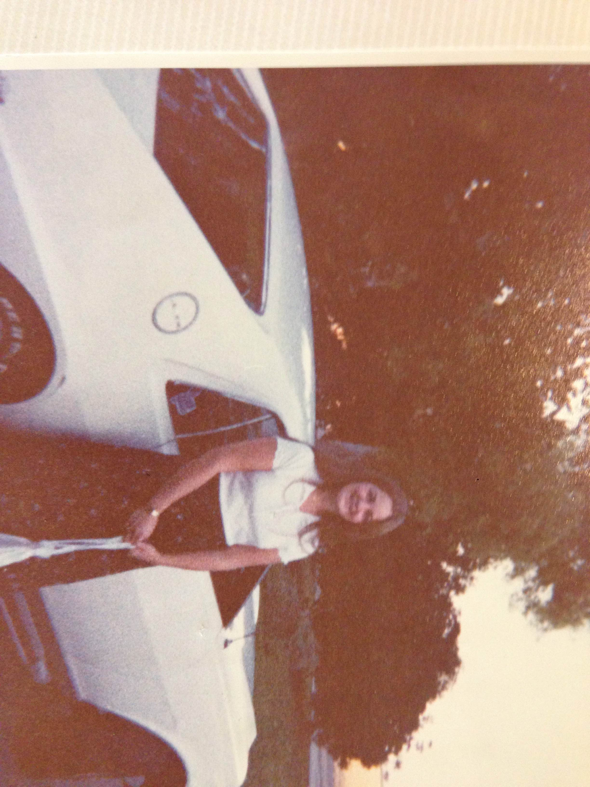
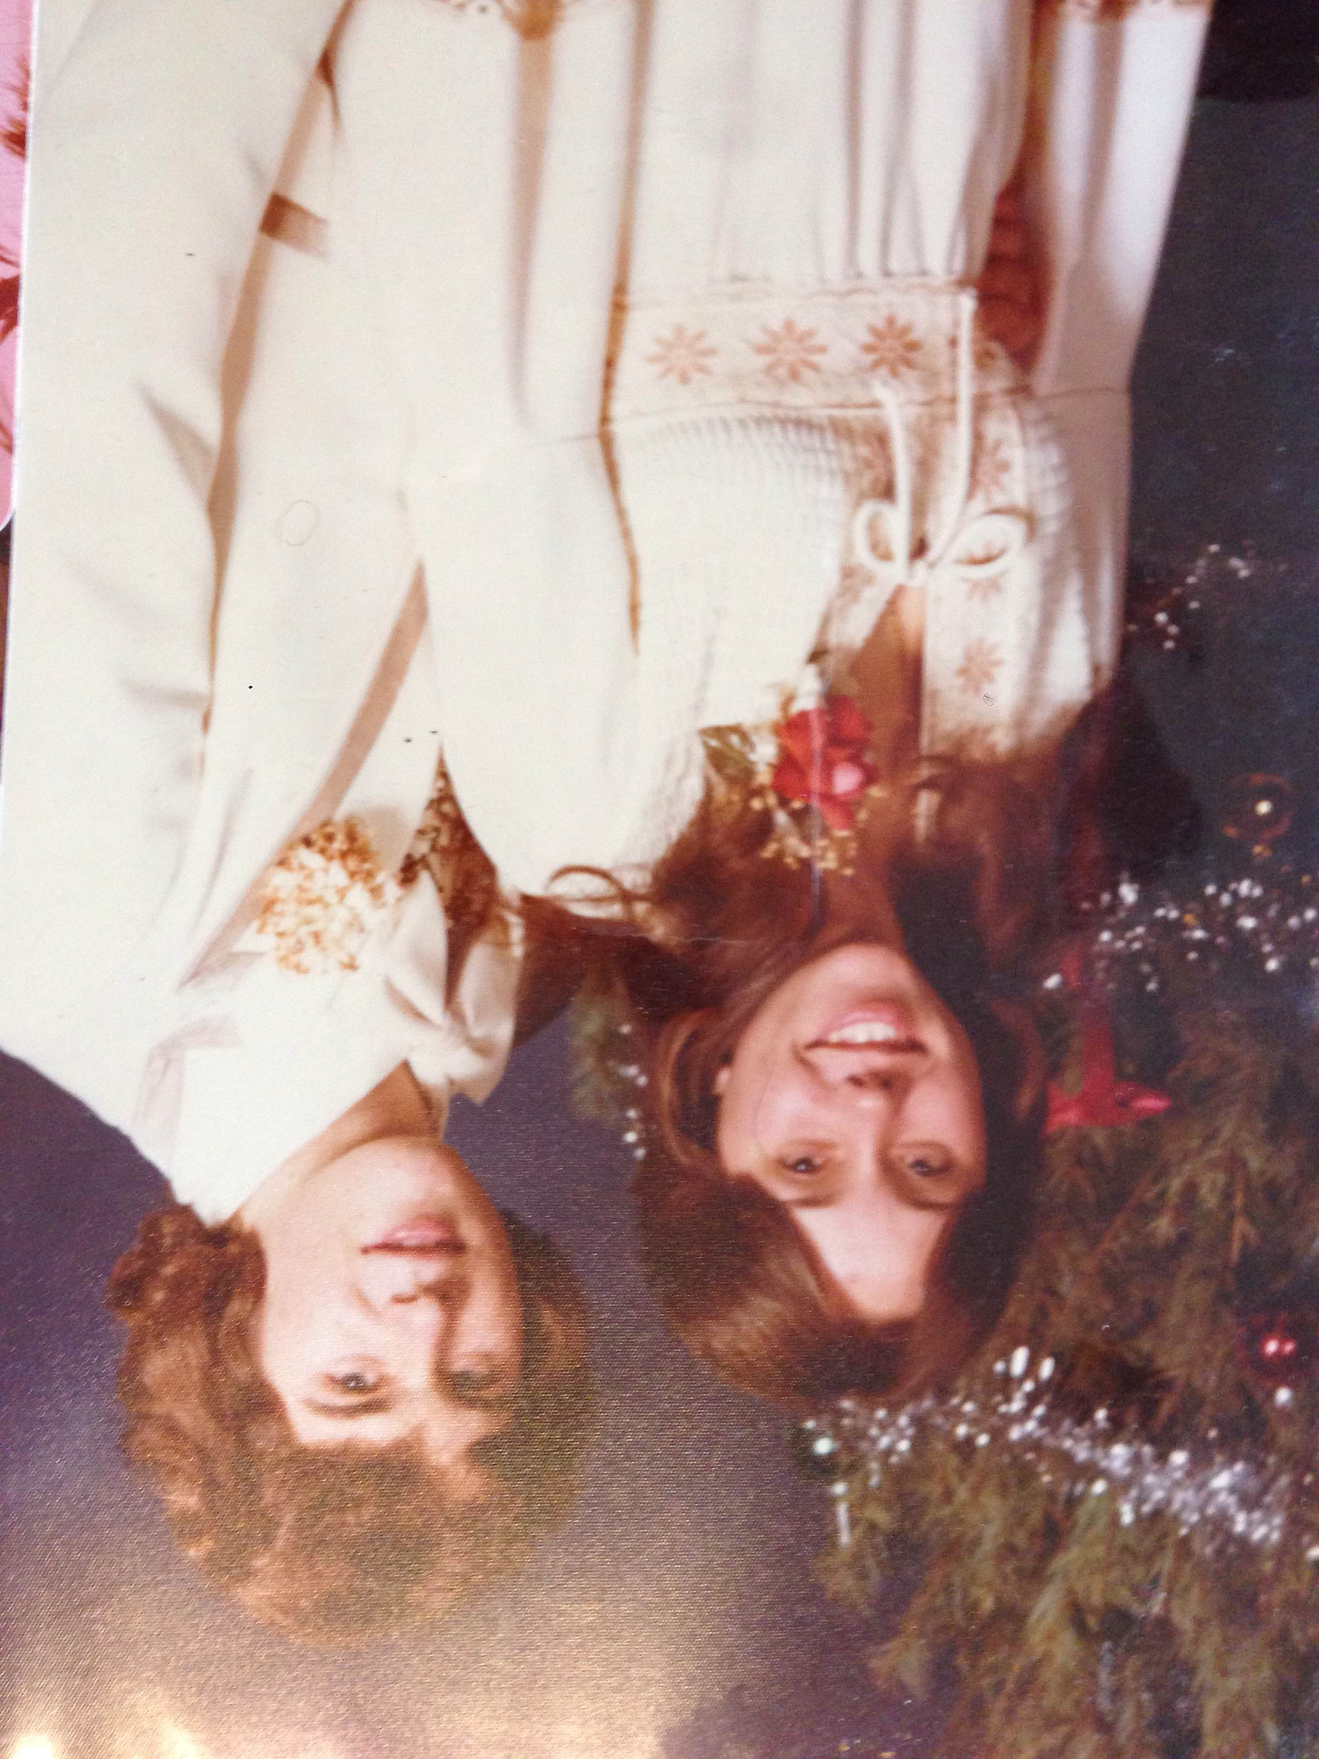
High School
1974-1978
Vietnam over 1975
Gas over $1/Gallon
PIT and Dal dominate Superbowls
Vikings lose 3
Nixon resigned ’74
Ford becomes President
Carter wins ’76
Reagan Gov. of CA, then Edmund Brown
Rolling Stones
Led Zepplin
Jimmi Hendrix
Aerosmith
Pink Floyd
The Doors
The Beatles
Queen
Neil Young

Slide 11
High School 1974-1978
Things that felt difficult or challenging for me while I was in High School were:
  Moved out of my dad’s house and lived with a friend Jr. year
  Mom wasn’t available due to alcoholism and living out of town
  Everything seemed to be based upon popularity not necessarily what was right
  Thought girl friend was pregnant my Jr. year…wasn’t!
  Didn’t know what I wanted to do with my life or how I would get into college

Slide 12
High School 1974-1978
Jobs I worked while I was in High School were:
  Dishwasher at the Jolly Roger Restaurant
  Bus-boy and bell attendant at the Bakersfield Inn
  Grocery store/Drug store clerk and stocker

Slide 13
Getting in to College
The top few things I did to ensure I got into college were:
  Get good grades
  Participate in Student Activities
  Participate in Sports
  Had friends who also wanted to go to college
  Joined the military and used tuition assistance benefits
  Received Presidential Appointment to the USAF Academy

Slide 14
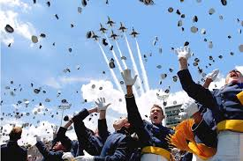
College
I attended college at the USAF Academy and received B.S. in International Affairs 1984
I attended the University of North Dakota and received a Masters of Arts in Political Science and a Masters in Business Administration 1986-1989
http://youtu.be/cnslusqiyPA

Slide 15
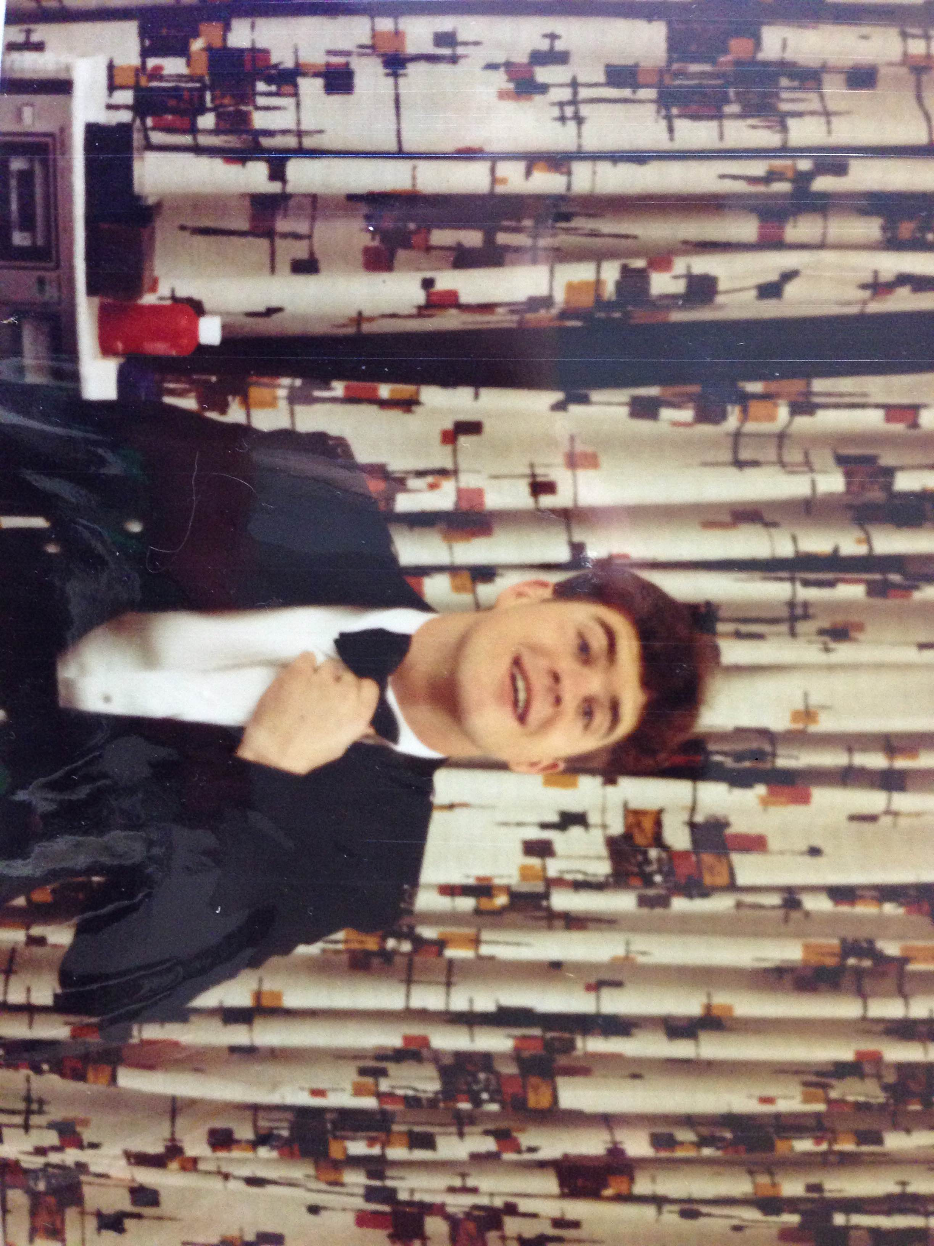
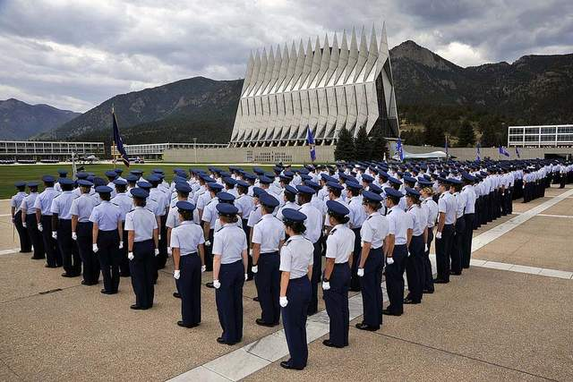
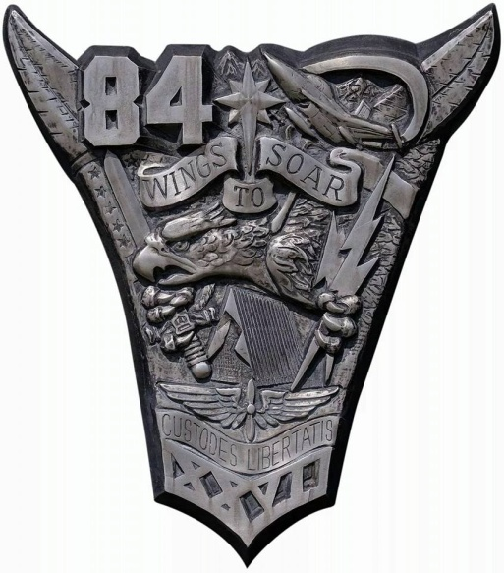
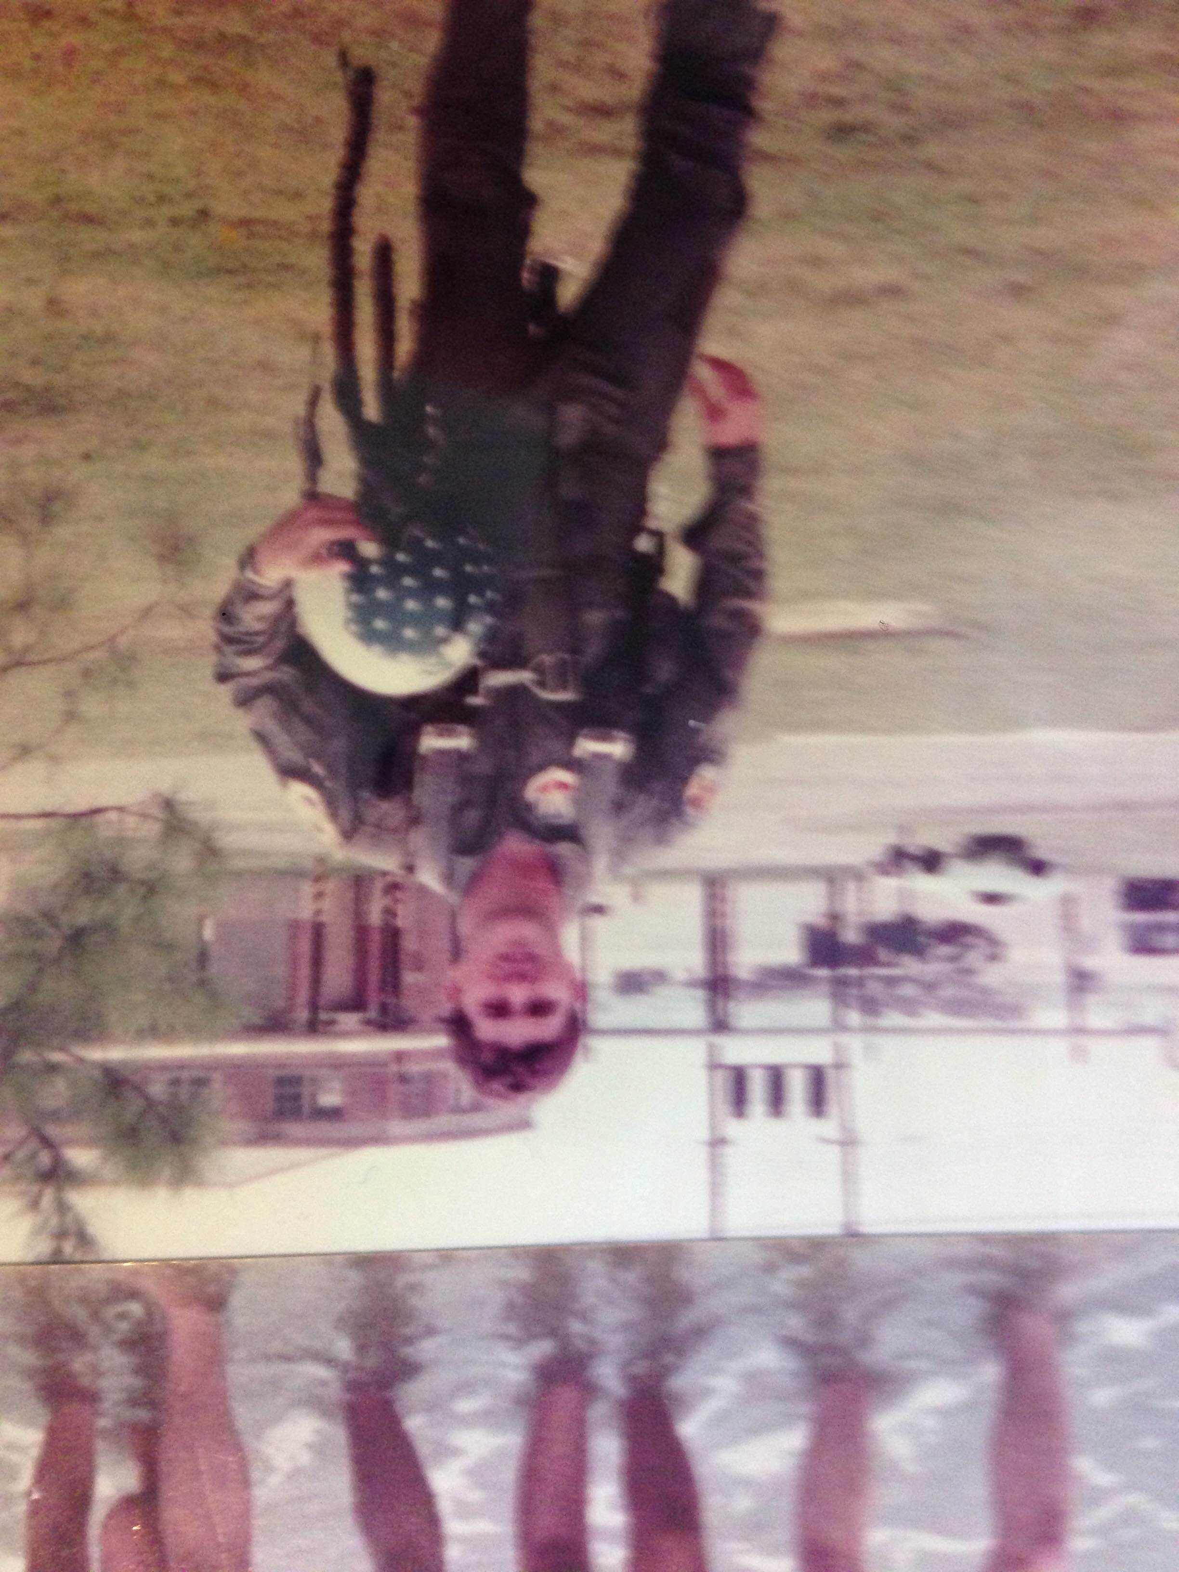
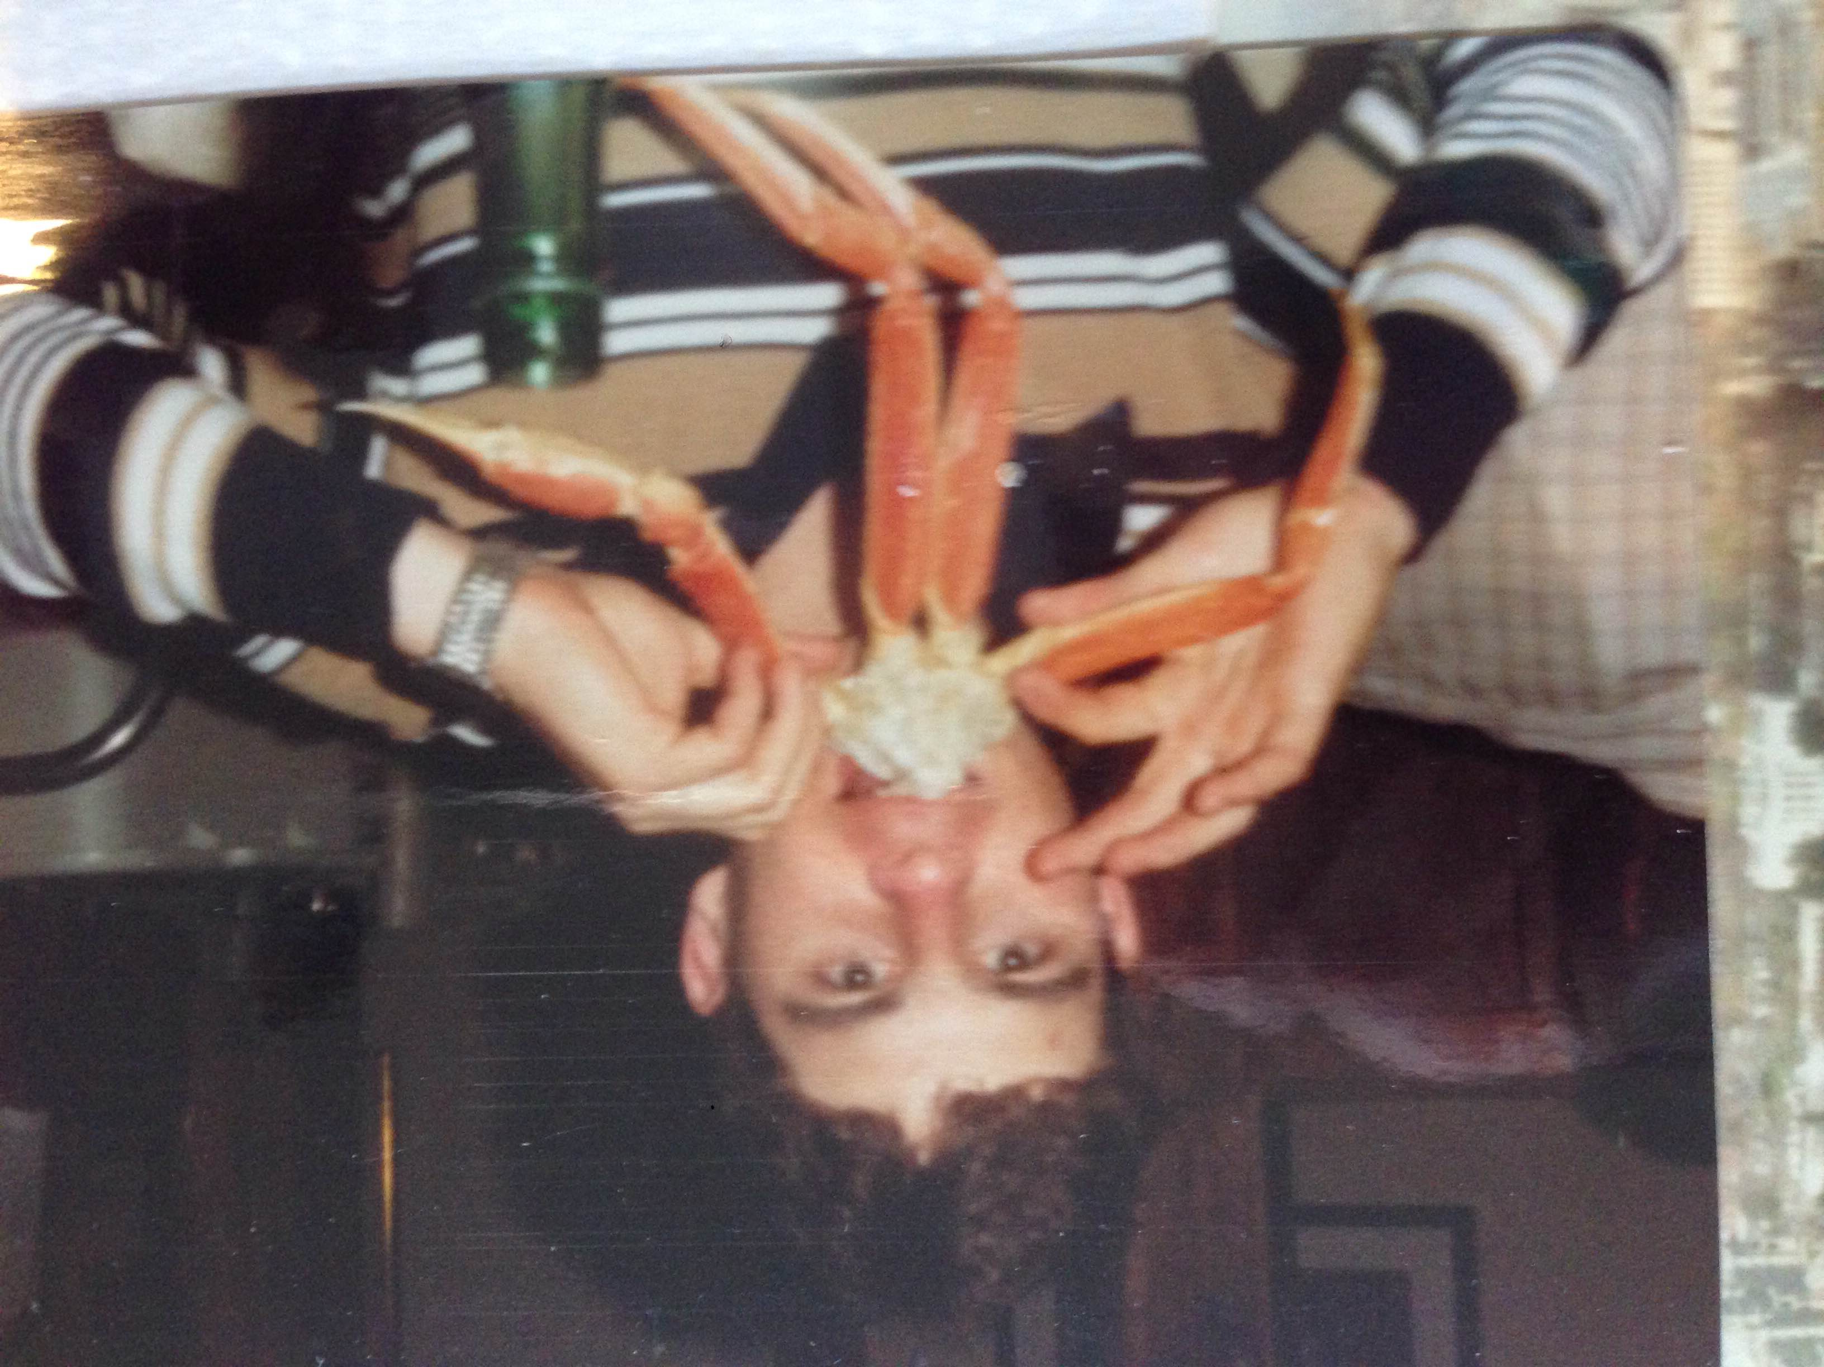
College
Things I enjoyed in College
Things I didn’t enjoy in College

Slide 16
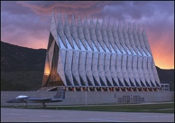
College
Favorite classes
Least favorite classes
Political Science
Business
Management
Accounting
Psychology
History
Physics
Engineering
Calculus
Mechanical Engineering
Electrical Engineering
Chemistry

Slide 17
College
Things that felt difficult or challenging for me while I was in College were:
  Having best friend kicked out of the academy for allegedly violating the cadet honor code…”we will not lie, steal, or cheat, nor tolerate anyone who does”
  Failing to get my Free-Fall Parachute Wings Emblem because I did not complete final 5th jump at 4,000 ft.
  Having to complete the USAF Survival, Evasion, Resistance, and Escape Course for 6 weeks in the middle of no-where during the summer
  Having to endure the difficulty of 4 yrs of intensive officer training and a rigorous academic curriculum

Slide 18

Getting a job after College
The top few things I did to ensure I got a good job after college were:
  Not a problem! Cadets graduate as a Second Lieut. And immediately serve in a career field they have selected corresponding to AF needs

Slide 19

United States air force
Every day in the USAF: the mission is to fly, fight, and win
It needs men and women in all sorts of career fields, not just pilots. It has officers and enlisted personnel
  Go to www.airforce.com

Slide 20

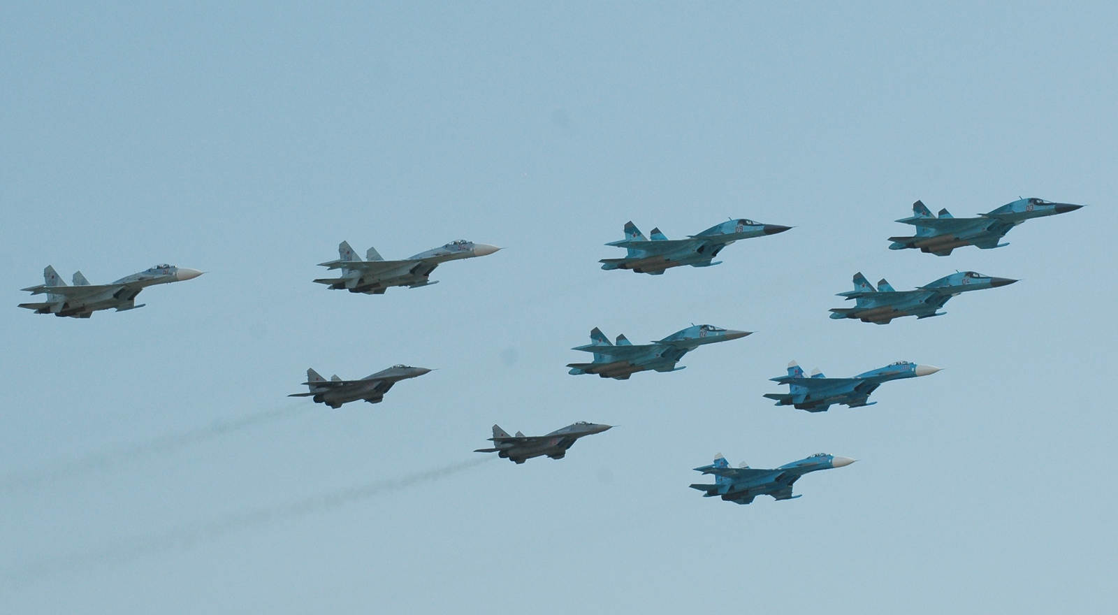
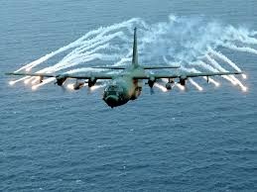
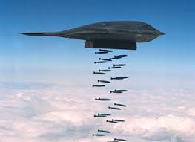
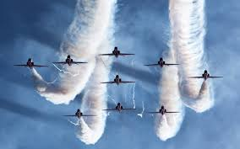
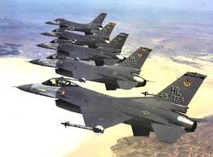
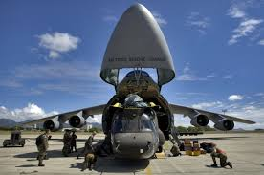

Slide 21
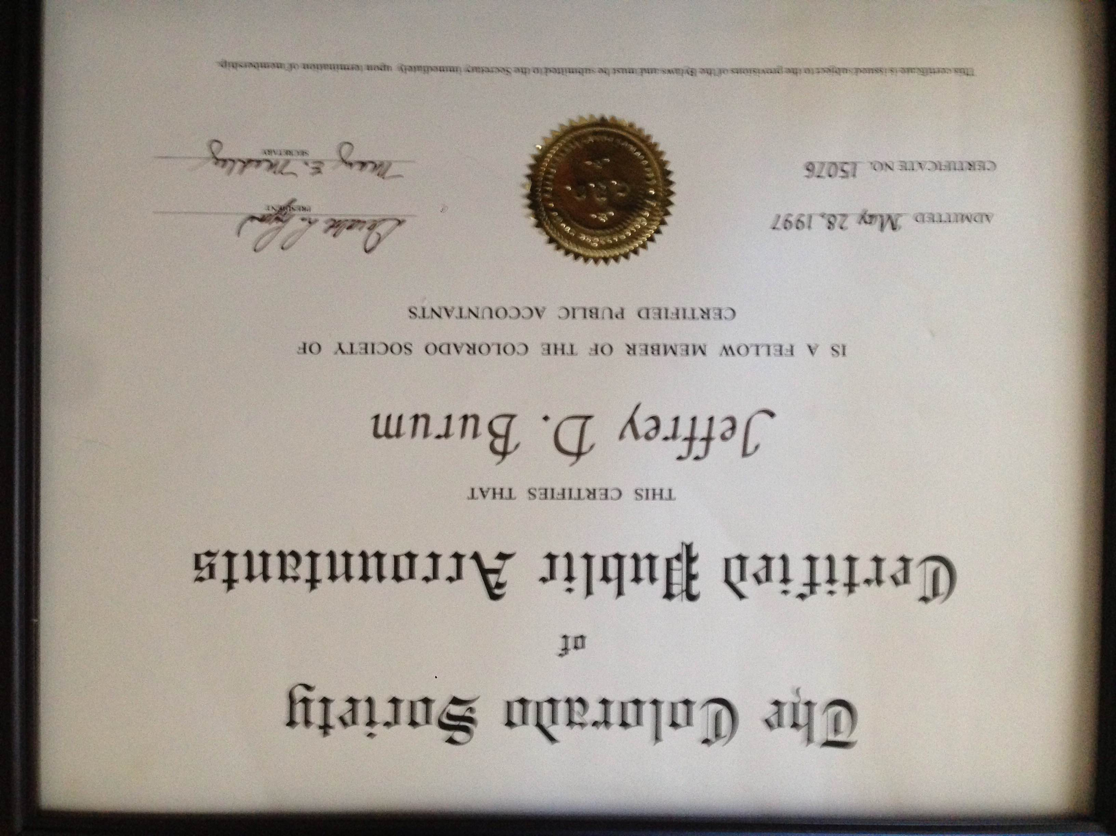
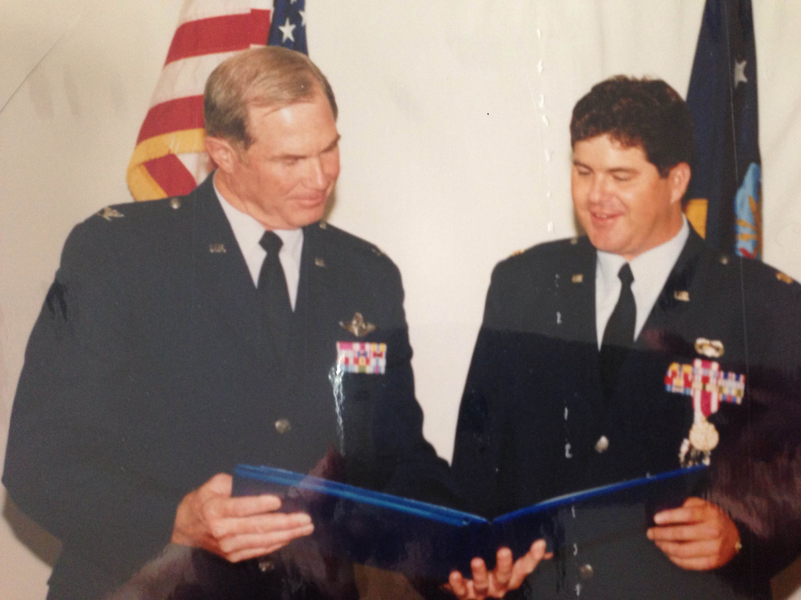





My Career Path
Civilian Career: Business owner of own Certified Public Accountant Firm and Investment Advisory Firm (98-present)
Enlisted in the Air Force as Med Tech, then got appointed to USAFA Prep School (78-79)
Air Force Officer Career: Cadet, 2 Lt., 1 Lt., Cpt, Maj., Retired (80-98)
Notes:
You may use this chart to describe your journey to the current career

Slide 22
My Career
The first job I had after college was:
  2nd Lt. ICBM Combat Crew in Grand Forks, ND
The worst job I have ever had was:
  Chief of Financial Management and Analysis at the USAF Academy

Slide 23
My Career
Challenges I have had to overcome throughout my career are:
  Relatively low Income (but good retirement benefits)
  Long hours, especially during unit evaluations
  Politics…hard work not always rewarded
  Separations during alerts or deployments
  Contracting Gulf War Illness and not being told or helped for 21 yrs. although my health gradually declined

Slide 24

Compensation in the air force
Mostly by rank and time
Enlisted and officer pay grades
Specialty Pay
Deferred Compensation/Defined Benefit Plan Retirement
Commissary Privileges
Free Health Care
  Complete information at www.airforce.com
Notes:
Use this graph to show general compensation ranges for people in various roles in your company

Slide 25









More than just work

Slide 26
Do it all over again?
If I could talk to my high school self, what would I say?
  No, I have Gulf War Illness and the VA scandals are a national disgrace.
    Alternatively, I would have been an attorney or an investment banker
  Yes, I’m proud to have served my country and contributed to world history (Won Cold War in 1989, Won Desert Storm in 1991-1995).
    My military career also set me up very nicely for my second career by having retired pay and health benefits.

Slide 27

529 College Plans
Invest Now or Borrow Later?
  How much will college cost?
Tax Advantages
  Gift, Federal Income Tax, and Estate Benefits
Age Based and Individual Asset Allocations

Slide 28

QUESTION AND ANSWER

