Slide 1
Kevin Davis YBA Presentation
January 9, 2015

Slide 2
INTRODUCTION
My name is Kevin L. J. Davis and I am 50 years old.
I work for the Investigative News Network (INN), a 501(c)3 nonprofit organization based in Encino, CA
We are a trade organization and consulting company for independent nonprofit news organizations that inform the public, hold the powerful accountable and help keep our democracy free
My role at INN is Chief Executive Officer & Executive Director
It is my job to be a spokesperson, raise money and oversee programs designed to benefit member nonprofit newsrooms around the country

Slide 3
The Early Years…
I was born and raised in London, England

Slide 4
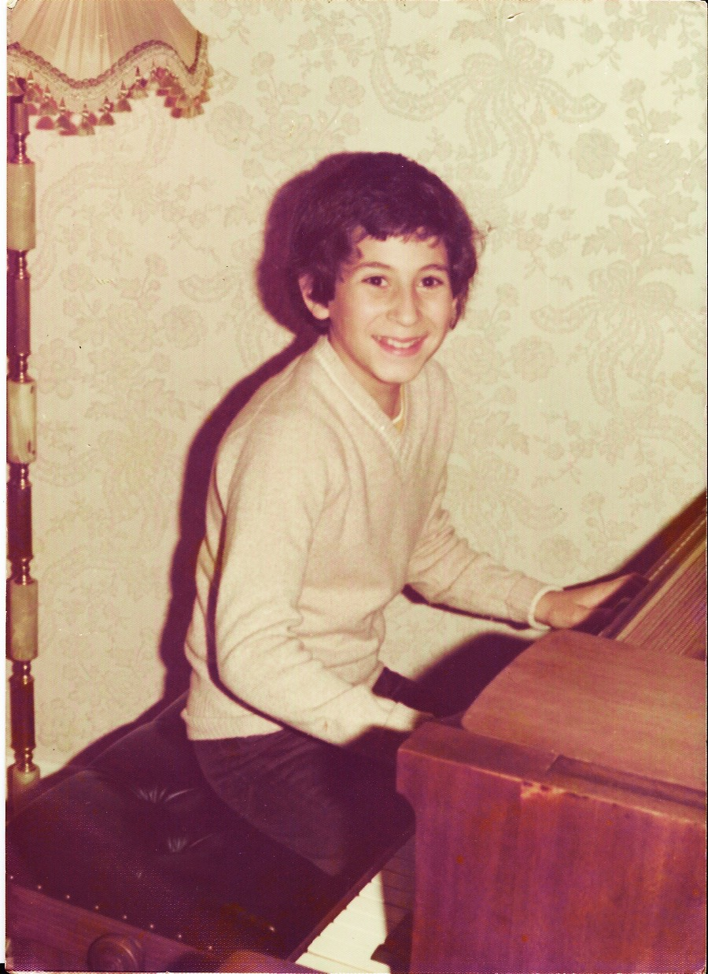
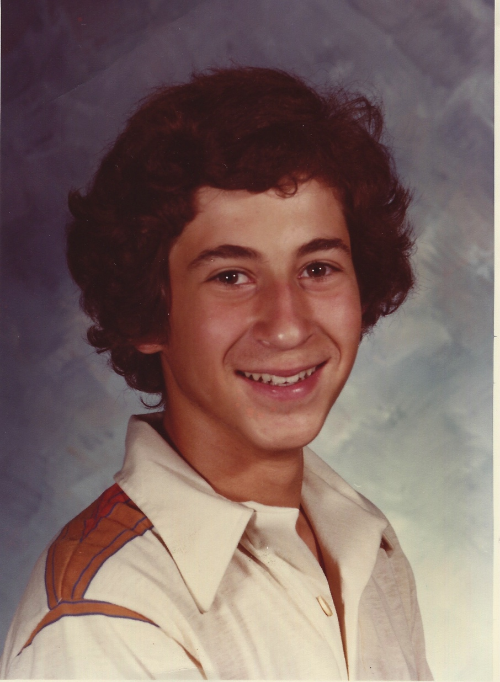
More Early Years…
We emigrated to Culver City, CA in 1978. I was 13.

Slide 5
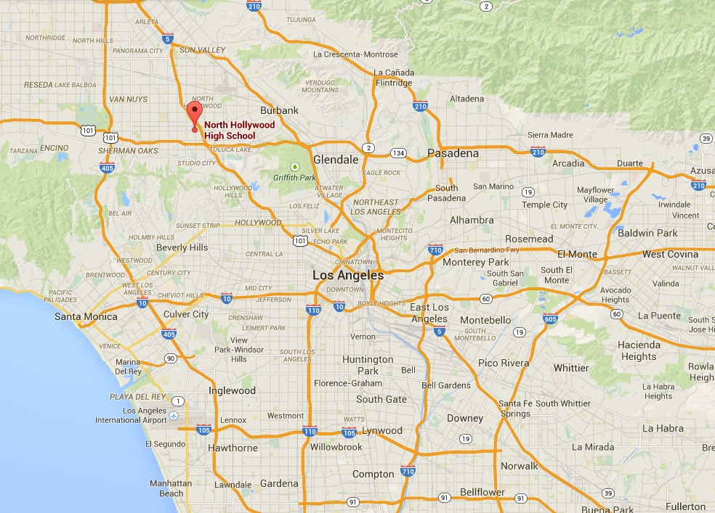
HIGH SCHOOL
I attended North Hollywood High School, in the San Fernando Valley, from
1980 – 1982

Slide 6
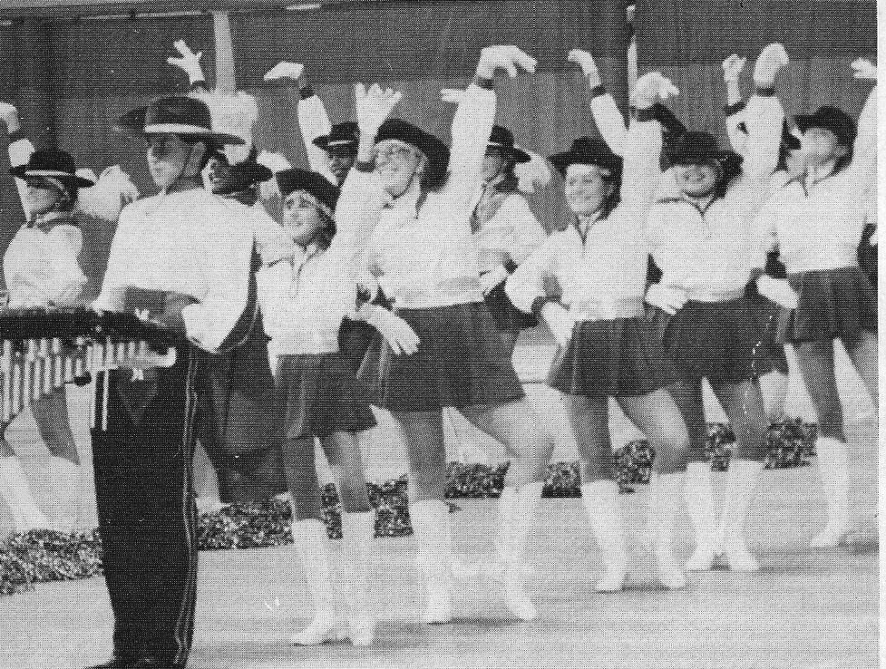
HIGH SCHOOL
I flunked 12th Grade the first time when I was in 9th Grade at Culver City Junior & High School
After moving to the San Fernando Valley, I set my mind to being an average student.
But oh how I loved wearing that Husky Marching Band uniform!

Slide 7
HIGH SCHOOL
Things I enjoyed in HS:
Things I did not enjoy in HS:
Being in a co-ed environment
Not having to wear a uniform
Feeling of belonging ( once I joined band)
Music and performing
Being called “English Dude”
Not growing-up with the other kids
Experiencing my family breaking-up three years after we moved here

Slide 8
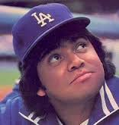
HIGH SCHOOL
Fondest memories from HS
Girls loved the accent
Getting to perform at Dodger Stadium for “Battle of the Bands” the night Fernando Valenzuela pitched at the height of “Fernando-mania”
Obstacles/Adversity you had to overcome in HS
Lack of guidance and understanding from my parents
Nobody like me/Not identifying with my peers
Always feeling like an outsider
Feeling the need to “dumb down” to fit in.
My Grandpa dying in London, and missing 1st semester senior-year finals

Slide 9
Biggest Life Changing Event
After living in the United States on an E-1 Treaty Trader’s Visa for 8 years, I was set for deportation.
Instead of deporting me, an Immigration Adjudicator made me a foreign student
That’s how I ended up being the first person in my family to go to College

Slide 10
College
I first attended Los Angeles Valley Community College
Then transferred to Cal State University Northridge
LA Valley College gave me a fresh start
CSUN was all we could afford, but gave me a great education

Slide 11
College
Activities in College:
Why I didn’t work for money while in College:
Competitive speech team
Specialized in
speech performance
extemporaneous speech
Worked for free as an unpaid, un-credited Intern for Columbia Pictures for 2 ½ years
Was denied right to work while in College
Was unable to attend my college graduation to go to INS interview in London that day
Received my “Green card” day I graduated college

Slide 12
College
Favorite classes:
Least favorite classes:
Journalism
Film history
Forensics
Rhetoric
Foreign languages
English literature 101 (because the teacher was a bore)
Statistics

Slide 13
College
Fondest memories:
Obstacles or Adversity
that I had to overcome:
Meeting peers who like me came from atypical backgrounds
Discovering Forensics and how fun it can be to speak competitively
Discovering that I had a brain
No family culture of continuing education
Foreign student fees
Inability to work through school

Slide 14
Career Path
I started as a “gopher” working in a jewelry factory
Became a Sales & Marketing Coordinator for a Movie Studio after regaining my right to work in US
Sold our small Internet services firm that sold to a big firm that went public
Replaced an HBS grad to become Publisher of LA 411
Became CEO & ED of INN 4 ½ years ago
Notes:
You may use this chart to describe your journey to the current career

Slide 15
Career

Slide 16
Career
My First Job:
My Worst Job:
Refining gold for a jewelry factory – Downtown, LA
Sales & Marketing Materials Coordinator for RCA Columbia Pictures Home Video
Refining gold for a jewelry factory in Downtown, LA
My First Real Job:

Slide 17
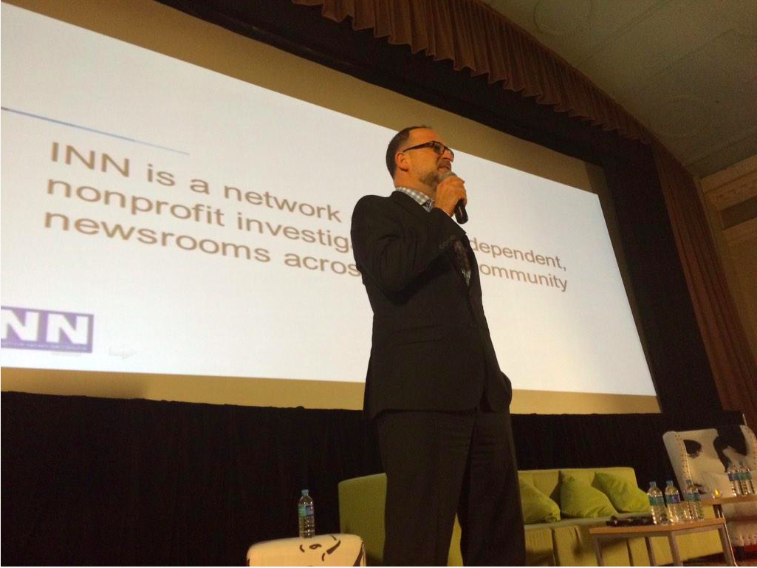
Career
Some challenges I had to overcome in my career:
I never went to Grad school (and wish I had)
I don’t have a business degree
I am “self taught” in business, journalism and technology
Being from the West Coast/Los Angeles comes with cultural baggage

Slide 18
CURRENT ROLE
History
First CEO & employee of the company
Started in 2009 with a meeting sponsored by the Rockefeller Bros Fund
Size
We have 11 employees in seven States
Our annual budget will be around $3MM for 2015
Location
Our employees are in California, Massachusetts, Illinois, Ohio, Minnesota, Missouri & Florida
We were incorporated in Washington DC, but are headquartered in Encino
Products
Services
WordPress content management system (CMS)
Social funding tool
Affordable business insurance
Business, strategic and technology consulting
Notes:
Use this graph to give more description of your current company (history, size, location, products and services, etc.)

Slide 19
Current Role
CEO
Strategy
Revenue Development
Financial Oversight
Risk Management
Program Development
Notes:
Use this graph to give more description of your role specifically (responsibilities, typical work week, direct reports, etc.)

Slide 20
Career Compensation
Management: $65 – 80k
Programmer:
$55 – 85k
Graphics Designer:
$65 – 80k
Coordinator
$28 - 34k
Pay is commensurate with experience
Notes:
Use this graph to show general compensation ranges for people in various roles in your company

Slide 21
ACADEMIC EXERCISE
We will now spend several minutes discussing the day’s academic module and how it is relevant in the ‘real world’

Slide 22
QUESTION AND ANSWER

