Slide 1
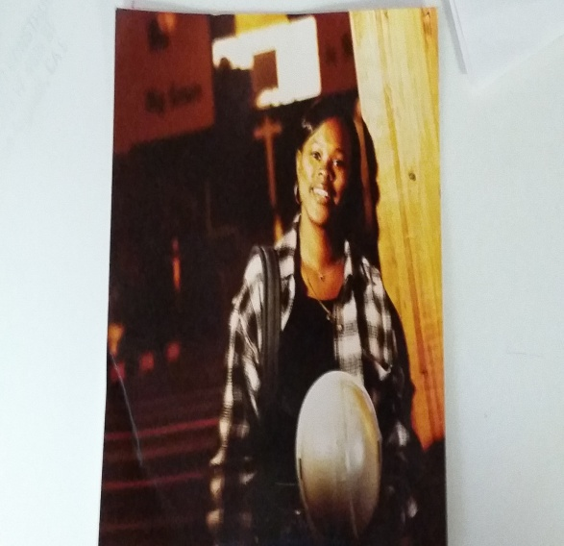
Sharon Coleman
President

Slide 2
Sharon’s Story
1. Have you always lived in California?

Slide 3
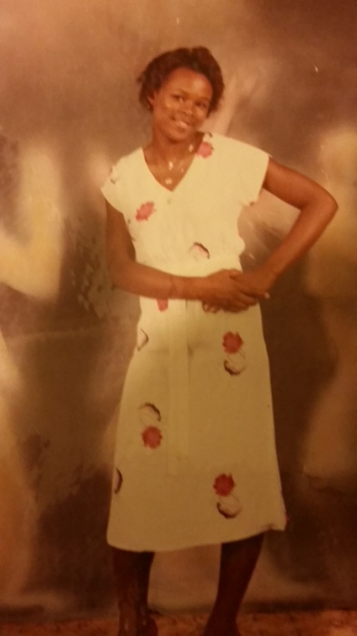
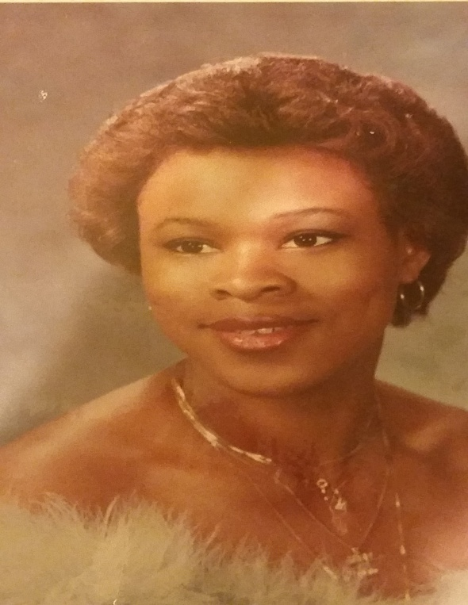
2. Did you have to go to school after high school?
3. What kinds of subjects did you like to study in school?
4. What kinds of subjects were important for you to know in order to be able to do your job?

Slide 4
5. Did you always know you wanted to do what you do? If not, how’d you start out?
6. How did you get to where you are? Was your path typical/not typical?

Slide 5
7. What do you do? What did you do before this?
8. What kinds of things do you do at your job?
9. Do you like your job?

Slide 6
Did you know?
As construction is one the largest industries, the construction trades is facing a severe shortage of skilled young talent in over 25 professions. In an attempt to fill
the projected one million careers opening up over the next 5-10 years.

Slide 7
Why Choose a Career in the Construction Industry?
Building schools, hospitals, bridges and roads all stay in the U.S. You can’t ship them oversees.
Each year the United States adds more than $600 billion worth of new construction projects such as new hospitals, schools, highways, bridges, homes, office buildings, stores, etc. That's about 10% of America's Gross Domestic Product.
The construction industry ranks among the top 10 largest sources of employment growth in our country, and it is estimated that the industry will have to recruit and train 240,000 new craft professionals each year to keep up with the growing demand.
Aging work force (average is 47 years old) - More jobs than students graduating now and in the future.
The construction industry is the second largest employer in the U.S., second only to all government employees including the armed forces.
Motivated graduates can easily move up the management ladder.
You can choose your work environment - inside or outside or both.

Slide 9
What I Have Learned
1. Try new things you may find that you like it and are even good at it!
2. Don't let anyone tell you that you can't do something just because of who you
are (a girl, for example!). Stubbornness can be a good thing! If someone tells you
that you "can't" do something well, it should just make you want to prove them
wrong you "can't" do something well, it should just make you want to prove them wrong!
3. Find something that you are passionate about, and go for it. If people can tell
you really care about what you are doing and are excited about it, they will want
to help you. And if you are working for something you love, you won't mind
working hard to reach your goal.
4. Don't be scared to ask for help - it doesn't make you look bad. It just shows
that you want to learn.

