Slide 1
YBA GUEST SPEAKER
BEN EVERARD

Slide 2
INTRODUCTION
My name is Ben Everard and I am 32 years old.
I work for a startup company.
We produce film and television projects.
My role at Grey Matter Productions is COO
Since I run my own business (with a partner), I am in charge of many different aspects of the company – legal, technology, marketing, etc.

Slide 3
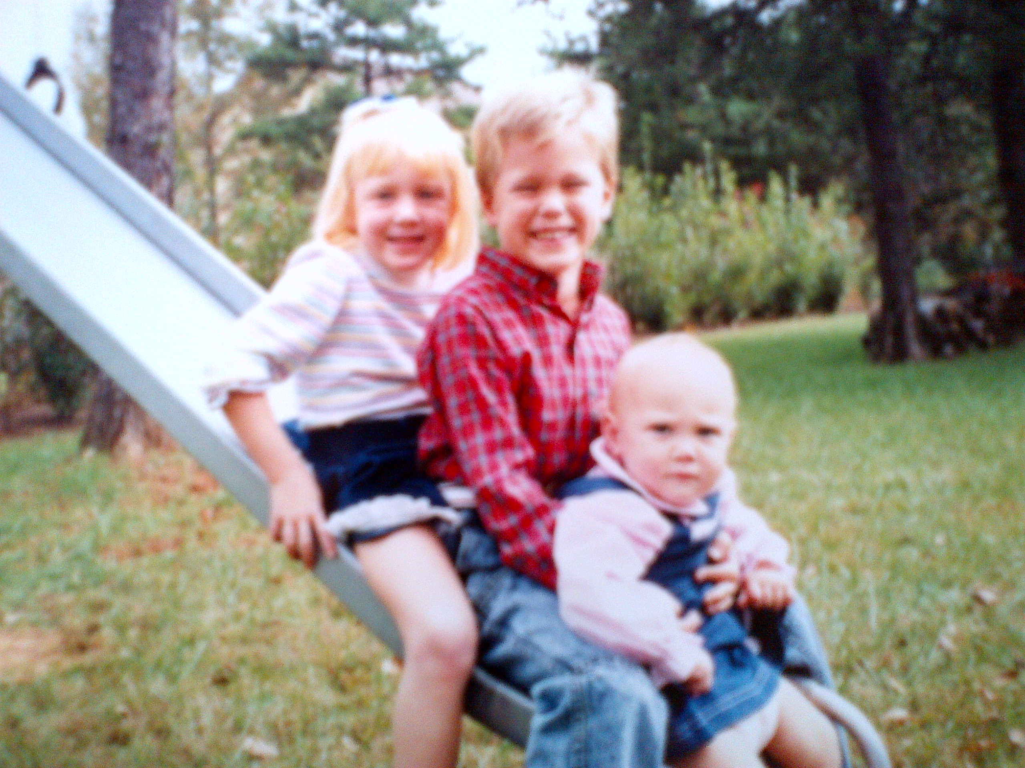
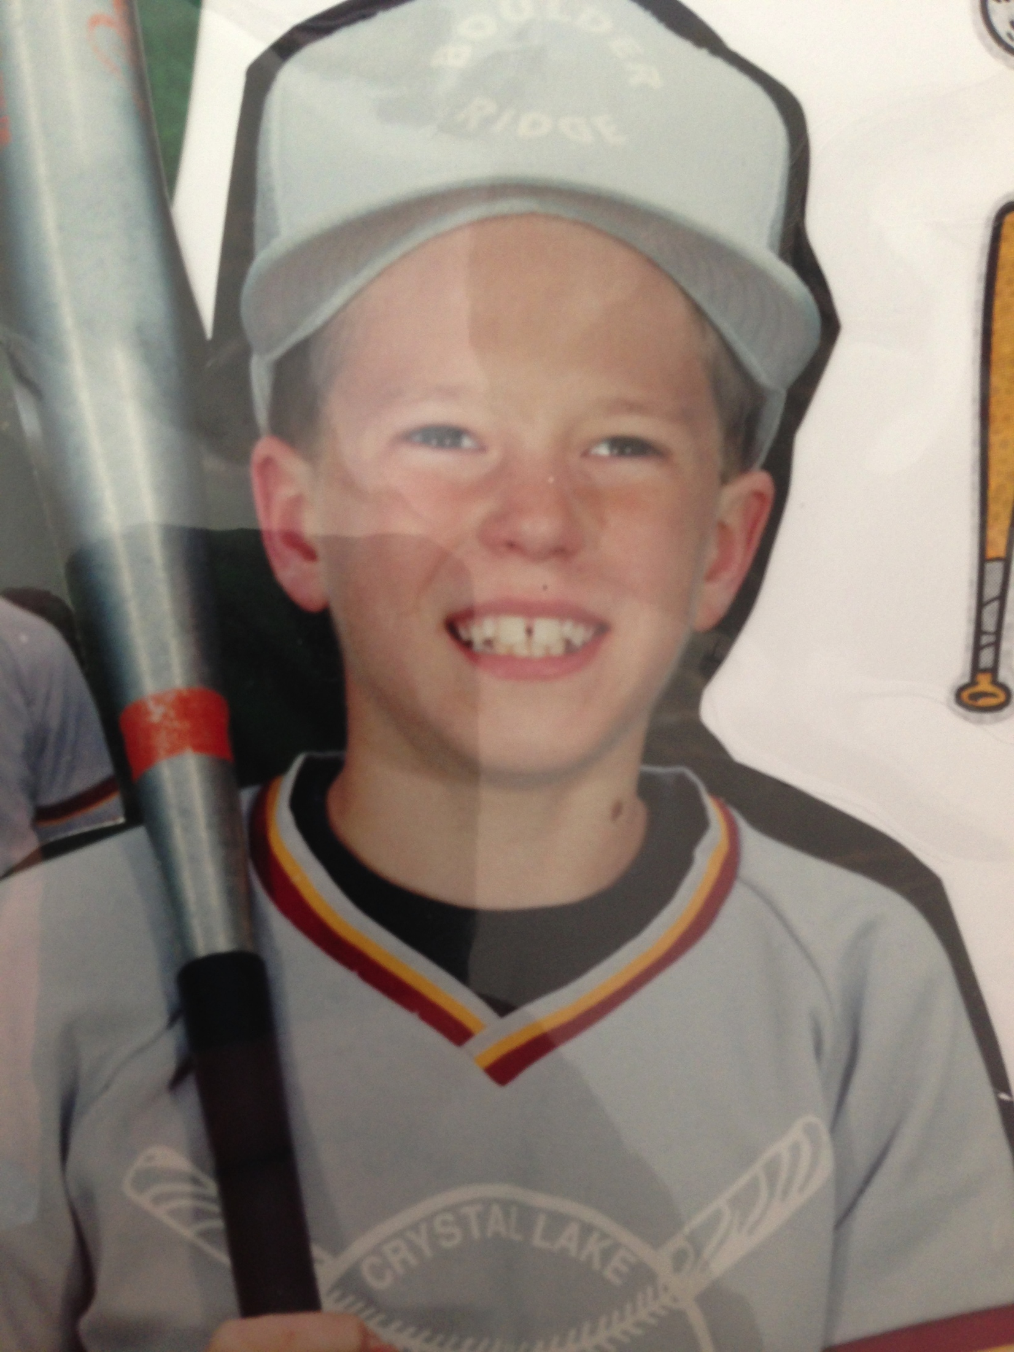
The Early Years…
I was born in Sheboygan, WI and raised in Illinois
This is a picture of me at 13 years old.
This is a picture of me at age 6.

Slide 4
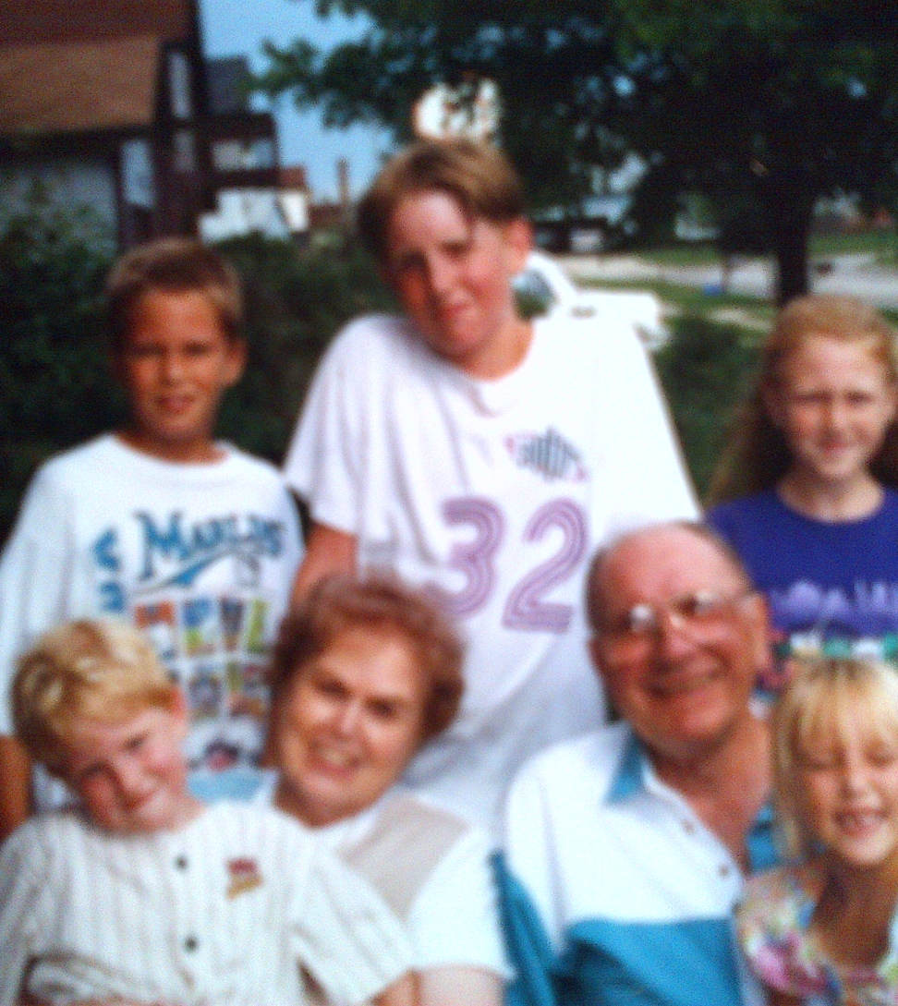
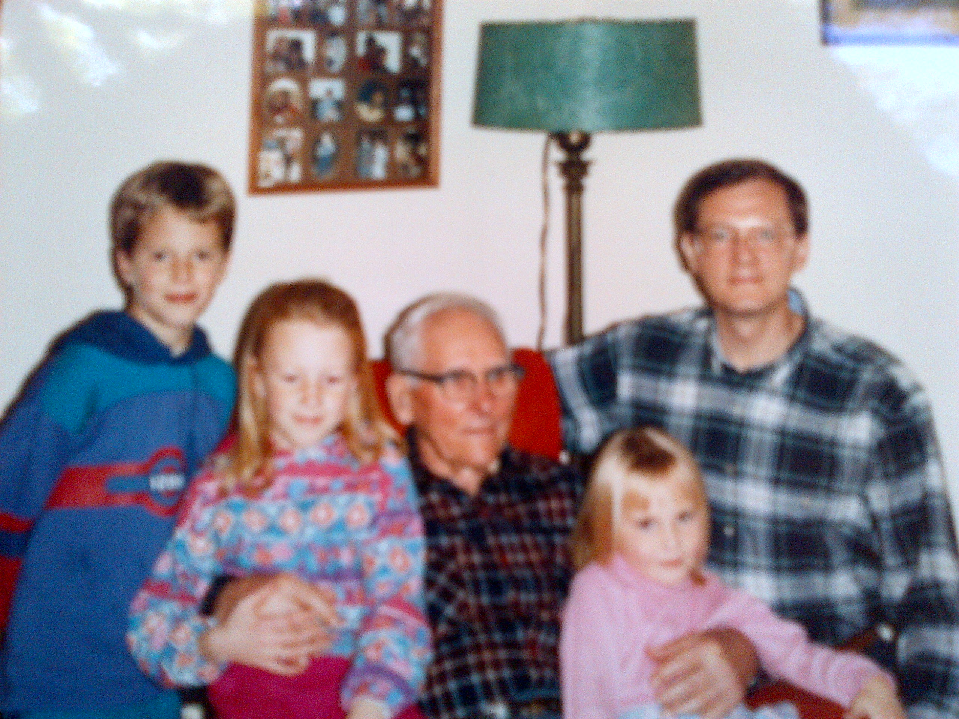
More Early Years…
A little about my family…
This is a picture of me and my sisters (2), cousins (2) and grandparents.
This is a picture of me and my great grandfather, two sisters, and father. FAMILY NAMES.

Slide 5
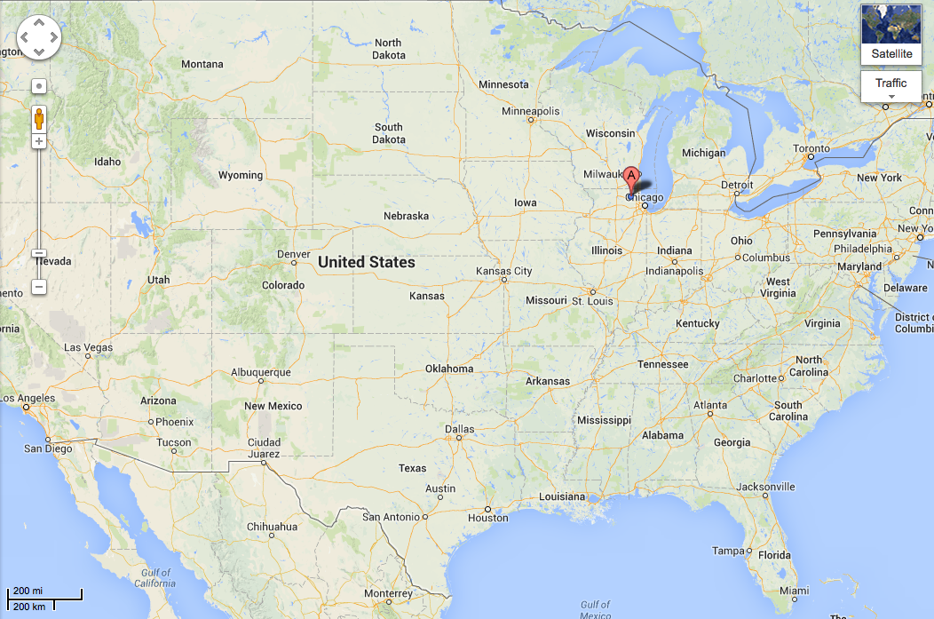
HIGH SCHOOL
I attended Crystal Lake South High School in Illinois.
Insert map shot here
\

Slide 6
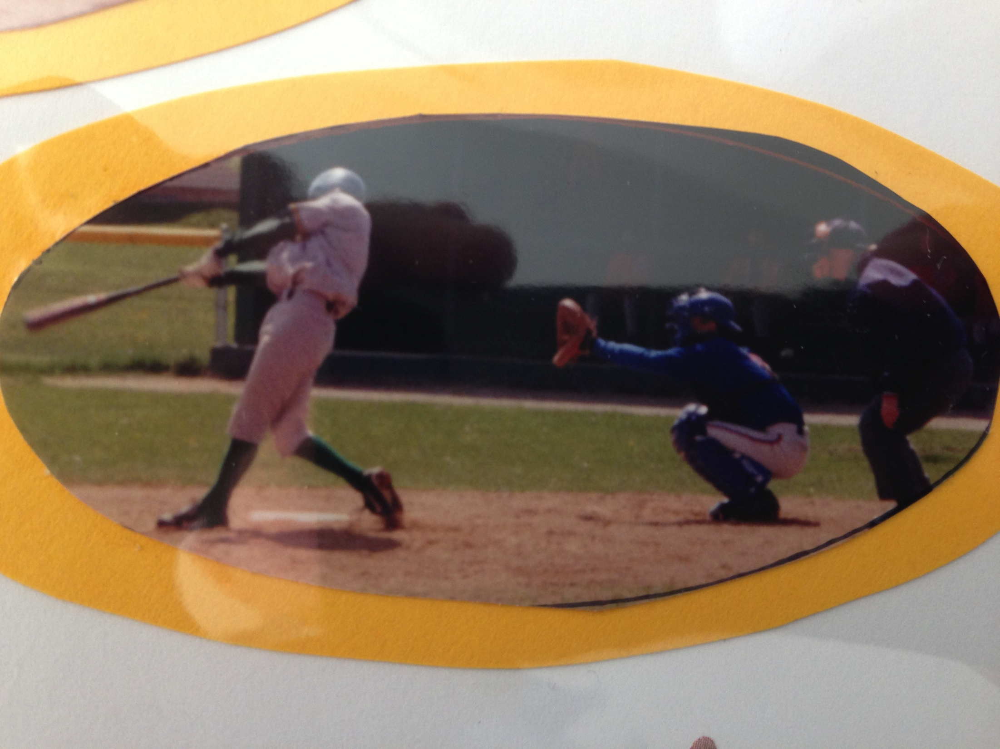
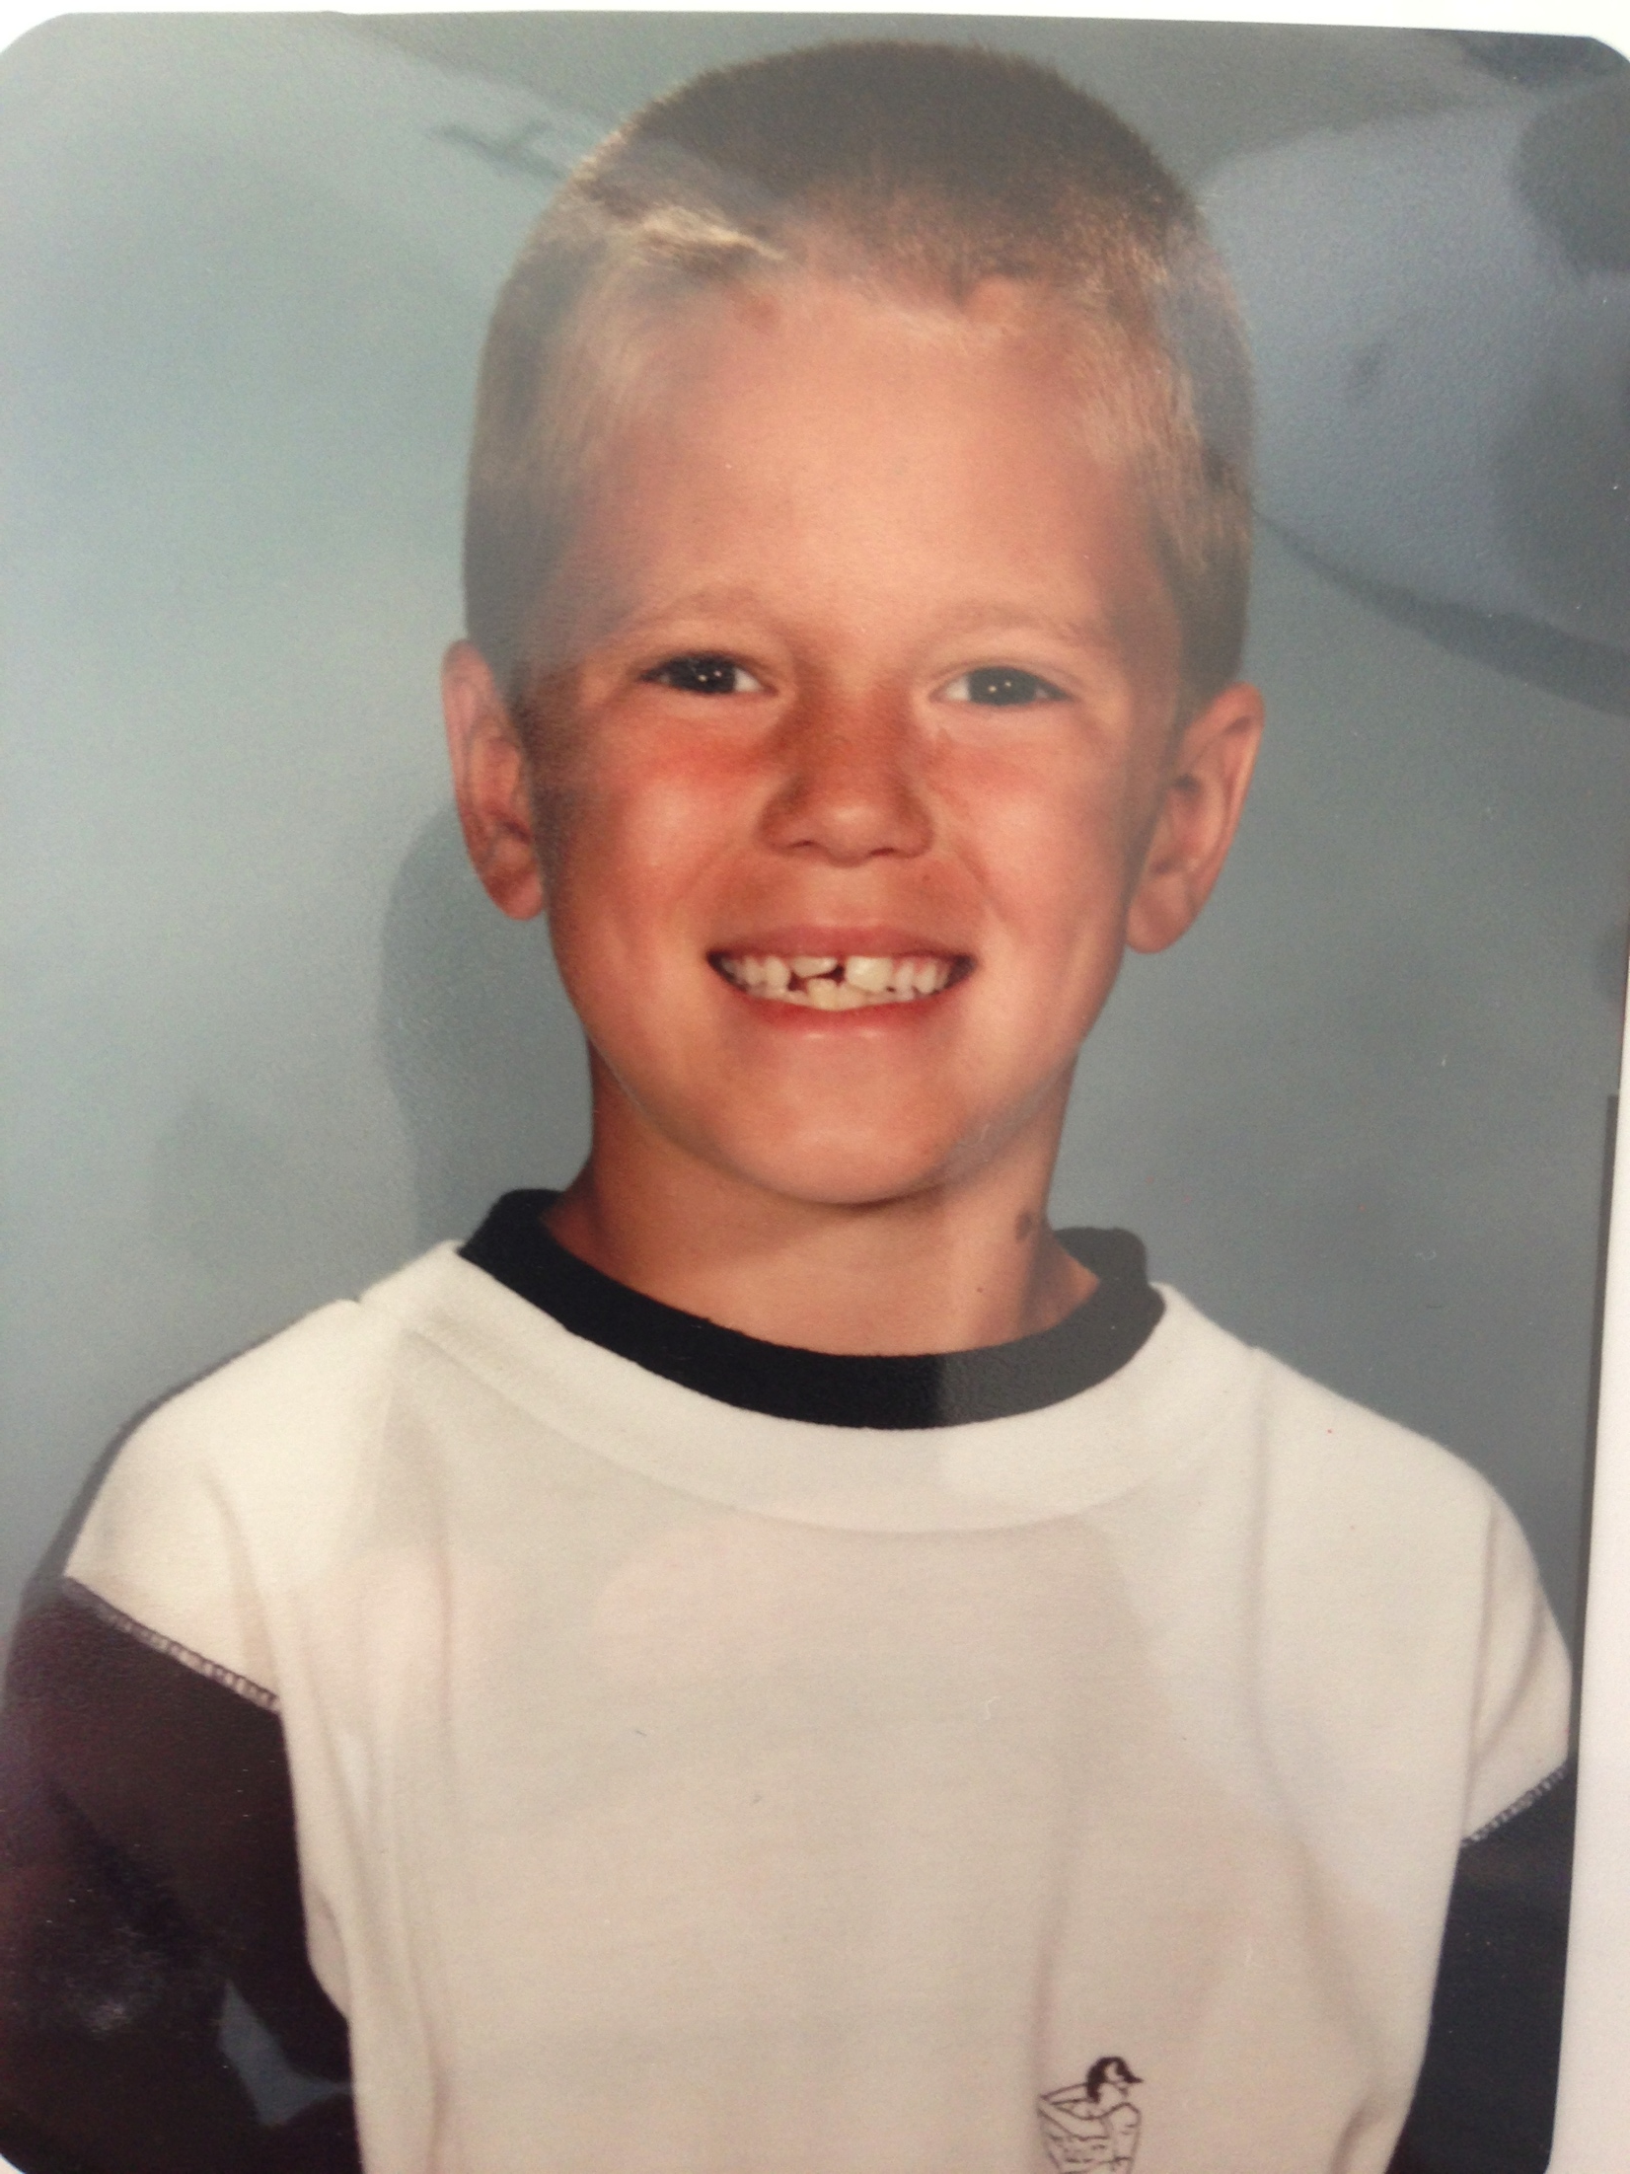
HIGH SCHOOL
As a HS student I was involved in basketball, baseball, and other extra curricular activities (NHS, etc)
As a HS student I was fairly outgoing, played sports, studied quite a bit and tried not to get into too much trouble.
\
Here is a shot of me in HS
Me as a 2nd grade student

Slide 7
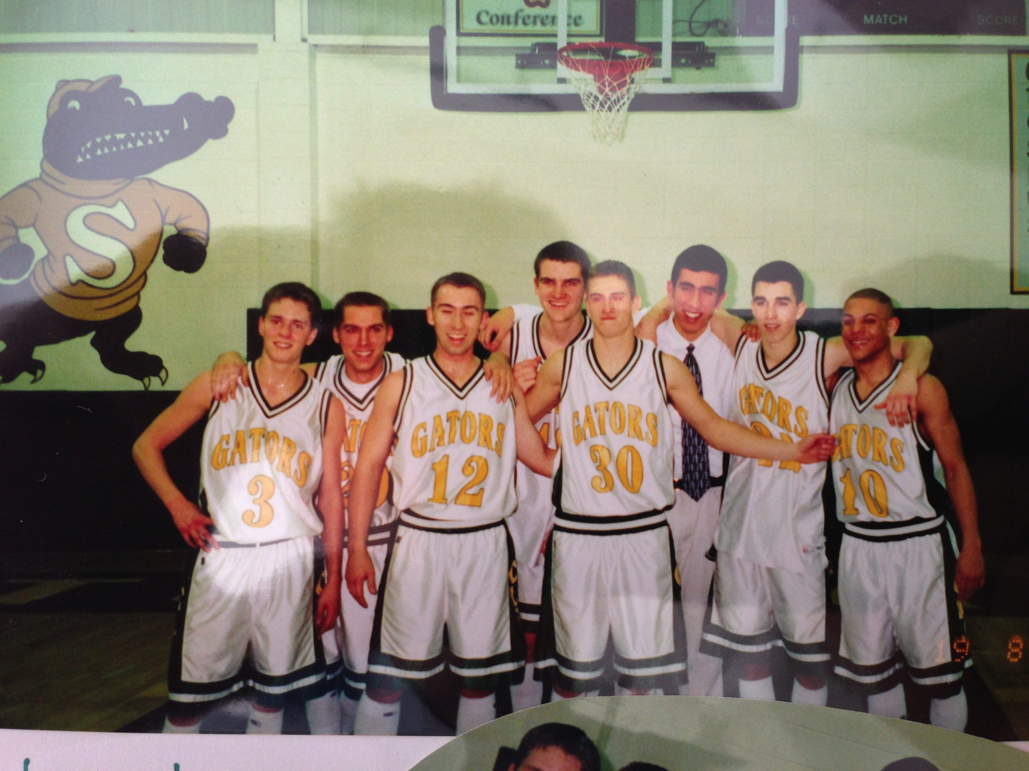
HIGH SCHOOL
Things I enjoyed in HS
Things I did not enjoy in HS
Spending time with friends
Playing athletics
Growing as a person
High school cliques
Certain classes/teachers
Awkward phases

Slide 8
HIGH SCHOOL
Activities/Athletics in HS
Jobs I worked while in HS
Baseball
Basketball
National Honor Society
Cross Country
Football
Golf Caddy
Mowed lawns

Slide 9
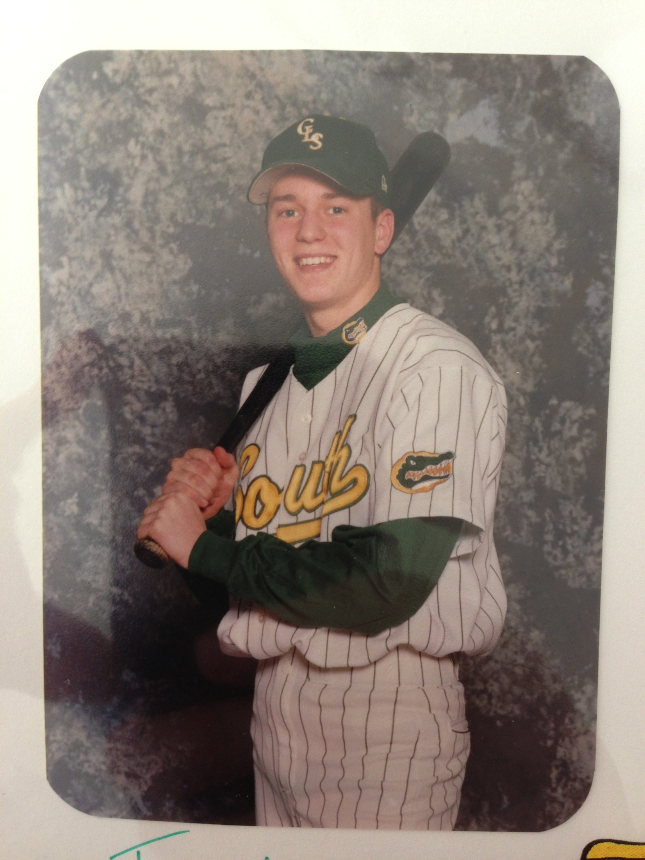
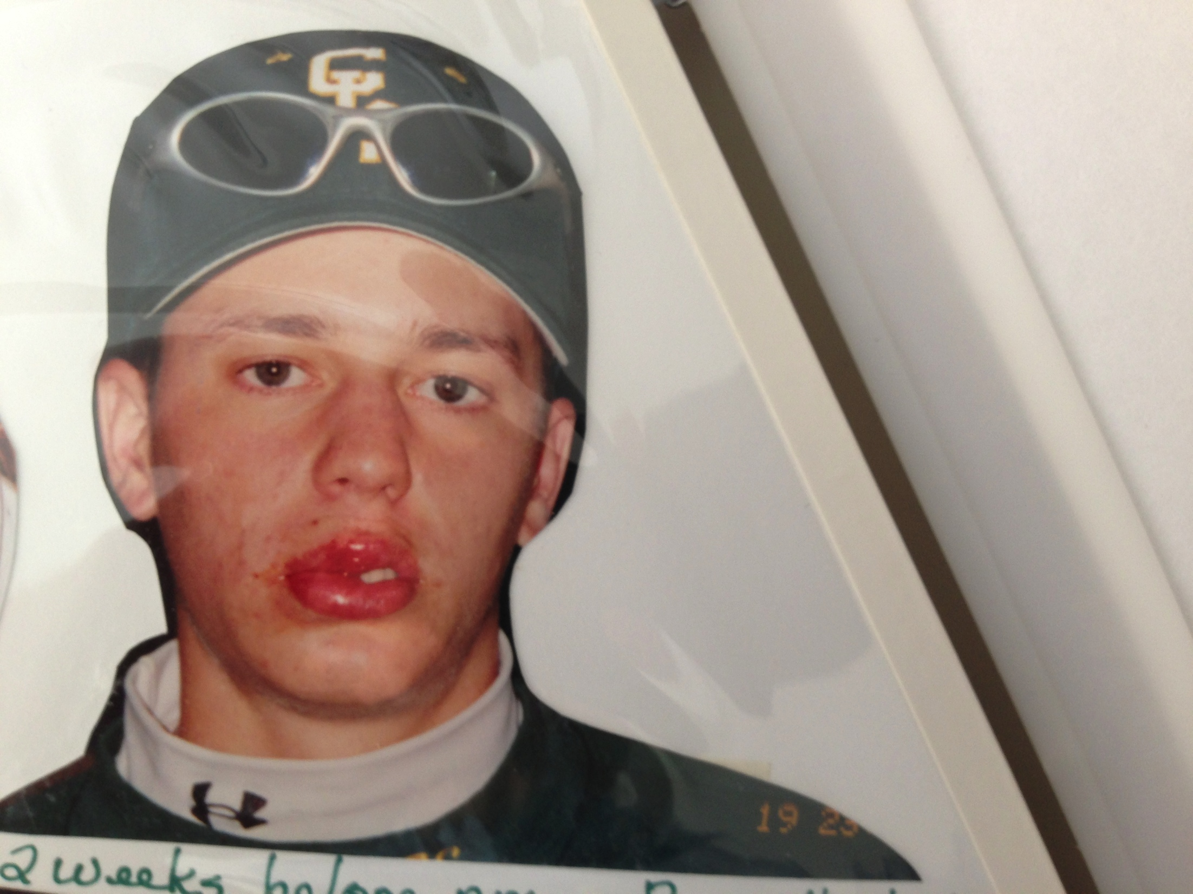
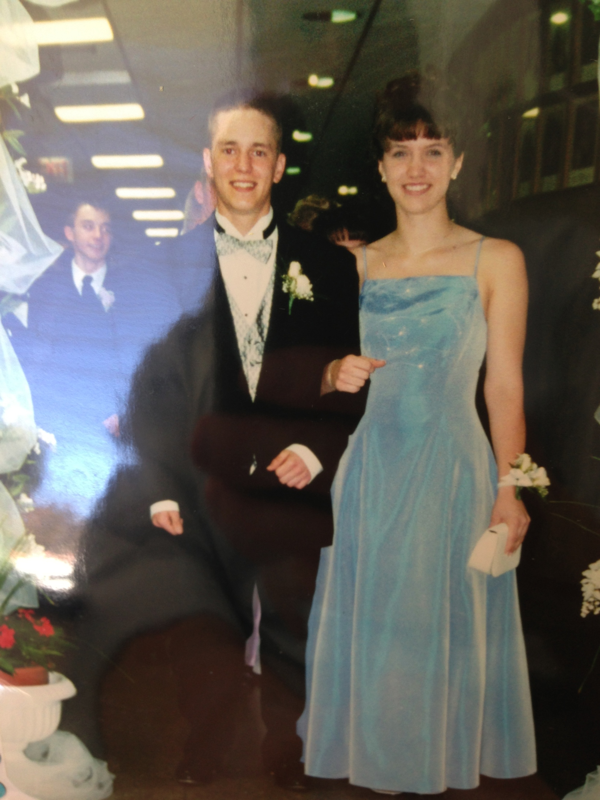
HIGH SCHOOL
Fondest memories from HS
Obstacles/Adversity you had to overcome in HS

Slide 10
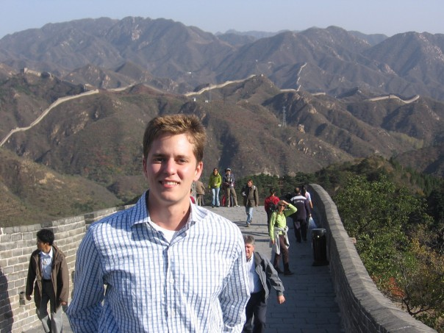
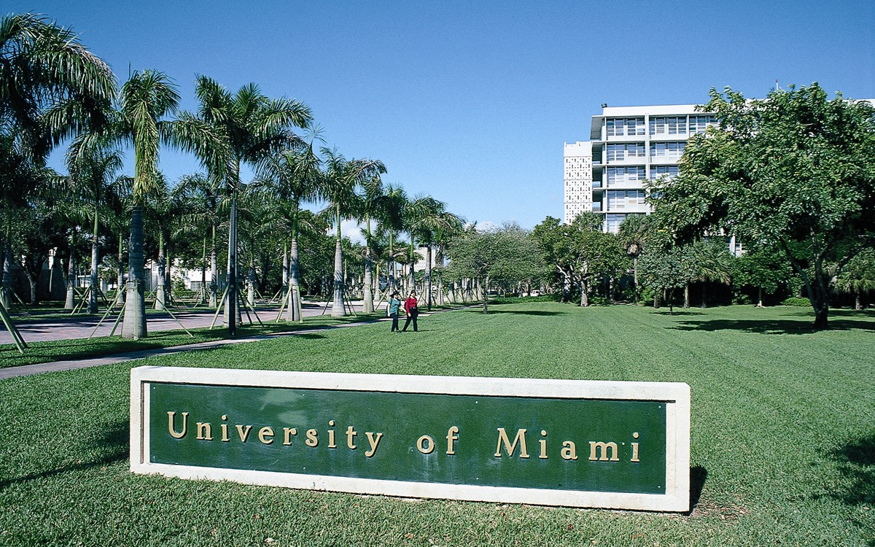
College or
Graduate School
I attended college in Miami, Florida
\
My senior year of college in China.

Slide 11
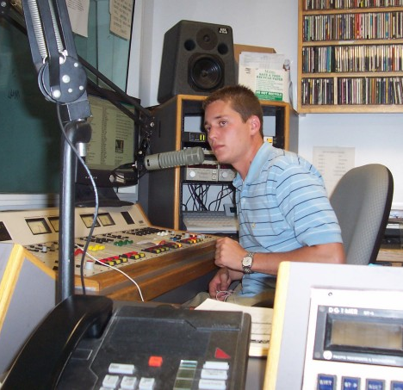
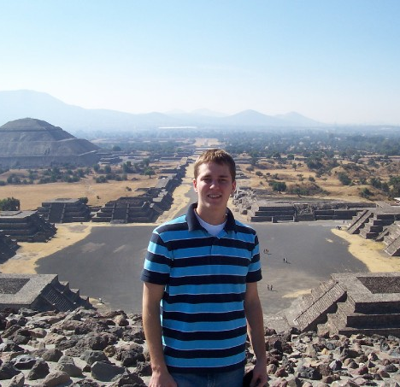
College or
Graduate School
Jobs I worked while in College
- Radio Host
Activities in College
Volunteer (Big Brothers/Big Sisters)
Student Government
Study Abroad

Slide 12
College or
Graduate School
Fondest memories
Obstacles or adversity that you had to overcome
Travelling
Meeting new friends
Experiencing a new city
Learning more about the world
Did not know anyone in Miami
Law school is quite difficult
Got married around the same time I took the bar

Slide 13
Career Path
Started as a summer associate at a law firm.
I became an associate and worked for three years
Then I founded my own company.
Notes:
You may use this chart to describe your journey to the current career

Slide 14
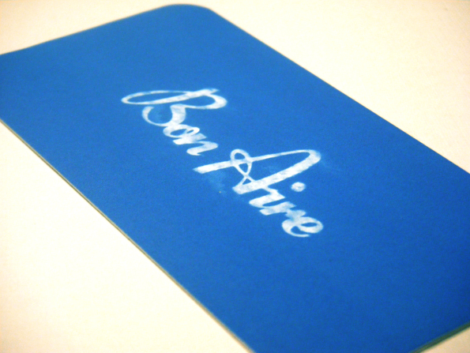


Career
Bon Aire Productions
Quinn Emanuel

Slide 15


Slide 16
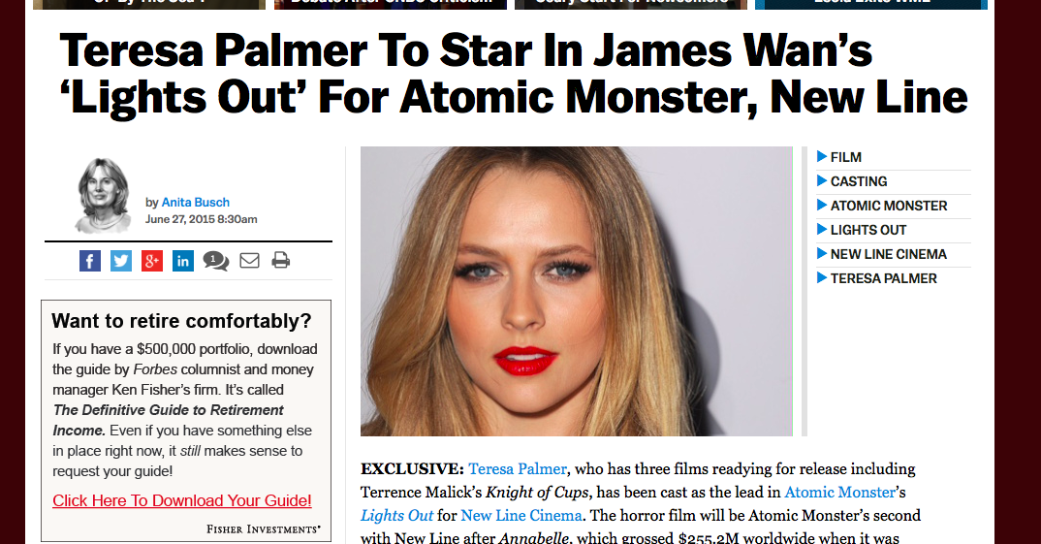
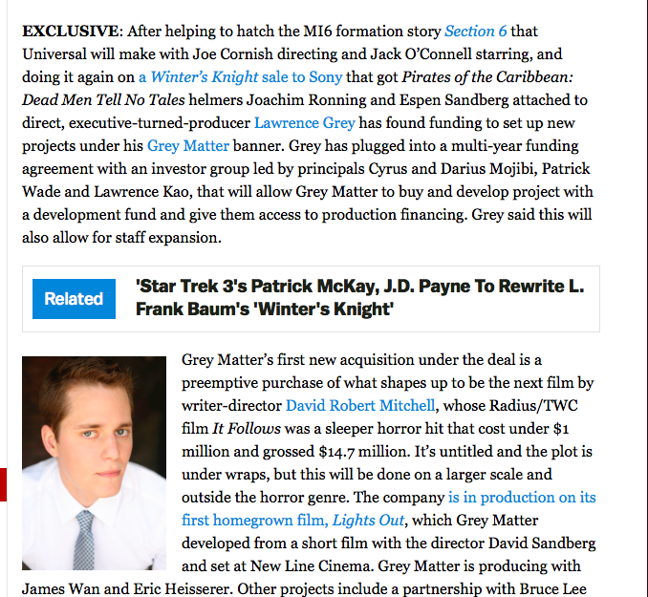

Slide 17
Career
Some challenges I had to overcome in my career
Law firm environment is tough
Moved to Los Angeles – didn’t know many people
Starting a new business is VERY tough

Slide 18
CURRENT ROLE
History
Co-Founder
Size
Create and produce media people enjoy.
Location
Working on getting projects on the air.
Products
Services
Notes:
Use this graph to give more description of your current company (history, size, location, products and services, etc.)

Slide 19
Current Role
Co-Founder
Marketing
Legal
Production
Finance
Notes:
Use this graph to give more description of your role specifically (responsibilities, typical work week, direct reports, etc.)

Slide 20
Career Compensation
??
Startup Business
????$$$$
Law firm associate
($160k)
Intern
Credit
Notes:
Use this graph to show general compensation ranges for people in various roles in your company

Slide 21
ACADEMIC EXERCISE
We will now spend several minutes discussing the day’s academic module and how it is relevant in the ‘real world’

Slide 22

QUESTION AND ANSWER

