Slide 1
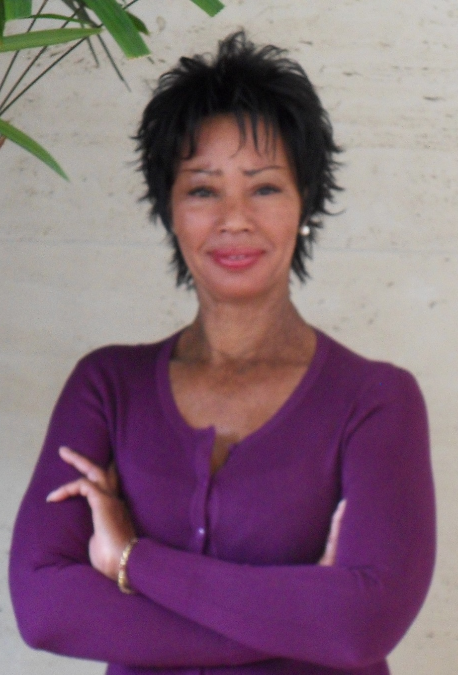

Life is a Constant Graduation
My Story

Slide 2
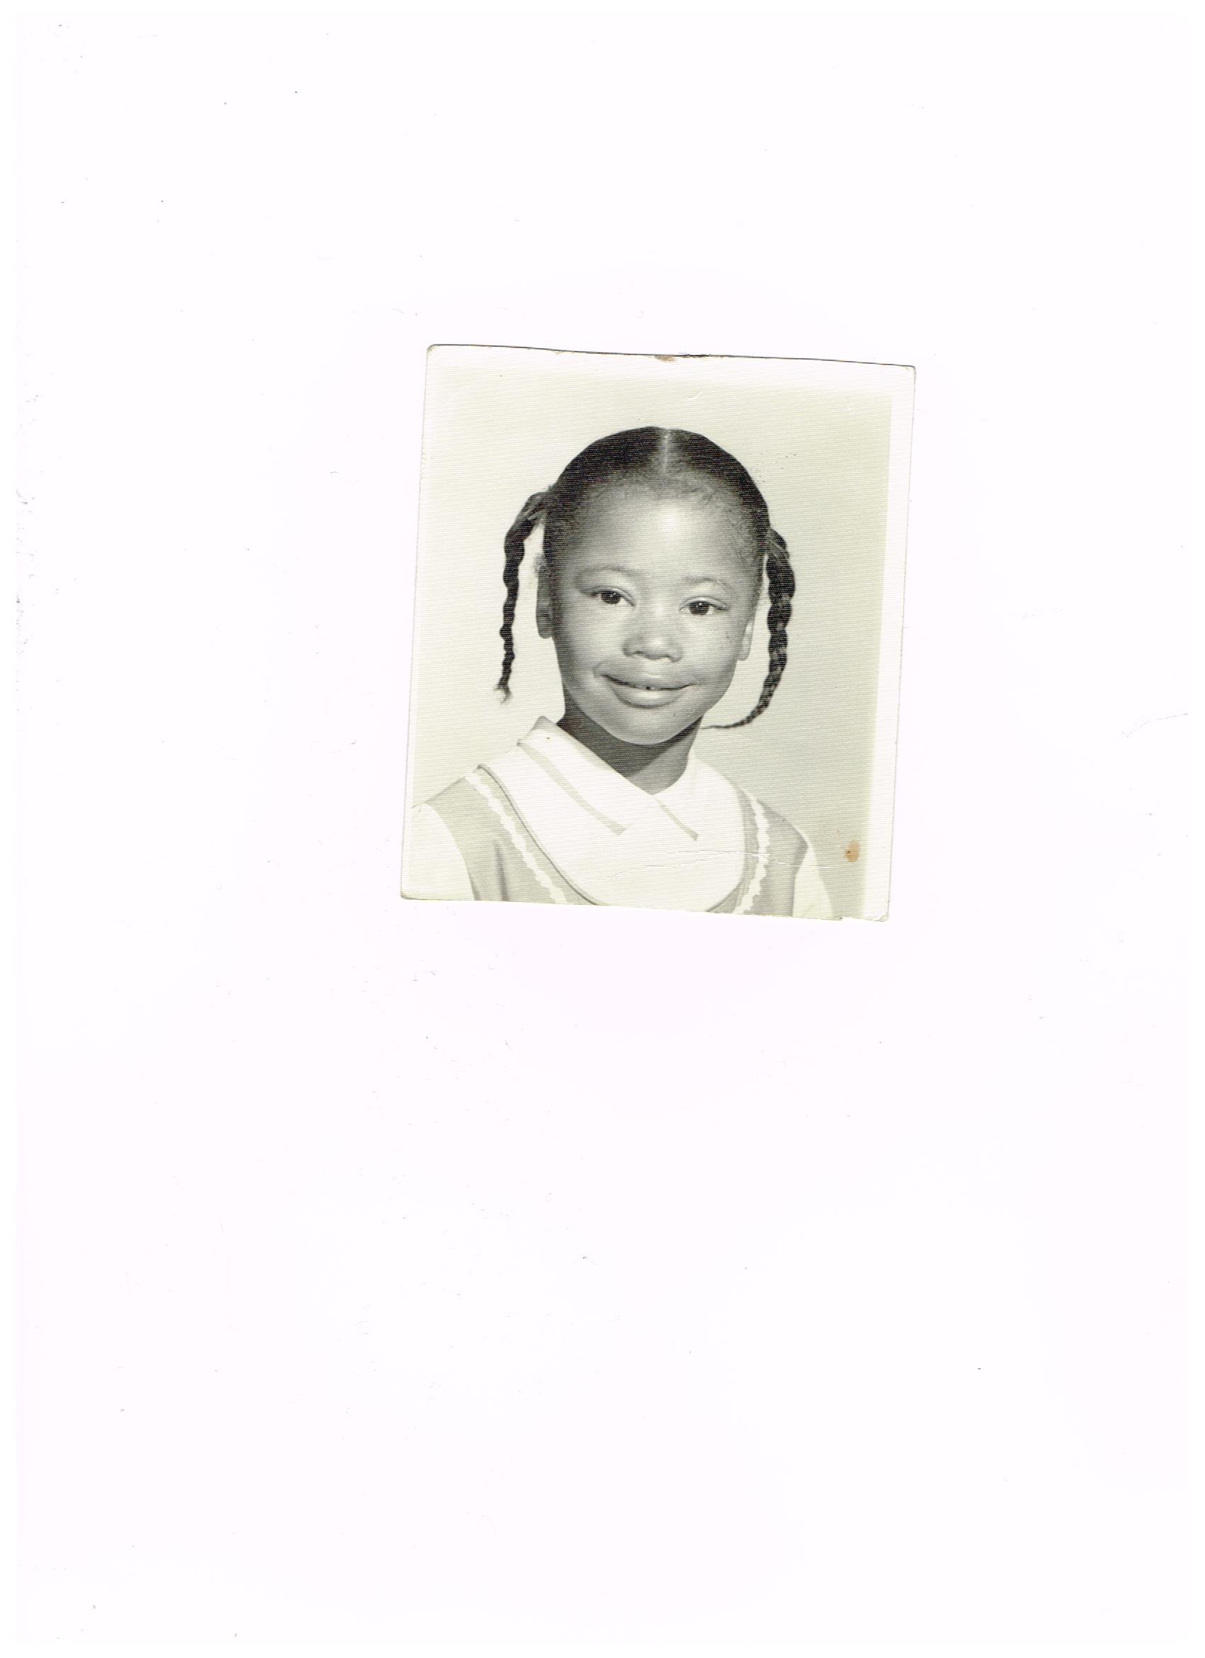
This is where it all began.
From 5 years old, I new I was different. Quiet yet I was so intrigued about the future and what it held. Back then the world seem to be in black and white.

Slide 3

High School was trippy
In 1975, I walked around asking a lot of questions

Slide 4


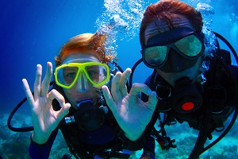

2 years later the world starts to develop color!
All I wanted is to know everything about life…

Slide 5

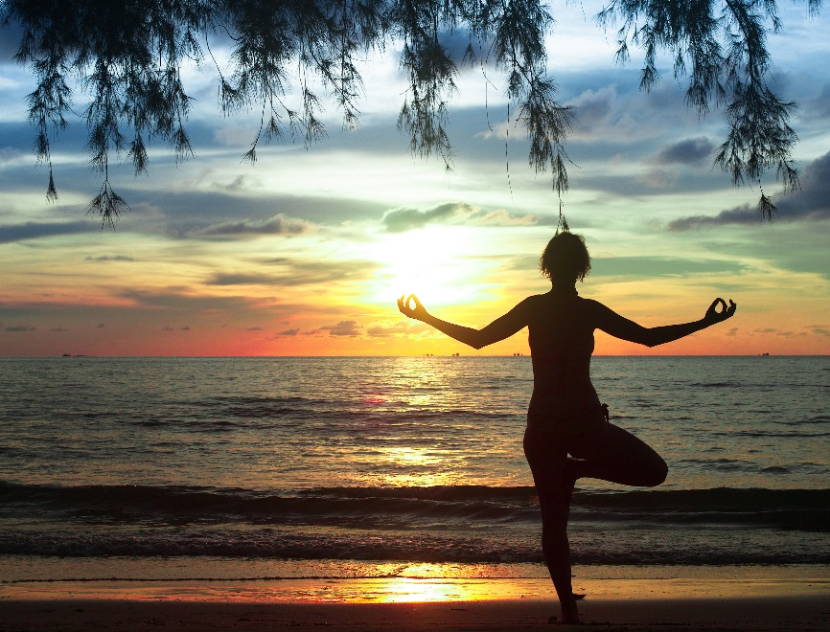

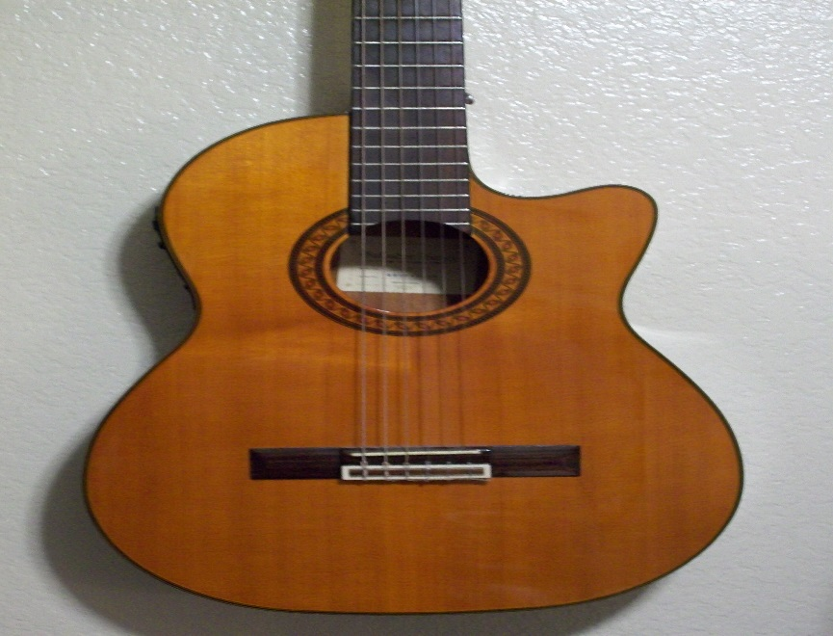
It took a few years and at 23, I realized that there was more to living than doing something that was insignificant
And that is when my life changed. My perspective changed. Now, I had something that was tangible, rewarding and it did not cost a cent. I ventured out of my comfort zone. And then…

Slide 6

No one mentioned that life involves constant curves balls.

Slide 7
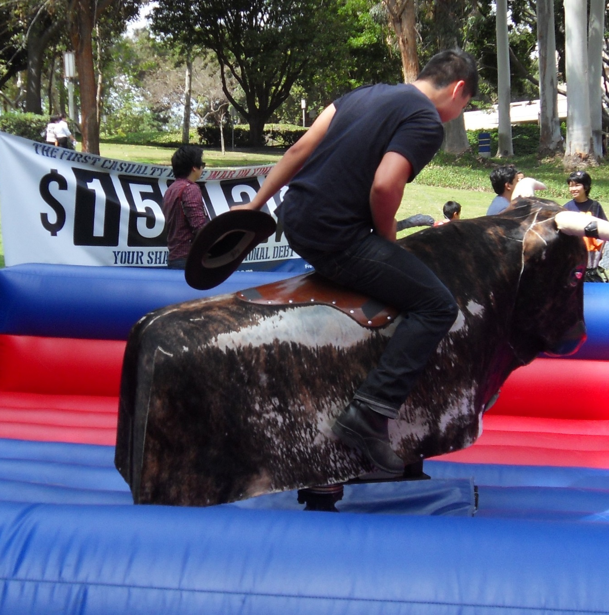
What I learned is to keep moving and never give up or give in

Slide 8
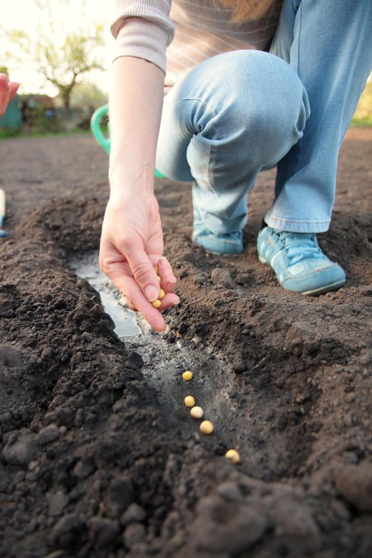
I had to start planting seeds for my future

Slide 9
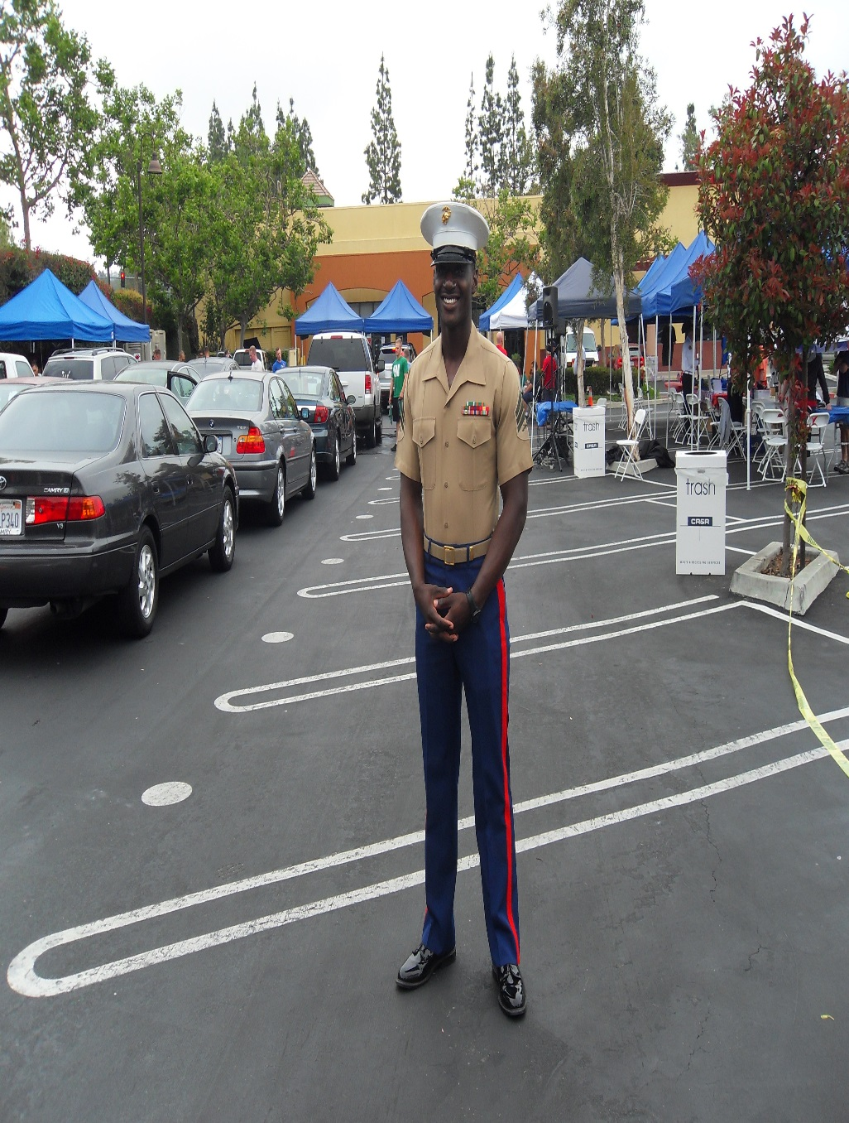

I continue to surround myself with positive, uplifting colleagues, friends and mentors
A life long lesson

Slide 10
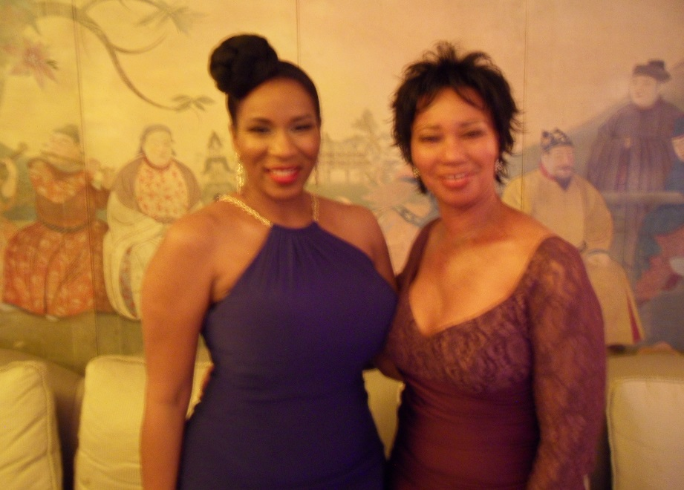
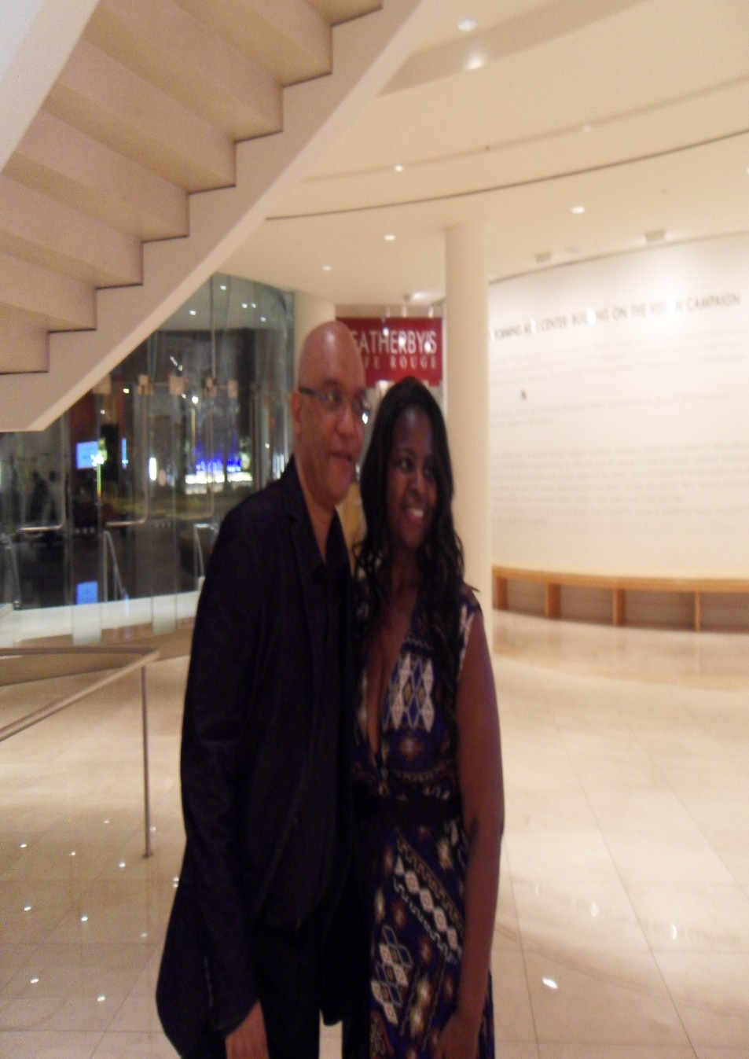
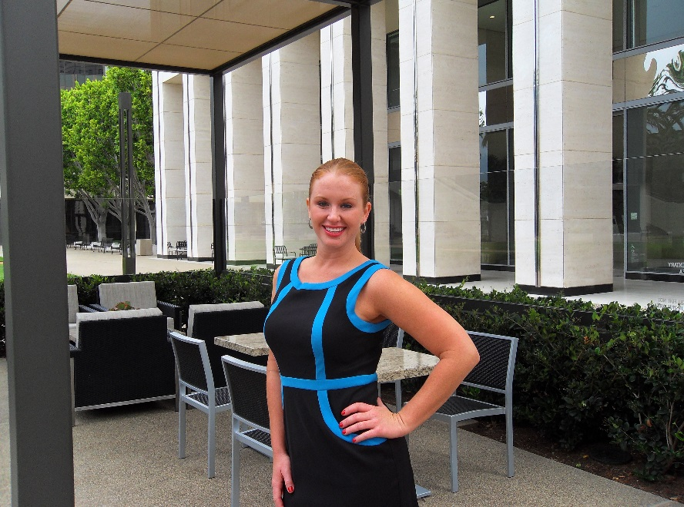
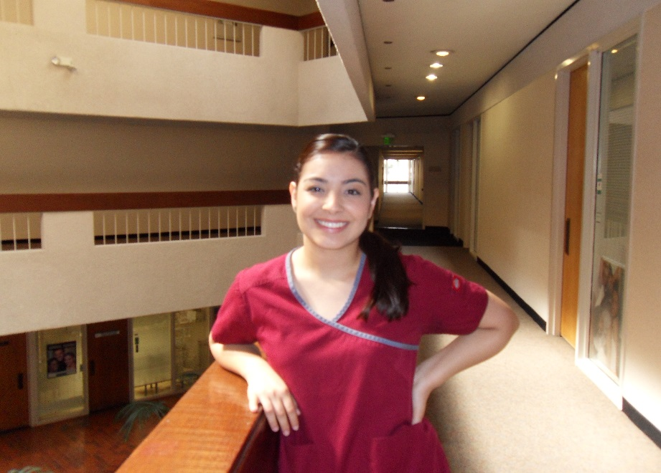
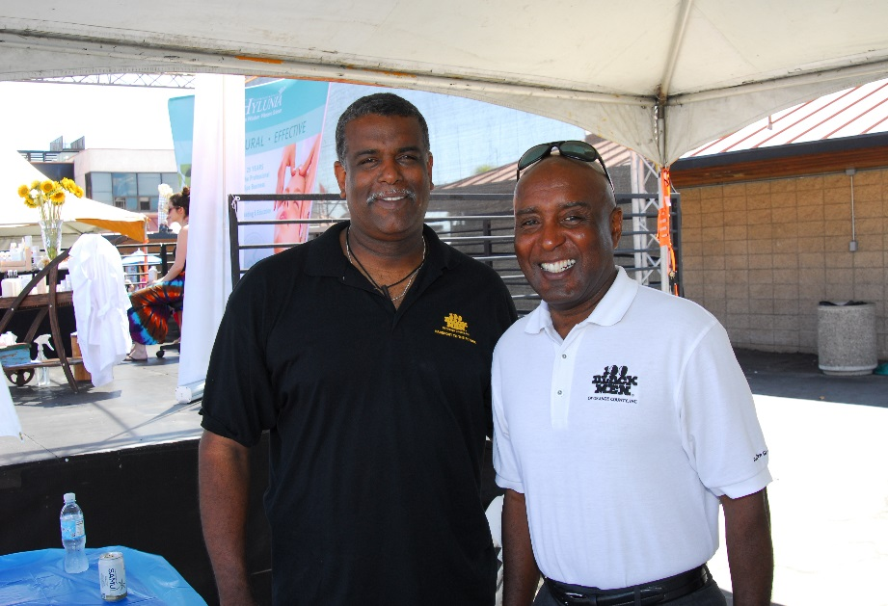

Slide 11
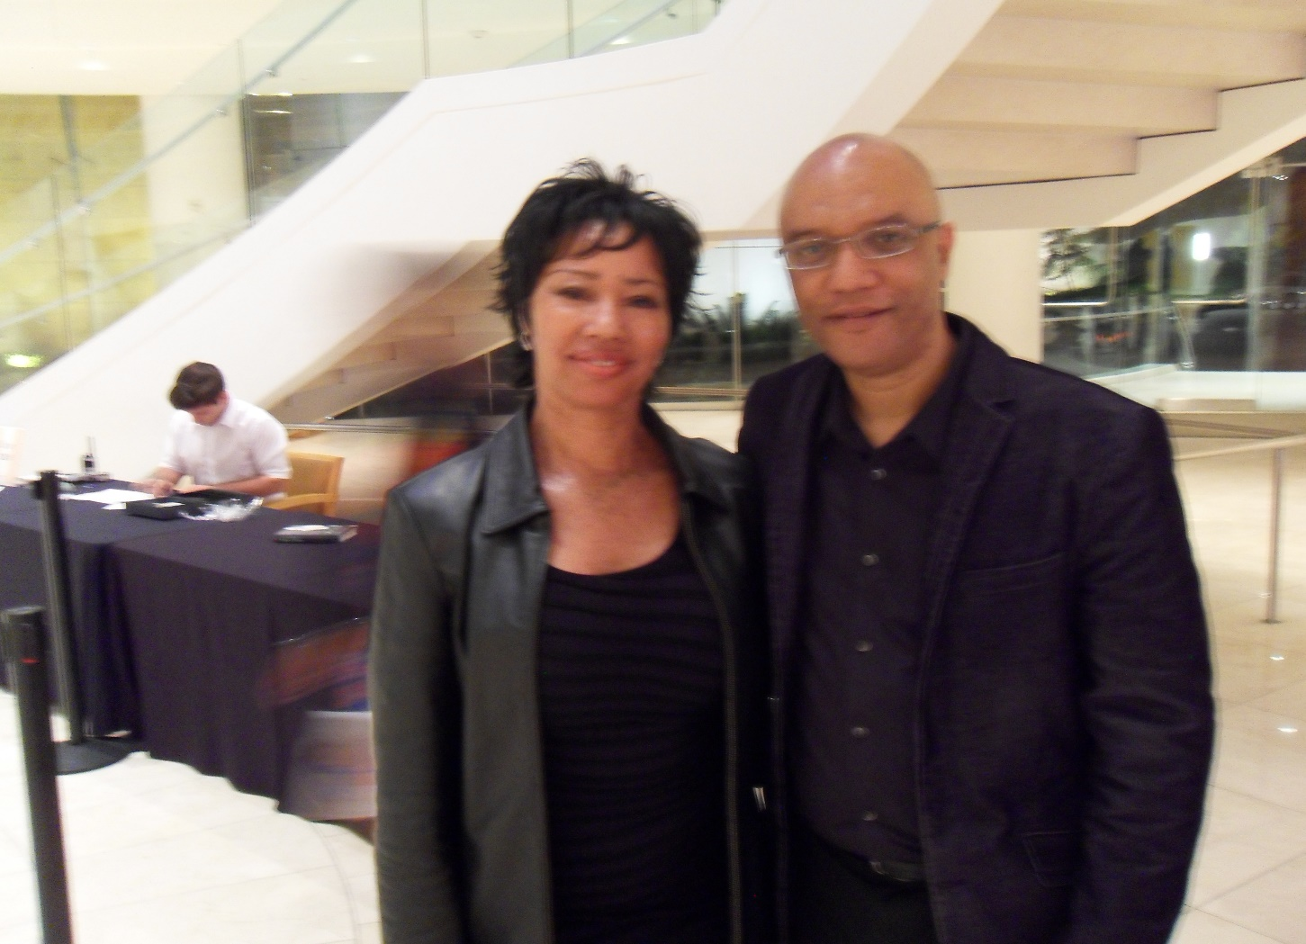
Little by little,
I could see my life becoming more than I could have ever imagined

Slide 12

I learned that we need collaborative partnerships to help achieve our goal

Slide 13


Now I can DO and BE ANYTHING!
Don’t stop believing in yourself

Slide 14

Always Remember, You Don’t

