Slide 1
Theory of the Kosmik Slingshot
Yael Swerdlow

Slide 2
The Old Me
My name was Marilyn – hated it in the womb – so NOT me
Always was an adventure junkie -tomboy that everyone tried to make conform
Created lots of inner conflict and doubt: What’s a Nice Jewish Girl to do????
But I knew what I believed in…what made me excited, who and what I wanted to become….

Slide 3
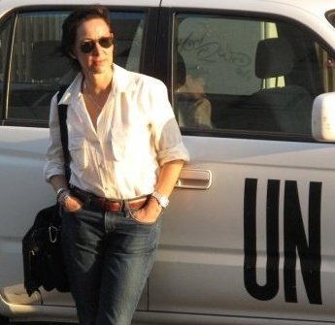
GLOBTROTTING PHOTOJOURNALIST
…..making the world a better place with my camera.

Slide 4
Career path
Self Taught, with classes:
Leigh Weiner’s advice: Pixels don’t matter, PEOPLE DO!!
So I was a History junkie, avid reader, Foreign Policy obsessed nerd:
Loved Stories, conversations, listening to tales of the “Old Country”
Be humble….okay, so sometimes I had a lot of
false bravado…..definitely imposter syndrome when it
came to the tech stuff.
Key is no ego….

Slide 5
1st Kosmik Slingshot Moment
These two quotes guide my life:
“The last of the great human freedoms is to chose one’s own attitude in any given set of circumstances, to choose one’s own way.” –Viktor Frankl
“Photography is nothing more than darkness illuminated by little points of Light.” Susan Sontag

Slide 6
Building my Career
Self taught – there are lots of naysayers out there: technology intimidated the daylights out of me!
Self doubt – maybe I was delusional thinking I could do this…..
Selfie? Didn’t exist then

Slide 7
Just Keep Showing Up
Be willing to pay your dues vs. entitlement
UPI $20/pix, Associated Press $50/pix LA Times $165/day
It’s not about the $$$$ - there is none in journalism
Would have done it for free
On the job training: grad school

Slide 8
Ummm…on the job training
My very first gig: President Reagan
Importance of mentors
Be willing to say you don’t know how to do something and ask for help

Slide 9
Career track
World Affairs Council
United Press International
USIA
Associated Press – took two interviews
Los Angeles Times – took SEVEN times
International Medical Corps
Freelance

Slide 10
Wait..I’m the next Annie Lebovitz??

Slide 11
Know your strengths

Slide 12
Reggie

Slide 14
Rwanda

Slide 15
Life changing moment

Slide 16
2nd Kosmik Slingshot Moment
Now that photojournalism broke my heart…where to now?
The other side of the camera!?!?!
Director of Media for the Israeli Consulate in LA
Uh-oh…

Slide 17
3rd Kosmik Slingshot Moment!
GRAD SCHOOL at 48????
MASTER OF PUBLIC DIPLOMACY
- Most fun other than shooting pix.
- Pulls together all my skills
- Get to hang out with peeps WAY younger

Slide 18
4th Kosmik Slingshot Moment!
Video Game scriptwriter???
F.8 Interactive
Snapcious
Women in Tech
Women’s Empowerment Foundation
- Back to essence: Photojournalism
- Spy Novel Diplomacy….PhD..???

Slide 19
Women’s Empowerment Foundation

Slide 20
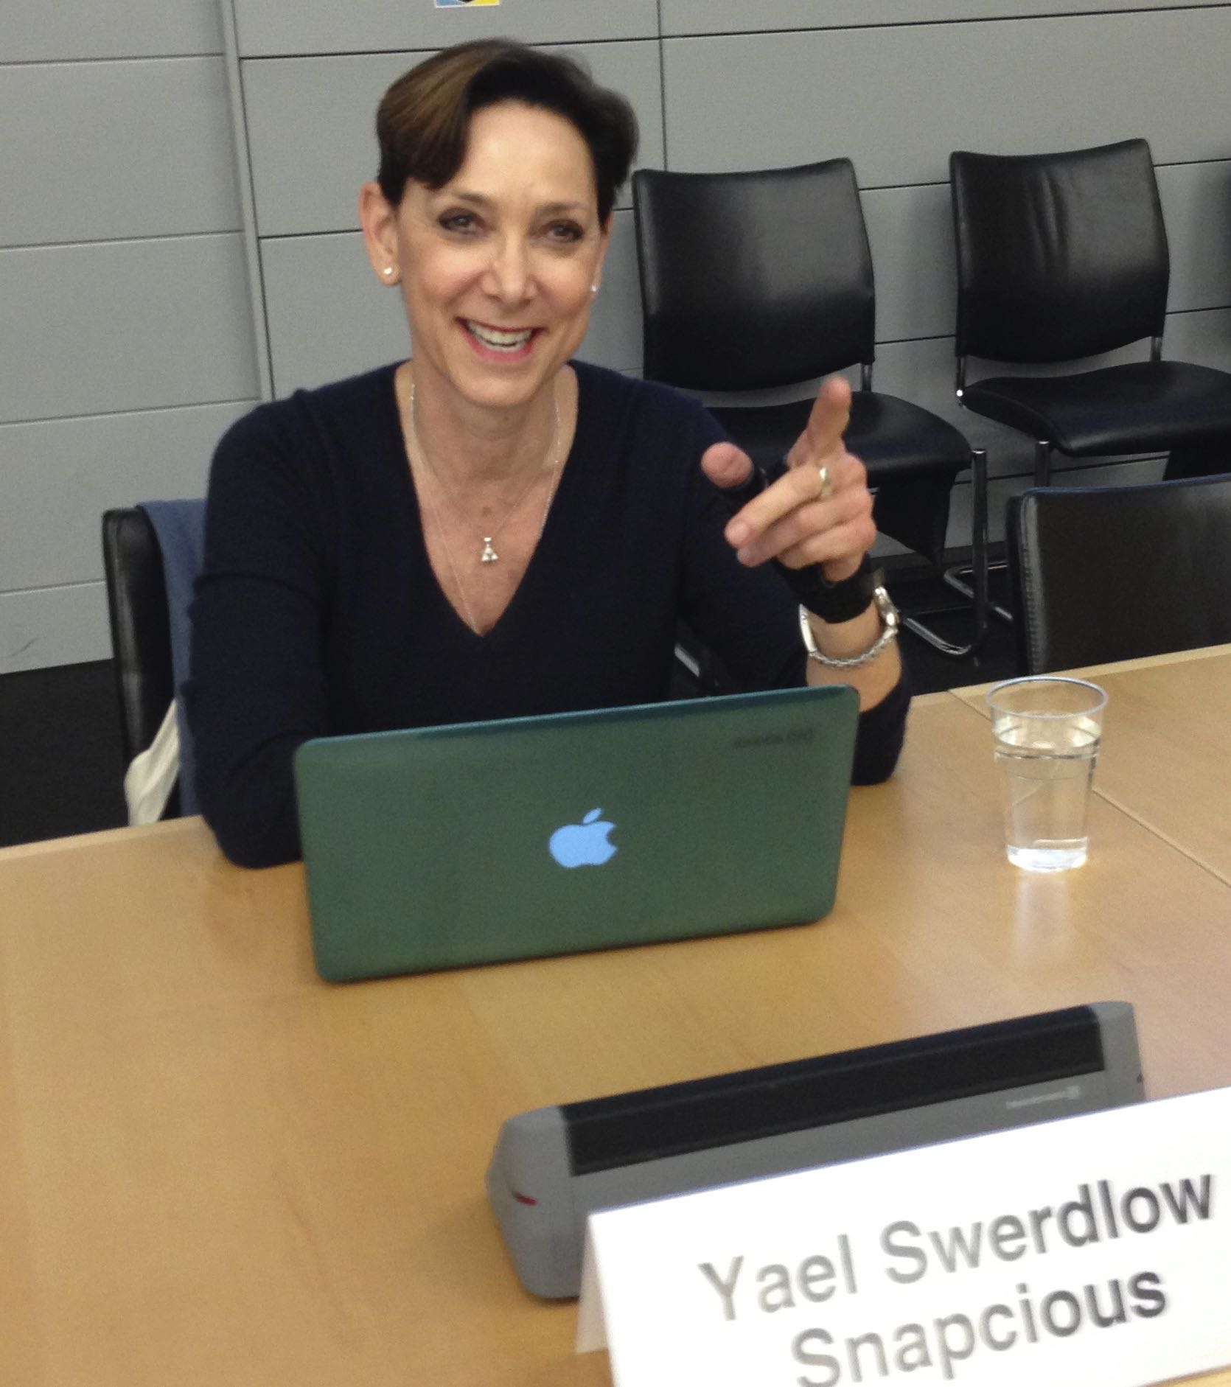
4th Kosmik Slingshot Moment

Slide 21
Mantra
“It is never too late to become what you might have been”
- George Sand

Slide 22
Reading list
Mastery by Robert Green
Daring Greatly by Brene Brown
In Search of History by Theodore H. White
Think by Lisa Bloom
Man’s Search for Meaning by Viktor Frankl

