Slide 1
David Gutierrez YBA Guest January 2016

Slide 2
INTRODUCTION
My name is David Gutierrez and I am 33 years old
I am the Managing Partner of Gutierrez & Anderson, a business advisory and accounting services firm and am an active investor and advisor to other businesses
My firm provides executive management and financial advisory services to small businesses and middle market companies ($1 million - $50 million in annual revenues)
My role at the company changes by the minute… one minute I’m an executive advising my clients, the next I’m taking out the trash…
My primary role is to ensure the success of the firm which is gaged by the success of our clients

Slide 3
What you should know about me?
I’m 62.5% Mexican… grandparents came from Jalisco, Mexico
I work a lot… work on average 75+ hours / week
I cannot stand going to the gym, it’s boring
I love to travel (Asia, Costa Rica, Australia, Mediterranean)
I have a girlfriend fiancé wife, her name is Ashley, she’s the boss!
I get bored watching TV, always need to be doing something productive (on iPad, on laptop or on the phone)
I am passionate about giving back to the community
I’m the only guy you’ll ever meet that admits to buying Pokémon cards, furbies, teletubbies and Barbies… more about this later

Slide 4
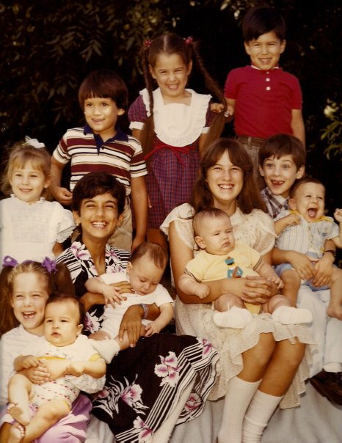
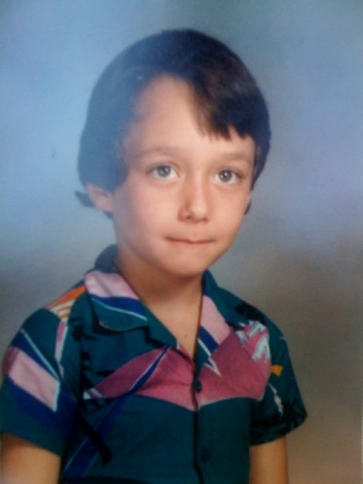
The Early Years…
I was born and raised in Sacramento, CA.
This is a picture of me
at 6 months
Here’s me at the age of 7

Slide 5
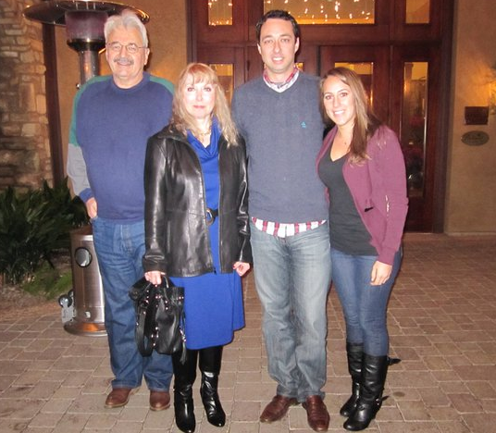
My Family
A little about my family…
Val
Ashley
Margie

Slide 6
My neighborhood
I grew up in an area of Sacramento called Northgate, a lower income neighborhood
Went to a rough junior high school where some of my friends started doing drugs or became active in gangs
Fortunate to stay active in sports/activities and had parents who kept me grounded

Slide 7
HIGH SCHOOL
I attended Natomas High School in Sacramento, CA.
DO NOT DO WHAT I DID!
As a HS student I was NOT very involved on campus… was really focused on going to college and having fun with friends. Still kept my grades up, but HS was a means to an end… a way out of the neighborhood…
I was fairly studious and maintained my grades, but had almost no extracurricular involvement on campus…

Slide 8
HIGH SCHOOL
Things I enjoyed in HS
Things I did not enjoy in HS
Making money
Abercrombie and Fitch
eBay
Friends
Girls
My ‘86 Camaro
School dances
AP classes
The SAT exam

Slide 9
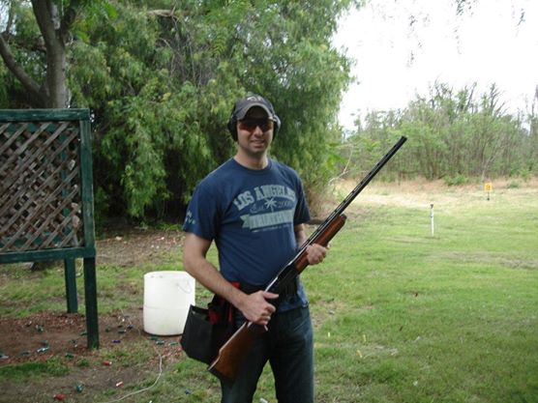
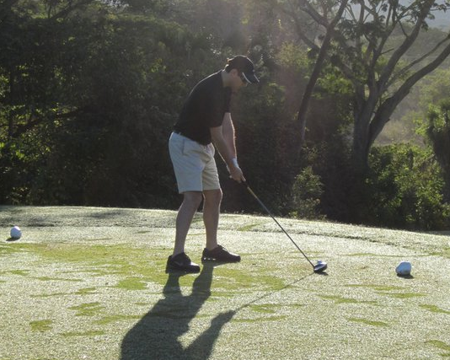
HIGH SCHOOL
Activities/Athletics in HS
Jobs I worked while in HS
Shot trap competitively
Played on the golf team…
Started my first business
Bagel shop
Banquet server / busser
Entrepreneur

Slide 10
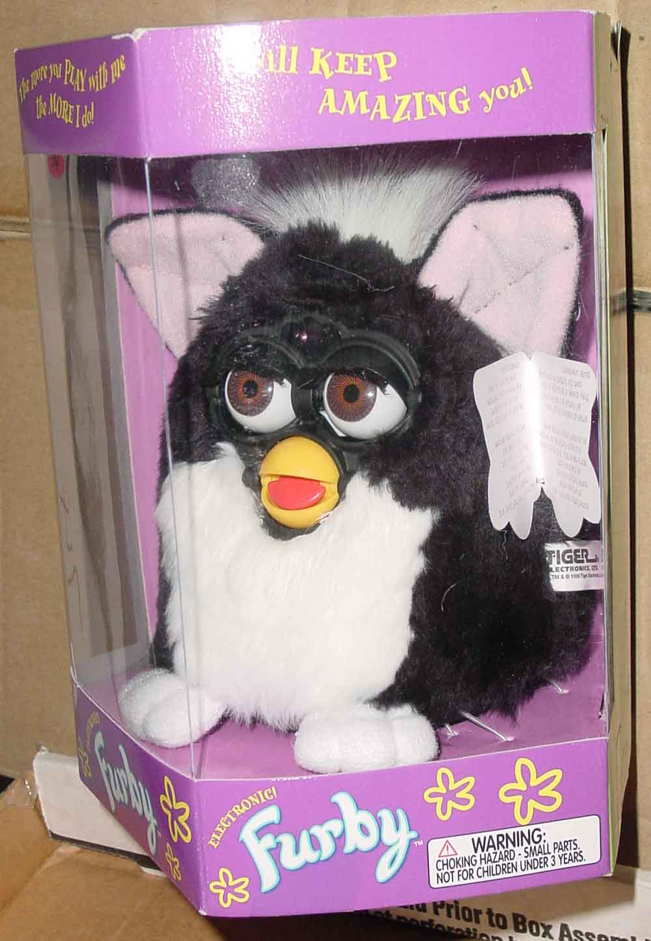
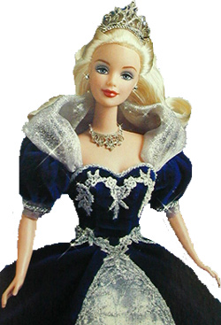
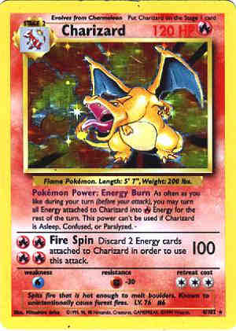
HIGH SCHOOL
I started my first business in high school, “All That and More Collectables”.

Slide 11
College
UC Riverside
Graduated in 2004
B.S., Business Administration
Most diverse campus in the UC System
Active in student groups
Very active with alumni and building my network
Formed my second business (TextbookZ.com)

Slide 12
College
University of Notre Dame
Graduated in 2005
Masters in Accounting from Mendoza College of Business
Best football team in the nation… ever!

Slide 13
What I wanted to be when I grew up!
Firefighter
They always got the cute girls in the movies…
They get to drive cool trucks fast.
The adrenaline rush…
Dentist
Made decent money…
Had nice teeth…
My dentist drove a nice car and played golf every Wednesday…

Slide 14
Career
What I became…
A Certified Public Accountant
Financial auditor
Experienced in business transactions
Understands financial statements (evaluate the health of a business)
Understands the tax system, opportunities to save money
Sounds sexy huh? It is.
Why?
Access to executives in a variety of industries
Great training/learning opportunities
Resume builder

Slide 15
Career Path
Intern at Ernst & Young
Always highly rated, focused on earning respect and trust of my clients, superiors and peers. Spent 8 years at EY building my network.
I am now the Managing Partner of G&A and working towards advising clients and expanding my private investments.
Notes:
You may use this chart to describe your journey to the current career

Slide 16
Career
My first Job
My worst Job
Bagel shop
Sliced bagels, made sandwiches, supervised people, cleaned floors, toilets, etc… all the exciting things you see in a bagel store.
Taught me that the “customer is always right”… or at least needs to think they are.
Working with people who have negative attitudes – not team players
Never had a bad job… seriously.
Strong work ethic.
Work until the job is finished.
Treat it like you own it

Slide 17
Current Roles
Owner
Investor and Corporate Controller
Investor and
Chief Financial Officer
Board Member
Notes:
Use this graph to give more description of your role specifically (responsibilities, typical work week, direct reports, etc.)

Slide 18
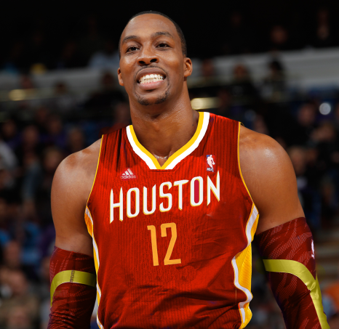
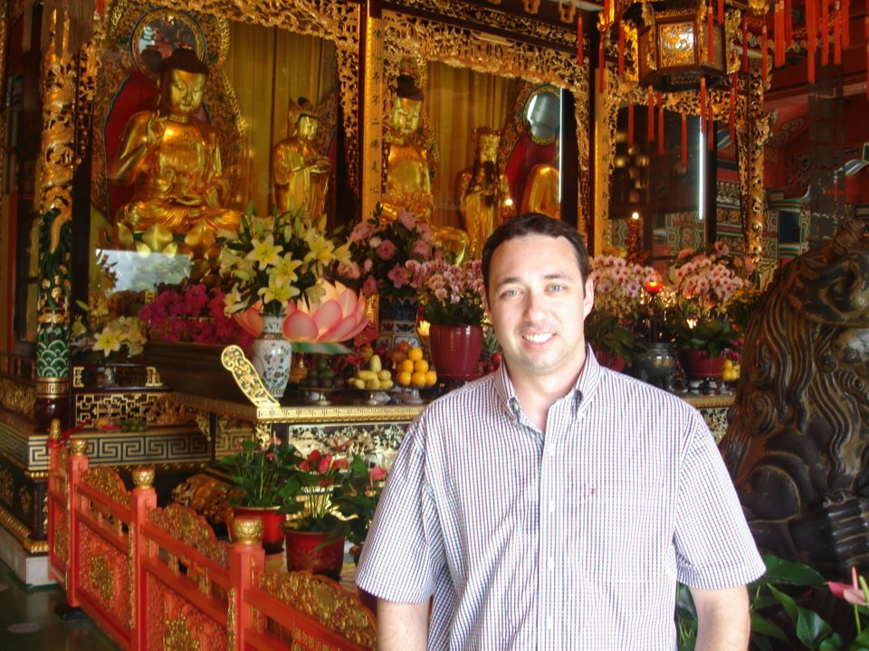
Cool Opportunities
Meet Interesting People
Working and learning from interesting people and team members
Athletes
Movie Producers
Successful
Entrepreneurs
Travel Opportunities
Australia
London
Hong Kong
China
Boston, Florida, Utah, Washington, D.C.
Work Perks
EY paid for my Masters
Work with lots of smart, motivated people
Financial stability
Met my fiancé
Notes:
Use this graph to give more description of your role specifically (responsibilities, typical work week, direct reports, etc.)

Slide 19
Why would anyone want to become a CPA?
Opportunity to understand the “language of business”… evaluate the success of businesses based on their financial results.
Gain an overall understanding of how businesses run and how to operate them efficiently.
Opportunity to work with several different types of businesses and clients.
Great foundation – limitless opportunities for growth

Slide 20
Careers You Can Pursue
Chief Financial Officer
Business Owner / Entrepreneur
Certified Public Accountant
Tax Accountant
Financial Controller
Cost Accountant

Slide 21
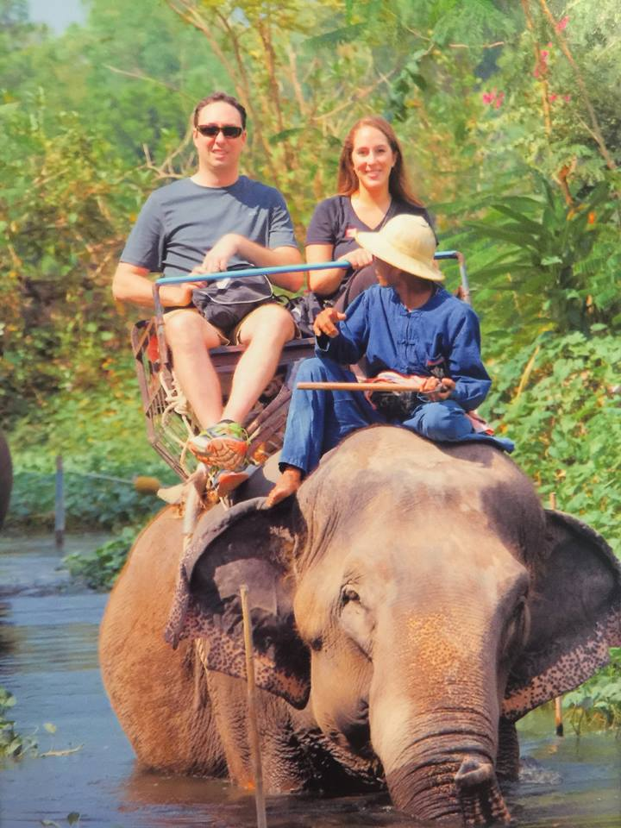
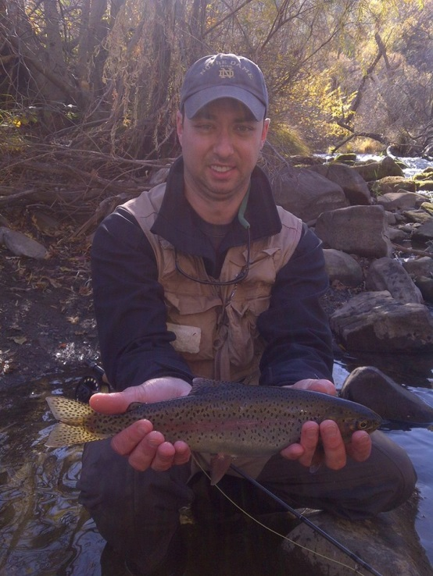
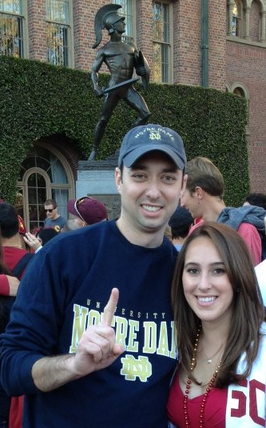
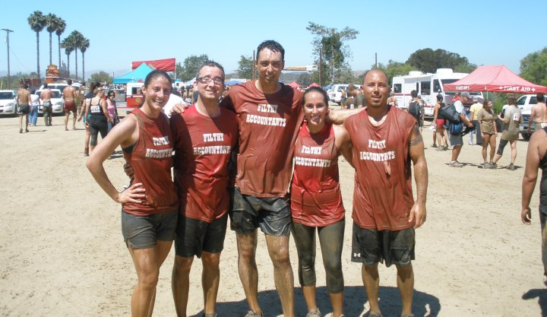
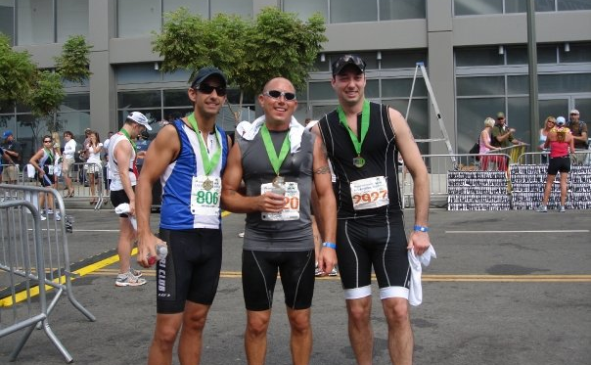
Work Hard… Play Harder

Slide 22
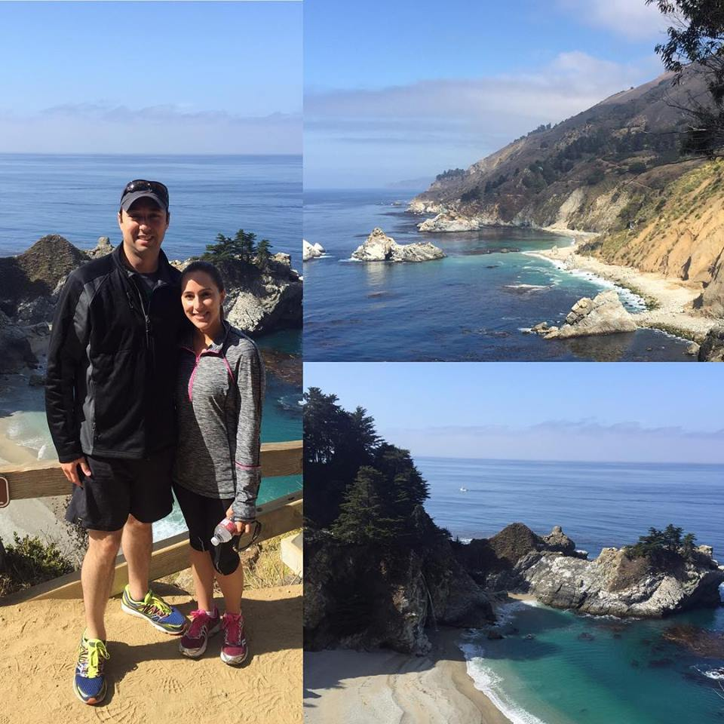
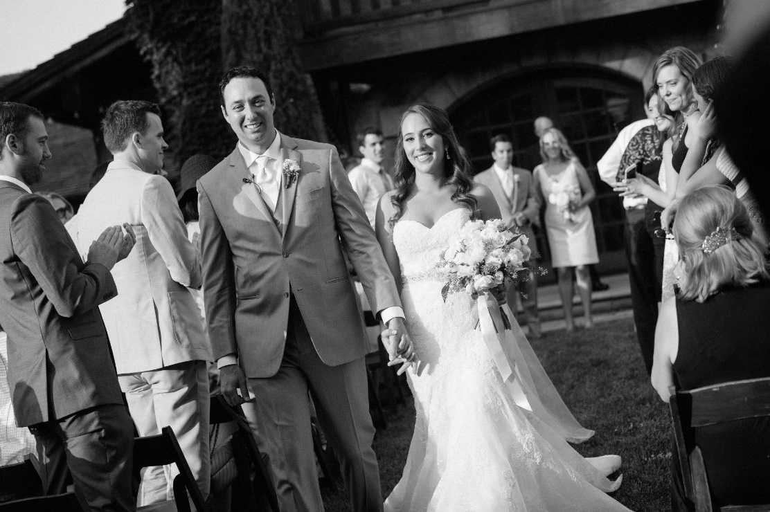
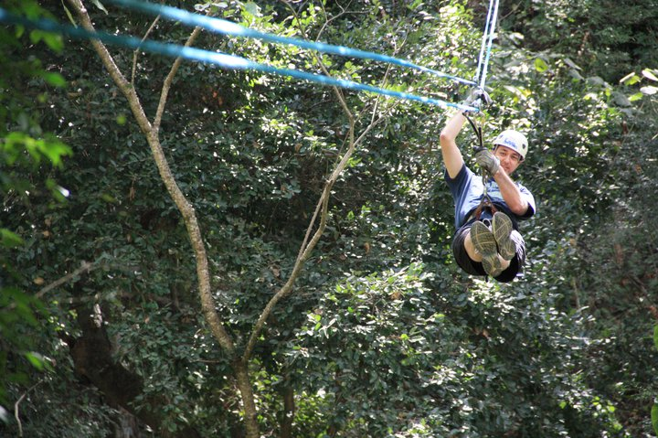
Work Hard… Play Harder

Slide 23
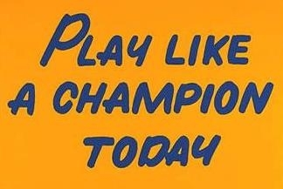
Words of wisdom
Work hard… play hard!
Treat it like you own it. Your peers, superiors, business partners and clients will take notice and the quality of what you do will shine!
Focus on what you can control… too many people waste time on issues and problems that have little to no impact on their lives.

Slide 24
QUESTION AND ANSWER

