Slide 1
Young Business Alliance Howard Perry (Presenter)
Today’s Growth Mindset Messages:
“Always Strive for Greatness”-LeBron James
“Perseverance, Secret of all triumphs”!! Victor Hugo

Slide 2
Howard Perry?
Thank you for allowing me to speak with you today. I was born in the 1950’s and my original home town is Brooklyn, NY and moved to St. Croix USVI at 7 years old.
Realtor and help people buy and sell homes.
Founding Member of the 100 Black Men of Long Beach Inc. Marketing Chairman and member of the mentoring committee and program for young men 8 to 18 years old.

Slide 3
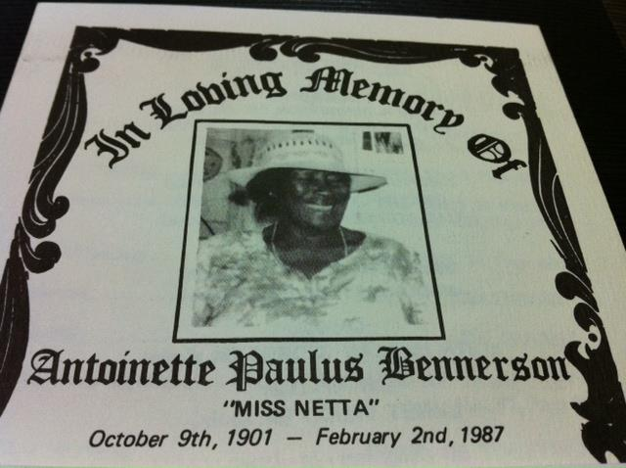
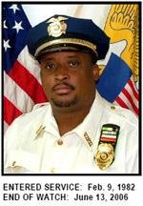
Family Pictures
30 C. King Street
Grandma
Mom and Jasmin
The crew

Slide 4
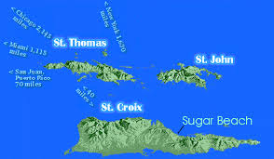
HIGH SCHOOL
I attended St. Joseph High in Saint Croix USVI
\

Slide 5
HIGH SCHOOL
As a HS student I was involved in Sports, Boys Scouts, Alter Boy
As a HS student I was finding myself, outgoing, love a party, leader, friend
\

Slide 6
Key Life opportunities
I am a Navy Veteran and my specialty was Electronics Technician
Xerox Corporation:
15 years as a Project/Telecommunications manager.
ICG/other Internet Comps
Sales Engineer, Local sales manager
Realtor since 2002.
1984: Bachelor of Science in computer systems from Florida A& M University
1998 Master of Science from National University
Lifelong learner
Dale Carnegie Sales, negotiations
Leadership though Quality
Website building

Slide 7
Growth Mindset Vs. Fixed Mindset
Fixed Mindset makes us vulnerable (weak, helpless) No recovery plan after setbacks
Growth Mindset makes us resilient (strong and persistent in spite of setbacks) Recovery Plan. We help manufacture strategies for success. Engagement
Current and confirmed research conducted by:
Dr. Angela Duckworth – GRIT
Dr. Carol Dweck- Growth Mindsets
Dr. Dennis Kimbrow- Laws of Success
Think & Grow Rich (Napoleon Hill)

Slide 8
Men Create Strategies for Success!!!
“Remember the first act of every morning be to make the following promise to yourself: - I will not fear anyone on Earth. - I will fear only God. - I will not bear ill will toward anyone. - I will not submit to injustice from anyone. - I shall conquer lies by truth. And in resisting lies, I shall put up with all suffering.” ― Mahatma Gandhi

Slide 9
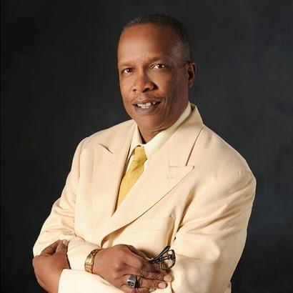
Born for Greatness!
I am Born to Win!
I am an Achiever!
I am a Goal Setter!
I am Strategic!
I am Brave enough to Change!
I Will Persist Until I Succeed!
I Will Win!

Slide 10
Career Path at Xerox
I started as a Data Technician
I was promoted to project manager after 3 years
I was promoted to Western Region Telecommunications manager after 5 years
Notes:
You may use this chart to describe your journey to the current career

Slide 11
Telecommunications System

Slide 12
Career
Some challenges I had to overcome in my career
How I overcame and mastered them
Challenges
Understanding my role
Culture/ Race
Technical skills
Professional Writing style
Communications
Mastery/Overcome Challenges
Benefits
Flexible Mindset/ Be Proficient at your job! Do more than asked.
Learn other cultures
Act in a professional manner
Take a writing class/read
Take a Dale Carnegie type class
Extra training

Slide 13
Current Role: Realtor
Realtor residential
Marketing
Negotiating
Sellers
Buyers
Notes:
Use this graph to give more description of your role specifically (responsibilities, typical work week, direct reports, etc.)

Slide 14
Realtor
Always Be Prepared!
Realtors are a member of the National Association of Realtors (NAR), a professional organization for those within the real estate industry.
Licensed by the State of California Bureau of Real Estate
Buying: The REALTOR® is responsible for protecting and promoting client's interests. They can represent buyers or sellers. They assist the home buyer in forming and writing the offer, and if the offer is accepted, they help with the final agreement to ensure it's legally binding and correct
Selling: Develop a Marketing Plan for Clients: Part of the REALTOR®'s job is to come up with a sound marketing plan designed to address the needs and attract buyers.

Slide 15
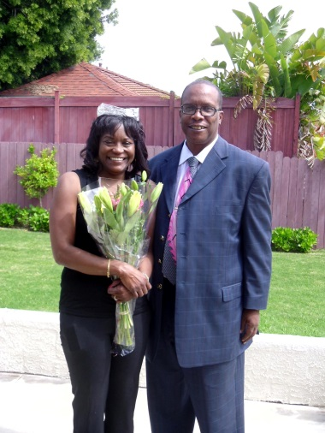
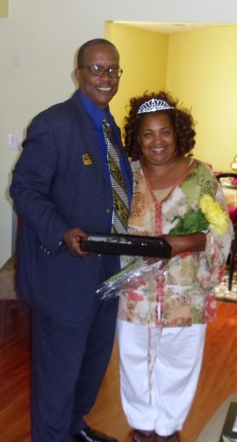
Real Estate/ Branding/Theme
Every Queen Deserves a Castle! My branding
Niche market
Primary focus women home buyers and sellers
www.facebook.com/everyqueenacastle
By definition, a well-defined and executed brand strategy affects all aspects of a business and is directly connected to consumer needs, emotions, and competitive environments.

Slide 16
QUESTION AND ANSWER

