Slide 1
Christie Cooper
June 1, 2015
Notes:
This template is in wide-screen format and demonstrates how transitions, animations, and multimedia choreography can be used to enrich a presentation.

Slide 2
Cooper Consulting Group, Inc,.
Notes:
This slide can be used as a background before the presentation begins.

Slide 3
Introduction
My name is Christie Cooper and I am 47 years old
I created my own company in August 2012, called Cooper Consulting Group, Inc,.
My company inspires learning and leadership development
I am the Founder and Chief Learning Officer
CCG is an S-corporation and I have 2 others on the board

Slide 4
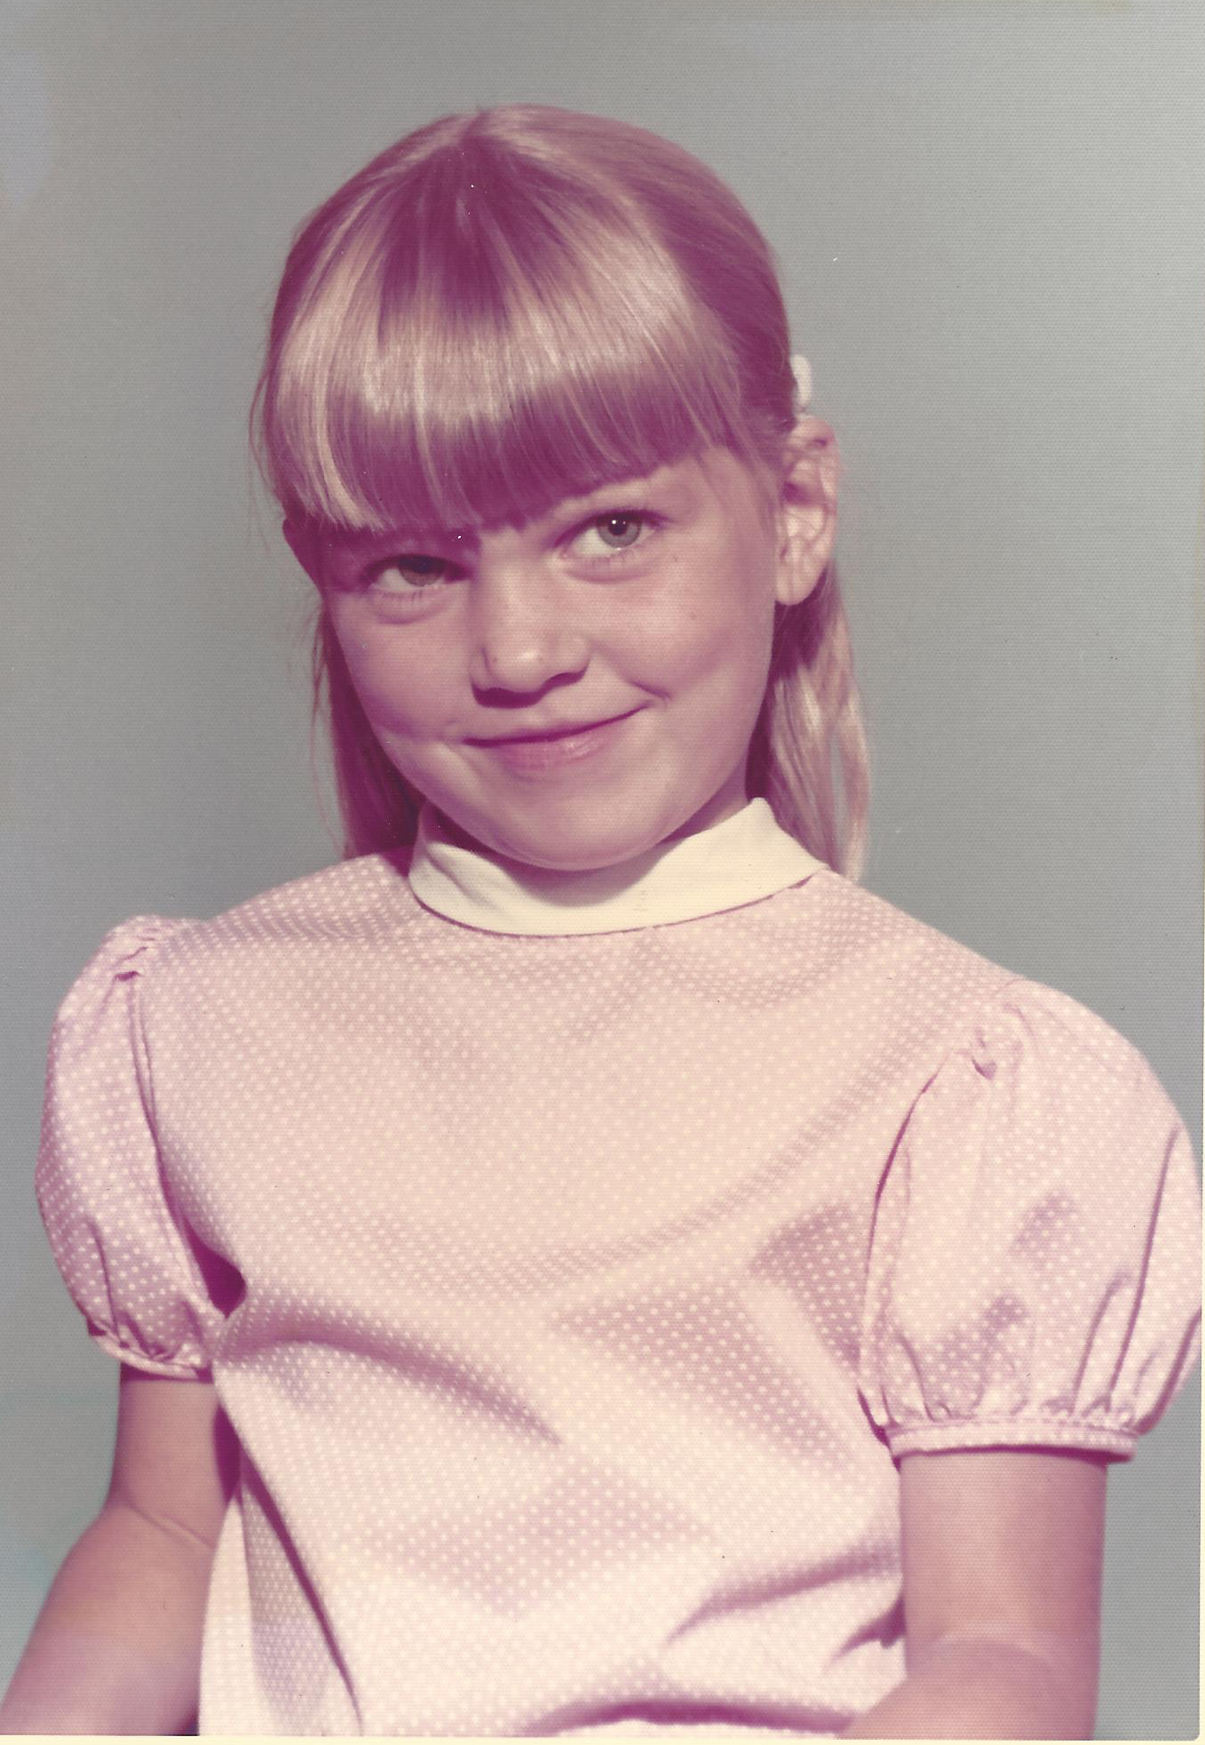
My Family Growing Up
My life was full of change!

Slide 5
My School Years
I attended 4 different elementary schools
I went to Marshall Junior High School
My High School was Lakewood High School and I graduated in 1986

Slide 6
High School Jobs
First paid job was as a housekeeper for my mom’s friend
At 16 I applied to Blacksmith’s Corner and was denied due to lack of experience
Taco Bell become my first “official” job – I made $3.35 per hour!
One year later I went back to Blacksmith’s Corner and was hired
I worked there for 2 years and made $12 my last year

Slide 7
After High School
I got married to my High School sweetheart
Moved to Cheyenne, WY for 2 years
Went to Laramie County Community College
Majored in Horse Management
Received my Associate of Science Degree
Moved back to CA
Attended Long Beach City College and Chaffey College
Was about one year shy of graduating with my Bachelor’s degree

Slide 8
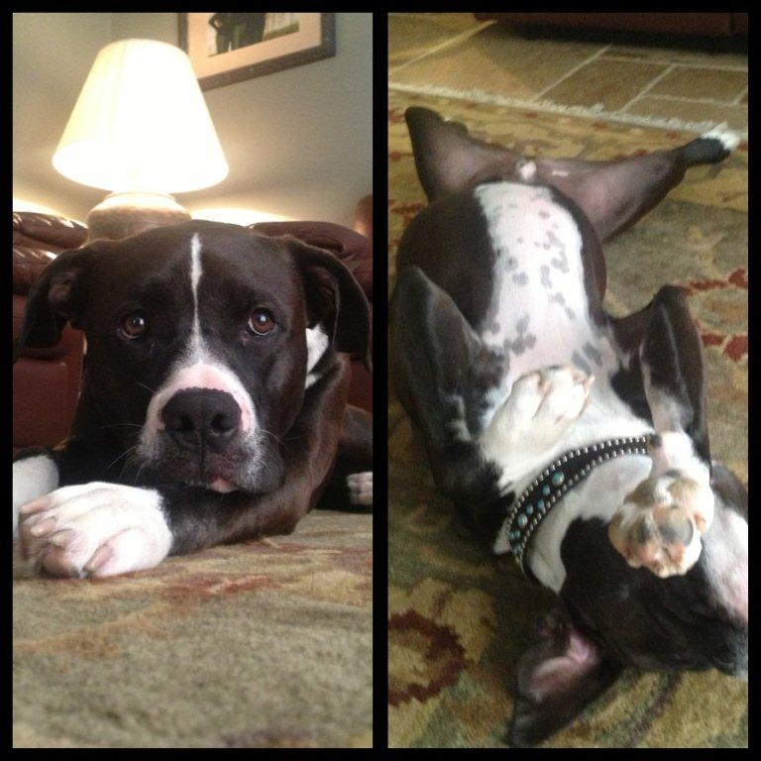
My Family Now

Slide 9
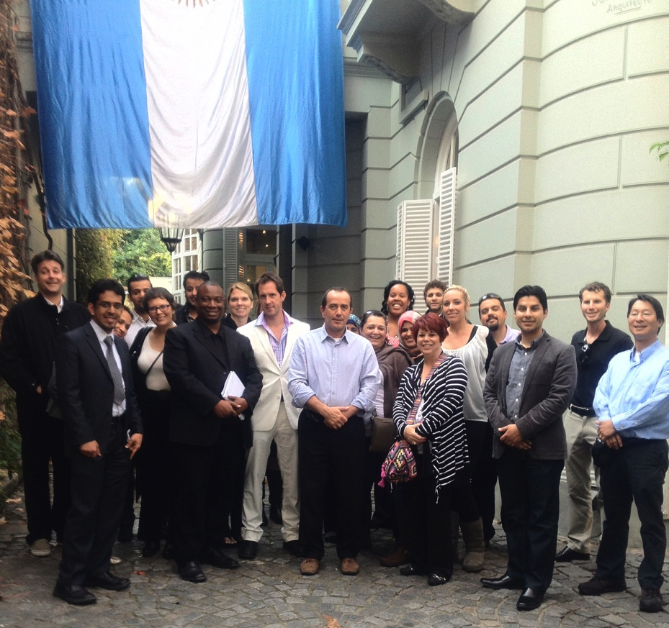
Oh Yeah…Back to School
In 7 STRAIGHT years I:
Completed my Bachelor’s Degree in Leadership from Azusa Pacific University
Went on to get my Master’s in Organization and Leadership
Finally, graduated with my Doctorate in Organizational Leadership in 2014 from Pepperdine University

Slide 10
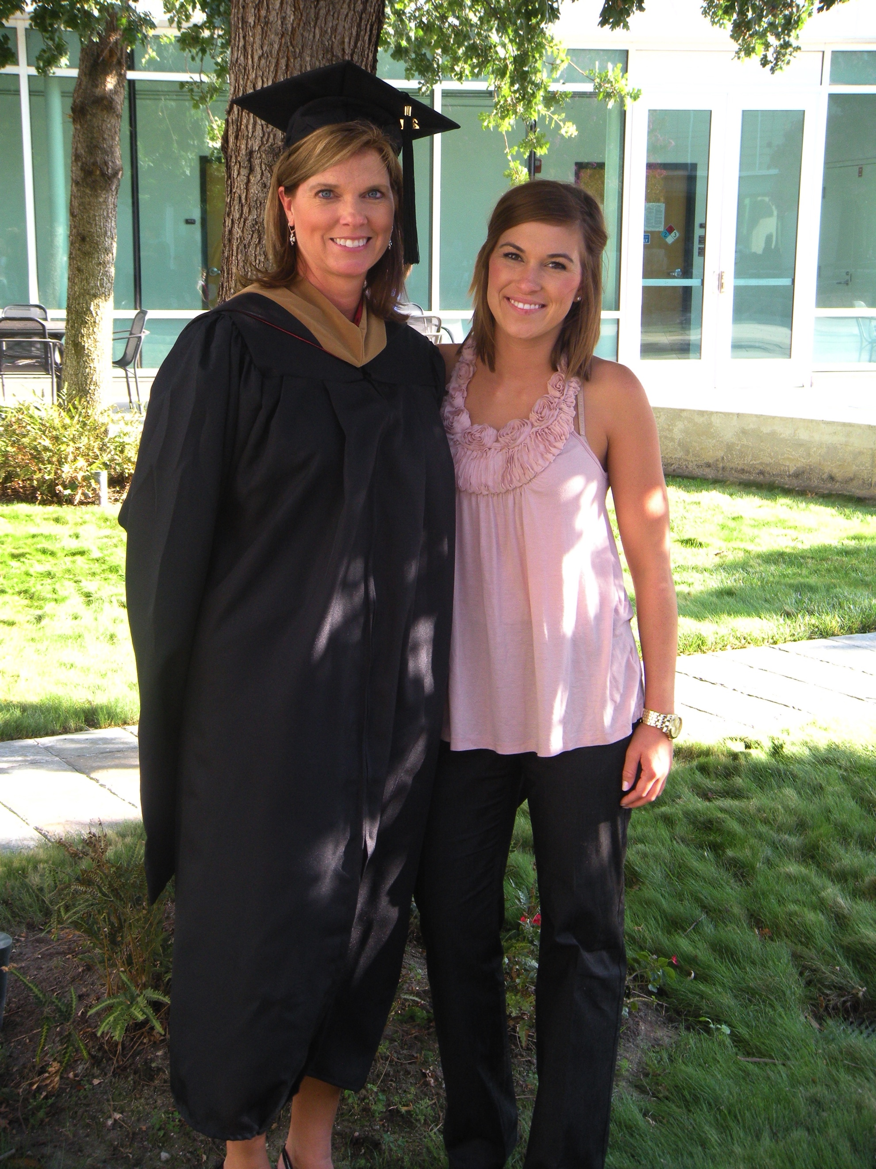

Slide 11
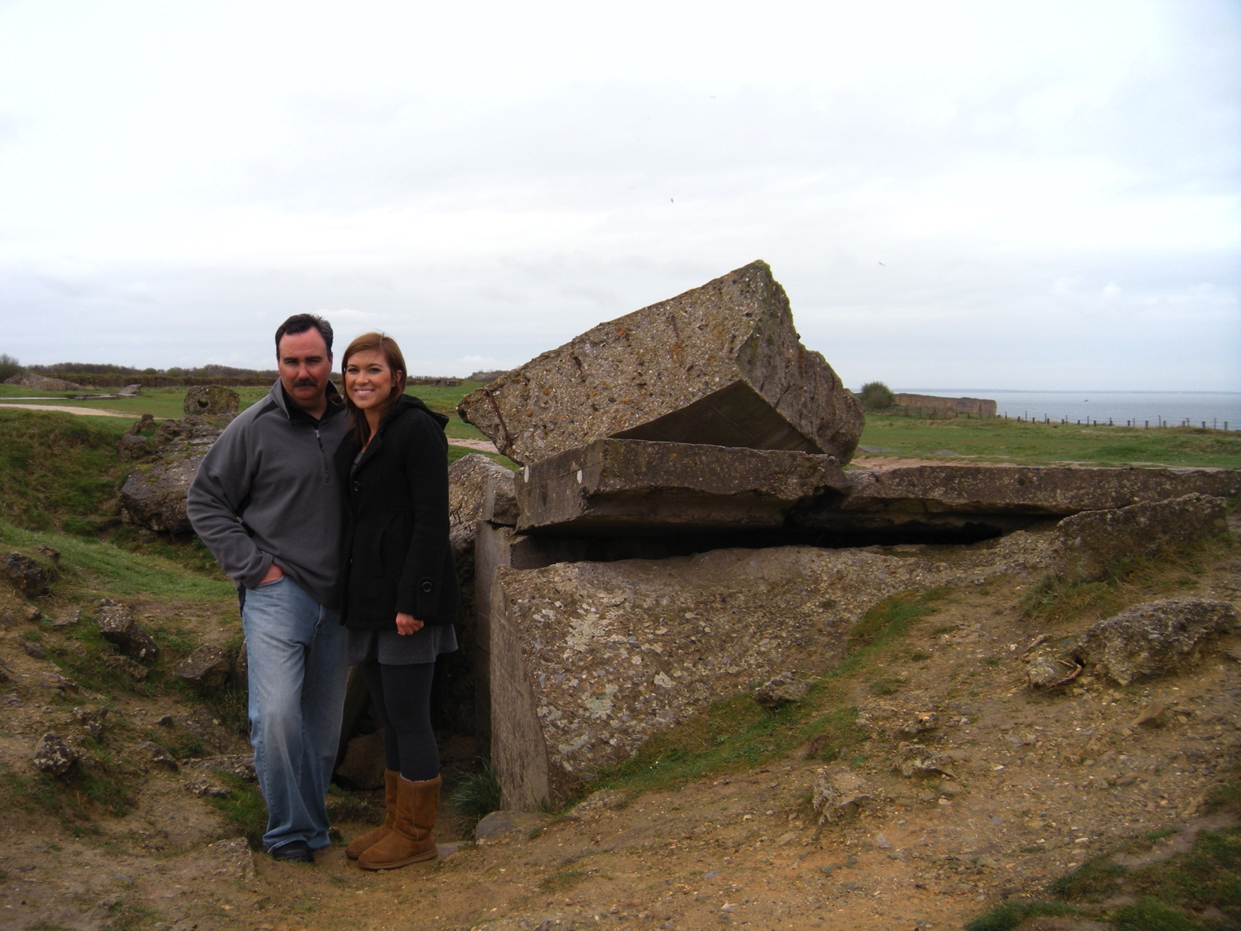
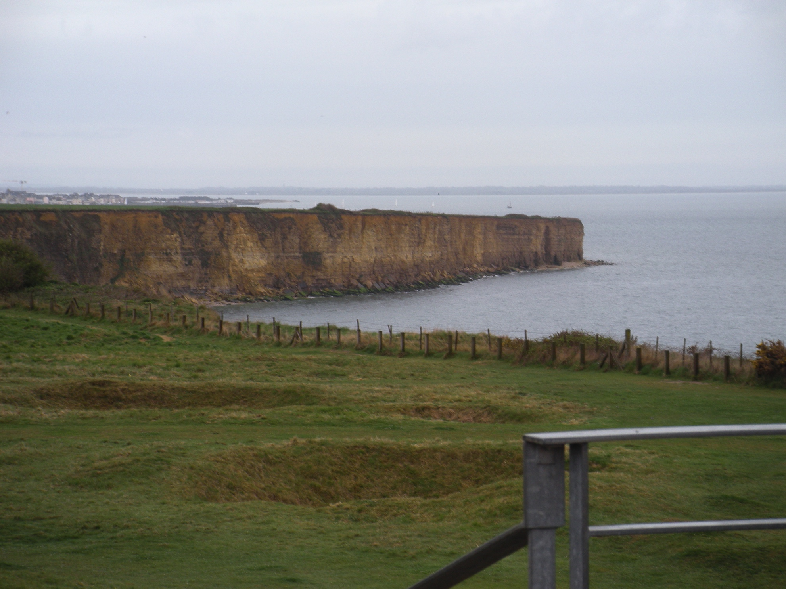
Favorite Vacations

Slide 12

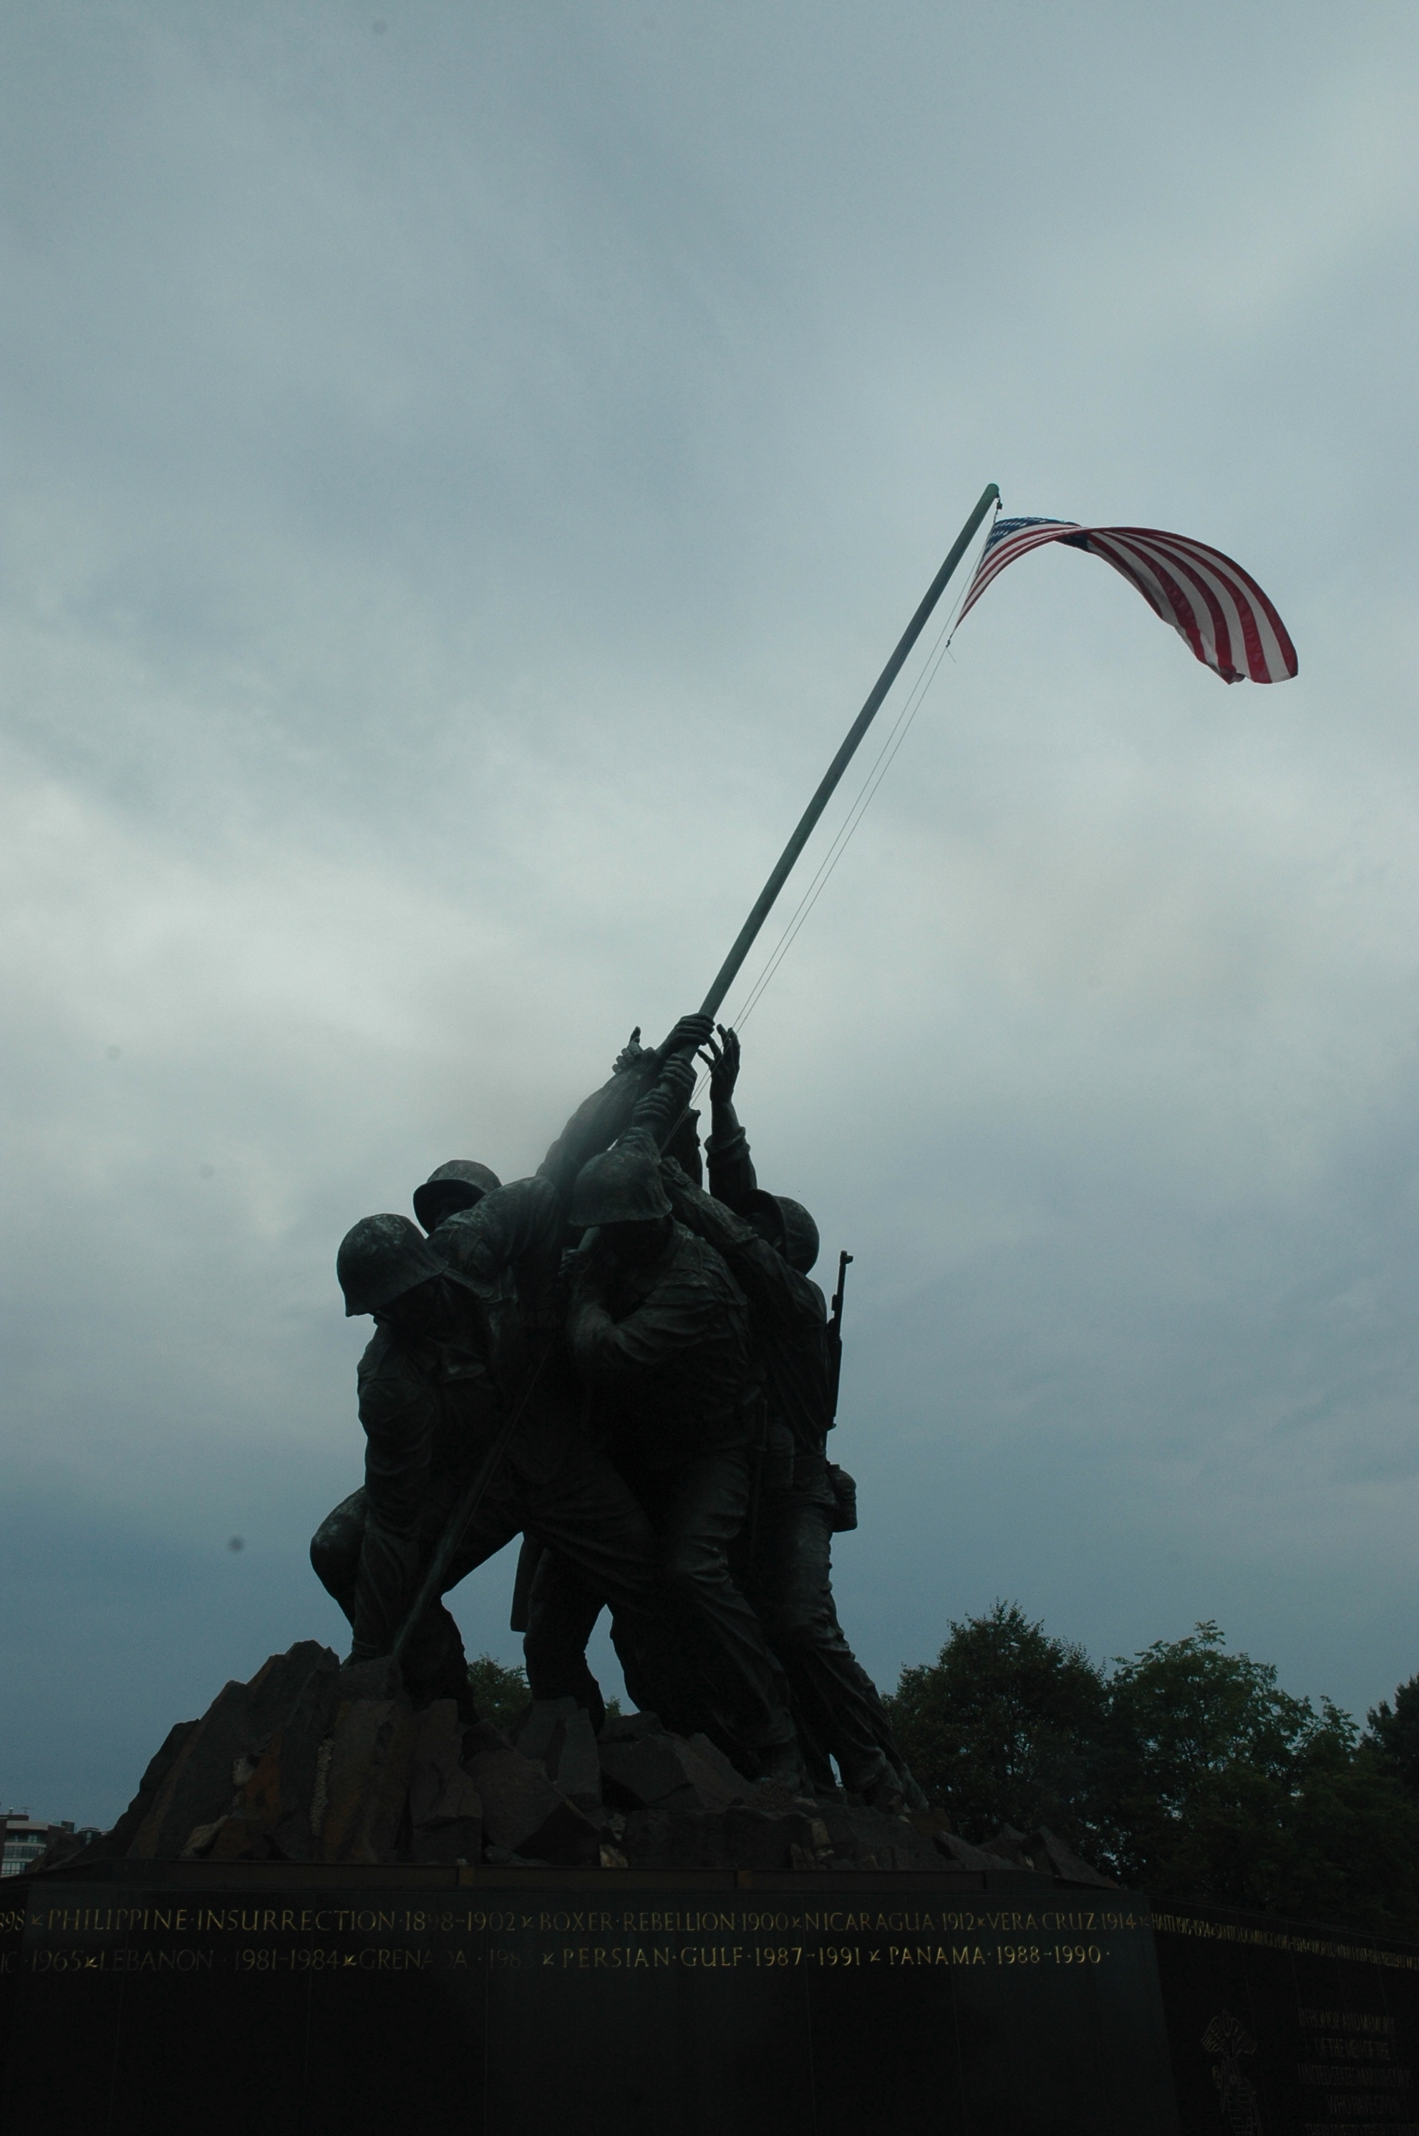
Favorite Vacations

Slide 13
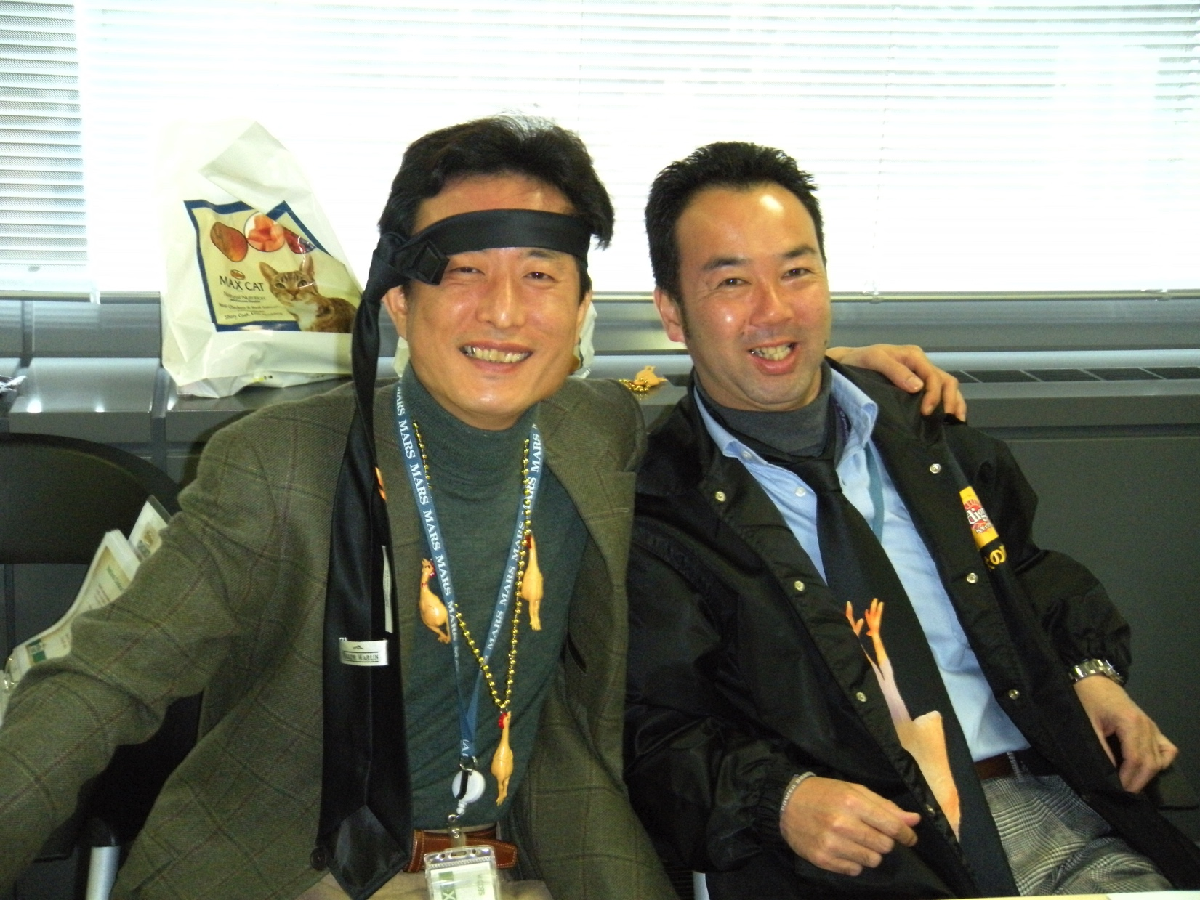
My Careers
For 18 years I worked at The Nutro Company, owned by Mars, Inc,.
Simultaneously worked at Mars and owned CCG (since 2012)
Graduated from Pepperdine in October 2014
Left Mars in November 2014

Slide 14
Challenges at Work
Mars:
  Lots of change – reorganizations every 2 years
  Expectation to change roles and move (preferred) every 18-24 months
  Culture was rapidly changing
  Lack of innovation
Nutro:
  “good ole’ boy club”
  People cherry picked for promotions
  No change - stagnant

Slide 15
Compensation
C-Suite - $225k and up
Senior Leadership $125 - $250k
Middle Management $95k - $135k
Sales Representatives $55k - $90k
  Company cars
  401k
  Pension plans
  Medical / dental / vision
  Paid holidays
  Bonus (sales 25% of base salary / all others 10% of base salary)
P/T Demo Representatives - $12-16 per hour

Slide 16
The Core Values
Courage
Collaboration
Creativity
That build our business

Slide 17
Our Purpose
To inspire leaders to leave a legacy that has a profound impact on others while creating healthy organizations.

Slide 18
Our Mission
Using a portfolio of unique workshops, we aim to inspire and develop the authentic leader within each person. We strive to create an amazing experience with our clients to be viewed as best-in-class training, coaching and consulting.

Slide 19
The Sweet Spot
Training
Coaching
Consulting
Consulting- we are brought in initially to analyze, find root causes and make recommendations for a solution
Training- we make recommendations for training programs if there is a gap in the areas of HR, leadership and/or team-building
Coaching- when individuals are coached after training, the stickiness is enhanced and greater results are seen

Slide 20
Our Goals For The Future

Slide 21
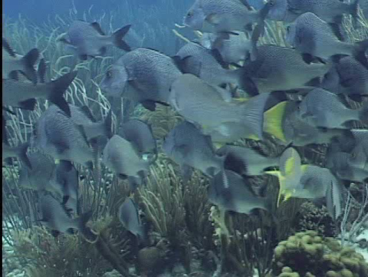
We are dedicated to inspiring learning and leadership development
so that future generations will have the way paved for them
and be able to blaze their own paths.

