Slide 1
It’s Never Too Late to Become Who/What You Might Have Been
Original quote- George Eliot (A Girl!)
My View on Life

Slide 2
INTRODUCTION
My name is Debra Fine and I’ve had many challenges that have ended up creating the great life that I have today
I’m the CEO of “I Have A Dream” Los Angels and founded the Fineline Foundation for Victims of Violent Crimes
I Have A Dream adopts at risk school classes and tutors, mentors and provides cultural and college prep, as well as case management from 3rd Grade –College
Fineline Foundation provide resources for victims of violent crimes to overcome trauma
I have the privilege of being able to give back after a strong career and do what I’m passionate about in the non-profit world

Slide 3
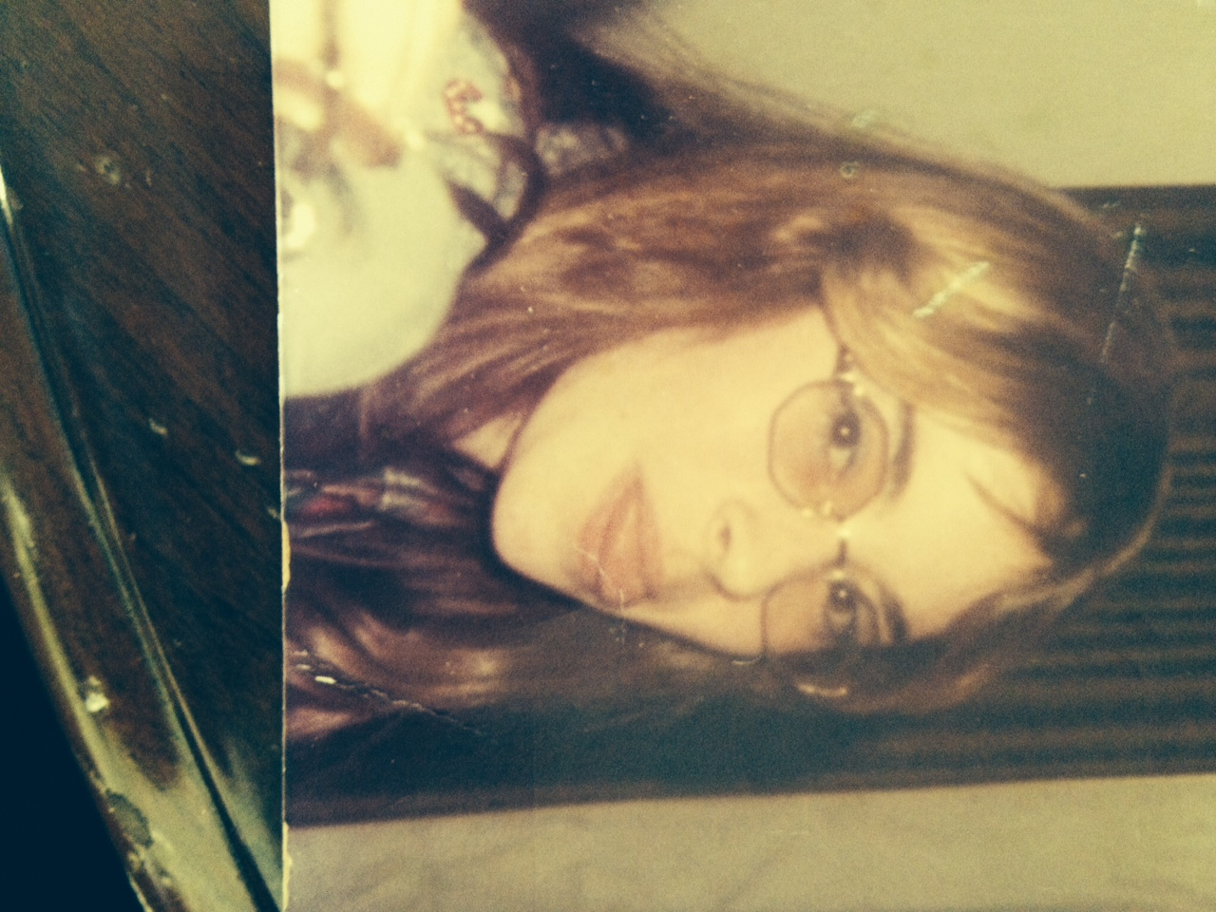
The Early Years
I was born in Illinois and raised in Elkhart, Indiana
Small Town/ rough start and I wanted to grow!
Always had some “grit” and hope for a better life
This is a picture of me at BLANK age. andAnd

Slide 4
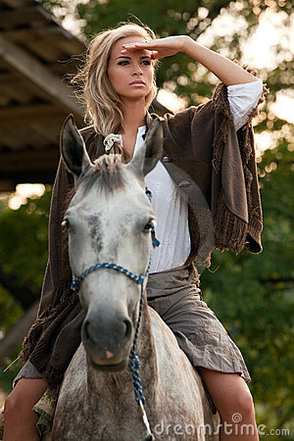
More Early Years…
My Passions made me feel good about myself
A little about my family…
This is a picture of me and INSERT FAMILY NAMES.

Slide 5
I rode and trained horses to stay out of trouble, job at 15
I moved to Chicago to grow
Early relationships caused trust issues
Role models
Mentor
Find who you are
Be with the type of people you want to be
Do estimable acts for self esteem
Senior year in Chicago
New Start
New Culture
Work
Gearing Up for college
Visiting schools

Slide 6
HIGH SCHOOL
Time to start thinking about College!
Grades
Sports and After school involvement
Community Service
Letters of recommendation/ Network and get a mentor
>
\
Here is a shot of me in HS
Me as a Blank grade student

Slide 7
Preparing for…
Do you Know ?
Five words that describe me best from five people I know and
Trade School
Two year Junior college
Will I move
Who am/what’s my style
Financial Aid/ Scholarships

Slide 8
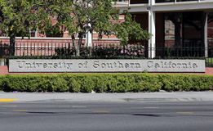
College
I attended college in Los Angeles at USC
My first year of college
I prepared to get accepted into college
\

Slide 9
College…stay on task
This probably won’t get you a job
This will
Get a study buddy- Good grades
Join/lead school clubs
Look on the college internship available board and do at least two of them
Do Community Service
Start to ask people In business to just give you a few minutes of their time to advise you
Interned: CBS in the newsroom and at a P.R firm and wrote = Samples of my work

Slide 10
Career Path
From my internship at CBS and my “media buy plan” I got a job in media sales
I loved marketing. I spoke to all possible mentors. I met the head of Pepsi on a plane and asked him for a job. He had me interview at his product placement firm. I got the job
My path was set for marketing. My clients were studios. Orion pictures got to know me and hired me as Director of Marketing ….
Notes:
You may use this chart to describe your journey to the current career

Slide 11
Always follow up with colleagues you meet at events and meetings. Keep an active list
Company pic
Company pic #2
My First start-up company- Became an entrepreneur
Company sold when our prices were falling ☹
Special Effects Titanic-Knew CEO from owning C9
Lesson: If you fail, learn from it, get the reason down to 10 honest words :

Slide 12
Lessons I Learned The Hard Way
Be your word- under promise and over deliver
Build relationships-It’s all about people who like to work together
Don’t backstab team play
Find a mentor (Again)
Know Your Strengths
NEVER GIVE UP
Give to others with no expectation of a return
Take responsibility for your part in a bad outcome
Know who you are
Any bad habits from “role models” when you were young….Lose them!

Slide 13
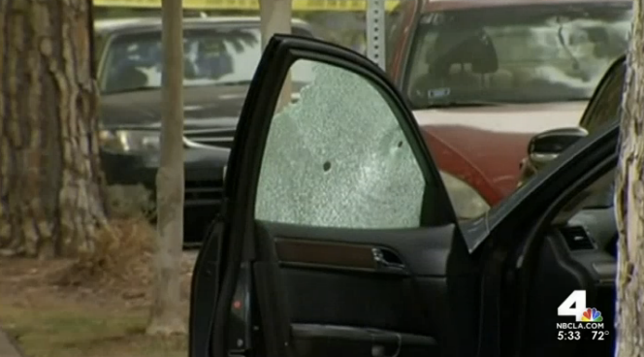
Life Happens, it’s how we come out of it that counts
We will now spend several minutes discussing the day’s academic module and how it is relevant in the ‘real world’
I was shot 5 times when I drove in between a mass shooter and his would be victims

Slide 14
QUESTION AND ANSWER

