Slide 1
Jamie DOURAGHY
Artisan Creative

Slide 2
INTRODUCTION
My name is Jamie Douraghy and I am 55 years old.
I am the founder of Artisan Creative.
My company does:
staffing and recruitment for creative and digital companies
My role at Artisan Creative is
To coach, guide, challenge and lead

Slide 3
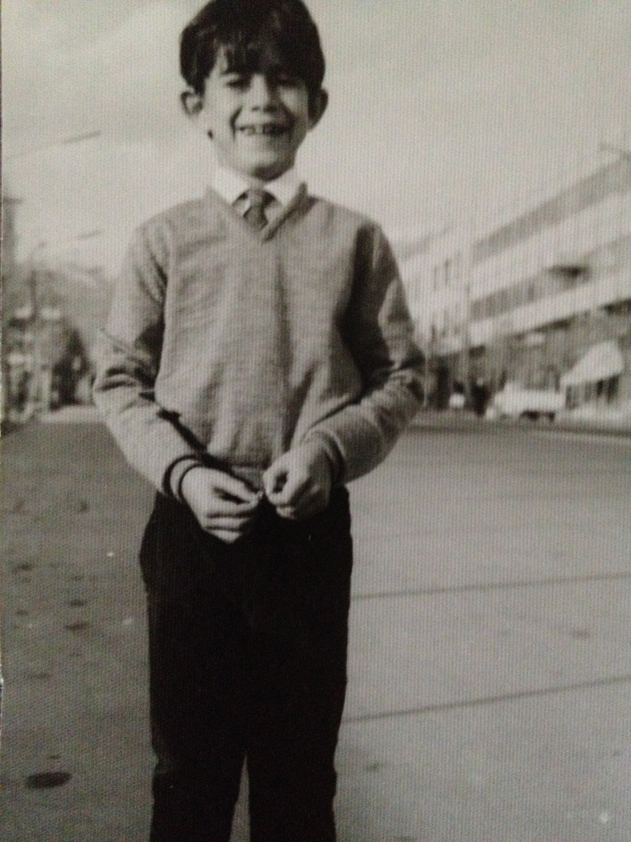
My childhood
I was born in New York City and raised in Iran, England & France
This is a picture of me at 7 in the streets of Tehran

Slide 4
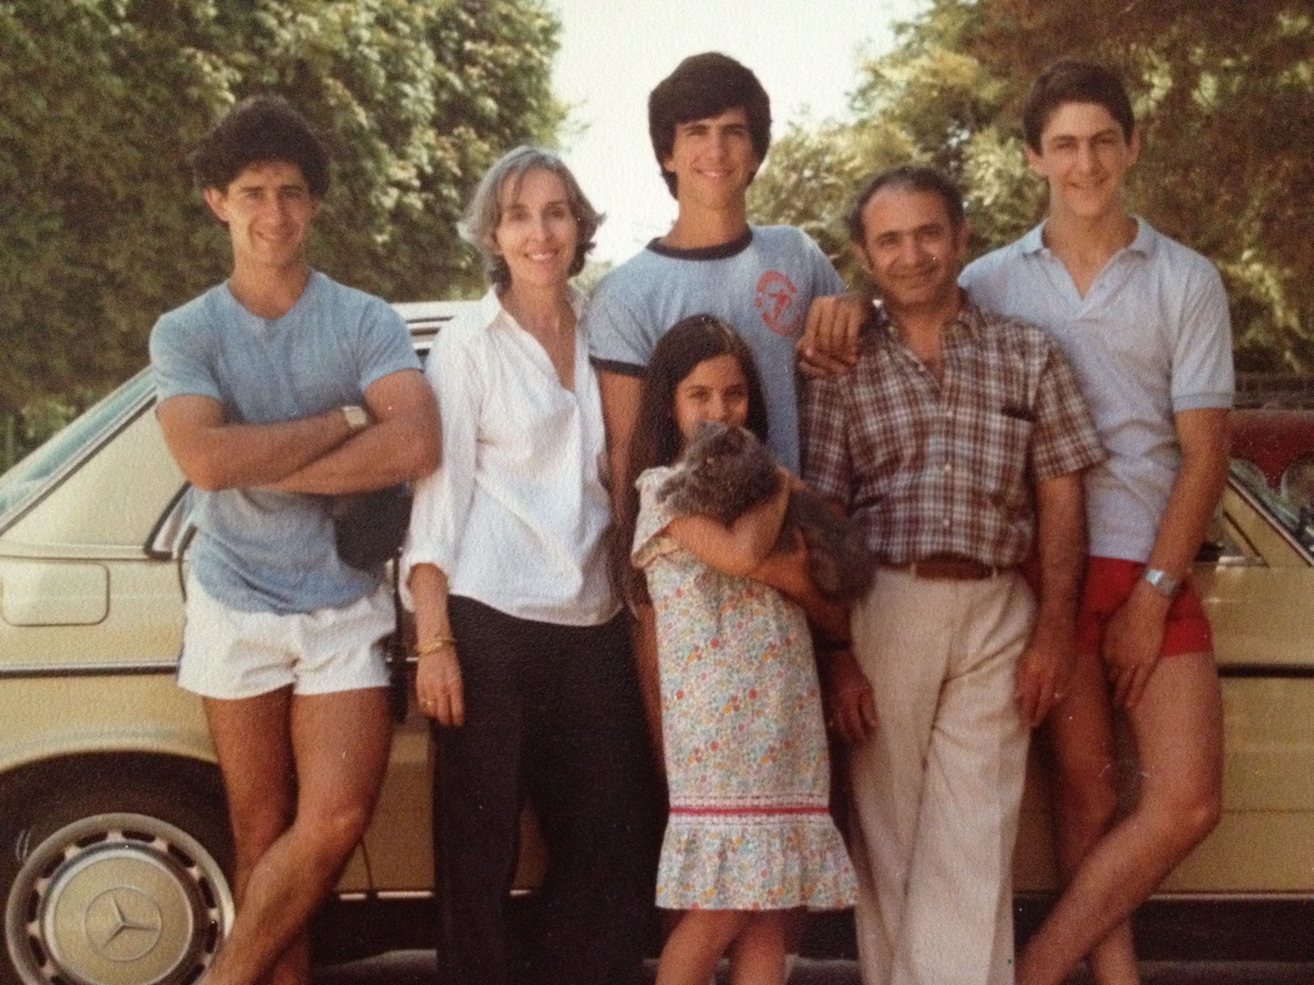
My family
Grew up in a culturally mixed family with an Iranian father and American mother. They lost everything in the revolution in Iran and started anew in Switzerland as immigrants
This is a picture of us in Portugal on a family road trip in the 80’s with my Parents, Bejan, Cameron, Camilla

Slide 5
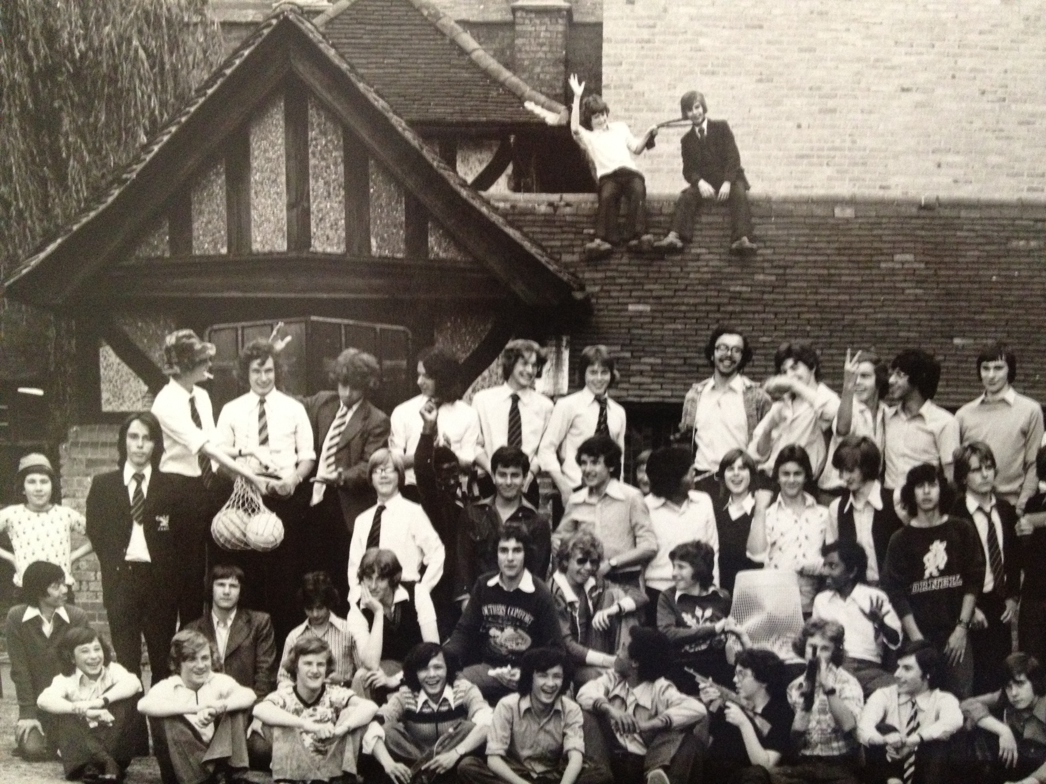
MY HIGH SCHOOL
I attended Forest School in London England

Slide 6
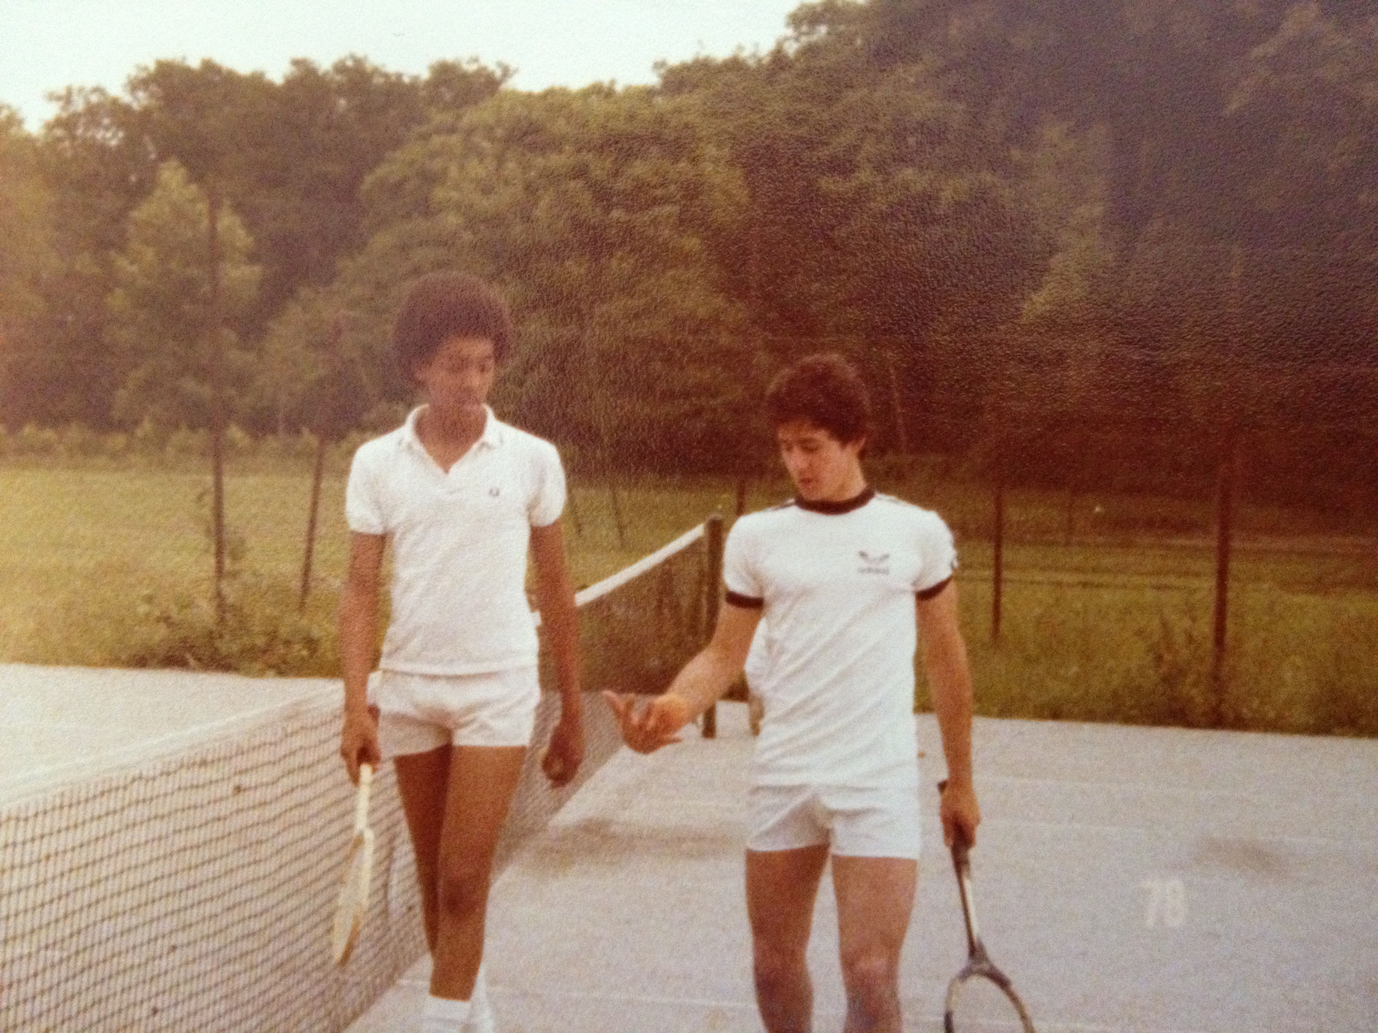
High School
As a HS student I was shy, athletic, and competitive
Here is a picture of me in HS

Slide 7
High School
Things that I really liked in Boarding School were:
History
Languages
Biology
All sports
Bonding with friends from around the world

Slide 8
High School
Things that felt difficult or challenging for me while I was in Boarding School were:
Teachers I couldn’t connect with or weren’t willing to take the time to get to understand me
Classes that I simply couldn’t wrap my brain around
Being a far away from home and only seeing my parents 2x a year.
Having to go to church 5x a week in school uniform
Terrible food that was made industrially
No girls!

Slide 9
High School
Responsibilities given as no jobs in boarding school:
I was ask to be a monitor and then head of the boarding house for my senior year. Being given a position of responsibility and leadership meant a lot to me, it helped build my self confidence

Slide 10
Getting in to College
The top things I did to ensure I got into college:
Became fluent in another language (french)
Became really good at 1 sport (fencing)
Volunteered at places that needed someone to help others
Spread my interests over a broad range of subjects

Slide 11
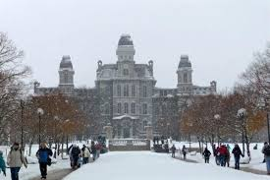
College
I attended college and grad school in Syracuse NY

Slide 12
College
Things I enjoyed
Things I didn’t
Being part of a school that had Div 1 sports
All you can eat good food
Opportunity to study and learn about anything I was interested in.
Great academic facilities
My brothers were at SU for my final year as a grad student
Being lost in the crowd
Snow and cold weather
Guys getting drunk & too often wanting to fight.

Slide 13
College
Favorite classes
Least favorite classes
Languages
History
Literature
Anthropology
International Relations
Political Science
Algebra
Anything Math related
Economic Theory

Slide 14
College
Jobs I worked while I was in College were:
French Tutor

Slide 15
College
Things that felt difficult or challenging for me while I was in College were:
Initially feeling out of place as an American who grew up outside the US and couldn’t full relate to what I felt were a different set of priorities.
Constant pressure to be “one of the guys” and do things that I didn’t want to participate in. Binge drinking, constantly playing tricks on others just for the sake of entertainment. At times destructive behavior.

Slide 16
Getting a job after College
The top few things I did to ensure I got a good job after college were:
Did some teaching assistant work
Internships whenever possible
Joined SU alumni association
Joined networking groups
Bought a suit and tie!
Moved to Washington DC where I believed I would find work in the Foreign Service.

Slide 17
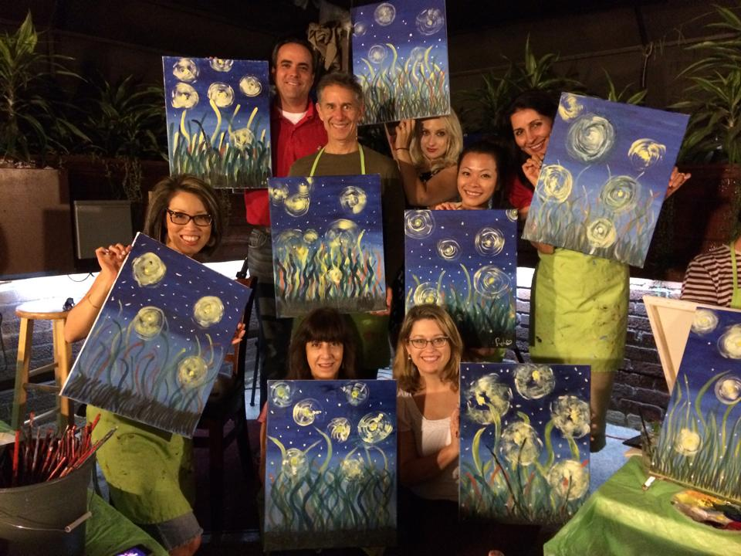
This is My Company
Every day at my company:
Started in 1996, serving LA and SF
Support a broad range of clients from fortune 500 to mid level
Believe in building long lasting relationships based on trust
Insert company picture

Slide 18
My Career Path
Notes:
You may use this chart to describe your journey to the current career

Slide 19
My Career
The first jobs I had after college were:
Bike Messenger, Waiter, Customer Service Rep at a Bank, all intersecting at different times while trying to land a job in the Foreign Service.
The worst job I have ever had was:
Working at the bank for a boss who only cared about himself and hitting his numbers. The next was falling off my bike during a snowstorm in DC while delivering important letters. I resigned that day!

Slide 20
My Career
Challenges I have had to overcome throughout my career are:
Growing the company from 1 office to 5 offices and 2 employees to 40, then having to cut everything back down when the recession hit and closed offices.
Staying focused on my company when I often chased many other business ideas that I thought were “good ones” at the time.
Hiring the wrong people for the wrong roles and not firing them fast enough when they didn’t work out.

Slide 21
My role within ARTISAn
CEO
MANAGEMENT
Account Manager
Recruiter
Admin
Notes:
Use this graph to give more description of your role specifically (responsibilities, typical work week, direct reports, etc.)

Slide 22
Compensation at ARTISAN CREATIVE
C-Suite
($200K)
Management
($125K)
Account Manager
($75K)
Recruiter
($40K)
Notes:
Use this graph to show general compensation ranges for people in various roles in your company

Slide 23
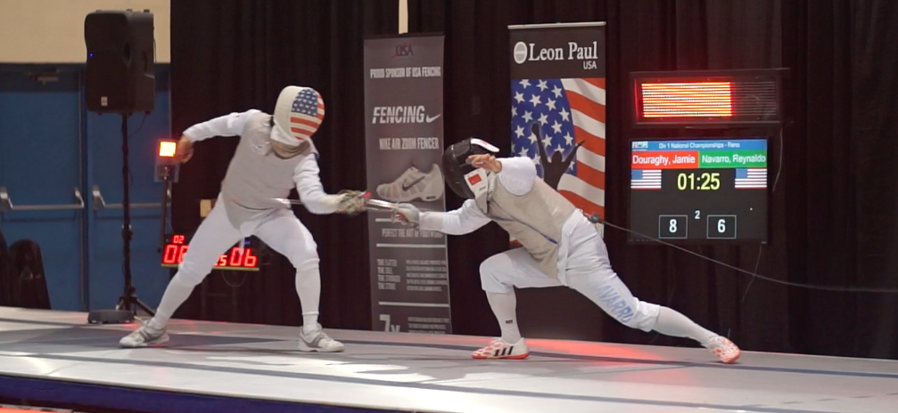
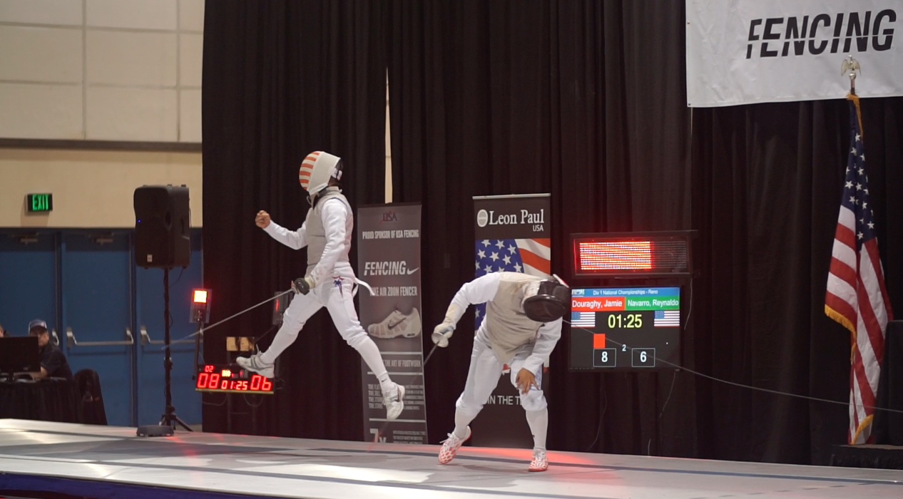
More than just work
When I am not at work I like to:
Travel globally
Volunteer time to help entrepreneurs around the world.
Fence competitively, both nationally and internationally

Slide 24
Do it all over again?
If I could talk to my high school self, what would I say?
Stay focused on what you care about the most
Don’t follow the crowd, find your own path
Read more
Listen to understand first and then you’ll be understood
Seek out good advice from teachers you trust
Get a mentor

Slide 25
QUESTION AND ANSWER

