Slide 1
Notes:
Thanks so Much Mike for having me here, I am grateful for the opportunity to be a part of this event. Hi everyone, I am so excited to be here with you. I’m Lisa G. a transformational weight loss coach that has spent over 20 years helping women and men over 40 and 50 make a massive difference in their lives. I am the creator of the best- selling Skinny Jeans Workout sold in Target and featured in life and style.. as one of the top ten in -home workouts.

Slide 2
6 Steps to Weight Loss
Weight Loss Coaching
Corporate Weight Loss
Team Building Retreats
Call Me! (310) 991-0801|lisag@lisagfit.com
Notes:
Today I’m here to tell you about my 90-day slim down plan, six steps to permanent weight loss over 50, Emotional eating will never take you out again after this program. I also teach you how to maneuver holiday, work and family pressure so you will never fall off the program.

Slide 3
Call Me! (310) 991-0801|lisag@lisagfit.com
Notes:
I’ll teach you as much as I can in the limited time I have with you. For those of you that want more. Don’t worry I’ll show you how you can get more information before I finish speaking,

Slide 4
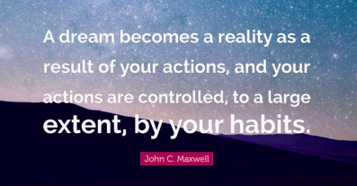
Hi, I am Lisa Goldenthal!
Call Me! (310) 991-0801|lisag@lisagfit.com
Notes:
Before I talk to you guys about my 90- day slimdown plan. I would like to tell you more about how I came to this system that I teach. I’ll never forget… when I was growing up in NYC, believe it or not as a white girl I when I lived in Brooklyn It felt like a war zone, and I learned how to deal with abuse quite often starting out at a young age, not only from the kids at school but from my father too. And as a young adult too.

Slide 5
Call Me! (310) 991-0801|lisag@lisagfit.com
Notes:
The end result was I learned to use food for comfort and numb out and I weighed 15 pounds more than I do now. That was painful for me and I felt like a failure and a fraud being in the fitness business. I used to feel like because I work, out I can eat anything I want but sadly that just isn’t true especially as we get older and our metabolism starts to slow down and we naturally start losing muscle.

Slide 6
Call Me! (310) 991-0801|lisag@lisagfit.com
Notes:
I used to sabotage all my hard work in the gym every weekend just numbing out with food and drinks, until I discovered my 90 day slimdown system that I teach, I finally got away from all those stories in my head that were keeping me stuck in self sabotage, and that’s why I’m here to help you take the necessary action to get off the diet roller coaster for good.

Slide 7
Does anyone want to learn how to rock out your skinny jeans with me?
Call Me! (310) 991-0801|lisag@lisagfit.com

Slide 8
Call Me! (310) 991-0801|lisag@lisagfit.com
Notes:
So what I discovered is my 90 day slim down plan that gives you the six steps to permanent weight loss after 50. Today I’ll discuss the most important step in my program the mindset piece that people tell me is life changing for them. Obviously, calories and exercise play a part, but the fastest way to a 90 day slim down success is to combine those things with retraining your brain and body to THINK Thin.

Slide 9
Close your eyes and take a deep breath.
Call Me! (310) 991-0801|lisag@lisagfit.com
Notes:
Close your eyes and take a deep breath. How do you want to feel In your body? Have you ever felt like you need help achieving your goals of getting into all those clothes in you closet? This is your vision for yourself.

Slide 10
Call Me! (310) 991-0801|lisag@lisagfit.com
Notes:
Before I get into retraining your brain, let’s talk about all the chatter in your head that’s been holding you back that’s holding you back from permanent weight loss, so you can win the weight loss Battle for good. I’m talking about “nothing works for me” I’m just big boned. My genetics are the problem. Do you ever give up because you’re afraid to fail?

Slide 11
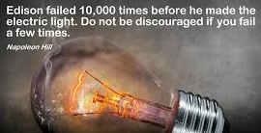
Call Me! (310) 991-0801|lisag@lisagfit.com
Notes:
Edison failed 10,000 times before he made the electric light. Don't be discouraged if you fail a few times.

Slide 12
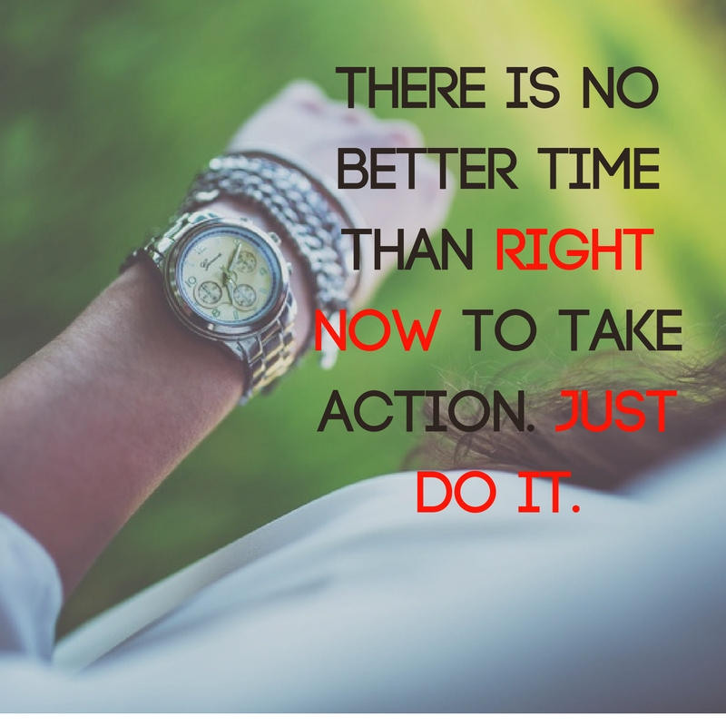
Call Me! (310) 991-0801|lisag@lisagfit.com
Notes:
Don't focus on the failure. Focus on all the times you did show up. Focus on what's already working for you RIGHT NOW.

Slide 13
Today it’s time to dig really deep and find out what’s holding you back.
Call Me! (310) 991-0801|lisag@lisagfit.com
Notes:
I will create a safe space for you to get out of your own way and finally take the require action to really get past the subconscious programming and triggers that have been stopping you. That is the reason so many of you make resolution’s every year to lose weight, but end up on the diet roller coaster. Today it’s time to dig really deep and find out what’s holding you back.

Slide 14
It’s our habits that can make or break our permanent weight loss.
Call Me! (310) 991-0801|lisag@lisagfit.com
Notes:
I want to talk about how in weight loss, we sometimes self- sabotage and then spiral down- hill. The good thing is, it’s not all the trials and tribulations in the past that really matter. It’s resilience, it’s time to say not me, not now. I don’t want to be unhealthy and diabetic when I get older. It’s our habits that can make or break our permanent weight loss.

Slide 15
Yoyo Dieting
Call Me! (310) 991-0801|lisag@lisagfit.com
Notes:
If you don’t have a someone to hold you accountable, you can get stuck on the yo-yo diet year after year Let me help you finally get away from the stories in your head that are keeping you stuck in self sabotage and realize your own self- worth. Do this right now to get started:

Slide 16
Grab a pen and Paper
Call Me! (310) 991-0801|lisag@lisagfit.com
Notes:
Take out a piece of paper and a pen and write down any negative things that were said to you in the past. Any negative opinions you formed about yourself based on those stories.

Slide 17
Example:
“I’m not lovable”
“I’m not worthy”
“I’m not good enough”
Call Me! (310) 991-0801|lisag@lisagfit.com
Notes:
For example: I’m not lovable, I’m not worthy or I’m not good enough, now write down a more empowering thought instead, and add that to your morning routine. I am statements are way more powerful, I am loveable, I am powerful I am worth it I am enough.

Slide 18
Call Me! (310) 991-0801|lisag@lisagfit.com
Notes:
Whatever’s holding you back I want to help you bust through it so that you can attain and maintain the healthy body you’ve envisioned.

Slide 19
Call Me! (310) 991-0801|lisag@lisagfit.com
Notes:
The 90 day slim down works for those of you that have tried everything out there and still struggle. I teach you how to address the necessary mindset shifts that need to happen and stop the night time eating, and emotional eating and find yourself in possibilities That are so amazing just like Janet did.

Slide 20
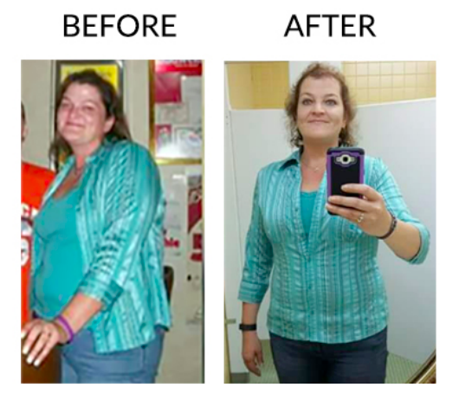
Call Me! (310) 991-0801|lisag@lisagfit.com
Notes:
“Janet was too busy to exercise and had already tried and failed with 15 other diet regimes, yet in the first six weeks working with me, she was able to loose 18 lbs. Since we started working together Janet has lost a total of 65 pounds. But more importantly, She has gained a new found confidence! People in her life, keep commenting that there is something different about her.” Janet loved the results from our time together. She has more energy and feels so much better about many aspects of her life. Losing 65 pounds during that time was amazing for her!

Slide 21
How to get out of your own way, take the required action and retrain your brain and body to think thin.
Call Me! (310) 991-0801|lisag@lisagfit.com
Notes:
In my 90 day slimdown program I teach you how to get out of your own way, take the required action and retrain your brain and body to think thin.

Slide 22
Would you like more?
Call Me! (310) 991-0801|lisag@lisagfit.com
Notes:
You will end up with not only permanent weight loss but unstoppable confidence and energy too! Just like Janet did.
Would you like more?

Slide 23
Call Me! (310) 991-0801|lisag@lisagfit.com
Notes:
In the 90 day slim down program I cover not only body weight exercises that can be done anywhere and quickly, but also my other six steps which include finding your selfish driving force, this is important because it will make you get out of bed and do the things you need to do when you don’t want to and smash your goals. Vision board and vision statement, This is super important because when you wake up you have your vision right nformeMorning mindset rituals that set you up for success, tracking and my biggest weight loss secret, intermittent fasting and eating a low carb high fat diet.

Slide 24
Jumpstart your total transformation! Let's connect!
www.lisagfitness.com
Call Me! (310) 991-0801|lisag@lisagfit.com
Notes:
Just go to right to my website Http://www.lisagfitness.com and meet my new messenger Bot Lisa Bot she’s so cute. Do it now hesitate to schedule a call with me to find out what’s holding you back from weight loss success.

Slide 25
Call Me! (310) 991-0801|lisag@lisagfit.com

