Slide 1
YBA GUEST RESOURCE TEMPLATE
Kelly Ke
FVP Branch Manager CTBC Bank USA

Slide 2
INTRODUCTION
My name is INSERT NAME and I am BLANK years old.
I work for INSERT COMPANY NAME.
My company does:
(One to two sentences about what company does):
My role at INSERT COMPANY NAME is INSERT ROLE
Every day I do (one to two sentences that’s a summary of your title/role)

Slide 3
My childhood
I was born in INSERT PLACE and raised in INSERT PLACE
This is a picture of me at (BLANK) age

Slide 4
My family
A little about my family
(one to two sentences about what it was like in your house growing up)
This is a picture of me and (insert family member names)

Slide 5
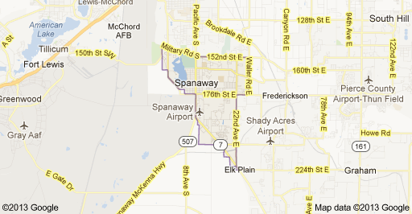
MY HIGH SCHOOL
I attended BLANK HS in BLANK CITY, STATE
(Insert map or image of high school or mascot etc. here)

Slide 6
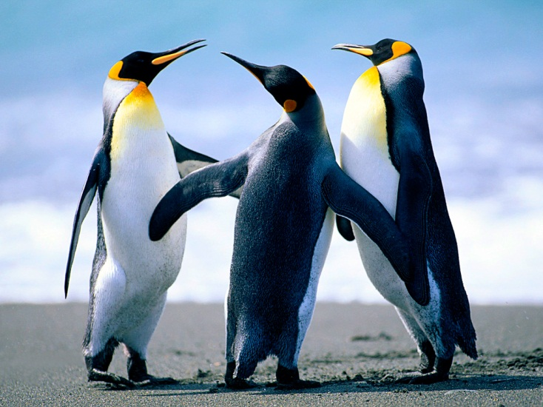
High School
As a HS student I was (shy, outgoing, nerdy, popular, athletic, academic, etc.) ……………………………………………………………….
Here is a picture of me in HS

Slide 7
High School
Things that I really liked in High School were:
(list classes, sports, hanging with friends, activities, etc.)

Slide 8
High School
Things that felt difficult or challenging for me while I was in High School were:
(list classes you didn’t like, adversities etc. you had to overcome and how you did it – keep it simple)

Slide 9
High School
Jobs I worked while I was in High School were:
(insert any paying and non-paying jobs and what you learned from doing that

Slide 10
Getting in to College
The top few things I did to ensure I got into college were:
(list things like grades, jobs, extra-curricular, sports, meeting alumni, writing letters, prep tests etc.)

Slide 11
College
I attended college (and) grad school in BLANK CITY, STATE
Insert map shot here

Slide 12
College
Things I enjoyed in College
Things I didn’t enjoy in College

Slide 13
College
Favorite classes
Least favorite classes

Slide 14
College
Jobs I worked while I was in College were:
(insert any paying and non-paying jobs and what you learned from doing that

Slide 15
College
Things that felt difficult or challenging for me while I was in College were:
(list and adversities you had to overcome and how you did it – keep it simple)

Slide 16
Getting a job after College
The top few things I did to ensure I got a good job after college were:
(list things like grades, jobs, internships, using career center, etc.)

Slide 17
This is My Company
Every day at my company:
(describe in more detail your company i.e. history of your company, what you sell/create/do, who your end client is, how many people work there, where it’s based, etc.)
Insert company picture

Slide 18
My Career Path
I started as a (mail room guy…)
I was promoted to (lower management after 5 years)
I am now the CEO of this organization ….
Notes:
You may use this chart to describe your journey to the current career

Slide 19
My Career
The first job I had after college was:
(insert here with a little description of what you did and how you got hired)
The worst job I have ever had was:
(give a funny anecdote and what you learned from that experience if possible)

Slide 20
My Career
Challenges I have had to overcome throughout my career are:
(list a few things that have made your career path difficult or that you have had to learn/change along the way)

Slide 21
My role within organization
CEO
MANAGEMENT
ENTRY LEVEL
ME
ENTRY LEVEL
Notes:
Use this graph to give more description of your role specifically (responsibilities, typical work week, direct reports, etc.)

Slide 22
Compensation at my company
C-Suite
($350K)
Management
($150K)
Middle Manager
($75K)
Entry Level
($20K)
Notes:
Use this graph to show general compensation ranges for people in various roles in your company

Slide 23
More than just work
When I am not at work I like to:
(Insert activities like exercising, golfing, traveling, being with family, buying cars, etc.)

Slide 24
Do it all over again?
If I could talk to my high school self, what would I say?
(insert a few lines of advice here)

Slide 25
QUESTION AND ANSWER

