Slide 1
YBA Justin Reese Presentation
Would you rent to this Tenant?

Slide 2
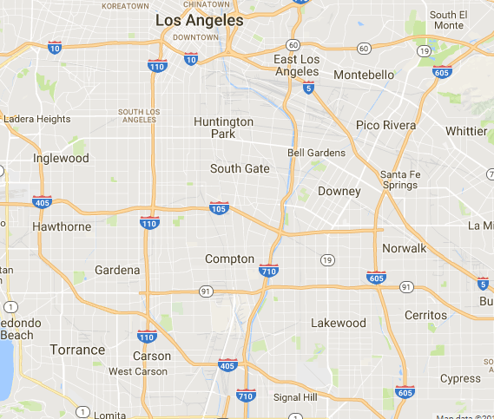
Vacant Unit
You are Landlord
Vacant rental unit in Los Angeles, CA.
You want to find a Tenant
How do you find a Tenant?
What factors (wanted and unwanted) are important in Tenant selection?
Why is this an important question?

Slide 3
Why underwriting is important
How does a bank loan work?
A bank issues a loan (agreement) and wants to get paid the money over time
How does a lease work?
A landlord issues a lease (agreement) and wants to get paid money over time.
Landlords are like Bankers
Same principle of underwriting risk to determining likelihood of a landlord to get paid money over time.

Slide 4
JRealty Approach
Equal Housing Opportunity
We do not discriminate in housing based on: race, color, national origin, religion, sex, familial status (families with children under the age of 18 or who are expecting a child), or handicap (if you or someone close to you has a disability). We use the following criteria to formulate uniform recommendation on all PTs.

Slide 5
JRealty Approach
2) Manager Discretion
If a potential tenant otherwise meets the admission criteria but we are not comfortable leasing to PT due to dialog that we feel PT might not happy with the unit, or communication that is uncomfortable, confrontational, rude, threatening or otherwise inappropriate, we may use the Management Discretion as the sole basis for recommending rejection.

Slide 6
JRealty Approach
3) Rent to Income Ratio
We like to see rent to income ratio of less than 33%. It is calculated by [Rent divided by Income]. For the income to count, it must pass #4.
Annual Rent/ Annual Income:
$12,000/ $35,000 = 34%

Slide 7
JRealty Approach
4) FICO Credit Score
The credit score must be tied to the same person who has the income. You are entitled to one free credit report from each of the three national credit reporting bureaus every year. You can get your free credit report online by visiting annualcreditreport.com.

Slide 8
Understanding Credit
Usual range between 450 and 850
Higher the score the best terms
Lower the score bad terms or denial
Credit score and report very important

Slide 9
Group Exercise
Break into groups of 5.
Discuss what you like and don’t like, about each applicant
Rank the Applicants in order of preference
Tenant | A | B | C | D | E
Rent to Income | 20% | 30% | 40% | 35% | 25%
FICO score | 500 | 700 | 600 | 650 | 550
Move in Date | ASAP | 15 days | 30 days | 30 days | 15 days
Essay | Good | Good | Medium | Medium | Good

Slide 10
Present Findings
1 or 2 people from each group to discuss their opinions and rank each Applicant from 1 to 5

Slide 11
JRealty Opinion
Tenant | A | B | C | D | E
Rent to Income | 20% | 30% | 40% | 35% | 25%
FICO score | 500 | 700 | 600 | 650 | 550
Move in Date | ASAP | 15 days | 30 days | 30 days | 15 days
Essay | Good | Good | Medium | Medium | Good
Rank | 5 | 1 | 3 | 2 | 4

Slide 12
About JRealty
My name is Justin Reese and I am 43 years old.
I work for JRealty.
My company does:
Property Management
Leasing
Maintenance
My role at JRealty is Owner, Broker
Every day I manage my staff of 7 employees, and make sure the company is running smoothly

Slide 13
MY CAREER PATH
1991 dropped out Mira Costa High School
1992 earned HS diploma from Adult School
1993? started classes at Santa Monica College (SMC)
2000 graduated UCLA (B.A. Anthropology)
2004 end active service USMC (IRR Captain 2008)
2006 earned MBA from Cornell University
2008 left Trammell Crow/ CBRE (Senior Financial Analyst)
2008 Started JRealty
Notes:
You may use this chart to describe your journey to the current career

Slide 14
Final Questions?
Final questions.
Thank you for your time!

