Slide 1
INTRODUCTION
My name is Jeremy Clarke and I am 28 years old.
I work for Vortex Web Solutions
Vortex Web Solutions builds websites for clients around the world and develops other web-based businesses
My role at Vortex Web Solutions is Founder and CEO
I have started many companies since I started Vortex in 2001 (while in high school). All using the web/tech.
Most recently, built a software service called WebMerge that generates millions of documents per year for thousands of customers around the world.

Slide 2
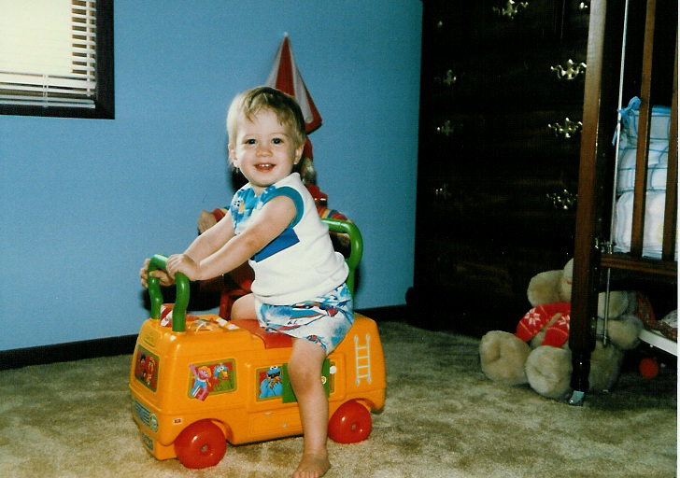
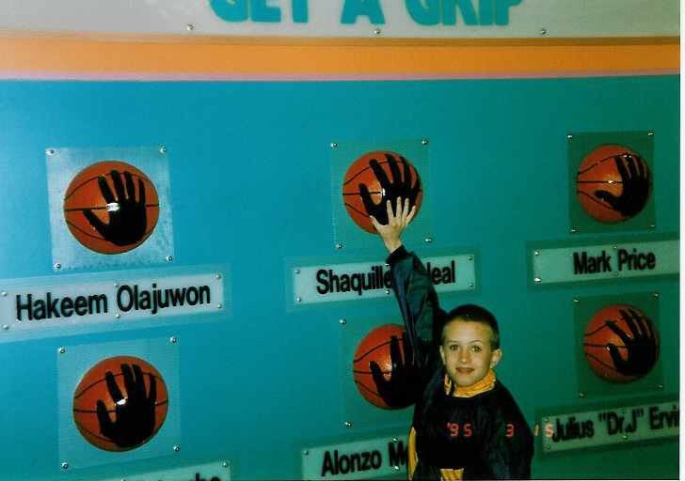
The Early Years…
I was born and raised in Indiana
This is me at 3 years old
… at 10 years.

Slide 3
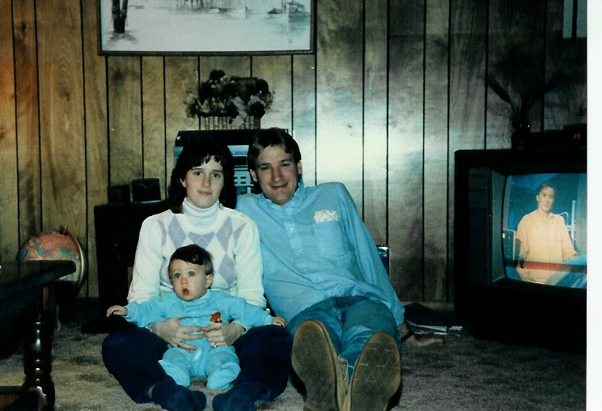
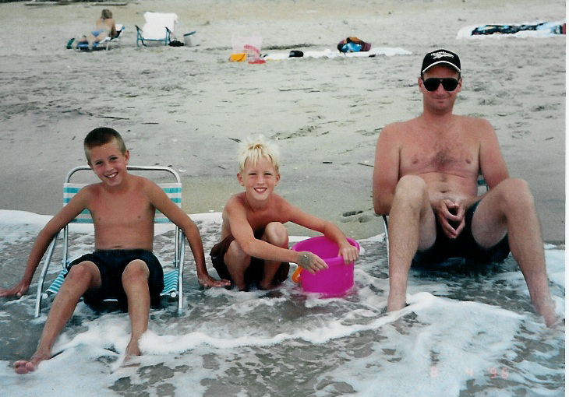
More Early Years…
A little about my family…
This is a picture of me and my parents (before my brother was born)
This is a picture of me, my brother Tyler, and my dad

Slide 4
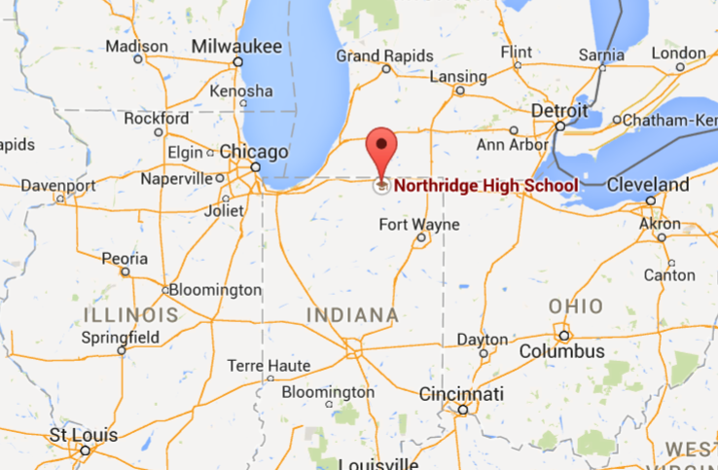
HIGH SCHOOL
I attended Northridge H.S. in Middlebury, IN
Insert map shot here
\

Slide 5
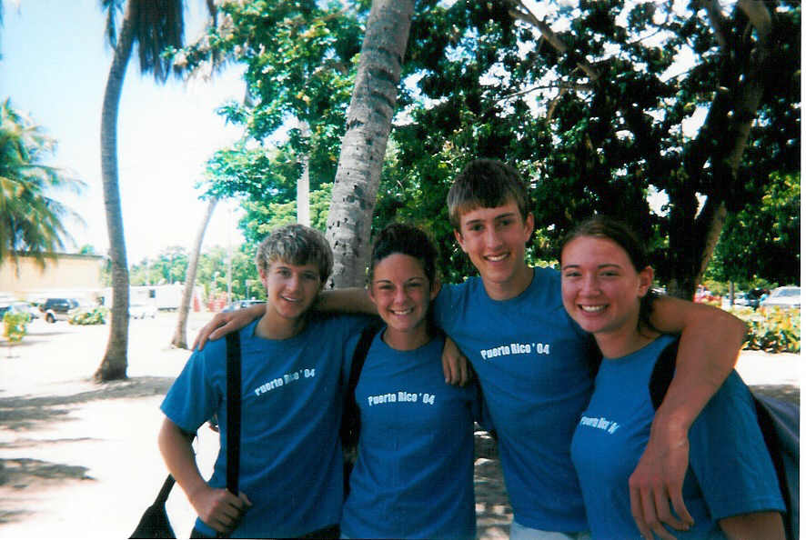
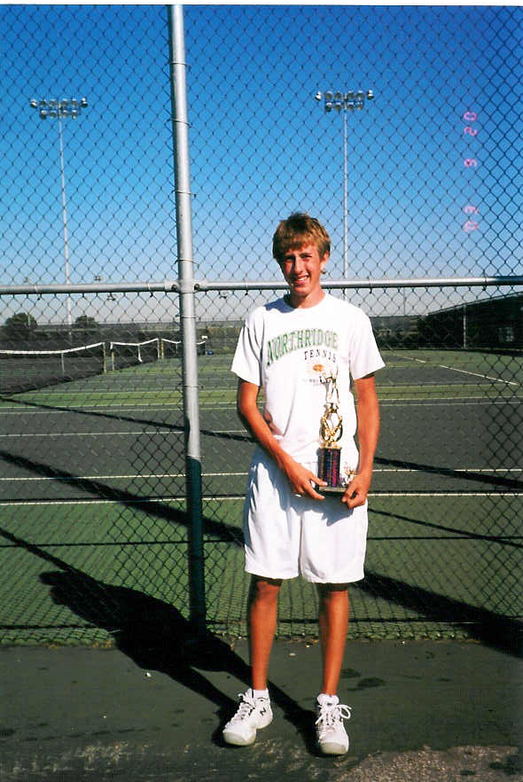
HIGH SCHOOL
As a HS student I was mostly involved in tennis (year-round)
As a HS student I was pretty outgoing and ran around with a good group of friends. I kept very busy with school work and tennis
\
Here is a shot of me in HS
Me in the 11th grade

Slide 6
HIGH SCHOOL
Things I enjoyed in HS
Things I did not enjoy in HS
Classes
  Math
  Gym
  Science
Sports
  Tennis
  Basketball
Out of School Activities
  Snowboarding
  Computers
Classes
  English/Language Arts
  Art
  History
Detention
  My friends and I would do stupid things and most resulted in detention
Partying
  I wasn’t a party animal and many of my friends were so I would have to find other things to do

Slide 7
HIGH SCHOOL
Activities/Athletics in HS
Jobs I worked while in HS
During the fall tennis season I would have practice until 6 or 7pm at night
Off-season tennis was 3 nights per week
The rest of my free time was spent on homework
My first job was a bus-boy at an Italian restaurant. I eventually moved into the kitchen and made pizzas
I also got a job at the local tennis club teaching lessons and stringing rackets.
I started making websites when I was 15.

Slide 8
HIGH SCHOOL
Fondest memories from HS
Obstacles/Adversity you had to overcome in HS
Playing tennis and winning tournaments (we made it to semi-state twice)
Hanging with friends
Starting my first business and making $$$
I often sacrificed time with my friends for work or tennis practice and that was hard
I had to work very hard during high school, but it was worth it

Slide 9
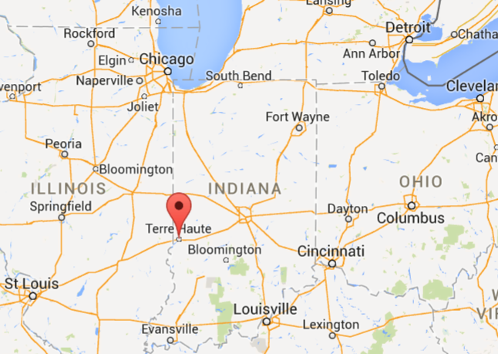
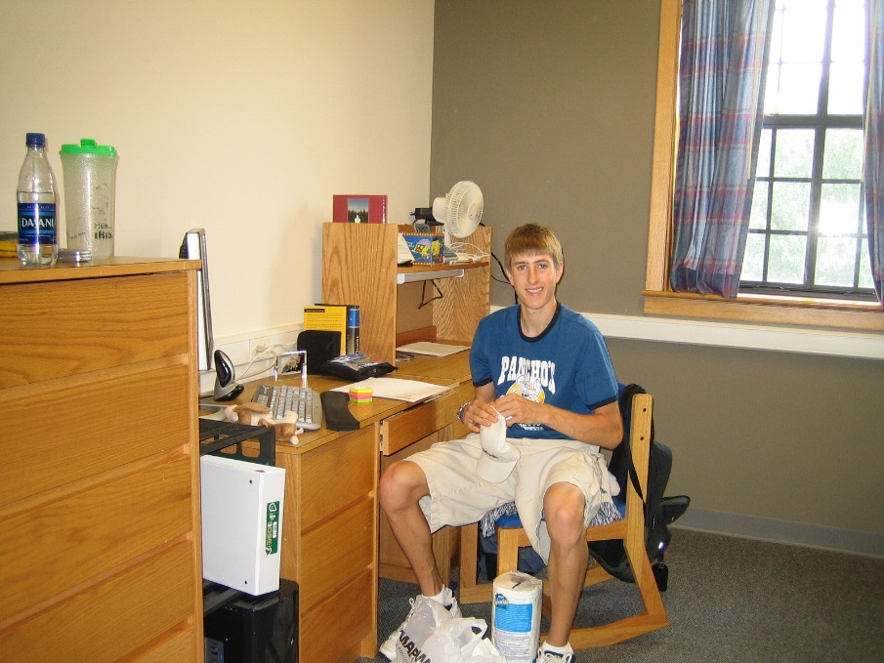
College or
Graduate School
I attended college/grad school in Terre Haute, IN
Insert map shot here
Move-in day at college

Slide 10
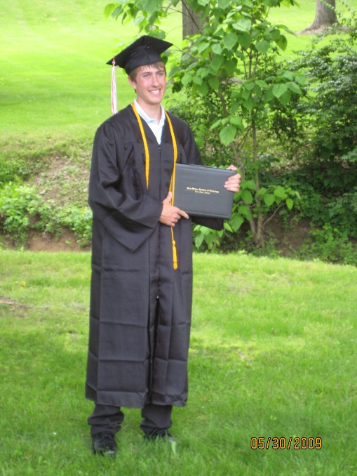
College or
Graduate School
Activities/Athletics in College
Jobs I worked while in College
I played a lot of intramural sports
  Soccer
  Basketball
  Volleyball
  Tennis
  Racquetball
I continued working on websites for clients and finding new ones
In my freshman year I started an education software company called Sharper Results
My junior year I started a restaurant review site called IndyDining.com

Slide 11
College or
Graduate School
Favorite classes
Least favorite classes
Economics
Biology
Computers/Software
Computers/Software (things I already knew)
English

Slide 12
College or
Graduate School
Fondest memories
Obstacles or adversity that you had to overcome
Made a lot of new friends
Played a lot of sports
Learned how to survive on my own
I had the financial support of my parents, but I also was able to pay for a lot of my college from my own business income
Making sure to focus on school when there are so many distractions

Slide 13
Career Path
I began my career creating small websites
I started 2 more businesses in college
I have built a business with thousands of customers worldwide
Notes:
You may use this chart to describe your journey to the current career

Slide 14




Career

Slide 15
Career
My first Job
My worst Job
I got my first job working at an Italian restaurant cleaning off tables after people ate.
I then moved into the kitchen as a dishwasher
After that I started cooking food (making pizzas and helping the chef)
My worst job was working for my dad’s company cleaning out giant kilns that dry out wood. It’s basically a big oven (the size of a small 2 story house). You had to hose, sweep and repeat to get all the saw dust out.

Slide 16
Career
Some challenges I had to overcome in my career
The biggest challenge is starting a company. There are a lot of moving parts and you have to be dedicated to making it “work”. But if you put your mind to it, you can make it happen and it feels great!

Slide 17
CURRENT ROLE
History
Vortex Web Solutions was founded in 2001
We provide web development solutions
Size
We have a pretty small team of designers and marketers
Our clients are small businesses up to $5B enterprises
Location
All employees work remotely from home!
Our customers are all over the world
Services
Web development (we build web applications)
WebMerge provides document generation services
Notes:
Use this graph to give more description of your current company (history, size, location, products and services, etc.)

Slide 18
Current Role
CEO
Sales
Marketing
Coding
Customer
Support
Notes:
Use this graph to give more description of your role specifically (responsibilities, typical work week, direct reports, etc.)

Slide 19
Career Compensation
Management ($100 - $150k)
Developer ($80-$100k)
Design ($60-$80k)
Marketing
$60-80k
Notes:
Use this graph to show general compensation ranges for people in various roles in your company

Slide 20
ACADEMIC EXERCISE
We will now spend several minutes discussing the day’s academic module and how it is relevant in the ‘real world’

Slide 21

QUESTION AND ANSWER

