Slide 1
Matthew Garff & Private Equity
Subtitle

Slide 2
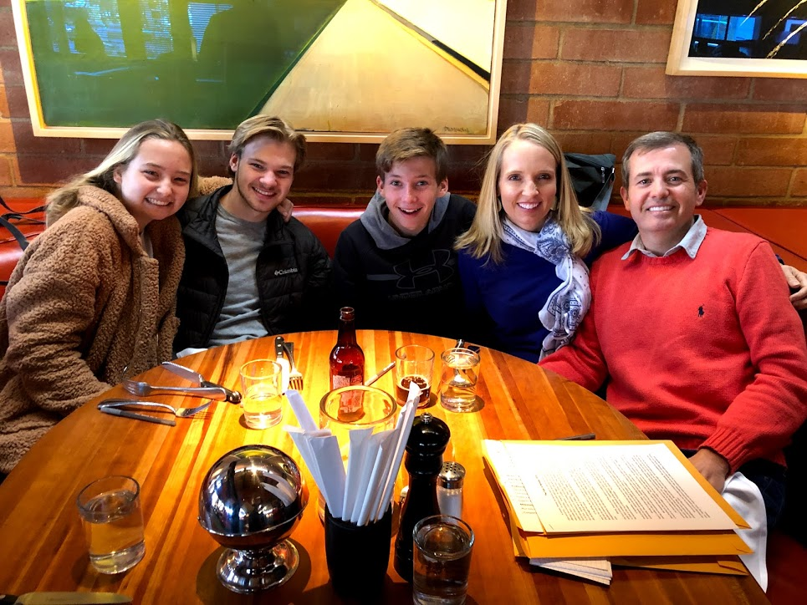
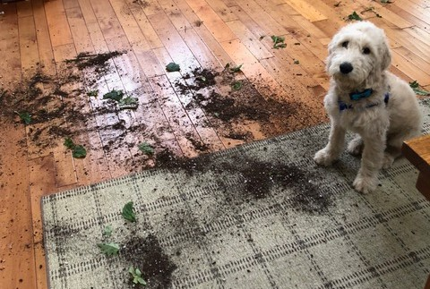
Matthew Garff from Sun Capital Partners
Grew up in Utah
Wonderful wife and three children
Dog/George

Slide 3
My Journey to Find my Career
Turning points
Community College / teacher
Golf Courses
Graduate School
Sun Capital Partners
What is Sun Capital? What is Private Equity?

Slide 4
Private Equity Continued
There are organizations that have a problem…. Extra Money
How to solve their problem… find places to invest their Extra Money

Slide 5
How does it work?
Organizations give us money
We find places for that money to be invested
We hope the investments grow in value
We get paid for helping to solve their problem
Our interests are aligned
The ultimate goal…. Return more $ then we received. Easy?

Slide 6
Examples of current investments…

Slide 7
I review many businesses….Two Examples
Ex #1: Condiments & Spices…
Ex #2: Frozen Berries….
Annual Sales: $400 million
Annual Profits: $30 million
“EBITDA”
Family owners that want to sell
4 manufacturing plants
50% sold to customers via grocery; 50% is sold to restaurants
How much is it worth? (Risk? Oppty?)
Annual Sales: $60 million
Annual Profits: $15 million
Family owners want to sell
One plant/Freezing equipment
75% grocery; 25% restaurants
How much is it worth? (Risk? Oppty?)

Slide 8
3 Things to do…
Buy for a fair price
Increase the value over time
Sell for a fair price
How do you know you are getting a fair deal?
How do you increase value?
How do you sell for a fair price?

Slide 9
Career in finance… is it for you?
Do you like business?
Do you like working hard at a desk?
Do you like analytical work?
Do you like high-pressure deadlines? Do you like type-A people? Do you mind working long hours?
If so…. Do well in high school.
Do well in college (finance, accounting, or economics)
Start in investment banking, then join private equity

Slide 10
More important stuff…
- Marshmallows… long term thinking
Who you are > What you are

