Slide 1
Marcela Bailey
Chief Digital Officer

Slide 2
INTRODUCTION
My name is Marcela Bailey and I am 47 years old
I work for the Hispanic Scholarship Fund (HSF)
HSF is a nonprofit organization that provides Scholarships and Services to help parents and students prepare, plan and pay for college and beyond.
My title at HSF is Chief Digital Officer
In this role, I am expected to develop the technology strategy and execution that supports all digital touch points for our organization internally and externally with all of our stakeholders.

Slide 3
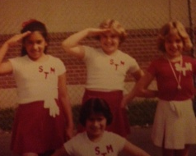
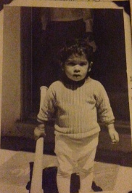
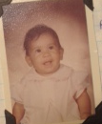
The Early Years…
I was born in Hollywood and raised in Alhambra, about 10 miles east of Los Angeles
I went to St Thomas More Catholic
School
This is a picture of me as a baby and 2 years of age.
This is a picture of me at 12 years of age on the Drill Team in the 6th grade.

Slide 4
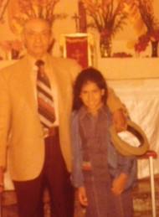
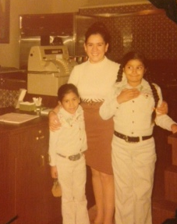
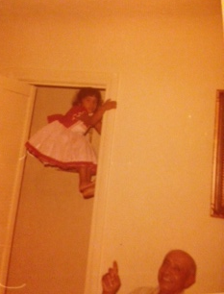
More Early Years…
A little about my family…
This is a picture of me and my mom “Mami Tona” my sister Lety and my Dad “Papa John”
This is a picture of me and INSERT FAMILY NAMES.

Slide 5
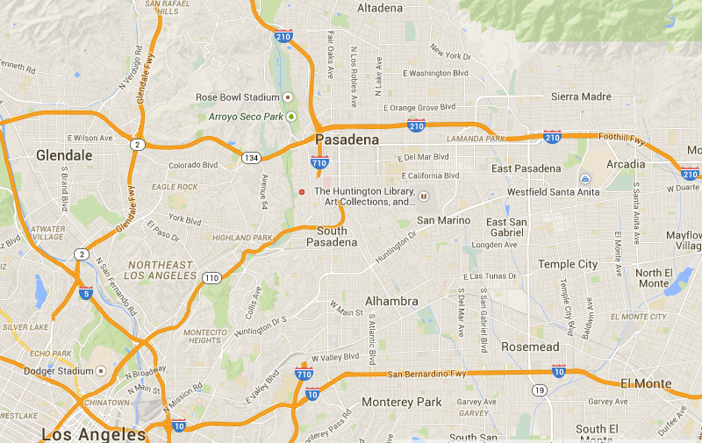
HIGH SCHOOL
I attended Mayfield Sr School in Pasadena, California
An all girls Catholic School
Insert map shot here
\

Slide 6
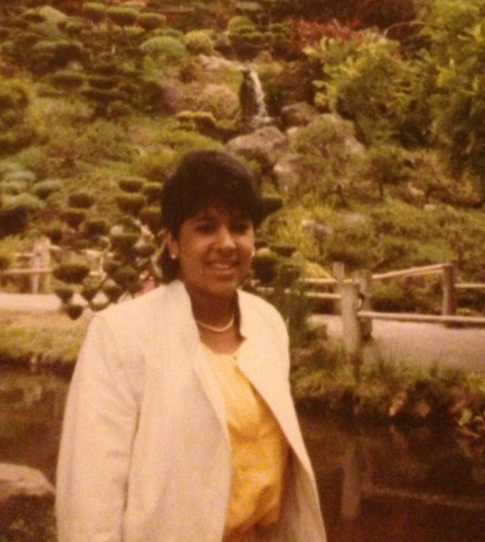
HIGH SCHOOL
As a HS student I was very focused on getting into the college of my choice
As a HS student I was shy and nerdy and hung out with other girls that were real smart
I also worked all of the time at my parent’s Mexican restaurant
\
Here is a shot on a trip to San Francisco with two other girls at 16

Slide 7
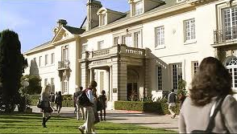
HIGH SCHOOL
Things I enjoyed in HS
Things I did not enjoy in HS
My close friends
Math – Took 5 years of math in 4
French – Went to Paris my Junior year
Art & Dance Class – Performed annualy
Working on weekends
Prissy girls & cliques
Uniforms
English & History Classes
My dad died my senior year

Slide 8
HIGH SCHOOL
Activities/Athletics in HS
Jobs I worked while in HS
Participated on our JV teams:
  Dance
  Volleyball
  Softball
  Soccer
A week off every year to explore new things:
  Year 1 – Camping & Cross Country Skiing
  Year 2 – College Tours
  Year 3 – France
  Year 4 - Dance
I worked at Casa Escobar in the Puente Hills Mall every weekend and summers
  Cashier
  Hostess
  Waitress
  Deli
  Fruits & vegetables, meat, seafood, alcohol and materials pick up
  Bookkeeping
  Receiving & Inventory

Slide 9
HIGH SCHOOL
Fondest memories from HS
Obstacles/Adversity you had to overcome in HS
Gained more independence from mom
Was at the top of my class
Developed some long-lasting friendships
Parents were never home, didn’t have any help or guidance on education
Grew up with my grandmother
Had to work and go to school

Slide 10
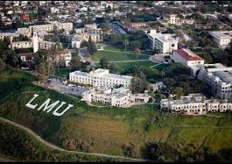

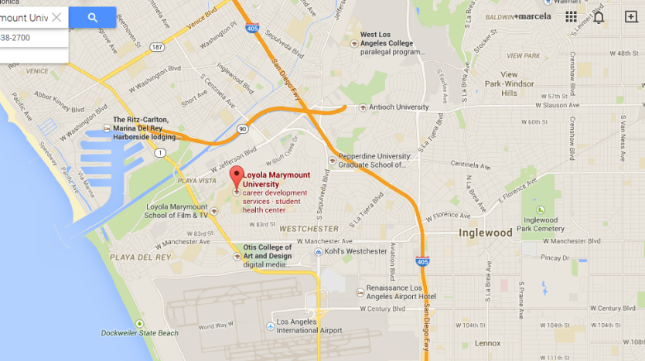

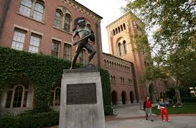
College & Graduate School
I attended college & grad school in Los Angeles, California
\

Slide 11
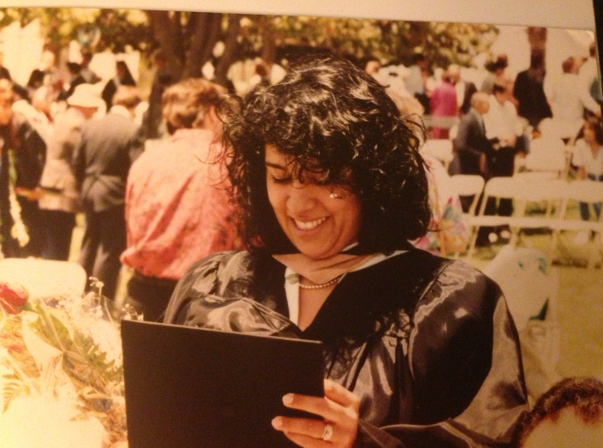
College or
Graduate School
Favorite classes
Least favorite classes
Supply Chain
Database Management
Organizational Development
Entrepreneurship
Marketing
Accounting I & II
French

Slide 12
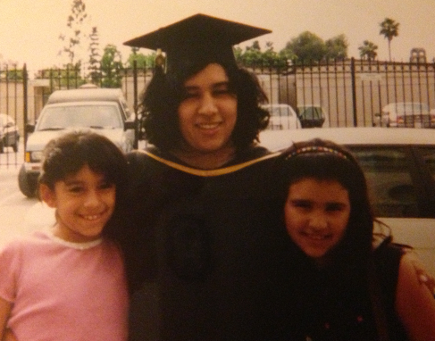
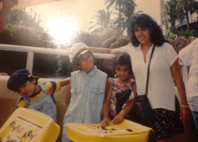
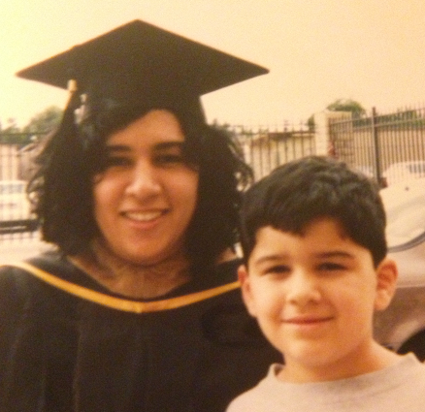
College & Graduate School
Fondest memories
Obstacles or adversity that you had to overcome
Lived away from home
Friends
Parties
Independence
Southern California Entrepreneurship Institute
Had my daughters Alex Sophomore year, Nikki last Year in College & my son Robert upon graduation
Worked all through school
Had no money for College
Juggling my kids, career & school

Slide 13
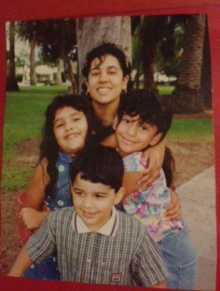
College or
Graduate School
Activities/Athletics in College
Jobs I worked while in College/Graduate School
Ballet Folklorico
MECHA
Casa Escobar – All areas
Marie Calendars – Pizza Girl
Lucky Supermarket - Bagger
Fat Burger – Burger flipper
Viva La Pasta – Waitress
Amfac Hotel – Event Server
La Serenata de Garibaldi - Waitress
Yamashiro – Banquet Server
GP Color – Billing & Collections clerk
Columbia/Sony Pictures – Accounting clerk

Slide 14



Career Path
Accounting clerk in 1991
Business Technology Analyst
1998
Manager Customer Service 1994
Manager IT
2003
VP IT
2008
CDO
2014
CIO
2009
Director IT
2006
Project Team Member
2000
HSF CIO
2013
Director Customer Service 1997
Customer Service Rep 1992
Director Special Markets 1996
Notes:
You may use this chart to describe your journey to the current career

Slide 15
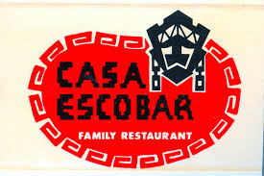
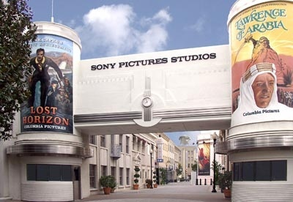

Career Highlights
Casa Escobar (1976 - 1988)
Sony Pictures Entertainment (1991-2013)
Hispanic Scholarship Fund (2013 – Today)

Slide 16
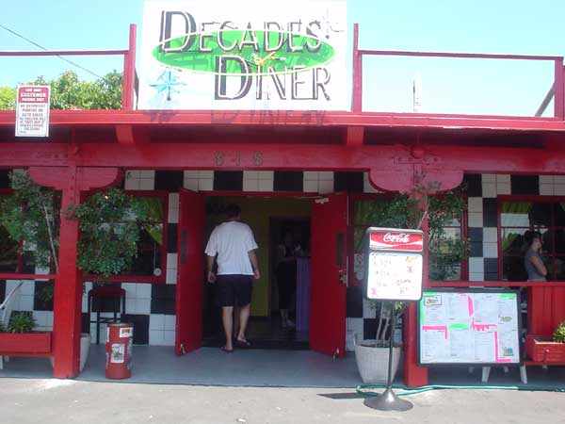
Career
My first Job
My worst Job
Casa Escobar
  Family Business
  Started at 9 years old
  Did every job there was to do
  Spent all weekends and summers working
Decades Diner
  Washing Dishes ☹

Slide 17
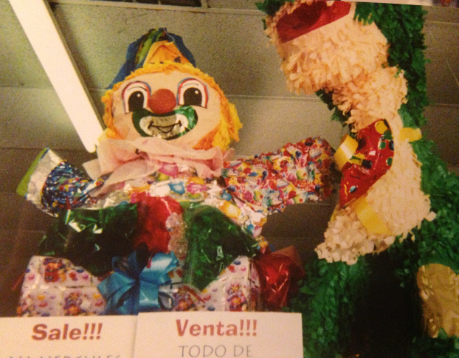

Career
Some challenges I had to overcome in my career
No Family Support
No Mentorship
Started Family at a young age
Worked Full Time
Completed my BA & MBA
Launched two small businesses
  At Your Service (1996-2010)
    Party Supplies
    Catering
    Staffing
    Rentals
    Decorating
  Decades Diner (2005)

Slide 18
CURRENT ROLE
History
Started Feb 2013
22 years experience at Sony Pictures
Size
$40MM
60 people
Location
Gardena, CA
Lots of US travel
Services
Scholarships
Youth Leadership Institute, College Camp, College 101, LUNA,
Mentoring
Internships & Career Match
Resources for Parents & Students
Notes:
Use this graph to give more description of your current company (history, size, location, products and services, etc.)

Slide 19
Current Role
CDO
CEO= Boss
My Team
- Business Analysts
- Data Scientist
- Reporting & Data Analyst
- Developers
60-80hr work week
Projects
- HSF.net Website
- Scholarship System
- MentorMatch
- Career Services
Notes:
Use this graph to give more description of your role specifically (responsibilities, typical work week, direct reports, etc.)

Slide 20
Career Compensation
C-Level
220-500k
Director/SVP
60-220k
Manager
40-60k
Receptionist / Analyst
$30-40k
Notes:
Use this graph to show general compensation ranges for people in various roles in your company

Slide 21
ACADEMIC EXERCISE
We will now spend several minutes discussing the day’s academic module and how it is relevant in the ‘real world’

Slide 22

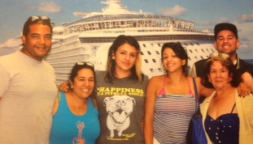
QUESTION AND ANSWER

