Slide 1
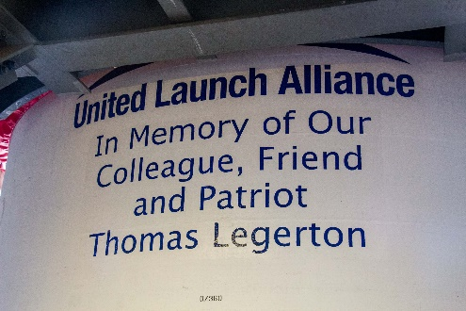
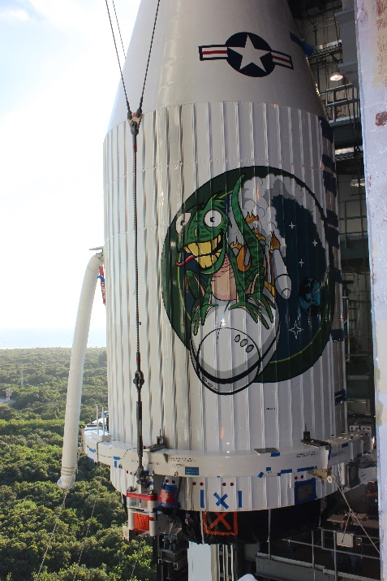
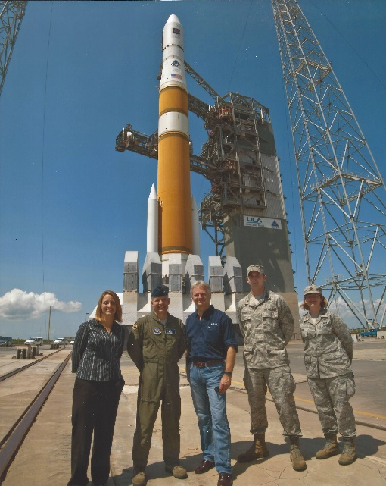
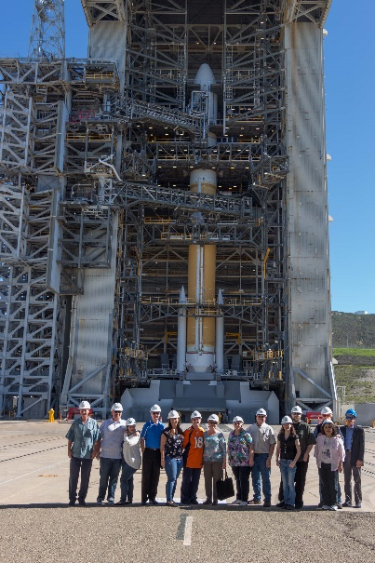
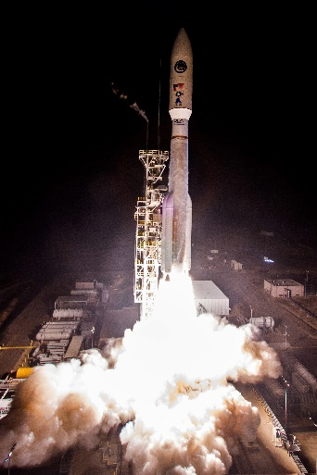
Jennifer Luce
“Rocket Scientist”
Senior Systems Engineer

Slide 2
Launch Video – SBIRs GEO-3, 2017

Slide 3
INTRODUCTION
My name is Jennifer Luce and I am 47 years old.
I currently work for Stellar Solutions, Inc.
My company provides:
High impact engineering services, end-to-end technical expertise & creative solutions to significant national & international customers with space project focus
Systems engineering and integration
Mission operations
Program management
Strategic planning
Job title: senior systems engineer
Manage tasks required to successfully prepare a satellite for launch on a rocket
Communicate and interface with a complex, technical team

Slide 4
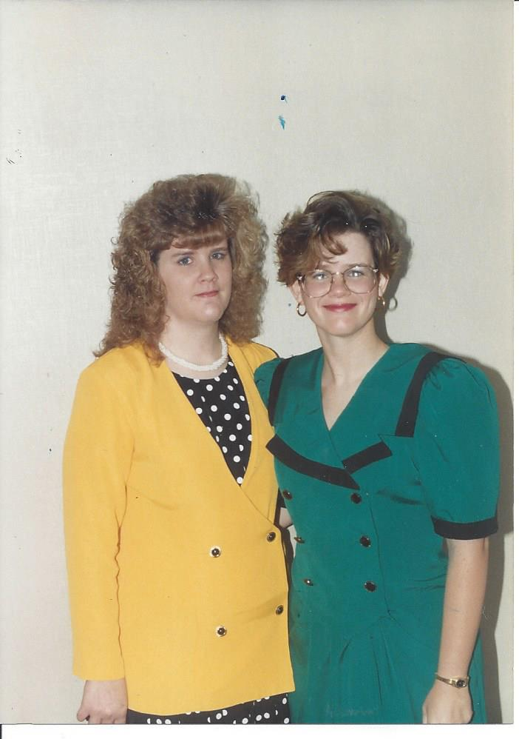
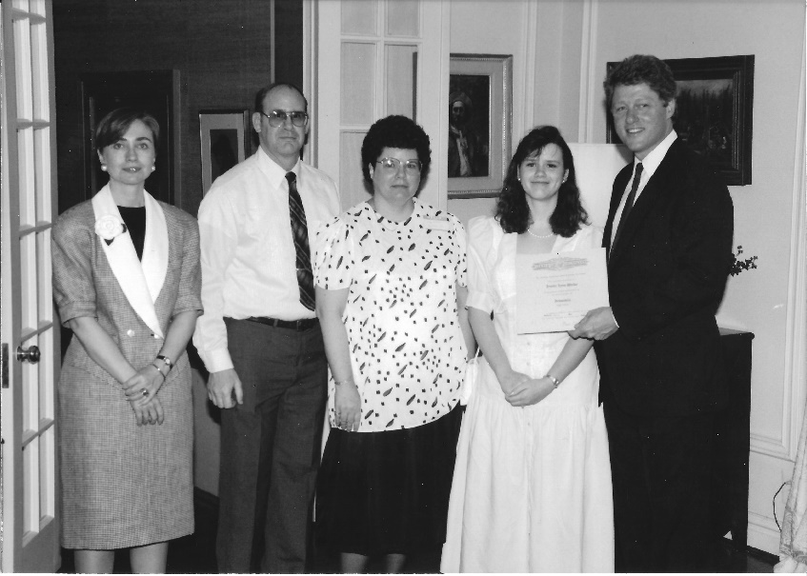
My childhood & family
Born in Wichita, Kansas and moved a lot in my first 2 years (military “brat”)
Last 8 years of childhood in Jacksonville, AR
Small family – one older sister & didn’t live near any relatives
Loving, but introverted parents
Didn’t have a lot of money growing up (hint – parents couldn’t pay for college)
6 months old
My parents and I meeting Governor Clinton
Me and My sister

Slide 5
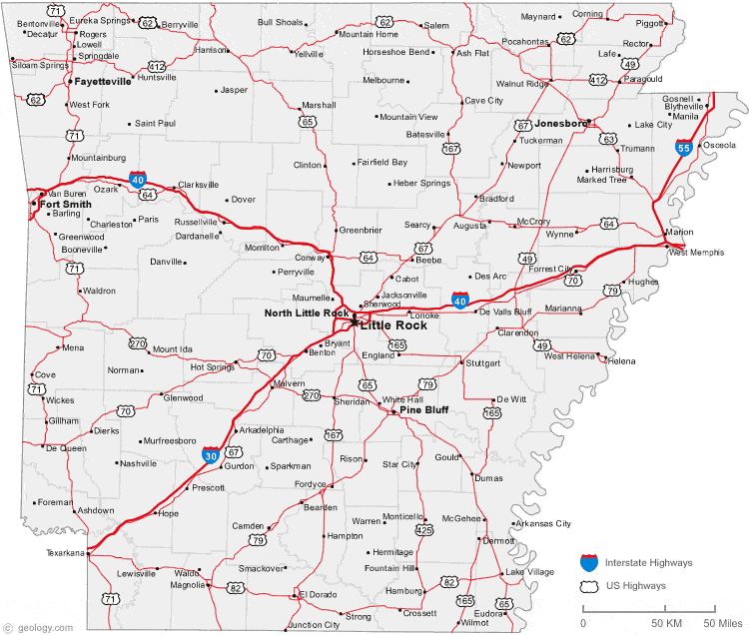
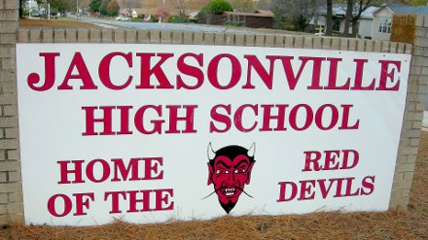
MY HIGH SCHOOL
I attended Jacksonville High School (10th – 12th) in Jacksonville, AR

Slide 6
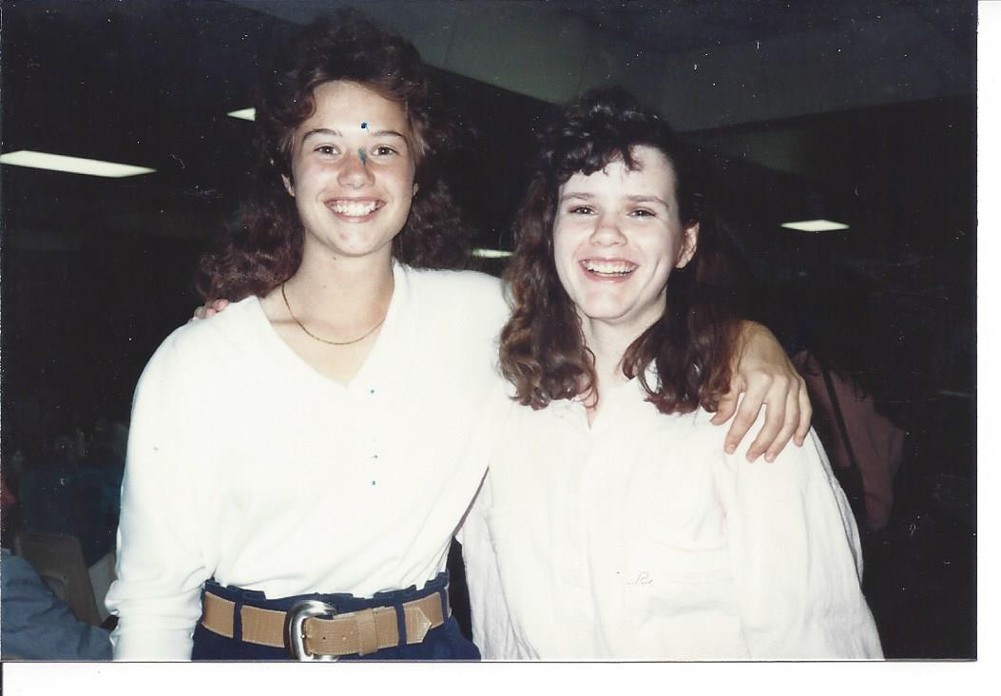
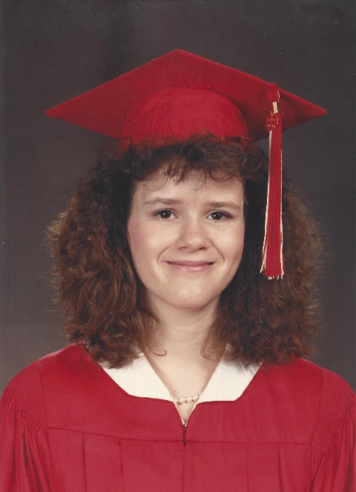
High School
As a HS student I was shy, serious, and nerdy (first in my class)
Co-Valedictorians
Senior picture

Slide 7
High School
Things that I really liked in High School were:
Band
Gifted and Talented classes
Governor’s School – Summer 1998 – ‘think for one’s self’
Studying
Jobs I worked while I was in High School were:
Church nursery worker
Babysitter
Sonic Restaurant

Slide 8
High School
Things that felt difficult or challenging for me while I was in High School were:
Hard to make close friends (gifted classes helped)
Figuring out what I wanted to do in life
No real goal, but wanted to leave Arkansas
Concentrated on ‘basic’ courses to set me up for college
As a sophomore, told I was pre-diabetic due to weight
Started walking a lot and ate less – lost 37 pounds

Slide 9
Getting in to College
The top few things I did to ensure I got into college were:
Good grades & community involvement
High college test scores: SAT & ACT
Awarded National Merit Scholarship
Talked with school counselor; helped with applications
Planned for filling out applications
Applied for NAVY ROTC and USAF ROTC Scholarships
Accepted 4-year USAF scholarship

Slide 10
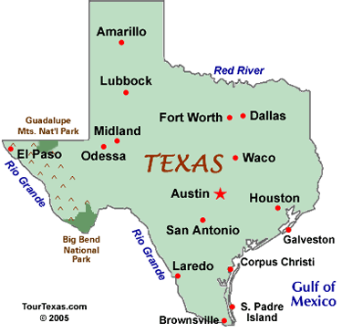
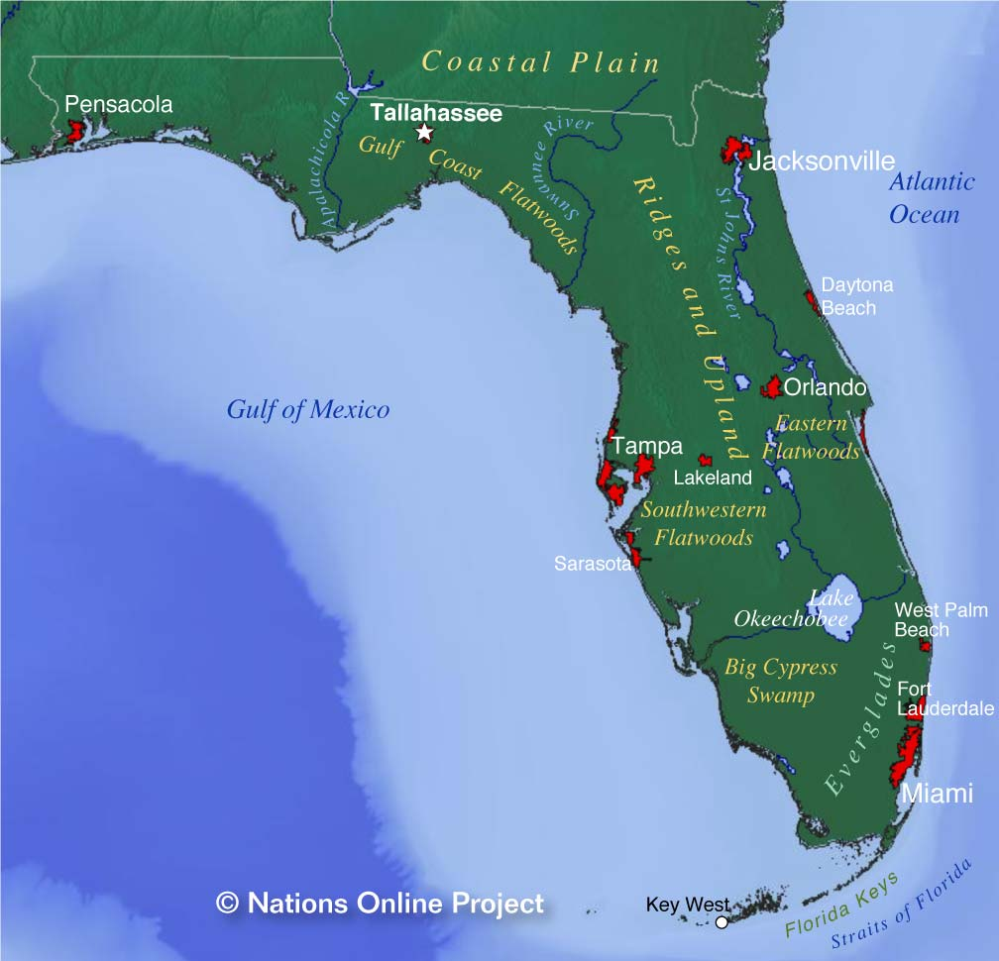
College Attended
1993 - graduated from Baylor University in Waco, Texas
Bachelor of Science in Mathematics
2000 - graduated from grad school from University of Central Florida in Orlando, Florida
Masters in Engineering Management
Insert map shot here

Slide 11
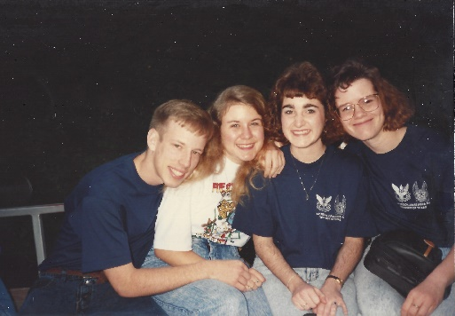
College
Things I enjoyed in College
Things I didn’t enjoy in College
Going to football games
Attending National Conclaves (Arnold Air Society)- my ‘Spring Break’
Freedom to choose classes
Being treated like an adult
Basic training – before junior year
My need to be perfect
Finding dorm room-mates
Getting my first B in my senior year
Favorite classes
Least favorite classes
German
Abstract Algebra
Old Testament class
Economics
World Literature class
Calculus III
Advanced Calculus
Lower level ROTC classes
Same professor

Slide 12
During College
Jobs I worked during summer break while I was in College were:
Babysitting
Pizza delivery with Papa John’s
Worked at daycare
My 2 scholarships covered tuition, room and boarding for my 4 years of college
Things that felt difficult or challenging for me while I was in College were:
Dealing with a major I couldn’t just switch – AF wanted those with Math degrees
Learned to pick classes with teachers I liked; studied hard
Insomnia – caused by thinking I had to do everything perfectly
Prioritize and conquer things to be done
Learned how to cross stitch
Someone told me
I would never make
It in the military

Slide 13
Getting a job after College
In early 1990s, difficult job market following college graduation
For me, “mandatory” job for 4 years to “pay back” my United States Air Force ROTC scholarship
The top few things I did to ensure I got a good job after college were:
Grades – work hard to get the best grades – shows dedication
Exercise – physical fitness tests ~ 6 months
Fill out the - “Dream sheet” – top 3 wishes for an assignment
United States Air Force chose my assignment – not even on my dream sheet
“63A” - Acquisition Manager – Los Angeles Air Force Base
Manage space programs for military customers
TIPS
Even if not a dream job, the current job can provide valuable lessons and experience for the next one
Want to be known as someone that is easy to work with; hard work helps, too!

Slide 14
Company #1 – US Air Force
Separate Military Service – 18 Sep 1949
Began as “Aeronautical Division, Signal Corps” on 1 Aug 1907
Mission: fly, fight and win...in air, space and cyberspace.
Vision: USAF will be a trusted and reliable joint partner with our sister services known for integrity in all of our activities, including supporting the joint mission first and foremost. We will provide compelling air, space, and cyber capabilities for use by the combatant commanders. We will excel as stewards of all Air Force resources in service to the American people, while providing precise and reliable Global Vigilance, Reach and Power for the nation.
325,100 End Strength in 2018
Where based? 3 continents
Starting 2018 salary for officers: $3,100/month & housing allowances

Slide 15
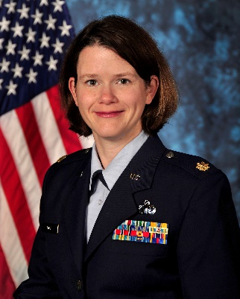
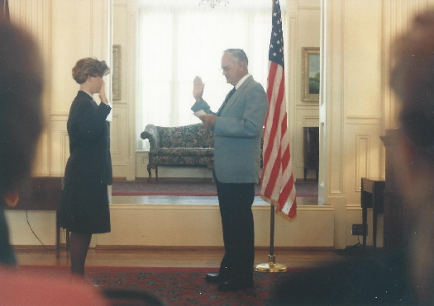
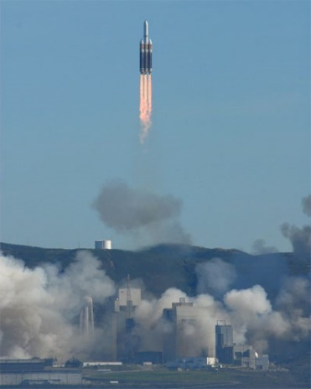
My USAF Career Path
My USAF Jobs
1993 - Los Angeles Air Force Base, CA
1998 - Patrick Air Force Base, Florida
2000 - Defense Manpower Data Center, Monterey, CA
2003 - National Reconnaissance Office, VA
2008 - Los Angeles Air Force Base, CA
Air Force Officer (2Lt) – 1993
5 jobs in US – support to 8 different DoD & Intelligence programs
Retired in 2013 – last assignment supported USAF Launch Programs
NROL-49,
Launched 2011
Notes:
You may use this chart to describe your journey to the current career

Slide 16
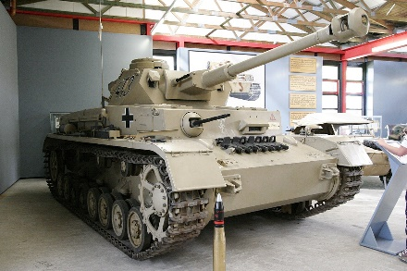
My Career #1
The first job I had after college was:
Project manager for the Global Positioning System (GPS)Ground Control Segment
Managed software upgrades that supported GPS IIR satellites after launch without breaking the older satellites
Lots of paperwork!
USAF told me where I was working
The worst (hardest) job I have ever had was:
Program Manager for Nuclear Treaty Subsurface (earthquake) System during Y2000 rollover
Micromanaging boss – 26+ revisions to 1 document
Gave WWII Panzers to his top performers
Learned how not to act as a boss

Slide 17
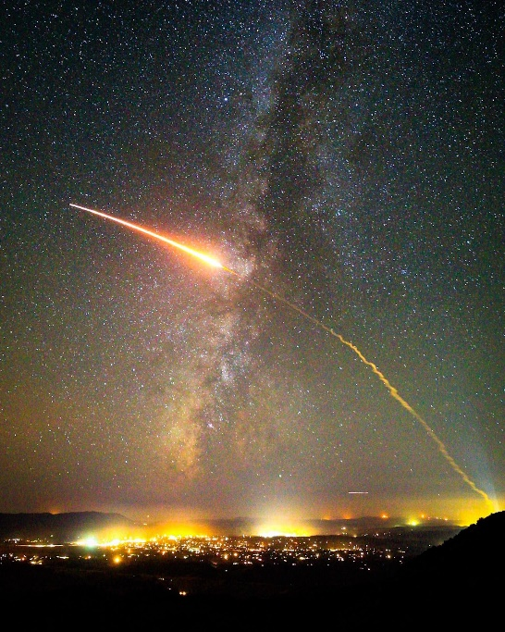
Things I learned in the USAF
Integrity – do the right thing even when no one is watching
Enhances trust in your coworkers and bosses
Importance of open communication
To some, information is power; this attitude can hinder getting the job done
Program saying, “Bad news does not improve with age”
Importance of saying “please” - some team members need it
Understand and adapt to team members
Attention to details are important
Hard work is often rewarded, even if you think no one is watching
Be humble, as one can always be replaced
NROL-42 Launch
(Cool to be part
Of this!)

Slide 18
Company #2 – Stellar Solutions, Inc
Woman-owned small business founded by Celeste Ford in 1995 with a simple vision:
SATISFY OUR CUSTOMERS’ CRITICAL NEEDS WHILE REALIZING OUR DREAM JOBS.
Headquarters: Palo Alto, CA
Offices: Colorado, Washington, DC, United Kingdom, France
~170 employees
Customers: Intelligence, Defense, Commercial, Civil, & International
Our customers not only get access to our full-time staff of engineers, but also to our team of part-time Stellar Advisors who can be leveraged for key niche expertise in critical short-term applications.
Areas of Expertise
Systems Engineering & Integration | Subsystem Expertise
Continuity, Resiliency & Cyber Engineering | Technical Training
Mission Operations & Engineering | Launch Vehicle Engineering, Integration & Procurement
Strategic Planning | Program Management
Due Diligence

Slide 19
My role within Stellar Solutions
Launch Vehicle Integration Manager, DoD Sector
El Segundo, CA
Mon – Fri; 0700-1645
Except on launch Day!
No direct reports; work as a subcontractor part of a 3-person mission team
Main tasks:
Provide “mission” status via report or briefing to leadership
Develop briefings & assessments
Coordinate launch rehearsals, tasks, and readiness reviews
Communication & interpersonal skills
main part of my job
At Stellar Solutions, employee satisfaction is a priority.
Notes:
Use this graph to give more description of your role specifically (responsibilities, typical work week, direct reports, etc.)

Slide 20
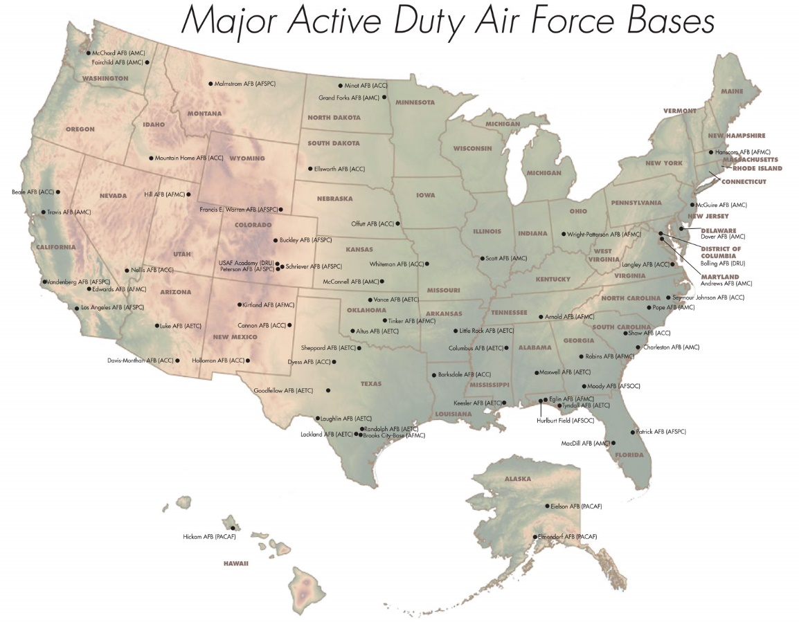
Recent Missions (as a contractor)
NROL-45 (Delta IV (5,2) – 10 Feb 16
Vandenberg AFB, CA
NROL-61 (Atlas V 421) – 28 Jul 16
Cape Canaveral AFS, FL
SBIRS GEO-3 (Atlas V 401) – 20 Jan 17
Cape Canaveral AFS, FL
NROL-42 (Atlas V 541) – 23 Sep 17
Vandenberg AFB, CA
NROL-47 (Delta IV (5,2)) – 12 Jan 18
Vandenberg AFB, CA
NROL-71 (Delta IV Heavy) – 15 Jan 18??
Attempt 1 – 7 Dec – scrubbed due to ground comm issue
Attempt 2 – 8 Dec – aborted at 7.5s due to launch software violation
Attempt 3 – 18 Dec – scrubbed due to high ground winds
Attempt 4 – 19 Dec – scrubbed due to elevated levels of hydrogen leak in left engine compartment
Recent lesson in problem solving
GOAL – launch a good rocket to ensure
satellite survives
All launches are complicated
Next one up is the most important
Notes:
Use this graph to give more description of your role specifically (responsibilities, typical work week, direct reports, etc.)

Slide 21
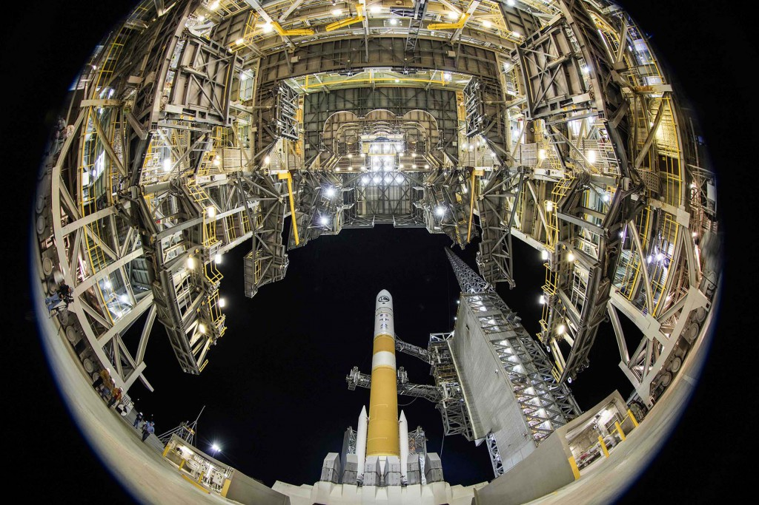
My Launch Team
NROL-45 – first mission
after joining Stellar Solutions
System Engineering
Mission Integration Team

Slide 22
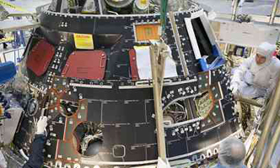
Compensation at my company
“Typical” Company
Take home pay: $125K
Holidays, vacation, sick days included
No company paid benefits (insurance)
401k deductions with employer matching
SubTotal - $130K
Stellar Solutions
Lower base salary - $105K
Individual benefits account – 50% of base salary
Flexible time off – 20% of time worked, added to salary
Company paid benefits (insurance)
Or credits if don’t accept benefits
Annual bonus – 10% of salary
Annual charity donation - $1K
Subtotal - $170K
Buy 2, Buy 200
Notes:
Use this graph to show general compensation ranges for people in various roles in your company

Slide 23
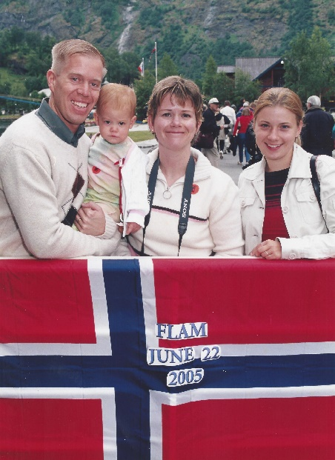
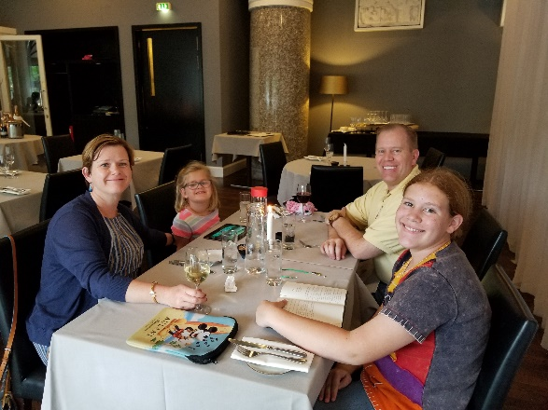
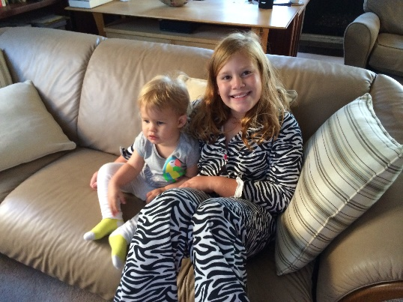
More than just work
When I am not at work I like to:
Run – half-marathons, Army Ten-milers
Travel inside and outside the US
Going to Disneyland – not just for kids
Read
Volunteer – sexual assault crisis counselor for YWCA GLA since 2014
Spending time with family is important
Married in 1995, two daughters (14 ½, 5 ½)
Norway 2005
Denmark 2018

Slide 24
Do it all over again?
If I could talk to my high school self, what would I say?
Go after opportunities – 100% guaranteed to not succeed if you don’t go for it
Honestly stand up for one’s self – at times, you will be the only one to do so (don’t oversell)
Learning how to deal with failure is more important than the failure – it helps us learn what doesn’t work and helps us improve
People respect “I don’t know, but I will find out” vs trying to make up an answer
Flexibility is key – what you may want to do now may not be what you want later
An introvert can be trained to be an extrovert (for a bit)

Slide 25
Launch video – NROL-47 in 2018

Slide 26
QUESTION AND ANSWER

