Slide 1
Phyllis Williams-Strawder
Business Coaching
for Parentalpreneurs, Teenpreneurs & Aspiring Entrepreneurs
Speaker - Author - Entrepreneur
Founder of CKO Creator
hello@ckocreator.com
www.ckocreator.com
(562) 356-8111
@CKOCreator

Slide 5
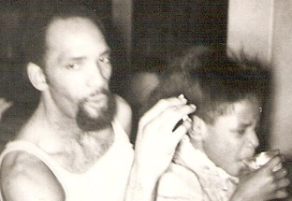
Ghetto Country
Raised hood adjacent by a momma with country roots
Father was an educated man with thug tendencies
Comfortable with myself and those around me
Mother tendencies
No less intelligent

Slide 6
Education vs. Knowledge
In and Out
Well Informed

Slide 7
Keep Learning
Crenshaw High
UCLA Drop Out
ELAC
CSULA
10k Small Business
Countless Trainings

Slide 8
Job vs. Career
Paycheck to paycheck
Advance in field

Slide 9
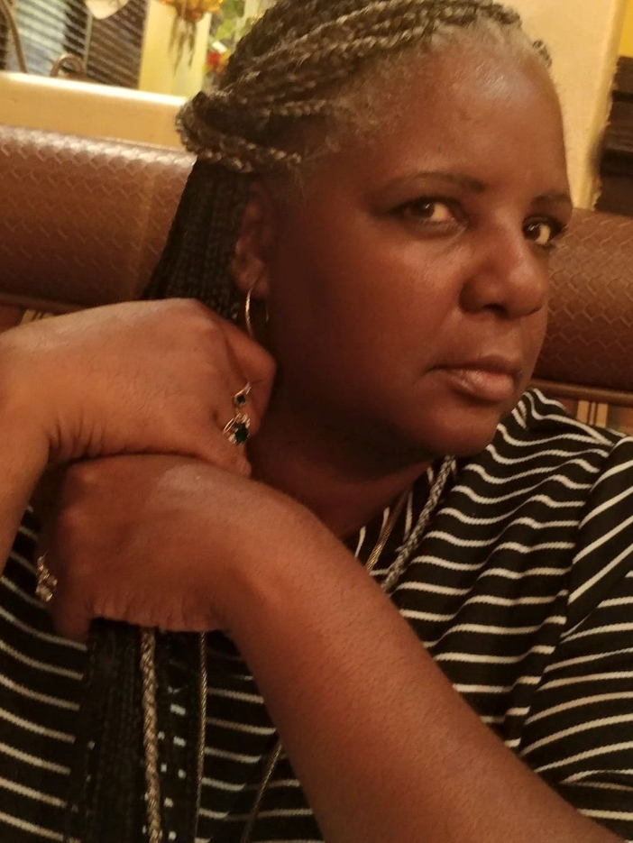
Keep Growing
Dead-in Job
Volunteer to gain knowledge
Don’t get attached to a crack check
Develop new skills

Slide 10
Exist vs. Living
Wash, rinse, repeat
Experience the world

Slide 11
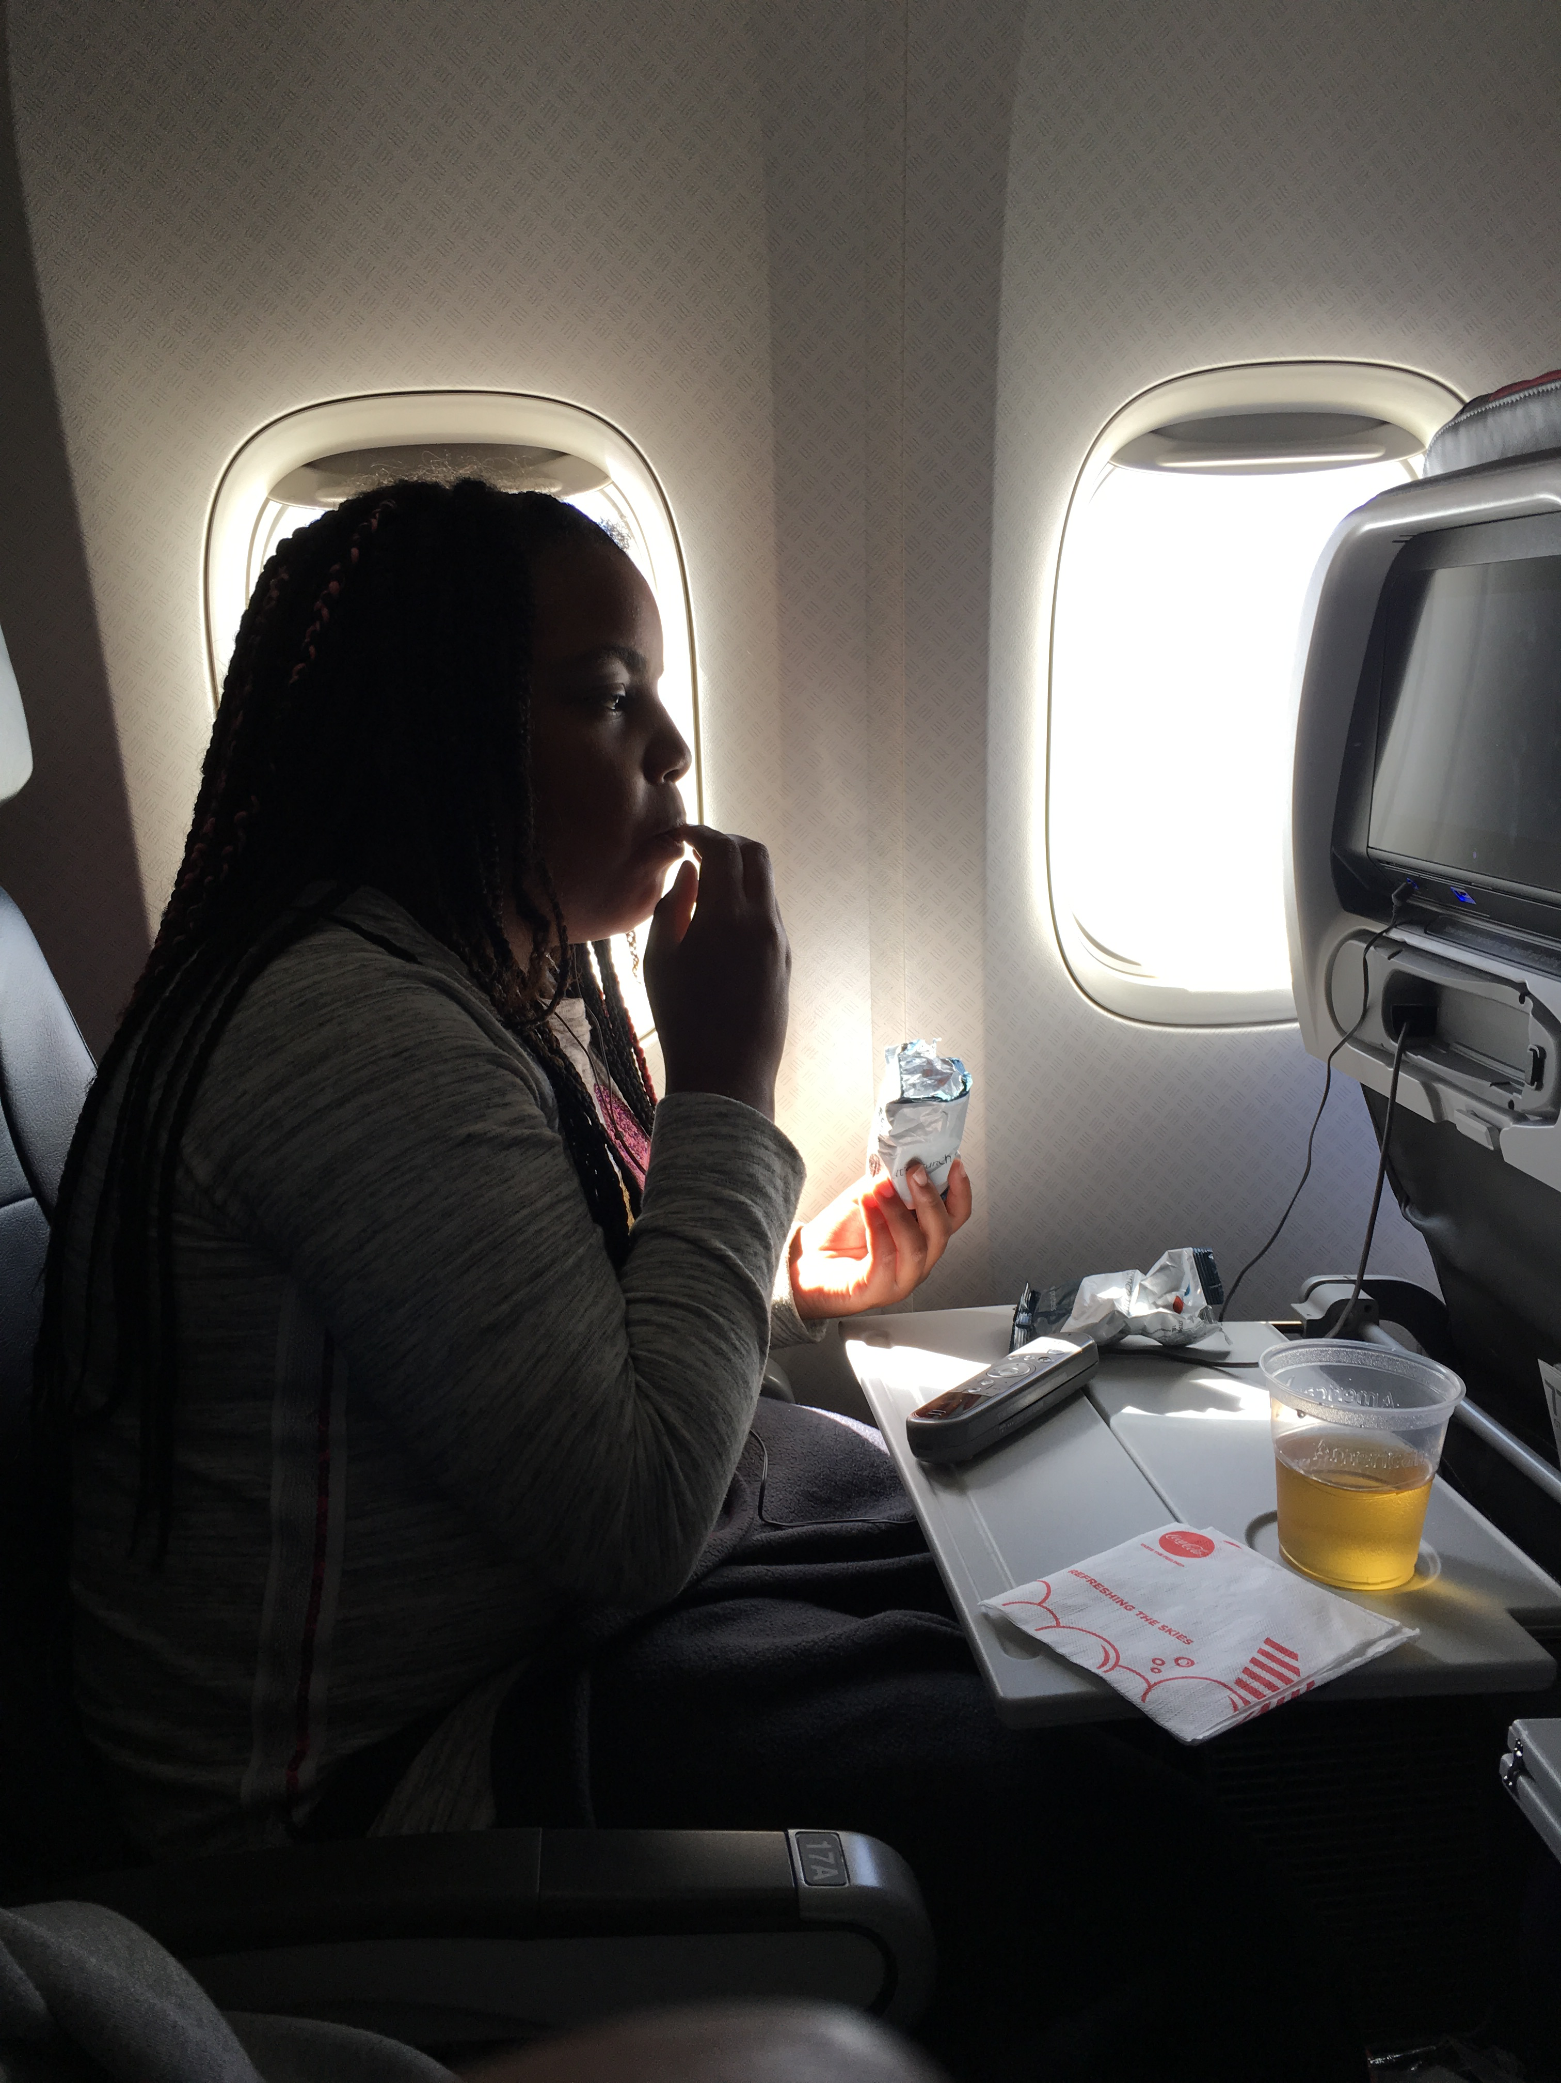
Experience The World
Venture outside your zone
Tag along travel
Step away from fast food
Experience other cultures

Slide 12
Things vs. Meaning
Most toys wins
Positive impact on the world

Slide 13
Life With Purpose
Who could use your help
What can you offer for free
How can you do good
Where are you needed

Slide 14
“There is no decision that we can make that doesn’t come with some sort of balance or sacrifice.”
–Simon Sinek

Slide 15
Value of Money
Car Savings
Financial Savings

Slide 16
Value of Money
First Apartment
First Property

Slide 17
Value of Money
Bus Pass
Passport

Slide 18
“There is no secret to balance in personal finance. Live within your means, no matter how much money you make.”
–Phyllis Williams-Strawder

Slide 19
Value of You
Dopamine Effect

Slide 20
Value of You
Pursuit of Happiness

Slide 21
Value of You
Separate ya who from ya do

Slide 22
Value of Money
You
Someone else

Slide 23
“Try not to become a person of success, but rather try to become a man of value.”
–Albert Einstein

Slide 24
Q & A

Slide 25
Phyllis Williams-Strawder
The CKO Creator
Speaker - Author - Entrepreneur
Founder of CKO Creator &
Espresso Mischief
hello@ckocreator.com
www.ckocreator.com
(562) 356-8111
@CKOCreator

