Slide 1
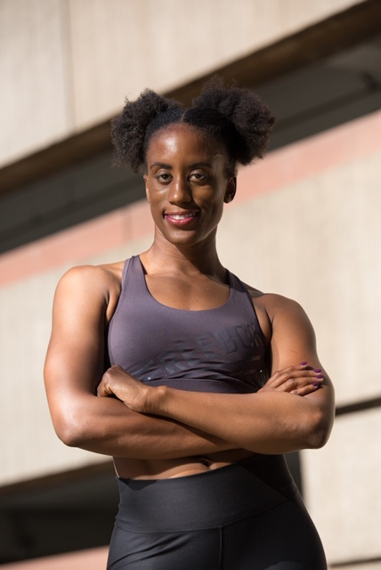
Simone Berry
Entrepreneur
Personal Trainer
Equinox Instructor
Everyday I’m Hustlin’
Non Profit Professional

Slide 2
Who is Simone
Regional Manager – Coaching Corps
Fitness Instructor – Equinox
Personal Trainer – Moni B Fit LLC
Entrepreneur – Training and Facilitation Consultant/Creator

Slide 3
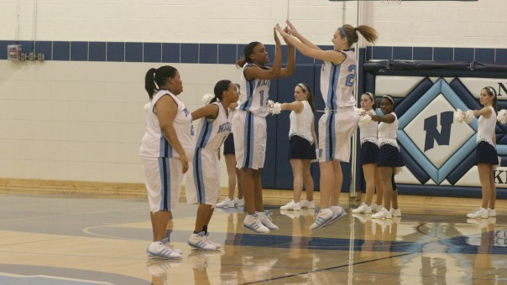
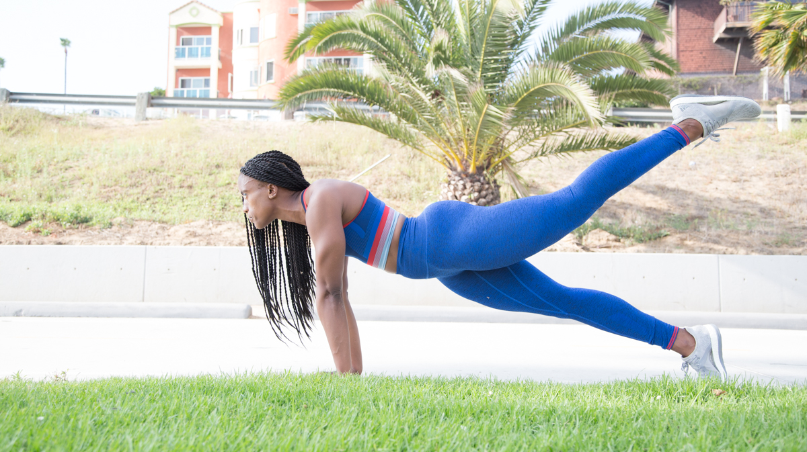
How I Got Here
Family/ Background
Education
Early Career
Passion

Slide 4
A Day in the Life
5:15AM – Wake Up!
5:30AM- Head Out
6AM- 7AM1st Personal Training Client
7 AM –8AM 2nd Personal Training Client
8 AM – 9AM 3rd Personal Training Client
9:10AM-9:30AM- Drive to Office/ Change Clothes for work
9:30AM- 5PM– Coaching Corps
5:30PM-6:30PM- Personal Workout
6:30PM-7:20PM- Prep for Class
7:30PM-8:30pm Teach at Equinox
8:40PM-9PM – Drive Home
9PM-10:30PM – Consulting Work
11PM- Sleep

Slide 5
Passion vs Purpose

Slide 6
Time to Hustle!
Activity: Mapping out your Side Hustle
Step 1:
Identify your passion
Tale a few minutes and write down causes/things that you’re passionate about
Select one passion to pursue
Step 2
Roles/Jobs related to your passion
Brainstorm jobs that relate to your passion
Narrow down a role you want to take on

Slide 7
Time to Hustle Cont.
Activity: Mapping out your Side Hustle
Step 3:
Qualifications/Credentials
List out credentials, certifications, education needed
Step 4:
Action Plan
3 month plan/ goal
1 year plan/ goal
Step 5:
Making It Mesh
Map out your current schedule and identify how/where your side hustle fits in

Slide 8
Activity Example
Passion: Fitness and Health
Possible Jobs: Gym Manager, Personal Trainer, Physical Therapist, Wellness Coach, Doctor, Coach, Dietician, Fitness Instructor…
Personal Trainer,
Qualifications: Personal Trainer Certification, CPR certification, Liability Insurance
Goals:
3 month – Get all certifications, build website, get 1-3 clients
1 year goal - Fill all training slots, pay off certification costs, make $10k
Make it Mesh: Train in the mornings before work ( 6am-9am) and on weekends

Slide 9
Share Out!
Discuss all 5 steps with a classmate
3-4 share with entire class

Slide 10
Questions

