Slide 1
Clean Living
in a
Toxic World

Slide 2
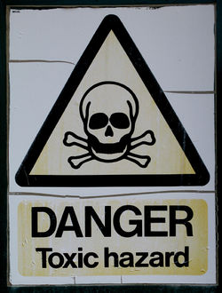
A toxin is a poisonous substance produced within living cells and organisms
A toxin is anything the body cannot use as energy

Slide 3
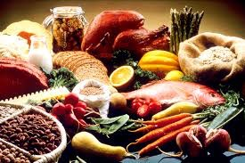
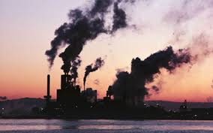
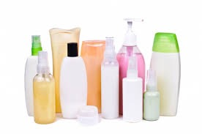
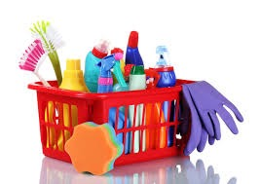
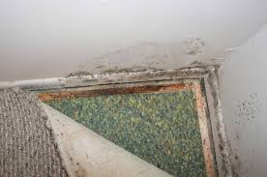
Toxins and Carcinogens are Everywhere

Slide 4
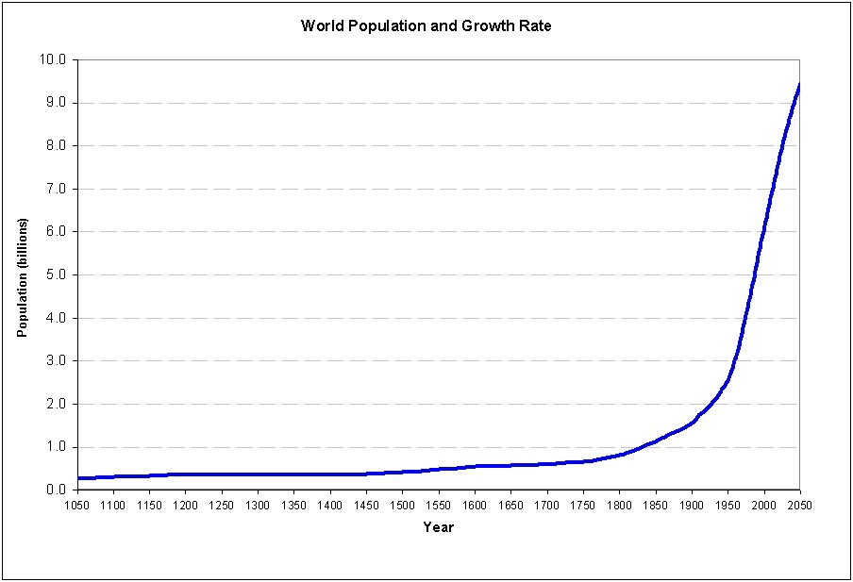

Slide 5
Better living
through
chemistry

Slide 6
Environmental Toxins are INCREASING

Slide 7
The Quality of our
Products is DECREASING

Slide 8
TOXIC BUILDUP
Your body is like a bathtub…
Toxins enter through the faucet and leave through the drain

Slide 9
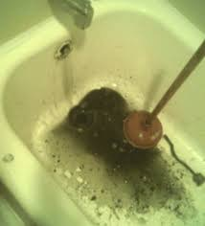
TOXIC BUILDUP
If you have a clogged drain (toxic buildup) you feel tired, sluggish, and lack energy
When your body is too laden with toxins, people typically turn to medications in order to clean up

Slide 10
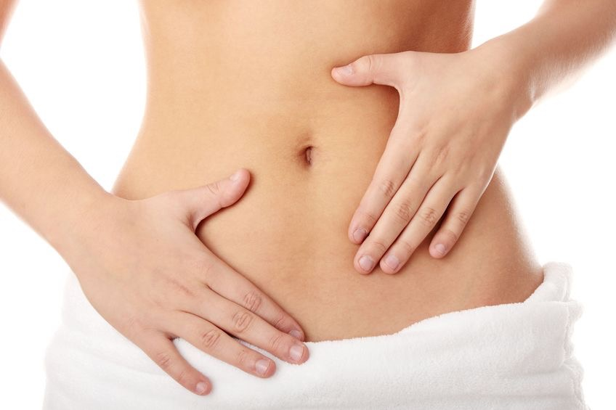
Toxic Load - Unhealthy Digestive Tract
Your intestinal wall becomes damaged by diet, antibiotics, medications, and stress
Your gut is responsible for 80% of your immune system health
80% of serotonin is created in your gut - responsible for mood, libido, sleep, appetite, and memory
Nearly all skin conditions start in the gut

Slide 11
Toxic Load - Entering Through Our Skin
Skin 101
Secretes
Absorbs
Sensation
Temperature regulation
Primary Carcinogens & Toxins
Parabens
Phthalates
Mineral Oil
Tallow
The average woman puts 515 chemicals on her body everyday; The average man—86

Slide 12
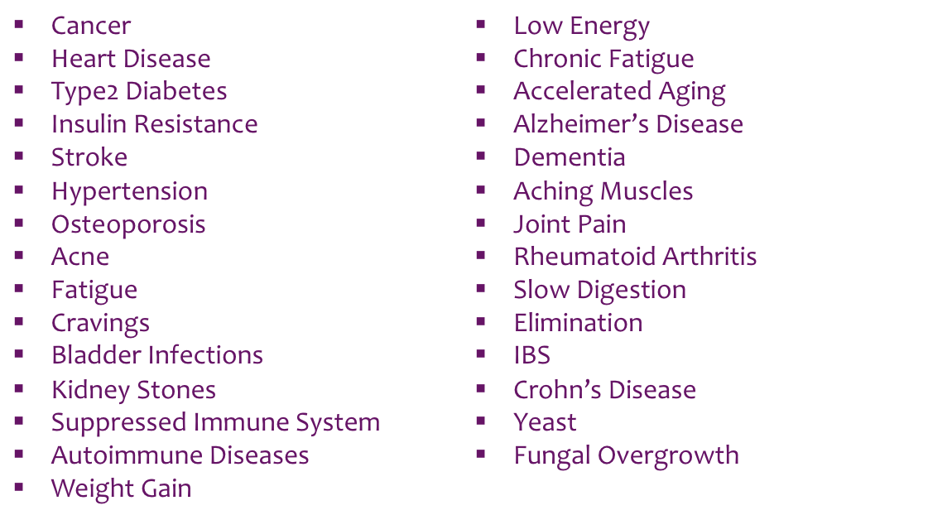
Diseases Caused by Toxic Load
Do any of these pertain to you or anyone you know or love?

Slide 13
CHEMICAL AND DRUG COMPANIES DO NOT NEED TO DICTATE OUR HEALTH!
Take those first steps to supporting your good health!

Slide 14
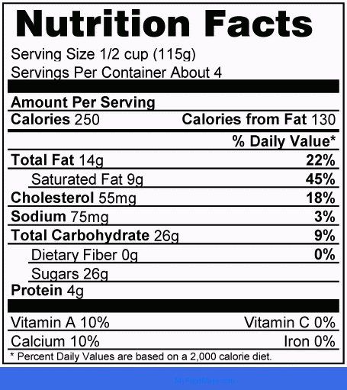
What’s in your products?

Slide 15
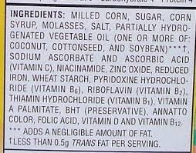
What’s in your products?

Slide 16
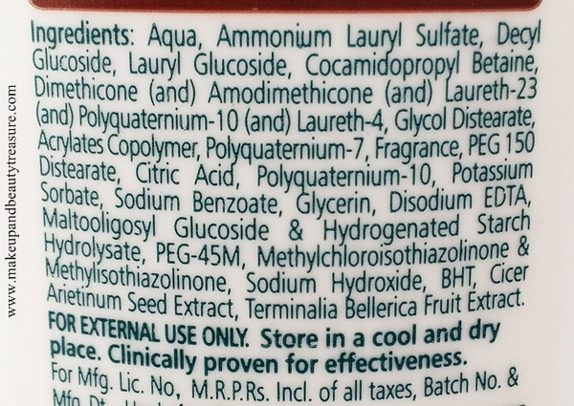
What’s in your products?

Slide 17
What’s in Your Products?
To date, the European Union has banned about
1,400 ingredients in their personal care products
To date, the FDA has banned
11 chemicals in our personal care products

Slide 18
People Use These Products Every Day
Body Wash
Body Lotion
Shampoo
Conditioner
Hand Soap
Face System
Makeup
Lipstick/Balm
Toothpaste
Deodorant
Food
Supplements
Drinks
Cleaning Products
How many of these do you use that contain toxins and carcinogens?

Slide 19
Call To Action -
Become your own Health Advocate
Read labels—Know what’s in your products
EAT REAL FOOD
Buy organic, non-GMO, Wild Caught, etc.
Educate yourself—don’t just take someone else’s word for it
Spend wisely/strategically—supply and demand
Vote—clean environmental initiatives and representatives who are environmentally friendly

Slide 20
Thank you!
Stephanie Rose
sroseld@gmail.com
stephanierose.arbonne.com

