Slide 1
YBA GUEST RESOURCE TEMPLATE
REMEMBER EACH DAY…
LAUGH
READ SOMETHING NEW
and
HELP SOMEONE!

Slide 2
INTRODUCTION
My name is CAROL DAVIS and I am 63 years old.
I work for MYSELF as OWNER OF 4 Companies.
My company does:
PRODUCES EVENTS
PRODUCES TV SHOWS
My role at with all 4 companies is to Ensure ITS SUCCESS
Every day I discuss current and past workings
Every day I plan for the future

Slide 3
My childhood
I was born in Hollywood, CA and raised in Gardena, CA
This is a picture of me at (BLANK) age

Slide 4
My family
A little about my family
(one to two sentences about what it was like in your house growing up)
This is a picture of me in the middle, my Sister Miriam to the Left and my dear departed Brother Jess to the right.

Slide 5
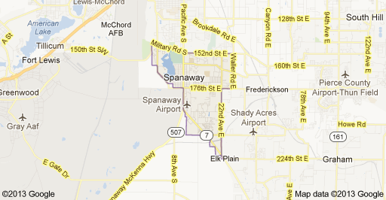
MY HIGH SCHOOL
I attended 3 High Schools in Los Angeles
WASHING TON, WESTCHESTER AND GRANT

Slide 6
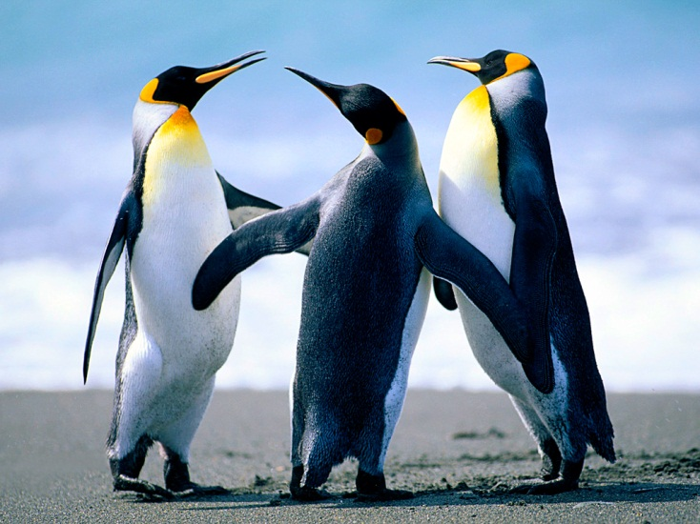
High School
As a HS student I was AN ABSOLUTE LOST SOLE!
No Idea who I was as a person, no self esteem & no idea of where I would end up, except probably dead at an early age.

Slide 7
High School
Things that I really liked in High School were:
Boys
Getting into trouble
Wondering what a Good Life was all about
Being Jealous of those around me
Bucking Authority

Slide 8
High School
Things that felt difficult or challenging for me while I was in High School were:
Reading & Studying
Authority & Playing “the game”
Figuring out what life was about
Figuring out what I would do after High School ended
Surviving around so many people

Slide 9
High School
Jobs I worked while I was in High School were:
Babysitting
Stealing
Designing Practical Jokes for money

Slide 10
Getting in to College
The top few things I did to ensure I got into college were:
NOTHING

Slide 11
College
I attended college and grad school in
Pierce College, Woodland Hills, CA
UCLA, Los Angeles, CA
Loyola SOL, Los Angeles, CA
University of Michigan, Ann Arbor, MI
Temple University, Philadelphia, PA

Slide 12
College
Things I enjoyed in College
Things I didn’t enjoy in College
Learning how to LEARN
Math
Physics
Psychology
Law
Organic Sciences
Right Brain Activities
Social Interaction
History
Paying the Costs of Education
GROWING UP!

Slide 13
College
Favorite classes
Least favorite classes
Science
Math
History
English

Slide 14
College
Jobs I worked while I was in College were:
Salesgirl at local Store
Flunky at University Bookstore

Slide 15
College
Things that felt difficult or challenging for me while I was in College were:
Learning to LEARN – Started Listening, Started Hearing, Got Help
Socialization – Made a couple of friends… then I looked Cool
Paying the Fees - Got Grants & a couple of Scholarships
Deciding what I wanted – Found a Fantastic Mentor

Slide 16
Getting a job after College
The top few things I did to ensure I got a good job after college were:
Became self aware
Developed a “CAN DO” attitude
Learned what Boundaries are and worked towards them
Spent time with and practiced what the Mentors were preaching
Decided and Practiced my own Mantra
Worked on developing equilateral usage of my Brain

Slide 17
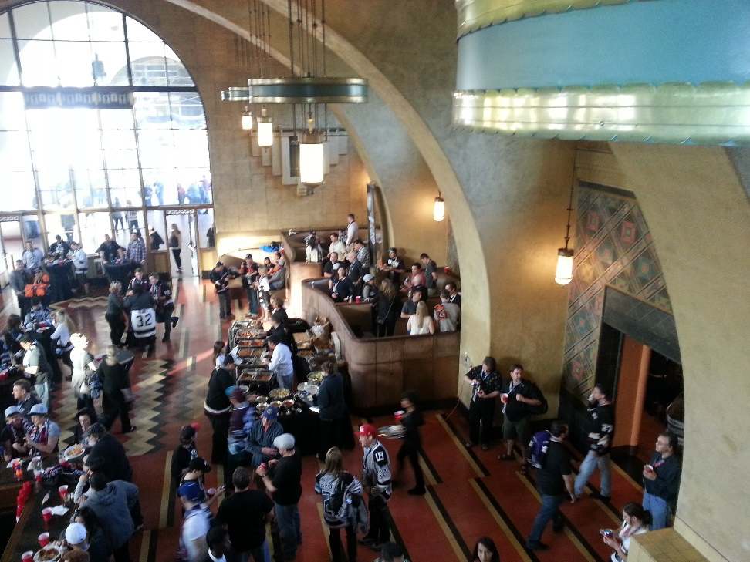
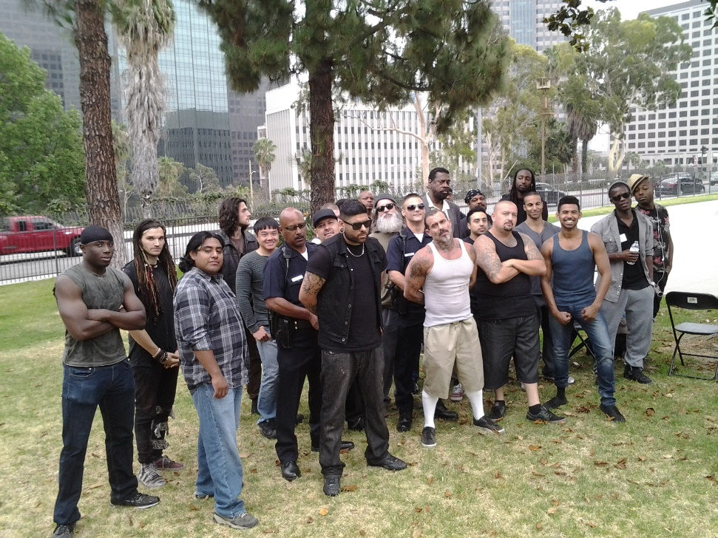
This is My Company
Every day at my 4 Companies:
I hold meetings about both Current and Future Events
I take an active roll in helping develop some of the Events
I spend time with Creative People to help myself become more creative

Slide 18
My Career Path
I paid equal amount of time & energy learning new things and taking chances when offered!
I worked for others spending my time working and learning, always learning!
I am now
Managing Partner of EventPro Productions
Managing Partner of EventPro Locations
Owner of CPER Productions
Co-Owner of ADAM-HENRY Productions
Notes:
You may use this chart to describe your journey to the current career

Slide 19
My Career
The first job I had after college was:
Medic on film “APOCALYPSE NOW”
The worst job I have ever had was:
Cleaning Toilets at University of Michigan! It was latterly the S___’s

Slide 20
My Career
Challenges I have had to overcome throughout my career are:
Lack of self-confidence
Dyslexia
Laziness
Being around People
Accepting people for who they are

Slide 21
My role within organization
CEO
CONSULTANTS
ENTRY LEVEL
ME
STAY LEVEL
Notes:
Use this graph to give more description of your role specifically (responsibilities, typical work week, direct reports, etc.)

Slide 22
Compensation at my company
C-Suite
($350K)
Management
($150K)
Middle Manager
($94K)
Entry Level
($82K)
Notes:
Use this graph to show general compensation ranges for people in various roles in your company

Slide 23
More than just work
When I am not at work I like to:
Volunteer time to organizations whose purpose is to provide opportunities
Spend time on my VR system
Spending time on the Water
Spend time “just thinking”

Slide 24
Do it all over again?
If I could talk to my high school self, what would I say?
Listen to my inner voice
Don’t let anyone tell you that you are a nothing
Try to understand Social Culture and its purpose
Learn from History
Start using my right brain, yes it hurts, but in the long run, I will be better off
Seek out and listen to Mentors
Shut out negative thoughts
Don’t try to “fit in”

Slide 25
QUESTION AND ANSWER

