Slide 1
Youth Business Alliance Presentation
Maywood Academy high school
12/6/2018

Slide 2
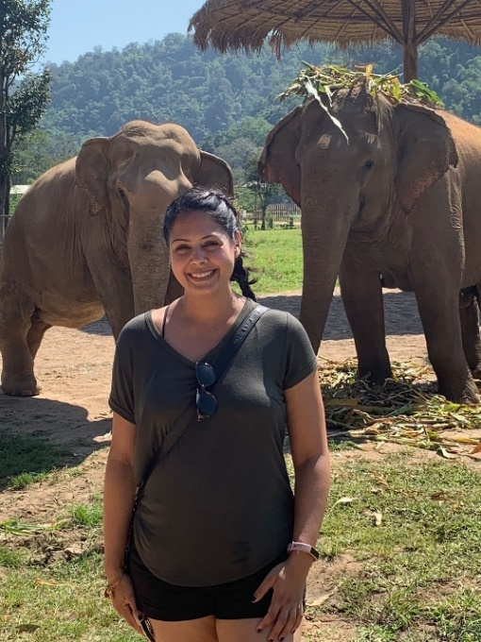
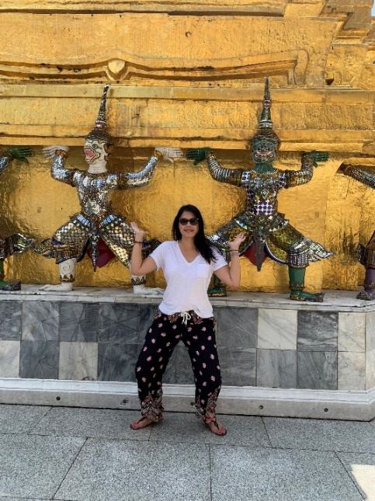
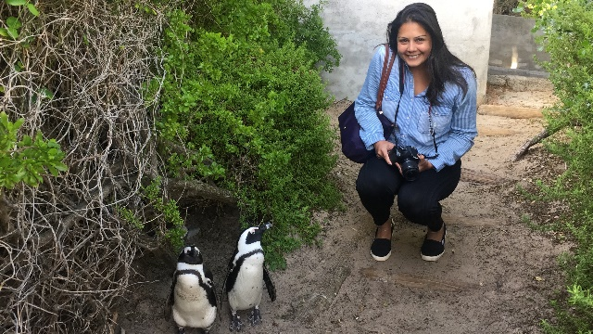
Background
Childhood and Family Background
Passions/Interest
Motivation/Lessons Learned along the way

Slide 3
Career Path

Slide 4
Career Lessons
Career Growth/Challenges Faced
Women in Real Estate
Knowing your Self-Worth
Don’t be afraid to ask

Slide 5
Retail Locations

Slide 6
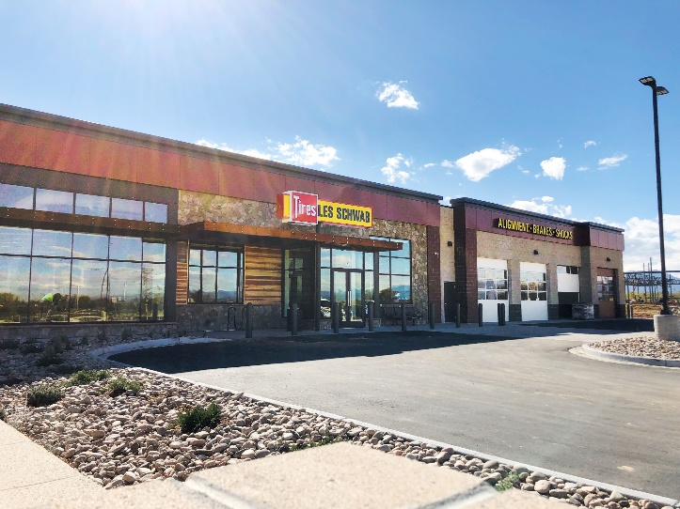
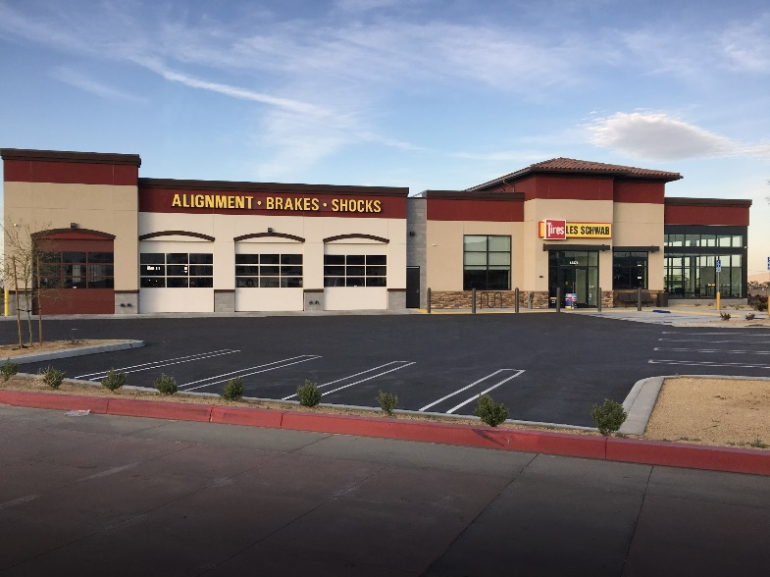
Real Estate Development (My Day to Day)
What did it take to build these retail buildings?
Identify/Justify
Negotiate
Design
City
Construction

Slide 7
Group Activity
Two types of property. What would you look for if you had to purchase for a company or yourself?
Home
Retail/Restaurant

Slide 8
Questions? Contact Info: rona.dhruv82@gmail.com

