Slide 1
Welcome To The Workshop!
YOUR LEADERSHIP STATE
Raamon Newman
Founder / CEO New Mavericks

Slide 2
YOUR LEADERSHIP STATE
Welcome To The Workshop!
Is an inner state where you are able to lead yourself and others forward in a positive progressive life supporting way based on WHO YOU ARE without being overcome, overshadowed, or conquered by internal or external enemies, stresses or incoherence.

Slide 4
All Black Haka

Slide 5
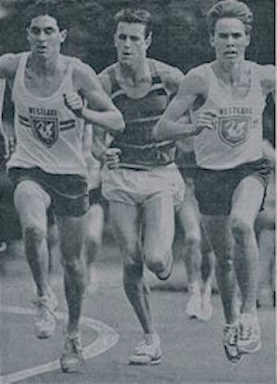

Slide 6
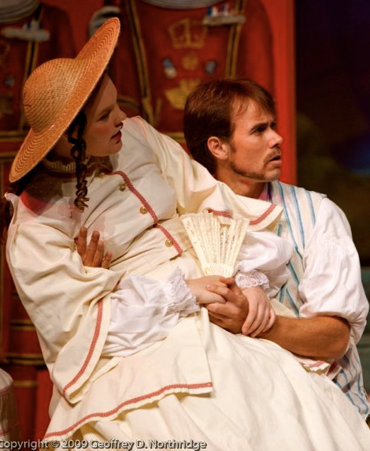
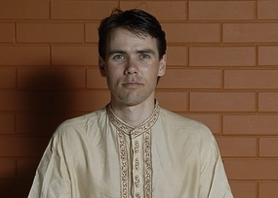
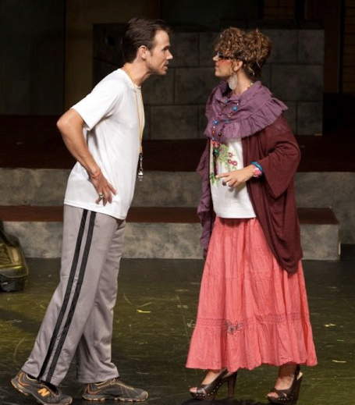
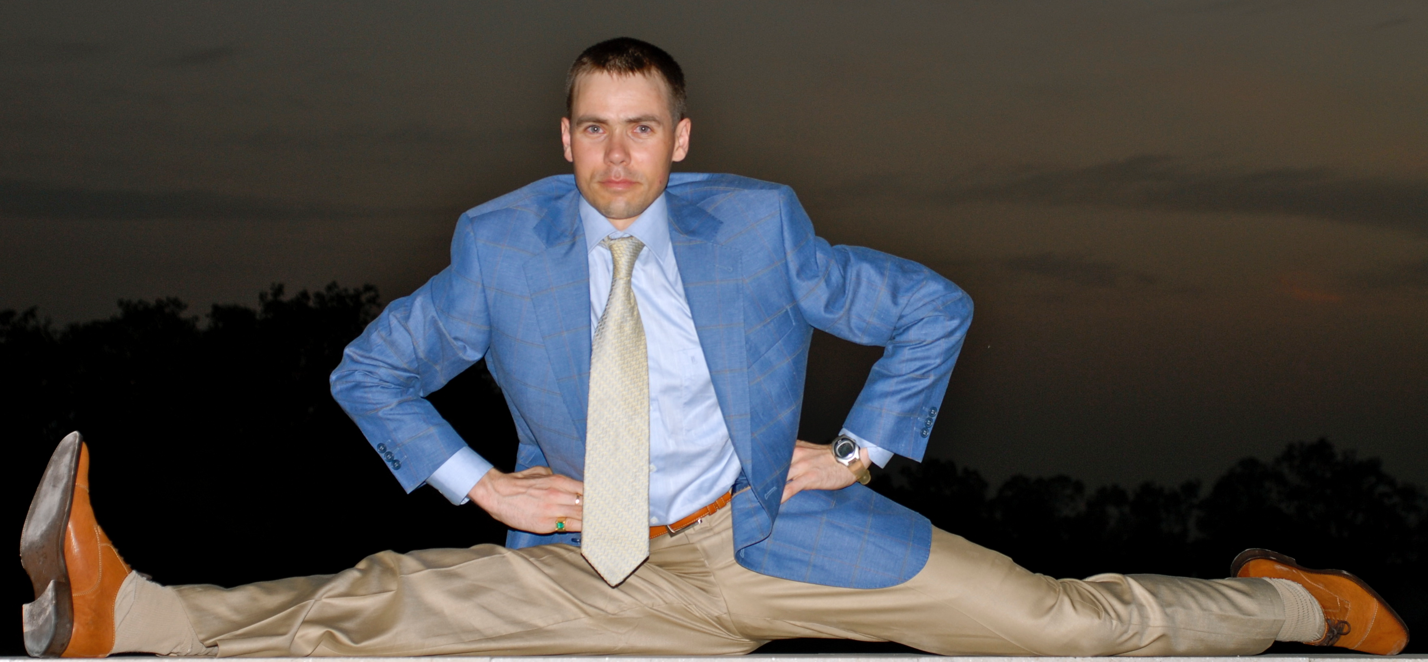
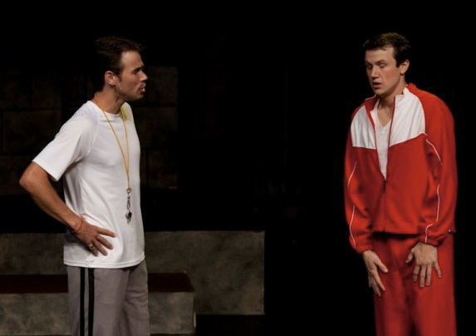

Slide 7
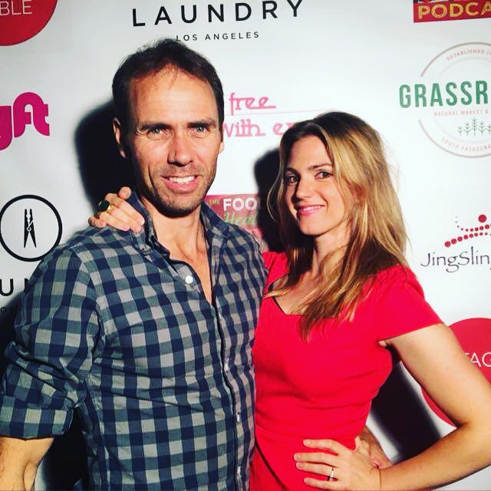
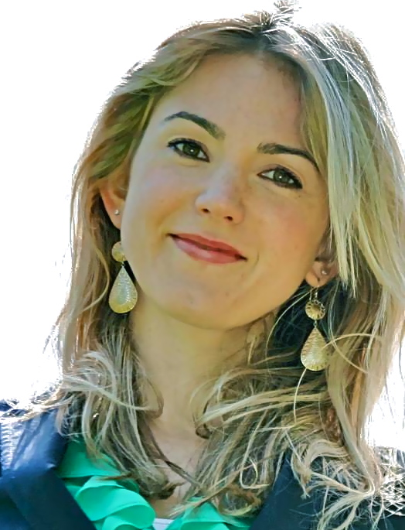
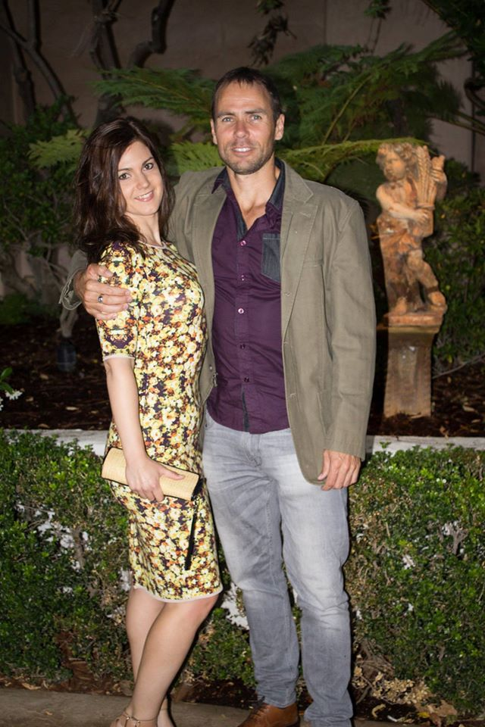
LOVE OF MY LIFE, EMILY
Personal Chef & Natural Health Educator
EmilyRoseShaw.com

Slide 8
THE BASIS OF ACCOMPLISHMENT
Welcome To The Workshop!
IS ACTION
THE BASIS OF ACTION
IS THINKING
THE BASIS OF THINKING
IS KNOWLEDGE
WHAT IS THE BASIS OF KNOWLEDGE?

Slide 9
WHERE DOES KNOWLEDGE COME FROM?
BOOKS
PEOPLE
PEOPLES MIND
PEOPLE’S CONSCIOUSNESS
======================================================
THE SOURCE OF KNOWLEDGE
IS CONSCIOUSNESS
KNOWLEDGE IS STRUCTURED
IN CONSCIOUSNESS
Welcome To The Workshop!

Slide 10
DEVELOP CONSCIOUSNESS & YOU WILL:
SEE MORE
FEEL MORE
KNOW MORE
& ACCOMPLISH MORE
Welcome To The Workshop!

Slide 11
SCIENCE OF ACHIEVEMENT
Welcome To The Workshop!
“Whatever you can conceive and believe you can achieve”

Slide 12
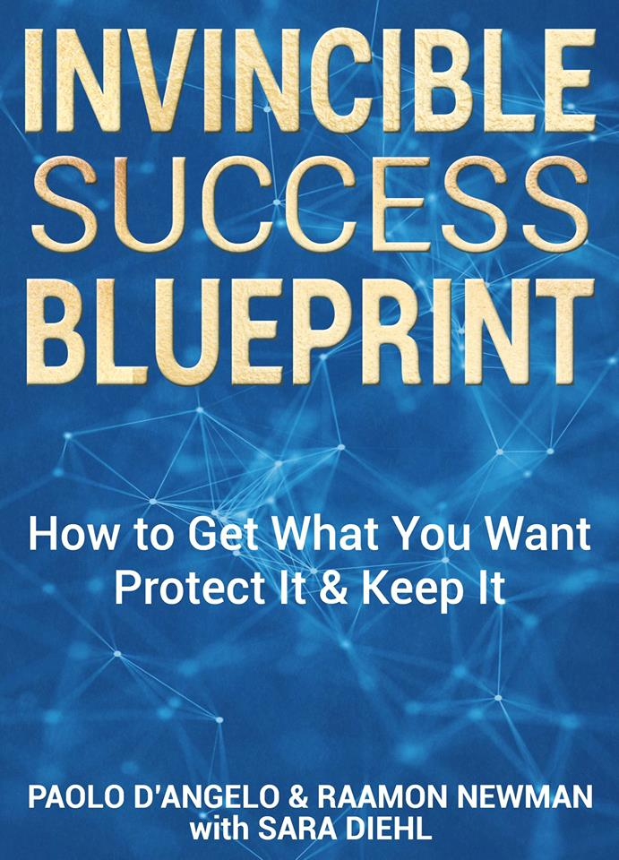
SCIENCE OF PROTECTION
“Your capacity determines what you conceive and believe & what you can achieve, protect
and keep”
Welcome To The Workshop!

Slide 13
WHY IS THE SCIENCE OF PROTECTION IMPORTANT?
Welcome To The Workshop!
1. FEAR OF LOSS / FOMO
On average we’re 2-3 times more motivated
by the fear of loss than the joy of gain.

Slide 14
2. COSTLY MISTAKES
Welcome To The Workshop!
Due to:
Ignorance: Not knowing or choosing not to know
2. Arrogance: Thinking we know when we don’t
3. Status Quo Inertia: Being bound by what we know

Slide 15
Welcome To The Workshop!
3. EXPONENTIAL CHANGE IN
AGE OF ACCELERATION
Things are changing so fast you have to be in tune with change that is best for you not all the change going on around you.

Slide 16
Welcome To The Workshop!
4. PRIMARY INFLUENCER EFFECT
As the leader of your life you are the primary influencer on your performance and outcomes

Slide 17
HOW IS THE
SCIENCE OF PROTECTION ACTIVATED?
Welcome To The Workshop!
Through developing
YOUR LEADERSHIP STATE
so you can….

Slide 18
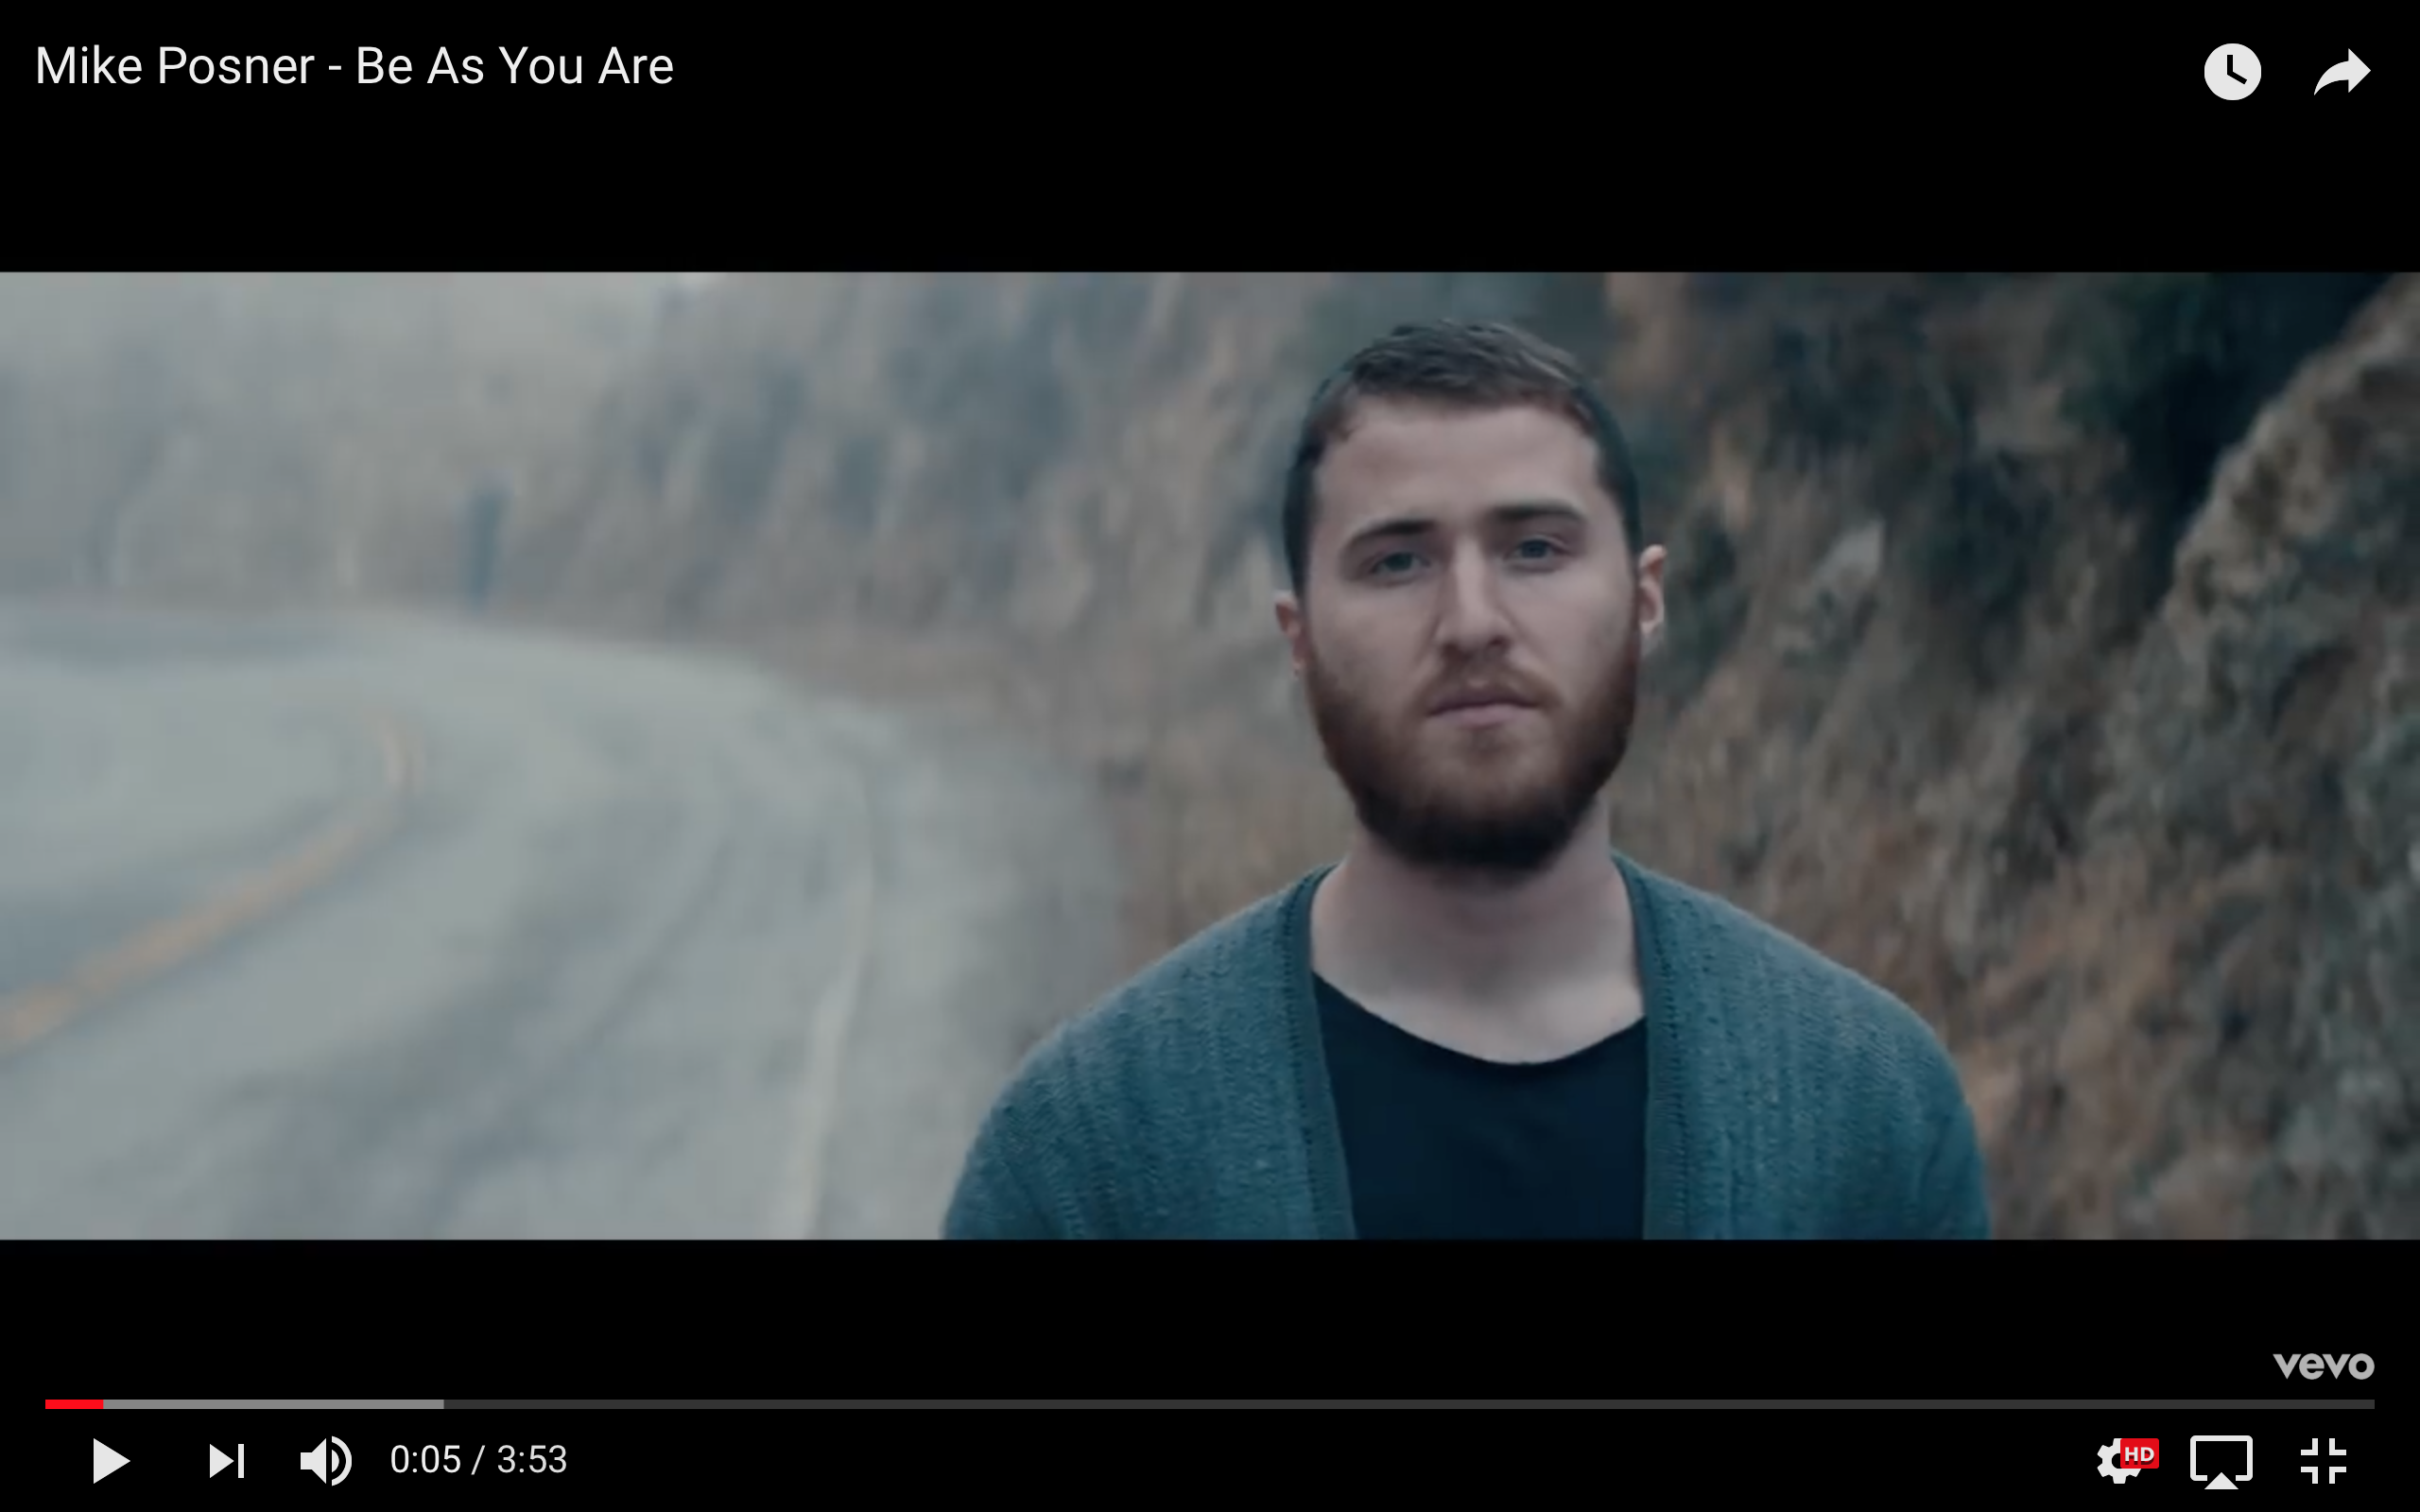
BE AS YOU ARE
MUSIC DANCE BREAK
All Black Haka

Slide 19
Welcome To The Workshop!
FOUR WAYS TO BE IN
YOUR LEADERSHIP STATE

Slide 20
1. HIGHER ENERGY FREQUENCY
Welcome To The Workshop!
PURE TRUTHFUL POSITIVE
FOCUSED STABLE HAPPY
PASSIONATE BALANCED FULFILLED
ENERGY

Slide 21
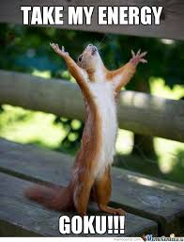
WHY?
Everyone loves good energy
Welcome To The Workshop!

Slide 22
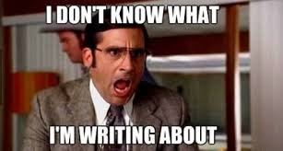
AND
ENERGY IS WHAT GIVES YOU MORE CLARITY & CREATIVITY
so you don’t have this problem
Welcome To The Workshop!

Slide 23
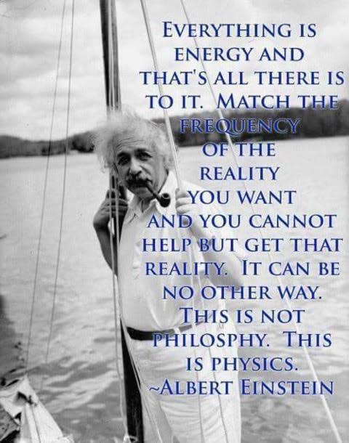
Welcome To The Workshop!

Slide 24
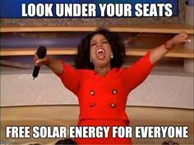
WE DON’T CREATE ENERGY
ALIGN WITH THE HIGHER ENERGY THAT IS ALREADY IN YOU

Slide 25
11 Simple Ways Have Better Energy
Be in tune with the cycles of rest and activity
Meditate & pray
Eat fresh organic locally grown food
Purifying fears, stresses and worries gives you better energy to progress
Exercise, stretch, yoga
Drink pure water
Welcome To The Workshop!

Slide 26
11 Simple Ways Have Better Energy
6. Oxygenating yourself with deep nose and diaphragm breathing
7. Get a daily dose of Sun’s vitamin D
8. Do acts of kindness that makes people happy, especially those who are unhappy or not kind
9. Have moments of gratitude for what you have
10. Express how you feel to yourself and others, you can’t be helped if you’re not open
11. Give people good energy when speaking with them because good relationships help create good results
Welcome To The Workshop!

Slide 27
BE WISE WITH YOUR ENERGY
Use your mental, emotional, physical energy wisely by developing a balanced settled alert mind and emotions = BALANCED ENERGY
Your Energy Changes Over Time
0-25 age is student life to develop mind, emotions and body allow these to develop without exhausting yourself
25-65 age is work & family life to expand wealth, relationships and happiness.
65-100 age is more to relax, enjoy, teach, give back,

Slide 28
2. BE WHO YOU ARE
Welcome To The Workshop!
Unapologetically be YOU
with Self presence, awareness and love
that embraces and includes others
no matter how different they are.

Slide 29
FULLY BE WHO YOU ARE
Welcome To The Workshop!
You are a unique expression of intelligence & life, no one is like you, so FOCUS ON WHO YOU ARE & WANT TO BECOME, NOT WHAT YOU WANT

Slide 30
FULLY BE WHO YOU ARE continued
Welcome To The Workshop!
2. Pay attention to clues, hints & feedback as to who you are from from yourself primarily and then family, friends, teachers, coaches, mentors secondarily who help you understand & support who you are and who you want to be

Slide 31
FULLY BE WHO YOU ARE continued
Welcome To The Workshop!
3. You get what you want by fully being
and expressing who you are.

Slide 32
FULLY BE WHO YOU ARE continued
Welcome To The Workshop!
4. The more you develop and understand who you are the easier it is to figure out the why, what, how, when and where of life

Slide 33
Welcome To The Workshop!
CAUTIONS TO BEING WHO YOU ARE

Slide 34
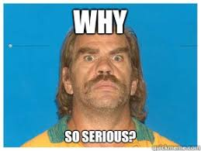
DON’T TAKE YOURSELF TOO SERIOUSLY
We have a serious obligation not to be too serious
Welcome To The Workshop!

Slide 35
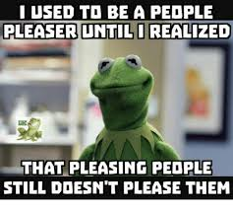
DON’T BE A PEOPLE PLEASER
Share your sweet truth that you believe
is best for you and everyone
Welcome To The Workshop!

Slide 36
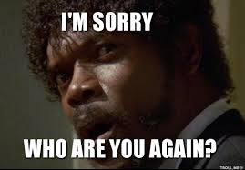
WHO YOU ARE WILL EVOLVE
Overtime you unfold more of who you really are
Welcome To The Workshop!

Slide 37
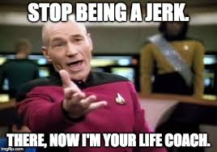
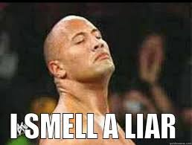
DON’T BE A JERK OR A LIAR
If you are fess up, apologize & people will like you again
Welcome To The Workshop!

Slide 38
4. HIGH QUALITY RELATIONSHIPS
Welcome To The Workshop!
Are truthful, coherent and abundant minded
When both people give maximum & do what they say
they’ll do then both people receive maximum
Quality of relationships determines quantity of results

Slide 39
RESPONDING TO PEOPLE
Welcome To The Workshop!
HAPPY respond with FRIENDLINESS
SAD & SUFFERING respond with COMPASSION
VIRTUEOUS respond with INSPIRATION & APPRECIATION
NEGATIVE respond with NEUTRALITY

Slide 40
AVERTING ENEMIES
Welcome To The Workshop!
OUTER ENEMIES are caused by INNER ENEMIES:
Greed
Anger
Lust
Vanity
Jealousy
False Attachment

Slide 41
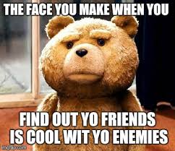
PURIFY YOUR INNER ENEMIES
so you don’t have to make this face
Welcome To The Workshop!

Slide 42
4. DEVELOP GLOBAL ALPHA
BRAIN COHERENCE
Welcome To The Workshop!
This is what world-class athletes, business people and musicians have that allows them to have more of the right thoughts at the right time to act on.
This determines how much receptivity,
protection, influence & support you have
for what you want to see happen

Slide 43
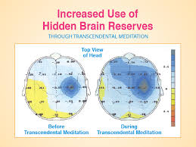
Welcome To The Workshop!

Slide 44
Welcome To The Workshop!

Slide 45
TOP THREE GLOBAL ALPHA ACTIVITES
Welcome To The Workshop!
EXERCISE
MUSIC
TRANSCENDING MEDITATION
Better Brain Coherence —> Better Thoughts —>
Better Energy —> Better Use of Time

Slide 46
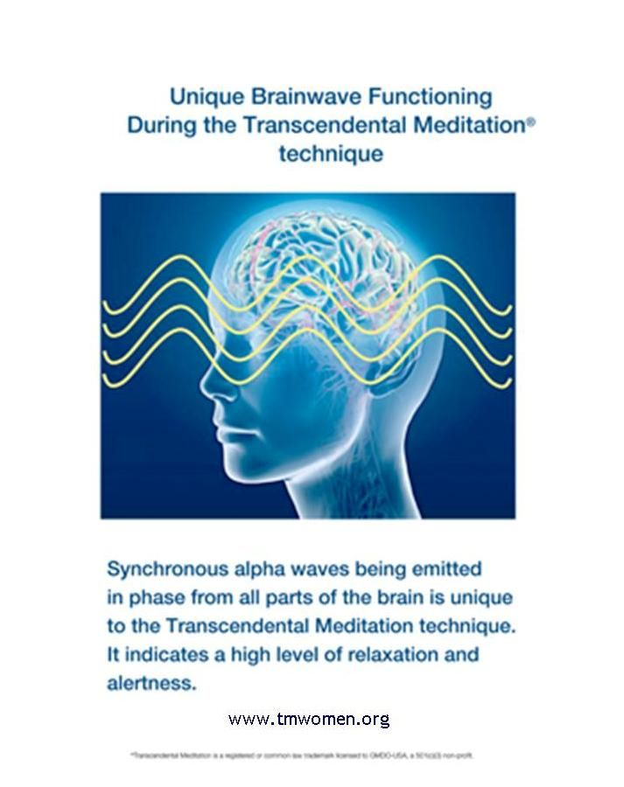
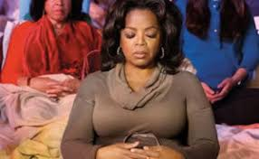
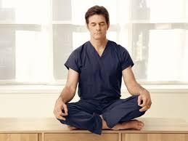
Welcome To The Workshop!

Slide 47
Welcome To The Workshop!

Slide 48
CALL to ACTION in Next 24-48 Hours
Find a quiet place, sit down, close your eyes & simply and purely BE for 15 mins to settle your mind and be in YOUR LEADERSHIP STATE.
2. After 15 mins I want you to slowly open your eyes, take a couple mins or lie down.
3. Then write down: 1-3 qualities or skills you want to develop to be more of who you are
1-3 ways to develop them
1-3 times each week you’ll practice them.
You have CONTROL over the QUALITY OF YOUR ACTION not the outcome.
DEVELOP skills & qualities you can use for a life time like writing, speaking, business,
coaching, teaching, music, design, math & tech skills, athletic, acting & dance
REMEMBER: RECOVERY & A SETTLED MIND determines the quality of your ACTIVITY
Welcome To The Workshop!

Slide 49
“Investing in yourself is the most important investment you’ll ever make in your life. There’s no financial investment that’ll ever match it, because if you develop more skill, more ability, more insight, more capacity, that’s what’s going to really prove economic freedom. It’s those skills that really make that happen.”
– Warren Buffet
Welcome To The Workshop!

Slide 50
Your questions, comments,
feedback, insights now…
or
email support@newmavericks.com
Welcome To The Workshop!

