Slide 1
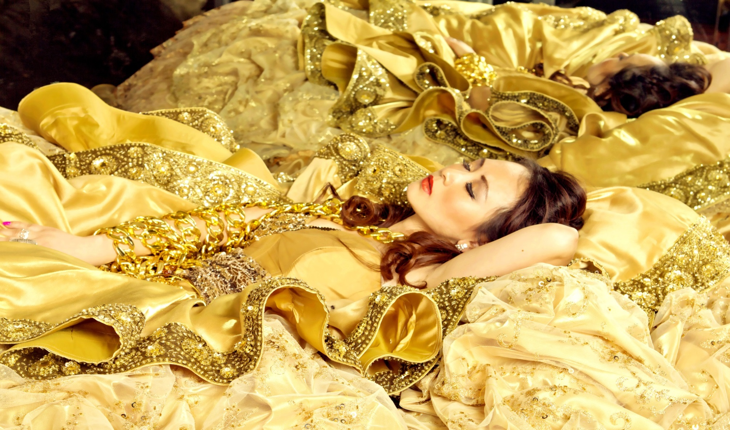
WELCOME
Elle Ellis
Fashionpreneur | MGM Fashion Reality Show Winner |
Nonprofit Advocate | Public Speaker
STYLE.ENTERTAIN.EMPOWER

Slide 2
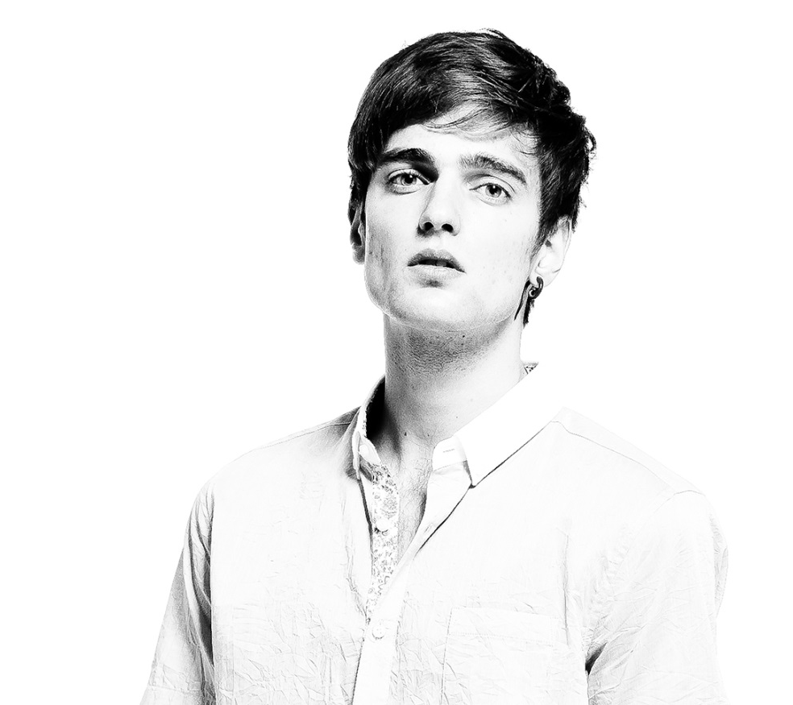
From childhood to college
I showed some natural talent in performing while at kindergarten. But my parents want me to get good scores at school which will help me land a stable job…
Rekindled my passion once grown up and become independent, leaving no regret to life!
Born in China
The only child of the family
Studied hard at schools
Worked hard and was able to land jobs at some of the industry leading companies
Become entrepreneurial after college. Trials and failures.

Slide 3
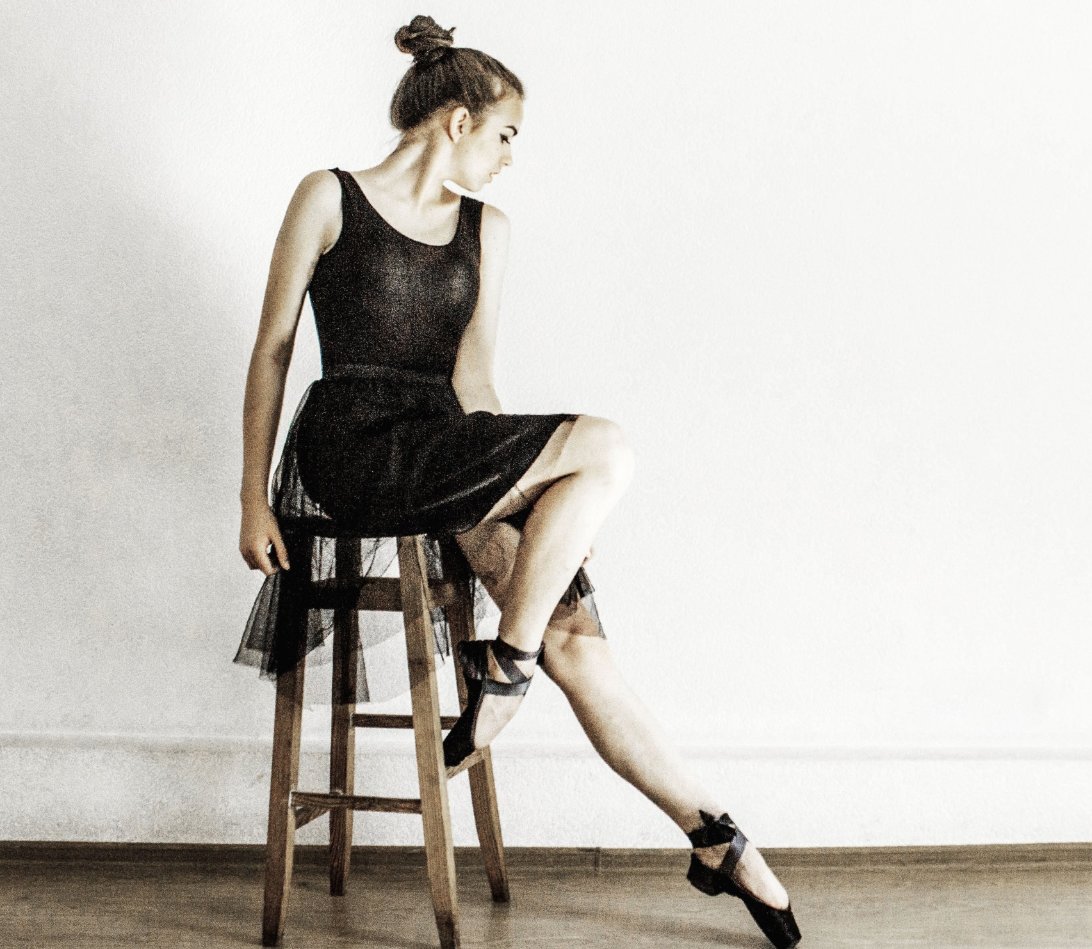
Only you can define yourself
The Sky is the limit
It can be quite common that families and friends might not approve your entrepreneurial endeavors or “hobbies”.
Take calculated risks and if it is right for you, don’t let limiting beliefs confine you.

Slide 4
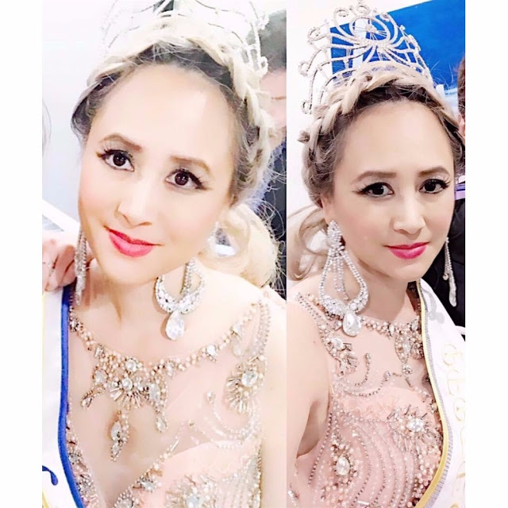
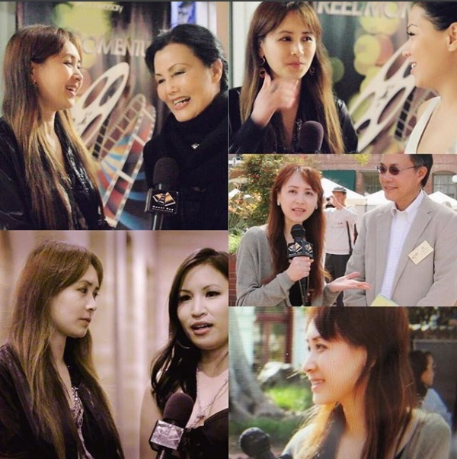
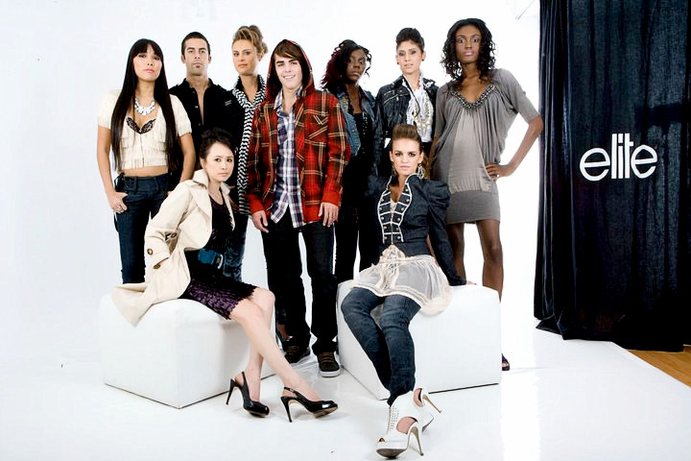
MODELING
Started modeling by first learning how to walk at Elite Fashion Academy
PAGEANT
Won a beauty pageant in 2017 and decided to use my voice to raise awareness for meaningful causes such as issues related to women and pets.
HOSTING
TV show hosting. Learning hosting at two hosting training programs.

Slide 5
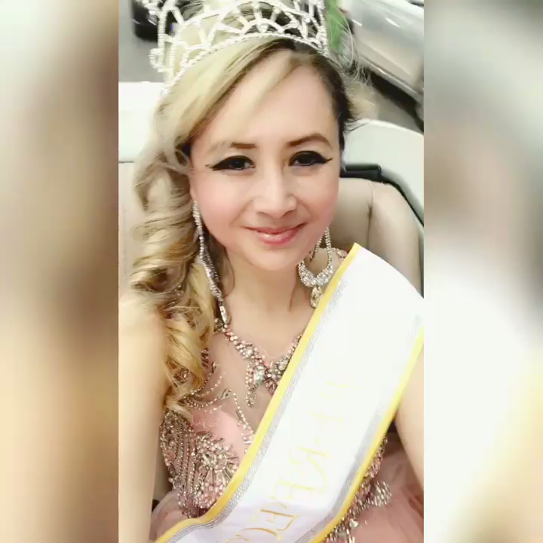
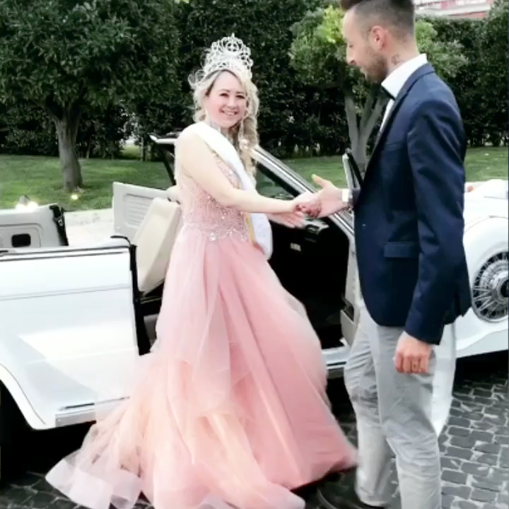
The Queen’s Royal Journey in Rome

Slide 6
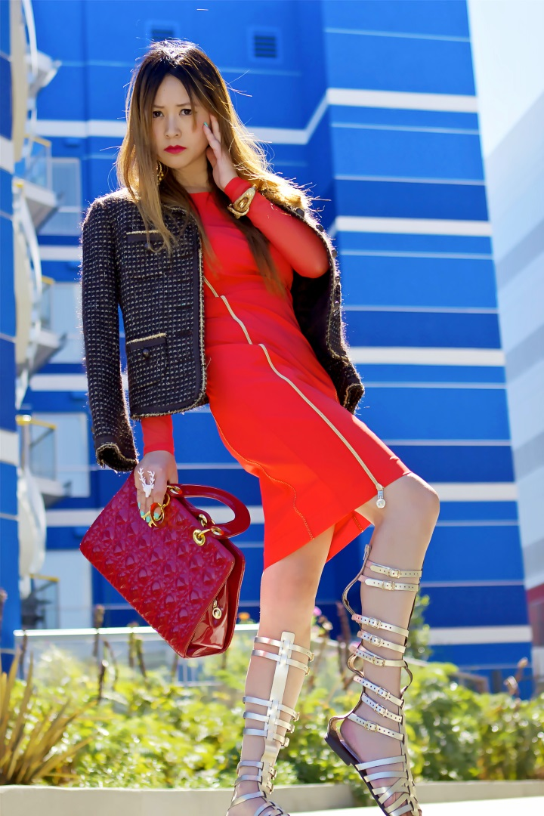
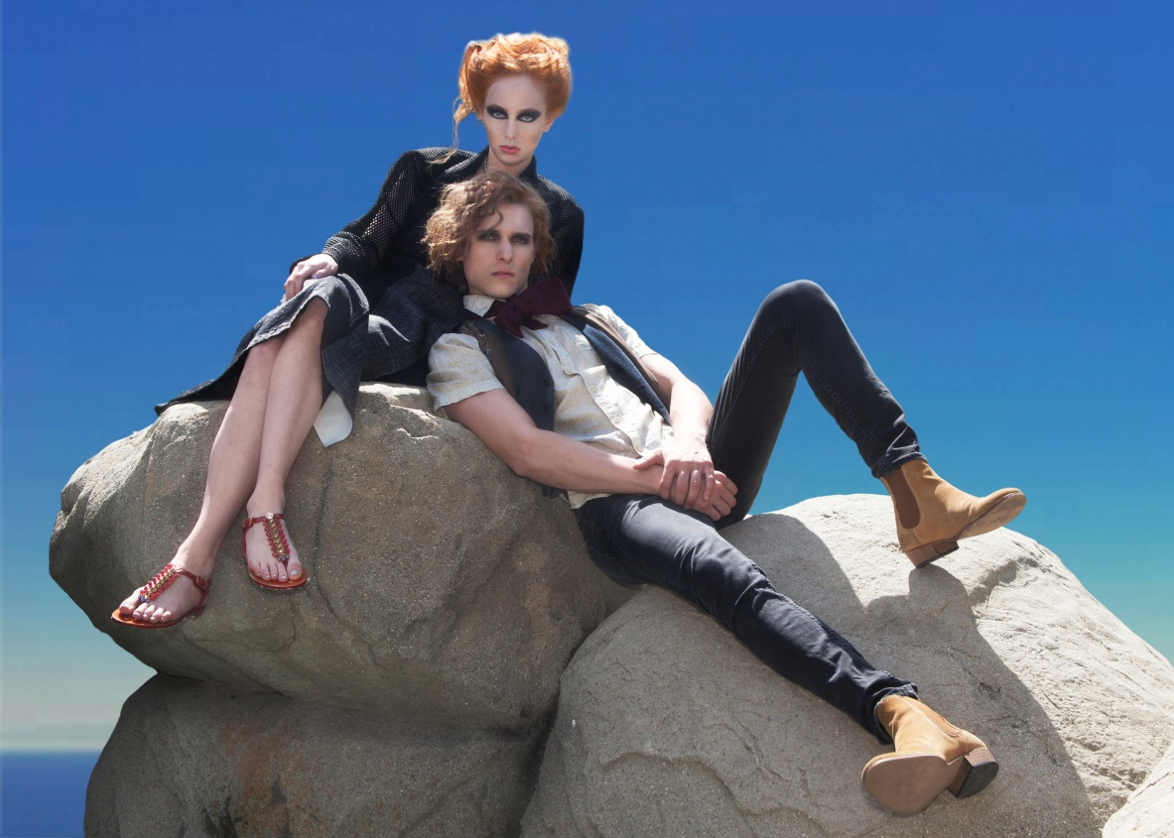
Fashion is my Passion
Fashion Blogging – personal style and society news
Fashion eCommerce website selling luxury designer shoes, bags and clothing

Slide 7
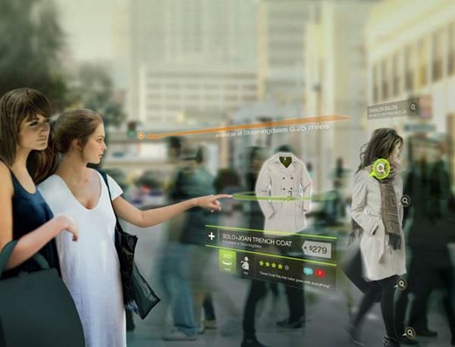
Startup Adventure
It Girl Styles is a unique fashion mobile
shoppable video network that disrupts the way
women shop and style with an entertaining
and futuristic like online shopping experience.
We are Vine with shopping button
within the player.
-Tried to be a startup founder bringing innovation to people’s lives and change the way they live forever
-I thought a business that would disrupt the way people shop forever would be most cool and grant me more success
-A venture capitalist’s words changed my belief forever: “We buy into the founders, not ideas. It is not about what idea will be most successful, but rather what you are most passionate about”
A slide from my fashion mobile app pitch deck

Slide 8


What next?
Global Expansion &
Digitalization
Global
Digital Strategy Management Consulting Firm
Media, entertainment, fashion and other industries
In order to work from anywhere in the world, I created this global management consulting business to allow myself be location free.

Slide 9

What next?
Author
TV Show Producer
Nonprofit Advocate&Activist
Public Speaker
Shoe Designer
Fashion & Digital Strategist
BRANDING
Branding is very important to your success and the success of your business.

Slide 10

Elle Ellis TV
-LOREM-
Car Model TV Show
WELCOME

Slide 11

Elle Ellis TV
Elle Ellis Foundation
Elle interviews Animal Rights Attorney on matters in vet malpractice, Yulin Dog Meat Festival and Animal Inequity

Slide 12
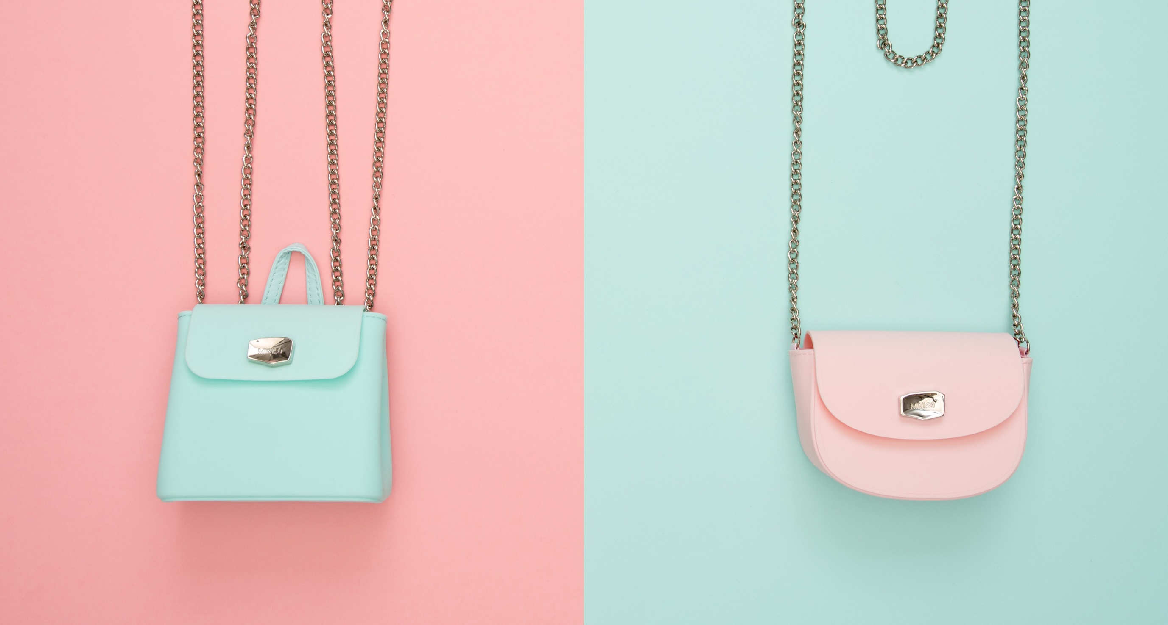
-WHAT IT TAKES-
PASSION
ACTION
DEDICATION
MOTIVATION
KNOWLEDGE
NETWORK
MENTOR
Figure out what you really want, follow your passion; dream but most importantly take actions

Slide 13
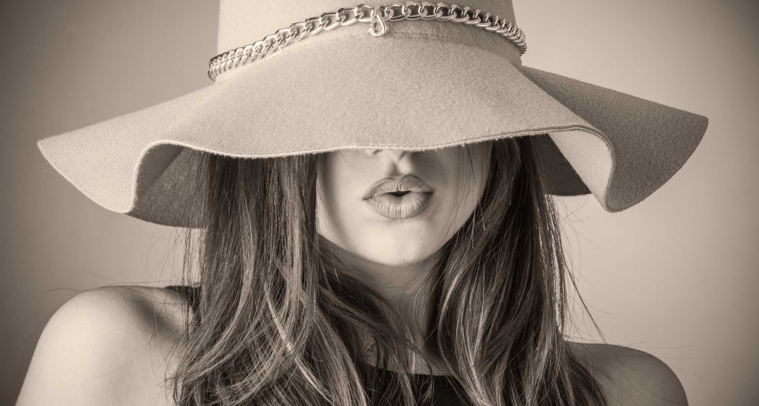
THE END
Be brave, be bold, be persistent, be disciplined, be entrepreneurial, brand yourself be smart and wise in money management, create wealth and most of all – Be Happy!

Slide 14
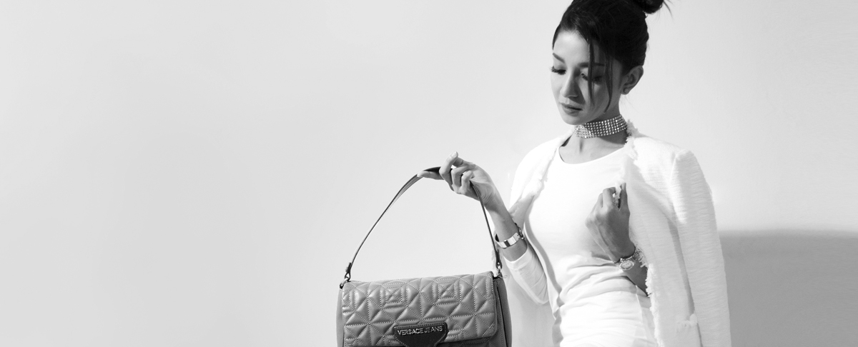

FUTURE
Questions?
@ElleEllisOfficial

