Slide 1
YBA GUEST: Paul Rudy
January 31, 2019

Slide 2
INTRODUCTION
My name is Paul Rudy and I am 48 years old.
I work for SLD Laser.
My company commercializes high brightness laser based light sources for lighting, auto, and display applications
My role at SLD is Co-founder, Chief Marketing Officer, and SVP Business Development
Every day, I work with customers and partners externally, and internally with engineering, manufacturing, finance, and quality to to satisfy customers, gain market share and optimize SLD’s competitive position, and create profitable growth to maximize shareholder value.

Slide 3
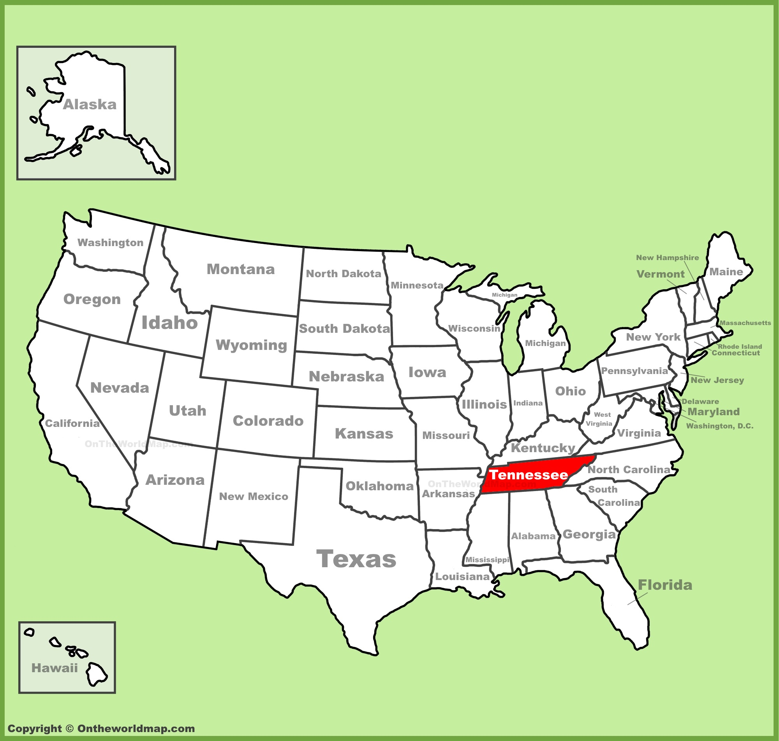
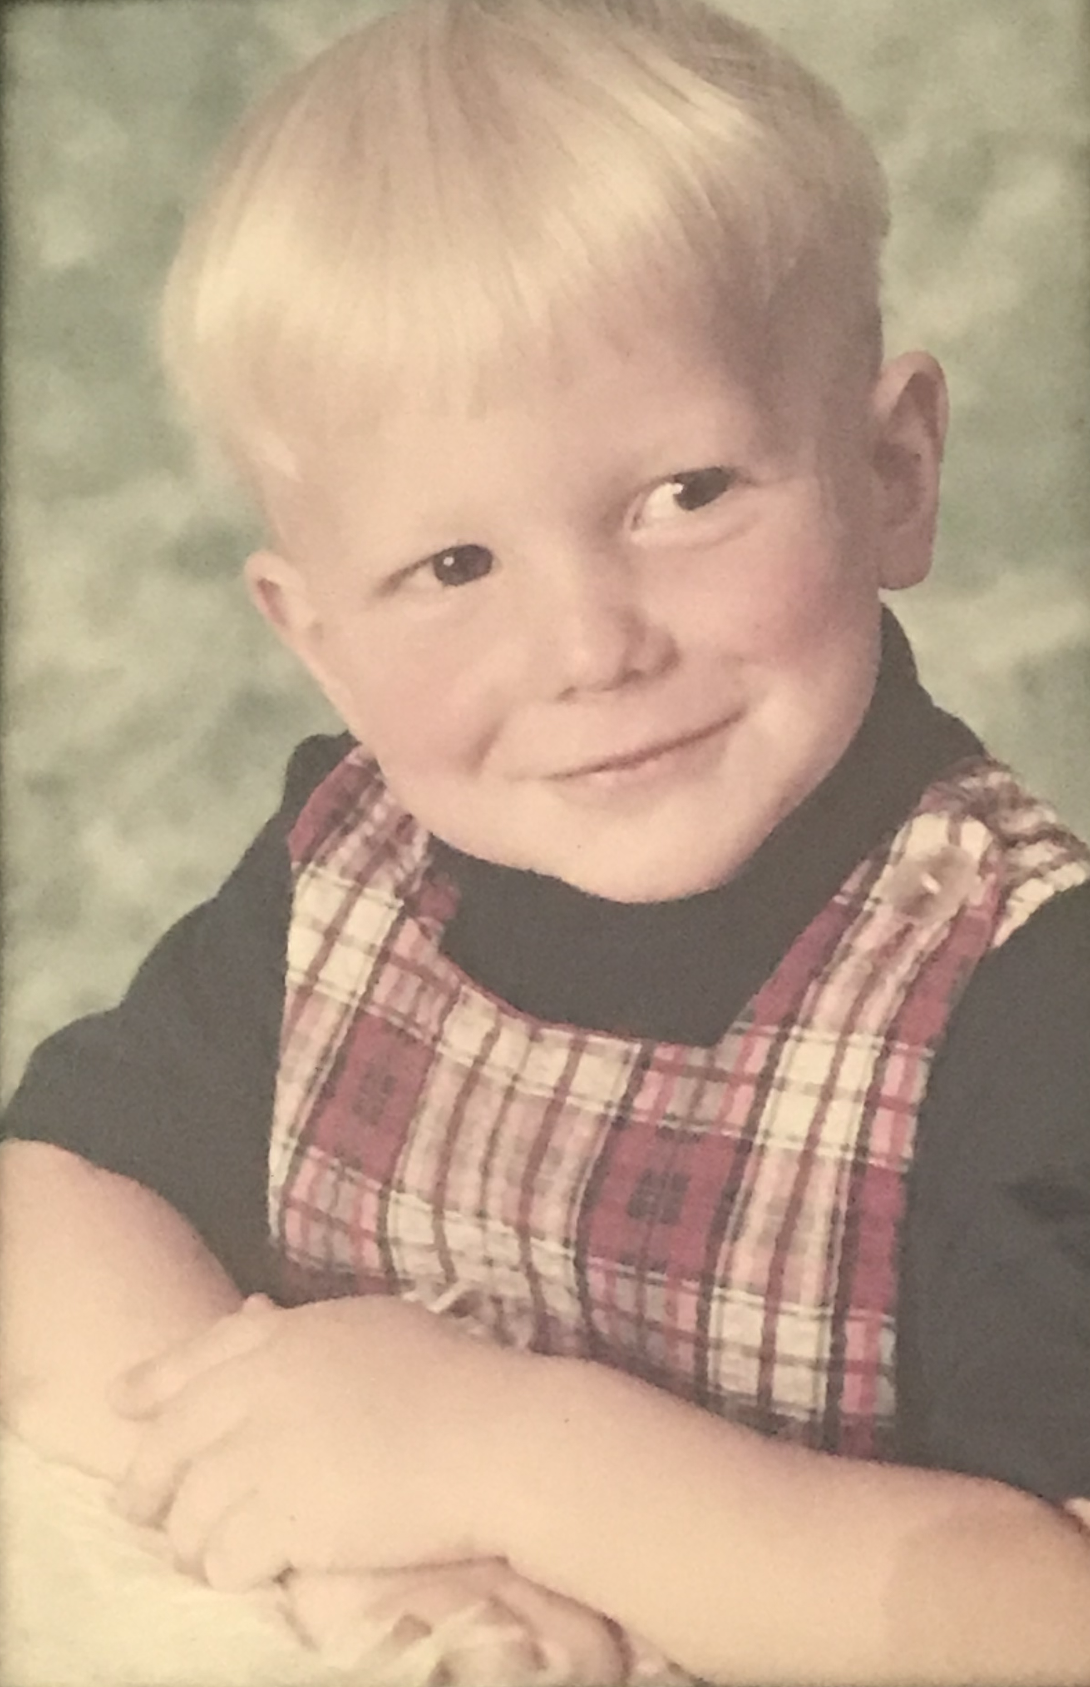
My childhood
I was born in Tennessee and raised in Pennsylvania
This is a picture of me in pre-school

Slide 4
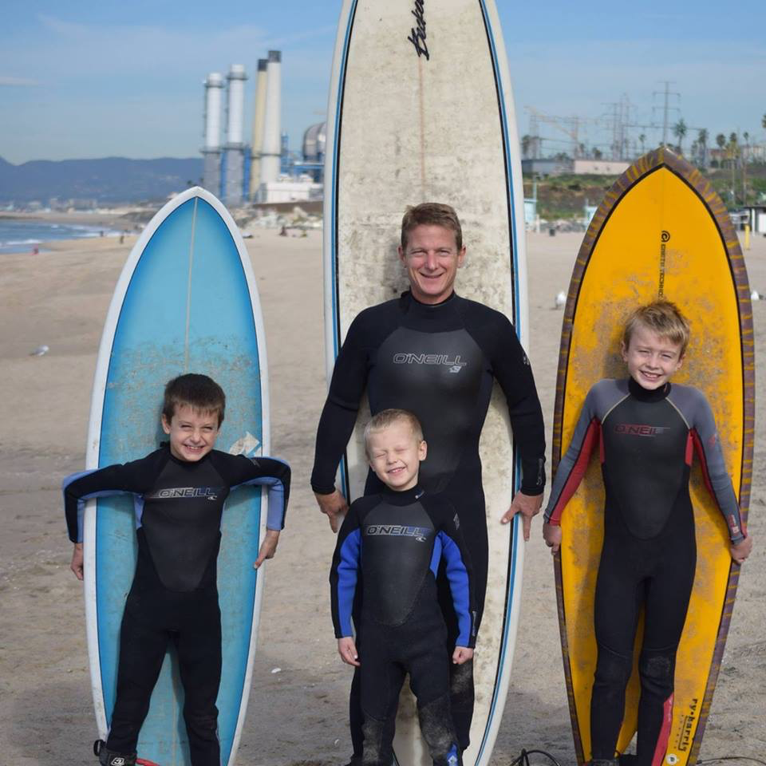
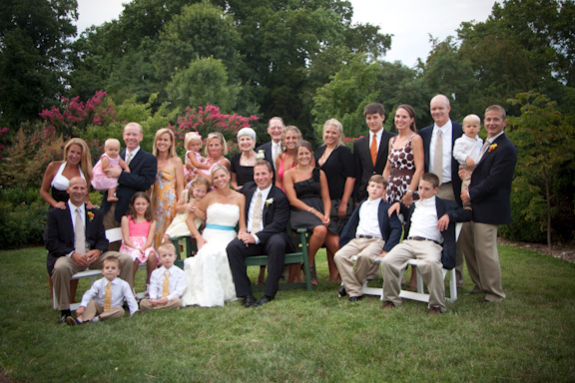
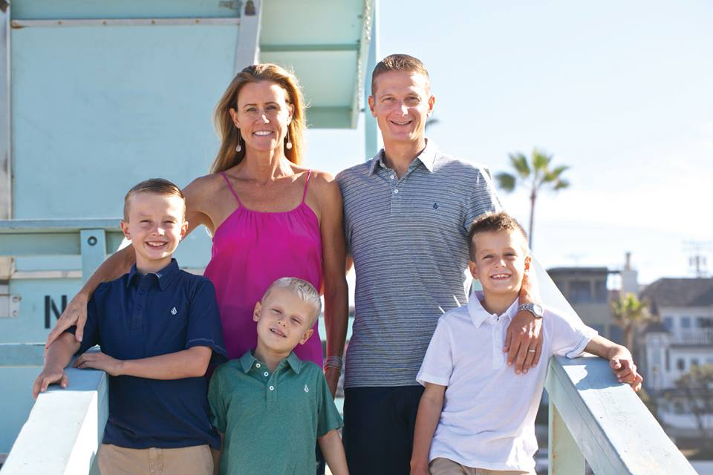
My family
I am the youngest of 5 kids, and have 2 brothers and 2 sisters
Surfing with my sons
This is a picture of me and my big family: my wife and kids and parents, brothers, sisters, inlaws (“outlaws”), nieces and nephews
My family

Slide 5
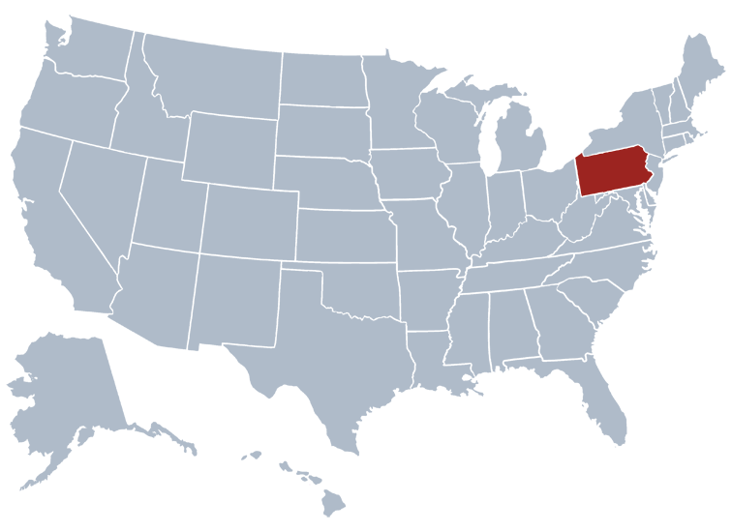
MY HIGH SCHOOL
I attended Manheim Township HS in Lancaster, PA
(near Amish country, ever see the movie “Witness?”)

Slide 6
High School
As a HS student I played soccer, wrestled, was very social.
Things that I really liked in High School were:
Soccer year round, especially in Europe in the summer
Wrestling
Physics
Math
Very close friends
Family

Slide 7
High School
Things that felt difficult or challenging for me while I was in High School were:
Balancing great grades, friends, family, sports and still being able to enjoy it all without feeling too busy or too tired or too stressed
Losing weight in wrestling (Ever see the movie “VisionQuest”?)

Slide 8
High School
Jobs I worked while I was in High School were:
Dishwasher
Busboy
Office job as a “cartographer” for micro-marketing firm
Soccer camp counselor

Slide 9
Getting in to College
The top few things I did to ensure I got into college were:
Studied hard to get great grades, became valedictorian
Took AP classes
Governors school for science
Mayors youth leadership conference
Sports
Visited Duke and really fell in love with it, people could sense I was passionate about it

Slide 10
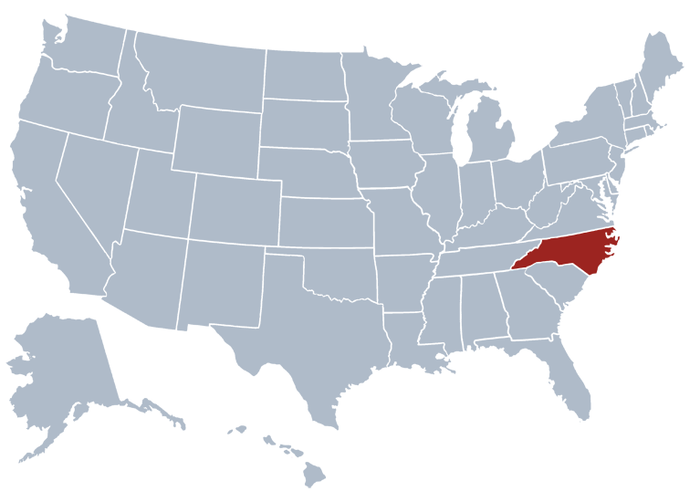
College
I attended college at Duke, Masters and PhD at University of Rochester, and MBA at USC

Slide 11
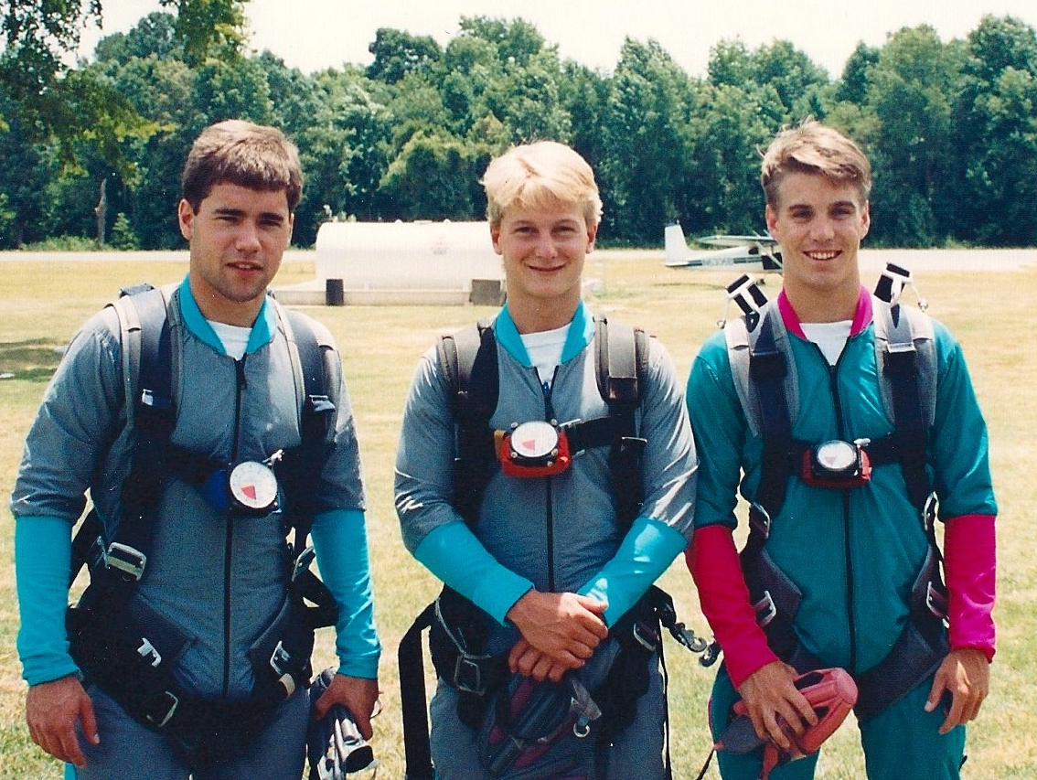
College
Things I enjoyed in College
Things I didn’t enjoy in College
Club soccer
Physics and philosophy
Started my own soccer camps “Net Advantage”
Social life: meeting folks from all over US
ACC
“Ponding”
Skydiving
Being away from great high school friends and family

Slide 12
College
Favorite classes
Least favorite classes
Physics: learning about lasers
Philosophy: working the left brain, logic
Film
Geography of Canada (don’t ask …!)

Slide 13
College
Jobs I worked while I was in College were:
Weight room in phys ed dept
Research assistant setting up laser lab
Net Advantage Soccer Camp

Slide 14
College
Things that felt difficult or challenging for me while I was in College were:
Balancing great grades, friends, family, sports and still being able to enjoy it all without feeling too busy or too tired or too stressed

Slide 15
Getting a job after College
The top few things I did to ensure I got a good job after college were:
Networked to meet lots of people in the company that wanted to work for
Offered creative ways to get involved with the company, invented an internship even though there wasn’t an official program
Made it clear to my PhD advisor that I wanted to work in Silicon Valley for a laser company as soon as I was finished getting my degree

Slide 16
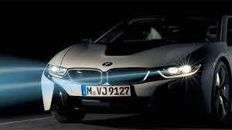
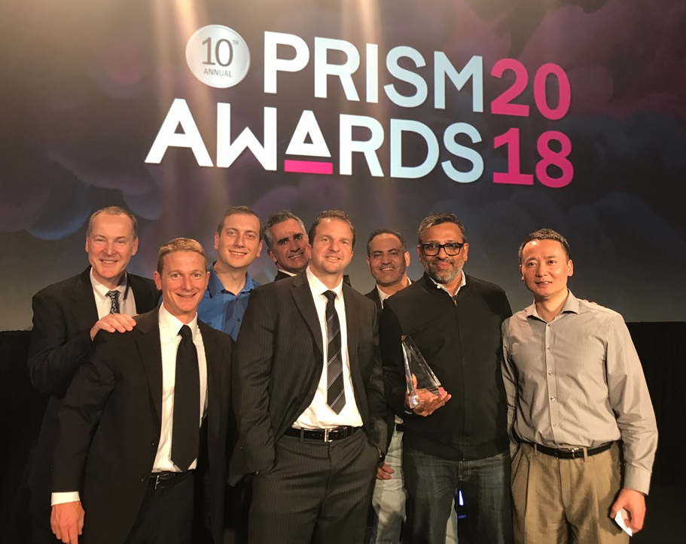
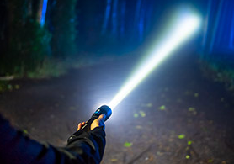
This is My Company
I co-founded SLD Laser with 3 colleagues in 2013
We have 120 people, located in Santa Barbara, Silicon Valley, and off-shore
We are pioneering semiconductor laser based specialty lighting sources for lighting, auto, and display
I am based in LA office, and visit each of our other sites frequently, and travel extensively (1/3 time) to Europe and Asia
Involved also teaching entrepreneurship at LMU, advisory/boards of 2 other companies
https://spectrum.ieee.org/transportation/advanced-cars/bmw-laser-headlights-slice-through-the-dark
https://www.bloomberg.com/news/articles/2019-01-15/the-headlight-of-the-future-is-a-laser

Slide 17
My Career Path
Promoted to Product Manager, Market Development Manager, and the Director of Product Marketing
Joined worlds largest laser company (Coherent) as advanced technical sales
Departed to become VP of Marketing and Business Development of growth phase laser company, acquired
Co-founded SLD Laser, CMO, SVP of Business Dev.
Advisor and board member to several other companies
Notes:
You may use this chart to describe your journey to the current career

Slide 18
My Career
The first job I had after college was:
Graduate research assistant in Grad school
After Grad school: Advanced Technical Sales at Coherent
The worst job I have ever had was:
Advisor to a large conservative company
They established a new division in a field they were not familiar with.
They went against my recommendations; invested too much too soon in the manufacturing lines before the products and technology were ready, instead of investing in R&D first to get the product right.
They ended up with a bunch of idle capacity, as I has feared. I was able to convince them to go back and invest in the product, but they lost several years and millions of dollars.
It was very frustrating, and made me want to start my own company.

Slide 19
My Career
Challenges I have had to overcome throughout my career are:
Some people are incredible motivated and inspiring, but others lack enthusiasm and a “can-do” spirit.
Sometimes great news and progress actually can cause the largest challenges because other stakeholders can get overly exuberant and may try to control things or get overoptimistic expectations.
Power brings the best and worst our in people, and so the further you go along in your career, the more likely you are to see the very best and very worst of folks.
Balancing extensive travel with family, friends, fitness

Slide 20
My role within organization
CEO and Co-founder
CMO and Co-founder
COO and Co-founder
CTO and Co-founder
Sales and Marketing org
Engineering and Mfg org
R&D and IP org
CFO, HR, Quality
Global team
Global team
Global team
Finance team
Accounting team
Notes:
Use this graph to give more description of your role specifically (responsibilities, typical work week, direct reports, etc.)

Slide 21
Compensation at my company
C-Suite
($350K)
Management
($150K)
Middle Manager
($75K)
Entry Level
($20K)
Notes:
Use this graph to show general compensation ranges for people in various roles in your company

Slide 22
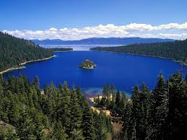
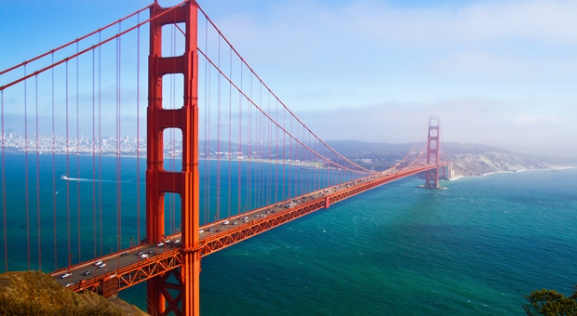
More than just work
When I am not at work I like to:
Family time with the kids, playing outdoor
Run, soccer, surf, waterski, snowboard
Travel with my wife
Visit family back east
Before kids: Escape from Alcatraz Triathlon, Boston Marathon, IronMan, mountain biking, now 10k races
Lake Tahoe
SF Bay

Slide 23
Do it all over again?
If I could talk to my high school self, what would I say?
Keep up the enthusiasm: Nothing is more contagious than enthusiasm, except for the lack of it
Logic and disciplined thinking can cut through challenges in all fields, and will always add value to a room
Become an expert at listening and discovery, and THEN advocate an informed position or solution. The world is full of folks that “tell, tell, tell” and “should, should should” but who are uninformed because they simply didn’t really take the time to listen, and are unable to imagine oneself in another’s shoes
Being either strong or kind is easy, leaders that are both are special
Think a step ahead, follow your passion, work NOW on arranging your next “thing”
Work does not feel arduous, if you love what you do
It is never too early to learn how to write a patent (provisional patent cost $65 to file), or understand business financials (income statement and balance sheet)

Slide 24
QUESTION AND ANSWER

Slide 25
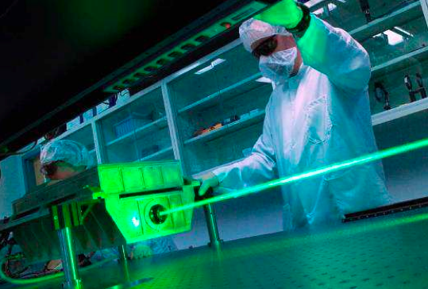
What are Lasers ??

Slide 26
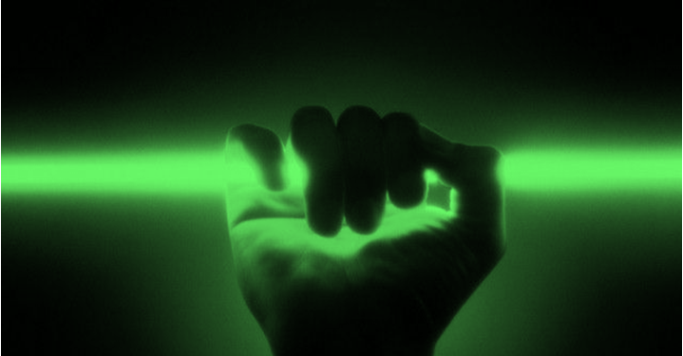
LASER
Single beam
Single color
Light Bulb
Spraying beam
Many colors = white

Slide 27
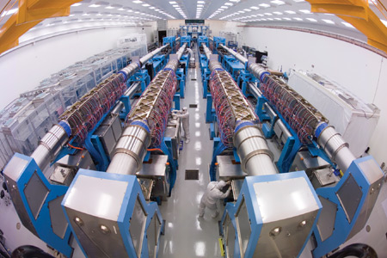
Some lasers are big
That is a person right there !!

Slide 28
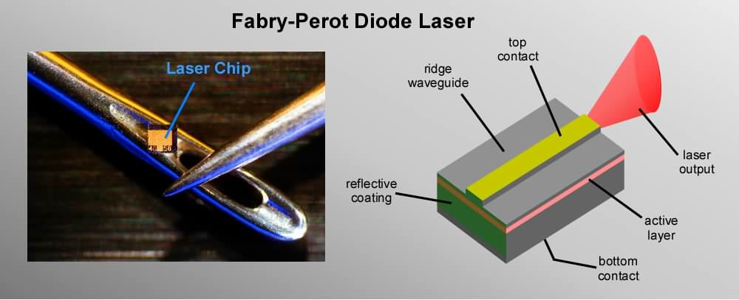
Some lasers are small
That is a needle right there !!

Slide 29
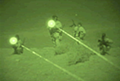
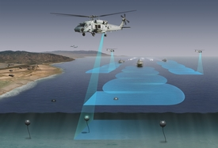
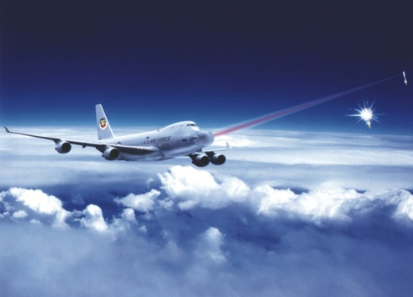
“Laser Dazzlers”
Lasers
for
Defense
“Underwater bomb detection”
“Star Wars”

Slide 30
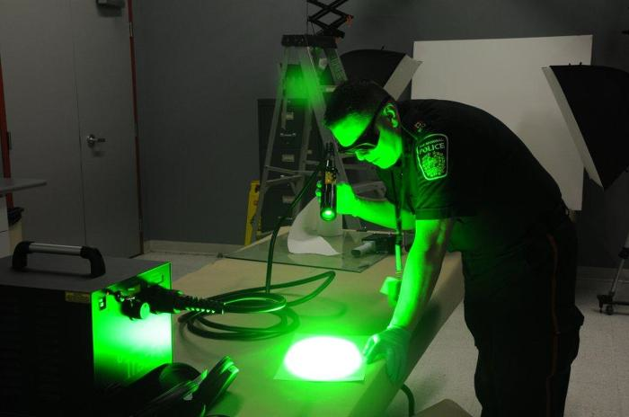
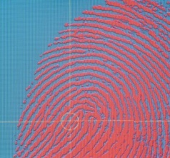
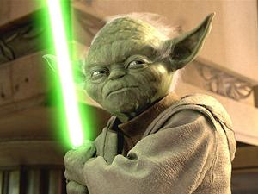
“Fingerprint detection”
Lasers
For
Fighting Crime
“Use the force”

Slide 31
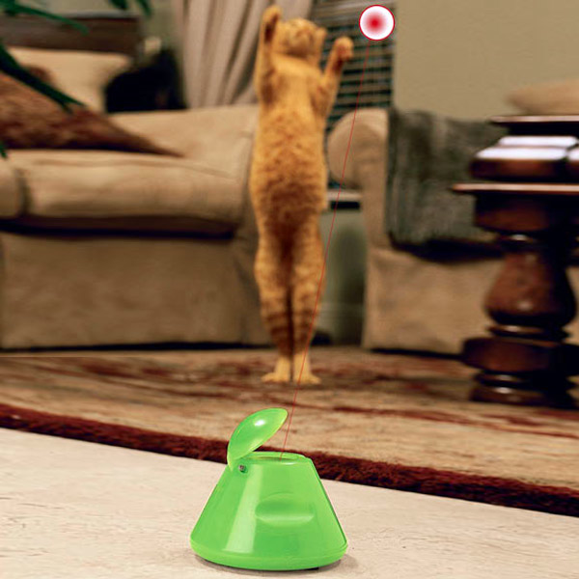
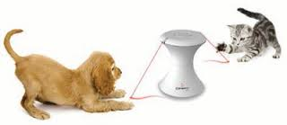
“Crazy Kitty”
Lasers
for
Exercising Pets

Slide 32
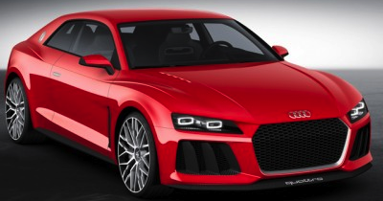
Lasers
For
Race Cars
“Laser Beamers”

Slide 33
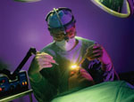
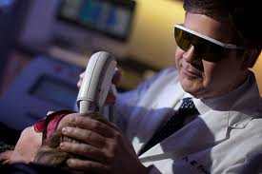
Lasers
for
Doctors
“LASIK – eye treatment”
“Laser Razors”

Slide 34
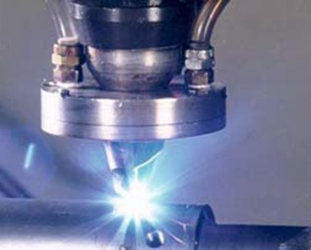
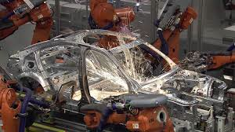
“Laser Drill”
Lasers
for
Cutting Metal
“Laser Welders”

Slide 35
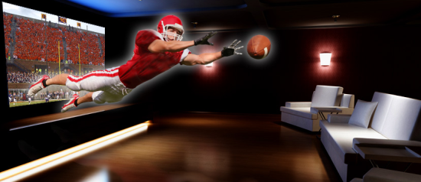
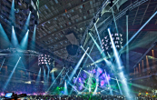
“Laser Cinema”
Lasers
for
TV and Movies
“Laser Light Shows”
“Laser TV”

Slide 36
“Fiber Optics”
Lasers
For
Video Games
“Laser Disc”
“X-Box”

Slide 37
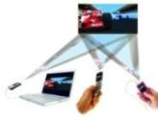
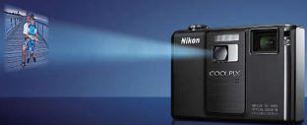
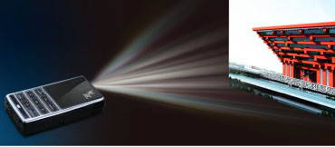
Lasers
for
iPhone/iPad
Movie Projectors

Slide 38
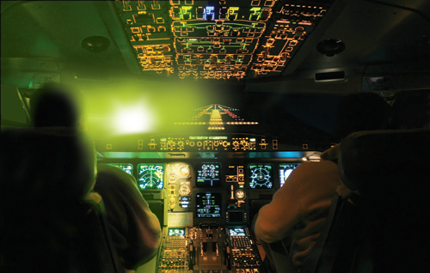
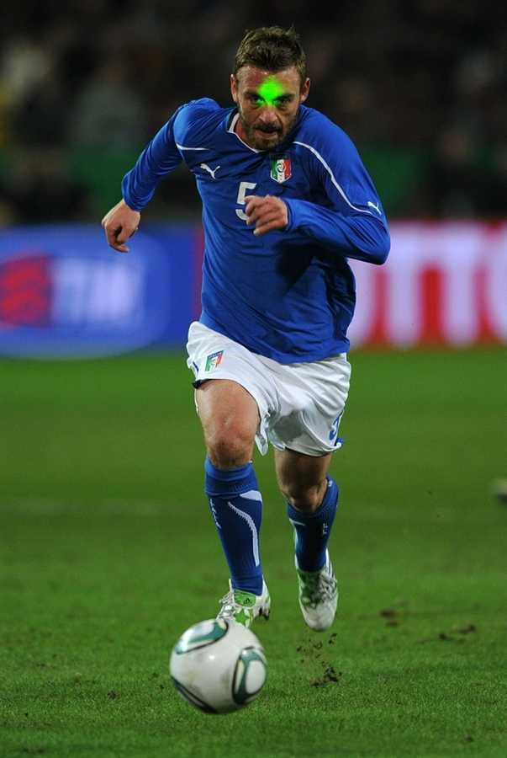
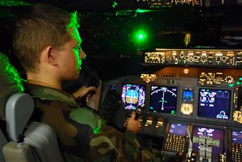
Laser safety is very important
It is against the law to shine laser pointers into eyes

Slide 39
Laser safety is very important
Goggles are required with high power lasers

Slide 40
How do Lasers work?

Slide 41
How do Lasers work?
Hint:
You need 2 Mirrors, and a Light Amplifier

Slide 42
How do Lasers work?
Mirror 1
Mirror 2
Light
Amplifier
Hint:
You need 2 Mirrors, and a Light Amplifier

Slide 43
How do Lasers work?
Mirror 1
Mirror 2
Light
Amplifier
Hint:
You need 2 Mirrors, and a Light Amplifier

Slide 44
How do Lasers work?
Mirror 1
Mirror 2
Light
Amplifier
Hint:
You need 2 Mirrors, and a Light Amplifier

Slide 45
How do Lasers work?
Mirror 1
Mirror 2
Light
Amplifier
Hint:
You need 2 Mirrors, and a Light Amplifier

Slide 46
How do Lasers work?
Mirror 1
Mirror 2
Light
Amplifier
Hint:
You need 2 Mirrors, and a Light Amplifier

Slide 47
How do Lasers work?
Mirror 1
Mirror 2
Light
Amplifier
Hint:
You need 2 Mirrors, and a Light Amplifier

Slide 48
How do Lasers work?
Mirror 1
Mirror 2
Light
Amplifier
Hint:
You need 2 Mirrors, and a Light Amplifier

Slide 49
How do Lasers work?
Mirror 1
Mirror 2
Light
Amplifier
Hint:
You need 2 Mirrors, and a Light Amplifier

Slide 50
What does LASER mean?
LASER is an acronym
Light
Amplification by
Stimulated
Emission of
Radiation

Slide 51
Now you are a laser expert !!
Single beam, Single color
Some are big, and some are small
Some are high power, and some are low power
Many awesome applications !!
Laser safety is very important
Made with 2 Mirrors, and a Light Amplifier
Light
Amplification by
Stimulated
Emission of
Radiation

